Slide 1
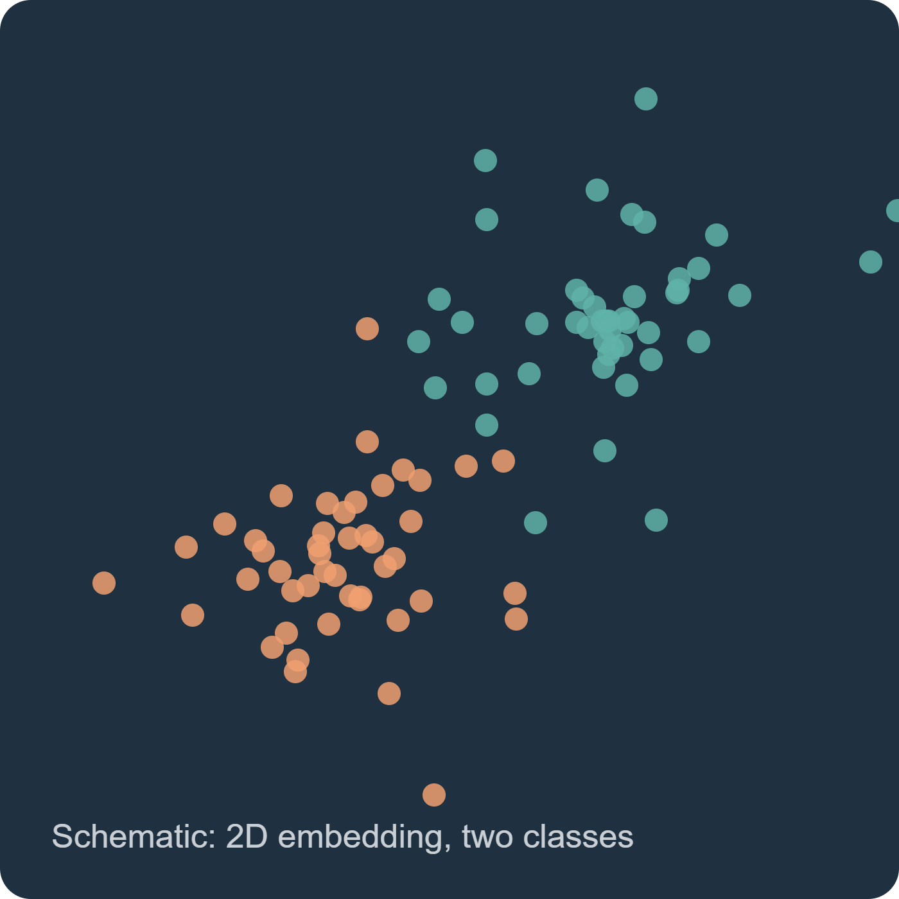
Dimensionality reduction for two biomedical tables
COMPARING CLASSIFICATION METHODS
Nine 2D embeddings, one fixed logistic regression

Slide 2
Study question and design
Can a two-dimensional representation preserve class information for held-out records?
Nine algorithms. Two parameter settings each. Three shared splits. One balanced logistic regression per embedding.
Primary ranking uses setting A only; setting B tests parameter sensitivity.

Slide 3
Does a 2D embedding keep what matters?
Compare
Test
Report
PCA, RBF kernel PCA, Gaussian SNE, t-SNE, PCA + t-SNE, UMAP, metric MDS, PCoA and Isomap.
A fixed, class-balanced logistic regression on each 2D embedding for a binary decision.
Predictive performance, parameter sensitivity and process CPU time.

Slide 4
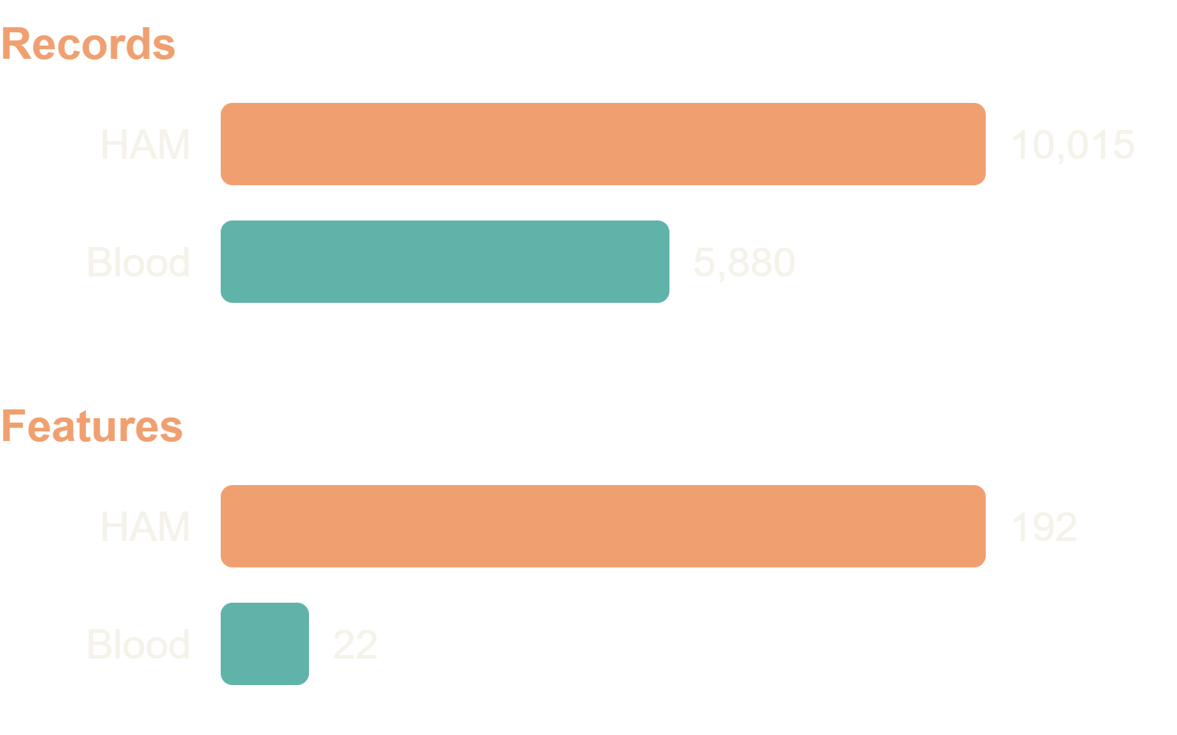
Two public Kaggle tables
HAM10000 lesions
8 × 8 RGB pixels. Melanoma versus all other diagnoses. Split grouped by lesion_id.
Blood cell records
Morphology, color and blood-count variables. Endpoint: anomaly_label.

Slide 5
Two datasets and their limits
HAM10000: 10,015 8 × 8 RGB lesion records, 192 pixel features, melanoma versus other diagnoses. Split by lesion ID.
Blood-cell anomaly table: 5,880 rows, 22 selected numeric features, anomaly versus normal. Patient IDs and independent clinical provenance are unavailable.
Neither dataset supports diagnostic deployment from this pilot.

Slide 6
What the nine methods do
PCA and kernel PCA retain linear or kernel structure. SNE, t-SNE, the PCA plus t-SNE hybrid, and UMAP emphasize neighborhoods.
Metric MDS preserves Euclidean distances. PCoA decomposes cosine distances. Isomap uses graph geodesics.
All output two coordinates, then use the same classifier.

Slide 7
The comparison measures retained class information
Input features are standardized using the training records. Each algorithm reduces them to two coordinates. The same balanced logistic regression then predicts held-out labels.
AUC asks whether positives generally receive higher scores than negatives across thresholds. Accuracy evaluates one fixed threshold. Log loss penalizes confident wrong probabilities. CPU time covers the full fitted pipeline.
A visually neat map is insufficient evidence unless held-out prediction also improves.

Slide 8
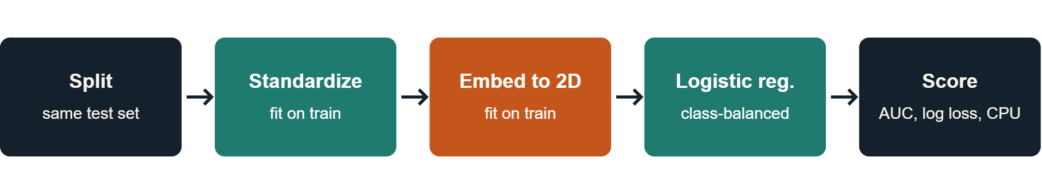
Leak-free evaluation protocol
Same test records for every method per dataset and seed. Setting A is the primary comparison; setting B is a sensitivity check, never picked on the test set.

Slide 9
The prediction model used in every run
1 Split records: HAM10000 by lesion ID; blood cells by stratified rows. Each seed uses 750 training and 300 held-out records.
2 Fit StandardScaler on training features only. Fit an unsupervised 2D embedding on those standardized records; map held-out records into the same coordinates.
3 Fit LogisticRegression(class_weight='balanced', max_iter=1000, random_state=100+seed) on the training coordinates. predict_proba gives the positive-class score; a fixed 0.5 cutoff gives class predictions.
The embedding is a feature extractor. Logistic regression is the classifier; its settings are identical across methods.

Slide 10
What the fixed classifier lets us compare
The same linear decision rule in two coordinates makes changes in held-out ROC AUC, log loss, and confusion counts reflect the complete representation pipeline. Class weighting increases the influence of the minority class during fitting.
A high AUC means better ranking across thresholds; it does not imply a useful 0.5 cutoff or calibrated probabilities. Accuracy may favor the majority class. Read sensitivity and precision together when positives are rare.
SNE, t-SNE, and MDS use a five-neighbor weighted approximation for unseen points. Their scores include the quality of that approximation. These are small pilot samples, not validated diagnostic models.

Slide 11
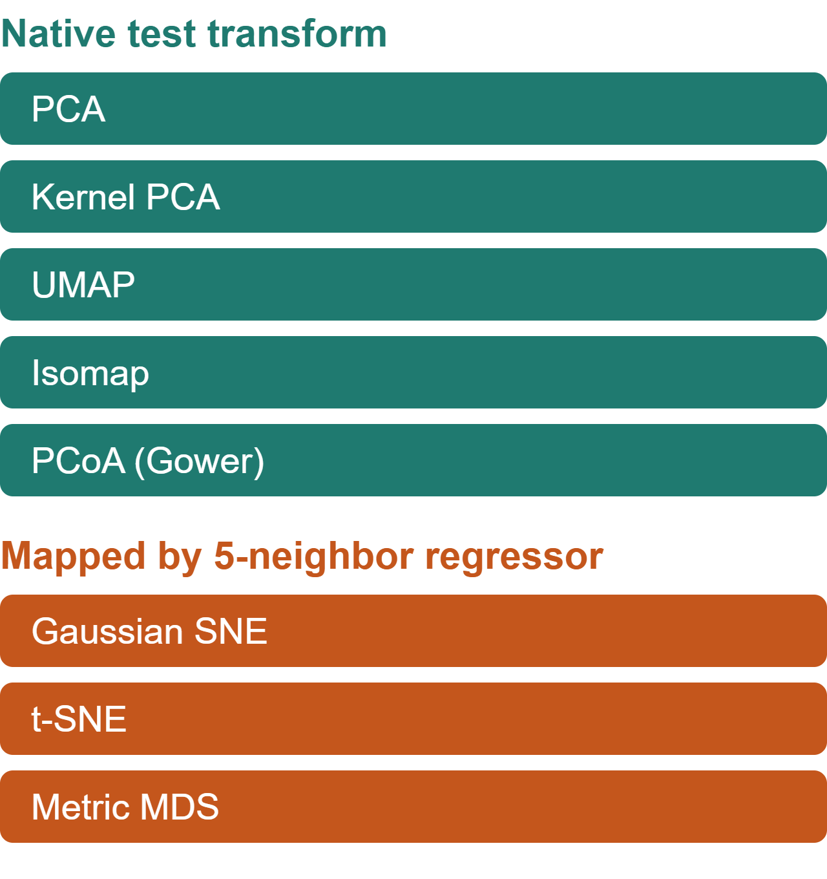
Two settings per method
Method | Setting A | Setting B
PCA | whiten false | whiten true
Kernel PCA | gamma 0.5 / f | gamma 2 / f
SNE, t-SNE | perplexity 15 | perplexity 30
UMAP | 15 neighbors | 30 neighbors
Metric MDS | 80 iterations | 150 iterations
PCoA | cosine | Manhattan
Isomap | 10 neighbors | 25 neighbors

Slide 12
Global geometry: PCA, kernel PCA, MDS, PCoA
PCA keeps directions with the most variance. It is fast, but large variance need not represent disease.
Kernel PCA uses an RBF similarity so curved patterns can become separable. Its gamma setting determines the scale of similarity.
MDS tries to preserve Euclidean distances between every pair. PCoA eigendecomposes a centered distance matrix; here cosine distance is primary. Both can devote two dimensions to variation unrelated to the label.

Slide 13
Local geometry: SNE, t-SNE, hybrid, UMAP, Isomap
SNE and t-SNE match neighbor probabilities. t-SNE's heavy tail reduces crowding; perplexity controls neighborhood scale. PCA plus t-SNE first filters the inputs to at most 30 components.
UMAP builds a fuzzy neighbor graph; its neighbor count controls how local the map is. Isomap uses graph shortest paths to estimate geodesic distances.
These maps can reveal local structure, but they may distort global distances and change when the neighborhood parameter changes.

Slide 14
How unseen test records enter each map
PCA, kernel PCA, UMAP, and Isomap transform new records directly. PCoA uses a distance-based Gower extension.
The chosen SNE, t-SNE, and MDS implementations have no native test transform. A five-neighbor weighted regressor estimates test coordinates from their training maps.
The measured ranking therefore compares complete representation pipelines, including this approximation. It does not compare only the training maps.

Slide 15
Read the results with care
No native transform
Low power
No FROC
SNE, t-SNE and MDS map test samples through a 5-neighbor regressor. That approximation is part of the pipeline.
Three repeated splits share training data. Tests are exploratory, not significance claims.
One label and score per record give an ROC curve, not a free-response ROC.

Slide 16
Method readings: PCA through the hybrid
PCA: blood-cell AUC 0.630, the best there. A simple linear map may suffice for these selected features; it is weakest on HAM AUC at 0.602.
Kernel PCA: 0.638 HAM, 0.624 blood. Curved RBF similarities help modestly, with kernel scale affecting the map.
SNE: 0.616 HAM, 0.581 blood. Local-neighbor matching does not consistently retain the label signal.
t-SNE: 0.638 HAM, 0.622 blood. Better than SNE on both, but its approximate test transform limits interpretation.
PCA plus t-SNE: 0.632 HAM, 0.616 blood. The preprocessing step shows no gain over t-SNE in this pilot.

Slide 17
Method readings: UMAP through Isomap
UMAP: 0.645 HAM, 0.600 blood. The neighbor graph ranks lesions well, but costs about 2.24 CPU seconds per HAM run.
MDS: 0.620 HAM, 0.562 blood. Preserving global Euclidean distances gives the weakest blood-cell AUC.
PCoA: 0.633 HAM, 0.616 blood. Cosine distances give middle-ranking performance; a different distance changes the result.
Isomap: 0.649 HAM, 0.582 blood. Graph geodesics lead HAM AUC but transfer poorly to the blood-cell table.
The mechanisms above are interpretations of measured associations, not proven causes.

Slide 18
Findings and reproduction
Results
Reproduce
Scope
Results figure gallery added on the following slides (accuracy, ROC, CPU time, loss and sensitivity).
python data/download_data.py, then src/benchmark.py --seeds 3 --train-n 750 --test-n 300, then src/analyze.py.
Methodological demonstration, not a diagnostic claim. Cite source datasets separately.

Slide 19
Evaluation figures — HAM10000
Skin-lesion binary classification • original plot files linked below
PREDICTIVE PERFORMANCE
DISCRIMINATION
PROBABILITIES
Accuracy
ROC curves
Log loss
Compare predictive correctness across 2D embeddings.
Compare discrimination across decision thresholds.
Compare probabilistic predictions and calibration sensitivity.
HAM10000_accuracy.png
HAM10000_roc.png
HAM10000_loss.png
COMPUTATIONAL COST
SENSITIVITY
ERROR DISTRIBUTION
CPU time
Parameters
Confusion matrices
Compare processor usage for the pipelines.
Inspect sensitivity between setting A and B.
Inspect classification outcomes by label.
HAM10000_cpu.png
HAM10000_parameters.png
HAM10000_confusion.png
SOURCE / github.com/Gamila-Elfayoumi/comparing-classification-methods

Slide 20
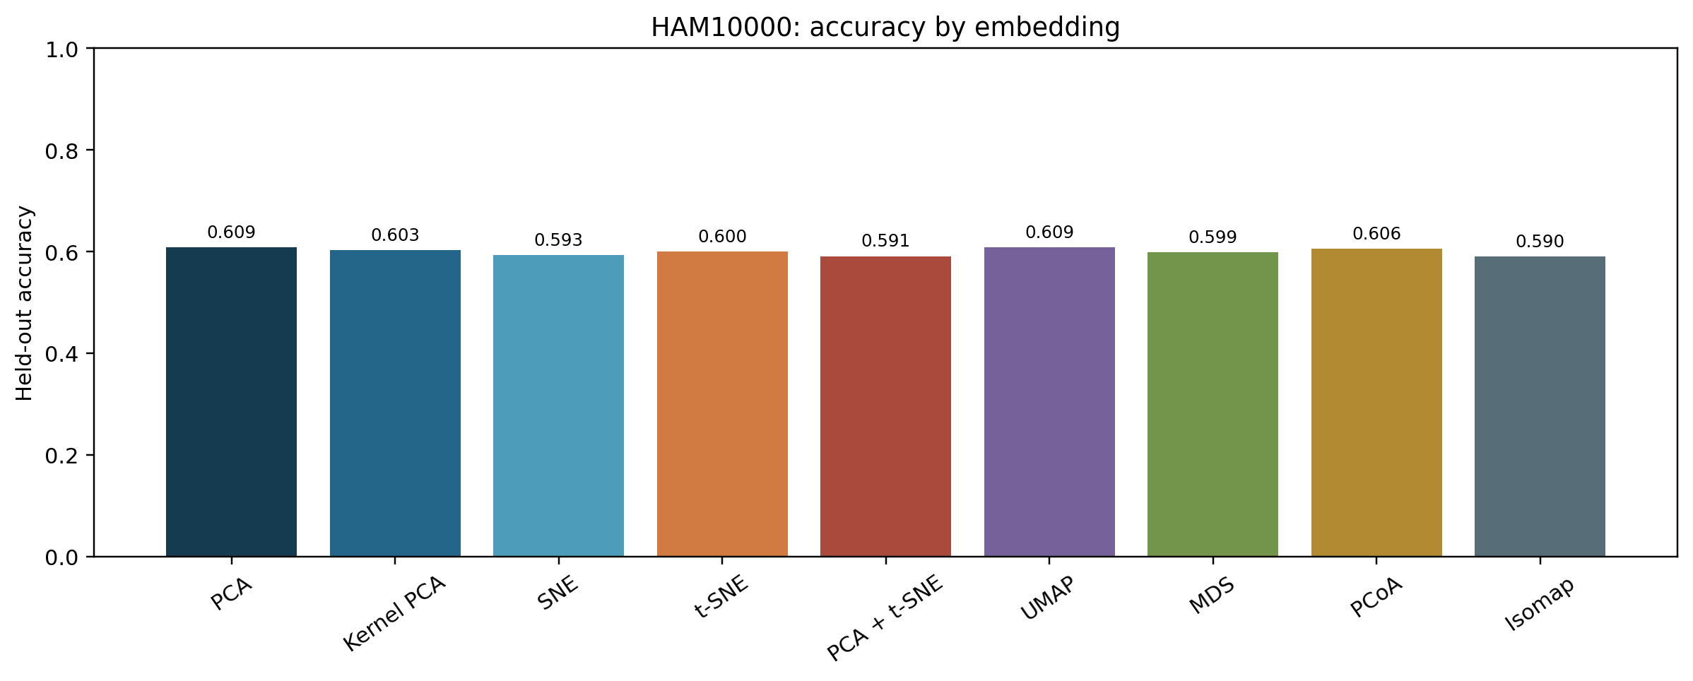
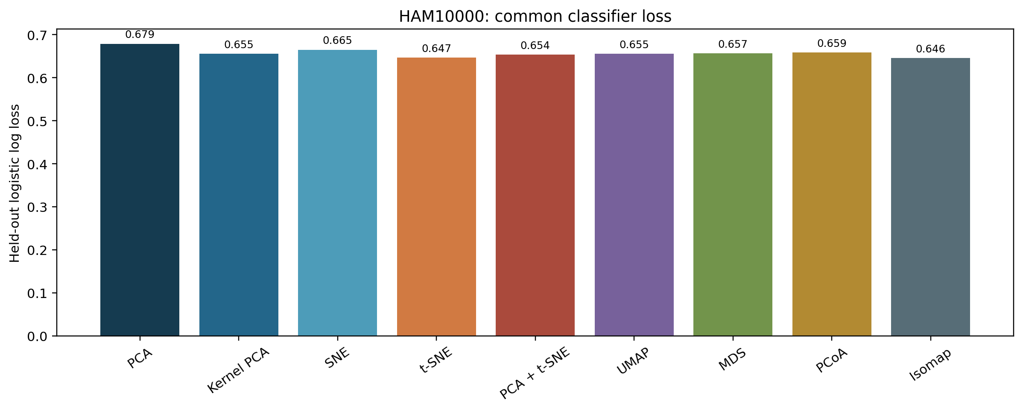
HAM10000: accuracy and loss
Highest mean AUC: Isomap, 0.649. The two charts show why accuracy and probability loss should be read together.

Slide 21
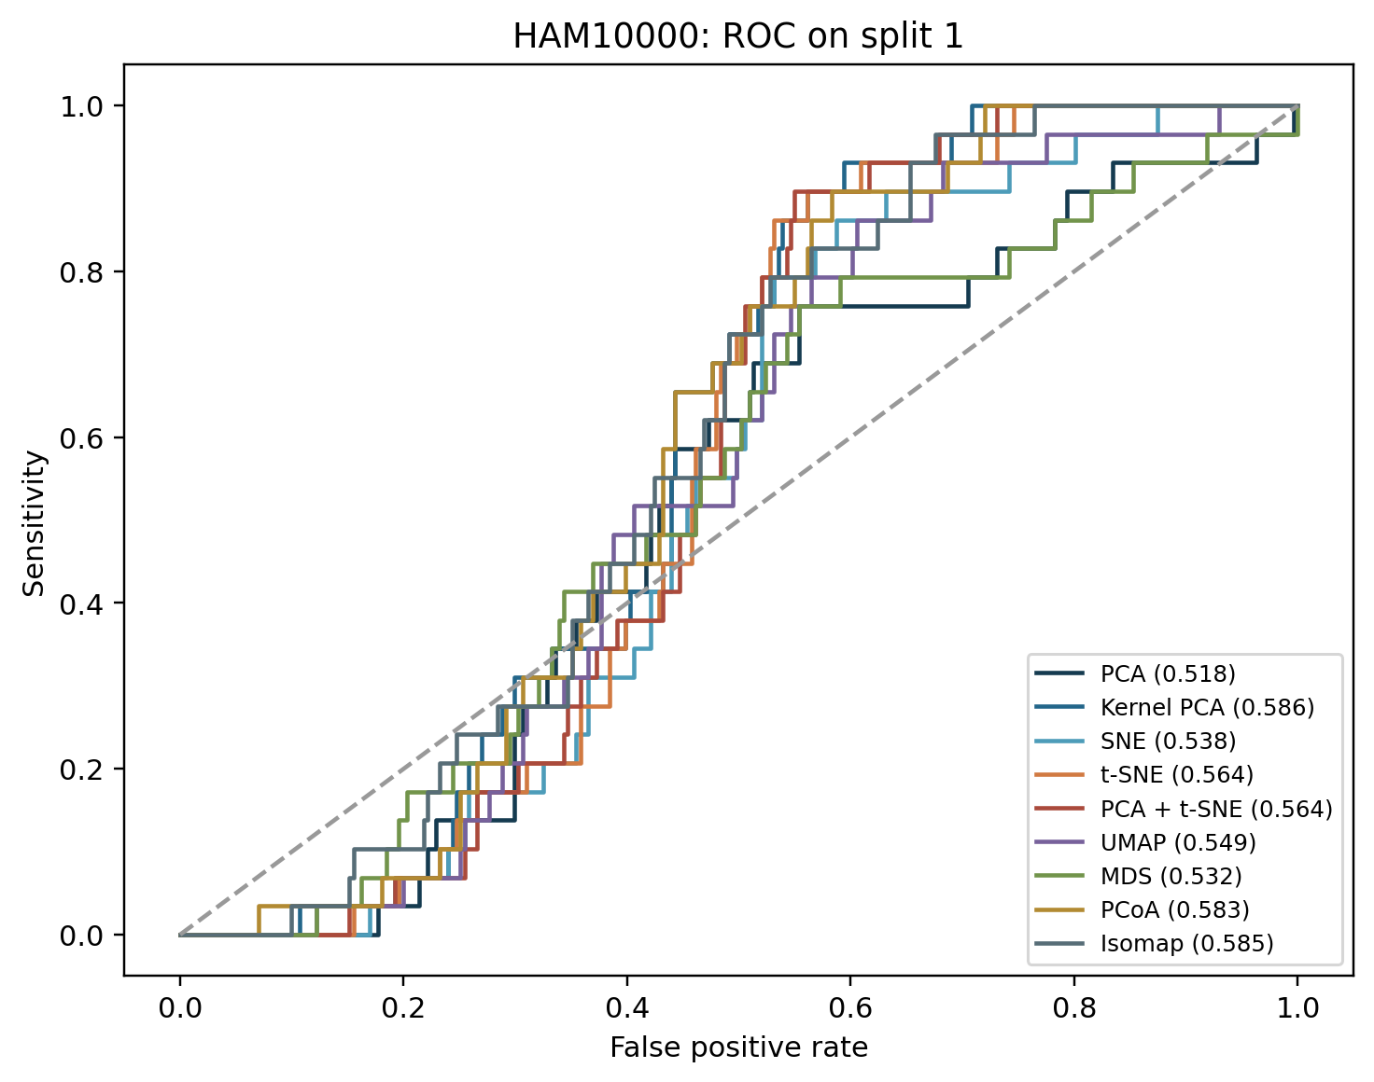
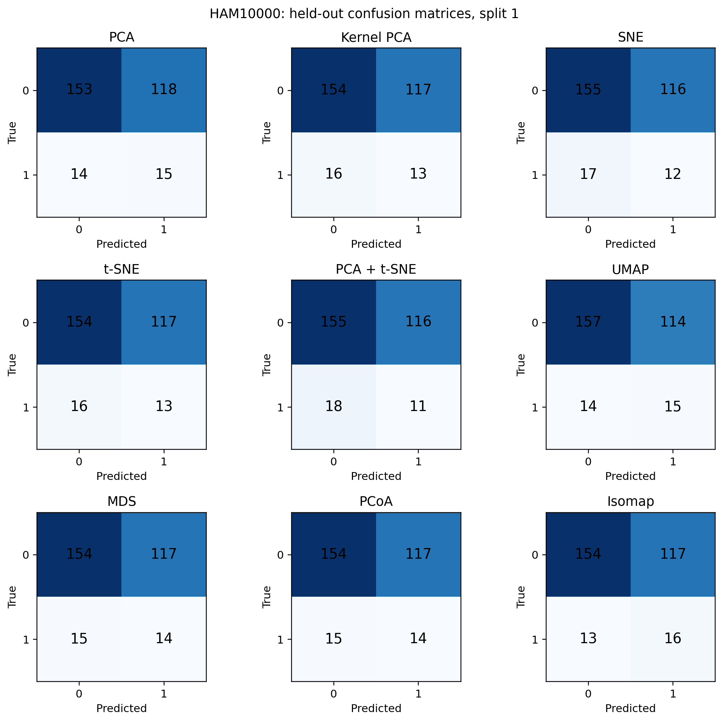
HAM10000: ROC and confusion matrices

Slide 22
HAM10000: better ranking, weak positive precision
Isomap leads mean ROC AUC at 0.649, versus 0.602 for PCA. A neighbor graph may retain class-related structure that the largest-variance PCA axes miss. The experiment does not establish that mechanism.
PCA has slightly higher accuracy, 0.609 versus 0.590. AUC measures ranking across thresholds, while accuracy uses the prespecified 0.5 threshold.
Isomap precision is 0.134: most positive calls are false positives. The 8 × 8 pixels and low melanoma prevalence limit clinical meaning.

Slide 23
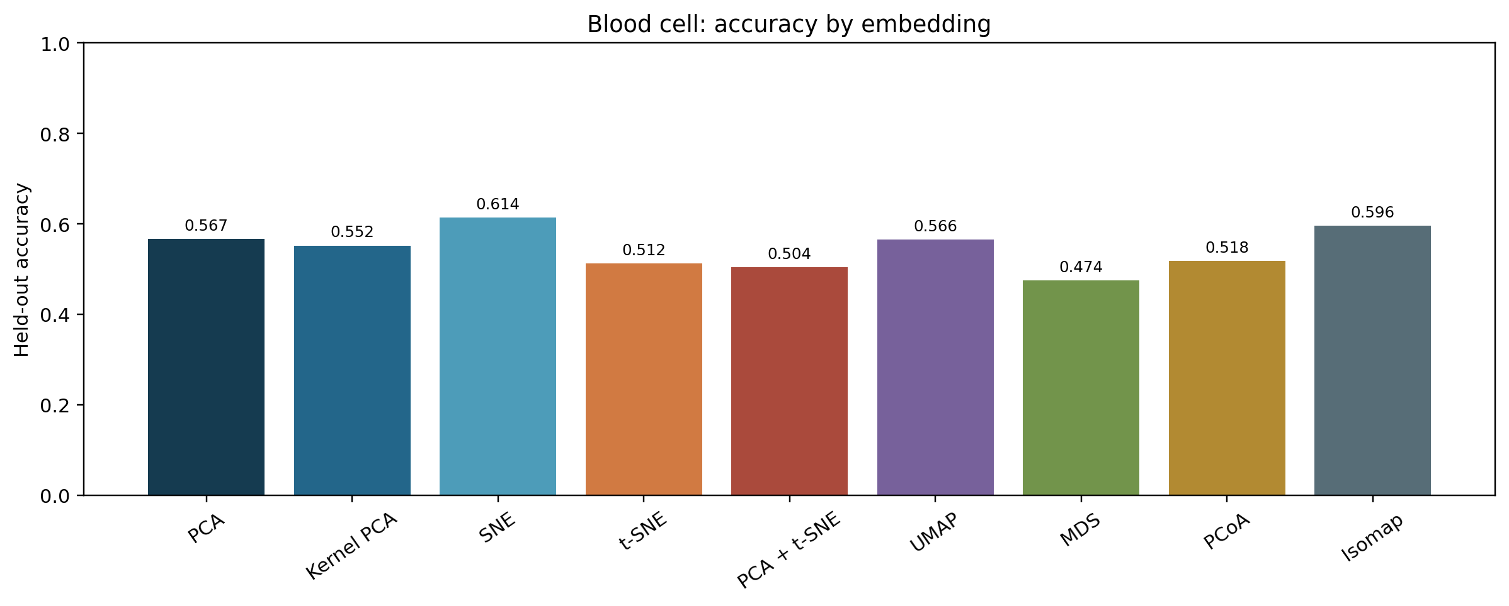
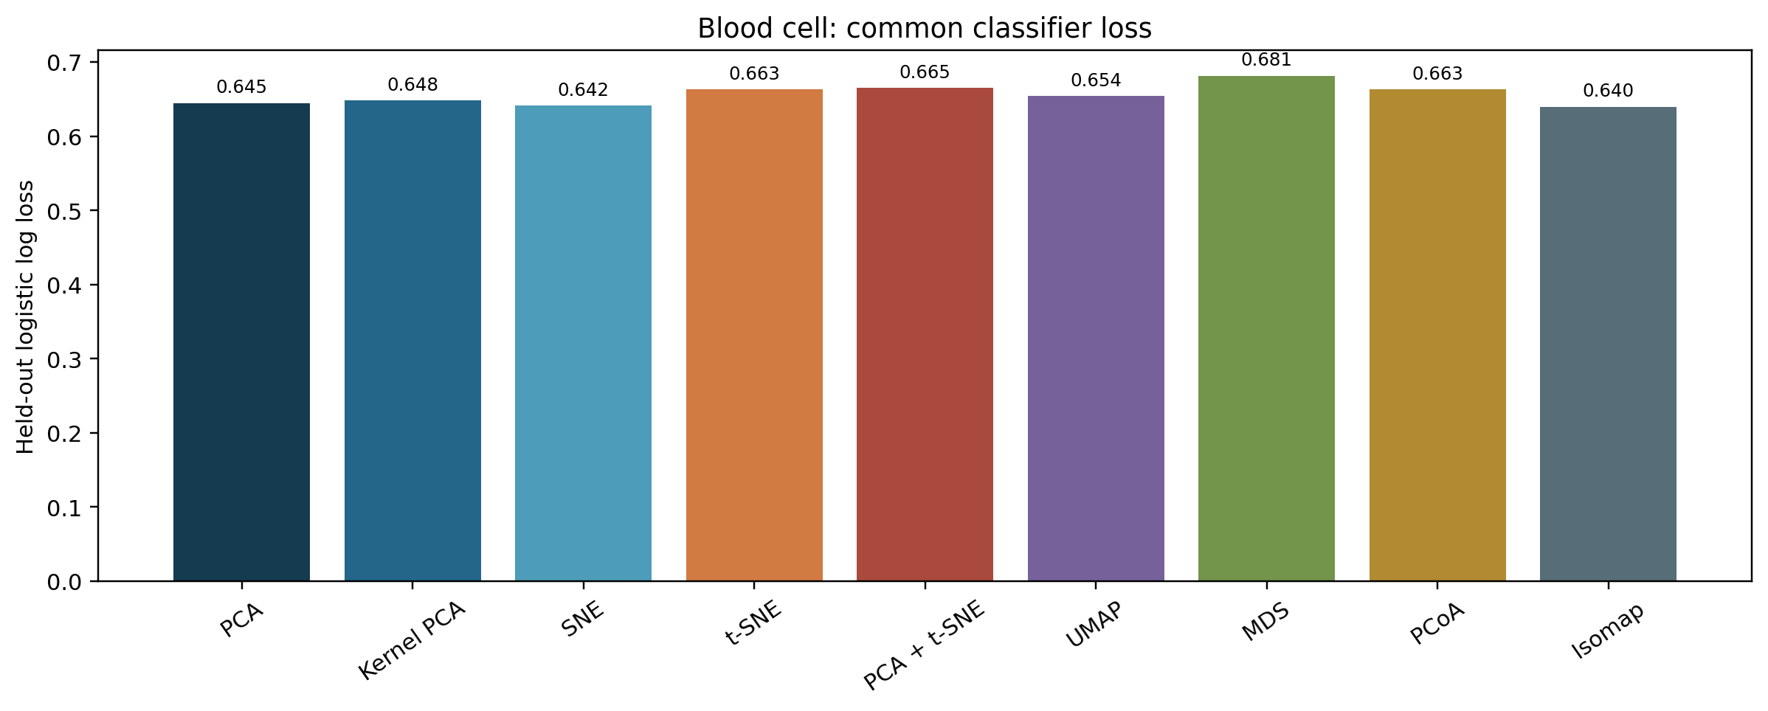
Blood cell: accuracy and loss
Highest mean AUC: PCA, 0.630. The two charts show why accuracy and probability loss should be read together.

Slide 24
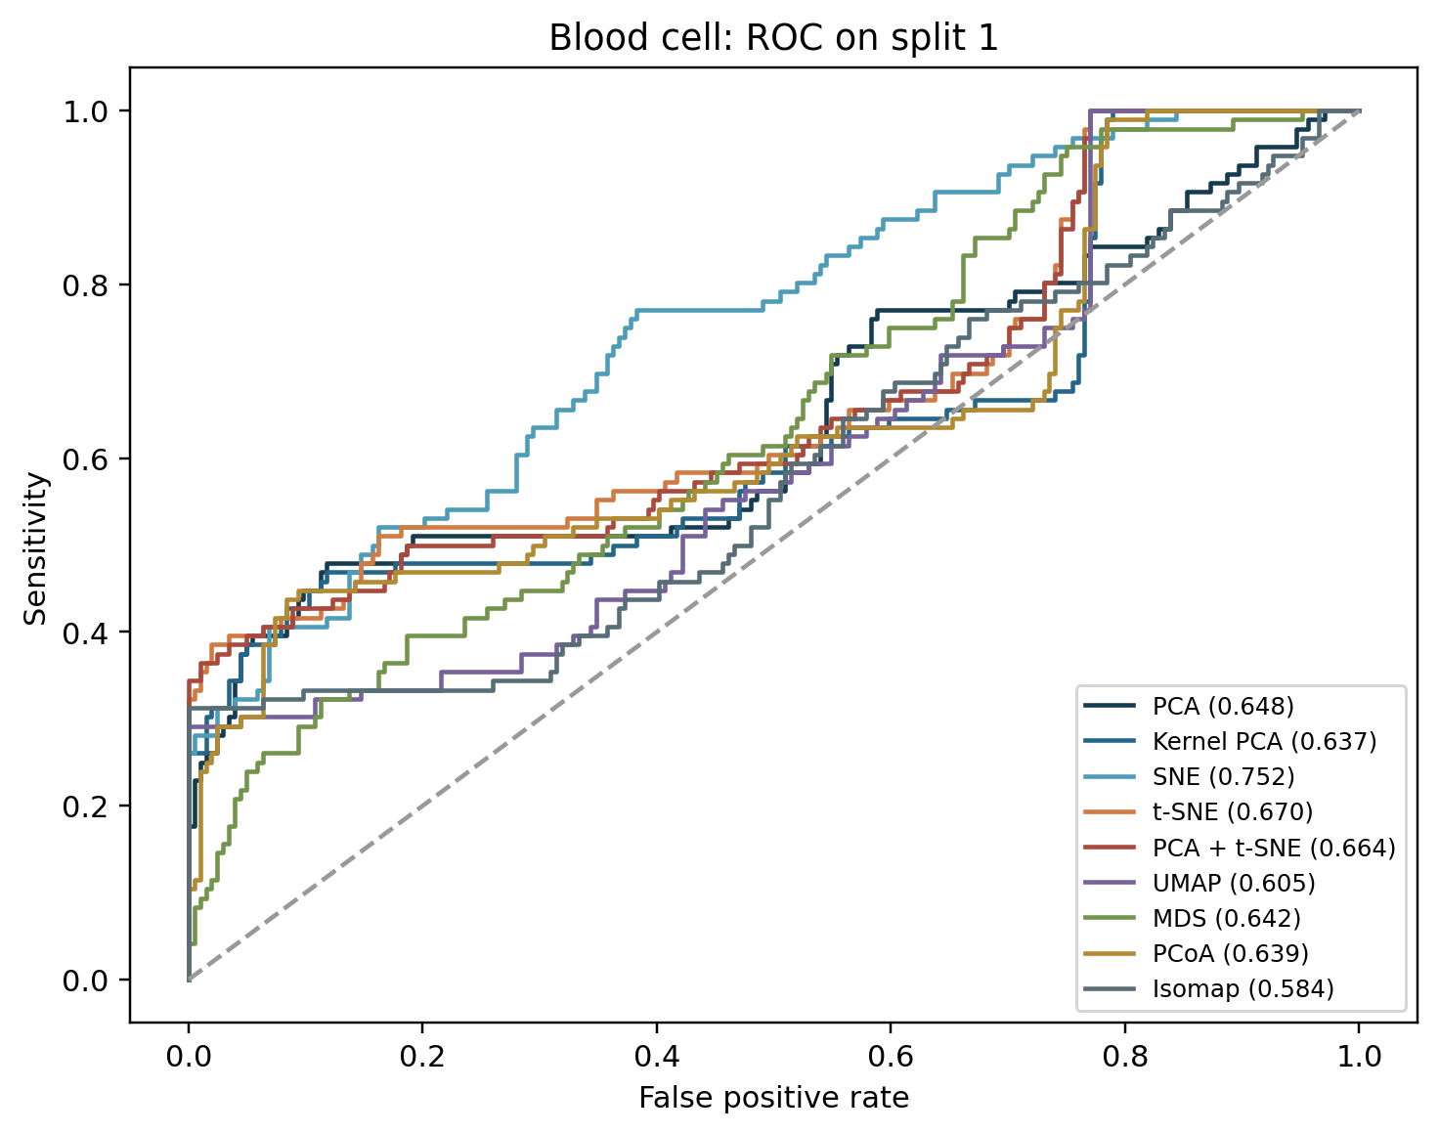
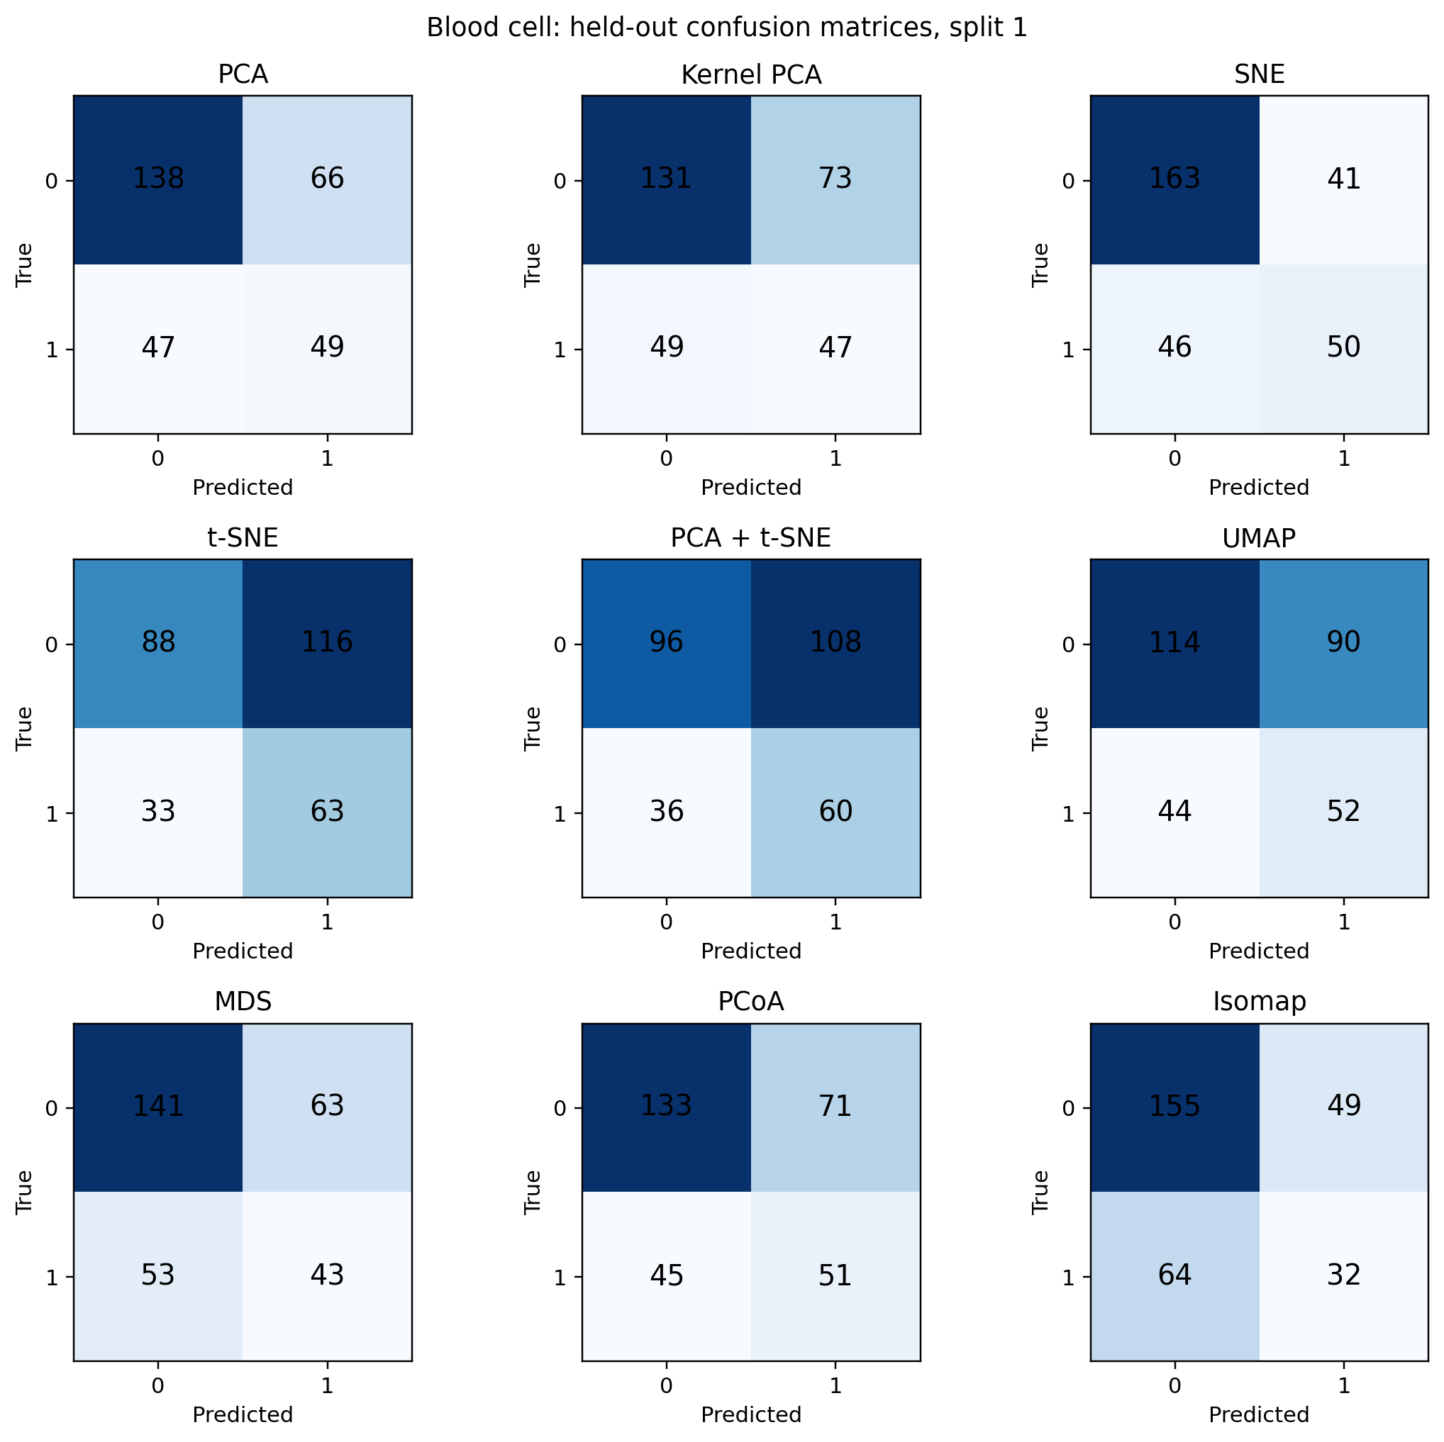
Blood cell: ROC and confusion matrices

Slide 25
Blood cells: fast PCA wins on ranking
PCA leads mean ROC AUC at 0.630 and takes about 0.02 CPU seconds. Broad linear variation may capture useful signal in the 22 selected features.
SNE reaches 0.614 accuracy but only 0.581 AUC. Its threshold decisions look better than its overall ranking; accuracy alone would give a misleading winner.
MDS has 0.562 AUC and takes about 1.06 CPU seconds. Keeping global distances in two dimensions did not retain much class signal here. Patient-level generalization remains untested.

Slide 26
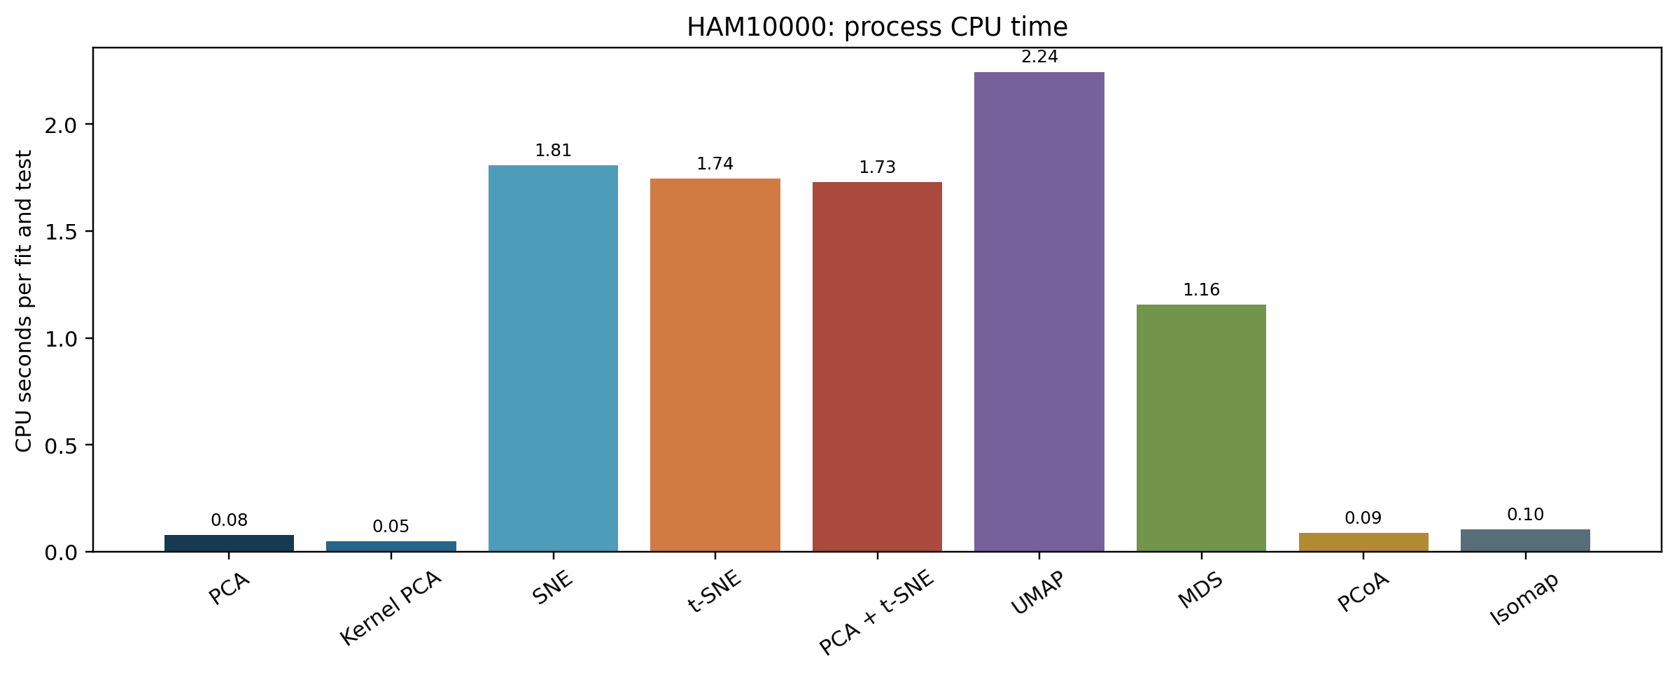
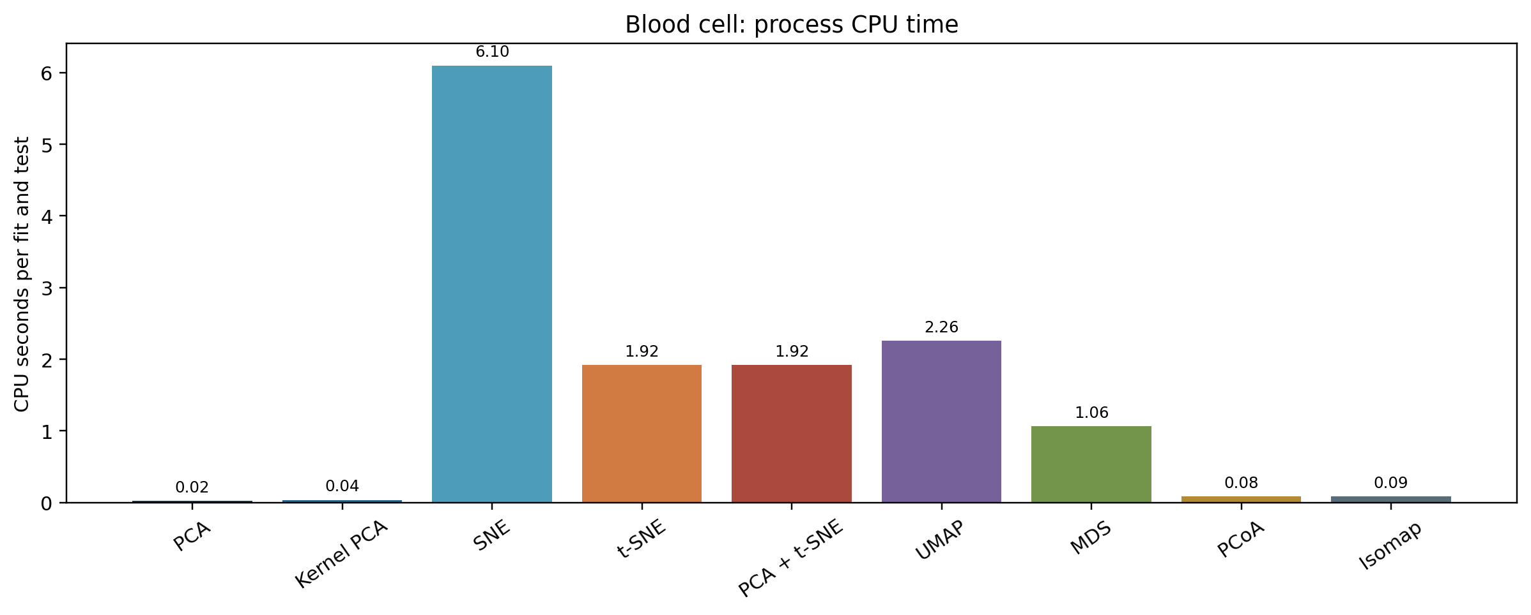
CPU time has a steep method cost
PCA and kernel PCA are fastest in this sample-size range. UMAP, SNE, and t-SNE require substantially more CPU time. UMAP's first compilation is measured separately.

Slide 27
CPU cost changes the practical choice
On blood cells, PCA needs about 0.02 CPU seconds and SNE about 6.10 seconds per run. SNE does not gain AUC in exchange for that extra compute (0.581 versus 0.630).
On HAM10000, Isomap leads AUC at about 0.10 CPU seconds; UMAP is close in AUC (0.645 versus 0.649) but takes about 2.24 seconds.
These are process CPU times for 750 training and 300 test records. UMAP's one-time compilation warmup is excluded and recorded separately; scaling can change the order.

Slide 28
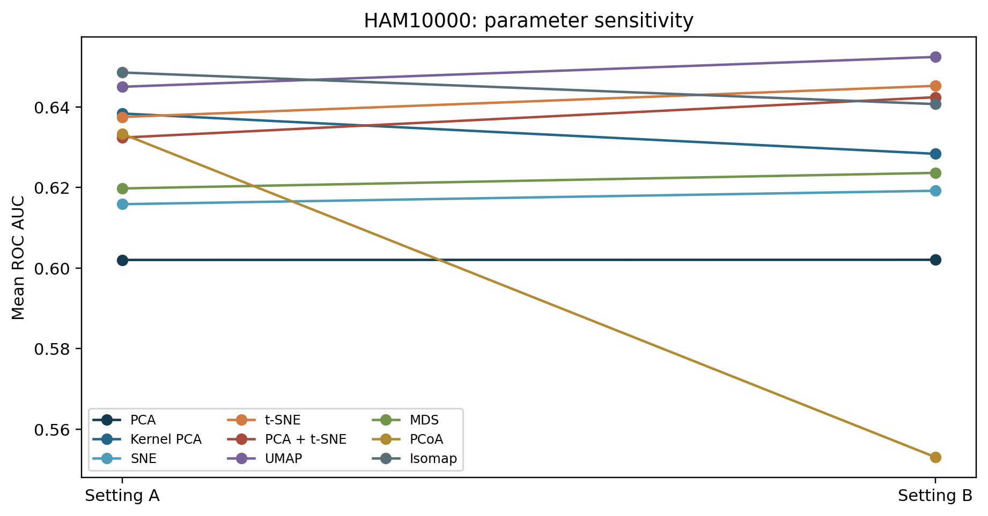
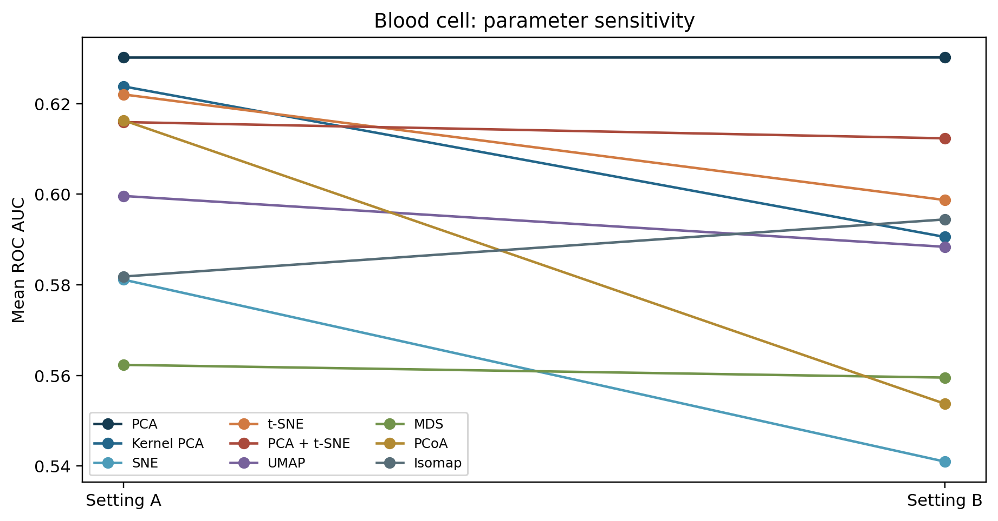
Parameter settings change the ranking
A second setting changes neighborhood size or perplexity. Selecting a winner on the test set would inflate the reported result.

Slide 29
What the parameter comparison can and cannot say
Setting A was declared primary before reading test results. Setting B checks whether whitening, kernel scale, perplexity, neighbor count, MDS iterations, or PCoA distance changes the result.
Large A-to-B shifts show tuning sensitivity, especially for methods that define neighborhoods. They do not justify choosing the better test-set setting after the fact.
A stronger study would tune parameters inside each training fold and then evaluate once on an untouched outer test fold.

Slide 30
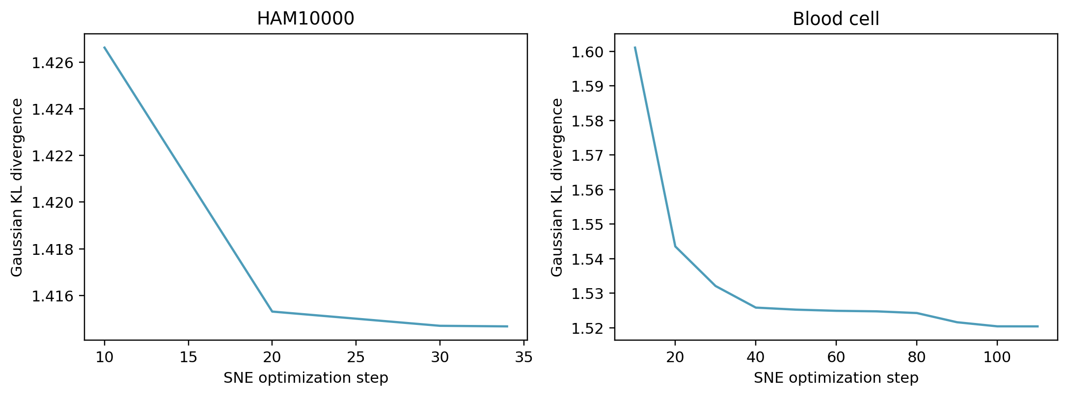
Gaussian SNE optimization loss
The plotted KL objective tracks Gaussian SNE fitting. Native PCA, t-SNE, and UMAP objectives have different meanings. The earlier classifier log-loss charts are comparable across methods.

Slide 31
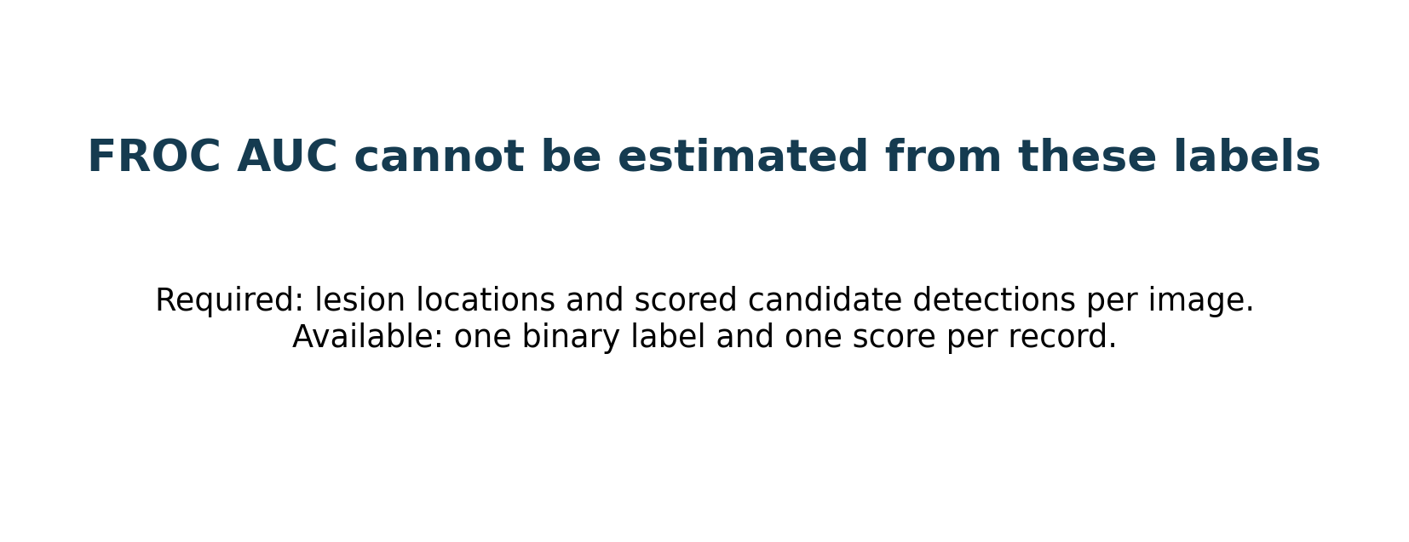
FROC AUC is not available
ROC AUC is reported. A valid FROC needs scored candidate lesion locations and false positives per image. These tables have one label and one score per record.

Slide 32
Statistical tests are exploratory
Repeated-measures ANOVA of AUC: F(8,40)=0.673, p=0.712. Descriptive MANOVA method term: Wilks' lambda=0.840, p=0.945.
Paired t, Wilcoxon, and McNemar z comparisons are in the repository. Three overlapping splits have low power. MANOVA's independence assumption is violated. Read all p values as diagnostics.

Slide 33
What counts as good or bad evidence here
A good result would combine high held-out AUC with useful sensitivity and precision, low log loss, stable parameters, and an acceptable CPU cost. None of these pilot AUCs exceeds 0.65.
A method can look good on one metric and weak on another: SNE has the highest blood-cell accuracy but lower AUC than PCA; Isomap leads HAM AUC but its positive precision is only 0.134.
Three overlapping splits do not provide a reliable superiority claim. The statistical tests and plots describe this experiment, not clinical readiness.

Slide 34
Notebook extension: eleven methods
The full Kaggle notebook adds locally linear embedding (LLE) and an exploratory PCA + UMAP hybrid to the original nine methods. It applies the same two settings, three seeds, held-out classifier, and metrics.
LLE reconstructs local neighborhoods from weighted neighbors. PCA + UMAP first reduces the feature space to at most 30 PCA coordinates, then builds the UMAP neighbor graph. Both are unsupervised two-dimensional representations.
Across three splits, HAM AUC is 0.648 for PCA + UMAP versus 0.649 for Isomap. Blood-cell AUC is 0.632 for PCA + UMAP versus 0.630 for PCA. These tiny differences do not establish superiority, and the hybrid costs more CPU time.

Slide 35
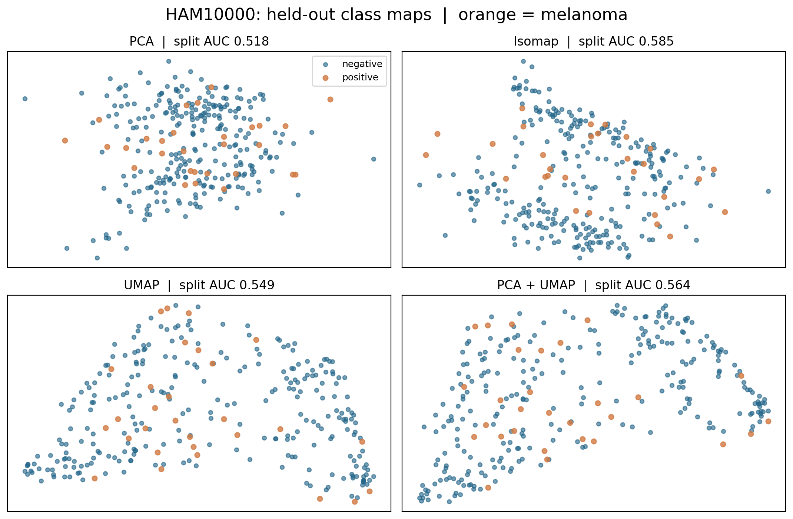
HAM10000: class maps remain mixed
Orange melanoma points overlap blue non-melanoma points in every map. Isomap and PCA + UMAP curve the geometry, but neither creates a clean class boundary.
This first split has lower AUC than the three-split mean for several methods. The change across splits is evidence of instability. Visual separation alone cannot select a winner.
Notebook extension: setting A, first split shown; AUC beside each map is for that split only.

Slide 36
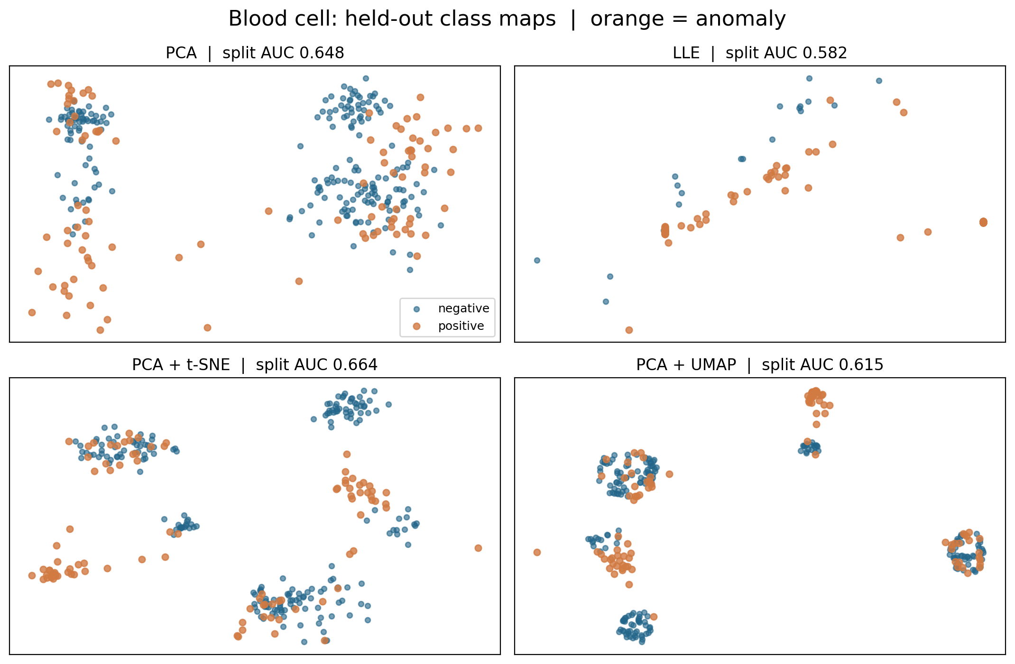
Blood cells: clusters are not class labels
PCA, LLE, PCA + t-SNE, and PCA + UMAP create different clusters. Both labels appear in several clusters, so cluster count or visual compactness does not measure classification quality.
PCA + t-SNE has a good AUC on the pictured split, but the three-split average favors PCA + UMAP narrowly. The table lacks patient IDs for patient-level testing.
Notebook extension: setting A, first split shown; AUC beside each map is for that split only.

Slide 37
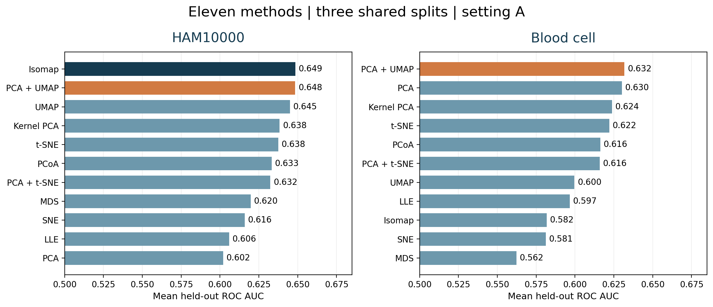
Eleven-method AUC comparison
Top differences of 0.001–0.002 are too small for a reliable superiority claim; compare CPU cost and uncertainty before choosing a method.
Source: kaggle/example_outputs/primary_summary.csv; figures generated by the full notebook.

Slide 38
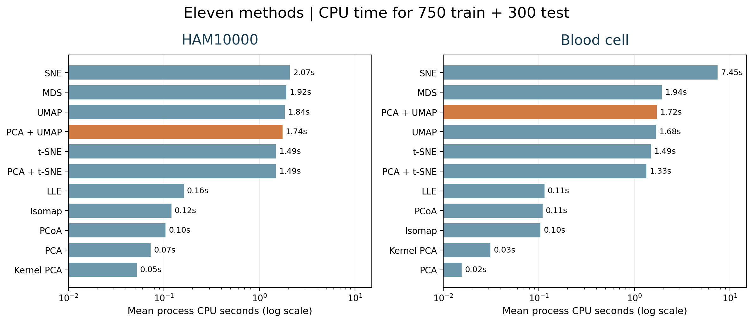
Eleven-method CPU comparison
PCA + UMAP uses about 1.74s on HAM and 1.72s on blood cells. The nearest AUC leaders use about 0.12s (Isomap) and 0.02s (PCA). Times depend on hardware and sample size.
Process CPU time excludes UMAP compilation warmup; logarithmic horizontal axis.

Slide 39
Interpretation and next steps
Performance changes with split and parameter choice. The 8 × 8 lesion images limit clinical meaning. The blood-cell table lacks patient-level validation.
For a journal study: use original or validated features, external cohorts, nested tuning, uncertainty intervals, and lesion locations if FROC is required.
Sources and exact numbers: AML_research_report.docx and results/primary_summary.csv

Slide 40
NEW EXPERIMENT
Metaheuristic feature selection
for two biomedical tables
GA · PSO · DE · GA + PSO · GA + DE
Separate wrapper study on selected original features; three shared outer splits.

Slide 41
Feature-selection protocol
Outer evaluation: 750 training and 300 held-out records per seed; three shared splits. HAM10000 separates lesion IDs. Blood-cell data use stratified rows because patient IDs are unavailable.
Candidate fitness: mean two-fold inner ROC AUC − λ × selected-feature fraction. Scaling and balanced logistic regression are refit inside each inner fold.
Setting A: λ = 0.02. Setting B: λ = 0.05. Each search attempts 56 mask evaluations; duplicate masks are cached. The test set never chooses masks or the penalty.
Source: results/feature_selection/; setting A unless stated.

Slide 42
Search mechanisms and equal budgets
GA: tournament selection, uniform crossover, bit mutation, and best-mask preservation.
PSO: binary particles update velocities from personal and global best masks.
DE: real-valued mutation and crossover, then binary thresholding and one-to-one replacement.
GA + PSO and GA + DE: three GA generations hand their population and best mask to three generations of the second optimizer. All searches use eight candidates and six generations.
Source: results/feature_selection/; setting A unless stated.

Slide 43
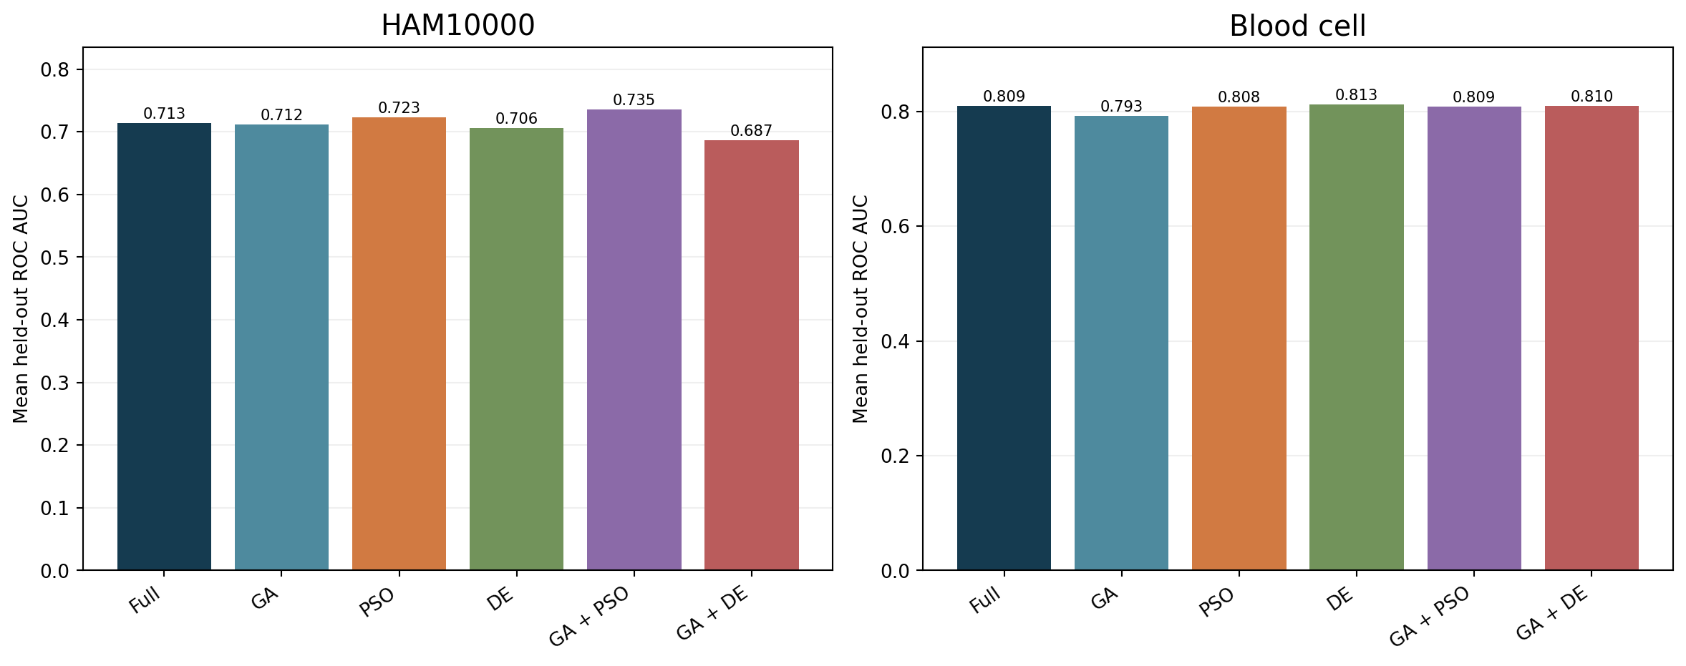
Feature selection: held-out ROC AUC
HAM: GA + PSO 0.735 versus full 0.713. Blood: DE 0.813 versus full 0.809. These small differences are exploratory.
Source: measured three-split feature-selection run; charts are descriptive.

Slide 44
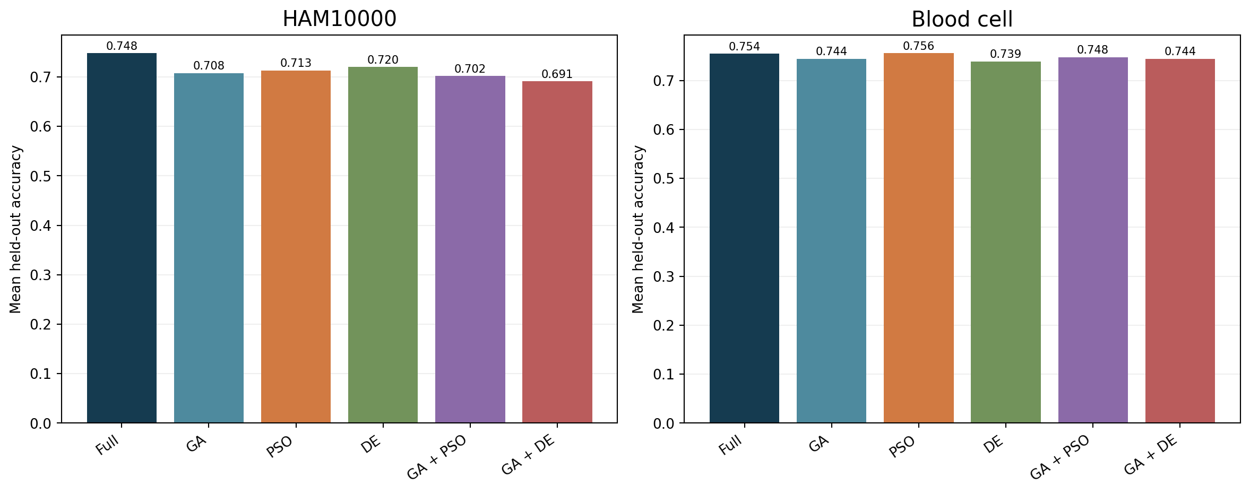
Accuracy at the fixed threshold
Accuracy depends on the 0.5 cutoff and class prevalence; read it with AUC, sensitivity, and precision.
Source: measured three-split feature-selection run; charts are descriptive.

Slide 45
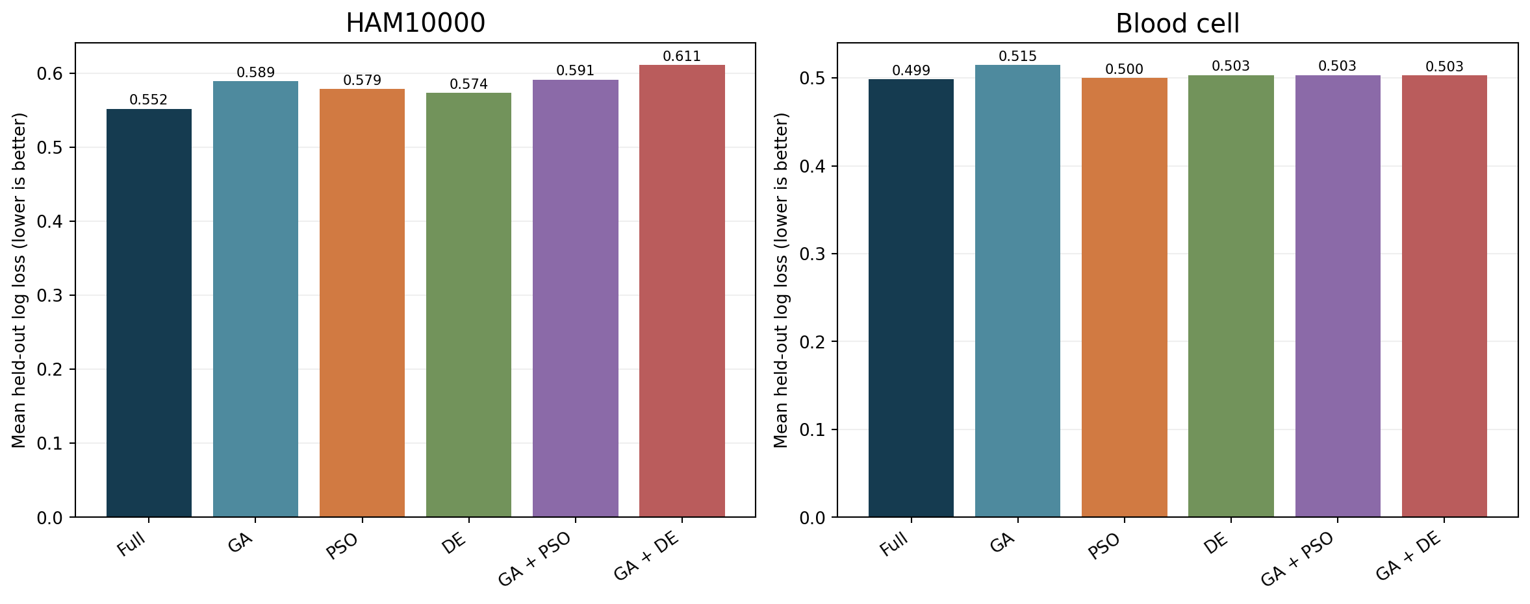
Probability log loss
Lower log loss is better; it penalizes confident wrong probabilities and complements AUC.
Source: measured three-split feature-selection run; charts are descriptive.

Slide 46
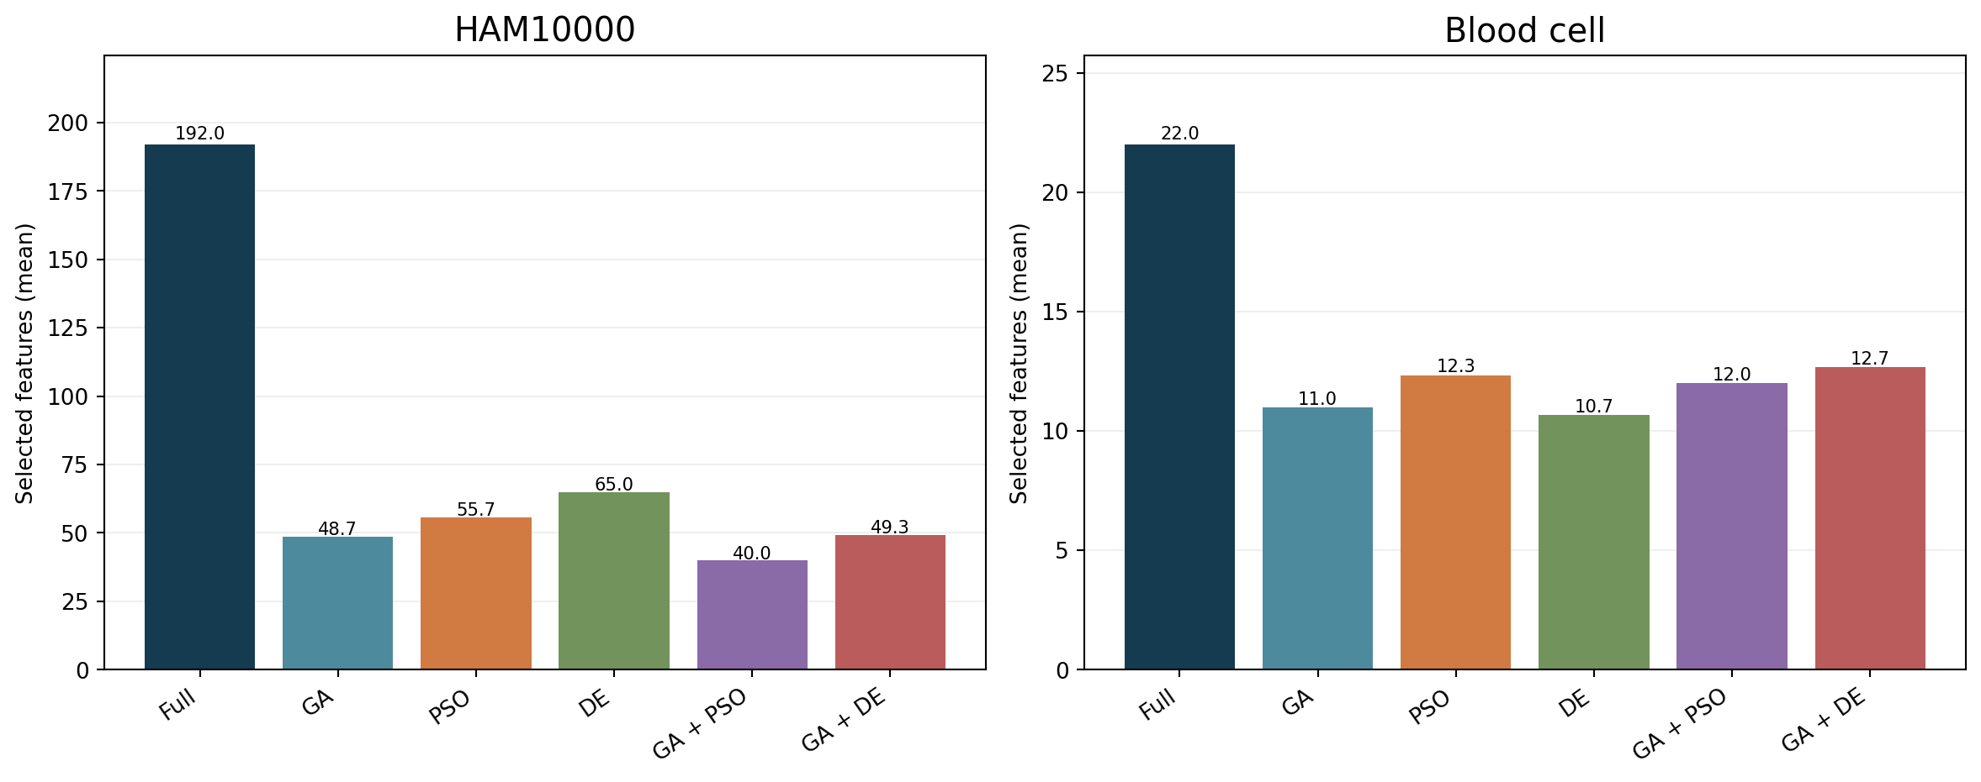
Feature reduction
GA + PSO retains 40/192 HAM features on average; DE retains 10.7/22 blood-cell features.
Source: measured three-split feature-selection run; charts are descriptive.

Slide 47
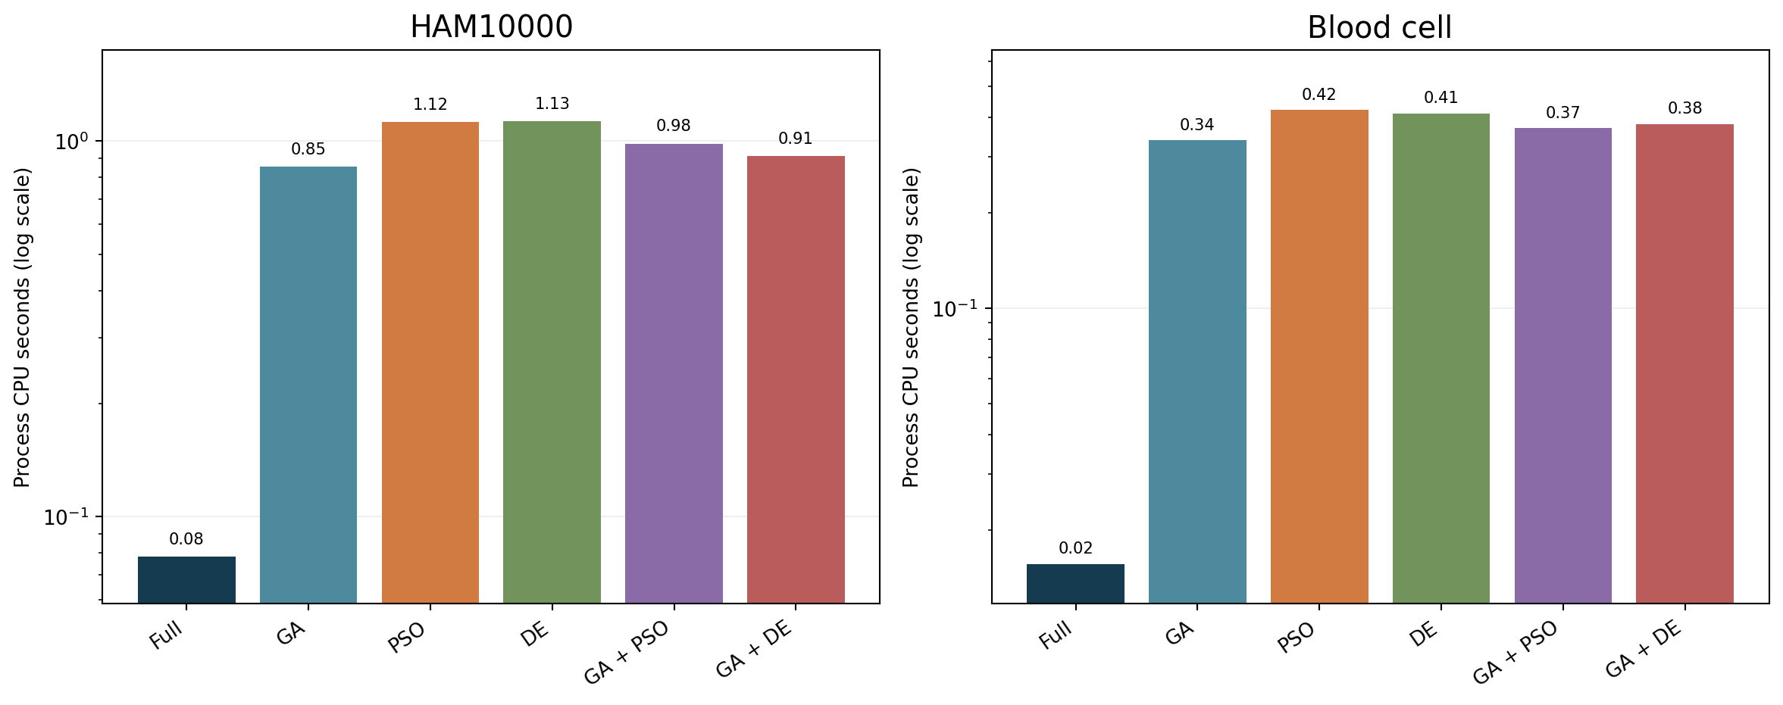
CPU cost of feature selection
Search adds CPU time: about 0.98 versus 0.08 seconds for HAM GA + PSO/full; 0.41 versus 0.02 for blood DE/full.
Source: measured three-split feature-selection run; charts are descriptive.

Slide 48
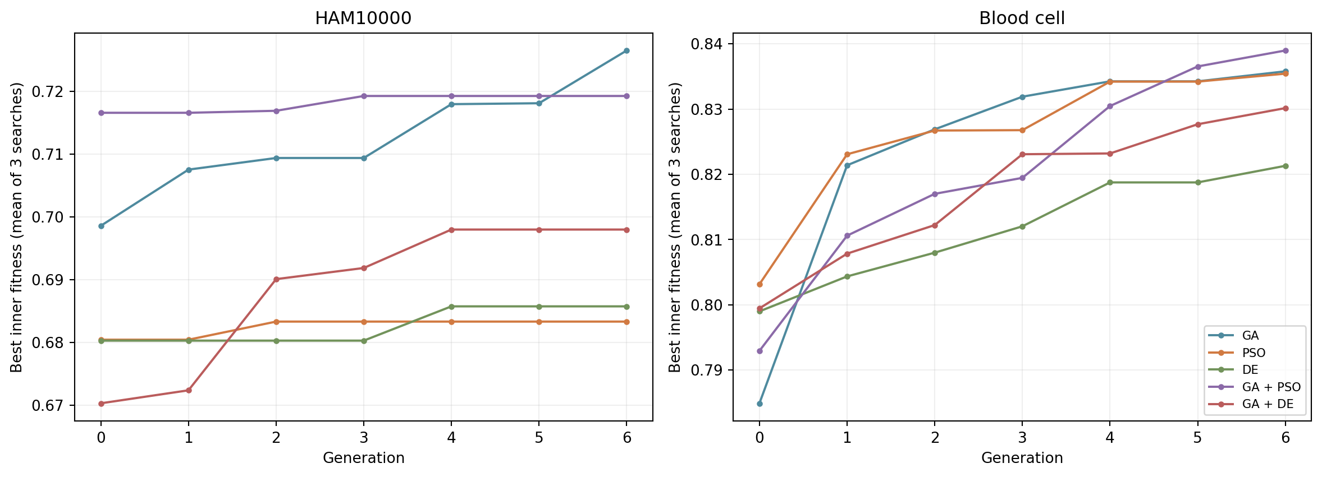
Search convergence is an inner-fold result
Fitness improves during search, but rising inner fitness does not guarantee better held-out AUC. Curves average three searches.
Source: measured three-split feature-selection run; charts are descriptive.

Slide 49
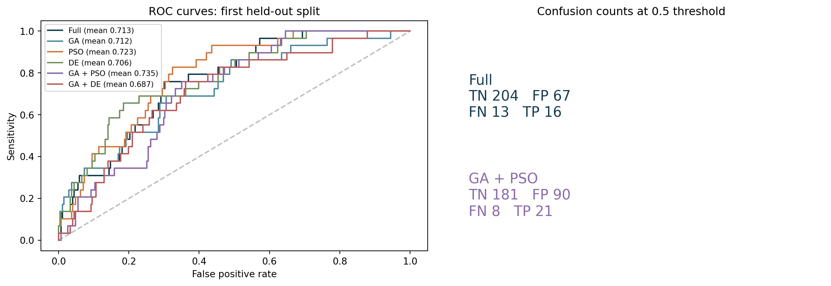
HAM10000: ROC and confusion counts
First split ROC curves and 0.5-threshold confusion counts; legend shows three-split mean AUC.
Source: measured three-split feature-selection run; charts are descriptive.

Slide 50
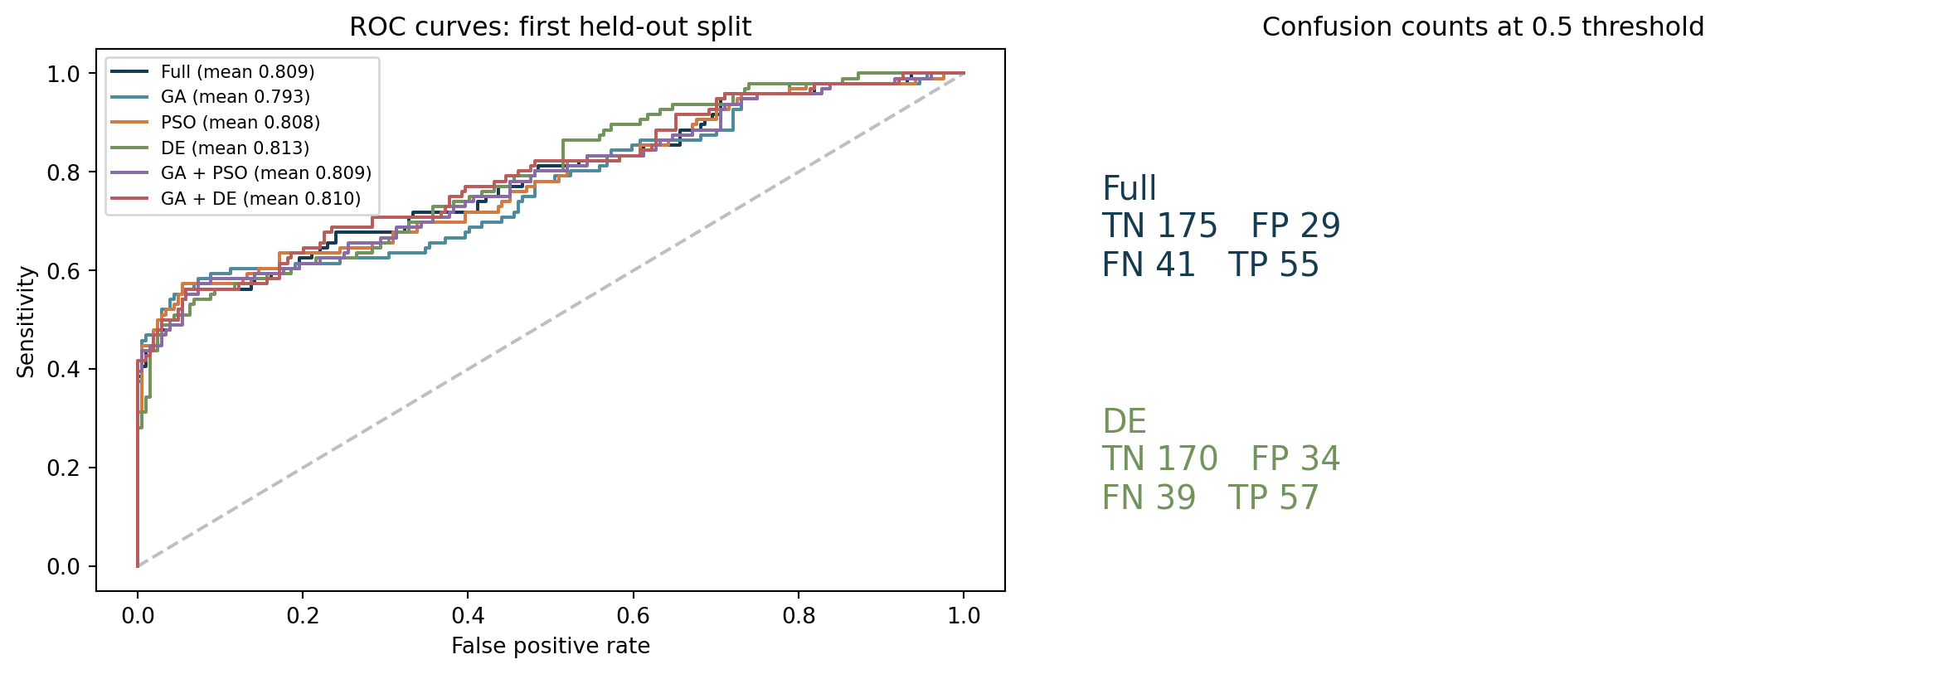
Blood cells: ROC and confusion counts
First split ROC curves and 0.5-threshold confusion counts; no patient-level validation is available.
Source: measured three-split feature-selection run; charts are descriptive.

Slide 51
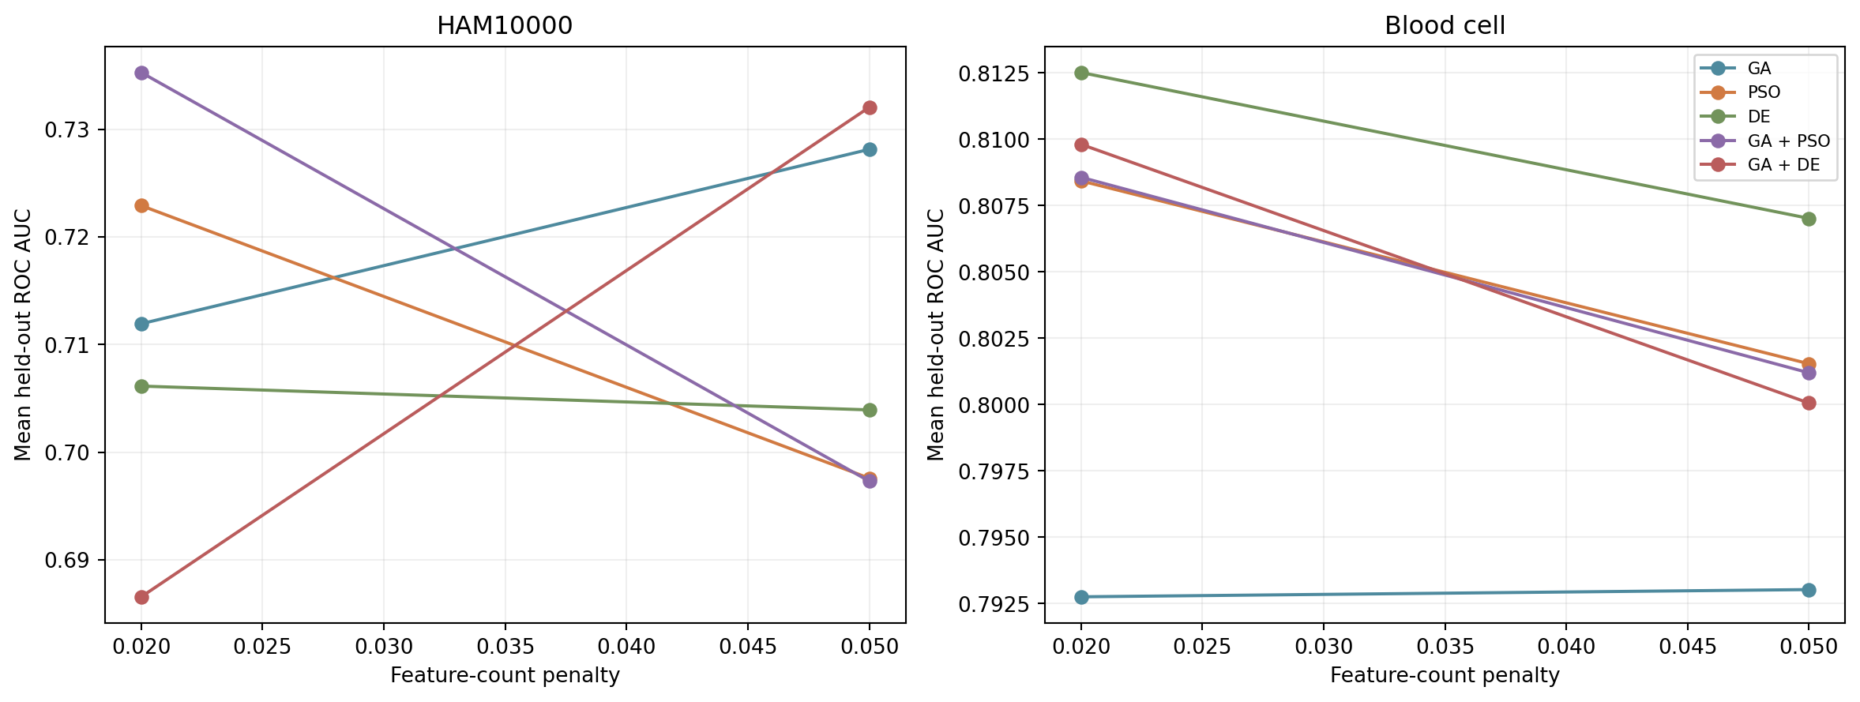
Penalty sensitivity
Changing λ changes masks and held-out AUC. Setting A was primary; do not select the better setting on the test set.
Source: measured three-split feature-selection run; charts are descriptive.

Slide 52
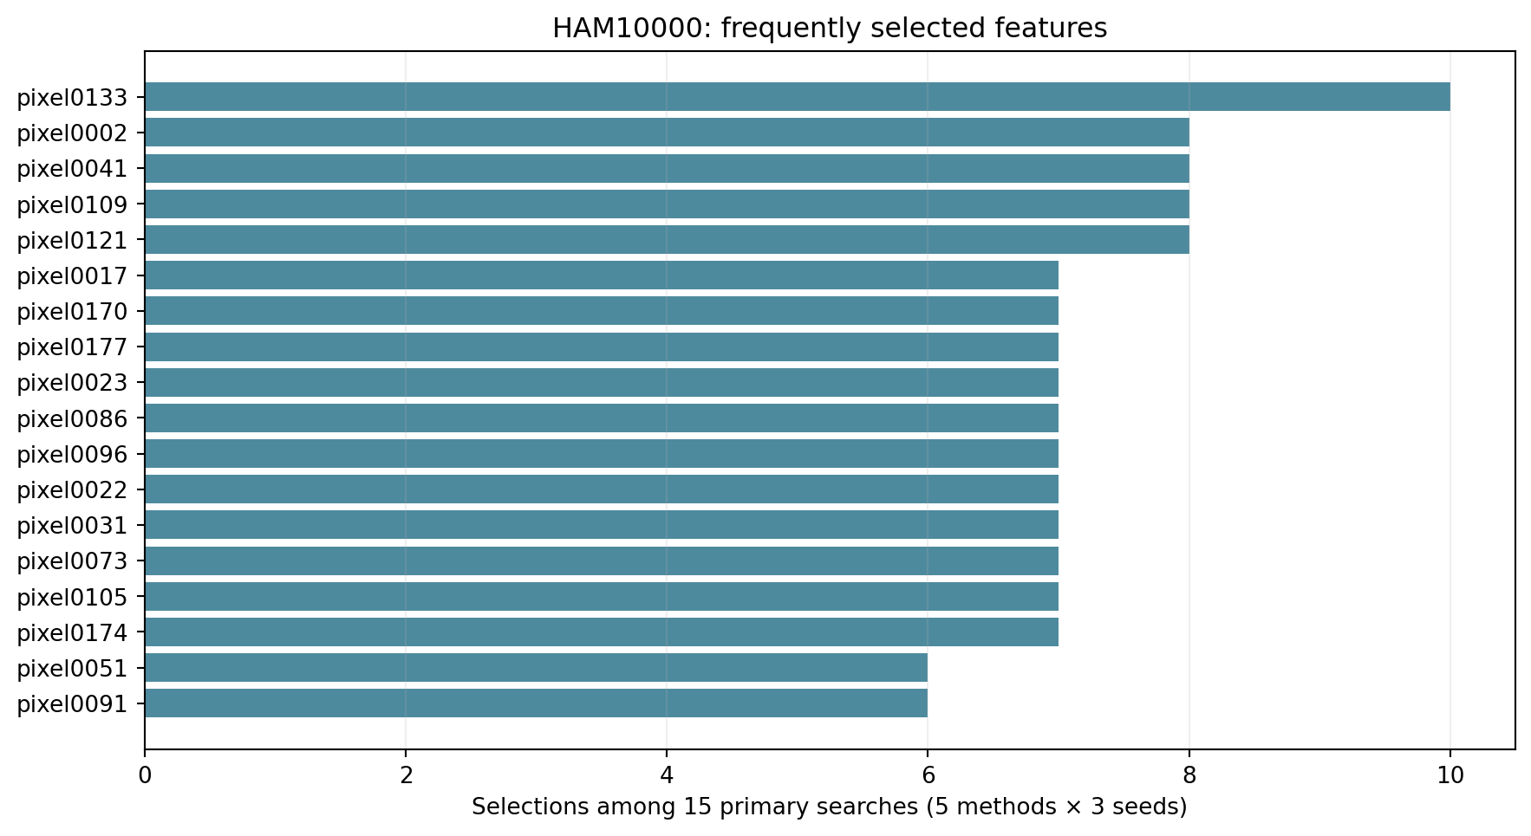
HAM10000: selected pixel frequencies
Top 18 pixels selected across 15 setting-A searches. Frequency is not a clinical importance estimate.
Source: measured three-split feature-selection run; charts are descriptive.

Slide 53
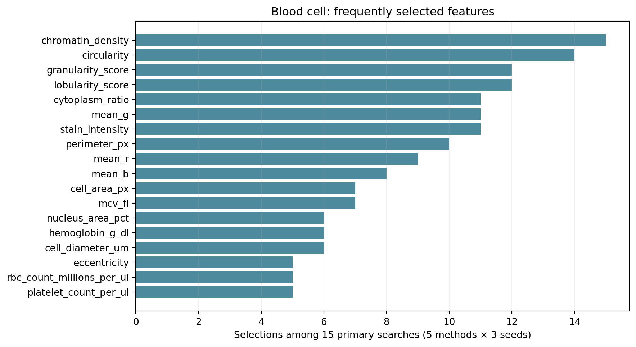
Blood cells: selected feature frequencies
Top 18 input fields selected across 15 setting-A searches. Correlated features can substitute for one another.
Source: measured three-split feature-selection run; charts are descriptive.

Slide 54
Interpretation and study limits
The hybrid is not always better: GA + DE has mean HAM AUC 0.687, below the full-feature baseline 0.713. Across three overlapping splits, all paired t and Wilcoxon comparisons against full features have p > 0.15.
HAM results vary strongly by split (full-feature AUC 0.762, 0.794, 0.584). The 8 × 8 lesion pixels limit biological interpretation. Blood cells lack patient IDs and verified external cohort provenance.
These selected-feature classifiers are not directly comparable with the earlier 2D embedding classifiers. A journal study needs independent groups, nested tuning, uncertainty intervals, and external validation. FROC cannot be computed from record labels alone.
Source: results/feature_selection/; setting A unless stated.

