Slide 1
Gaming-Bets
An E-Sport App!
By André Helbig, Felix Morsbach
If E-Sport was easy, it would be called Soccer!

Slide 2
Agenda
Vision
Use Cases
Project Management
Scrumming
Project Team
Technical Architecture
Database
Behavior Driven Development

Slide 3

Vision
We strive to be the best!!!
We love E-Sports!
We want to win!!

Slide 4
…now let´s get serious!

Slide 5
Open for MORE!

Slide 6
Project Team
Felix Morsbach: Project Manager, Test Manager, Implementer, Desinger
André Helbig: Integrator, Tester, Designer
Niclas Petersohn: Software Architect, Implementer, Tester

Slide 7

Project Management
Jira as preferred platform
Optimal for Agile Developement
Easy to Use
Burndown Chart
Notes:
Integrated jira into DIE
Automatically loging worktime

Slide 8
Scrumming?
Iterative Process
Ready for YOUR Wishes!

Slide 9
Technical Architecture
*Insert wanted Communcation Method here*
Human
Android
Java
MySQL
Notes:
Easy to Replace Communication Typ!
Frameworks?

Slide 10
Database
ERM Modell
Prepared Statements
Protection against SQL-Injections
Notes:
Prepared Statements
Frameworks?

Slide 11
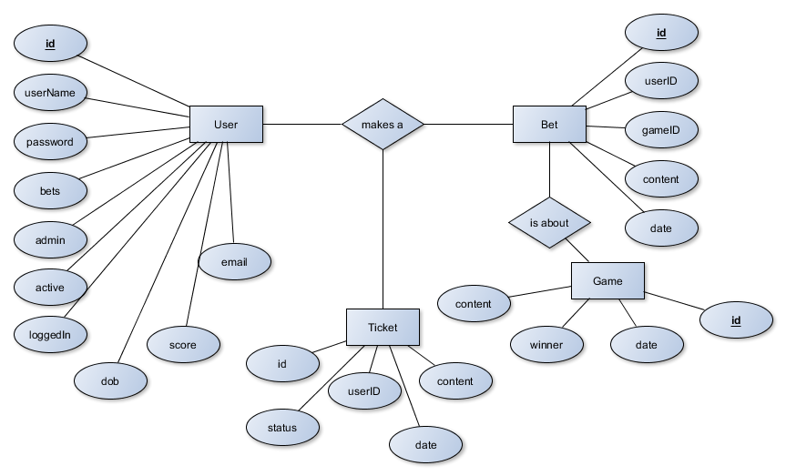
Entity Relationship Model

Slide 12
Behavior Driven Developement
Tests written in Gherkin
Easy to Use for non Programmers
Use predefined Steps!
Calabash for Android Testing
Reports

Slide 13
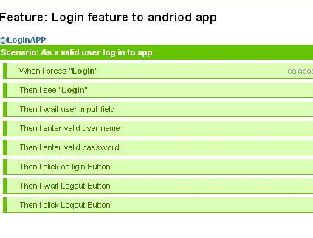
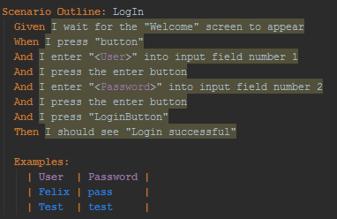
.feature File
Calabash
Report

Slide 14
Demo
lets gooo?
Notes:
Link updated?

