Slide 1
Gaming-Bets
An E-Sport App!
If E-Sport was easy, it would be called Soccer!

Slide 2
Agenda
Vision
Use Cases
Project Management
Scrumming
Project Team
Technical Architecture
Class Diagram
Behavior Driven Development

Slide 3

Vision
We strive to be the best!!!
We love E-Sports!
We want to win!!

Slide 4
…now let´s get serious!

Slide 5
Open for MORE!

Slide 6
Project Management
Jira as preferred platform
Optimal for Agile Developement
Easy to Use
Burndown Chart
Notes:
Integrated jira into DIE
Automatically loging worktime

Slide 7
Scrumming?
Iterative Process
Ready for YOUR Wishes!

Slide 8
Project Team
Felix Morsbach: Project Manager, Test Manager, Implementer, Desinger
André Helbig: Integrator, Tester, Designer
Nicals Petersohn: Software Architect, Implementer, Tester

Slide 9
Technical Architecture
*Insert wanted Communcation Method here*
Human
Android
Java
MySQL
Notes:
Easy to Replace Communication Typ!

Slide 10
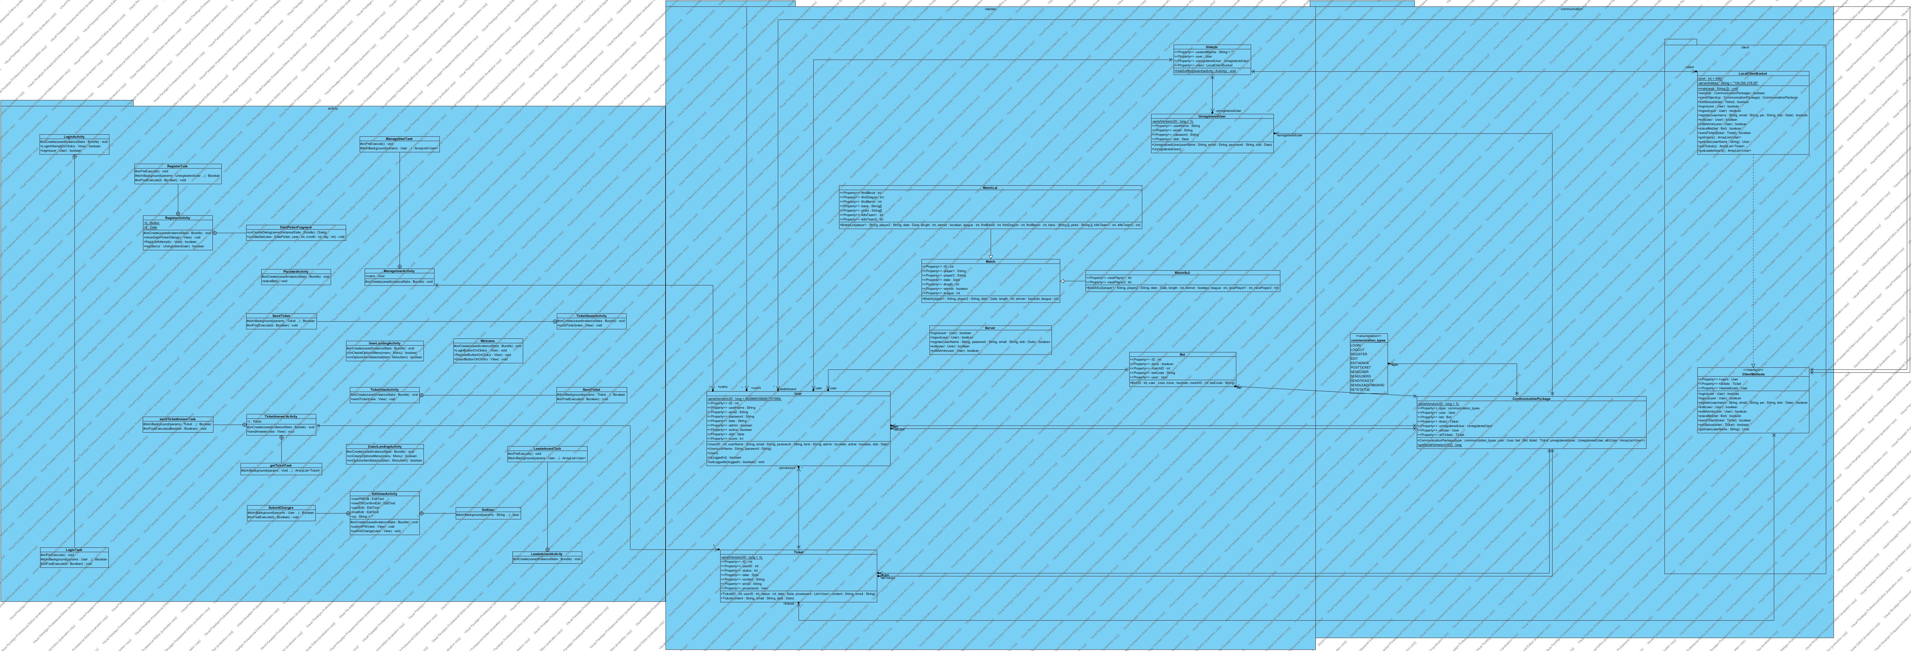
Class Diagramm

Slide 11
Behavior Driven Developement
Tests written in Gherkin
Easy to Use for non Programmers
Use predefined Steps!
Calabash for Android Testing
Reports

Slide 12
Demo
lets gooo?
Notes:
Link updated?

