Slide 1

LISTIC
Laboratoire d’Informatique, Systèmes, Traitement de l’Information et de la Connaissance
Patrick LAMBERT

Slide 2

LISTIC
  “Smart” Information Processing
  Computer Science
Two main domains
  CIT : Knowledge, Images and
  Remote Sensing
  CoDe : Combination and Decision
  RSLR : Networks and Distributed
  Software Systems
Three research
groups

Slide 3
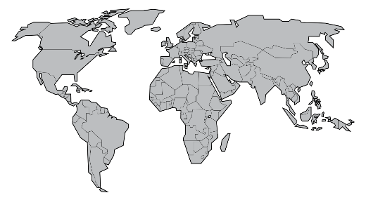
LISTIC: a few indicators
Staff:
  Associate Professors or Professors: 36
  Technical Staff: 2 Administrative Staff: 2
  PhD students: ~ 20 + ~ 8 co-directions
Actual implications in:
  4 national projects
  3 international projects
  2 “main” industrial projects and “several” industrial collaborations
  Many academic (national or international) collaborations

Slide 4
1st group: CIT
Scientific Directions
From Data to Knowledge (signal and image processing methodologies, video analysis, data mining, knowledge extraction, machine learning)
Knowledge Conceptualization (reasoning and knowledge, ontology, terminology and formal semantic)
Scientific Challenges
Big Data and Multi Modality
Using Models from other fields (geosciences…)
Technological and Societal Challenges
Natural Phenomenon Surveillance
Analysis of very large data set

Slide 5
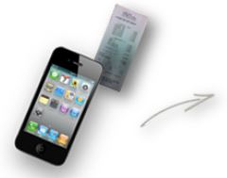

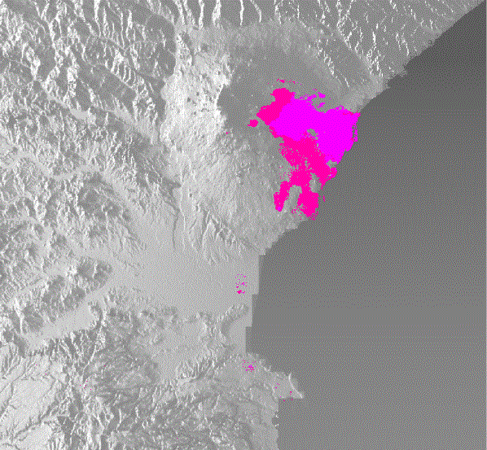
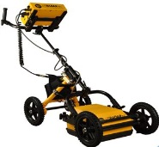
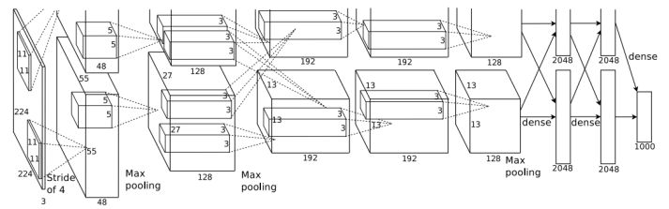
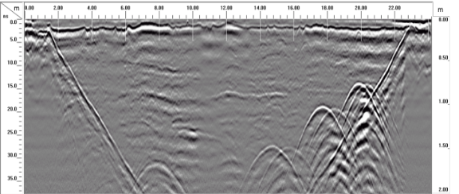
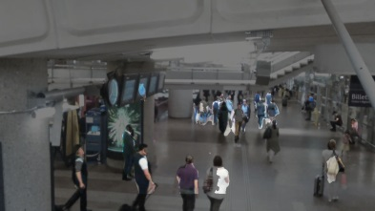

1st group: CIT
33CL COCA COLA 0,73
deformation measurements of volcanoes
Automatic reading of purchase receipts
1st group:
Deep Learning for crowd detection
Localisation of the subsoil gas network

Slide 6
2nd group: CoDe
Scientific Directions
Tools for representing information imperfection (probabilistic, fuzzy set, possibilistic, evidence approaches)
Methods for aggregating heterogeneous information, Decision making in dynamic uncertain context
Scientific Challenges
Management of dynamic context in Fusion Systems
Introduction of meta-knowledge and human behavior
Joint utilization of theories managing uncertainty (probability, possibility, evidence)
Technological and Societal Challenges
Factory of the futur
Smart Buildings
copyright®Yannick Perrin

Slide 7
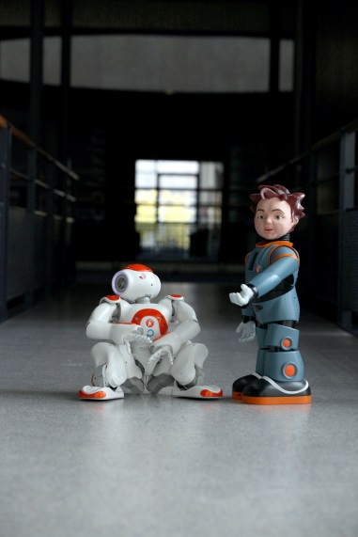
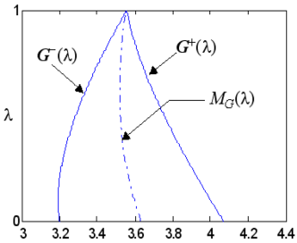
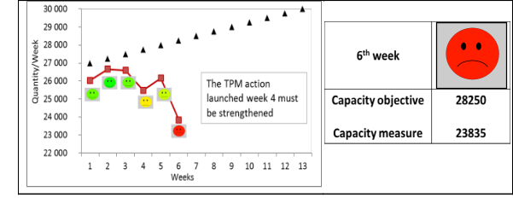
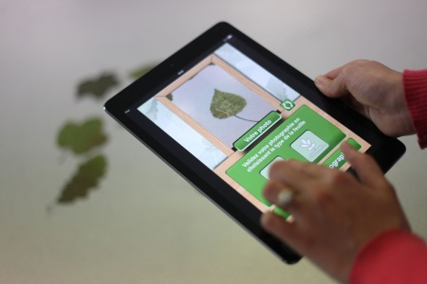
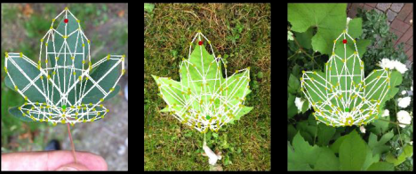
2nd group: CoDe
* Copyright Yannick Perrin
*
Service robotics
Arithmetic of Fuzzy Intervals
*
Industrial performance systems
Automatic tree recognition
copyright®Yannick Perrin
copyright®Yannick Perrin

Slide 8

3rd group: RSLR
Scientific Directions
Management of distributed software systems
Management of network architecture
Scientific Challenges
Adaptability, dynamic evolution of software systems (dynamic eco-systems)
Cloud computing
Technological and Societal Challenges
Internet of the futur, Internet of things
Smart City
Security in networks
copyright®Yannick Perrin

Slide 9
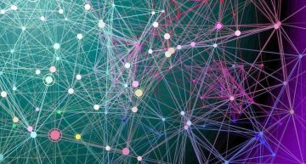
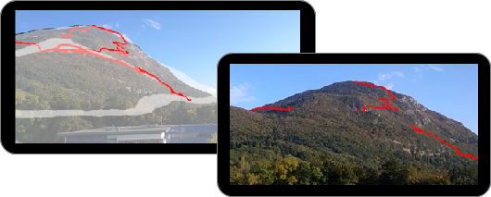
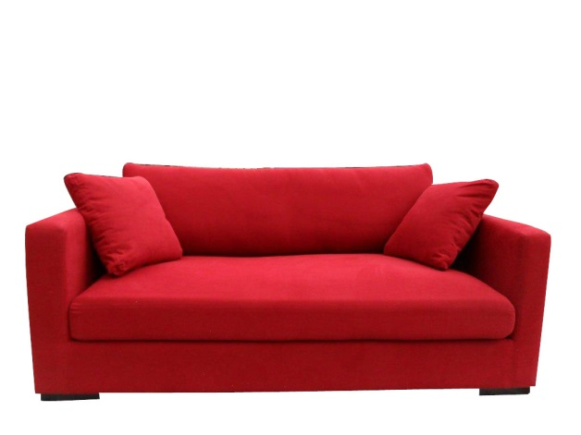

3rd group: RSLR
Large-Scale Data Management
(Fiability, Access, Consistency)
virtual terrain model
Internet of Things
Smart Sofa
copyright®Yannick Perrin

