Slide 1
Basics of for Loops in Bash
Dr. Will Gammerdinger
March 25, 2021

Slide 2
The Problem
You have a long list of items that you would like a series of commands to be iterated over
Common Examples:
You want to modify many similar files
You want to repeat an action a set number of times

Slide 3

Solution
Loops
Types of Loops
for Loops
while Loops
until Loops

Slide 4
Expected Learning Outcomes
To modify an existing for loop
To design a for loop

Slide 5
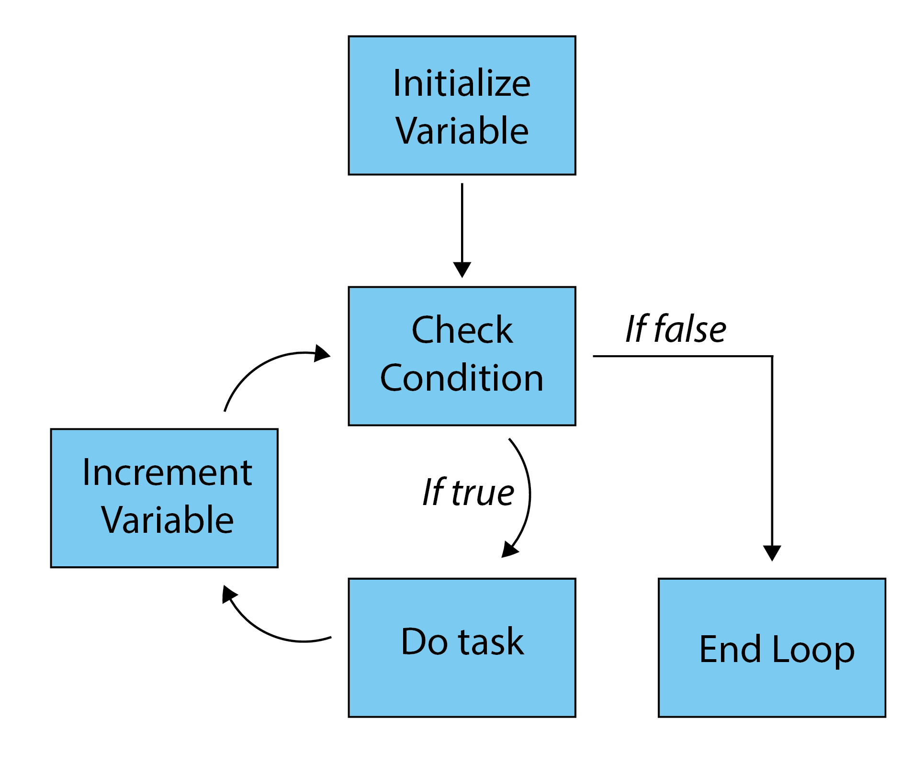
for Loops
Components of a loop
Variable
End Condition
Task
Increment

Slide 6
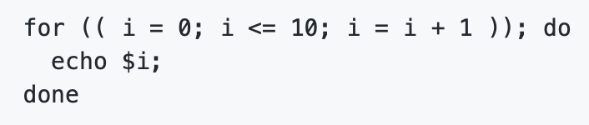
C-style for loop
Variable
End Condition
Increment
Task

Slide 7
Muddiest Point
What part(s), if any, of for loops would
you like clarification on?

