Slide 1
Visualizing NGS data
Will Gammerdinger
8/13/2015

Slide 2
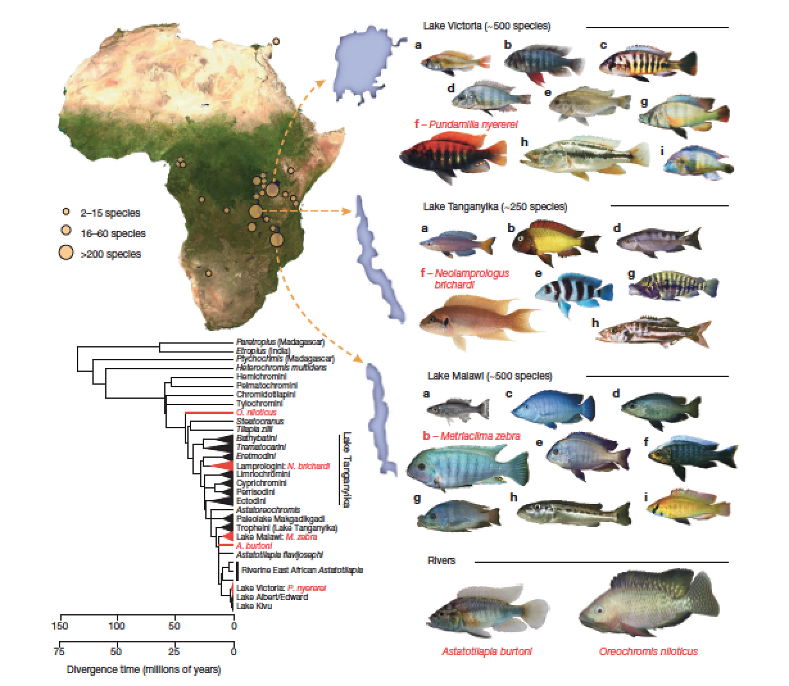
African Cichlids
Brawand et al., 2014
Notes:
In the last 5my since humans and chimps have diverged, 2,000 cichlid species have arose

Slide 3
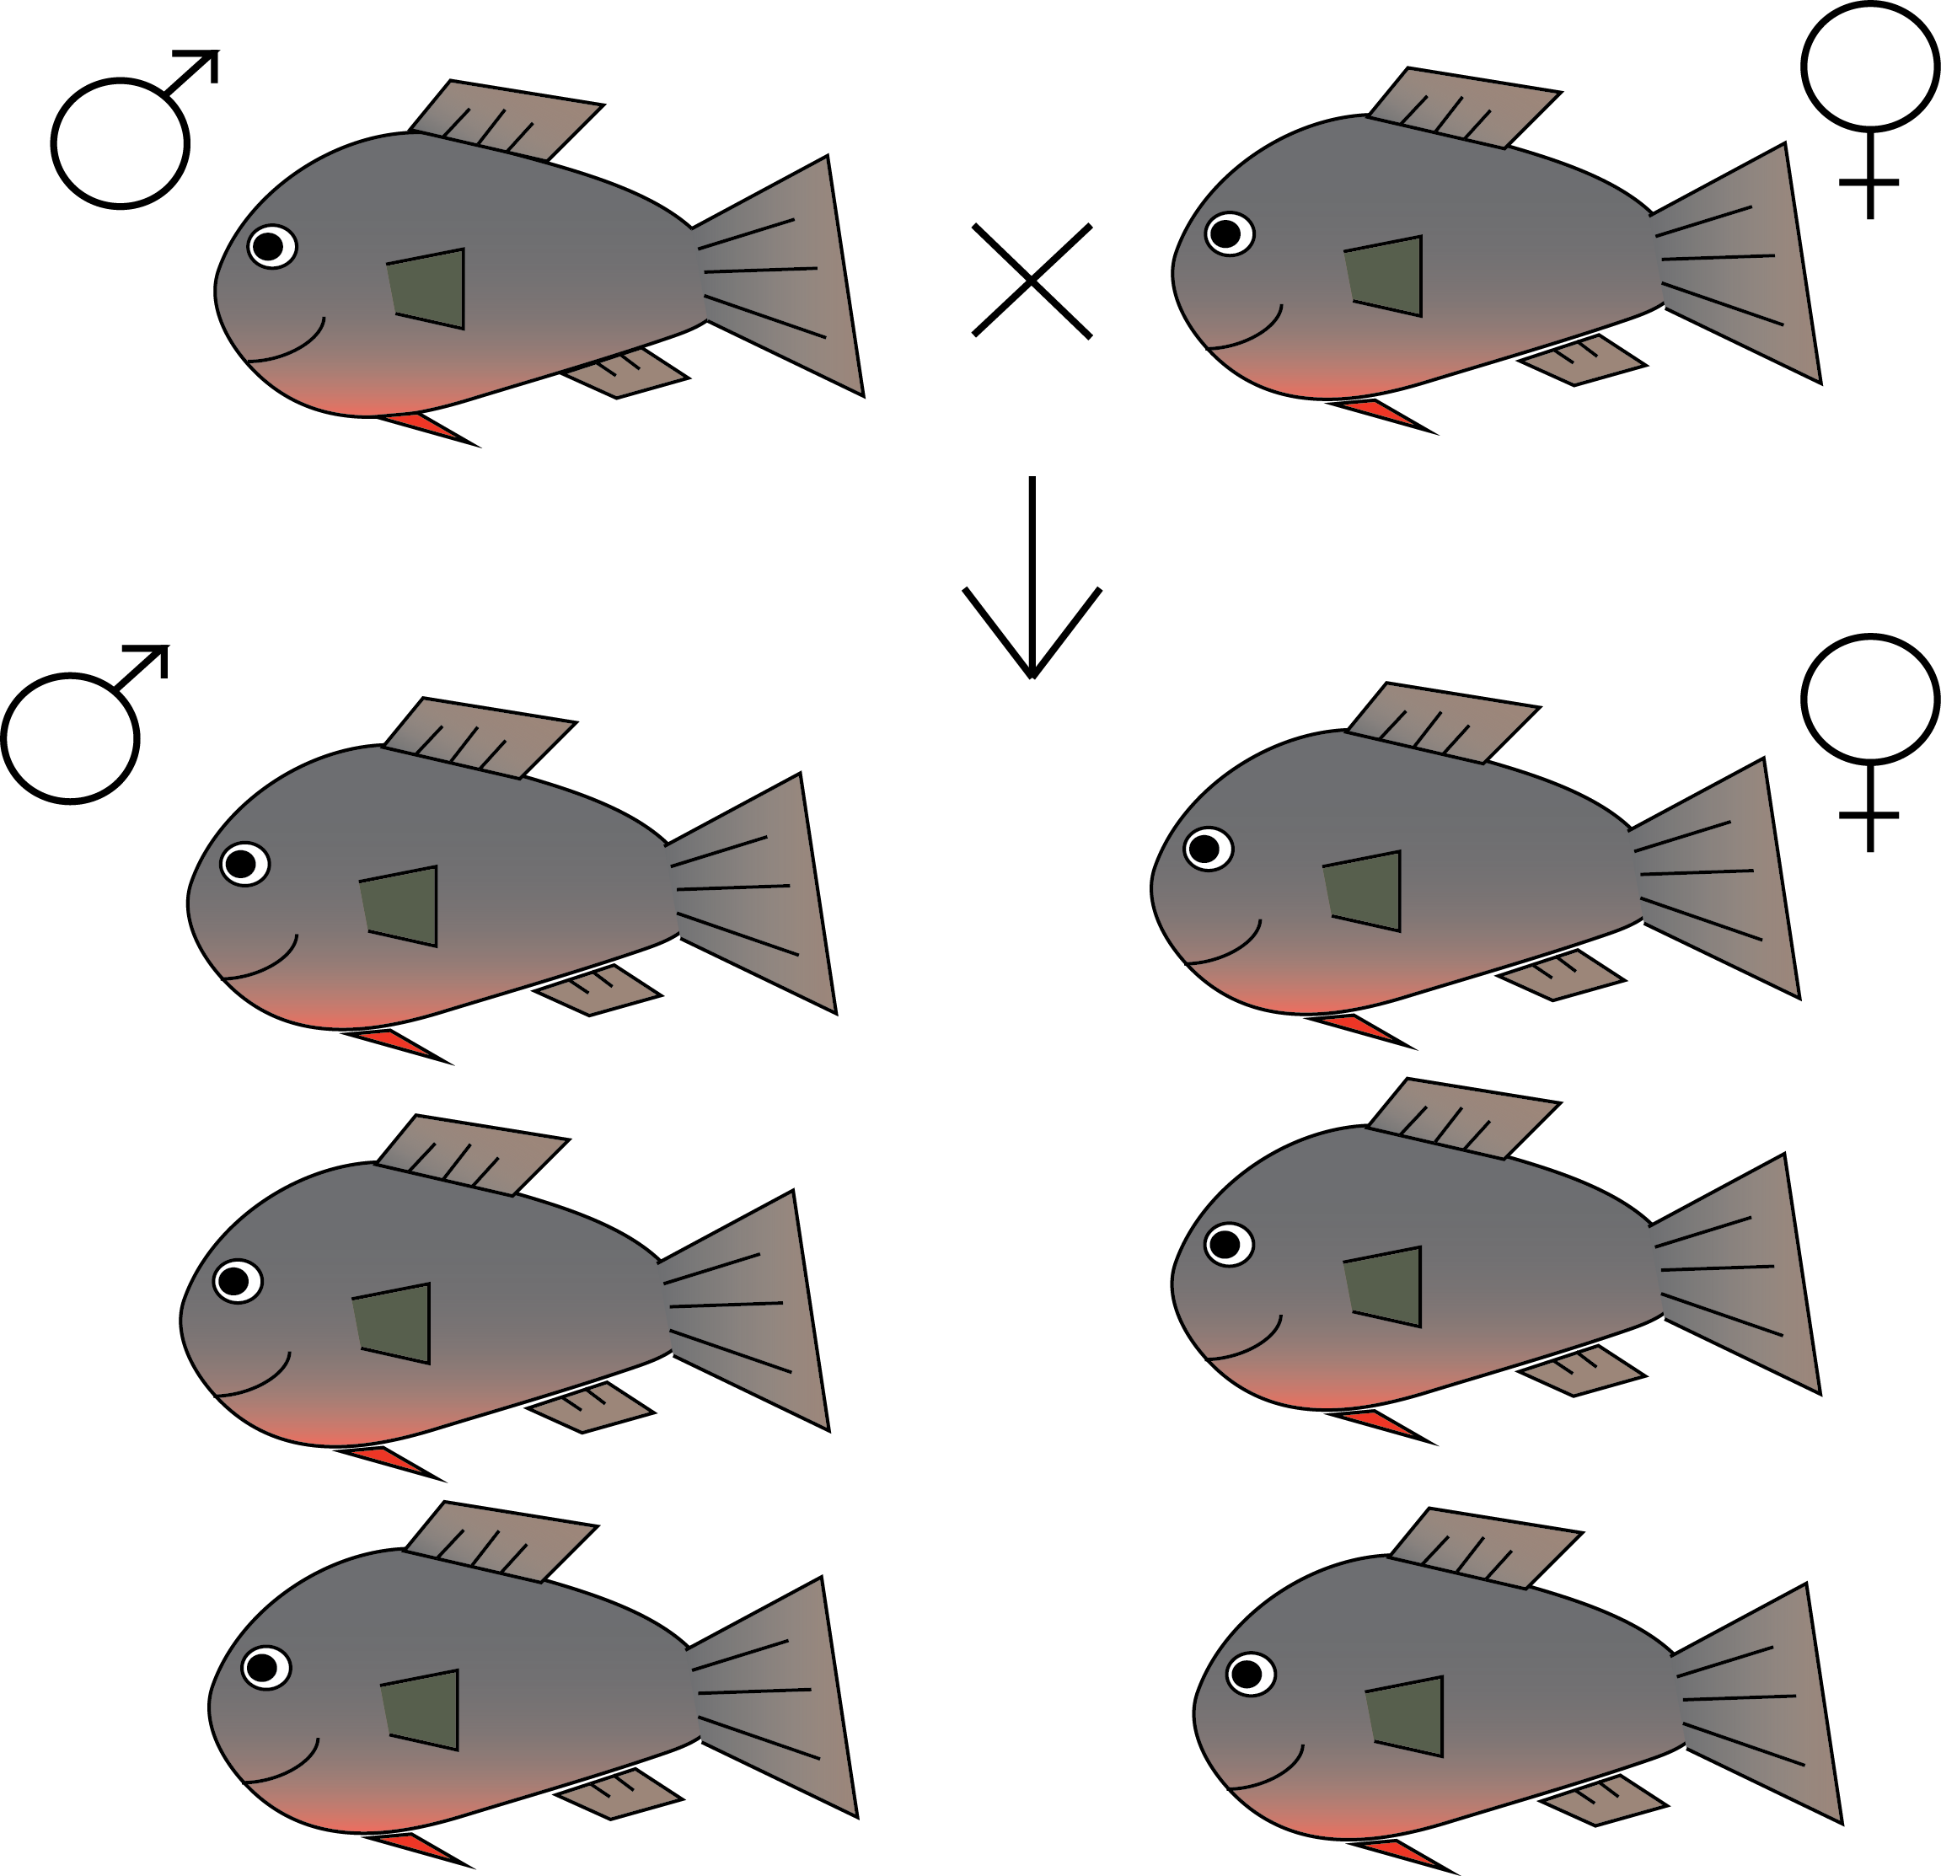
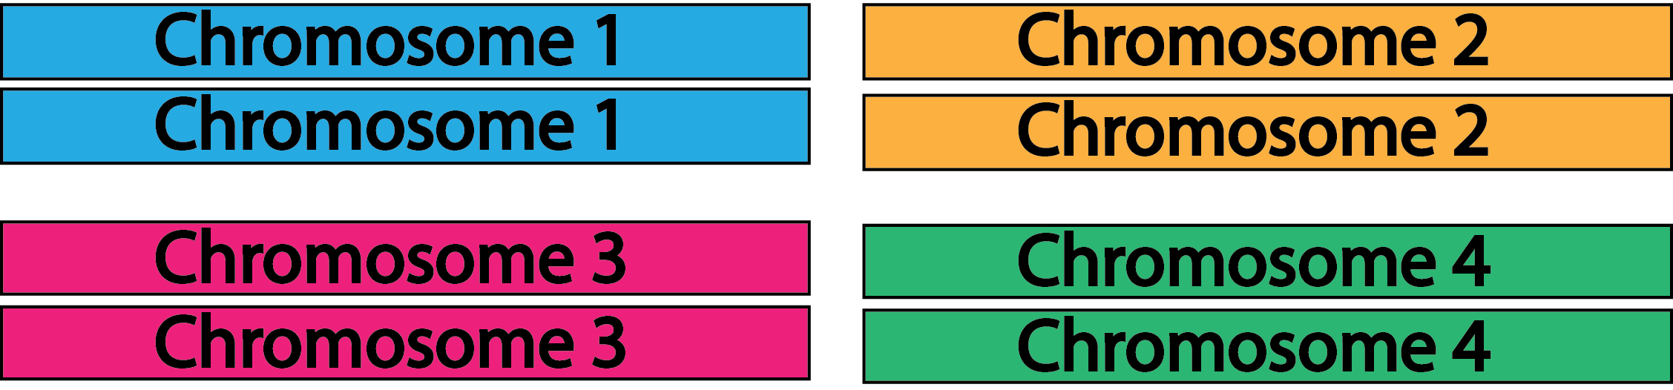
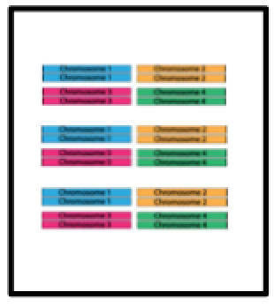
Experimental Design
Male Pool
Female Pool

Slide 4










Sequencing
Male Pool
Female Pool

Slide 5
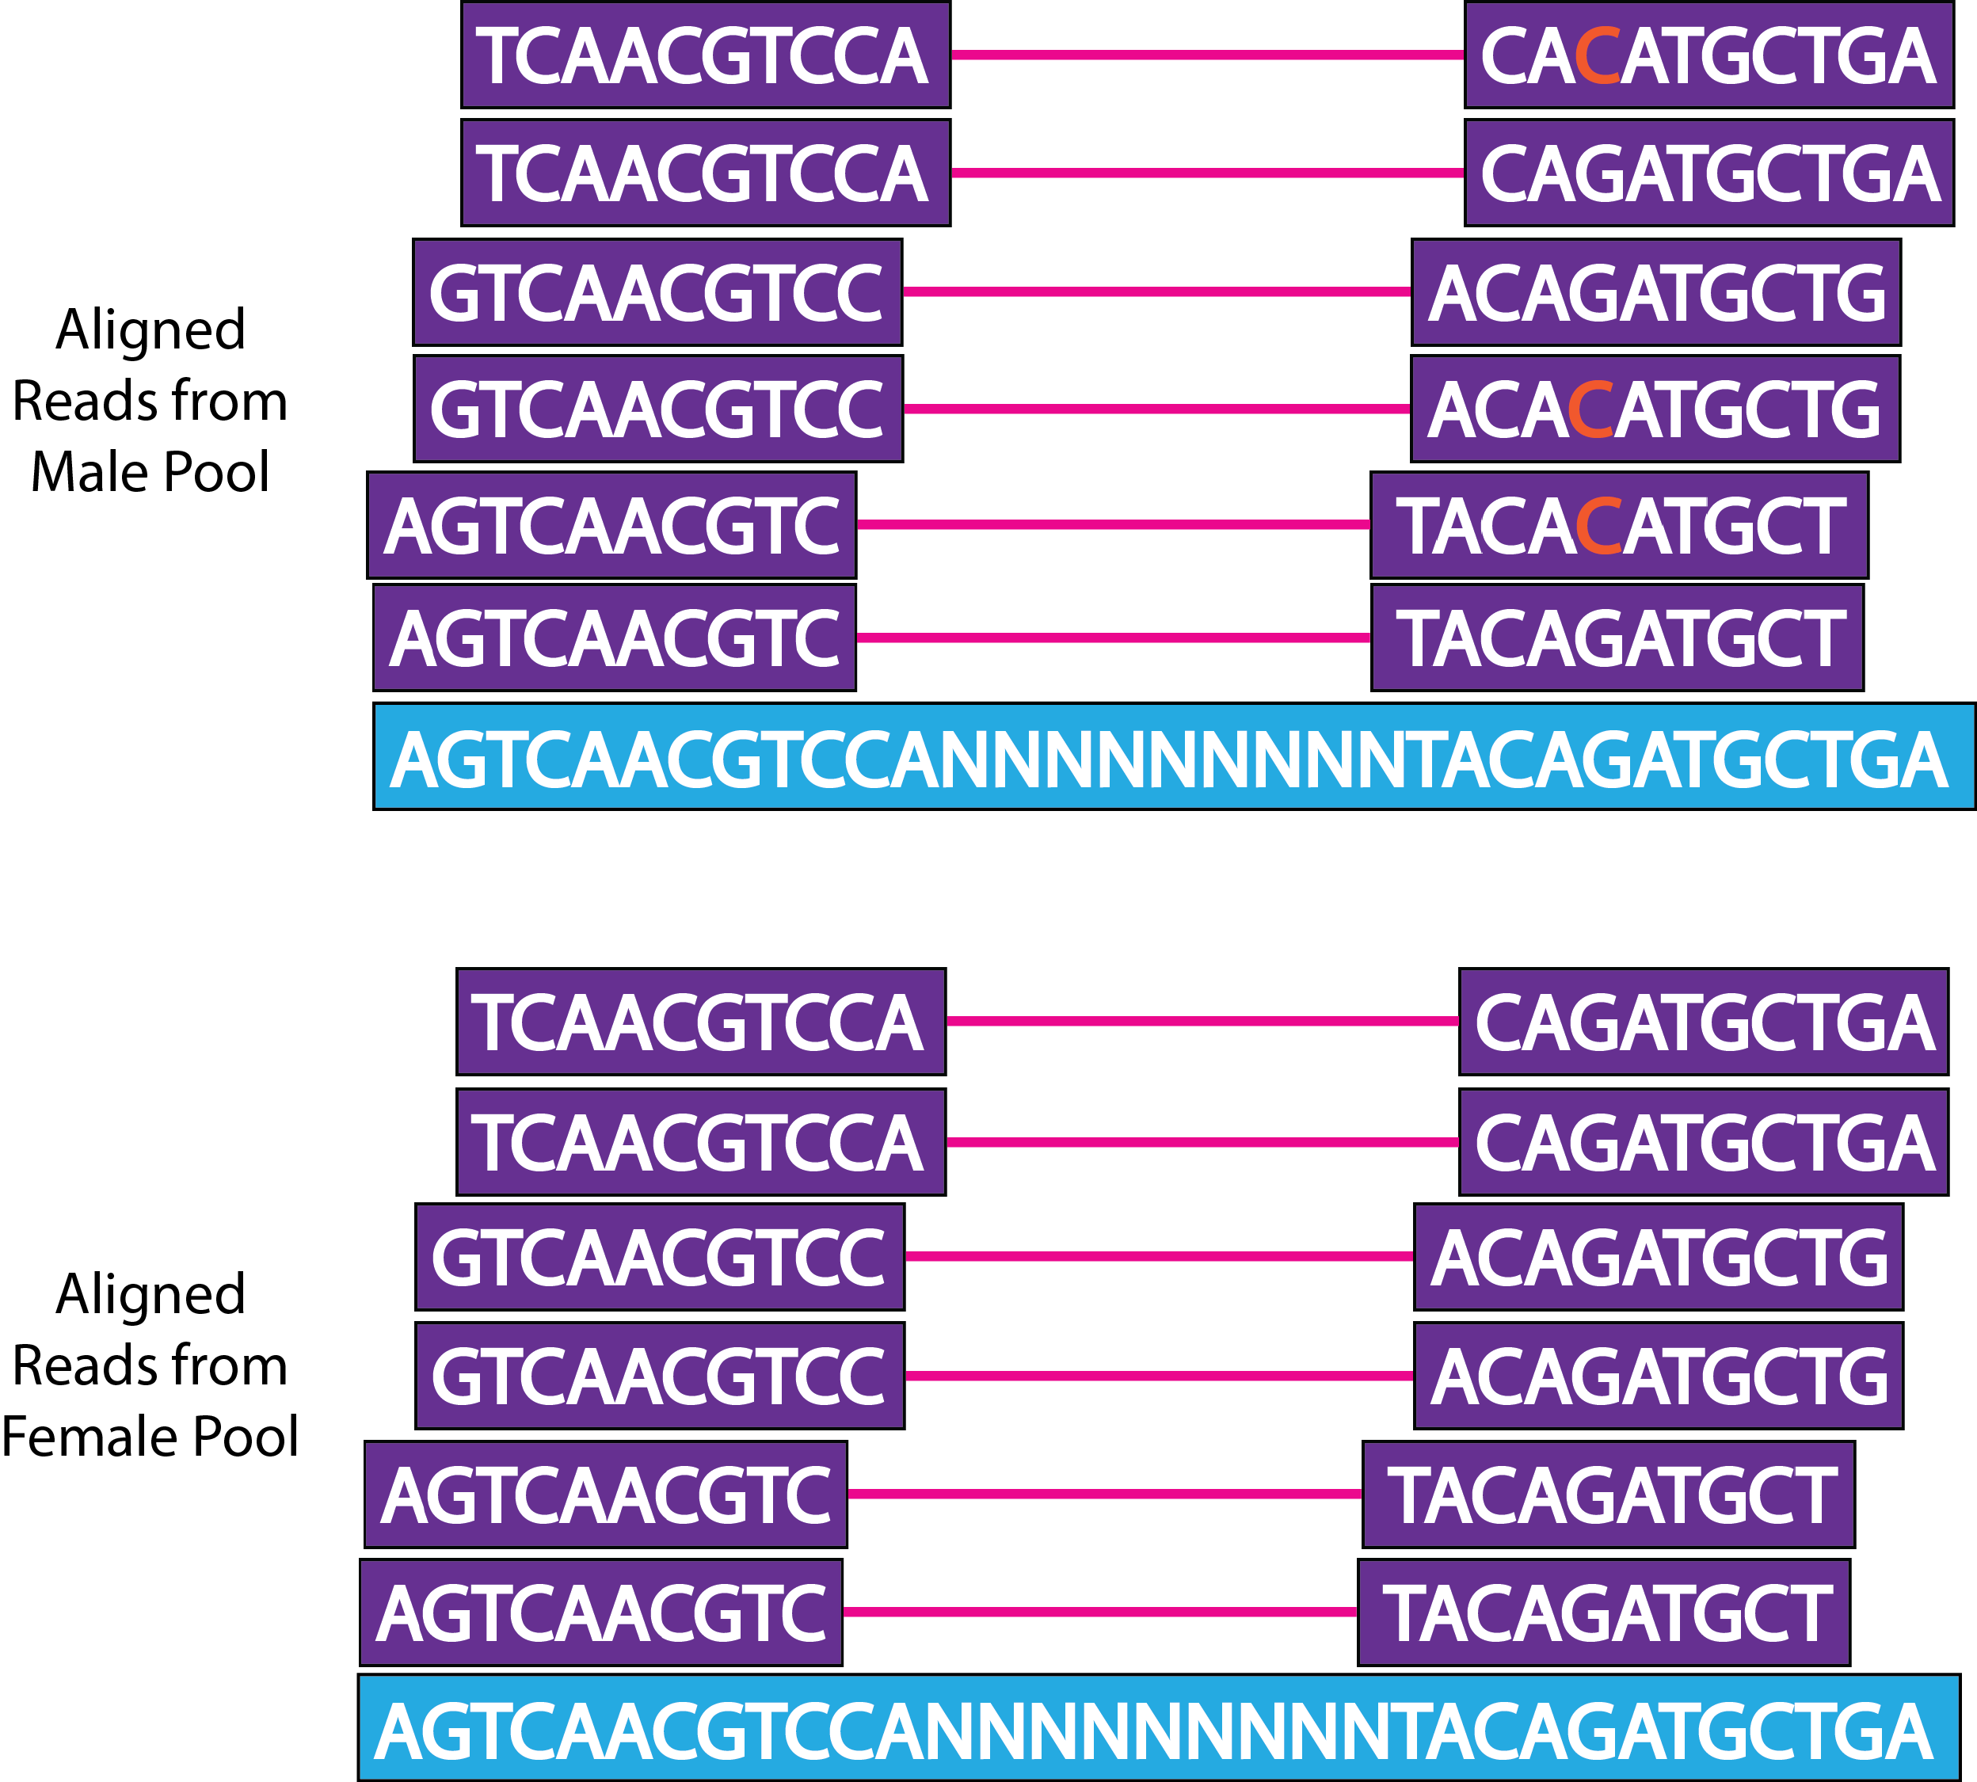
Alignment of Reads

Slide 6
Outline of Pipeline

Slide 7
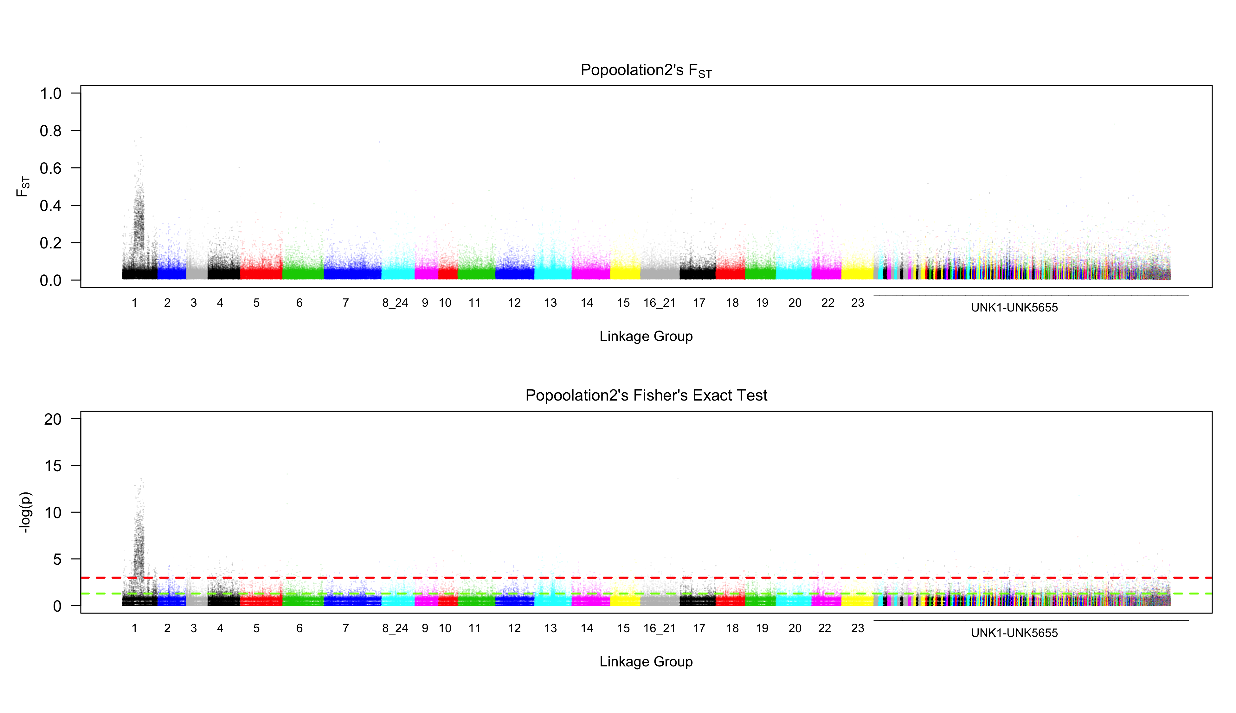
Manhattan Plot

Slide 8
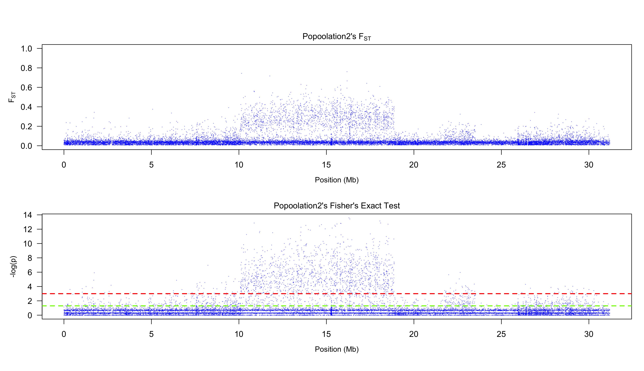
Specific Chromosome Plot

Slide 9
Tutorial Time
https://github.com/Gammerdinger/Manhattan_plots

