Slide 1
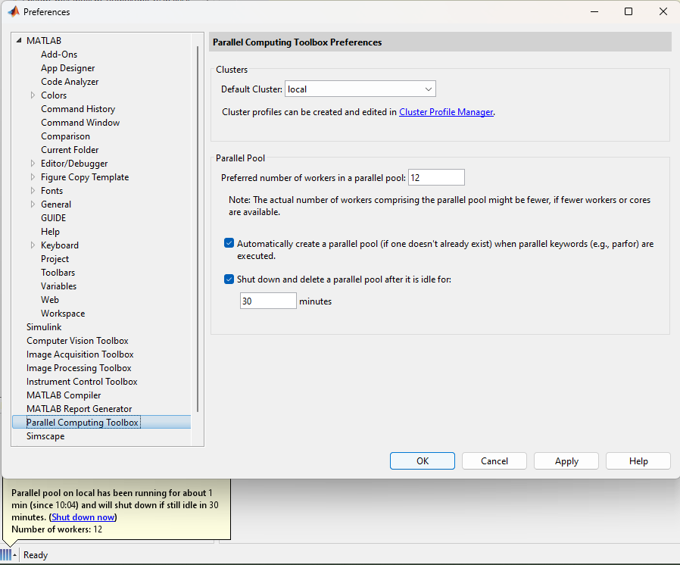

We updated the engine to allow multiple cores to work on the model optimization in parallel.
This decreased runtime by approximately one order of magnitude.
To activate multiple cores, click on the four bars on the bottom left and select “Parallel Preferences”.
Then activate as many parallel pools as you prefer / want to spare.
The procedure has been validate against the previous settings and showed the same parameter space explorer results (but faster runtime).

Slide 2
Overview on the changed files:
File | Status
calc_conf.m | modified (2 blocks)
set_glo2_worker.m | new helper file, must be on the MATLAB path (e.g. BYOM/engine)

