Slide 1
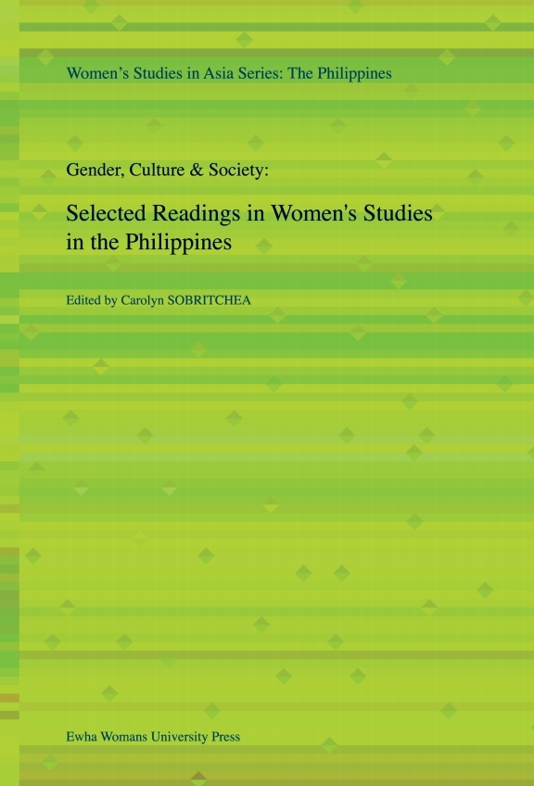
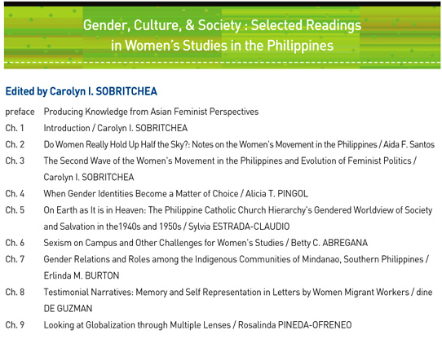
[필리핀] Gender, Culture, & Society: Selected Readings in Women's Studies in the Philippines
[Philippines] Gender, Culture, & Society: Selected Readings in Women's Studies

Slide 2
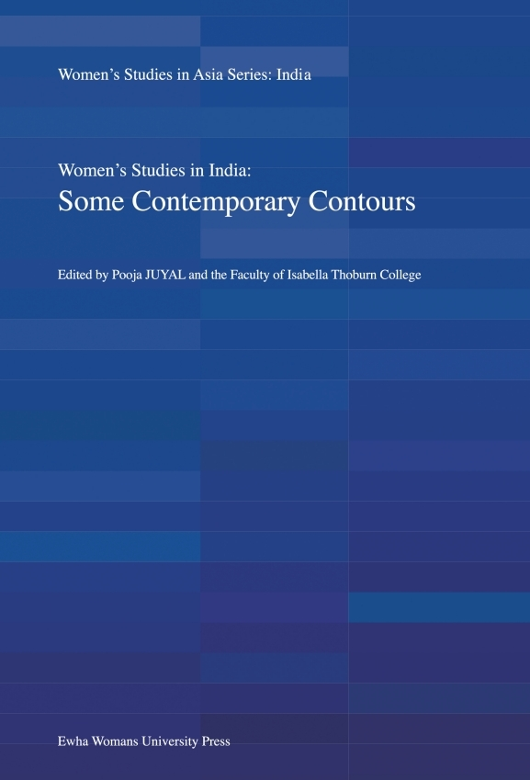
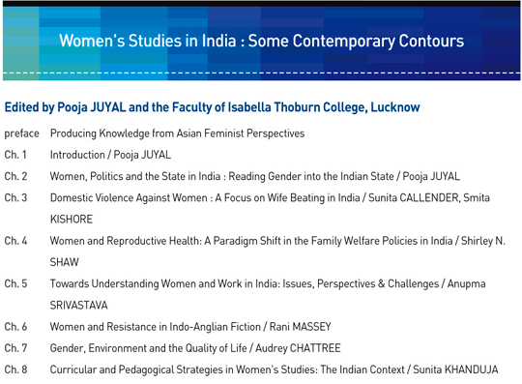
[인도] Women's Studies in India: Some Contemporary Contours
[India] Women's Studies in India: Some Contemporary Contours

Slide 3

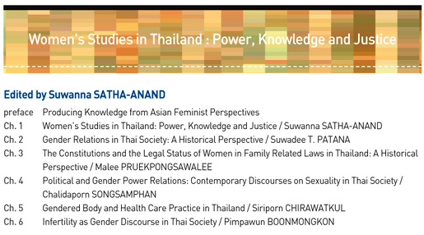
[태국] Power, Knowledge and Justice
[Thailand] Power, Knowledge and Justice

Slide 4
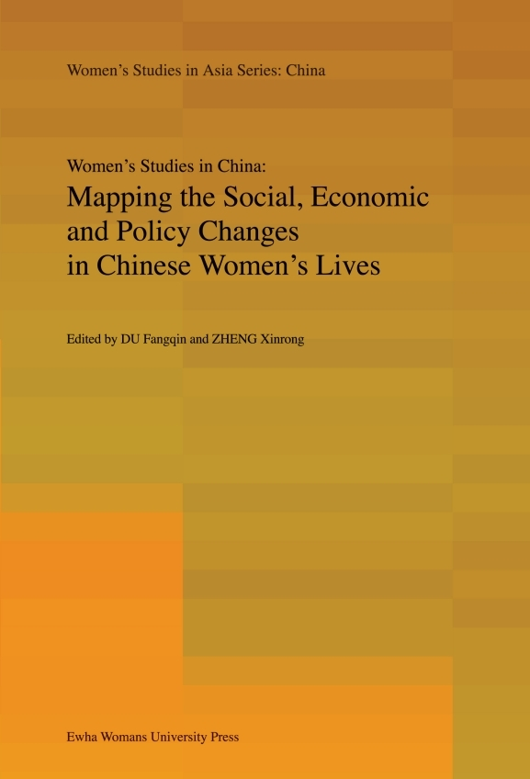
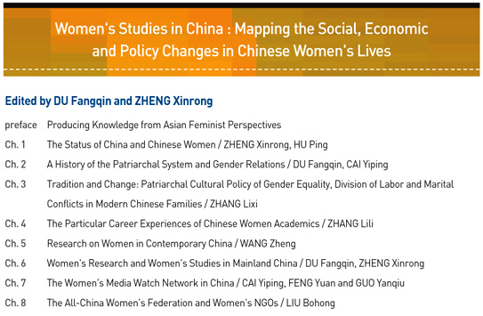
[중국] Mapping the Social, Economic and Policy Changes in Chinese Women's Lives
[China] Mapping the Social, Economic and Policy Changes in Chinese Women's Lives

Slide 5
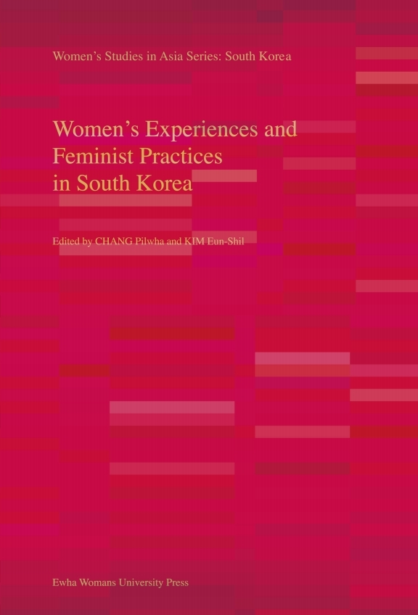
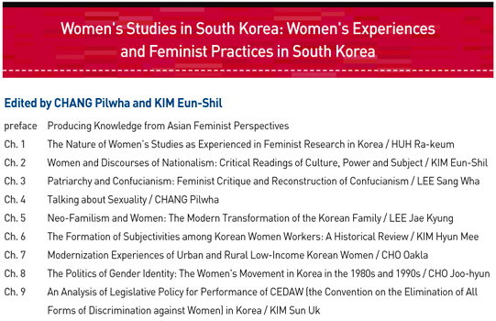
[한국] Women's Experiences and Feminist Practices in South Korea
[South Korea] Women's Experiences and Feminist Practices in South Korea

Slide 6
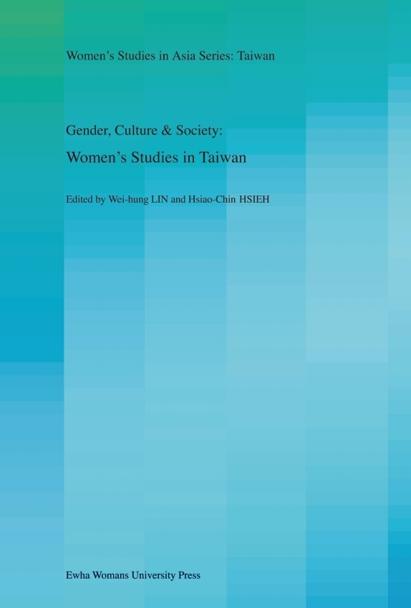
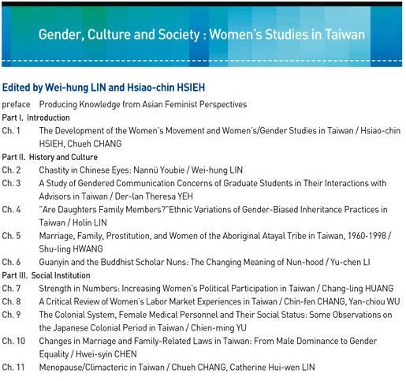
[Taiwan] Gender, Culture and Society: Women's Studies in Taiwan
[대만] Gender, Culture and Society: Women's Studies in Taiwan

Slide 7
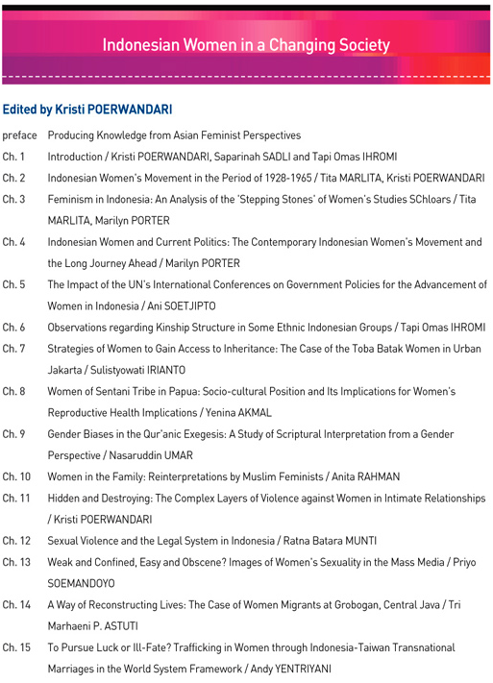

[Indonesia] Indonesian Women in a Changing Society
[인도네시아] Indonesian Women in a Changing Society
2020 07 13

