Slide 1


NEXT GEN EMPLOYABILITY PROGRAM
CREATING A FUTURE-READY WORKFORCE
Student Name :
GAMPA SAITEJA
Student ID :
STU64352b5d8d0bc1681206109
Mobile No:
7658990750
Mail ID:
20r01a67d5@cmritonline.ac.in
College Name :
CMR INSTITUTE OF TECHNOLOGY

Slide 2
CAPSTONE PROJECT SHOWCASE
Project Title
Health Care Data Driven Decisions using Power BI (DA)
Abstract | Problem Statement | Project Overview | Proposed Solution | Technology Used | Modelling & Results | Conclusion | Q&A

Slide 3
Abstract: Leveraging Power BI for Improved Healthcare
1
The Health Care Data Driven Decisions is an important task in the health care sector to assess the efficiency of treatments, optimize resource allocation, and improve patient outcomes.
2
In this analysis, various factors such as alcohol, smoking, age group, and week name are used to predict the likelihood of health outcomes.
3
The main goal of this project is to leverage data analytics to enhance decision-making processes, optimize resource allocation, and ultimately improve patient outcomes in the healthcare sector.
4
This analysis can assist health institutions in making informed decisions and refining processes to enhance overall operational effectiveness and patient care quality.

Slide 4


Problem Statement
Data Access and Analysis Challenges: In healthcare, accessing and analyzing data efficiently is a significant challenge.
Slow Decision-Making Process: Traditional methods for data analysis are slow and cumbersome, leading to delays in decision-making.
Suboptimal Patient Care: Without real-time insights, there is a risk of suboptimal patient care and treatment strategies.
Finding Total No. of Patients, smoking, alcohol, week name, age group.

Slide 5

Project Overview
Importing and Pre-processing:
Data successfully imported from various sources.
Cleaned and transformed for analysis.
Data Analysis Expression (DAX):
Implemented DAX formulas for calculations and analysis in Power BI.
Visualization and Dashboard:
Created visually appealing charts and an interactive dashboard.
Formatting and Testing:
Ensured consistent formatting and thoroughly tested for accuracy and functionality.

Slide 6
Proposed Solution
Integration of Power BI: Implementing Power BI into the healthcare system for streamlined data analysis.
Data Visualization: Utilizing Power BI's visualization tools to present complex healthcare data clearly.
Customized Reporting: Developing tailored reports within Power BI to address specific healthcare needs.
Identified Total No. of Patients, smoking, alcohol, week name, age group by writing DAX function using Card visual

Slide 7

Technology used
Microsoft Power BI for data visualization
• Microsoft Excel for dataset

Slide 8
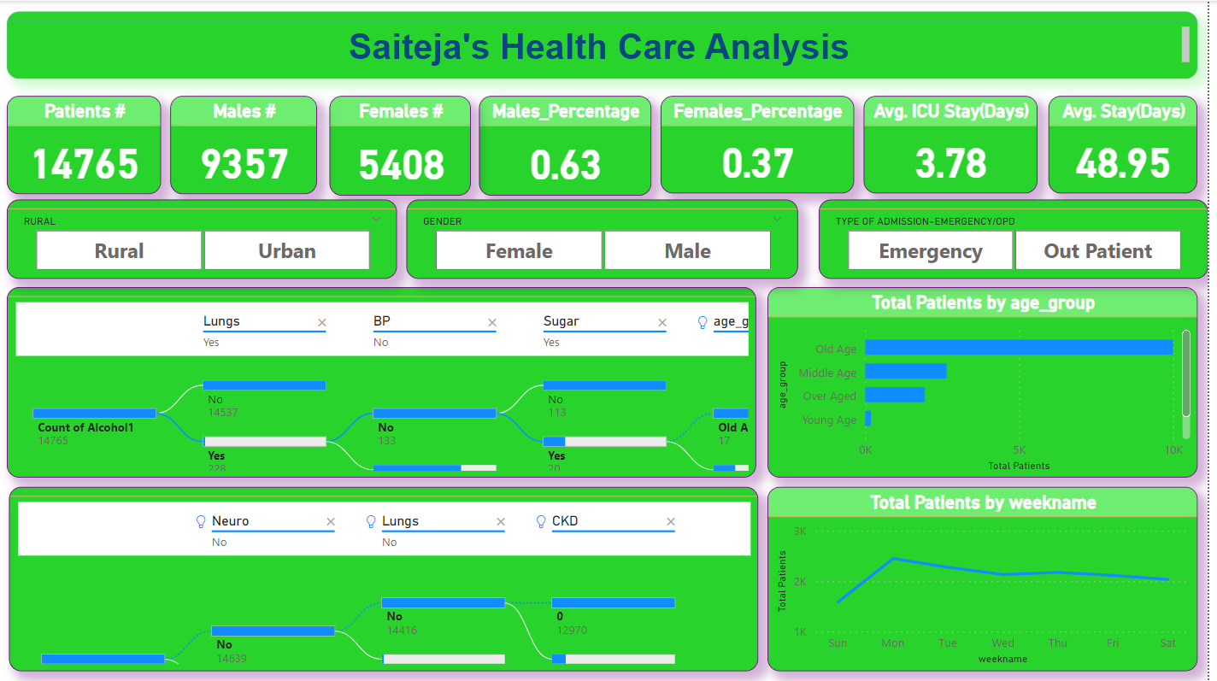
Modelling & Result

Slide 9
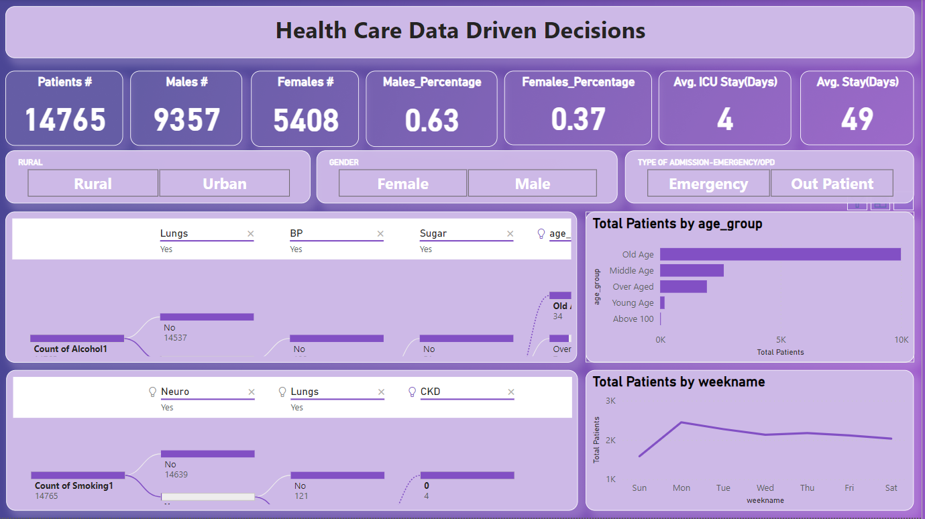
Modelling & Result

Slide 10
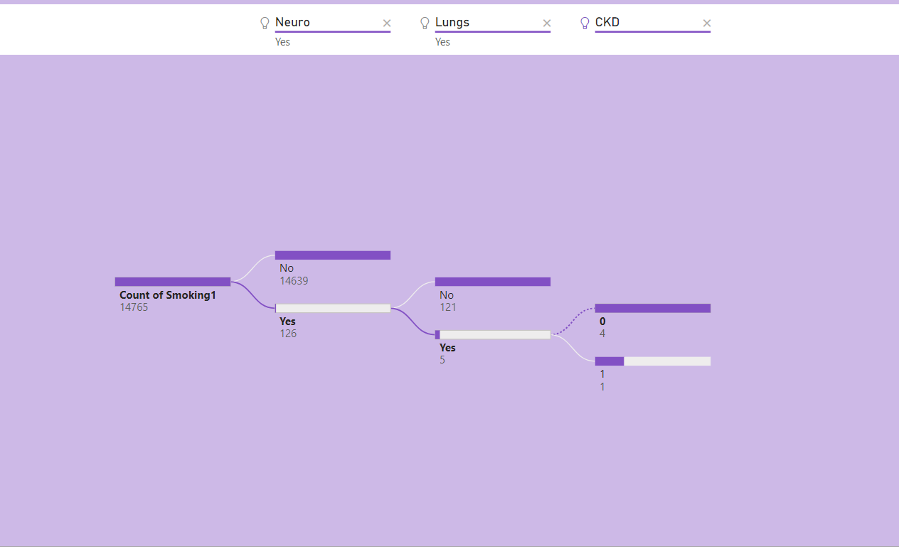
Modelling & Result

Slide 11
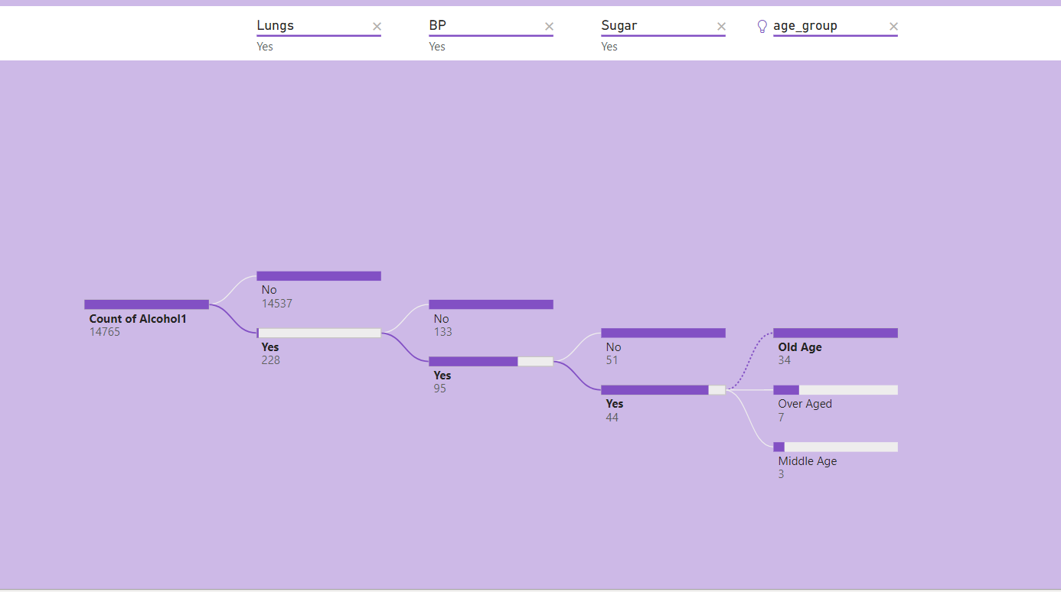
Modelling & Result

Slide 12

Conclusion
Power BI helps healthcare teams make smarter decisions by using data.
They can easily see important information about patients, treatments, and how well things are going.
This means they can work more efficiently, improve patient care, and use their resources wisely.
Ultimately, this leads to better healthcare for everyone involved.

Slide 13


Notes:
Thank You !!

