Slide 1
Predicting Urban Water Quality With Ubiquitous Data - A Data-Driven Approach.
Under the Guidance of
P.Anusha
Assoc.Prof.
Dept of CSE(Data Science)
Presented by :
G.SAI TEJA 20R01A67D5
G.BHANU 21R05A6717
M.KARTHIK 21R05A6713
K.SANDEEP 20R01A67F2

Slide 2
INDEX
ABSTRACT
INTRODUCTION
EXISTING SYSTEM
DISADVANTAGES
PROPOSED SYSTEM
ADVANTAGES
ALGORITHMS
SYSTEM REQURIEMENTS
CONCLUSION

Slide 3
ABSTRACT
Urban water quality is of great importance to our daily lives. Prediction of urban water quality help control water pollution and protect human health. However, predicting the urban water quality is a challenging task since the water quality varies in urban spaces non-linearly and depends on multiple factors, such as meteorology, water usage patterns, and land uses. In this work, we forecast the water quality of a station over the next few hours from a data-driven perspective, using the water quality data and water hydraulic data reported by existing monitor stations and a variety of data sources we observed in the city, such as meteorology, pipe networks, structure of road networks, and point of interests (POIs). First, we identify the influential factors that affect the urban water quality via extensive experiments. Second, we present a multi-task multi-view learning method to fuse those multiple datasets from different domains into an unified learning model. We evaluate our method with real-world datasets, and the extensive experiments verify the advantages of our method over other baselines and demonstrate the effectiveness of our approach.

Slide 4
INTRODUCTION
Urban water is a vital resource that affects various aspects of human, health and urban lives. People living in major cities are increasingly concerned about the urban water quality, calling for technology that can monitor and predict the water quality in real time throughout the city. Urban water quality, which serves as “a powerful environmental determinant” and “a foundation for the prevention and control of waterborne diseases” [1], refers to the physical, chemical and biological characteristics of a water body, and several chemical indexes (such as residual chlorine, turbidity and pH) can be used as effective measurements for the water quality in current urban water distribution systems [2].
With the increasing demand for water quality information, several water quality monitoring stations have been deployed throughout the city’s water distribution system to provide the real-time water quality reports in a city. Figure 1 illustrates the water quality monitor stations that have been deployed in Shenzhen, China. Besides water quality monitoring, predicting the urban water quality plays an essential role in many urban aquatic projects, such as informing waterworks’ decision making (e.g., pre-adjustment of chlorine from the waterworks), affecting governments’ policy making (e.g., issuing pollution alerts or performing a pollution control), and providing maintenance suggestions (e.g., suggestions for replacements of certain pipelines).

Slide 5
PROBLEM STATEMENT
The problem statement revolves around the challenging task of predicting urban water quality, which is influenced by non-linear variations and multiple factors. Existing data-driven approaches, such as IBL, ANN, and SVM, have limitations in urban scenarios and struggle to integrate data from different sources. The research aims to address these challenges by proposing a novel data-driven approach that considers various data domains, identifies influential factors, employs multi-task multi-view learning, and evaluates the effectiveness using real-world datasets from Shenzhen, China.

Slide 6
EXISTING SYSTEM
Several studies in the environmental science have been tried to analyze the water quality problems via data-driven based approaches, and those studies covers a range of topics, from the physical process analysis in the river basin, to the analysis of concurrent input and output time series [64] [65]. The approaches adopted in these studies include instance-based learning models (e.g., kNN) as well as neural network models (e.g., ANN). In general, those data-driven approaches in the environmental science can fall into the following three major categories: Instance-based Learning models (IBL), Artificial Neural Network models (ANN) and Support Vector Machine models (SVM).

Slide 7
DISADVANTAGES
The system is implemented only Multi-task Multi-view Learning Approaches.
Instance-based learning models (IBL) is a family of learning algorithms that model a decision problem with instances or examples of training data that are deemed important to the model.

Slide 8
PROPOSED SYSTEM:
_ Data-driven Perspective: We present a novel data-driven approach to co-predict the future water quality among different stations with data from multiple domains. Additionally, the approach is not restricted to urban water quality prediction, but also can be applied to other multi-locations based coprediction problem in many other urban applications.
_ Influential Factor Identification: We identify spatially-related (such as POIs, pipe networks, and road networks) and temporally-related features (e.g., time of day, meteorology and water hydraulics), contributing to not only our application but also the general problem of water quality prediction.

Slide 9
ADVANTAGES
1) Water quality data: We collect water quality data every five minutes from 15 water quality monitoring stations in Shenzhen City. It comprises residual chlorine (RC), turbidity (TU) and pH. In this paper, we only use RC as the indexfor water quality, since RC is the most important and effective measurement for water quality in current urban water distribution system.
2) Hydraulic data: Hydraulic data consists of flow and pressure, which are collected every five minutes from 13 flow sites and 14 pressure sites, respectively.

Slide 10
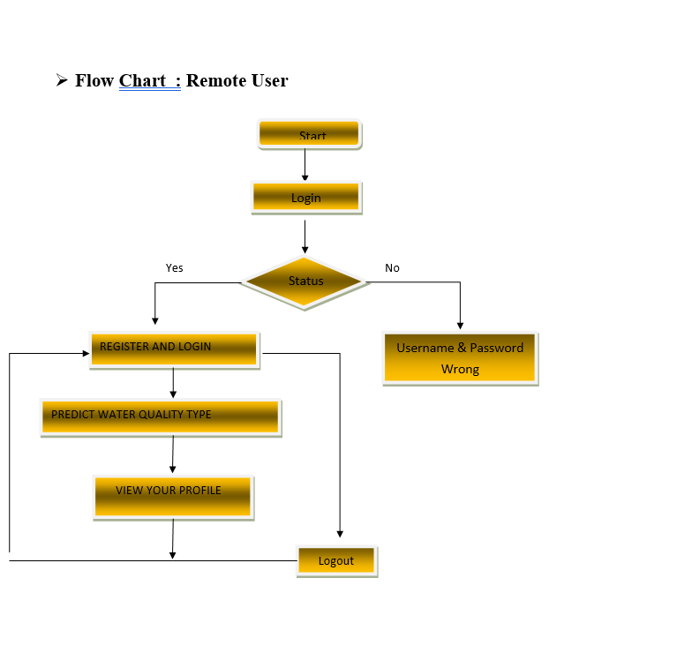

Slide 11
Algorithms
Decision Tree Classifiers:
Decision trees are used for classification and regression tasks.
They create a tree-like model based on the features of the data to make decisions.
The tree is constructed by recursively splitting the data based on the most informative features.
Each leaf node in the tree represents a class or a regression value.
Gradient Boosting:
Gradient boosting is an ensemble learning method that builds a strong predictive model by combining the predictions of multiple weak models, typically decision trees.
It builds trees sequentially, with each new tree correcting the errors of the previous ones.
It minimizes a specified loss function by adjusting the weights of individual trees.
K-Nearest Neighbors (KNN):
KNN is a simple and powerful classification algorithm.
It classifies a data point based on the majority class among its k-nearest neighbors in the feature space.
It is non-parametric, lazy learning, and doesn't learn until a test example is given.

Slide 12
Logistic Regression:
Logistic regression is used for binary or multinomial classification.
It models the relationship between the dependent variable and one or more independent variables.
It estimates the probability that a given instance belongs to a particular category.
Naïve Bayes:
Naïve Bayes is a probabilistic classification algorithm based on Bayes' theorem.
It assumes independence between features, which simplifies the calculation of probabilities.
Despite its simplistic assumption, it often performs well and is computationally efficient.
Random Forest:
Random Forest is an ensemble learning method that builds multiple decision trees and combines their predictions.
It addresses overfitting by averaging or voting on the predictions of individual trees.
It is widely used for classification and regression tasks.
Support Vector Machines (SVM):
SVM is a discriminative machine learning technique for classification and regression.
It finds the optimal hyperplane that best separates different classes in the feature space.
SVM aims to maximize the margin between classes, making it robust against outliers.

Slide 13
SYSTEM REQUIREMENTS:
➢ H/W System Configuration:-
➢ Processor - Pentium –IV
➢ RAM - 4 GB (min)
➢ Hard Disk - 20 GB
➢ Key Board - Standard Windows Keyboard
➢ Mouse - Two or Three Button Mouse
➢ Monitor - SVGA

Slide 14
SOFTWARE REQUIREMENTS:
Operating system : Windows 7 Ultimate.
Coding Language : Python.
Front-End : Python.
Back-End : Django-ORM
Designing : Html, css, javascript.
Data Base : MySQL (WAMP Server).

Slide 15
CONCLUSION :
This paper presents a novel data-driven approach to forecast the water quality of a station by fusing multiple sources of urban data. We evaluate our approach based on Shenzhen’s water quality and various urban data. The experimental results demonstrate the effectiveness and efficiency of our approach. Specifically, our approach outperforms the traditional RC decay model [2] and other classical time series predictive models (ARMA, Kalman) in terms of RMSE metric. Meanwhile, as our approach consists of two components, each of the components demonstrates its effectiveness through extensive experiments and analysis. In particular, the first component is the influential factors identification, which explores the factors that affect the urban water quality via extensive experiments and analysis in Section 3 and 4. The second one is a spatiotemporal multi-view multi-task learning (STMTMV) framework that consists of multi-view learning and multi-task learning. The experiments have shown that STMTMV has a predictive accuracy of around 85% for forecasting next 1-4 hours, which outperforms the single-task methods (LR) by approximately 11% and the single-view methods (t-view and s-view) by approximately 11% and 12%, respectively. The code has been released at: https://www.microsoft.com/en-us/research/publication/urbanwater- quality-prediction-based-multi-task-multi-view-learning-2/ In future, we plan to deal with the water quality inference problems in the urban water distribution systems through a limited number of water quality monitor stations.

Slide 16
REFERENCES
[1] W. H. Organization, Guidelines for drinking-water quality, 2004, vol. 3.
[2] L. A. Rossman, R. M. Clark, and W. M. Grayman, “Modeling chlorine
residuals in drinking-water distribution systems,” Journal of environmental
engineering, vol. 120, no. 4, pp. 803–820, 1994.
[3] Y. Zheng, “Methodologies for cross-domain data fusion: An overview,”
IEEE Transactions on Big Data, vol. 1, no. 1, pp. 16–34, 2015.

Slide 17
THANK YOU

