Slide 1
CSS preprocessor

Slide 2
What is CSS?
CSS is the language for describing the presentation of Web pages, including colors, layout, and fonts. It allows one to adapt the presentation to different types of devices, such as large screens, mobile device etc.
CSS Is Made Up of Three Parts: A selector, property and value.
selector {property: value}
Selector could be html element, class or id.
example : body {color: black;}

Slide 3
CSS Specificity
Specificity is the means by which browsers decide which CSS property values are the most relevant to an element and, therefore, will be applied. Specificity is based on the matching rules which are composed of different sorts of CSS selectors
Specificity is usually the reason why your CSS-rules don’t apply to some elements, although you think they should
Every selector has its place in the specificity hierarchy
There are four distinct categories which define the specificity level of a given selector: inline styles, IDs, classes, attributes, and elements
!important is killer

Slide 4
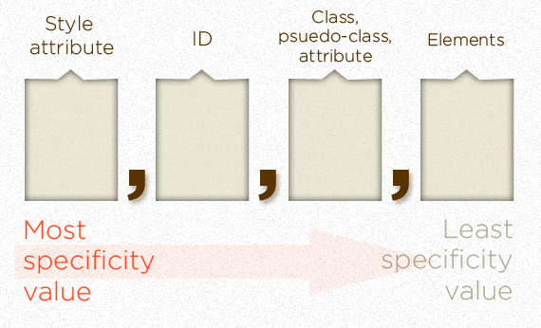
CSS Specificity hierarchy
Inline styles :
<h1 style="color: #fff;">
IDs (# of ID selectors)
#someId{ float: none; }
Classes, attributes and pseudo-classes
.someClass{ width: 200%; overflow: visible; } // class
input[type="text"] { width: 150px; } // attribute
a:hover {cursor: pointer} // pseudo-classes
Elements and pseudo-elements
ul li {color:red}

Slide 5
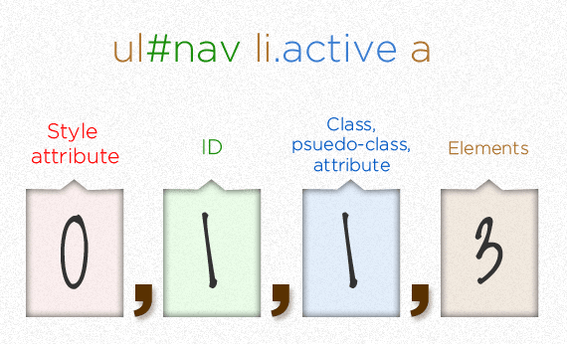
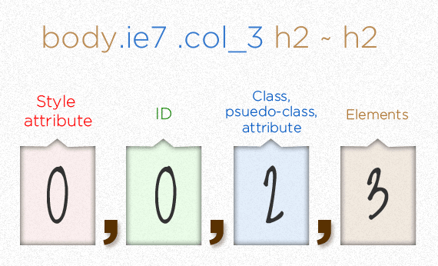
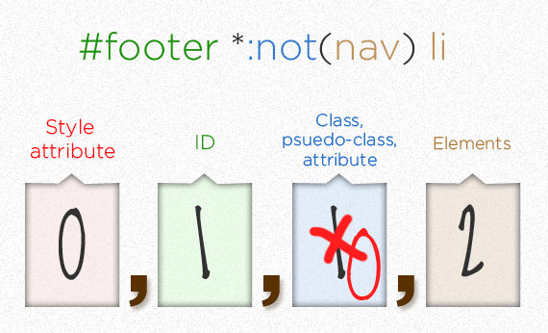
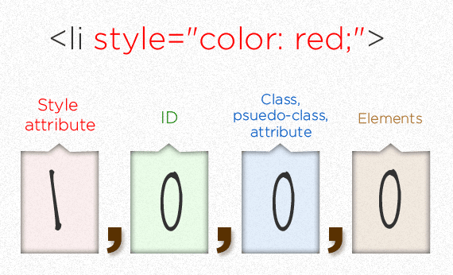
CSS Specificity examples

Slide 6
What is preprocessor
A preprocessor is a program that takes one type of data and converts it to another type of data
When stylesheets are getting larger, more complex, and harder to maintain. This is where a preprocessor can help. CSS preprocessor are superset of CSS and helps us write maintainable
It enforces us to follow DRY principle

Slide 7
SCSS (Sassy CSS)
Sass lets us use features that don't exist in CSS yet like variables, nesting, mixins, inheritance and more, with a fully CSS-compatible syntax. that make writing CSS fun again.
Requires ruby to install SASS
> gem install sass
sass --watch scss-file.scss
sass scss-file.scss css-file.css
sass-convert style.sass style.scss
sass-convert style.scss style.sass
SassScript : sass -i
Notes:
Sass –version
sass-convert style.sass style.scss // sass to scss
sass-convert style.scss style.sass // scss to sass
watch
sass --watch control-stmt.scss

Slide 8
SCSS features
Comments : Single, multi line, interpolation
Nesting : Sass allows CSS rules to be nested within one another
Variables: Variables begin with $ signs, and used like CSS properties
@directives: import, extend
Control directives and expression : @if, @for, @each and @while
Mixin: Allow you to define styles that can be re-used by using @include directives.
Function: Define your own functions
Notes:
Nesting :
Referencing Parent Selectors: &:hover , & will be replaced with parent selector
Nested Properties font: use full for same namespace
Variables:
CSS properties as variable, selectors as variables, number operations, color operations
Lists (10px 10px 0px, 1px), maps(key1: value1, key2: value2, key3: value3);
@Directive :
@import takes a filename to import. By default, CSS @import rule:
If the file’s extension is .css.
If the filename begins with http://.
If the filename is a url().
If the @import has any media queries
@extends: inherit properties
single, multiple, chain, Placeholder Selectors : a%selector wont render itself unless we extend it.
Mixin
with/without parameter, default parameters, variable parameters
Function : function should have return value, need not to use @include

Slide 9
.dap-team {
content: “Thank you”
}

