Slide 1
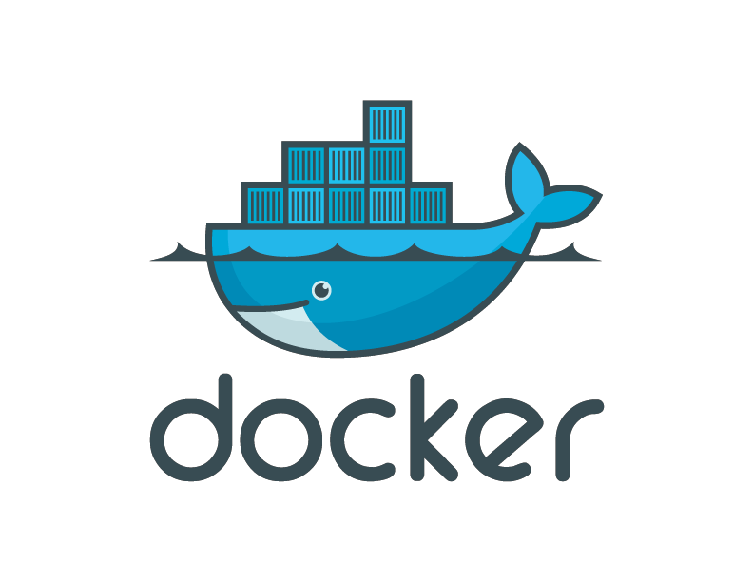
Introduction to Docker

Slide 2
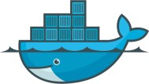
Contents
Introduction to Containers
What is Docker?
Docker Architecture
Installing Docker
Docker Engine
Docker Images
Docker File
Docker Hub
Docker CLI
Kubernetes

Slide 3
What is Docker
Docker
is an
open-source
project
that
automates the
deployment of applications inside software container
Docker
containers wrap up a
piece of software in a
complete file system that contains everything it needs to
run: code, runtime, system
tools, system libraries –
anything you can install on a server.
This
guarantees that it will always run
the same,
regardless of the environment it is running in.

Slide 4
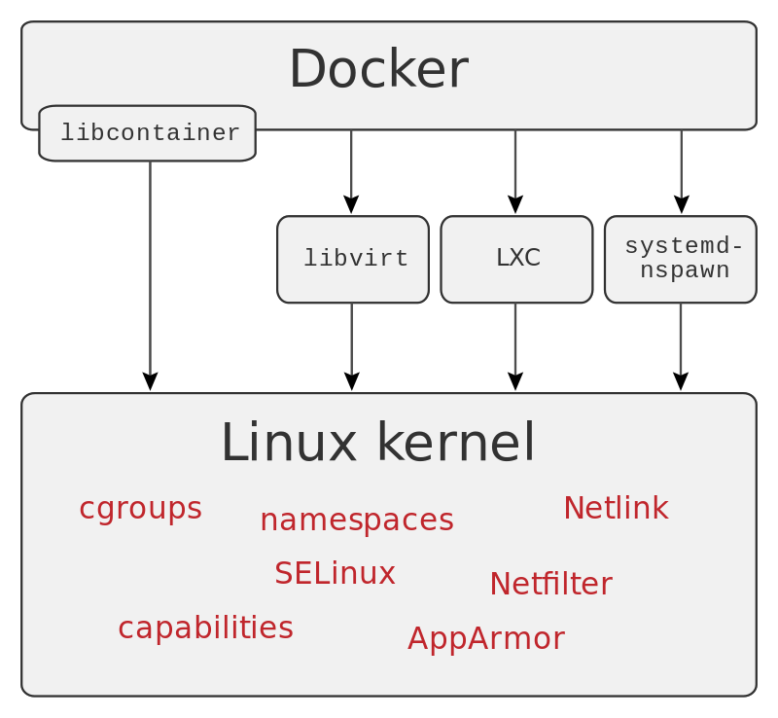
Docker Architecture

Slide 5
Containers
LXC
(Linux Containers) is an operating-system-level
virtualization method for running multiple isolated Linux systems (containers) on a control host using a single Linux kernel.
The Linux kernel provides the cgroups functionality that
allows limitation and prioritization of resources (CPU, memory, block I/O, network, etc.) without the need for starting any virtual machines, and namespace isolation
functionality that allows complete isolation of an
applications' view of the operating environment, including
process trees, networking, user IDs and mounted file systems

Slide 6
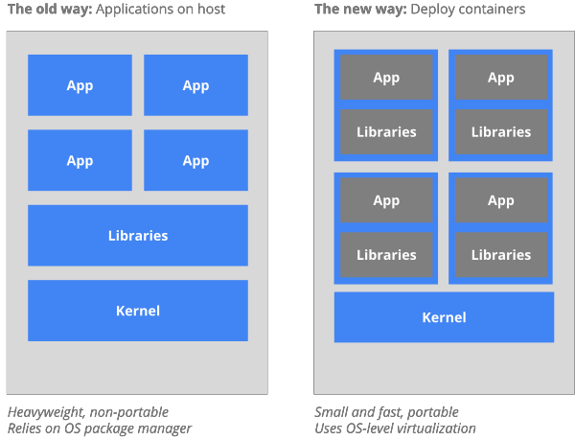
Why Containers

Slide 7
Why Developers Care
Build once, run anywhere
A
clean, safe, hygienic
and portable
runtime
environment for your app.
No worries about missing dependencies, packages and other pain points during subsequent deployments.
Run each app in its own isolated container, so you can run various versions of libraries and other dependencies for each app without worrying

Slide 8
Why Developers Care
Automate
testing, integration,
packaging…anything
you can script
Reduce/eliminate concerns about compatibility on
different platforms, either your own or your customers.
Cheap, zero-penalty containers to deploy services? A VM without the overhead of a VM? Instant replay and reset of image snapshots? That’s the power of Docker

Slide 9
Why Devops Cares?
Configure once…run anything
Make the entire lifecycle more efficient, consistent, and repeatable
Increase the quality of code produced by developers.
Eliminate inconsistencies between development, test,
production, and customer environments

Slide 10
Why Devops Cares?
Support segregation of duties
Significantly continuous systems
improves the speed
and reliability of
deployment and
continuous
integration
Because the containers are so lightweight, address significant performance, costs, deployment, and portability issues normally associated with VMs

Slide 11
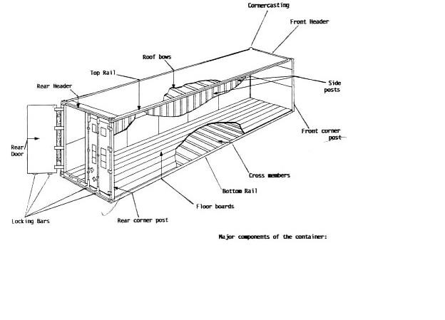
Why it works—separation of concerns
The Developer
Worries about what’s “inside” the container
His code
His Libraries
His Package Manager
His Apps
His Data
All Linux servers look the same
The Administrator
Worries about what’s “outside” the container
Logging
Remote access
Monitoring
Network config
All containers start, stop, copy, attach, migrate, etc. the same way

Slide 12
Containers vs. VMs
Containers are isolated, but share OS and, where appropriate, bins/libraries
…result is significantly faster deployment, much less overhead, easier migration, faster restart
 | App A |  | App A’ |  | App B
 | Bins/ Libs |  | Bins/ Libs |  | Bins/ Libs
 | Guest |  | Guest |  | Guest OS
 | OS |  | OS
 | Hypervisor (Type 2)
 | Host OS
 | Server
VM
Guest
OS
Guest OS
App A | App B App A’ |  | App B’ |  | App B’ |  | App B’
 |  |  |  |  |  |  |  | Docker
Bins/Libs Bins/Libs
Host OS
Server
Container

Slide 13
Installing Docker
Notes:
Install Docker on command-line
Modify network properties
Restart network and docker

Slide 14
Docker Engine
Docker Engine is a
major components:
client-server
application
with
these
A server which is a type of long-running program called a daemon process.
A REST API which specifies interfaces that programs can use to talk to the daemon and instruct it what to do.
A command line interface (CLI) client.

Slide 15
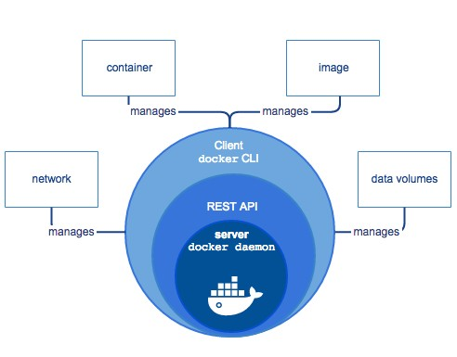
Docker Engine

Slide 16
Docker images
A Docker image is a read-only template. For example, an image could contain an Ubuntu operating system with Apache and your web application installed.
Images are used to create Docker containers. Docker provides a simple way to build new images or update existing images, or you can download Docker images that other people have already created.
Docker images are the build component of Docker.

Slide 17
Docker File
Docker
can build images automatically
by reading the
instructions from a Dockerfile.
A Dockerfile is a text document that contains all the commands a user could call on the command line to assemble an image.
Using docker build users can create an automated build that executes several command-line instructions in succession.
The docker build command builds an image from a Dockerfile and a context.

Slide 18
Docker File - Example
Instructions INSTRUCTION arguments
Eg. RUN echo 'we are running some # of cool things!’
Parser directives: FROM ImageName
Example:
#Comment
FROM windowsservercore COPY testfile.txt c:\
RUN dir c:\
To Build image using this file:
docker build -f /path/to/a/Dockerfile .
Notes:
Create a Dockerfile
Explain the steps
Various Line beginners to use (FROM, RUN, CMD, ENTRYPOINT, ENV, COPY, ADD)

Slide 19
Creating Dockerfile

Slide 20
Docker Hub
Docker registries hold images.
These are public or private stores from which you upload
or download images.
The public Docker registry is provided with the Docker Hub. (hub.docker.com)
It serves a huge collection of existing images for your use. These can be images you create yourself or you can use images that others have previously created.
Docker
Docker.
registries are the distribution component of
Notes:
Differentiate between private and public repositories

Slide 21
Docker CLI
The CLI makes use of the Docker REST API to control or interact with the Docker daemon through scripting or direct CLI commands.
Many
other Docker
applications
make
use of the
underlying API and CLI.
The CLI is also used to issue commands.

Slide 22
Docker commands
docker [options] command [arg…]
docker build|tag
docker pull|push
docker run
docker ps
docker stop|start|restart
docker rm
docker rmi
docker logs
Notes:
Demonstrate and explain each commands and there usage scenarios

Slide 23
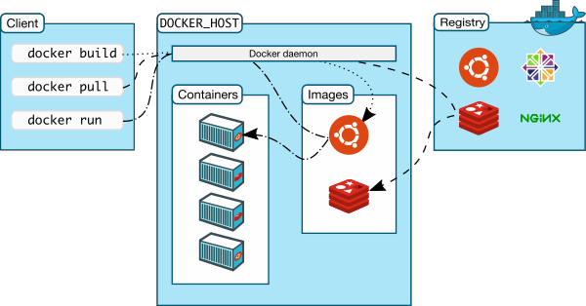
Docker Architecture

Slide 24
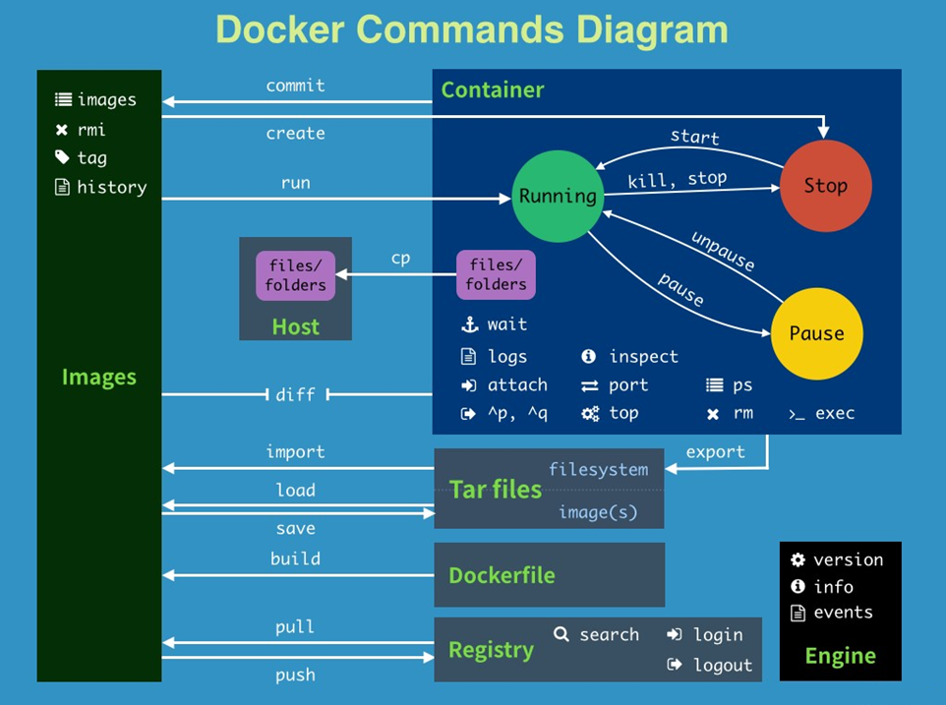

Slide 25
What are the basics of the Docker system?
Container A
Push
Docker Container Image Registry
Search
Pull
Build
Run
Dockerfile For
A
Container A
Container B
Container C
Docker
Source Code Repository
Docker Engine
Host 1 OS (Linux)
Host 2 OS (Linux)

Slide 26
Making it all work together
Notes:
Execute entire build process
Deploy application to tomcat server on docker
Demonstrate the hello world UI
Explain how and what options are provided to make it work

Slide 27
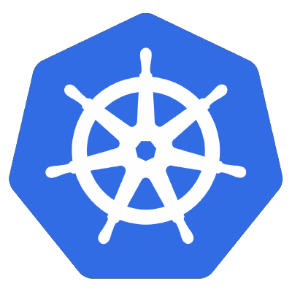
Kubernetes
Kubernetes is automating operations
an open-source
platform for
deployment,
of application
scaling,
containers
and
across
clusters of hosts, providing container-centric infrastructure.
With Kubernetes, you can:
Deploy your applications quickly and predictably.
Scale your applications on the fly.
Seamlessly roll out new features.
Optimize use of your hardware by using only the resources you need

Slide 28
Kubernetes Features
Kubernetes is:
portable: public, private, hybrid, multi-cloud
extensible: composable
self-healing:
modular, pluggable, hookable,
auto-placement, auto-restart,
auto-replication, auto-scaling
The Kubernetes project was started by Google
in 2014.

Slide 29
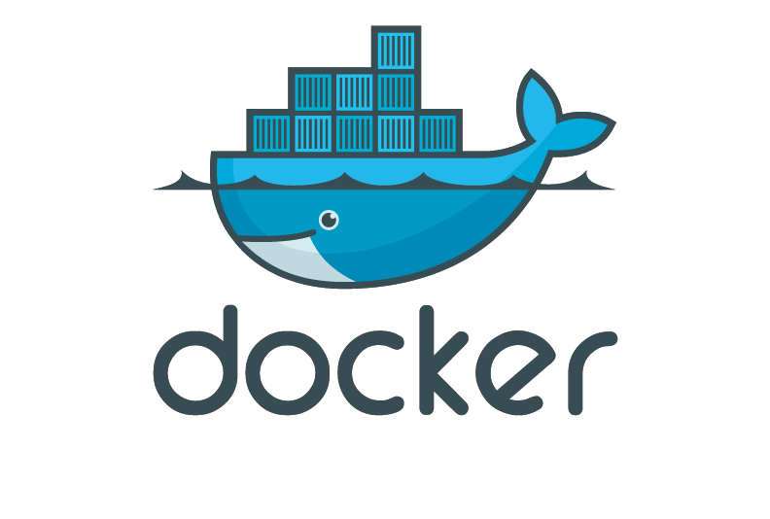
Thank you

