Slide 1


School Financial Management System.
Product Vision · 2026

Slide 2











THE APPLICATION
A complete DIGITAL school finance office.
Current Offline First Design
Runs entirely on one school PC
Receive fees & issue receipts instantly
Track student balances in real time
No internet required for any operation
Generate financial reports on demand
Maintain the cashbook automatically
No downtime, network outages don't matter
All data stays on school premises
Auditable, timestamped transaction log
Role-based access for administrators
Simple to install, no server setup
2

Slide 3
PHASE 01
SmartBursar
Desktop
React
User Interface
The pilot product.
ONE school, ONE computer.
Current Phase.
Tauri
Desktop Host
Single PC deployment
Python
SQLite local database
Business Logic
Full offline operation
Zero network configuration
SQLite
Receipts · Cashbook · Reports · Balances
Local Database
3

Slide 4
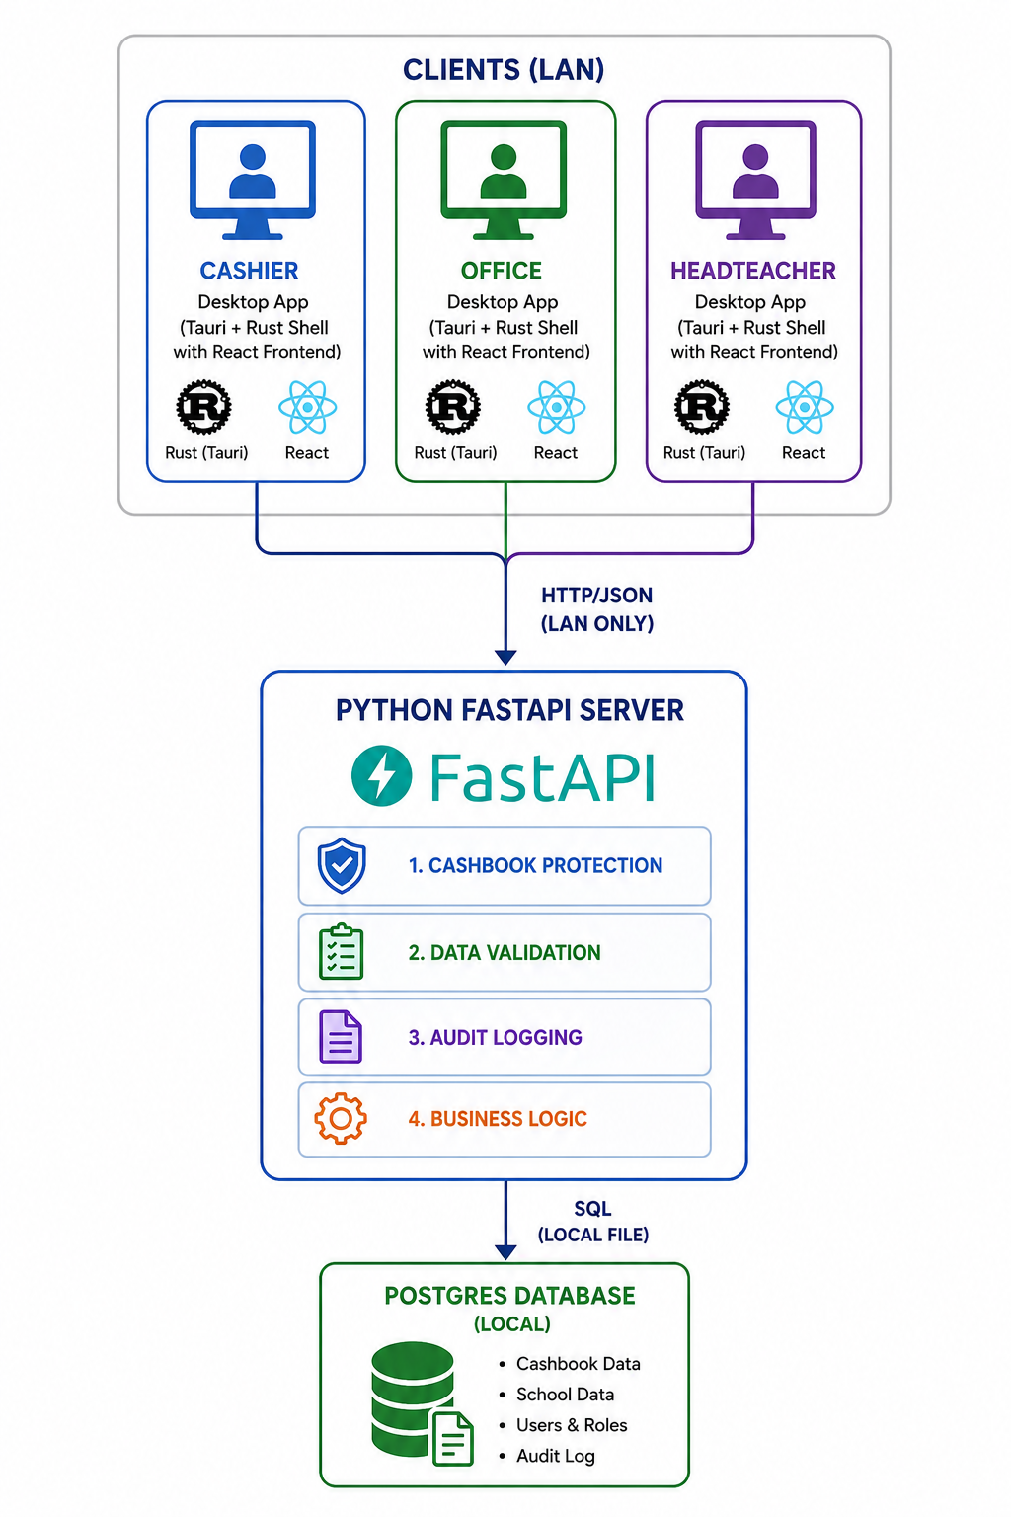
PHASE 02
SmartBursar
PLUS+
Multiple staff.
One SHARED financial system.
Across the same school network.
Multiple Concurrent users possible!
Bursar
Headteacher
Deputy
Director
4

Slide 5




PHASE 03
SmartBursar
Enterprise
Multiple campuses.
Central oversight.
Cloud-based financial management.
School A
Central Cloud
Multi-campus
Cross-school reporting
School B
Multiple schools connected to a central system
Aggregate analytics across all campuses
School C
Cloud synchronization
Proprietor access
Automatic backups and remote access
Remote financial oversight from anywhere
5

Slide 6
TECHNOLOGY STACK
Purposefully chosen.
User Interface
React (Vite)
Desktop screens for bursar, cashier, headteacher, etc.
Desktop Host
Tauri + Rust
Packages the app as a cross-platform executable
Core Engine
Python
All financial logic lives here, independent of transport
Data Layer
SQLite / PostgreSQL
Secure local database, zero configuration for phase 1, and minimal adjustment for phase 2 and 3 to use PostgreSQL
Future Transport
HTTP / FastAPI / JSON
Optional adapter for phase 2 and 3 multi-user networking
Core Principle: The business logic doesn't know or care how it was called — IPC, HTTP, CLI. Everything else is just transportation.
6

Slide 7
ARCHITECTURE
Designed to EVOLVE,
Instead of be rewritten.
APPLICATION CORE
SmartBursar is built around a Hexagonal (Ports & Adapters) architecture.
The Application Core, with all the business rules, sits at the centre.
Transport is interchangeable.
Payment Service
Student Service
Cashbook Service
Reports Service
SQLAlchemy ORM
RESULT:
Adding HTTP networking in Phase 2, or Cloud Hosting in Phase 3 is an extension, not a rewrite.
7

