Slide 1

Extending Steinberg’s Fatigue Analysis
of Electronics Equipment Methodology
via Rainflow Cycle Counting
By Tom Irvine

Slide 2
Project Goals
Develop a method for . . .
Predicting whether an electronic component will fail due to vibration fatigue during a test or field service
Explaining observed component vibration test failures
Comparing the relative damage potential for various test and field environments
Justifying that a component’s previous qualification vibration test covers a new test or field environment

Slide 3
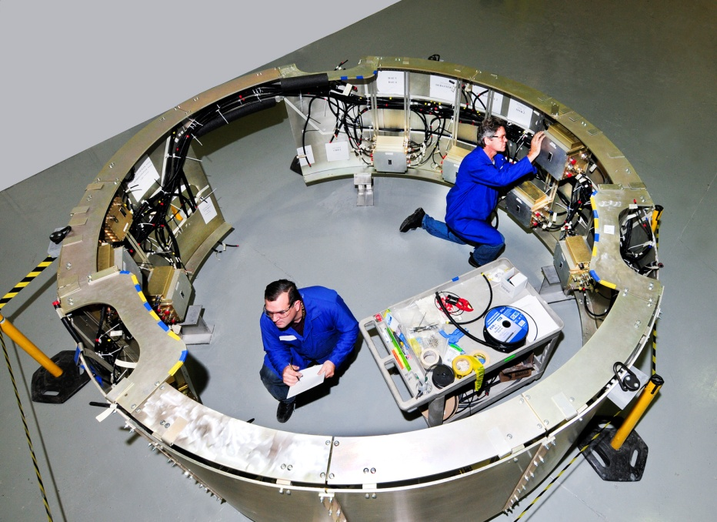
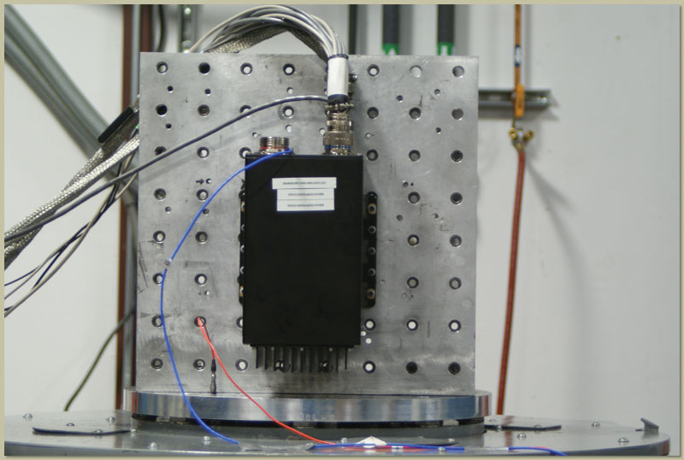
Electronic components in vehicles are subjected to shock and vibration environments.
The components must be designed and tested accordingly
Dave S. Steinberg’s Vibration Analysis for Electronic Equipment is a widely used reference in the aerospace and automotive industries.

Slide 4
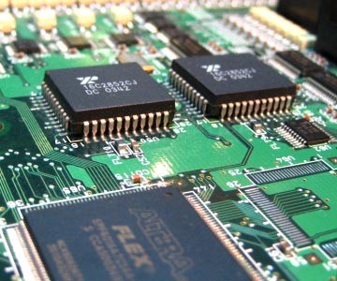
Steinberg’s text gives practical empirical formulas for determining the fatigue limits for electronics piece parts mounted on circuit boards
The concern is the bending stress experienced by solder joints and lead wires
The fatigue limits are given in terms of the maximum allowable 3-sigma relative displacement of the circuit boards for the case of 20 million stress reversal cycles at the circuit board’s natural frequency
The vibration is assumed to be steady-state with a Gaussian distribution

Slide 5
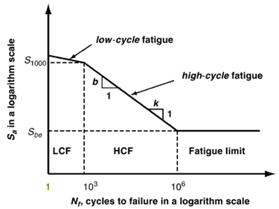
Fatigue Curves
Note that classical fatigue methods use stress as the response metric of interest
But Steinberg’s approach works in an approximate, empirical sense because the bending stress is proportional to strain, which is in turn proportional to relative displacement
The user then calculates the expected 3-sigma relative displacement for the component of interest and then compares this displacement to the Steinberg limit value

Slide 6
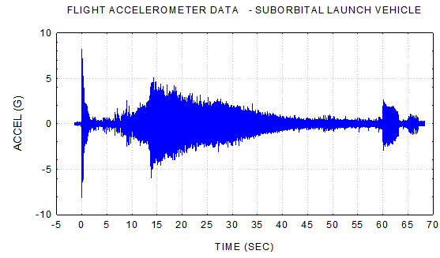
An electronic component’s service life may be well below or well above 20 million cycles
A component may undergo nonstationary or non-Gaussian random vibration such that its expected 3-sigma relative displacement does not adequately characterize its response to its service environments
The component’s circuit board will likely behave as a multi-degree-of-freedom system, with higher modes contributing non-negligible bending stress, and in such a manner that the stress reversal cycle rate is greater than that of the fundamental frequency alone

Slide 7


These obstacles can be overcome by developing a “relative displacement vs. cycles” curve, similar to an S-N curve
Fortunately, Steinberg has provides the pieces for constructing this RD-N curve, with “some assembly required”
Note that RD is relative displacement
The analysis can then be completed using the rainflow cycle counting for the relative displacement response and Miner’s accumulated fatigue equation

Slide 8
Steinberg’s Fatigue Limit Equation
L
Relative Motion
h
Component
Z
B
Relative Motion
Component
Component
Component and Lead Wires undergoing Bending Motion

Slide 9
Let Z be the single-amplitude displacement at the center of the board that will give a fatigue life of about 20 million stress reversals in a random-vibration environment, based upon the 3σ circuit board relative displacement.
Steinberg’s empirical formula for Z _{3σ limit} is
inches
B | = | length of the circuit board edge parallel to the component, inches
L | = | length of the electronic component, inches
h | = | circuit board thickness, inches
r | = | relative position factor for the component mounted on the board, 0.5 < r < 1.0
C | = | Constant for different types of electronic components 0.75 < C < 2.25

Slide 10
Relative Position Factors for Component on Circuit Board
r | Component Location (Board supported on all sides)
1 | When component is at center of PCB (half point X and Y)
0.707 | When component is at half point X and quarter point Y
0.50 | When component is at quarter point X and quarter point Y

Slide 11
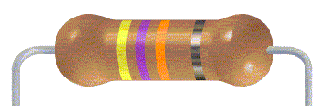
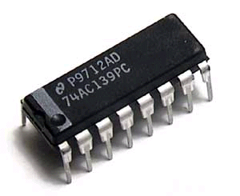
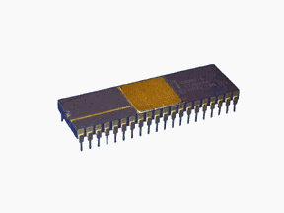
C | Component | Image
0.75 | Axial leaded through hole or surface mounted components, resistors, capacitors, diodes
1.0 | Standard dual inline package (DIP)
1.26 | DIP with side-brazed lead wires

Slide 12
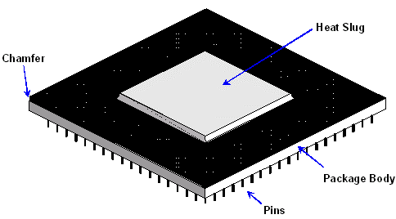
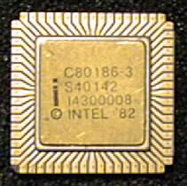
C | Component | Image
1.0 | Through-hole Pin grid array (PGA) with many wires extending from the bottom surface of the PGA
2.25 | Surface-mounted leadless ceramic chip carrier (LCCC) A hermetically sealed ceramic package. Instead of metal prongs, LCCCs have metallic semicircles (called castellations) on their edges that solder to the pads.

Slide 13
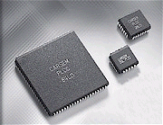

C | Component | Image
1.26 | Surface-mounted leaded ceramic chip carriers with thermal compression bonded J wires or gull wing wires
1.75 | Surface-mounted ball grid array (BGA). BGA is a surface mount chip carrier that connects to a printed circuit board through a bottom side array of solder balls
Additional component examples are given in Steinberg’s book series.

Slide 14

Rainflow Fatigue Cycles
Endo & Matsuishi 1968 developed the Rainflow Counting method by relating stress reversal cycles to streams of rainwater flowing down a Pagoda. ASTM E 1049-85 (2005) Rainflow Counting Method
Develop a damage potential vibration response spectrum using rainflow cycles.

Slide 15
Sample Time History

Slide 16
Rainflow Cycle Counting
Rotate time history plot 90 degrees clockwise
Rainflow Cycles by Path
Path | Cycles | Stress Range
A-B | 0.5 | 3
B-C | 0.5 | 4
C-D | 0.5 | 8
D-G | 0.5 | 9
E-F | 1.0 | 4
G-H | 0.5 | 8
H-I | 0.5 | 6

Slide 17
Sample Base Input PSD
An RD-N curve will be constructed for a particular case.
The resulting curve can then be recalibrated for other cases.
Consider a circuit board which behaves as a single-degree-of-freedom system, with a natural frequency of 500 Hz and Q=10. These values are chosen for convenience but are somewhat arbitrary.
The system is subjected to the base input:
Base Input PSD, 8.8 GRMS
Frequency (Hz) | Accel (G^2/Hz)
20 | 0.0053
150 | 0.04
2000 | 0.04

Slide 18
Synthesize Time History
The next step is to generate a time history that satisfies the base input PSD
The total 1260-second duration is represented as three consecutive 420-second segments
Separate segments are calculated due to computer processing speed and memory limitations
Each segment essentially has a Gaussian distribution, but the histogram plots are also omitted for brevity

Slide 20
Synthesized Time History PSDs

Slide 21
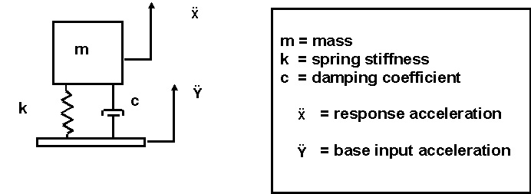
SDOF Response
The response analysis is performed using the ramp invariant digital recursive filtering relationship, Smallwood algorithm.
The response results are shown on the next page.

Slide 23
Relative Displacement Response Statistics
No. | 1-sigma (inch) | 3-sigma (inch) | Kurtosis | Crest Factor
1 | 0.00068 | 0.00204 | 3.02 | 5.11
2 | 0.00068 | 0.00204 | 3.03 | 5.44
3 | 0.00068 | 0.00204 | 3.01 | 5.25
Note that the crest factor is the ratio of the peak-to-standard deviation, or peak-to-rms assuming zero mean.
Kurtosis is a parameter that describes the shape of a random variable’s histogram or its equivalent probability density function (PDF).
Assume that corresponding 3-sigma value was at the Steinberg failure threshold.

Slide 24
Rainflow Counting on Relative Displacement Time Histories
The total number of rainflow cycles was 698903
This corresponds to a rate of 555 cycles/sec over the 1260 second duration.
This rate is about 10% higher than the 500 Hz natural frequency
Rainflow results are typically represented in bin tables
The method in this analysis, however, will use the raw rainflow results consisting of cycle-by-cycle amplitude levels, including half-cycles
This brute-force method is more precise than using binned data

Slide 25
Miner’s Accumulated Fatigue
Let n be the number of stress cycles accumulated during the vibration testing at a given level stress level represented by index i.
Let N be the number of cycles to produce a fatigue failure at the stress level limit for the corresponding index.
Miner’s cumulative damage index CDI is given by
where m is the total number of cycles
In theory, the part should fail when CDI=1.0
Miner’s index can be modified so that it is referenced to relative displacement rather than stress.

Slide 26
Derivation of the RD-N Curve
Steinberg gives an exponent b = 6.4 for PCB-component lead wires, for both sine and random vibration.
The goal is to determine an RD-N curve of the form
log₁₀ (N) = -6.4 log₁₀ (RD) + a
N | is the number of cycles
RD | relative displacement (inch)
a | unknown variable
The variable a is to be determined via trial-and-error.

Slide 27
Cycle Scale Factor
Now assume that the process in the preceding example was such that its 3-sigma relative displacement reached the limit in Steinberg’s equation for 20 million cycles.
This would require that the duration 1260 second duration be multiplied by 28.6.
28.6 = (20 million cycles-to-failure )/( 698903 rainflow cycles )
Now apply the RD-N equation along with Miner’s equation to the rainflow cycle-by-cycle amplitude levels with trial-and-error values for the unknown variable a.
Multiply the CDI by the 28.6 scale factor to reach 20 million cycles.
Iterate until a value of a is found such that CDI=1.0.

Slide 28
Numerical Results
The numerical experiment result is
a = -11.20 for a 3-sigma limit of 0.00204 inch
Substitute into equation
log₁₀ (N) = -6.4 log₁₀ (RD) -11.20 for a 3-sigma limit of 0.00204 inch
This equation will be used for the “high cycle fatigue” portion of the RD-N curve.
A separate curve will be used for “low cycle fatigue.”

Slide 29
Fatigue as a Function of 3-sigma Limit for 20 million cycles
The low cycle portion will be based on another Steinberg equation that the maximum allowable relative displacement for shock is six times the 3-sigma limit value at 20 million cycles for random vibration.
But the next step is to derive an equation for a as a function of 3-sigma limit without resorting to numerical experimentation.
Let N = 20 million reversal cycles.
a = log₁₀ (N) + 6.4 log₁₀ (RD)
a = 7.30 + 6.4 log₁₀ (RD)
Let RDx = RD at N=20 million.

Slide 30
RDx = 0.0013 inch for a = -11.20
a = 7.3 + 6.4 log₁₀ (0.0013) = -11.20 for a 3-sigma limit of 0.00204 inch
The RDx value is not the same as the Z _{3σ limit} .
But RDx should be directly proportional to Z _{3σ limit} .
So postulate that
a = 7.3 + 6.4 log₁₀ (0.0026) = -9.24 for a 3-sigma limit of 0.00408 inch
This was verified by experiment where the preceding time histories were doubled and CDI =1.0 was achieved after the rainflow counting.

Slide 31
RD-N Equation for High-Cycle Fatigue
Thus, the following relation is obtained.
(Perform some algebraic simplification steps)
The final RD-N equation for high-cycle fatigue is

Slide 32
The derived high-cycle equation is plotted in along with the low-cycle fatigue limit.
RD is the zero-to-peak relative displacement.

Slide 33
Damage Equivalence
Note that the relative displacement ratio at 20 million cycles is 0.64.
(0.64)(3-sigma) = 1.9-sigma
This suggests that “damage equivalence” between sine and random vibration occurs when the sine amplitude (zero-to-peak) is approximately equal to the random vibration 2-sigma amplitude

Slide 34
Conclusions
A methodology for developing RD-N curves for electronic components was presented in this paper
The method is an extrapolation of the empirical data and equations given in Steinberg’s text
The method is particularly useful for the case where a component must undergo nonstationary vibration, or perhaps a series of successive piecewise stationary base input PSDs
The resulting RD-N curve should be applicable to nearly any type of vibration, including random, sine, sine sweep, sine-or-random, shock, etc.
It is also useful for the case where a circuit board behaves as a multi-degree-of-freedom system
This paper also showed in a very roundabout way that “damage equivalence” between sine and random vibration occurs when the sine amplitude (zero-to-peak) is approximately equal to the random vibration 2-sigma amplitude
This remains a “work-in-progress.” Further investigation and research is needed.

Slide 35
Complete paper with examples and Matlab scripts may be freely downloaded from
http://vibrationdata.wordpress.com/
Or via Email request
tom@vibrationdata.com

