Slide 1
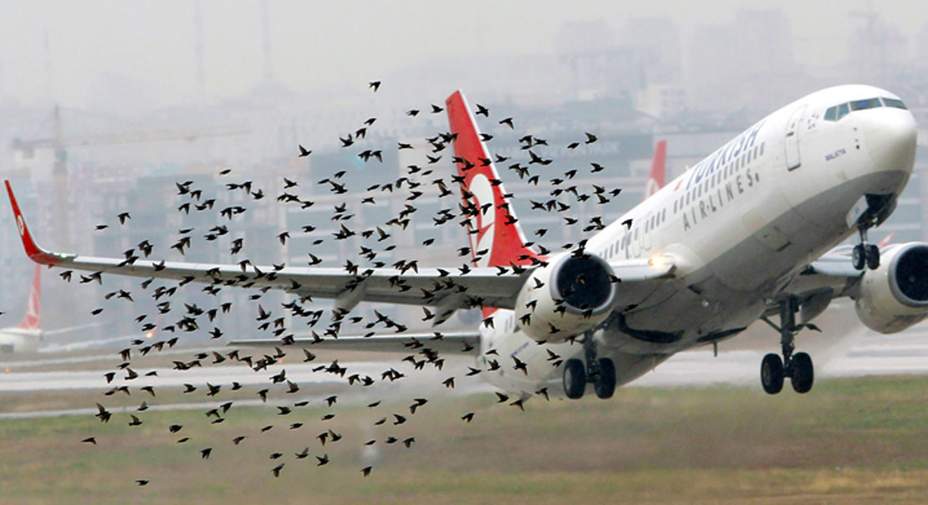
Bird Strikes in Aviation
GanaPrathyusha PM
Data 230 Term project

Slide 2
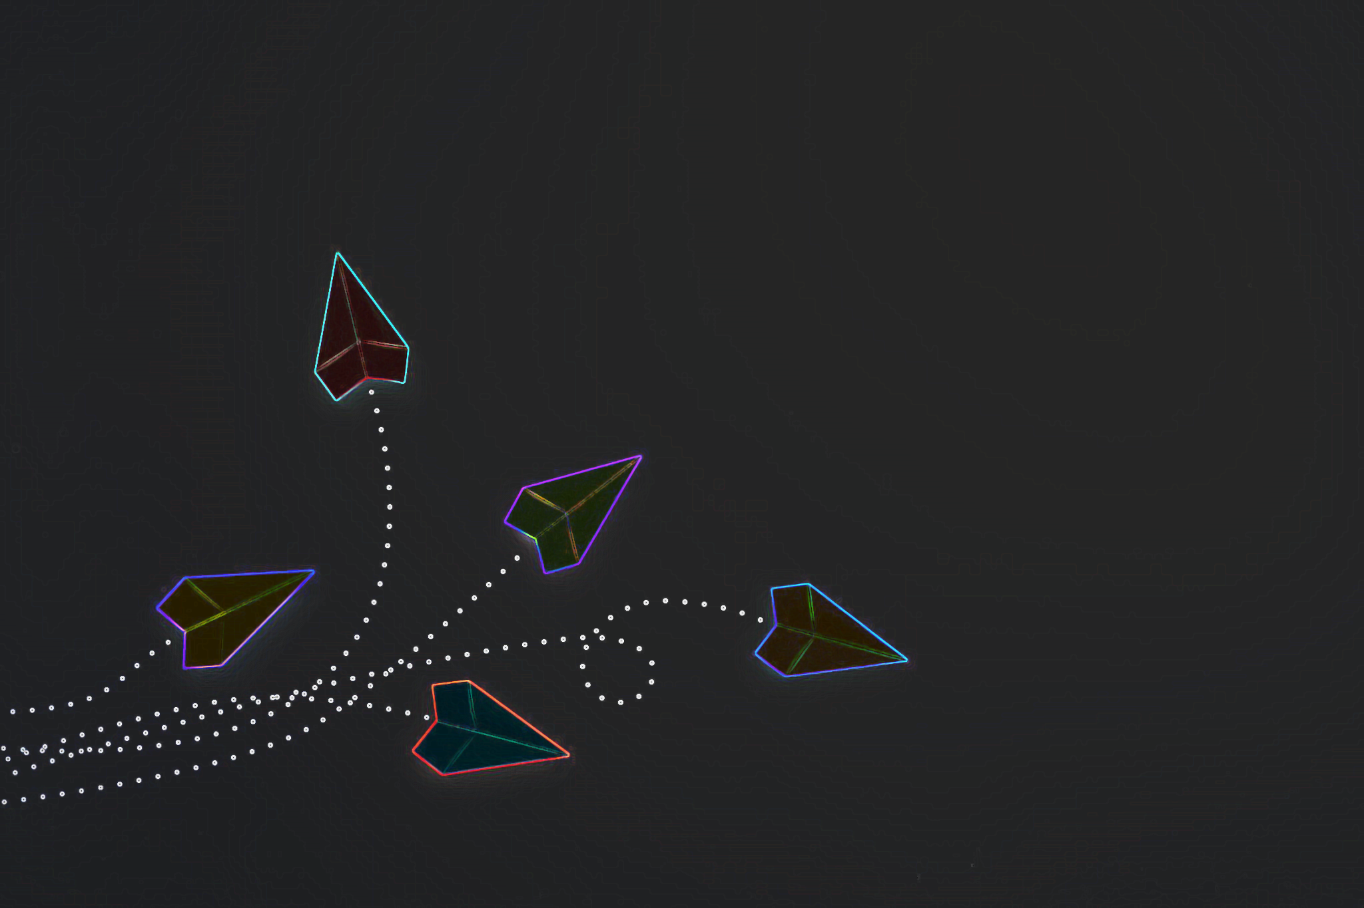
Agenda
Introduction
Project overview
Key findings
Dashboard
Analysis
Summary
Q&A

Slide 3

Introduction
Aviation industry
Major problems in aviation
COVID19 crisis
Bird strikes
Eastern Air Lines Flight 375
Notes:
Intro about myself
Air travel and cargo is a necessity for modern life
Aviation industry revenue $964 bil
Estimates loss of $130bil due to covid-19 between 2019-2022
Bird strike is an aviation term for a collision between a bird and an aircraft.
Frequency of bird strikes.
Eastern Air lines flight 375 October 4, 1960– 62 dead people
September 16, 2023, the Italian Frecce Tricolori Aermacchi MB-339 squadron departed from the Turin Airport for an airshow.Pilot admitted in hosp for burn injuries, a five-year-old girl died in the crash

Slide 4
Project overview
Objective
Dashboard to visualize the analysis on bird strike incidents from 2011-2023
Dataset
Realtime data from Federal Aviation Administration(FAA)
Tools
Tableau, PyNotebook, Excel

Slide 5



How many times was a pilot not warned about a possible bird strike but encountered one?
How many bird strike events occurred despite the pilot being warned?
Which phase of the flight journey is the most vulnerable to a bird strike?
How does the frequency of bird strikes change with respect to the season and time of the day?
Which aircraft types are more sustainable to bird strike and incur lower repair costs?

Slide 6
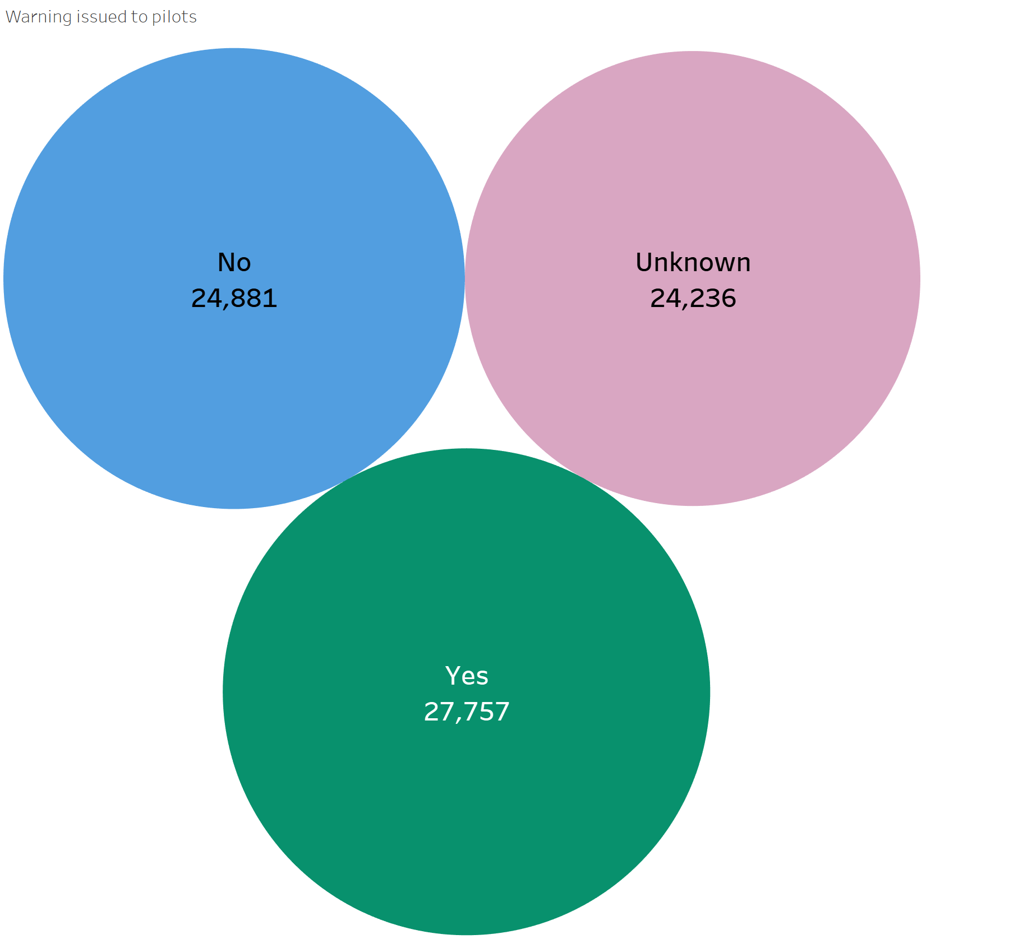
Key findings
Analysis Of Warning Status Unknown
Analysis done to see how many bird strike incidents occurred and the warning status is unknown.
We have observed that the unknown category is significant in size nearly equal to the number of incidents where warnings were either issued or not.

Slide 7
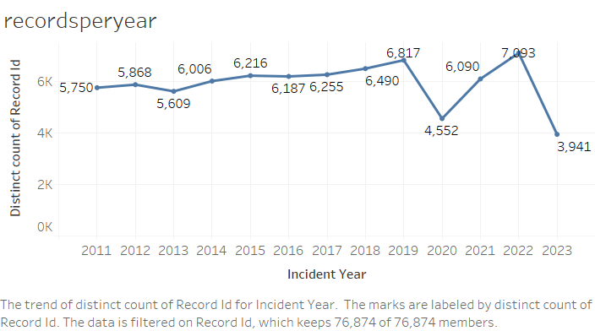
Key findings
Analysis of number of recors over time
Analysis done to see trend increase or decrease of number of bird strikes over the time from 2011-2023
We observed there is increase trend from 2011-2019.
2019-2021 there is dip dues to covid crisis.

Slide 8
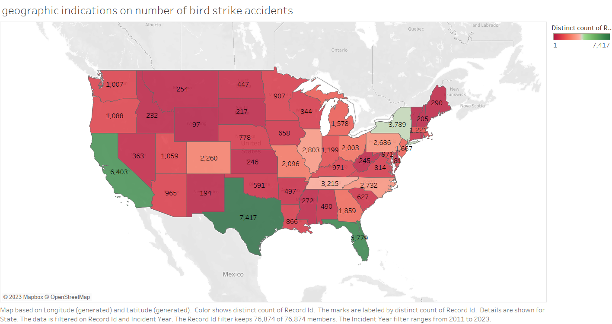
Key findings
Geographic indications
We have done analysis to find which state has more number of bird strikes occurred.
From the visualization we observed that Texas has more number of incidents happened.
States with busiest airports such as Texas, florida and California reports more bird strikes due to more number of flights.

Slide 9
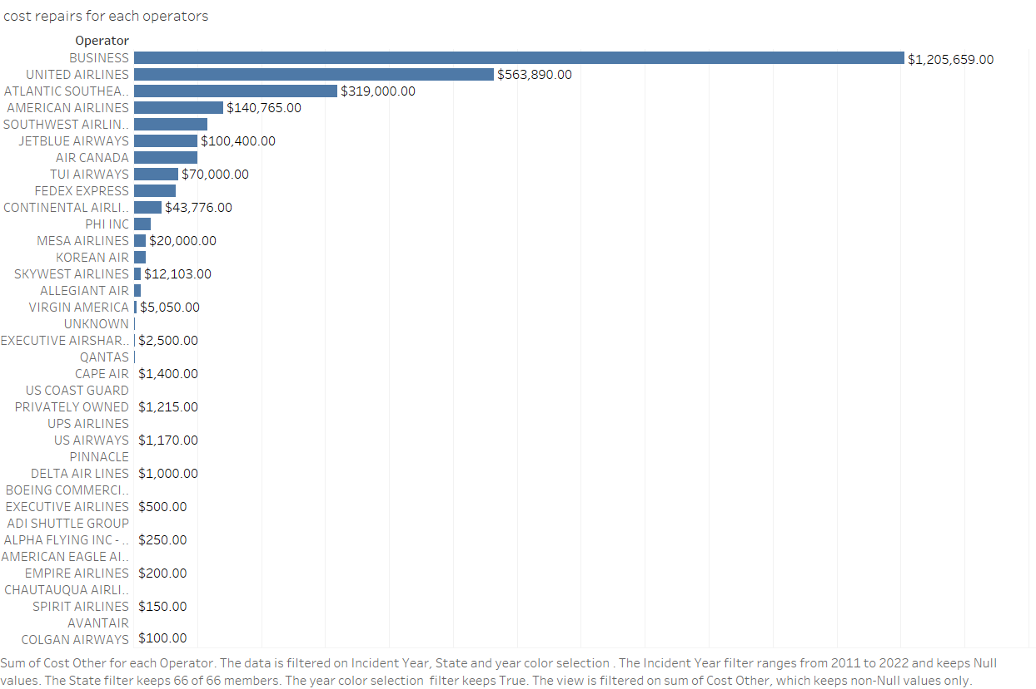
Key findings
Operator Vs Cost repairs
The analysis was done to see which operator is investing more in repair costs.
Whereas Business Airlines and United Airlines invested the highest for repair costs

Slide 10
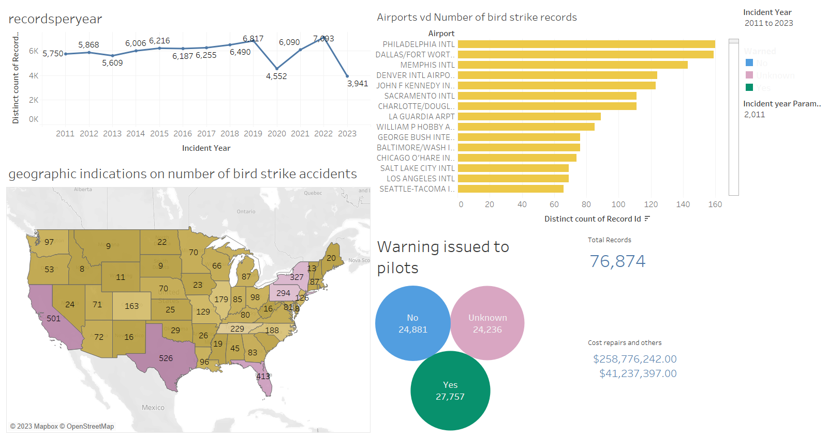
Dashboards
Dashboard for number of records based on different factors

Slide 11
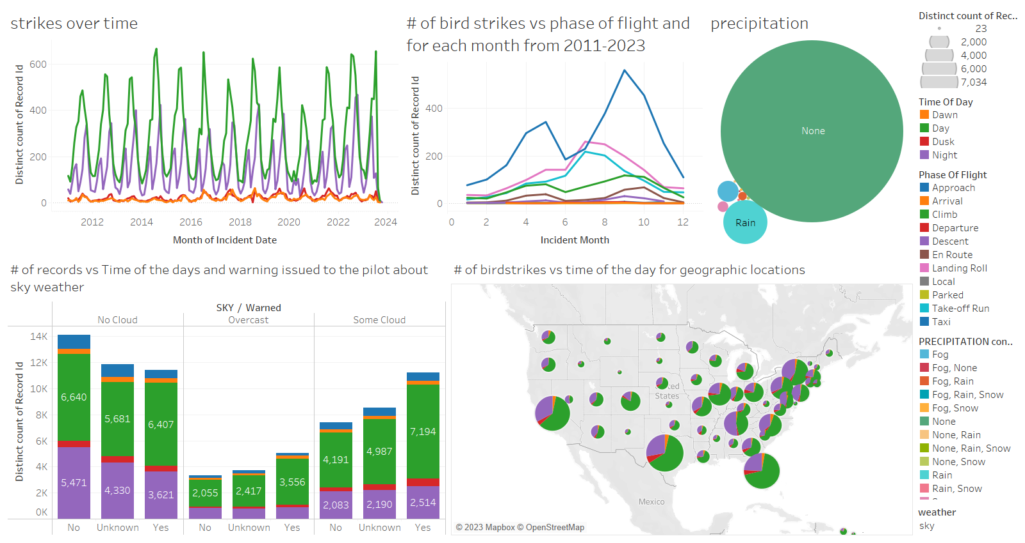
Dashboards
Impact of seasons, time of day and warning issued to pilots or not on bird strike incidents

Slide 12
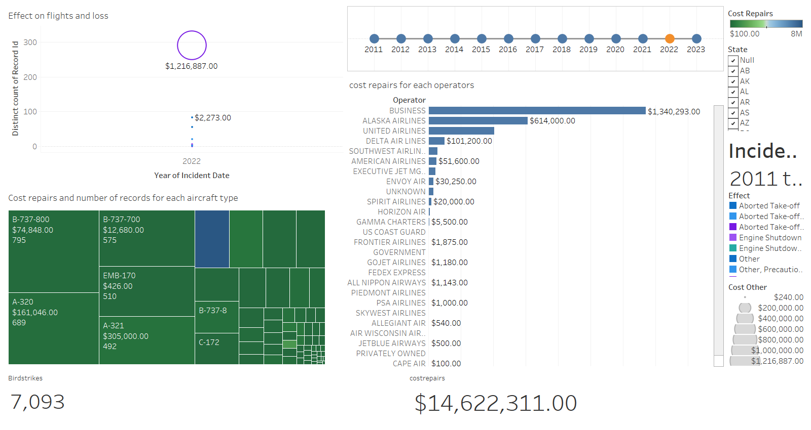
Dashboards
Cost repairs and other losses

Slide 13
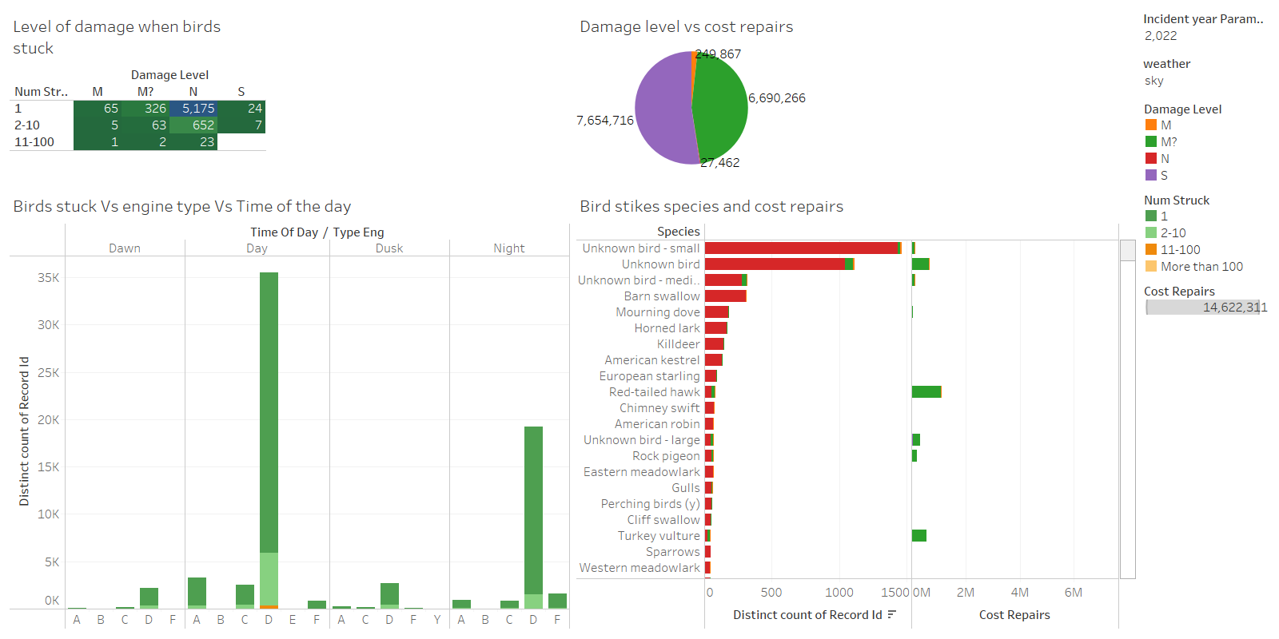
Dashboards
Level of damage and economic loss

Slide 14
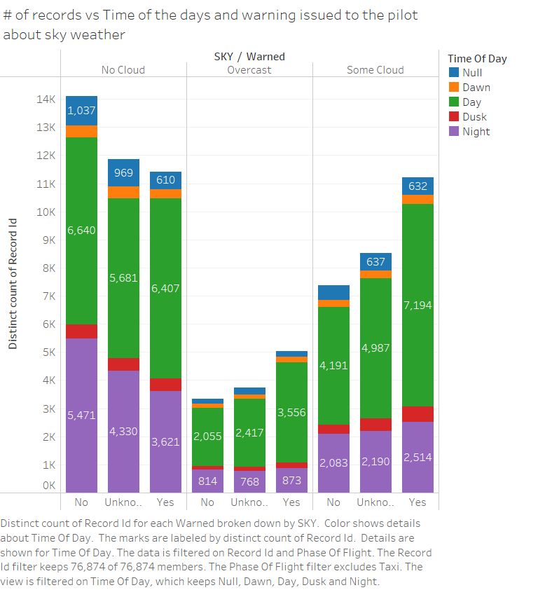
Analysis
NUMBER OF BIRD STRIKES, TIME OF THE DAY AND WEATHER WARNING ISSUED TO PILOTS
objective 1: to check if the pilots are being warned well in advance about the possibility of a bird strike.
observation: the warning systems are working well, as we can notice that in most instances the pilots are being warned about the wildlife
objective 2: to understand if the pilots being warned can avoid a bird strike
observation: pilots are failing to avert a bird strike even when a warning has been issued
recommendation: improved coordination between pilots and ground staff aiding the pilot in being better prepared to avert a bird strike

Slide 15
Analysis
NUMBER OF BIRD STRIKES, TIME OF THE DAY AND WEATHER WARNING ISSUED TO PILOTS
Objective 3: To understand the pattern of bird strikes with respect to sky condition and time of the day
Observation: We can observe that most of the strikes happened during day time and during no cloud condition.
Recommendation: This issue requires improvements in pilot training and simulation, especially for the pilots flying during the day time.

Slide 16
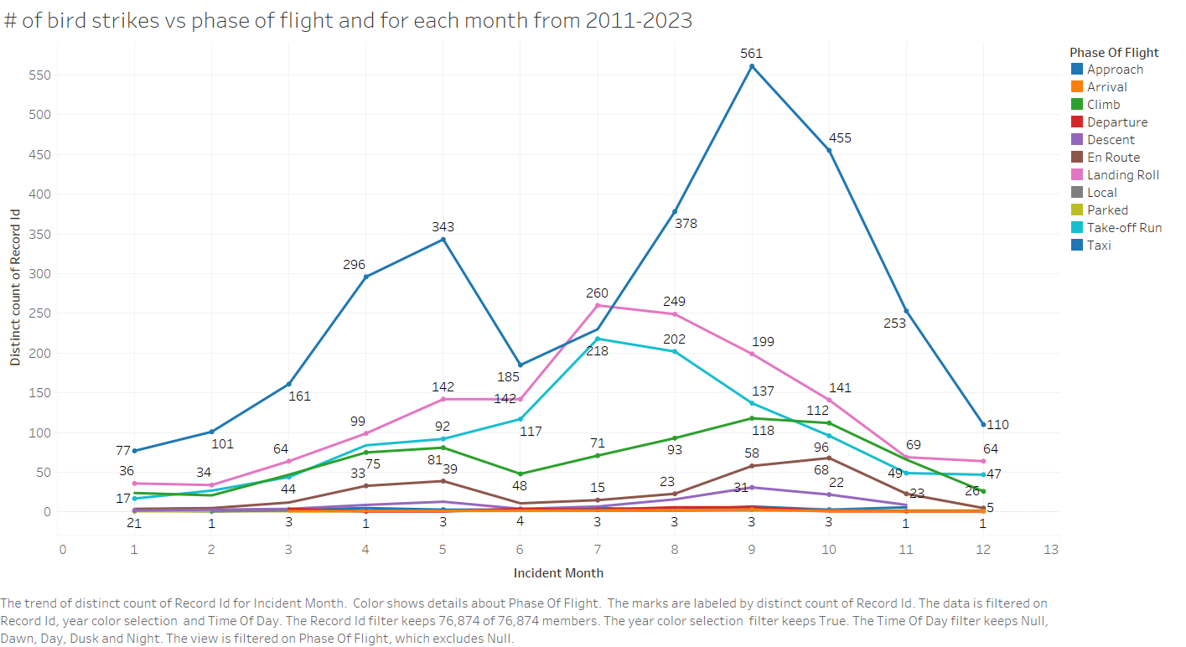
analysis
BIRD STRIKE FREQUENCY VS PHASE OF FLIGHT
Objective 1: To analyze which part of a flight's journey makes it most vulnerable to bird strikes
Observation: It was seen that the maximum number of bird strikes are being observed during approach, landing roll and takeoff run. Most of the incidents are happening during the months of august, September, and october
Recommendation: Pilots should be informed about the wildlife in their vicinity and should be made better equipped and trained to handle the wildlife.

Slide 17
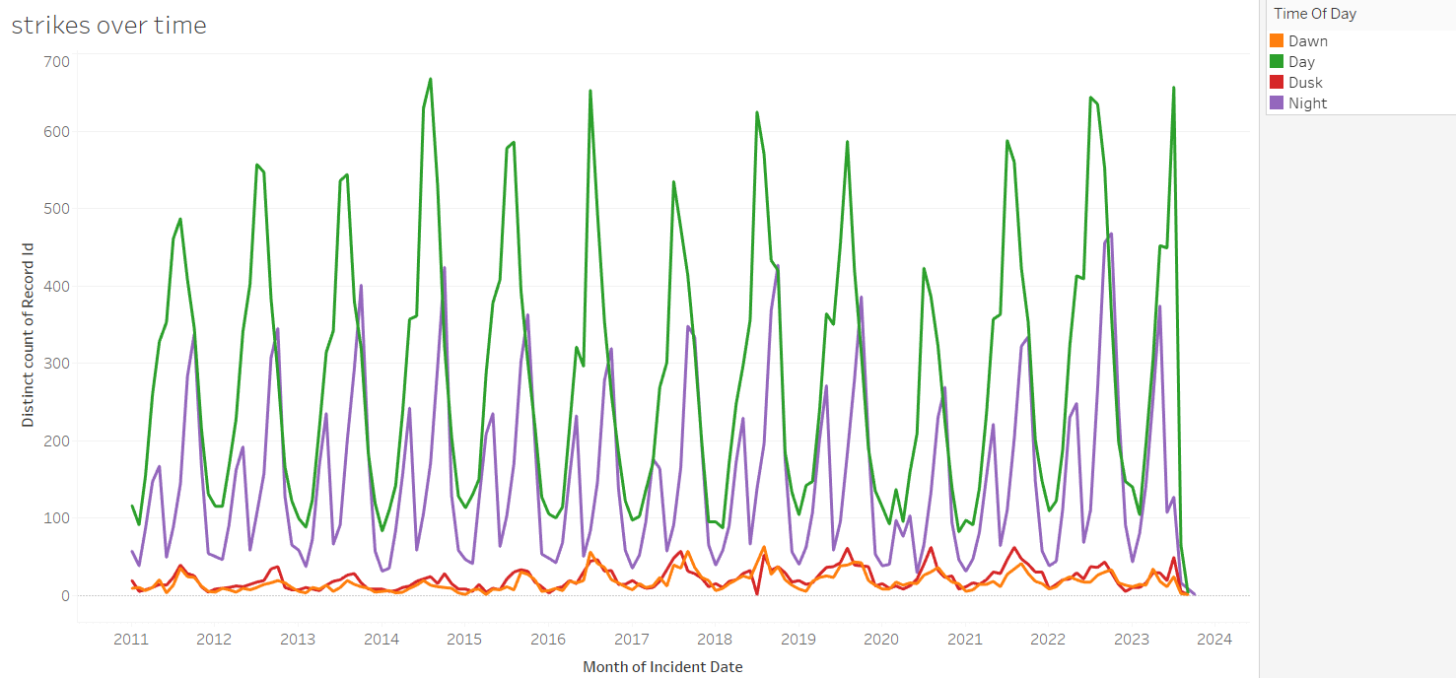
analysis
BIRD STRIKE FREQUENCY VS SEASONS VS TIME OF DAY
Objective 1: To understand the pattern of bird strikes with respect to seasons and time of the day
Observation: Most of the incidents are happening during the months of august, September, and october during the day in fall.
Recommendation: This issue requires improvements in pilot training and simulation, especially for the pilots flying during the day in fall.

Slide 18
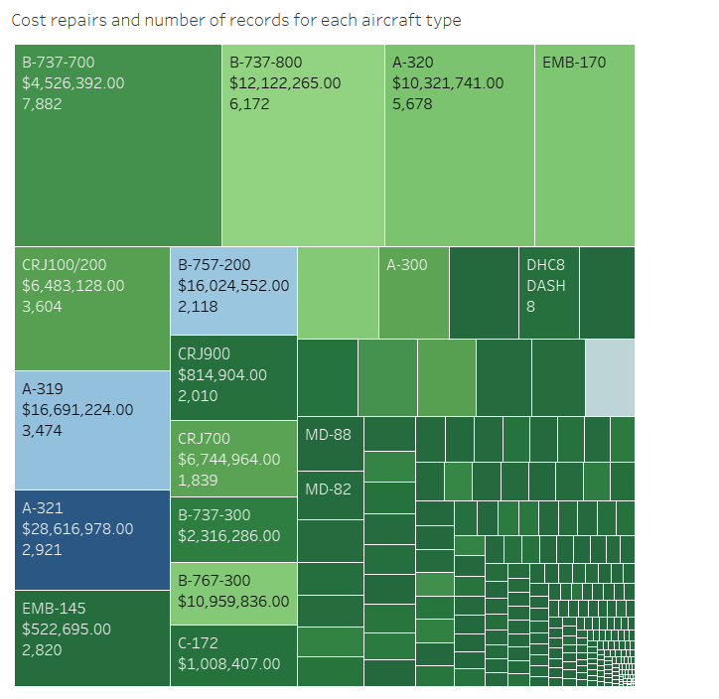
Analysis
COST REPAIRS AND NUMBER OF BIRD STRIKE INCIDENTS FOR DIFFERENT AIR CRAFTS
OBJECTIVE : To analyse which type of aircraft is most vulnerable to the bird strikes.
OBSERVATION: We observed that B type aircrafts have most spent for cost repairs. That means it has most severe damages.
RECOMMENDATION : Avoid using of b type aircrafts.

Slide 19
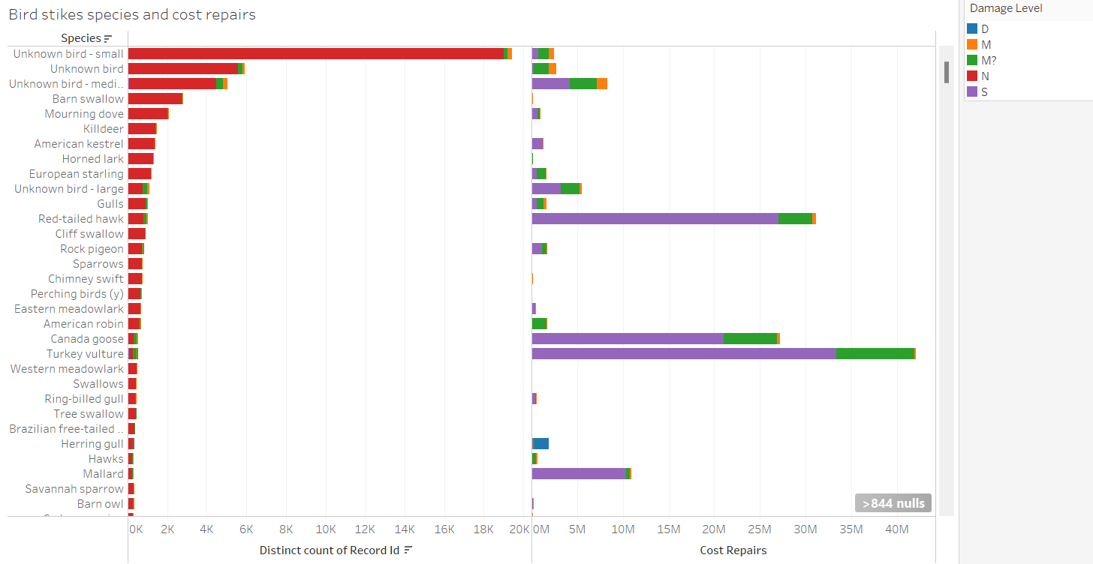
Analysis
COST REPAIRS AND NUMBER OF BIRD STRIKE INCIDENTS FOR DIFFERENT AIR CRAFTS
OBJECTIVE : We analyse bird strikes based on the species and amount of damages caused by those. OBSERVATION: We observed that small birds are frequently hits the plane andmost of the time they got shredded and less number of damages. But most dames are caused by turkey vultures.
RECOMMENDATION :Focus wildlife management and habitat alteration efforts at airports to deter large bird species, as they are linked to higher costs in repairs

Slide 20
Summary
There should be a fool-proof set of guidelines generated to deal with a bird strike warning. ATC, ground staff and the pilot in-charge should work hand in hand to avert a possible bird strike.
Every pilot should be aware of the wildlife in and around the area from which the flight will take off and well-planned and tactical simulations about how to tackle the wildlife should be incorporated into their training.
Considering the repair costs being posed, it is recommended to avoid using a class-A and class-B aircraft, since the aircrafts, on being involved in a bird strike incur a high repair cost.

Slide 21
Thank You

