Slide 1






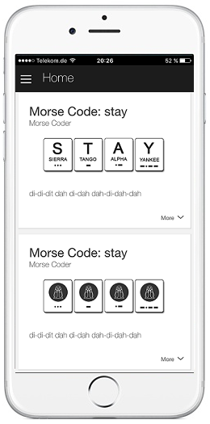
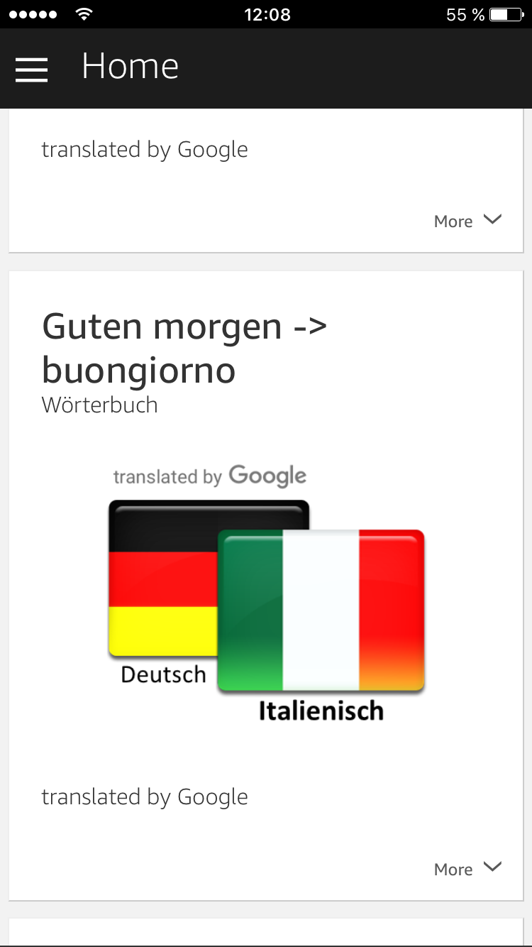


Microsoft
Translator API
4
5
AWS
Polly
1
2
7
12
11
9
Translator
Skill
AWS
Lambda
AWS
EC2
12
6
3
10
8
AWS
DynamoDB
AWS
S3

