Slide 1






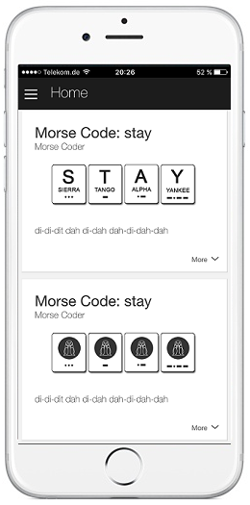


Microsoft
Translator API
3
4
AWS
Polly
1
2
7
11
10
9
Translator
Skill
AWS
Lambda
AWS
EC2
6
5
8
11
AWS
DynamoDB
AWS
S3

