Slide 1


K.RAMAKRISHNAN COLLEGE OF TECHNOLOGY
(AUTONOMOUS), TRICHY.
ONLINE SURVEY SYSTEM
PRESENTED
K.GANAGHASHREE
2303811710422043
SUPERVISOR
Mr. M. Saravanan, M.E.,
AP/CSE.

Slide 2
PRESENTATION OVERVIEW
Objective
Project Introduction
Problem Statement
Methodologies (Programming concepts relevant to problem statement)
Architecture of the proposed system
List of Modules
Merits
Results and Discussion
Queries

Slide 3
OBJECTIVE
The Online Survey System aims to streamline the process of conducting surveys by allowing administrators to create and manage survey questions, while enabling users to respond easily. It helps collect, organize, and analyze user feedback effectively, providing insights through structured responses and summaries.

Slide 4
PROJECT INTRODUCTION
The Online Survey System helps in conducting and managing surveys efficiently. Users can log in, participate in surveys by answering questions, and submit their responses. Administrators can create and manage survey questions, view user feedback, and analyze responses. This system ensures seamless interaction, organizes data effectively, and provides insights for better decision-making, enhancing the overall survey experience.

Slide 5
PROBLEM STATEMENT
Traditional survey methods are time-consuming, prone to errors, and lack an organized way to manage questions, collect responses, and analyze feedback effectively.
Users often face difficulties in engaging with surveys, while administrators struggle with managing and analyzing survey data efficiently, leading to a need for a streamlined and user-friendly solution.

Slide 6
METHODOLOGIES
Object-Oriented Programming (OOP): The system uses OOP principles to organize survey workflows into modular, reusable components.
GUI (Graphical User Interface): AWT provides components like TextField, Button, and Dialog for user-friendly interactions.
Event Handling: The ActionListener interface manages actions like login, submit, and navigation efficiently.
Data Structures: Uses ArrayList for questions and HashMap for efficient response management.
Exception Handling: Validates inputs and shows error messages for invalid or missing data.
Error Handling: Prevents crashes and ensures smooth user interactions.

Slide 7
ARCHITECTURE OF THE PROPOSED SYSTEM
START
ADMIN LOGIN
CREATE SURVEY MODULE
USER LOGIN
ADMIN VIEW
SURVEY ANALYSIREPORT
USER RESPOND TO SURVEY
STOP
LOGOUT

Slide 8
LIST OF MODULES
Admin Login Module: Allows administrators to securely log in and access survey management functions.
Admin Create Survey Module: Enables administrators to add, modify, or clear survey questions.
User Login Module: Allows users to securely log in and participate in surveys.
User Respond to Survey Module: Facilitates users in answering survey questions and submitting responses.
Admin View Survey Analysis Report Module: Provides administrators with a detailed analysis of user responses.
Logout Module: Ensures secure logout for both administrators and users, protecting data integrity.

Slide 9
MERITS
Provides distinct access for users (survey participants) and administrators
Allows administrators to create, view, and manage survey questions easily.
Enables users to effortlessly participate in surveys and submit their responses.
Allows administrators to view and analyze user responses efficiently.
Systematically tracks survey questions and user responses for organized data management.

Slide 10
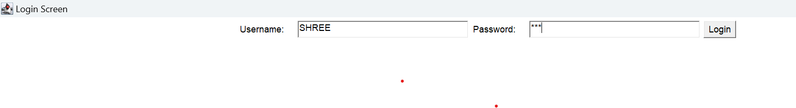
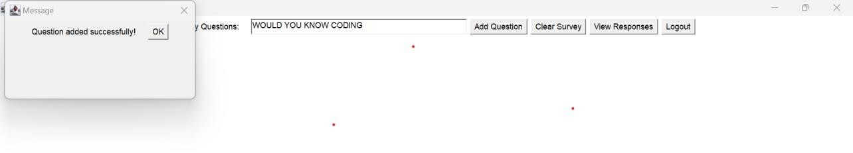
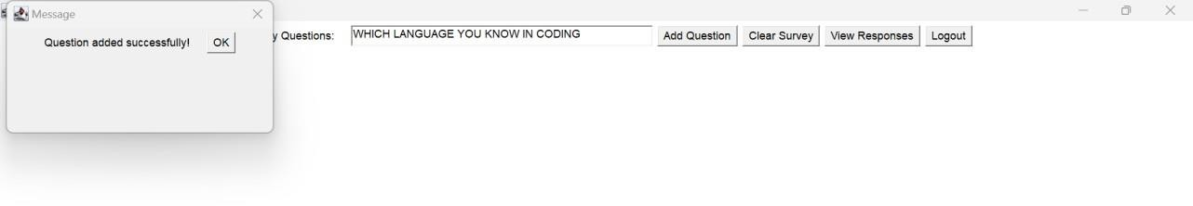
RESULTS AND DISCUSSION
ADMIN LOGIN
CREATE SURVEY MODULE

Slide 11
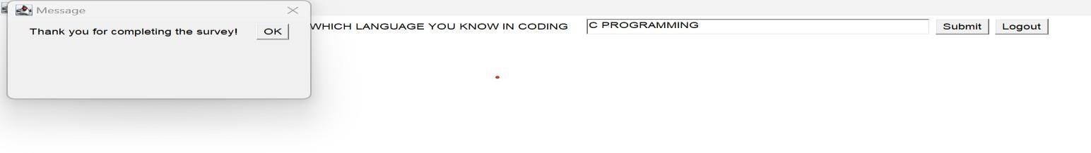
RESULTS AND DISCUSSION
USER LOGIN AND RESPOND TO SURVEY
USER 1

Slide 12
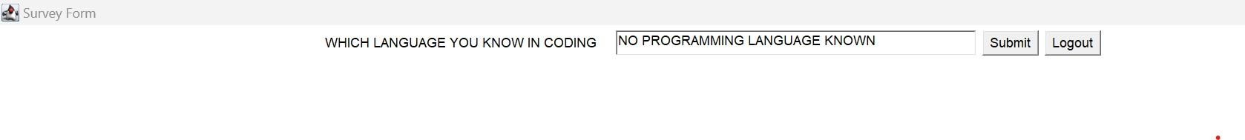
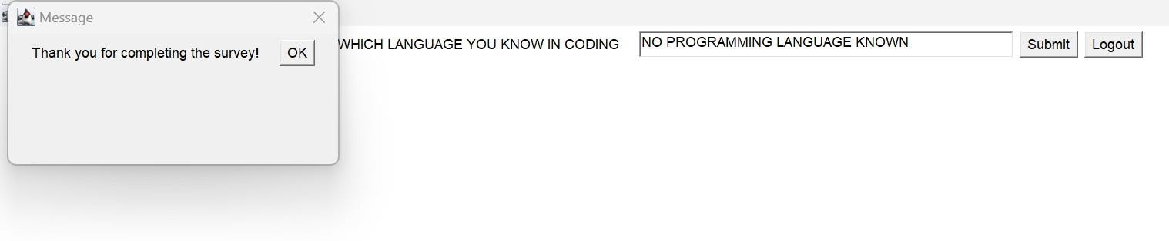
RESULTS AND DISCUSSION
USER 2

Slide 13
RESULTS AND DISCUSSION
ADMIN VIEW SURVEY ANALYSIS REPORT
ADMIN LOGIN

Slide 14
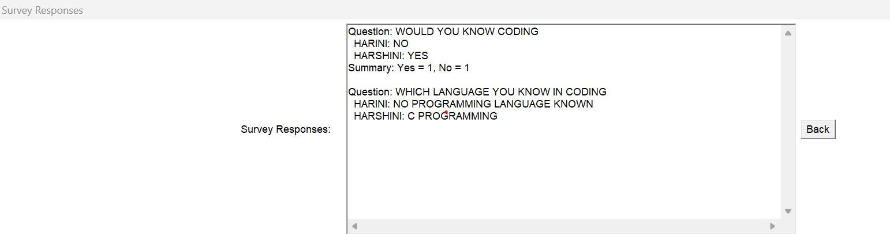
RESULTS AND DISCUSSION
LOGOUT
ADMIN VIEW THE ANALYSIS

Slide 15
QUERIES ?

