Slide 1
Carvana Image Masking Challenge
- Gananathan K

Slide 2
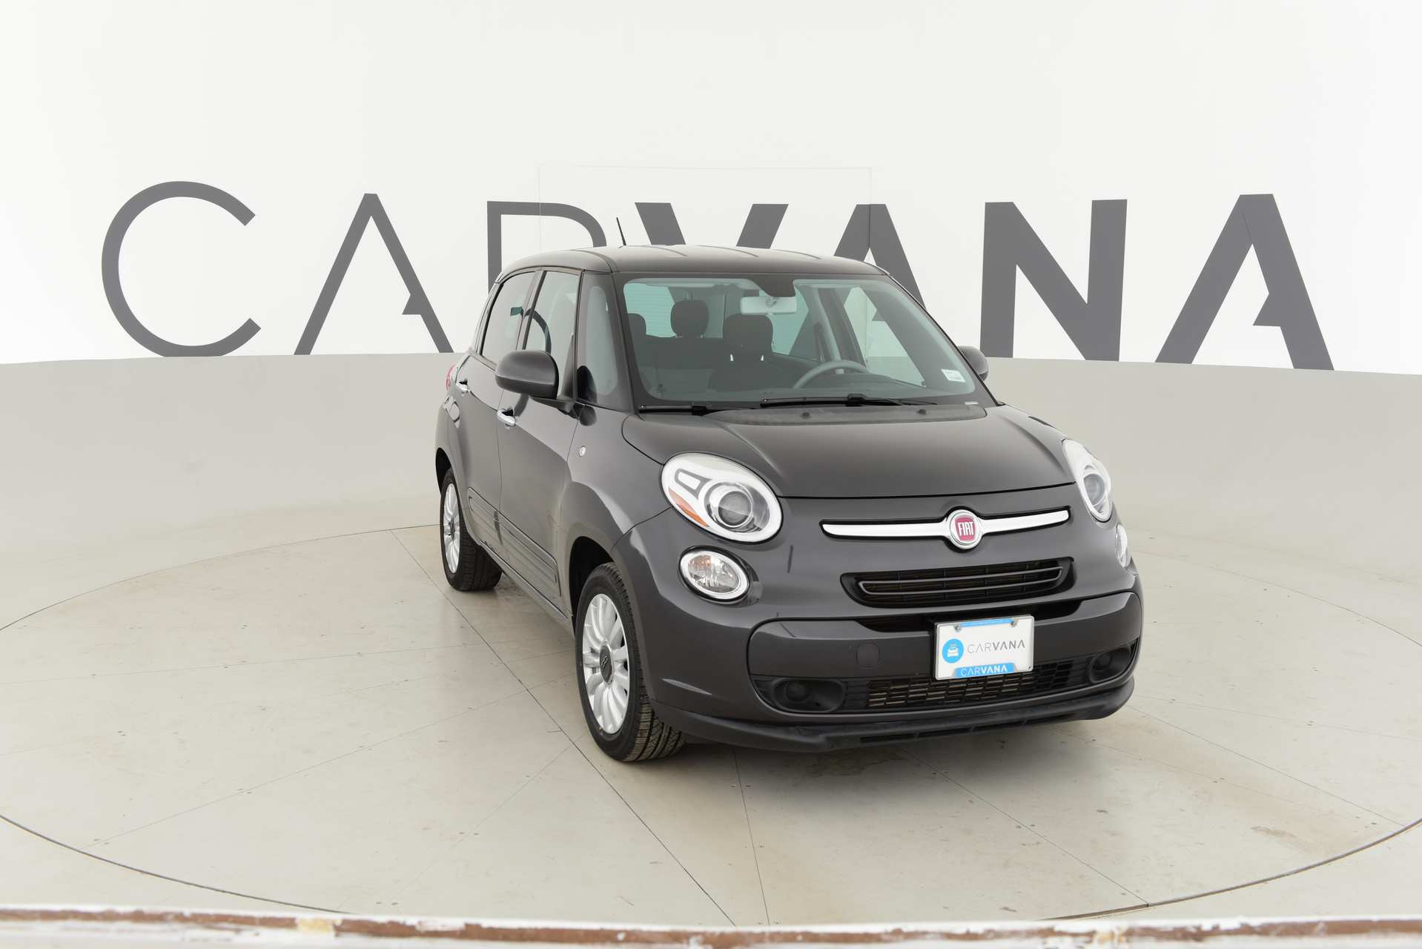
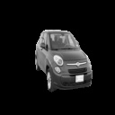
Objective
To segment the high-resolution car images by excluding the background studio banners.
Original Image
Segmented Image

Slide 3
Dataset description
Folder | Description | No. of Images | Image_dimensions
/train/ | folder contains the training set images | 5088 | 1918x1280(used low resolution images)
/test/ | folder contains the test set images | 100,084
/train_masks/ | folder contains the training set masks in .gif format
/test_set/ | folder which contains a sample of 50 images from the test set | 50

Slide 4
Process Architecture
Input Data
Pre – Processing
Training
Post – Processing
Segmented Output
U – net
Resizing
Min-Max Normalization
Blob - Detection
Hard thresholding

Slide 5
Training set-up
Framework used | Keras
Training Environment | Google Colab
Model Used | U – Net
Training image dimension | 128x128x3
Loss function | Binary Crossentropy
Optimizer | Adam
Learning rate | 0.0001
Metric | Dice Coefficient

Slide 6
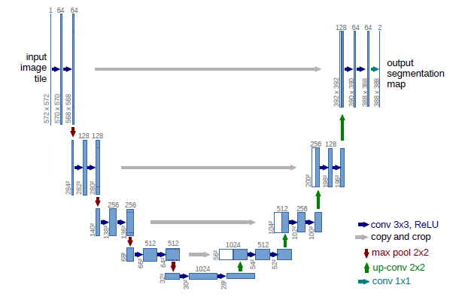
U-Net Architecture
Layer Types
Conv2D
MaxPooling2D
Concatenate Layer
UpSampling2D

Slide 7
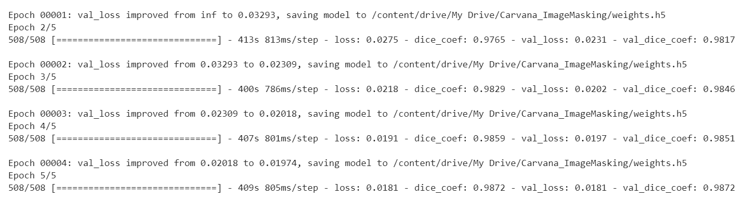
Model Performance - Evaluation
Epoch 5 – have a reduced loss value when compared to the previous epochs also there is noticeable increase in the dice-coef value , so using it for the final prediction.

Slide 8
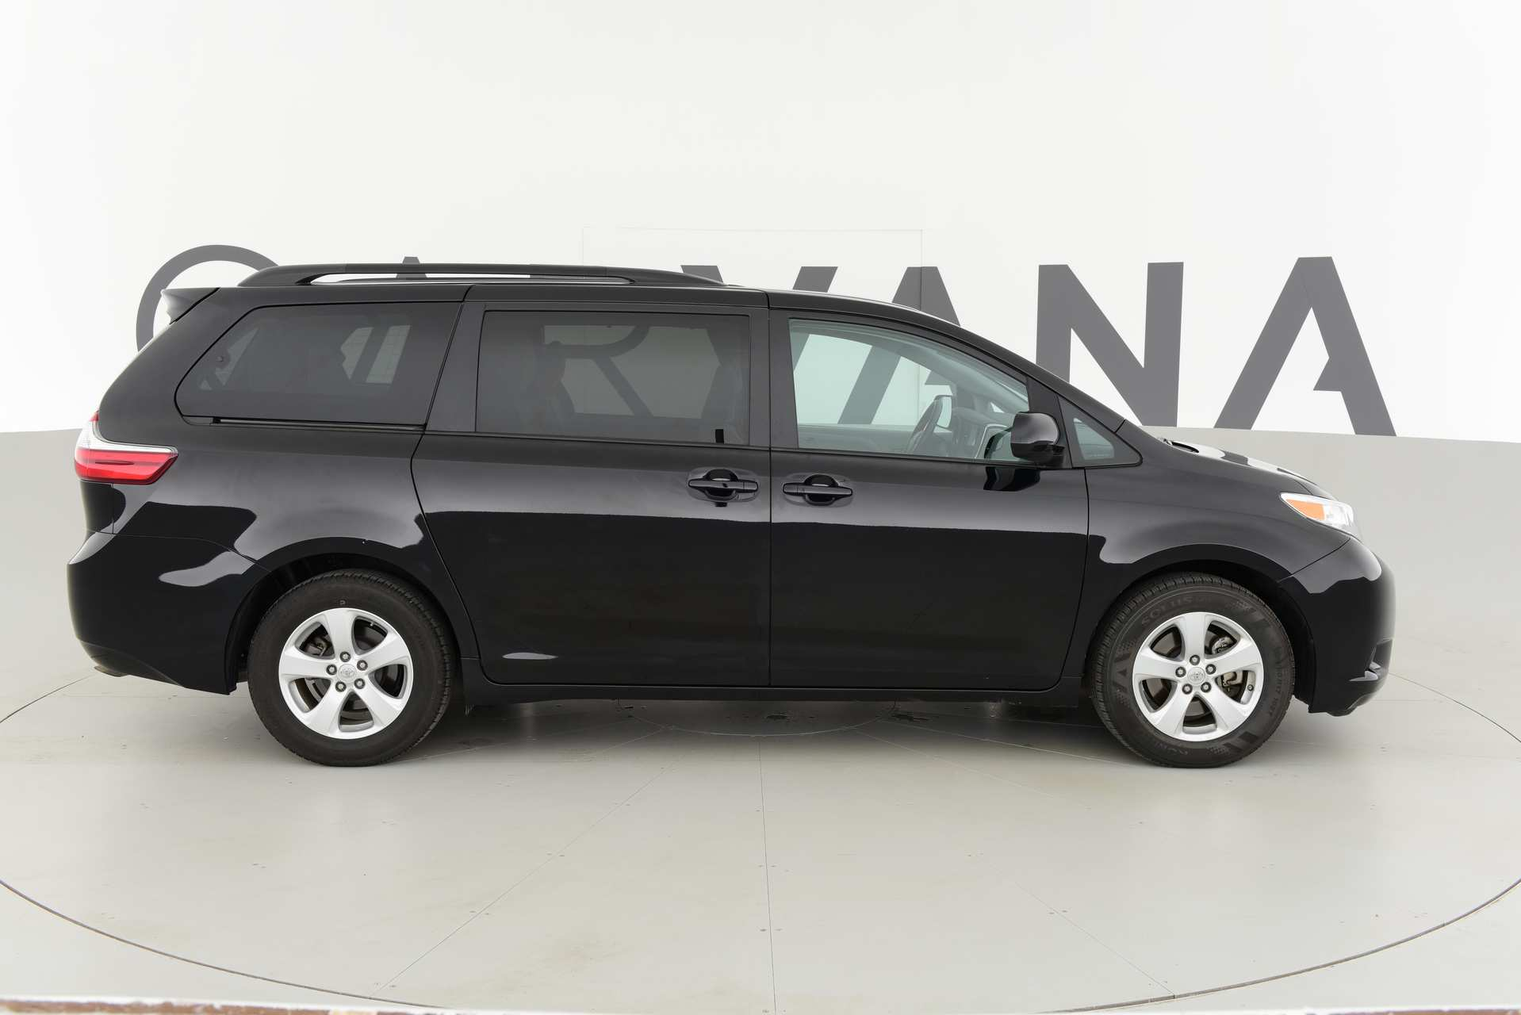
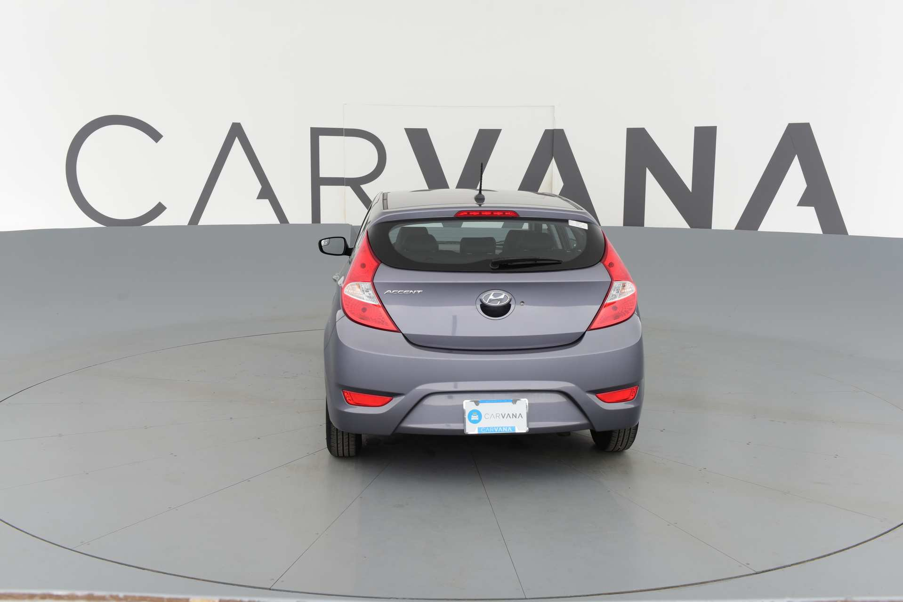
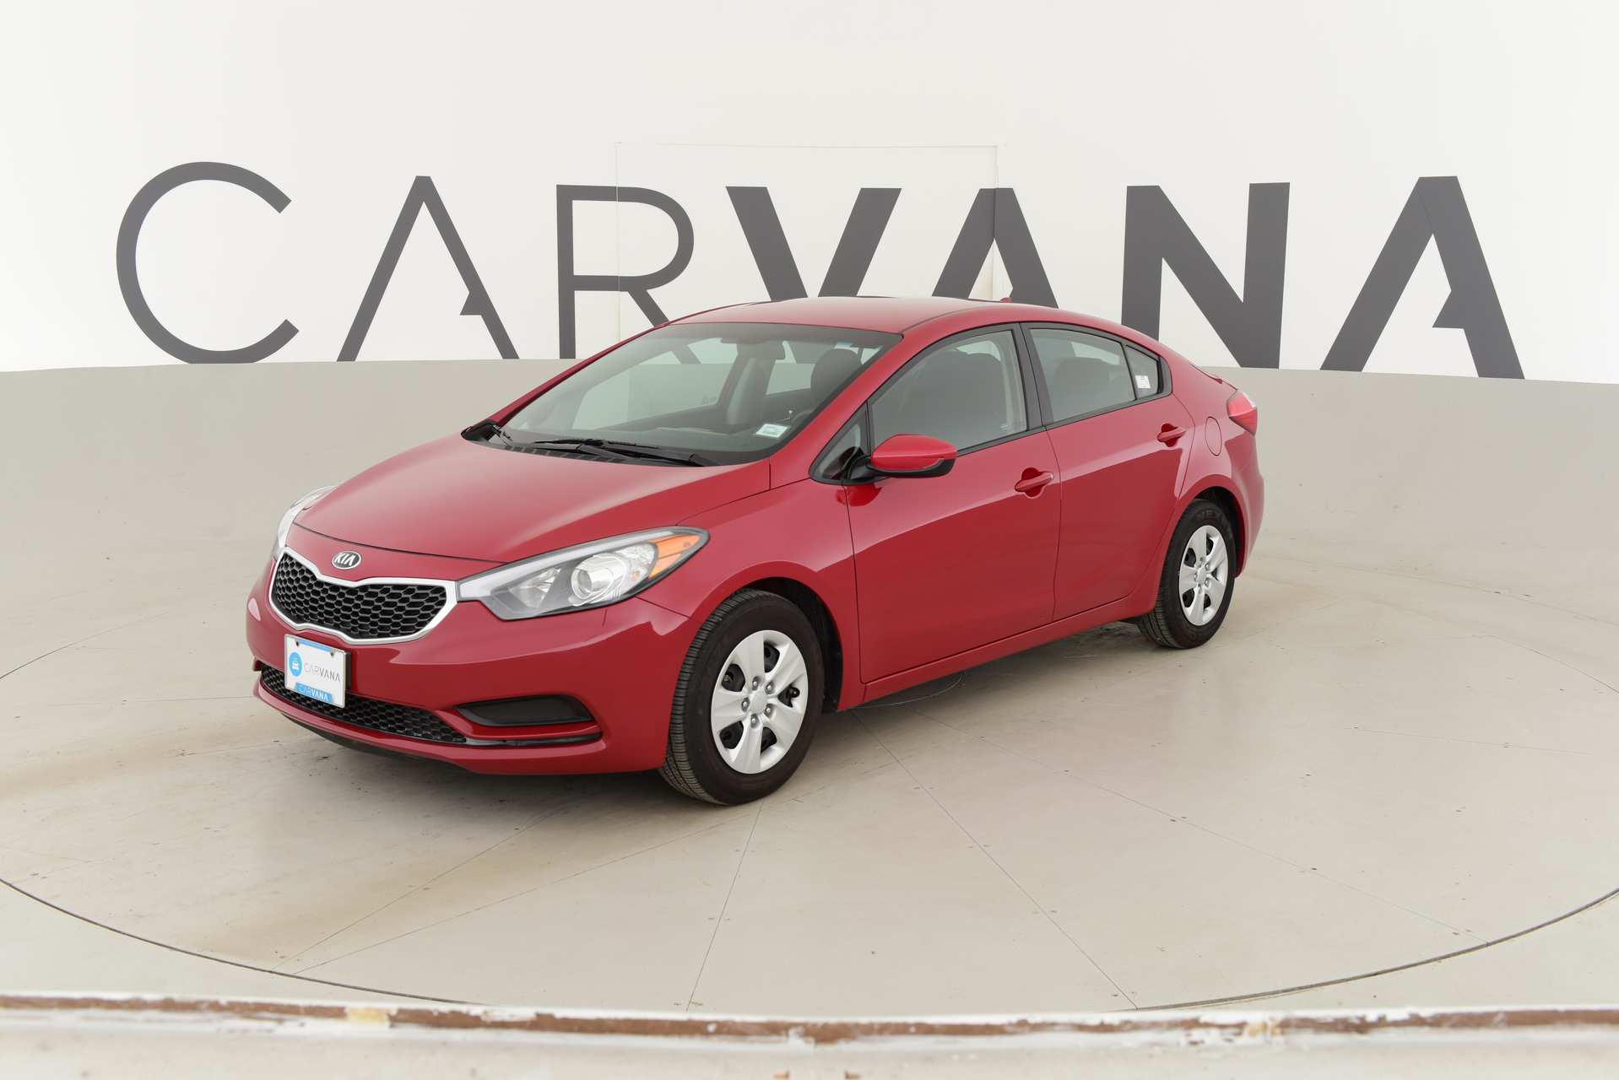
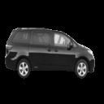
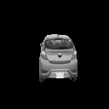
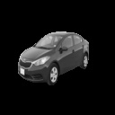
Sample segmentation results

Slide 9
Challenges & Future work
Other models (Mask R-CNN) can be tried provided more training resources.
Data Augmentation can be done to improve the prediction results of the model.
Usage of Dice – loss as the loss function might bring in improvement in the overall performance of the model.

Slide 10
Thank you!

