Slide 1
Google Play Console Registration
Go to below url
https://play.google.com/console/u/0/signup
Userid /Password
Ganapathirajangappan82@gmail.com
W2w2W@W@
Select get started under “Yourself”

Slide 2
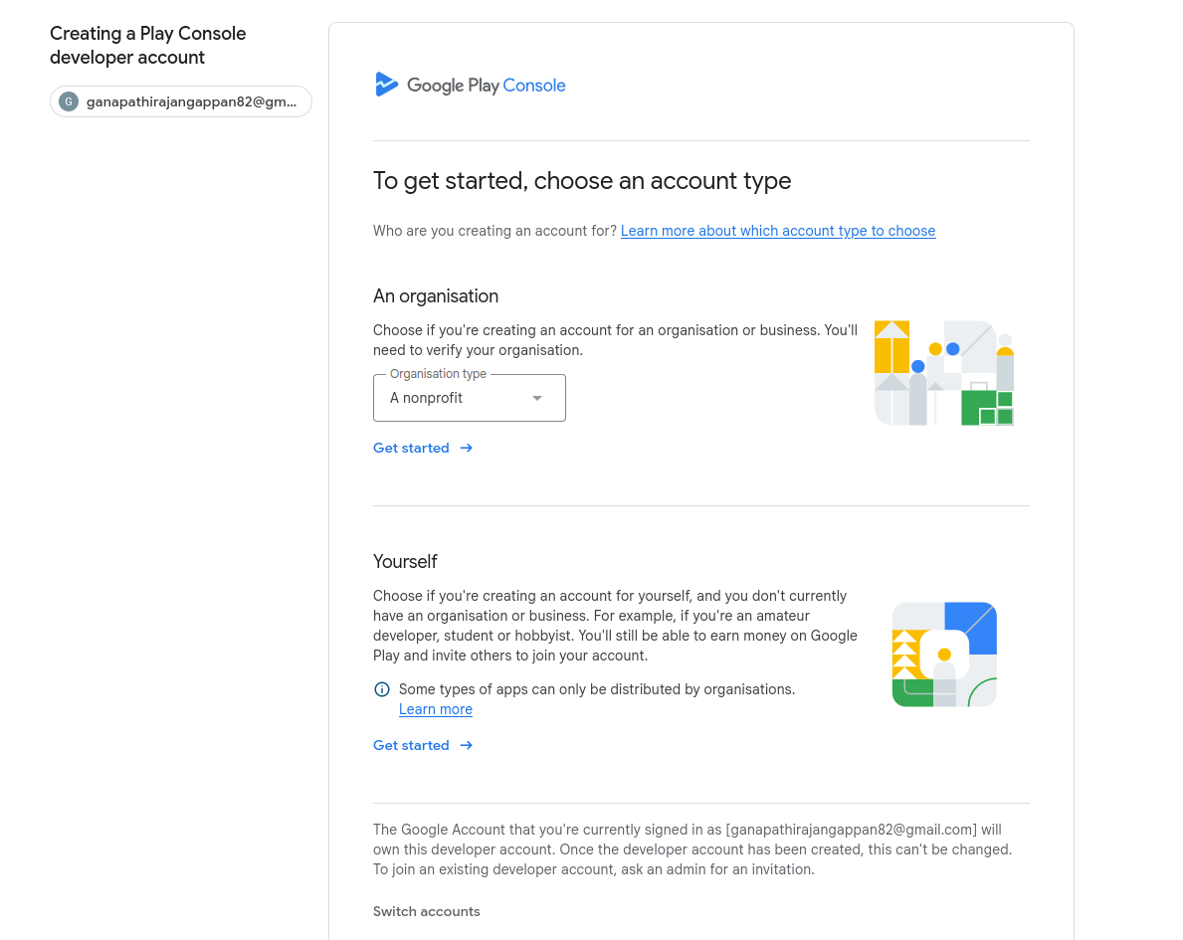

Slide 3
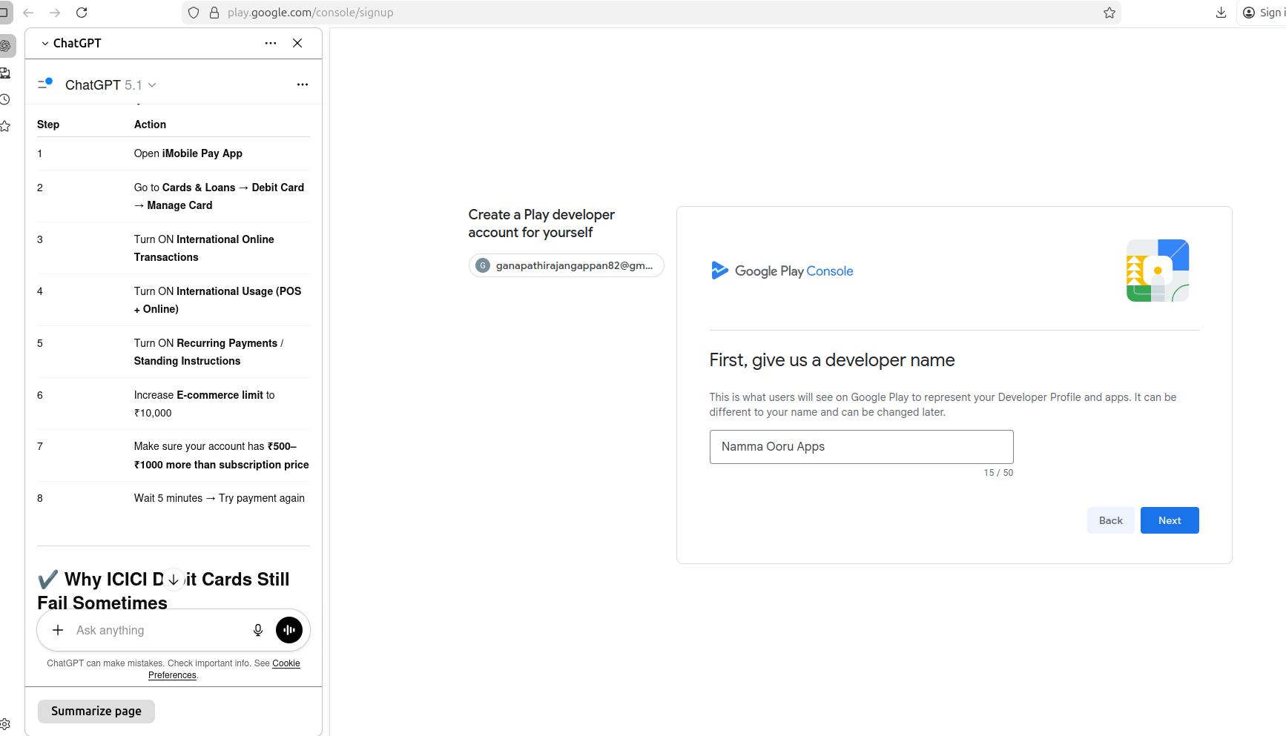

Slide 4
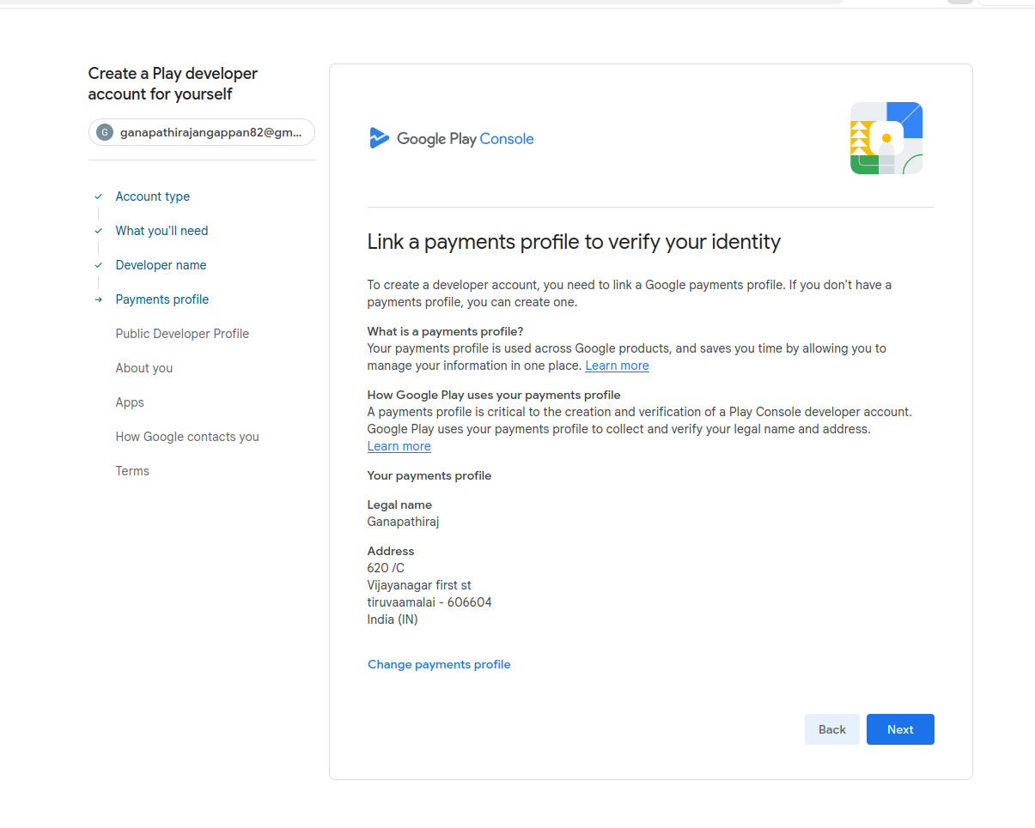

Slide 5
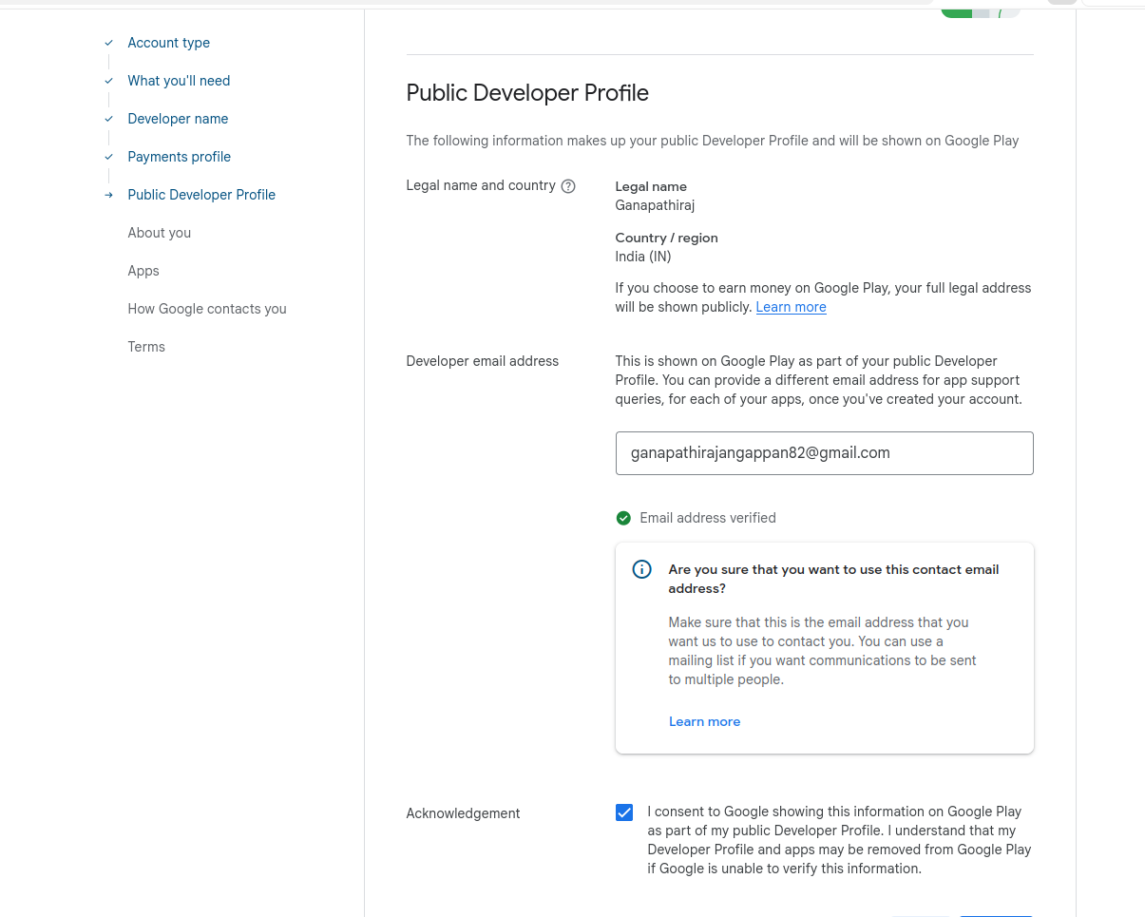

Slide 6
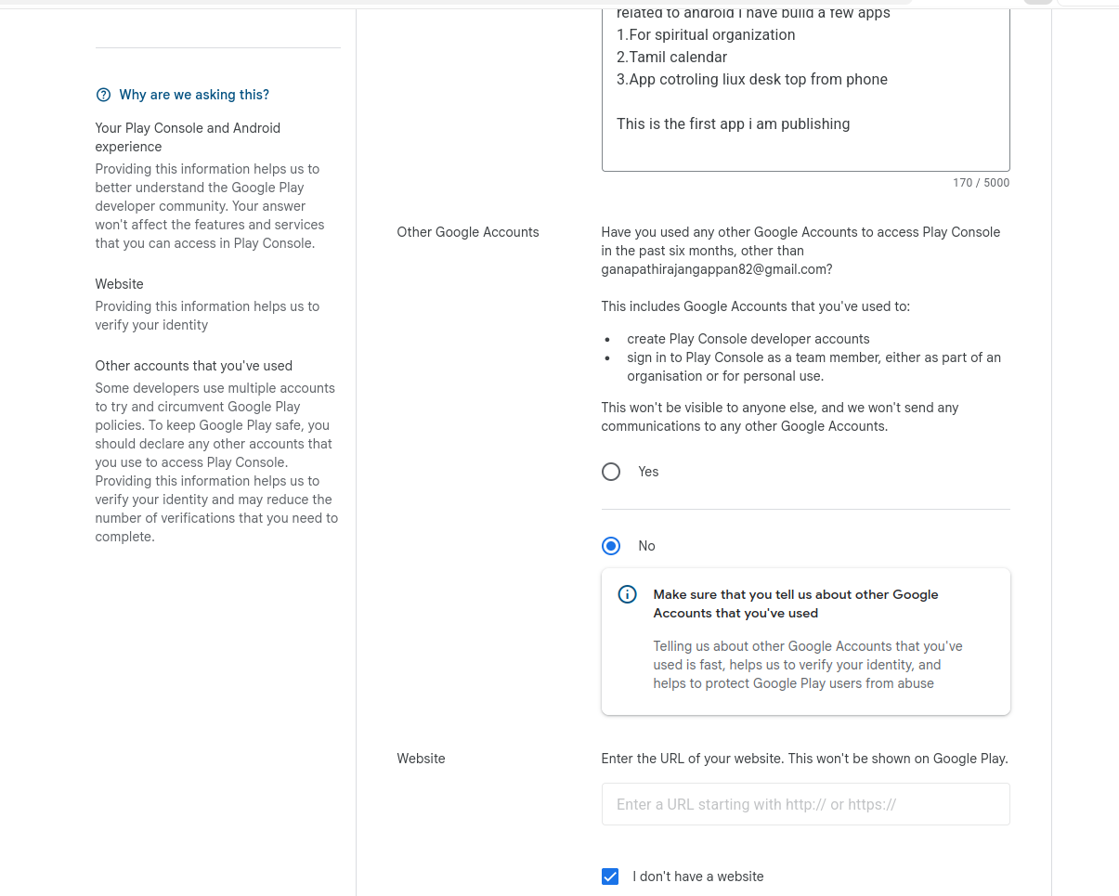

Slide 7
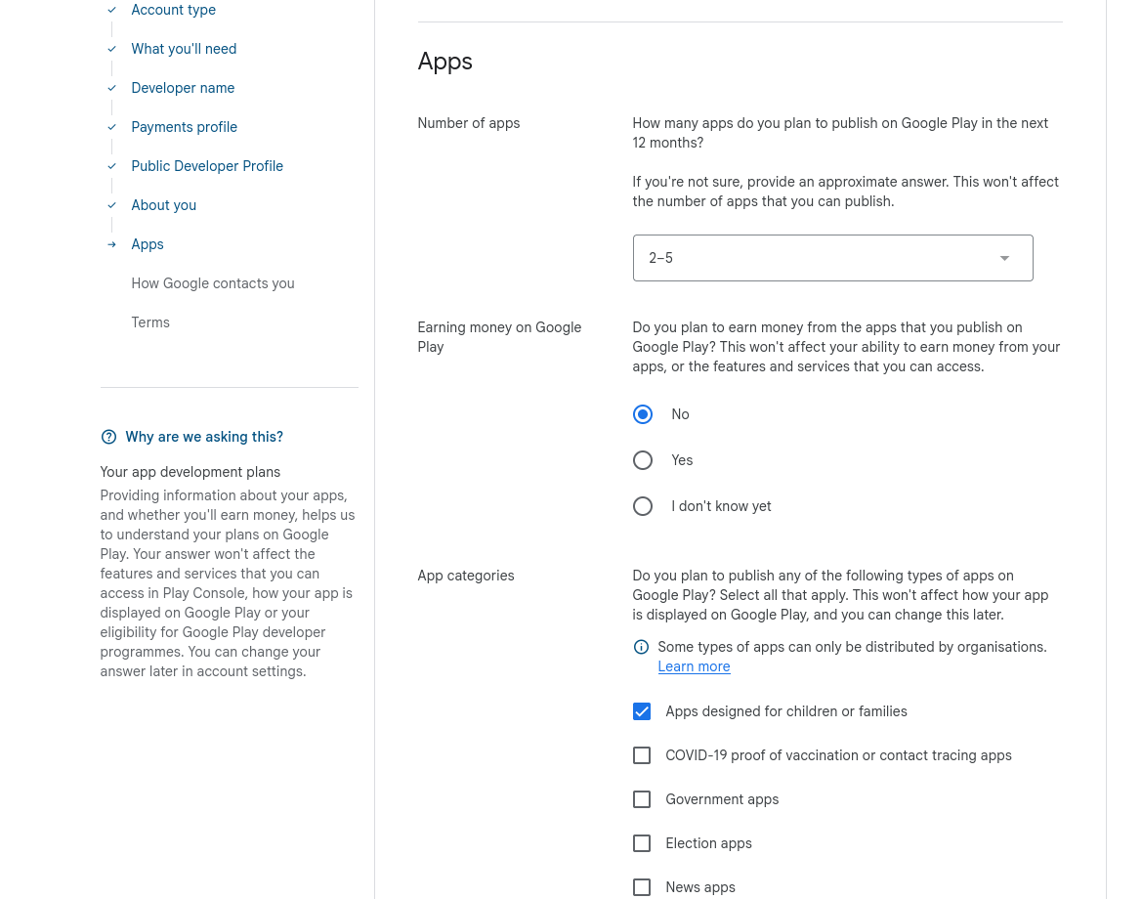

Slide 8
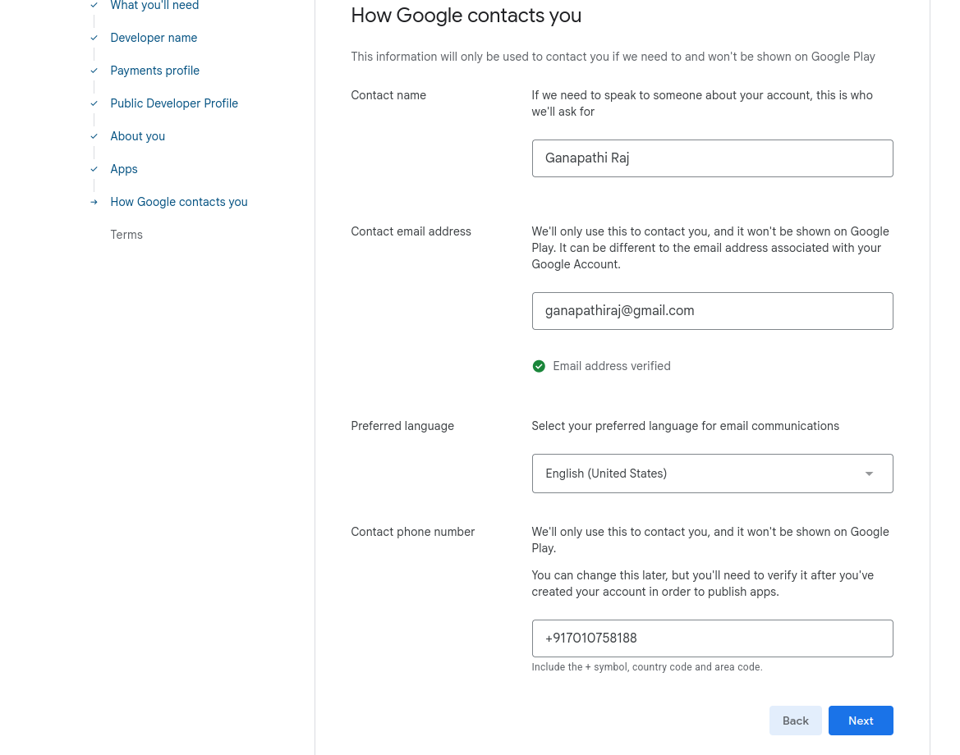

Slide 9
