Slide 1
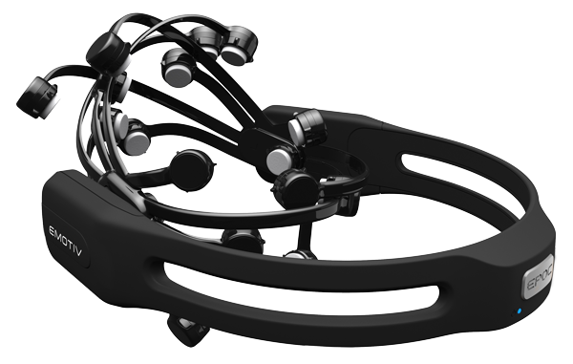
HARDWARES AND SOFTWARES REQURIED.
Emotive Epoc.
Xavier Control Panel.
Raspberry Pi- 3B.
L-293D .
EMOTIVE EPOC : EEG Electrode (Hardware) .
It is a neuroheadset that is used in the field of research, industrial and gaming applications.
It consists of 14 channels and is placed on the head such that all the 14 electrodes are in contact with the scalp to detect the EEG signal.
The headset also consists of gyroscope which detects the orientation of the head.
The headset can wirelessly connected to a computer using an USB transceiver which helps to transfer the brain signals and thus, it can be analysed easily.

Slide 2
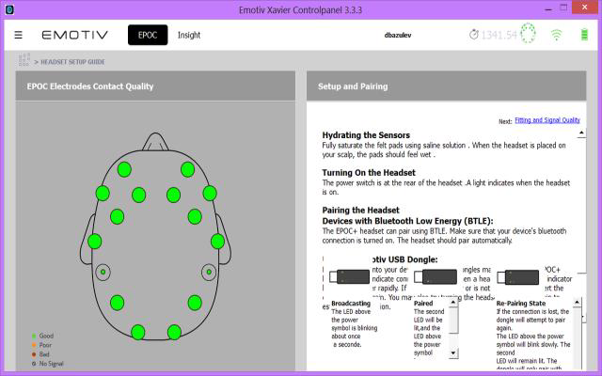
XAVIER CONTROL PANEL : Brain monitoring interface (software).
The headset can be interfaced with emotiv SDK Xavier Control Panel which gives the quality of contact of electrodes with the scalp.
The control panel also offers interfaces called EmoEngine which helps to connect directly to the headset and EmoComposer which can emulate the behaviour of EmoEngine without connecting to a headset.
It gets acquainted with EEG and brain monitoring.
Fit and connect the EEG headset, set base lines (eyes open/eyes closed), monitor and record performance metrics, facial expressions and practice mental commands. Begin self assessment via this easy to use desktop application

Slide 3
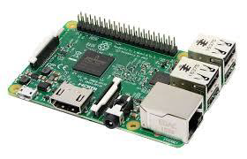
RASPBERRY PI - 3B : Microcontrolloer (Hardware).
The various signals that are obtained from the headset can be used to control a real time situation using a microcontroller.
T he controller can be programmed such that each of the signals it receives can enable GPIO pins which are further connected to other external hardware.
The signal that are obtained from the headset is transferred to a Raspberry-pi over Wi- Fi using socket connection and each of the data it receives makes the motor run in clockwise or counter-clockwise direction.
L-293D : Motor driver (Hardware)
The voltage given at the output of Raspberry-pi is not sufficient to run a DC motor and hence the latter cannot be controlled directly through the GPIO pins.
A motor driver is a device which can run the motor using an external power source and control its direction depending on inputs from the GPIO pins of Raspberry-Pi.
The motor driver L-293D is a 16 pin IC which can supply a maximum current of 600mA and drive motors up to 36v and control two motors simultaneously.

Slide 4
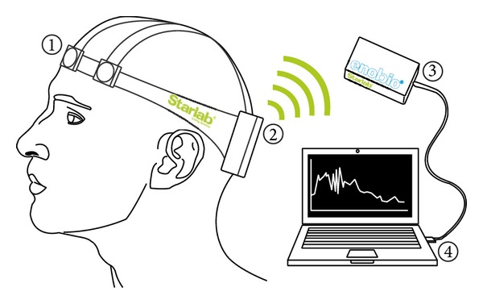
EEG ELECTRODES
What is EEG?
What are the parameters of EEG electrodes?
What are the different EEG electrodes available?
What is Emotive Epoch?
What are the different components?
How to setup Emotive Epoc hardware?
How to interface the Emotive hardware?
What are the different features of Emotive Epoc?
How to extract the signals?

Slide 5
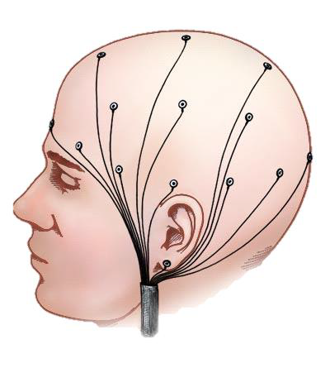
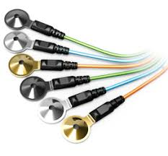
What is EEG?
Electroencephalography (EEG) is an electrophysiological monitoring method to record electrical activity of the brain.
EEG measures voltage fluctuations resulting from ionic current within the neurons of the brain. In clinical contexts, EEG refers to the recording of the brain's spontaneous electrical activity over a period of time, as recorded from multiple electrodes placed on the scalp.
The electroencephalogram is a varying potential observed between two electrodes placed at two separate points on the scalp.
USES: EEG is used to diagnose epilepsy, which causes abnormalities in normal EEG readings. It is also used to diagnose sleep disorders, depth of anesthesia, coma, encephalopathy, and brain death. EEG is the method to diagnose of tumors, stroke and other focal brain disorders.

Slide 6
What are the parameters for placement of EEG electrodes?
CORTICAL HOMUNCULUS:
A cortical homunculus is a distorted representation of the human body, based on a neurological "map" of the areas of brain dedicated to motor functions, or sensory functions, for different parts of the body.
Homunculus is Latin for "little man", and was a term used in alchemy and folklore prior to the concept being utilized in scientific literature. A cortical homunculus, or "cortex man", illustrates the concept of a representation of the body lying within the brain.
A motor homunculus represents a map of brain areas dedicated to motor processing for different anatomical divisions of the body. The primary motor cortex is located in the precentral gyrus, and handles signals coming from the premotor area of the frontal lobes.
A sensory homunculus represents a map of brain areas dedicated to sensory processing for different anatomical divisions of the body. The primary sensory cortex handles signals coming from the thalamus. These signals are transmitted from the gyro to the brain stem and spinal cord via corresponding nerves.

Slide 7
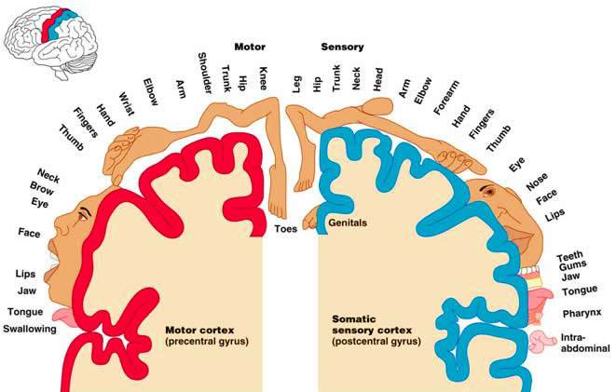

Slide 8
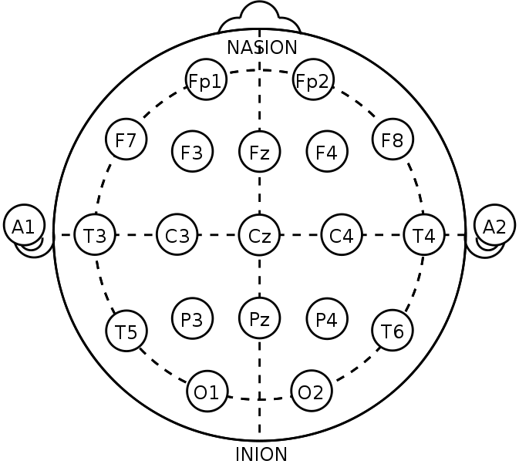
10-20 SYSTEM:
The 10–20 system or International 10–20 system is an internationally recognized method to describe and apply the location of scalp electrodes in the context of an EEG test or experiment.
This system is based on the relationship between the location of an electrode and the underlying area of cerebral cortex. The "10" and "20" refer to the fact that the actual distances between adjacent electrodes are either 10% or 20% of the total front–back or right–left distance of the skull

Slide 9
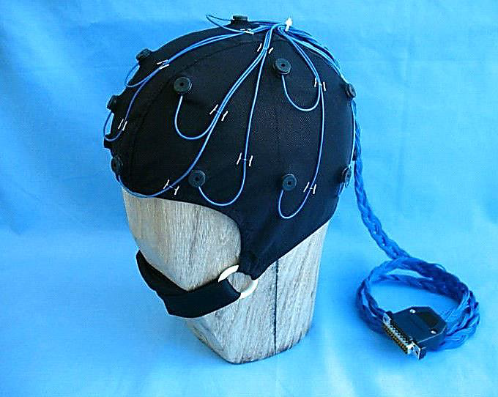
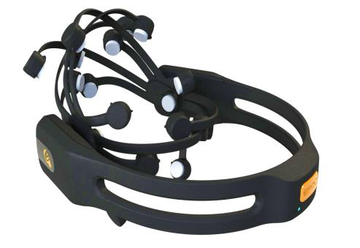
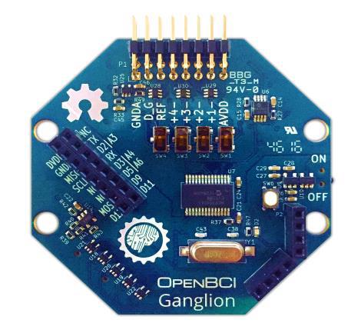
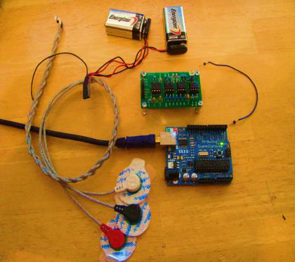
What are the different electrodes available?
Cap type EEG Electrode Set
EEG Electrode Headset
A Simple EEG Electrode Set
OpenBCI-Ganglion

Slide 10
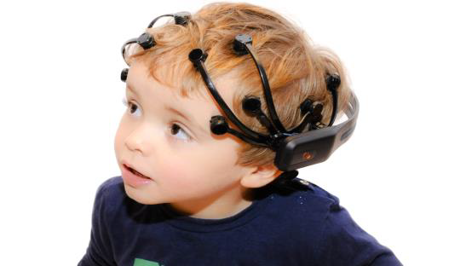
EMOTIV
Emotiv Systems is an Australian electronics innovation company developing technologies to evolve human computer interaction incorporating non-conscious cues into the human-computer dialog to emulate human to human interaction.
Developing brain–computer interfaces based on electroencephalography (EEG) technology, Emotiv Systems produced the EPOC near headset, a peripheral targeting the gaming market for Windows, OS X and Linux platforms.
The EPOC has 16 electrodes and is originally designed to work as a brain-computer interface (BCI) input device.
The company was founded in Australia in 2003 by technology entrepreneurs Tan Le, Nam Do, Allan Snyder, and Neil Weste.

Slide 11
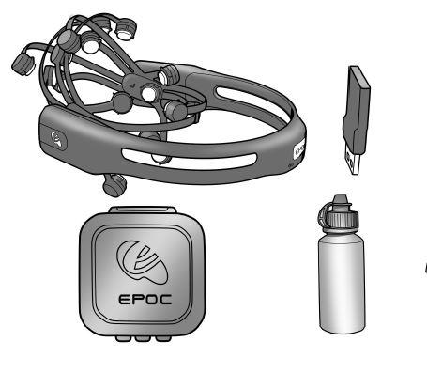
HEDSET:
The kit consists of:
EMOTIV EPOC Headset
Sensors
USB Receiver
Saline Solution

Slide 12


EMOTIV EPOC HEADSET SETUP
Step 1 - Initial charging of headset.
Step 2 - Hydrating the Sensors

Slide 13
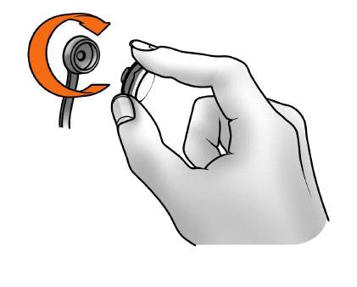
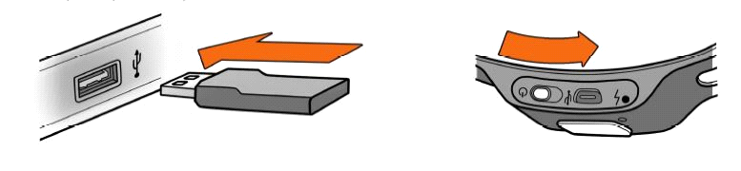
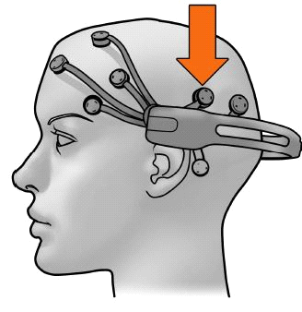
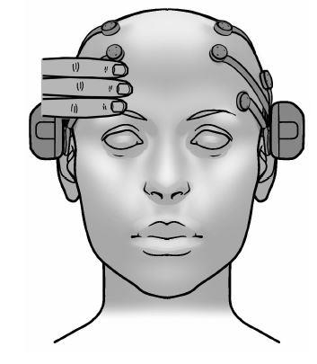
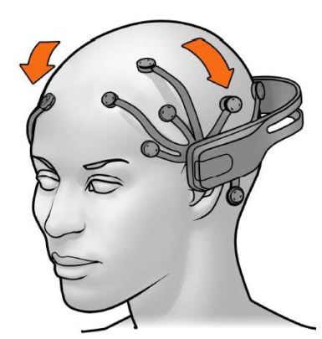
Step 3 - Sensor Assembly
Step 4 - Pairing the Neuroheadset
Step 5 - Headset Placement

Slide 14
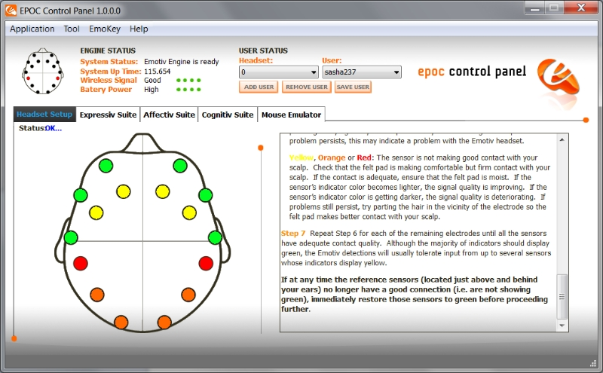

XAVIER CONTROL PANEL
The Xavier Control Panel is an open source SDK developed by the EMOTIV Inc. which helps to give an interactive environment for the user, controlled by the EMOTIV EPOC headset.
The following features are included in the interface:
The contact quality of the electrodes with the scalp can be determined once the USB transceiver is connected to the headset.
The above figure shows contact quality of 14 electrodes to capture EEG data and 2 electrodes as reference electrodes. The EEG data is captured by the electrodes only after reference electrodes are in proper contact with the scalp.
The contact quality is indicated by colours as follows:

Slide 15
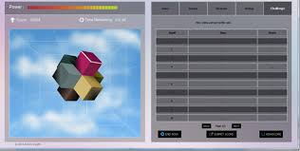
MENTAL COMMANDS
The Xavier Control helps to train and detect mental commands and help to test the same using an interactive environment.
The list of actions that can be trained are:
PUSH
PULL
LEFT
RIGHT
ROTATE CLOCKWISE
ROTATE ANTI-CLOCKWISE
LIFT&DROP
NEUTRAL
I.Training
The mental command NEUTRAL has to be trained in beginning to unlock all the other actions .Each of the action can be trained for 8 seconds. The responsiveness of the mental commands depends on the skill rating. The Skill rating increases every time the action is trained, that is, each time the action is trained, the accuracy of the action being retrieved increases.
II. Action
Once the mental commands are trained, the SDK can be put in ACTION mode and the block starts to move in the direction the user thinks in, that is, when the user thinks to push the block, the block gets pushed inward.

Slide 16
FACIAL COMMANDS
The Xavier control panel also helps to detect the facial commands of the person wearing the headset.
The facial commands that can be detected are:
1.BLINK
2.LEFT WINK
3.RIGHT WINK
4.SMILE
5.RAISED EYEBROWS
6.FROWN
7.LAUGH
The facial commands can be divided as:
Upper face action: Surprise, Frown
Eye related action: Blink, wink right/left
Lower face action: Smile, Clench, Laugh

Slide 17
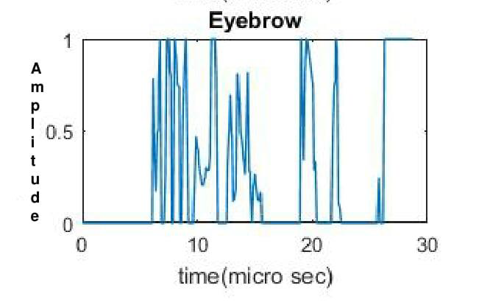
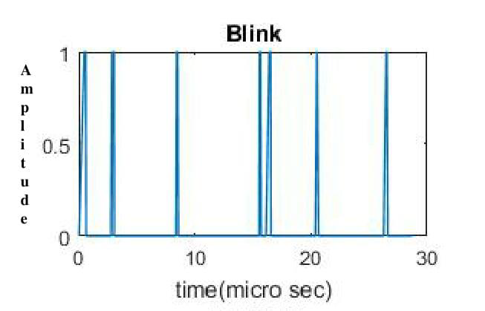
POWER VALUES OF FACIAL & MENTAL COMMANDS:
The EMOTIV EPOC provides an API (Application Program Interface) which gives a library of functions which can be used to determine the facial, mental commands along with the intensity of the thought which is defined as Power which is in the range of 0 and 1.
The power values for the mental commands gives the information about how intense the thought is being made by the user , that is, a power value tending to 1 determines that the person is thinking about the trained thought intensively and vice-versa.
The EMOTIV EPOC headset determines the facial command and is send across to the USB transceiver as an ASCII character.
The facial expression BLINK, WINK LEFT and WINK RIGHT will always have a power value of 1 during their respective events as it can be defined by only a single degree of movement. The graph shows the number of blinks the user has made in a period of time and it also indicates that it has taken amplitude values of either 0 or 1.

Slide 18
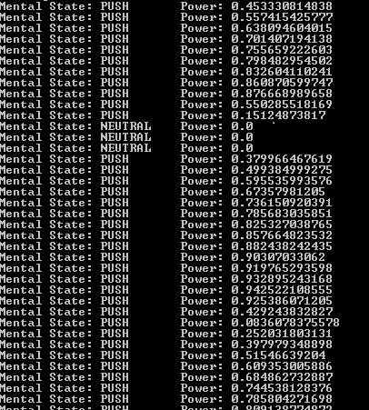
The facial commands that are sent from the head set will have the ASCII character etermining the facial expression and the power values. S50 is an example of data that is sent from the head set and it defines that the facial expression of the user is smile and has a power value of 0.5.
The mental command specific events are declared and can be trained until the desired skill rating is obtained. The trained commands can be stored in the user profile that is created by the user .The headset makes the trained data as a reference and return the command user thinks in real time. The snippet below shows real time thought of commands PUSH and NEUTRAL that were initially trained by the user.

