Slide 1


Library Management System

Slide 2
Profile
About Me:
M.V.V.S.Ganapati
B.Tech,ECE
Sri Vasavi Engineering College
Why Data Science:
•Interested in solving business problems using data.
•Passionate about SQL, analytics, and visualization.
Experience:
• Fresher
LINKEDIN: https://www.linkedin.com/in/ganapati-meesala-b83b5640a/
GitHub: https://github.com/Ganapati88

Slide 3
Problem Statement
The Library Management System generates data related to books, borrowers, loans, and library branches. The project uses SQL to analyze this data and identify useful patterns and insights for better library management.
Main Objectives
Analyze book and borrowing activities
Identify popular and frequently borrowed books
Analyze borrower behavior
Compare library branch performance
Find useful insights from loan and book data
Support better library management decisions

Slide 4
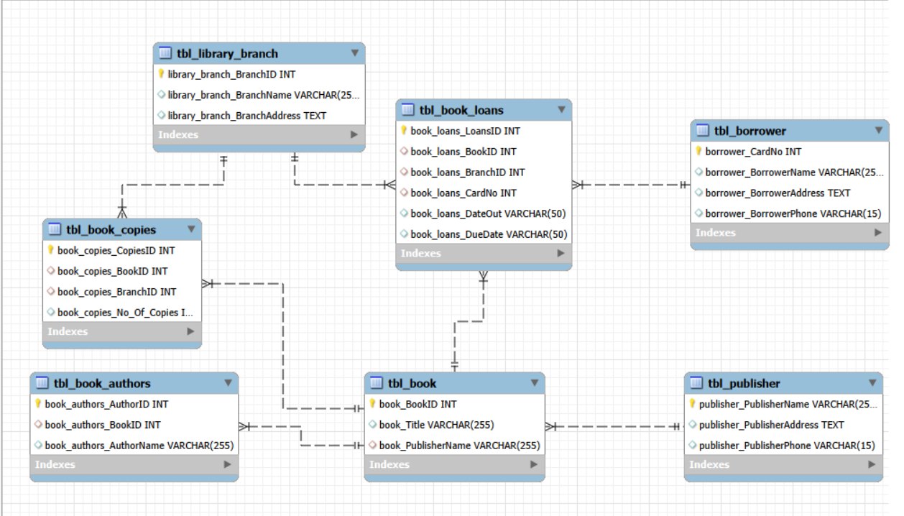
Database Schema

Slide 5
Dataset Overview
Data Source: MySQL Database
Database Name:library_db
Total Tables: 7
Tables:
tbl_publisher,tbl_book,tbl_book_authors,tbl_library_branch,tbl_book_copies,tbl_borrower,tbl_book_loans
Visualization & Analysis Tool: Power BI
Purpose: To analyze library data and understand books, borrowers, loans, and branch activities

Slide 6
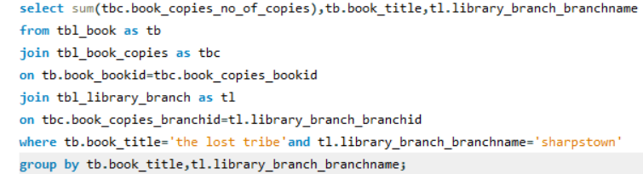
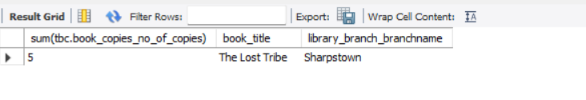
BUSINESS QUESTIONS
Module 1 – Book Analytics
1. How many copies of the book titled "The Lost Tribe" are owned by the library branch whose name is "Sharpstown"?
QUERY:
RESULT:

Slide 7
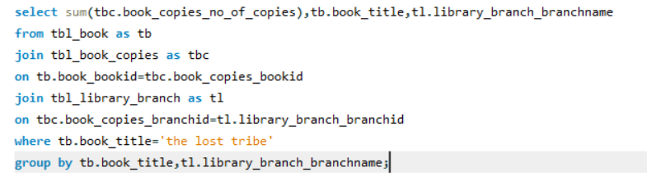
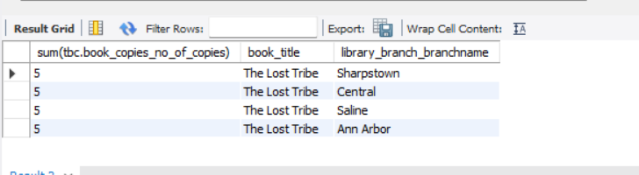
2. How many copies of the book titled "The Lost Tribe" are owned by each library branch?
QUERY:
RESULT:

Slide 8
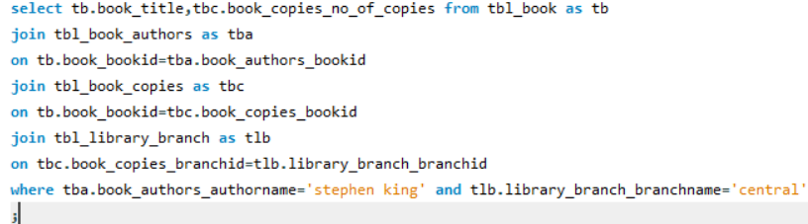
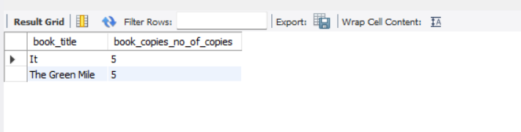
3. For each book authored by "Stephen King", retrieve the title and the number of copies owned by the library branch
whose name is "Central"
QUERY:
RESULT:

Slide 9
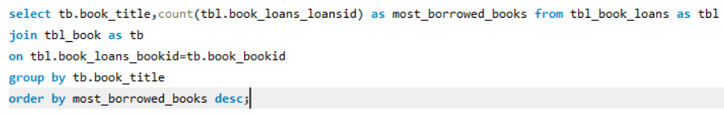
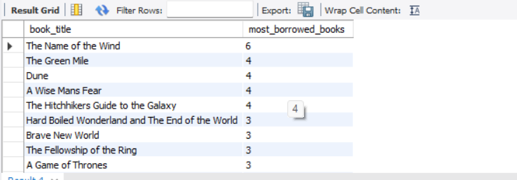
4. Which books are borrowed the most across all library branches?
QUERY:
RESULT:

Slide 10
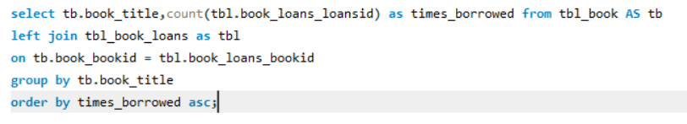
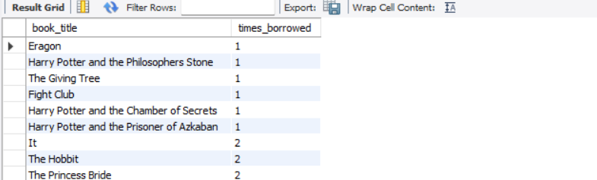
5. Which books have the lowest borrowing frequency?
QUERY:
RESULT:

Slide 11
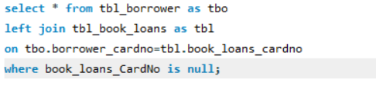
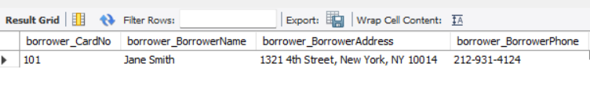
Module 2 – Borrower Analytics
1. Retrieve the names of all borrowers who do not have any books checked out.
QUERY:
RESULT:

Slide 12
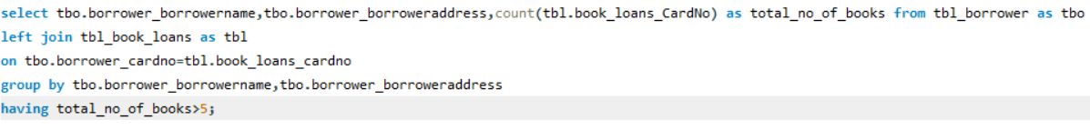
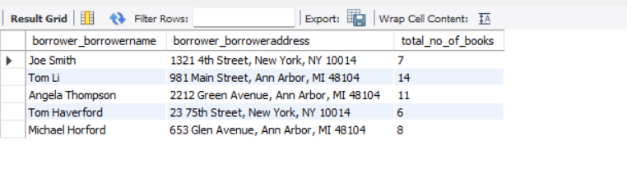
2. Retrieve the names, addresses, and number of books checked out for all borrowers who have more than five books checked out
QUERY:
RESULT:

Slide 13
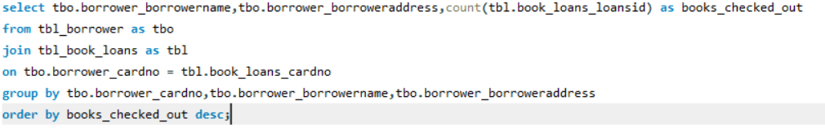
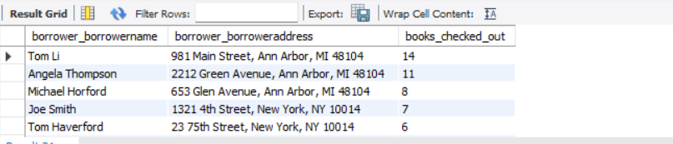
3. Which borrowers currently have the highest number of books checked out?
QUERY:
RESULT:

Slide 14
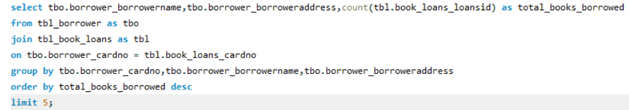
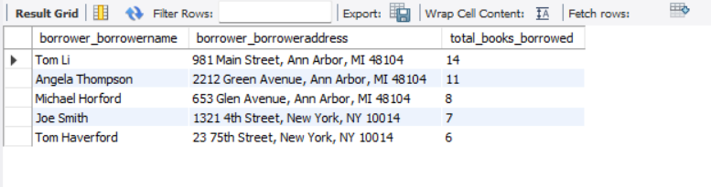
4. Who are the Top 5 most active borrowers?
QUERY:
RESULT:

Slide 15
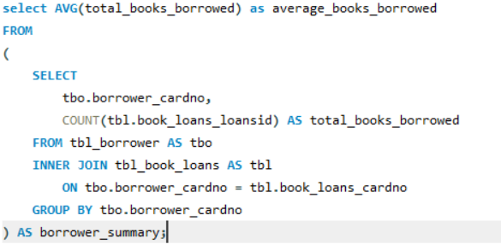
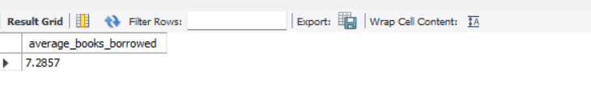
4. What is the Average Number of Books Borrowed per Borrower?
QUERY:
RESULT:

Slide 16
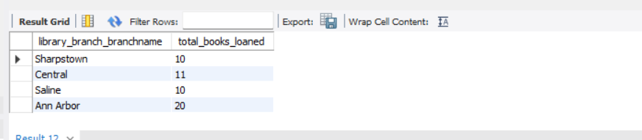
Module 3 – Branch Analytics
1. For each library branch, retrieve the branch name and the total number of books loaned out from that branch.
QUERY:
RESULT:

Slide 17
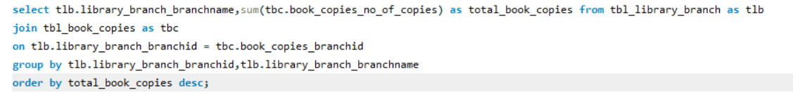
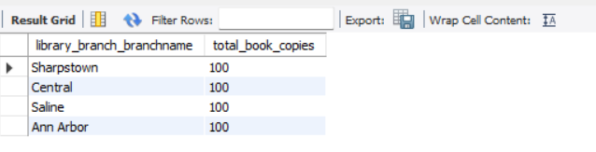
2. Which library branch owns the highest number of book copies?
QUERY:
RESULT:

Slide 18
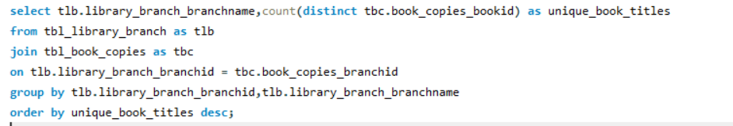
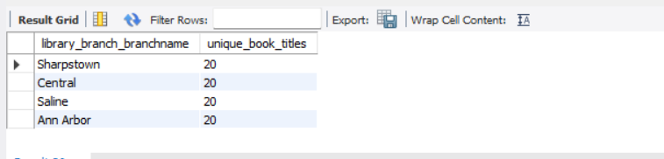
3.Which library branch has the highest number of unique book titles?
QUERY:
RESULT:

Slide 19
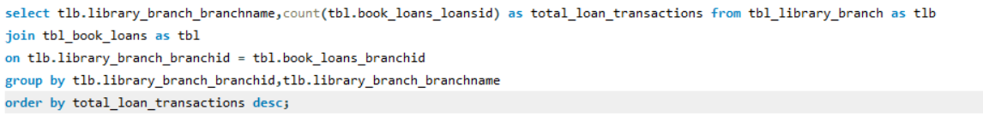
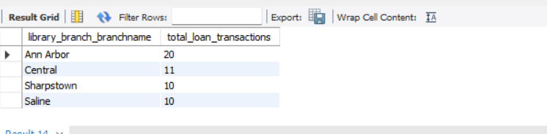
4. Which library branch has processed the highest number of loan transactions?
QUERY:
RESULT:

Slide 20
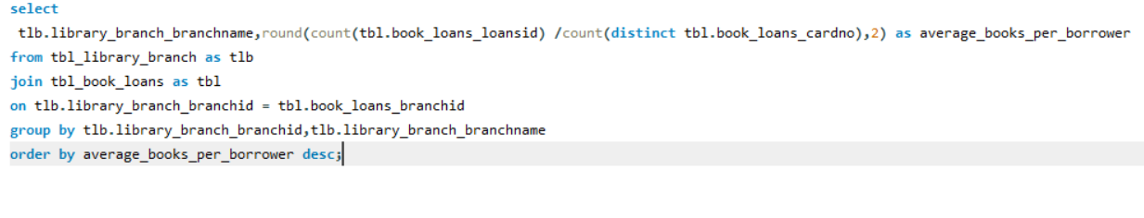
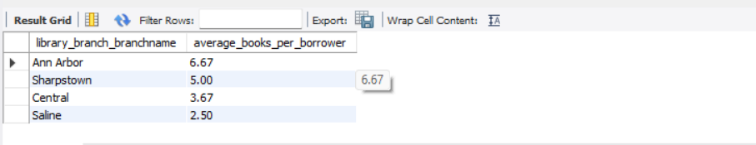
5. Which library branch has the highest average number of books borrowed per borrower ?
QUERY:
RESULT:

Slide 21
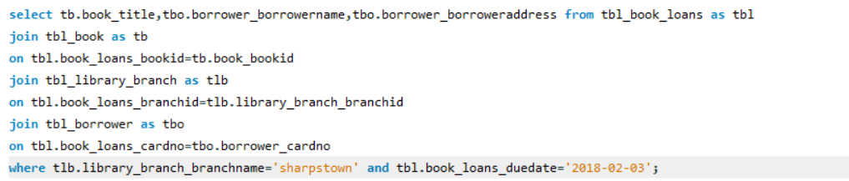
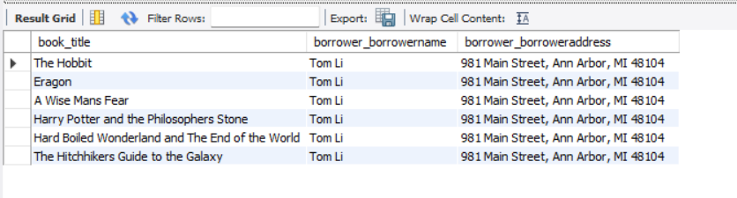
Module 4 – Loan Analytics
For each book that is loaned out from the "Sharpstown" branch and whose Due Date is 2/3/18, retrieve the book title, the borrower’s
name, and the borrower's address.
QUERY:
RESULT:

Slide 22
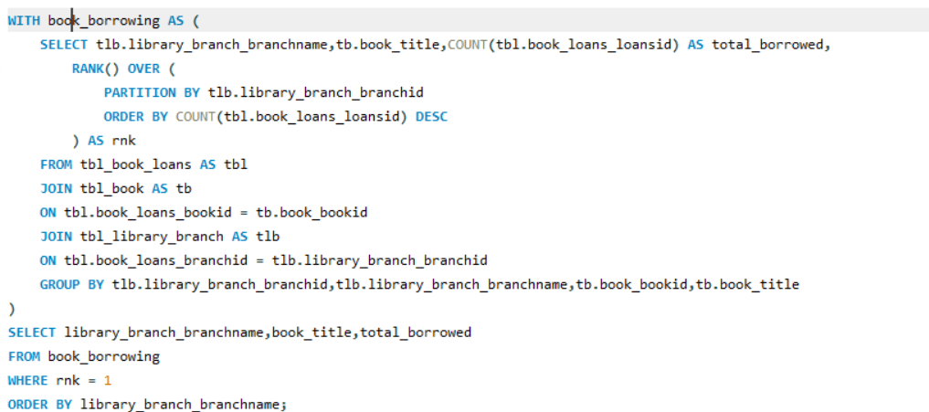
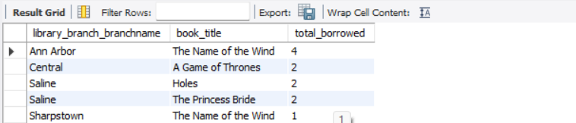
2. Which books have been borrowed the most in each library branch?
QUERY:
RESULT:

Slide 23
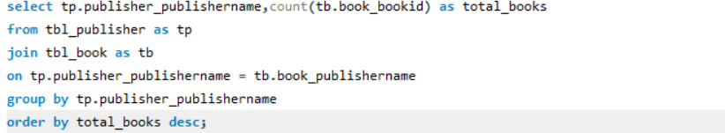
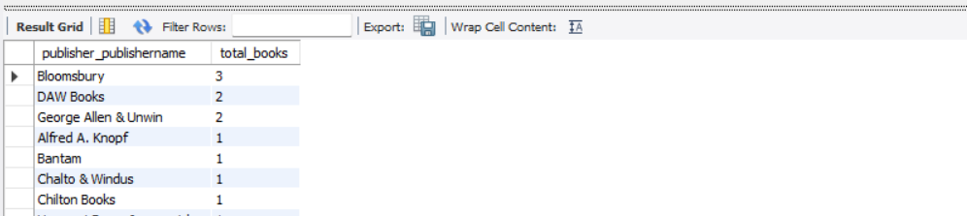
Module 5 – Publisher Analytics
1. Which publishers have the highest number of books available in the library?
QUERY:
RESULT:

Slide 24
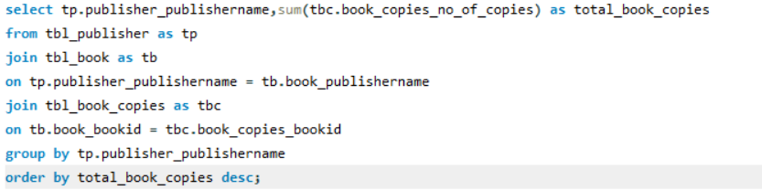
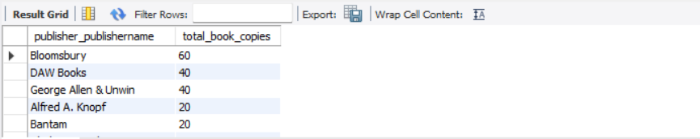
2. Which publisher owns the highest number of book copies across all library branches?
QUERY:
RESULT:

Slide 25
Key Insights:
• Identified the most frequently borrowed books.
• Identified books with the lowest borrowing frequency.
• Found the most active borrowers in the library.
• Identified borrowers with more than five books checked out.
• Compared branches based on total loan transactions.
• Identified the branch with the highest number of book copies.
• Found publishers with higher book availability.
• Analyzed loan activity across different library branches.

Slide 26
Recommendations:
• Keep additional copies of highly borrowed books.
• Review low-demand books before purchasing more copies.
• Monitor borrowers with multiple books checked out.
• Encourage borrowers to return books on time.
• Improve resources in branches with lower activity.
• Use loan data to plan book purchases.
• Maintain sufficient copies based on borrowing demand.
• Regularly analyze library data to improve resource management.

Slide 27
Conclusion:
This project uses SQL to analyse different aspects of the Library Management System, including books, borrowers, branches, loans, and publishers. The analysis helped identify borrowing patterns, popular books, active borrowers, and branch performance,providing useful insights for better resource management and more informed library decisions.

Slide 28

THANK YOU
Presented by:
Name: M.V V Sesha Ganapati
B.Tech ,ECE

