Slide 1
Mini-Project Progress Review 2
Project Title
: Crypto Advisor
Project Guide : Dr. Uma
Project Team ( Names & USN) : Joseph Alwin Kulathara Ajimon Ganesh C Revanth
Om Divyatej
PES1UG20CS553 PES1UG20CS551 PES1UG20EE043

Slide 2
Project Abstract and Scope
A basic introduction of the Project
An overview of the scope it entails.

Slide 3






Why an Advisor?
The Points which ensures people to rely on the Crypto Advisors:
The Advisor is not Emotion driven unlike Humans which increases its probability of making a better choice than Humans in most of the cases.
The process of Buying would become comparatively faster than humans since the advisor consider many factors all at once unlike humans.
The Crypto advisor does run a round Back-testing in a very efficient way unlike humans.

Slide 4
Suggestions from Review - 1
The suggestions and remarks given by the panel members.
To change project course from trading bots to giving recommendation/advice.
Referring and analysing cryptocurrency papers.
Building simple user interface for the customers.

Slide 5
Suggestions from Review - 1
The feasibility on the same showing the progress.
This is an example picture which shows how easy and interactive the Interface would be.
We have referred a couple of papers which explains about the functionalities and procedural aspects before advising the buy options to users.

Slide 6
Project Requirements
Requirements for the Project:
Functional requirements.
The plots based on the historical data sets to the End user on demand
Analyzing the data through the plots obtained.
Non-functional requirements
Making the advisor more reliable
Ensuring Ease of Usage for the End User
Training the Model to handle the errors in a very
efficient way

Slide 7
Detailed Literature Survey
Summary of Paper 1:
(Real Time monitoring of Bitcoin prices on several Cryptocurrency markets)
In order to predict the price variations of Bitcoin there is a need to consider methods like “Price Movement”, “Data Mining”, “Intelligent Computing”.
Ways to get data about Price Movement:
Clinging on to those easily exchangeable markets with easy access to their Web API services.
Encoding the Web API using Javascript, html and Storing the data in MySQL database.

Slide 8
Detailed Literature Survey
Summary of Paper 2:
(Cryptocurrencies Transactions Advisor Using a Genetic Mamdani-type Fuzzy Rules Based System)
There are already more than
180 different exchanges operating throughout the world, such as Kraken, Coinbase, Bitstamp, bitFlyer, Bitfinex, OKCoin, Huobi and BTCC.
To deal with the accuracy-interpretability trade off, a genetic algorithm was employed to each cryptocurrency Evaluated.
Since the models are interpretable, a specialist could choose, among the best models, the one(s) that he or she judges to have higher chances of success.

Slide 9
Detailed Literature Survey
Summary of Paper 3:
(Bitcoin Price prediction using Machine Learning)
A way to predict the prices of a coin in the future is to perform both short term predictions(months) and long term predictions(At least 2 years)
Applying the Normalization techniques like ‘Log transformation’, ‘Z-Score normalization’ and ‘Standard deviation Normalization’.
Using ‘normc’ functionality in MATLAB for normalization.
Standard Deviation normalization: z = (x-µ)/σ)

Slide 10
Detailed Literature Survey
Summary of Paper 3:
(Bitcoin Price prediction using Machine Learning)
A way to predict the prices of a coin in the future is to perform both short term predictions(months) and long term predictions(At least 2 years)
Applying the Normalization techniques like ‘Log transformation’, ‘Z-Score normalization’ and ‘Standard deviation Normalization’.
Using ‘normc’ functionality in MATLAB for normalization.
Standard Deviation normalization: z = (x-µ)/σ)

Slide 11
Detailed Literature Survey
Summary of Paper 4:
(Awoke 2021 – Price prediction using Deep Learning)
Deep learning technique like LSTM* can be used for Bitcoin Price predictions because of its efficiency.
Using the Formulae of “Root Mean Squared Error” and “Mean Absolute Error”
(LSTM – Long Short Term Memory.)

Slide 12
Detailed Literature Survey
Issues for which we got solutions from the papers:
Paper 1: Real Time monitoring of Bitcoin prices on several Cryptocurrency markets
Blog1: DevTeam.org
Issue: From where to get the API’s
Solution:
Demonstrates how to encode and extract the API’s from various trustable Exchangeable markets.
The Markets from where there’s a possibility of Easy extraction of
APIs such as “Coinbase”, “Kraken”, “Bittrex”, “LEX.io”, “Poloniex”

Slide 13
Detailed Literature Survey
Issues for which we got solutions from the papers:
Paper 2: Cryptocurrencies Transactions Advisor Using a Genetic Mamdani- type Fuzzy Rules Based System
Blog2: Cryptomaton.org
Issue: How to ensure Buying/Selling of Cryptocurrency when it is so Volatile?
Solution:
Building the Advisor in such a way that it considers the market news sentiments on a daily basis.
Installing the “Moving Averages” Statistics into the Advisor to make the best possible decision.

Slide 14
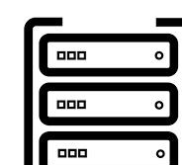

System Design
Design Description
Flowchart / Data Flow Diagram
Steps to be taken by the advisor to analyse and make decisions
Stacks of Data received form Database.
Datasets
3.. Data Sent
2. .Request Data
1 .Request Data
4. Retrieved Data
Stacks of Data to Analyze

Slide 15
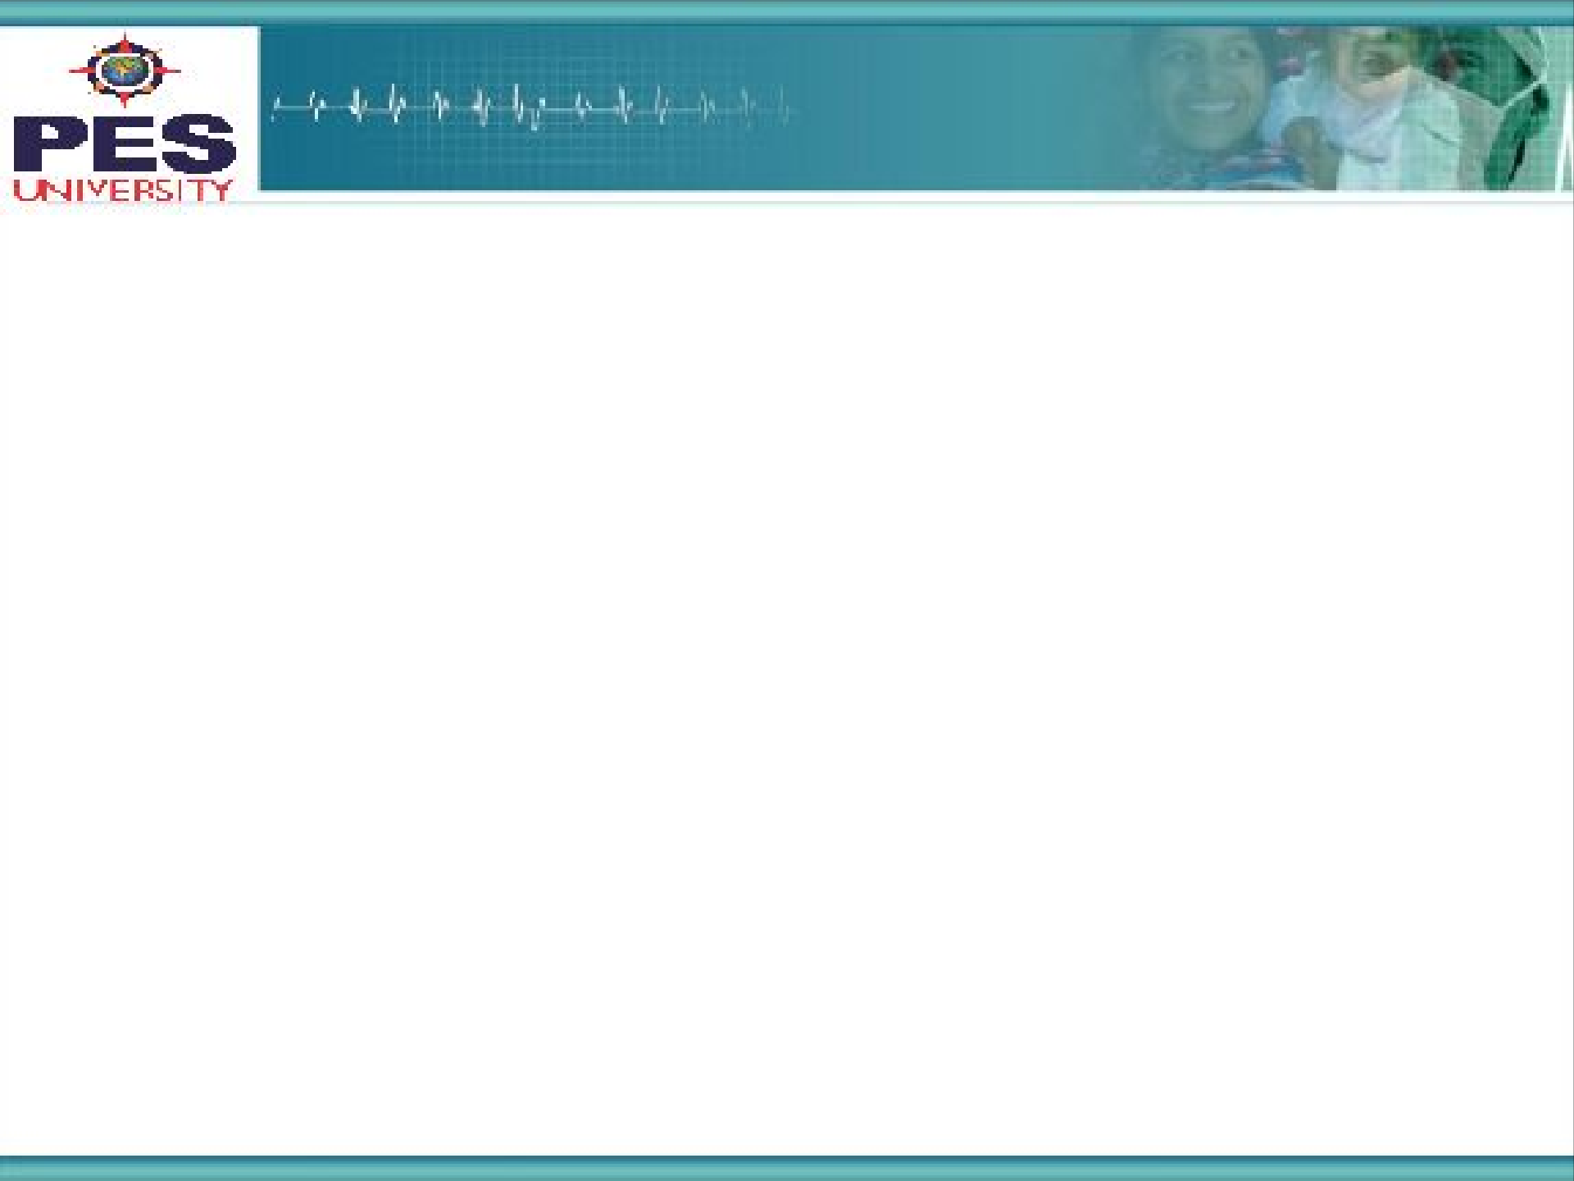
Technologies Used
The Technologies we are planning to use and the reason for doing so:
Python, Firebase, Rest API, JS, Bootstrap, React
Reason:
Python will be used to send requests to Binance using their REST Api and syntax is easy.
Firebase: For storing fluctuating data.
JS,Bootstrap, React: Best for front end and all devices.

Slide 16
Project Progress So far
The Project Progress so far:
Accounts with API access on Binance has been made. Backend part ,which includes connecting to Binance, getting Coin prices, checking which coin has the largest traded volume, and storing the extracted data in a local MySql server has been achieved. We can go for firebase services in the future considering the complexity of handing real-time data in MySql.
The percentage completion of the project:
75%

Slide 17
Conclusion
Things to be done:
Adding the Bootstrap frameworks to the user interface
Understanding the Graphs obtained based on Historical Datasets for applying different modular trading strategies.
Building algorithm models for RSI, Moving Averages strategy.

Slide 18
References
List of Papers referred:
Paper 1:
Real Time monitoring of Bitcoin prices on several Cryptocurrency markets using Web API, Telegram Bot, MySQL Database, and PHP-Cron Job
Paper 2:
Cryptocurrencies Transactions Advisor Using a Genetic Mamdani-type Fuzzy Rules Based System
Paper 3:
Bitcoin Price prediction using Machine Learning
Paper 4:
Awoke 2021 – Price prediction using Deep Learning

Slide 19
Thank You

