Slide 1
Capstone Project
Project Title : Online Batch Job Scheduling System
Course : Design and Analysis of Algorithms
Roll No : CH.SC.U4CSE24118
Notes:
Good morning sir. My DAA Capstone project is titled Online Batch Job Scheduling System.
In modern computing environments such as cloud platforms or distributed systems, thousands or even millions of jobs arrive continuously. Each job requires certain computational resources and has a deadline.

Slide 2
Problem Statement (In short) :
Number 3 : (What does future hold?)
Design a batch processing scheduler that selects N jobs for today’s execution from a set of pending jobs. Each job has a compute requirement (Cᵢ) and a deadline (Dᵢ). The scheduler must ensure that selected jobs can be completed before their deadlines, while balancing the compute load across days for system stability.
Since future job arrivals are unknown, the scheduler must make robust decisions using only current information, ensuring today's selection remains efficient even if more urgent jobs appear later.
Output Format: List of N jobs selected for execution today.
Notes:
The problem asks us to design a batch processing scheduler.
Each job has two parameters:
Ci, which represents the compute requirement
Di, which represents the job deadline.
From the set of pending jobs, the scheduler must select N jobs for today's execution.
The challenge is that future job arrivals are unknown, which means the system must make decisions using only the currently available jobs.
Because of this uncertainty, the scheduler must make robust decisions so that today's scheduling remains efficient even if more urgent jobs arrive later.
The output of the algorithm is simply the list of N jobs selected for execution today

Slide 3
Understanding and Analyzing The Problem
The problem is more related to a Online Job Scheduling System where decisions must be made without knowledge of future
inputs.
Challenges given :
Deadline sensitivity
Compute load variability
No look-ahead capability - Future job arrivals are unknown.
Key Insight from my understanding :
To maintain stability we need to ensure 2 things :
Firstly, earlier deadline should be of more priority (Major)
Secondly, computing load which is chosen should be small (This happens if 2 deadlines are equal)
Missing a deadline is far worse than having a small imbalanced load in a day (This is why I have taken deadline as the first priority)
This solution ensures :
Urgent jobs are handled
Workload remains smooth (Over an average)
Scheduling remains robust under uncertainty.
Notes:
This problem falls under Online Job Scheduling Systems.
In online scheduling, decisions must be made without knowledge of future inputs.
There are three major challenges.
First is deadline sensitivity. Jobs close to their deadlines must be prioritized to avoid expiration.
Second is compute load variability. Some jobs require large computational resources, which can overload the system if scheduled together.
Third is lack of look-ahead capability, meaning we cannot predict future job arrivals.
From analyzing these challenges, we derive two key insights.
First, earlier deadlines should always be given higher priority. Second, when deadlines are equal, we should choose jobs with smaller compute requirements.
Missing a deadline is far worse than having a slightly unbalanced workload. That is why deadline priority is the primary factor.
This approach ensures urgent jobs are handled, workload remains smooth, and scheduling stays robust under uncertainty.

Slide 4
Algorithmic Approach & Design (Inc. Justification)
Design of the Algo
Input: Jobs J with compute C_i and deadline D_i
Input: Current day T
Input: Number of jobs to schedule N
1. Remove all jobs where D_i < T
2. Sort remaining jobs by:
a) Earliest deadline first
b) Smallest compute requirement
3. Select first N jobs from sorted list
4. Execute selected jobs
5. Store remaining jobs as backlog
6. Compute metrics:
total compute load
backlog size
expired job count
Why This Algo ?
There could have been more possibilities :
EDF + SCF -> (Most efficient)
EDF + LCF -> (Okay moderately)
EDF + RCF -> (Better than LCF)
NOT EDF -> (Worst among all)
Abbreviations :
EDF -> Early Deadline First
LCF -> Larger Compute First
SCF -> Shorter Compute First
RCF -> Random Compute First
Notes:
The algorithm follows a greedy scheduling strategy combined with merge sort.
The algorithm works in six main steps.
First, we remove all expired jobs, meaning jobs whose deadline is earlier than the current day.
Second, we sort the remaining jobs using two priorities:
Earliest Deadline First
Smallest Compute Requirement
Sorting is implemented using merge sort, which guarantees O(n log n) performance.
Third, we select the first N jobs from the sorted list.
Fourth, these jobs are executed for today's batch.
Fifth, any remaining jobs are stored as a backlog for future scheduling.
Finally, the system calculates metrics such as total compute load and backlog size.
This approach ensures urgent jobs are prioritized while maintaining balanced system workload

Slide 5
Clear Justification Of Algorithm (By comparing)
Strategy | Deadline Handling | Load Balance | Robustness | Overall
EDF + SCF | Excellent | Smooth | High | Best
EDF + RCF | Good | Unpredictable | Medium | Moderate
EDF + LCF | Good | Load Spikes | Low | Below Average
No EDF | Poor | Poor | Very Low | Worst
EDF +SCF
Day1 : ████
Day2 : █████
Day3 : ████
Day4 : █████
EDF +LCF
Day1 : ███████████
Day2 : ██
Day3 : █
Day4 : ██
Notes:
To justify this algorithm, I compared several possible scheduling strategies.
The best approach is EDF plus SCF, which means Earliest Deadline First with Smallest Compute First.
This ensures urgent jobs are handled while keeping workload balanced.
Another possible strategy is EDF plus RCF, where compute priority is random. This works but produces unpredictable load distribution.
EDF plus LCF, meaning Largest Compute First, schedules heavy jobs early and often creates load spikes.
The worst strategy is not prioritizing deadlines, which may cause jobs to miss deadlines.
Therefore, EDF plus SCF provides the best combination of deadline satisfaction, balanced workload, and robustness.
This diagram shows why SCF is better than LCF.
With EDF + SCF, the workload is distributed smoothly across days.
With EDF + LCF, heavy jobs are executed early, causing large compute spikes followed by very low workloads.
These spikes can overload the system and reduce flexibility for handling future jobs.

Slide 6
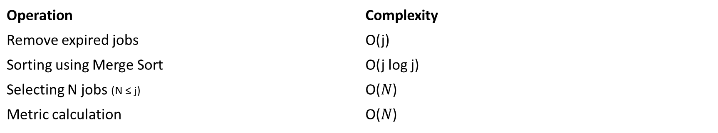
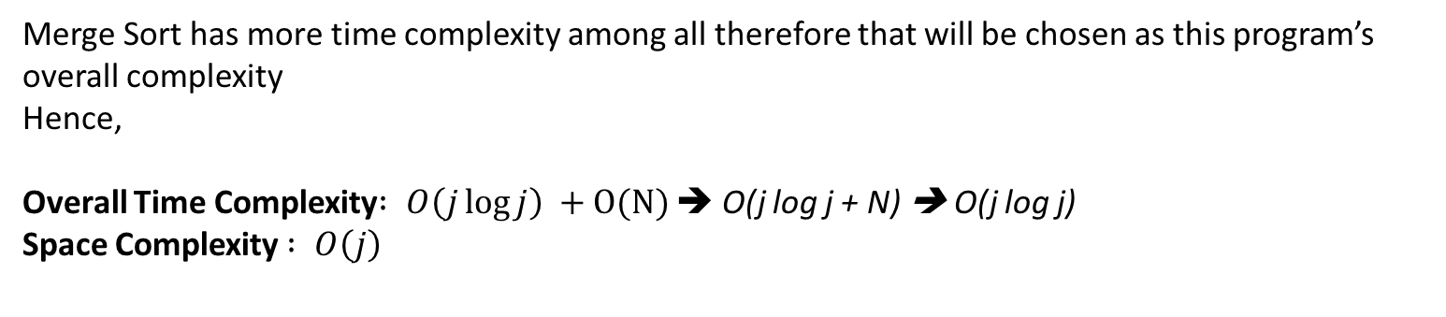
Algorithmic Analysis on Asymptotic Notations
Let j be the number of jobs.
Operation | Complexity
Remove expired jobs | O(j)
Sorting using Merge Sort | O(j log j)
Selecting N jobs (N ≤ j) | O($N$)
Metric calculation | O($N$)
Merge Sort has more time complexity among all therefore that will be chosen as this program’s overall complexity
Hence,
Overall Time Complexity$: O\left(j\log{j}\right) +O(N)$ ➔ O(j log j + N) ➔ O(j log j)
Space Complexity$: O\left(j\right)$
Notes:
Next we analyze the algorithm using asymptotic notations.
Let j represent the number of jobs.
Removing expired jobs takes O(j) time.
Sorting jobs using merge sort takes O(j log j) time.
Selecting N jobs and computing metrics both take O(j) time.
Among these operations, sorting dominates the running time.
Therefore the overall time complexity is O(j log j).
The space complexity is O(j) due to the temporary arrays used in merge sort

Slide 7
Example Problem (Solved in 2 ways) :
Available jobs today: (Current Day 5)
Job | Compute (Ci) | Deadline (Di)
J1 | 10 | 6
J2 | 2 | 6
J3 | 3 | 6
J4 | 4 | 7
J5 | 5 | 7
 |  | N = 2
Tomorrow a very urgent job will arrive (assume)
Job | Compute | Deadline
J6 | 4 | 6
Notes:
To demonstrate why the algorithm works better, let us consider this example.
Assume today is Day 5 and we need to select N = 2 jobs.
We have several jobs with different compute requirements and deadlines.
Now we compare two strategies.
First is EDF + LCF, where the largest compute job is selected first. This results in selecting jobs J1 and J3 with a total compute load of 13, which creates a heavy workload spike.
Second is EDF + SCF, where smaller compute jobs are selected first. This results in selecting jobs J2 and J3 with a total compute load of 5, which is much more balanced.
This example clearly shows that EDF + SCF prevents workload spikes and keeps the system more stable

Slide 8
Solution
Methods Jobs Selected Today Compute Load
EDF + LCF J1, J3 13 (Heavy spike)
EDF + SCF J2, J3 5 (Balanced)
EDF + LCF tends to schedule large compute jobs early, which can cause system load spikes and reduce flexibility for future urgent jobs.
EDF + SCF keeps the workload balanced, making the scheduler more robust in online environments where future jobs are unknown.
Notes:
To demonstrate why the algorithm works better, let us consider this example.
Assume today is Day 5 and we need to select N = 2 jobs.
We have several jobs with different compute requirements and deadlines.
Now we compare two strategies.
First is EDF + LCF, where the largest compute job is selected first. This results in selecting jobs J1 and J3 with a total compute load of 13, which creates a heavy workload spike.
Second is EDF + SCF, where smaller compute jobs are selected first. This results in selecting jobs J2 and J3 with a total compute load of 5, which is much more balanced.
This example clearly shows that EDF + SCF prevents workload spikes and keeps the system more stable.

Slide 9
Key Concepts & Working
Greedy Approach (Local best choice is made at every point)
Divide and Conquer (Merge Sort)
Job scheduling (Robust)
System Working
User inputs jobs with compute units and deadlines.
Scheduler removes expired jobs.
Jobs are sorted using Earliest Deadline First (EDF) + compute priority (smallest first).
First N jobs are selected for execution.
Remaining jobs form the backlog for future scheduling.
Links :
BatchSched — Sign In
Ganath-Avinash/BatchSched: A clear batch scheduling algorithm to avoid future conflicts in scheduling process
Notes:
This solution is based on three key algorithmic concepts.
First is the Greedy Algorithm, where the locally optimal decision is made at each step.
Second is Divide and Conquer, which is used in merge sort to efficiently sort jobs.
Third is Robust Job Scheduling, where decisions remain effective even when future jobs are unknown.
The system works as follows.
The user inputs jobs with compute units and deadlines. The scheduler removes expired jobs. The remaining jobs are sorted using Earliest Deadline First with compute priority. The first N jobs are selected for execution, while remaining jobs form the backlog

Slide 10
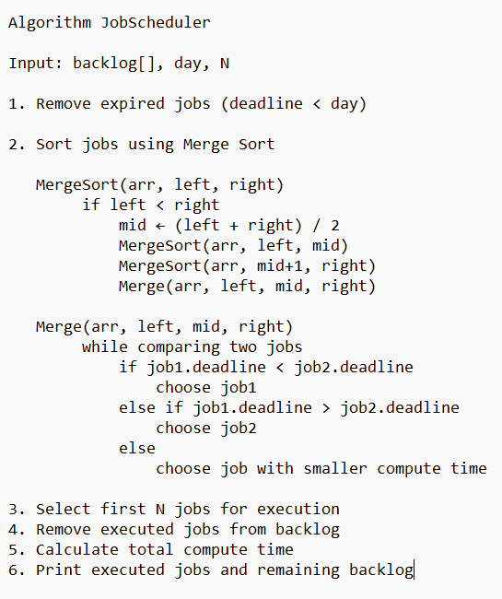
Pseudocode :
Method of sorting with a priority almost solves half the problem
Notes:
This project was implemented in two forms.
First, a CLI-based scheduler written in C, which demonstrates the algorithm execution , and here Is the pseudocode for it.
Second, a web-based interface, which visually shows job scheduling results.
The system can run for single-day scheduling as well as multi-day scheduling simulations.
These implementations demonstrate the practical applicability of the algorithm.”

Slide 11
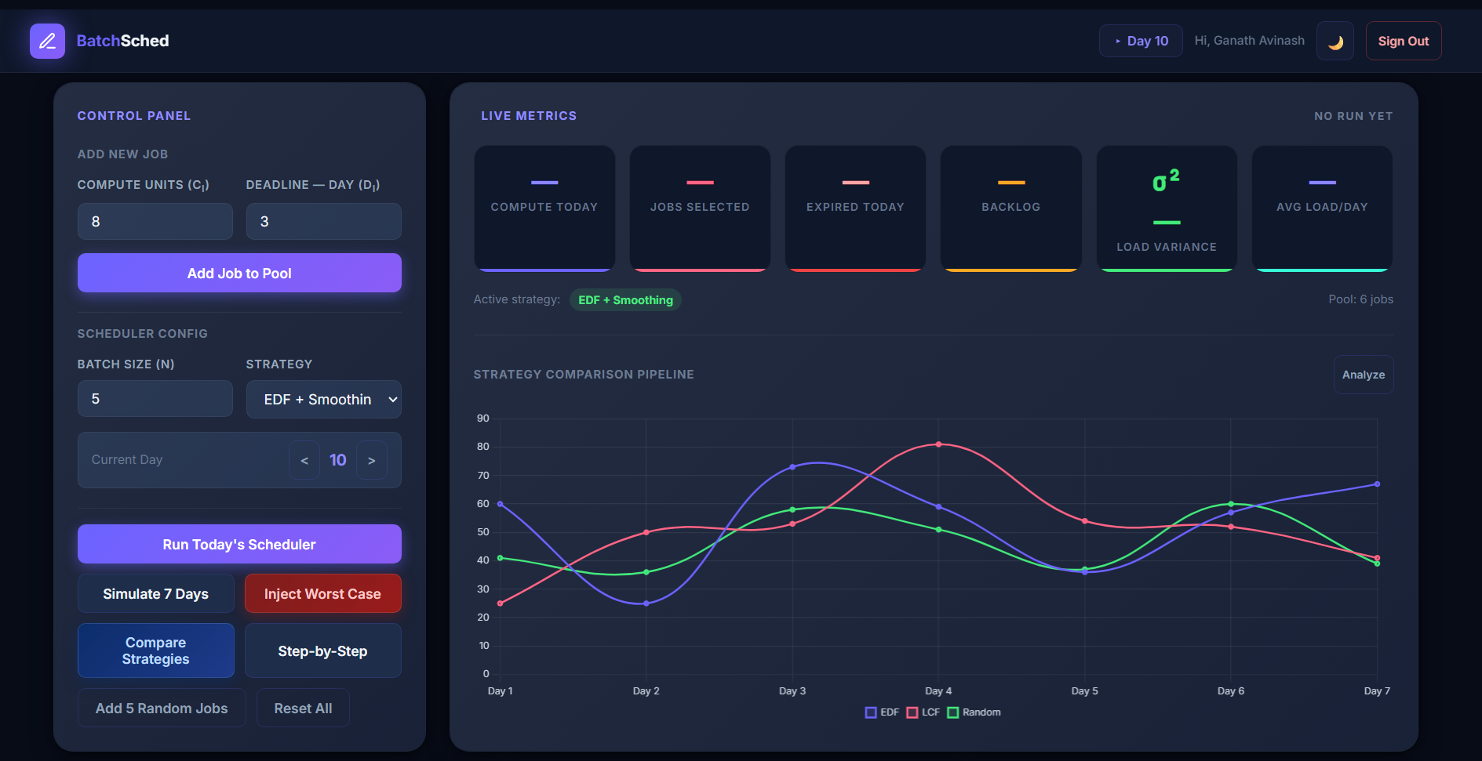
Outputs (Web, CLI)

Slide 12
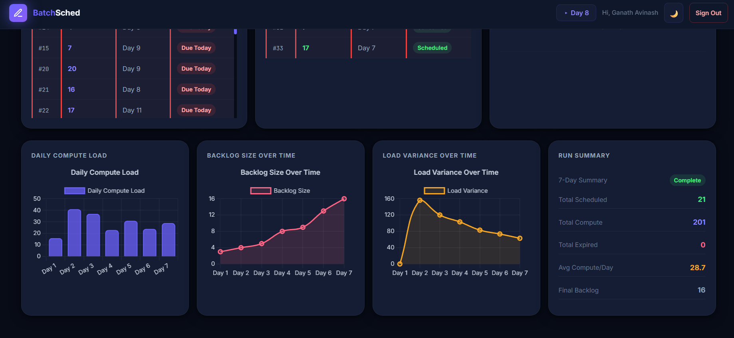
Output (Web)

Slide 13
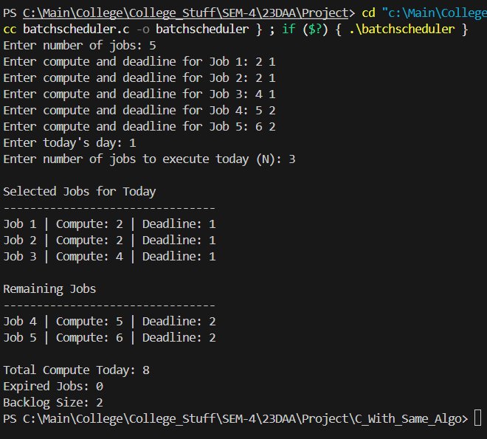
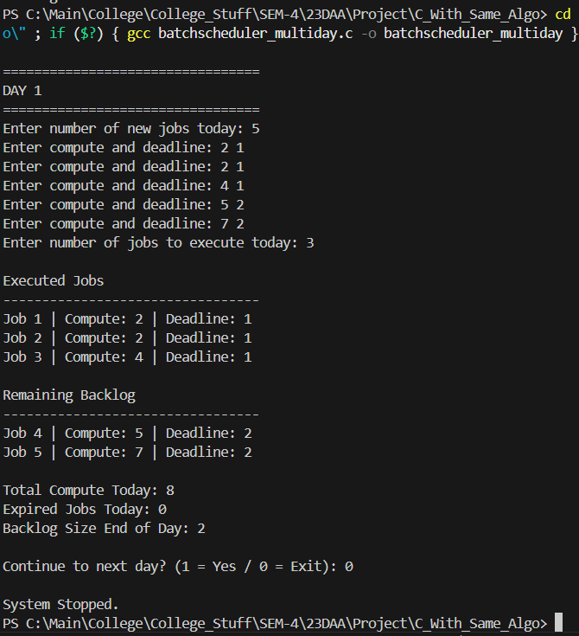
CLI (Simple sample IP & OP)
Single Day Program
Multi Day Program
Notes:
To conclude, this project presents an efficient solution for online batch job scheduling.
By combining Earliest Deadline First with Smallest Compute First, the algorithm ensures deadline satisfaction while maintaining balanced system workload.
The algorithm runs in O(n log n) time and performs well even when future job arrivals are unknown.
This makes the approach suitable for real-world systems such as cloud computing platforms and large-scale batch processing systems.
Thank you.

Slide 14
Thank You

