Slide 1
Introduction to Dynamic Web Content
Notes:
Note from Chuck. If you are using these materials, you can remove my name and URL from this replace it with your own, but please retain the CC-BY logo on the first page as well as retain the entire last page when you remix and republish these slides.

Slide 2

Application
Software (i.e. PHP)
Database
Data Model
End
User
SQL
SQL
Developer
Database
Tools (i.e. phpMyAdmin)
DBA

Slide 3
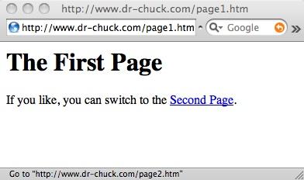

Browser
HTML
CSS
DOM
JavaScript
JQuery
Web Server
PHP
MySQL
Apache
http://www.dr-chuck.com/page1.htm

Slide 4
HTTP - Hypertext Transfer Protocol
The dominant Application Layer Protocol on the Internet
Invented for the Web - to Retrieve HTML, Images, Documents etc
Extended to be data in addition to documents - RSS, Web Services, etc..
Basic Concept - Make a Connection - Request a document - Retrieve the Document - Close the Connection
http://en.wikipedia.org/wiki/Http

Slide 5
Uniform Resource Locator
http://www.dr-chuck.com/page1.htm
protocol
host
document

Slide 6
Getting Data From The Server
Each the user clicks on an anchor tag with an href= value to switch to a new page, the browser makes a connection to the web server and issues a “GET” request - to GET the content of the page at the specified URL
The server returns the HTML document to the Browser which formats and displays the document to the user.

Slide 7
Web Server
80
Browser

Slide 8
Web Server
80
Browser
Click

Slide 9
Request
Web Server
80
GET http://www.dr-chuck.com/page2.htm
Browser
Click

Slide 10
Request
Web Server
80
GET http://www.dr-chuck.com/page2.htm
Browser
Click

Slide 11
Request
Web Server
Response
80
<h1>The Second Page</h1><p>If you like, you can switch back to the <a href="page1.htm">First Page</a>.</p>
GET http://www.dr-chuck.com/page2.htm
Browser
Click

Slide 12
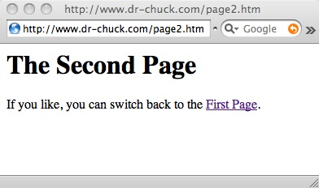
Request
Web Server
Response
80
<h1>The Second Page</h1><p>If you like, you can switch back to the <a href="page1.htm">First Page</a>.</p>
GET http://www.dr-chuck.com/page2.htm
Browser
Click
Parse/
Render

Slide 13
Advanced Concepts
- Internet Standards
- Making an HTTP Request

Slide 14
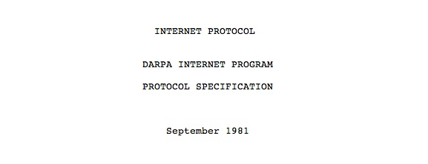
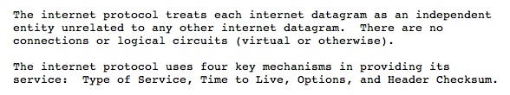
Internet Standards
The standards for all of the Internet protocols (inner workings) are developed by an organization
Internet Engineering Task Force (IETF)
www.ietf.org
Standards are called “RFCs” - “Request for Comments”
Source: http://tools.ietf.org/html/rfc791

Slide 15
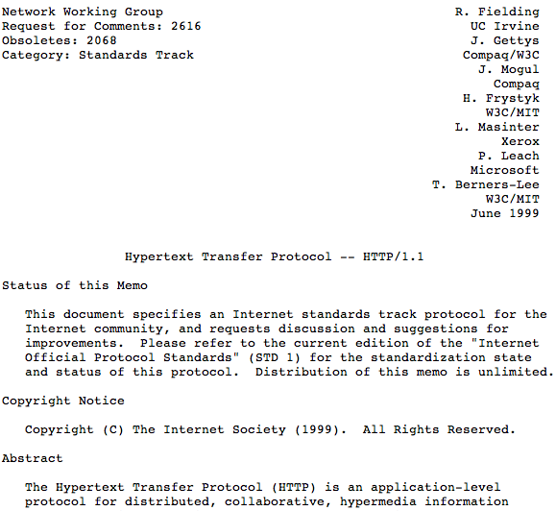
http://www.w3.org/Protocols/rfc2616/rfc2616.txt

Slide 16
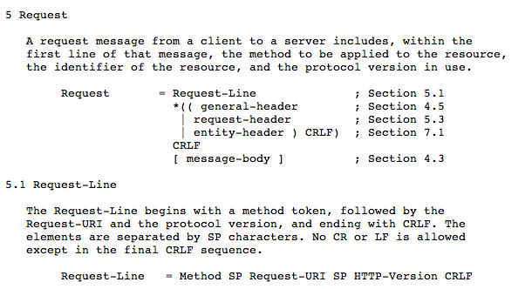

Slide 17
Making an HTTP request
Connect to the server like www.dr-chuck.com
      a "hand shake"
Request a document (or the default document)
      GET http://www.dr-chuck.com/page1.htm HTTP/1.0
      GET http://www.mlive.com/ann-arbor/ HTTP/1.0
      GET http://www.facebook.com HTTP/1.0

Slide 18
Web Server
$ telnet www.dr-chuck.com 80
Trying 74.208.28.177...
Connected to www.dr-chuck.com.Escape character is '^]'.
GET http://www.dr-chuck.com/page1.htm HTTP/1.0
HTTP/1.1 200 OK
Date: Thu, 08 Jan 2015 01:57:52 GMT
Last-Modified: Sun, 19 Jan 2014 14:25:43 GMT
Connection: close
Content-Type: text/html
<h1>The First Page</h1>
<p>If you like, you can switch to
the <a href="http://www.dr-chuck.com/page2.htm">Second
Page</a>.</p>
Connection closed by foreign host.
Browser

Slide 19

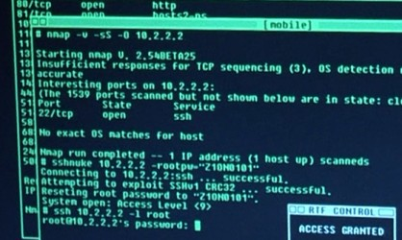
Accurate Hacking in the Movies
Matrix Reloaded
Bourne Ultimatum
Die Hard 4
...
http://nmap.org/movies.html

Slide 20
Getting to Know Our Browsers
Practical Skills

Slide 21
Find Developer Mode
Chrome: View->Developer
FireFox: https://getfirebug.com/
Safari: Preferences -> Advanced -> Show Develop Menu

Slide 22
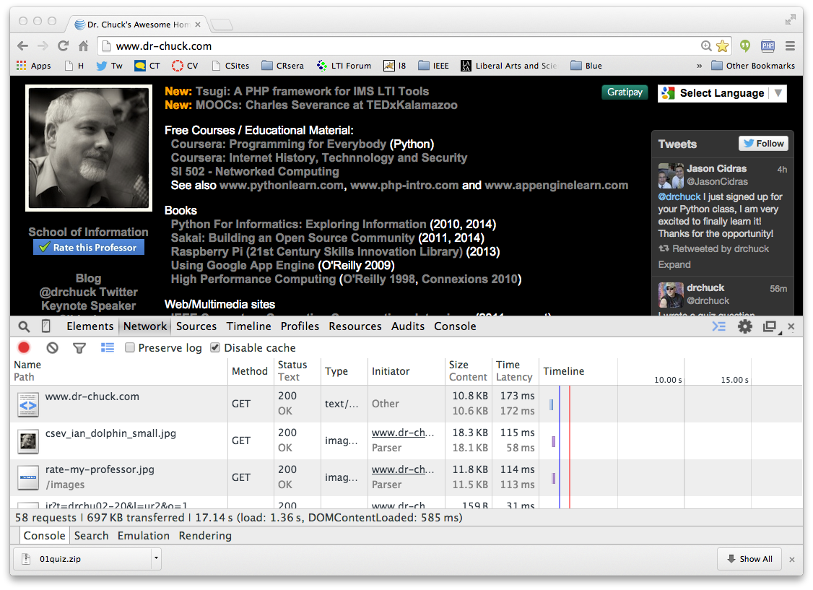
DEMO

Slide 23
Request
Web Server
Response
80
<h1>The Second Page</h1><p>If you like, you can switch back to the <a href="page1.htm">First Page</a>.</p>
GET http://www.dr-chuck.com/page2.htm
Browser
Click
Parse/
Render

Slide 24
This is only the beginning…
In the Browser – HTML, CSS, "Document Object Model" (the DOM) and JavaScript
In the Web Server – Apache(or similar) web server with a PHP extension installed
In the Database Server running MySQL, Postgress, Oracle, SQL Server or similar

Slide 25
Time
Browser
Web Server
Database Server
D
OM
Apache
static
files
MySql
Parse
Request
Parse
Response
PHP
php
code
JavaScript
RRC/HTTP
SQL

Slide 26
Summary
Many modern web applications use a stack of open source software working together
While you can use frameworks to accelerate productivity, this course focuses on what is really going on so you can fully understand what frameworks are doing on your behalf

