Slide 1
Form Processing in PHP

Slide 2
PHP Global Variables
Part of the goal of PHP is to make interacting with HTTP and HTML as easy as possible.
PHP processes the incoming HTTP request based on the protocol specifications and drops the data into various super global variables (usually arrays).

Slide 3
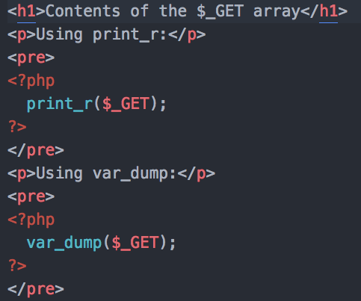
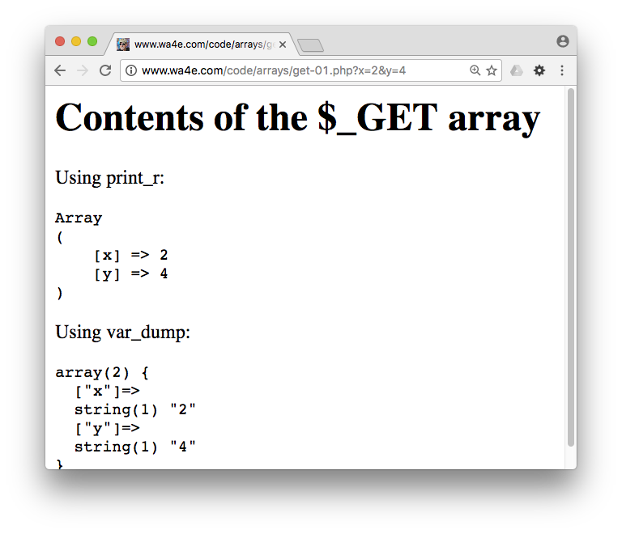
(Review from Arrays)
http://www.wa4e.com/code/arrays/get-01.php

Slide 4


Time
Browser
Web Server
Database Server
DOM
Apache
static
files
MySql
get-01.php?x=2
Parse
Request
Parse
Response
$_GET
PHP
php
code
ind.php
JavaScript
RRC/HTTP
SQL

Slide 5
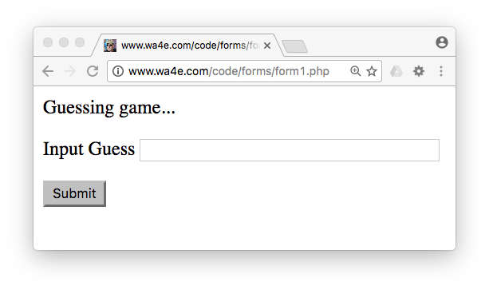
Forms – User Input / Action
<p>Guessing game...</p>
<form>
<p><label for="guess">Input Guess</label>
<input type="text" name="guess" id="guess"/></p>
<input type="submit"/>
</form>
http://www.wa4e.com/code/forms/form1.php

Slide 6
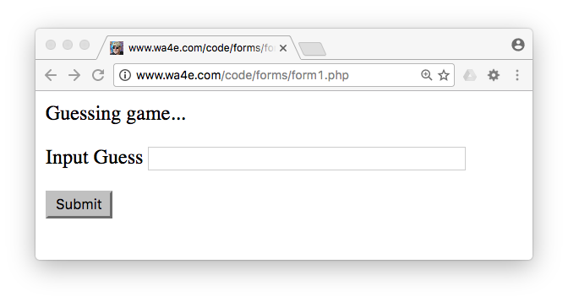


form1.php
Forms Submit Data
<p>Guessing game...</p>
<form>
<p><label for="guess">Input Guess</label>
<input type="text" name="guess" id="guess"/></p>
<input type="submit"/>
</form>

Slide 7
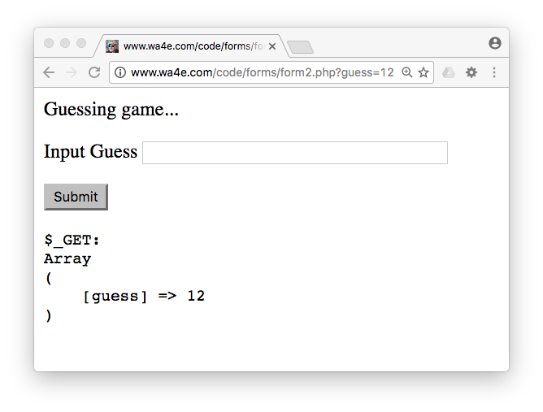
form2.php
<p>Guessing game...</p>
<form>
<p><label for="guess">Input Guess</label>
<input type="text" name="guess" id="guess"/></p>
<input type="submit"/>
</form>
<pre>
$_GET:
<?php
print_r($_GET);
?>
</pre>

Slide 8
GET and POST with Forms

Slide 9
Time
Browser
Web Server
Database Server
DOM
Apache
static
files
MySql
Parse
Request
Parse
Response
$_POST
PHP
php
code
form1.php
JavaScript
RRC/HTTP
SQL

Slide 10
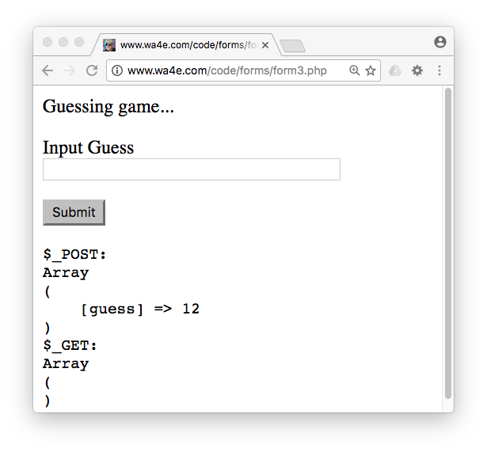
<p>Guessing game...</p>
<form method="post">
<p><label for="guess">Input Guess</label>
<input type="text" name="guess" size="40" id="guess"/></p>
<input type="submit"/>
</form>
<pre>
$_POST:
<?php
print_r($_POST);
?>
$_GET:
<?php
print_r($_GET);
?>
</pre>
form3.php

Slide 11
Forms GET vs. POST
Two ways the browser can send parameters to the web server
    GET - Parameters are placed on the URL which is retrieved.
    POST - The URL is retrieved and parameters are appended to the request in the HTTP connection.

Slide 12
Passing Parameters to The Server
GET /form1.php?guess=42
Accept: text/html
User-Agent: Lynx/2.4 libwww/2.14
Web Server
HTTP
Request
POST /form3.php
Accept: text/html
User-Agent: Lynx/2.4 libwww/2.14
Content-type: application/x-www-form-urlencoded
Content-length: 13
guess=42
Browser
<input type="text" name="guess" id="yourid" />

Slide 13
Time
Browser
Web Server
Database Server
DOM
Apache
static
files
MySql
Parse
Request
Parse
Response
$_POST
PHP
php
code
form3.php
JavaScript
RRC/HTTP
SQL

Slide 14
Rules of the POST/GET Choice
POST is used when data is being created or modified.
GET is used when you are reading or searching things.
Web search spiders will follow GET URLs but generally not POST URLs.
GET URLs should be “idempotent” - the same URL should give the “same thing” each time you access it.
GET has an upper limit of the number of bytes of parameters and values (think about 2K).

Slide 15
Form Input Types

Slide 16
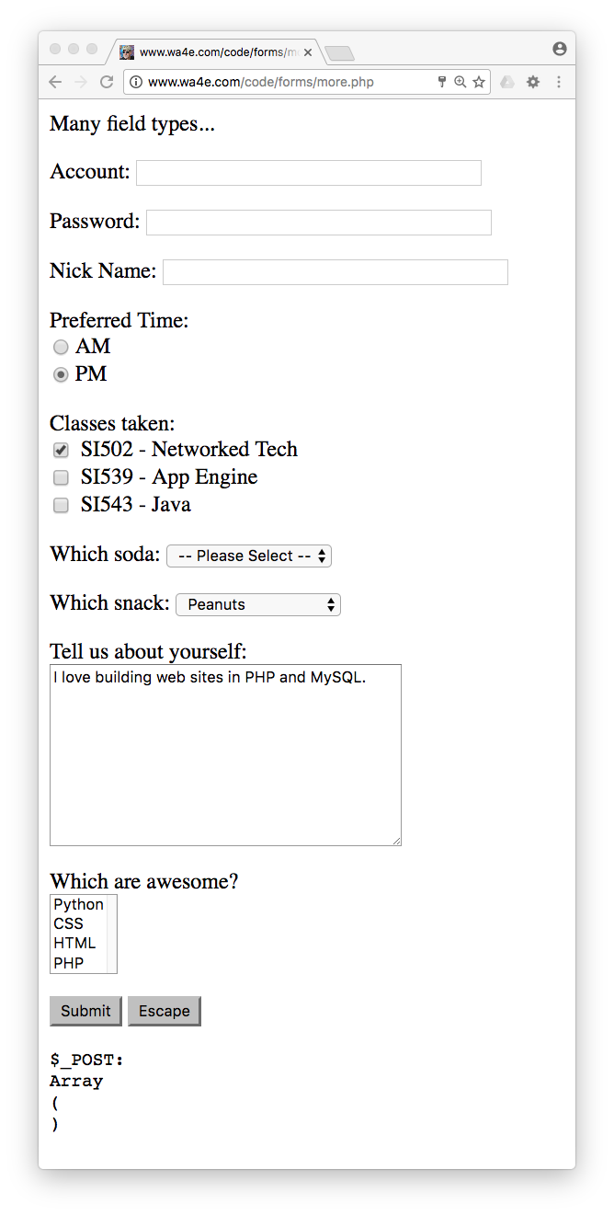
Other Input Types
Text
Password
Radio Button
Check Box
Select / Drop-Down
Textarea
http://www.wa4e.com/code/forms/more.php

Slide 17
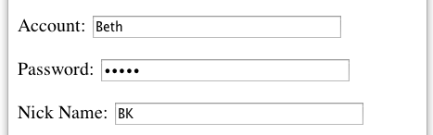
more.php
<p>Many field types...</p>
<form method="post" action="more.php">
<p><label for="inp01">Account:</label>
<input type="text" name="account" id="inp01" size="40" ></p>
<p><label for="inp02">Password:</label>
<input type="password" name="pw" id="inp02" size="40" ></p>
<p><label for="inp03">Nick Name:</label>
<input type="text" name="nick" id="inp03" size="40" ></p>
$_POST:
Array
(
[account] => Beth
[pw] => 12345
[nick] => BK
[when] => pm
...
)

Slide 18
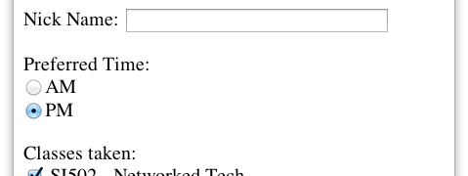
more.php
<p>Preferred Time:<br/>
<input type="radio" name="when" value="am">AM<br>
<input type="radio" name="when" value="pm" checked>PM</p>
$_POST:
Array(
...
[nick] => BK
[when] => pm
[class] => si502
...
)

Slide 19
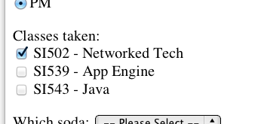
<p>Classes taken:<br/>
<input type="checkbox" name="class1" value="si502" checked>
SI502 - Networked Tech<br>
<input type="checkbox" name="class2" value="si539">
SI539 - App Engine<br>
<input type="checkbox" name="class3">
SI543 - Java<br> </p>
$_POST:
Array(
...
[when] => pm
[class1] => si502
[soda] => 0
...
)
$_POST:
Array(
...
[when] => pm
[class3] => on
[soda] => 0
...
)

Slide 20
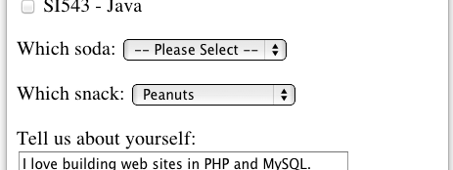
<p><label for="inp06">Which soda:
<select name="soda" id="inp06">
<option value="0">-- Please Select --</option>
<option value="1">Coke</option>
<option value="2">Pepsi</option>
<option value="3">Mountain Dew</option>
<option value="4">Orange Juice</option>
<option value="5">Lemonade</option>
</select>
</p>
more.php
$_POST:
Array(
...
[class] => si502
[soda] => 0
[snack] => peanuts
...
)
The values can be any string, but numbers are used quite often.

Slide 21
more.php
<p><label for="inp07">Which snack:
<select name="snack" id="inp07">
<option value="">-- Please Select --</option>
<option value="chips">Chips</option>
<option value="peanuts" selected>Peanuts</option>
<option value="cookie">Cookie</option>
</select>
</p>
$_POST:
Array(
...
[class] => si502
[soda] => 0
[snack] => peanuts
...
)

Slide 22
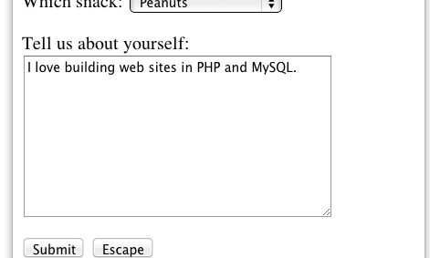
more.php
<p><label for="inp08">Tell us about yourself:<br/>
<textarea rows="10" cols="40" id="inp08" name="about">
I love building web sites in PHP and MySQL.
</textarea>
</p>
$_POST:
Array(
...
[about] => I love building web sites in PHP and MySQL.
[dopost] => Submit
...
)

Slide 23
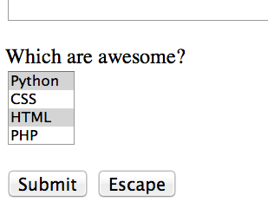
more.php
<p><label for="inp09">Which are awesome?<br/>
<select multiple="multiple" name="code[]" id="inp09">
<option value="python">Python</option>
<option value="css">CSS</option>
<option value="html">HTML</option>
<option value="php">PHP</option>
</select>
$_POST:
Array(
...
[code] => Array
(
[0] => css
[1] => html
)
[dopost] => Submit
...
)

Slide 24
more.php
<p>
<input type="submit" name="dopost" value="Submit"/>
<input type="button"
onclick="location.href='http://www.wa4e.com/'; return false;"
value="Escape">
</p>
$_POST:
Array(
...
[dopost] => Submit
...
)
On submit input types, the text is both in the UI and in $_POST so we tend to look for the key, not the value.

Slide 25
HTML5 Input Types
HTML5 defines new input types
Not all browsers support all input types
They fall back to type="text"
http://www.w3schools.com/html/html5_form_input_types.asp

Slide 26
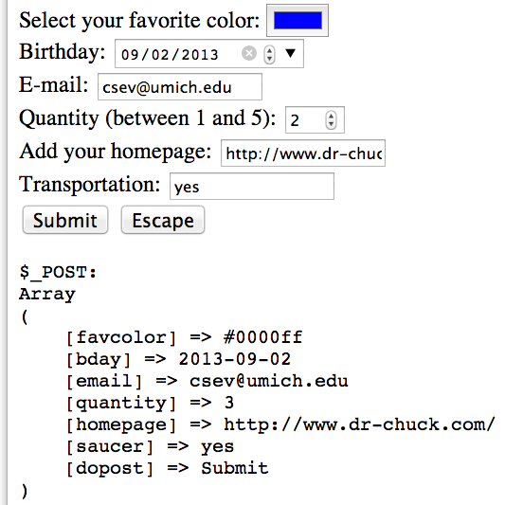
Select your favorite color:
<input type="color" name="favcolor" value="#0000ff"><br/>
Birthday:
<input type="date" name="bday" value="2013-09-02"><br/>
E-mail:
<input type="email" name="email"><br/>
Quantity (between 1 and 5):
<input type="number" name="quantity"
min="1" max="5"><br/>
Add your homepage:
<input type="url" name="homepage"><br>
Transportation:
<input type="flying" name="saucer"><br>
Validation happens when you press submit.
http://www.wa4e.com/code/forms/html5.php

Slide 27
Data Security / Integrity / Validation

Slide 28
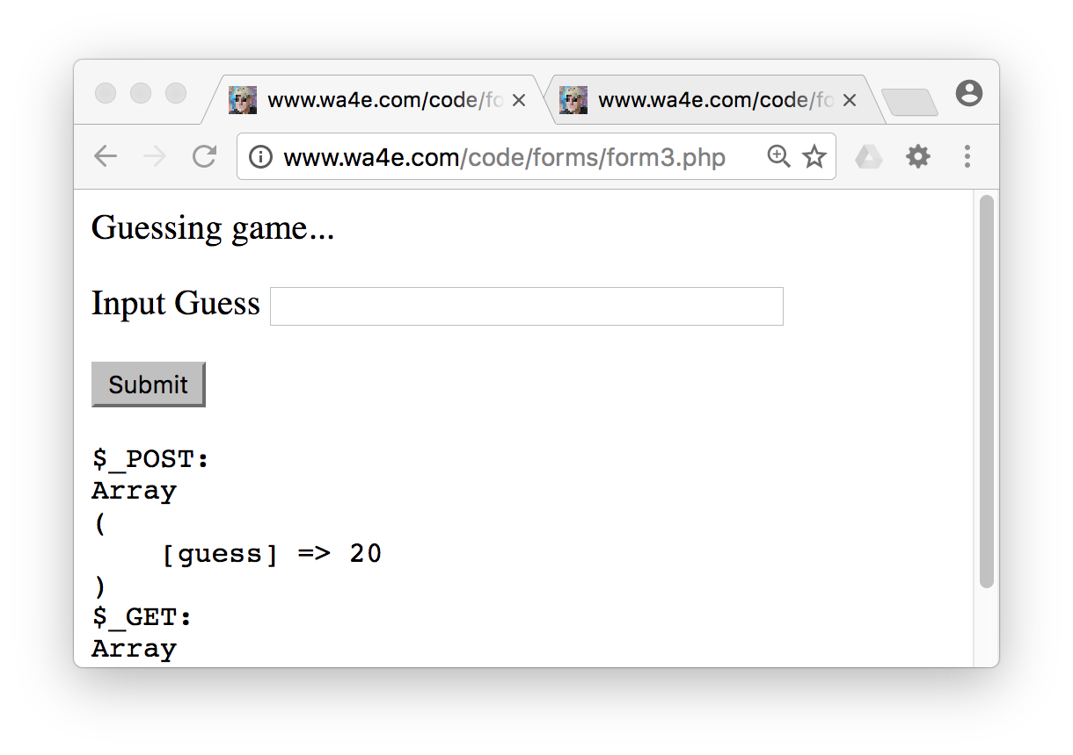
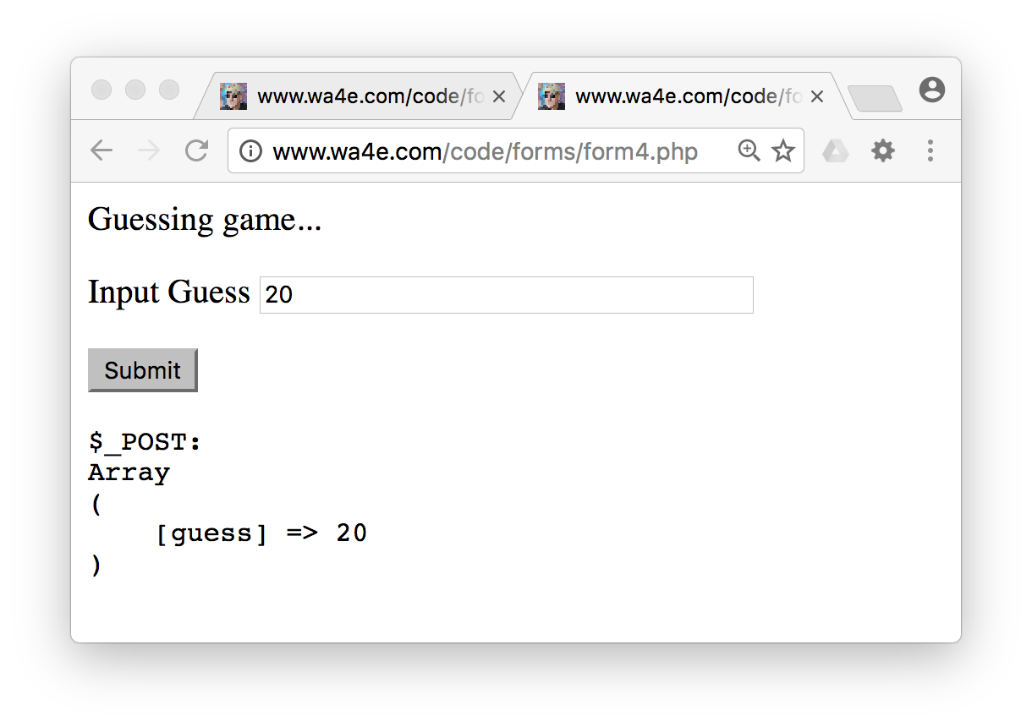
Persisting Form Data
When we submit forms and there is an error, we just expect that the data will remain in the form when the page is redisplayed.
The application needs to make sure to put the previous values back into the form.

Slide 29
<?php
$oldguess = isset($_POST['guess']) ? $_POST['guess'] : '';
?>
<p>Guessing game...</p>
<form method="post">
<p><label for="guess">Input Guess</label>
<input type="text" name="guess" id="guess"
size="40" value="<?= $oldguess ?>"/></p>
<input type="submit"/>
</form>
“Persisting”
Form Data
Across
Requests
form4.php
<?= $oldguess ?>
<?php echo($oldguess); ?>
Review: Ternary Operation

Slide 30
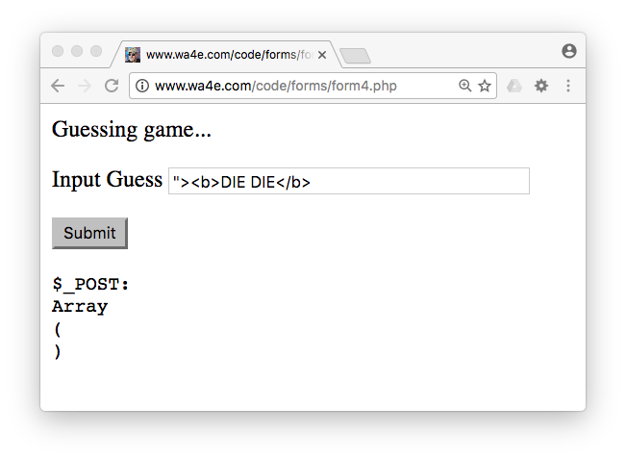
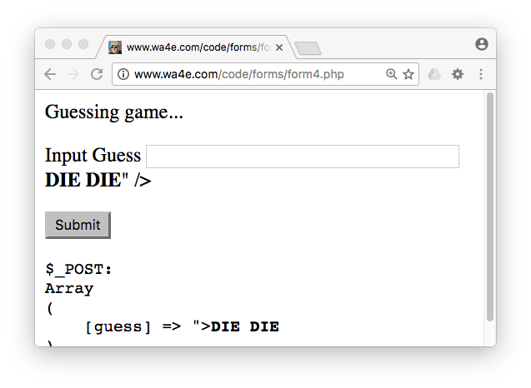
Hygiene Alert!
What happens when we use an HTML character in a form field value?

Slide 31
form4.php
<form method="post">
<p><label for="guess">Input Guess</label>
<input type="text" name="guess" id="guess
size="40" "value=""><b>DIE DIE</b>" /></p>
<input type="submit"/>
</form>

Slide 32
To The Rescue: htmlentities()
<form method="post">
<p><label for="guess">Input Guess</label>
<input type="text" name="guess" id="guess"
size="40" value="<?= htmlentities($oldguess) ?>"/></p>
<input type="submit"/>
</form>
form5.php

Slide 33
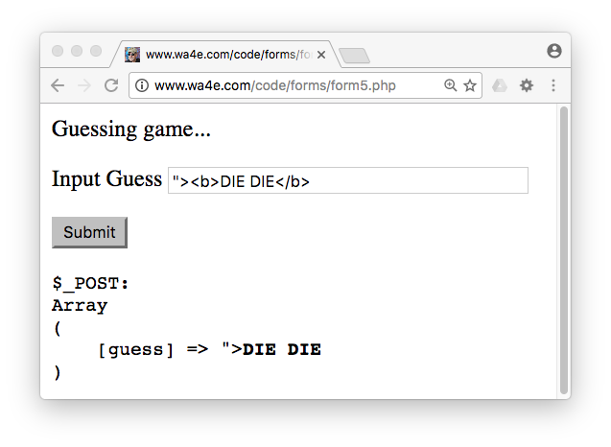
<form method="post">
<p><label for="guess">Input Guess</label>
<input type="text" name="guess" id="guess"
size="40" value="<?= htmlentities($oldguess) ?>"/></p>
<input type="submit"/>
</form>
<input type="text" name="guess" id="guess"
value="&quot;&gt;&lt;b&gt;DIE DIE&lt;/b&gt;" /></p>

Slide 34
In-Server Data Validation

Slide 35
Time
Browser
Web Server
Database Server
DOM
Apache
static
files
MySql
Parse
Request
Parse
Response
$_POST
PHP
php
code
form3.php
JavaScript
RRC/HTTP
SQL

Slide 36
Incoming Data Validation
Making sure all user data is present and the correct format before proceeding
  Non-empty strlen($var) > 0
  A number is_numeric($var)
  An email address strpos($var, '@') > 0
  Or filter_var($var, FILTER_VALIDATE_EMAIL) !== false
  ....

Slide 37
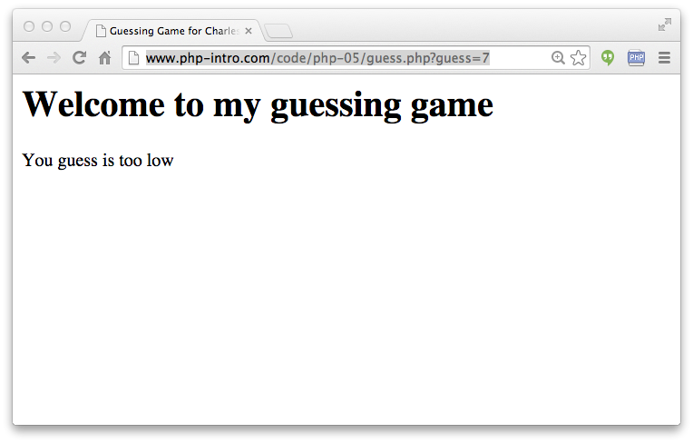
http://www.wa4e.com/code/forms/guess.php?guess=7

Slide 38
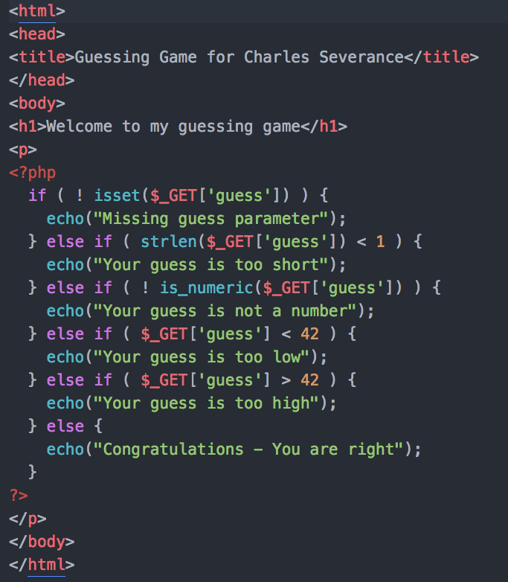
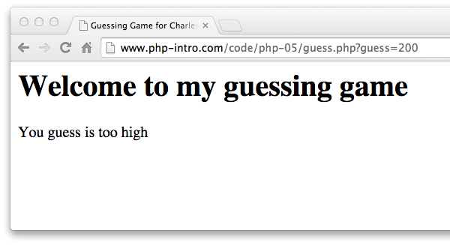
http://www.wa4e.com/code/forms/guess.php?guess=200

Slide 39
Summary
Forms, $_GET and $_POST
Form fields
New form fields in HTML5
Sanitizing HTML
Data Validation

