Slide 1
PHP Arrays
Notes:
Note from Anup. If you are using these materials, you can remove my name and URL from this replace it with your own, but please retain the CC-BY logo on the first page as well as retain the entire last page when you remix and republish these slides.

Slide 2
PHP Arrays Rock!
Better than Python Dictionaries
Better than Java Hash Maps
PHP Arrays have all the benefits of Python Dictionaries but they can also maintain the order of the items in the array
http://en.wikipedia.org/wiki/Associative_array

Slide 3
Associative Arrays
Can be key => value or simply indexed by numbers
Ignore two-dimensional arrays for now...
http://en.wikipedia.org/wiki/Associative_array

Slide 4
Integer Indices
<?php
$stuff = array("Hi", "There");
echo $stuff[1], "\n";
?>
There

Slide 5
Key / Value
<?php
$stuff = array("name" => "Chuck",
"course" => "WA4E");
echo $stuff["course"], "\n";
?>
Web 2

Slide 6
Dumping an Array
The function print_r() shows PHP data - it is good for debugging.
<?php
$stuff = array("name" => "Anup",
"course" => "Web 1");
echo("<pre>\n");
print_r($stuff);
echo("\n</pre>\n");
?>
Array(
[name] => Anup
[course] => Web 2
)

Slide 7
var_dump vs. print_r
<?php
$stuff = array("name" => "Anup",
"course" => "CIT 106");
var_dump($stuff);
?>
array(2) {
["name"]=>
string(5) "Anup"
["course"]=>
string(5) "SI664"
}

Slide 8
var_dump() and false
<?php
$thing = FALSE;
    echo("One\n");
    print_r($thing);
    echo("Two\n");
    var_dump($thing);
?>
One
Two
bool(false)
http://stackoverflow.com/questions/3406171/php-var-dump-vs-print-r

Slide 9
Building Up an Array
You can allocate a new item in the array and append a value at the same time using empty square braces [ ] on the right hand side of an assignment statement.
$va = array();
$va[] = "Hello";
$va[] = "World";
print_r($va);
Array(
[0] => Hello
[1] => World
)

Slide 10
Building Up an Array
You can also add new items in an array using a key.
$za = array();
$za["name"] = "Anup";
$za["course"] = "Web 2";
print_r($za);
Array(
[name] => Anup
[course] => Web 2
)

Slide 11
Looping Through an Array
<?php
$stuff = array("name" => "Anup",
"course" => "CIT 106");
foreach($stuff as $k => $v ) {
echo "Key=",$k," Val=",$v,"\n";
}
?>
Key=name Val=Anup
Key=course Val=CIT 106

Slide 12
Looping Through an Array
<?php
$stuff = array("Anup","CIT 106");
foreach($stuff as $k => $v ) {
echo "Key=",$k," Val=",$v,"\n";
}
?>
Key=0 Val=Anup
Key=1 Val=CIT 106

Slide 13
Counted Loop Through an Array
<?php
$stuff = array("Anup","CIT 106");
for($i=0; $i < count($stuff); $i++) {
echo "I=",$i," Val=",$stuff[$i],"\n";
}
?>
I=0 Val=Anup
I=1 Val=CIT 106

Slide 14
Arrays of Arrays
$products = array(
'paper' => array(
'copier' => "Copier & Multipurpose",
'inkjet' => "Inkjet Printer",
'laser' => "Laser Printer",
'photo' => "Photographic Paper"),
'pens' => array(
'ball' => "Ball Point",
'hilite' => "Highlighters",
'marker' => "Markers"),
'misc' => array(
'tape' => "Sticky Tape",
'glue' => "Adhesives",
'clips' => "Paperclips")
);
The elements of an array can be many things other than a string or integer. You can even have objects or other arrays.
echo $products["pens"]["marker"];
Markers

Slide 15
Array Functions

Slide 16
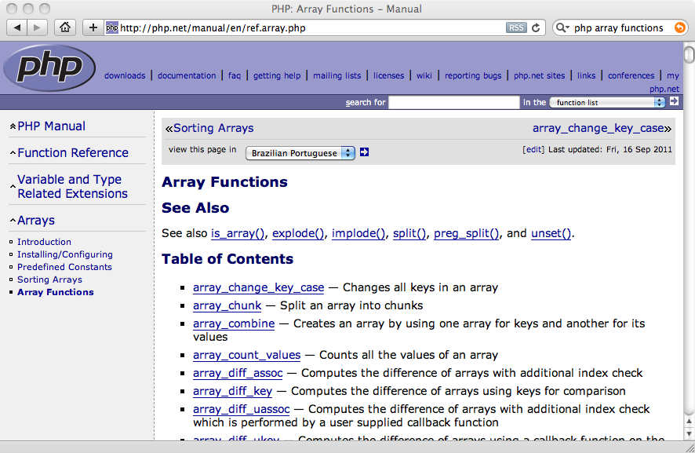

Slide 17
Array Functions
array_key_exists($key, $ar) - Returns TRUE if key is set in the array
isset($ar['key']) - Returns TRUE if key is set in the array
count($ar) - How many elements in an array
is_array($ar) - Returns TRUE if a variable is an array
sort($ar) - Sorts the array values (loses key)
ksort($ar) - Sorts the array by key
asort($ar) - Sorts array by value, keeping key association
shuffle($ar) - Shuffles the array into random order

Slide 18
Course exists
name is set
addr is not set
$za = array();
$za["name"] = "Anup";
$za["course"] = "Web 2";
if (array_key_exists('course',$za) ) {
echo("Course exists\n");
} else {
echo("Course does not exist\n");
}
echo isset($za['name']) ? "name is set\n" : "name is not set\n";
echo isset($za['addr']) ? "addr is set\n" : "addr is not set\n";

Slide 19
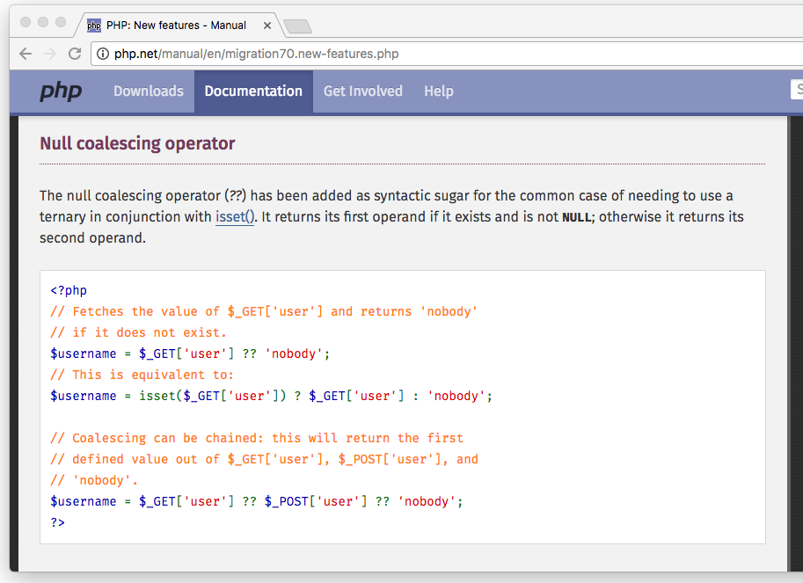

Slide 20
Null Coalesce
<?php
$za = array();
$za["name"] = "Anup";
$za["course"] = "Web 2";
// PHP >= 7.0.0 only
$name = $za['name'] ?? 'not found';
$addr = $za['addr'] ?? 'not found';
echo("Name=$name\n");
echo("Addr=$addr\n");
// PHP < 7.0.0 equivalent
$name = isset($za['name']) ? $za['name'] : 'not found';
Name=Anup
Addr=not found

Slide 21
Count: 2
$za Is an array
$za = array();
$za["name"] = "Anup";
$za["course"] = "Web 2";
print "Count: " . count($za) . "\n";
if ( is_array($za) ) {
echo '$za Is an array' . "\n";
} else {
echo '$za Is not an array' . "\n";
}

Slide 22
Array(
[name] => Anup
[course] => Web 2
[topic] => PHP
)
Array(
[0] => Anup
[1] => PHP
[2] => Web 2
)
$za = array();
$za["name"] = "Anup";
$za["course"] = "Web 2";
$za["topic"] = "PHP";
print_r($za);
sort($za);
print_r($za);

Slide 23
Array(
[name] => Anup
[course] => Web 2
[topic] => PHP
)
Array(
[course] => Web 2
[name] => Anup
[topic] => PHP
)
Array(
[name] => Anup
[topic] => PHP
[course] => Web 2
)
$za = array();
$za["name"] = "Anup";
$za["course"] = "Web 2";
$za["topic"] = "PHP";
print_r($za);
ksort($za);
print_r($za);
asort($za);
print_r($za);

Slide 24
Exploding Arrays
$inp = "This is a sentence with seven words";
$temp = explode(' ', $inp);
print_r($temp);
Array(
[0] => This
[1] => is
[2] => a
[3] => sentence
[4] => with
[5] => seven
[6] => words
)

Slide 25
Arrays and URL Parameters

Slide 26


Time
Browser
Web Server
Database Server
DOM
Apache
static
files
MySql
Parse
Request
Parse
Response
$_GET
PHP
php
code
ind.php
JavaScript
RRC/HTTP
SQL

Slide 27
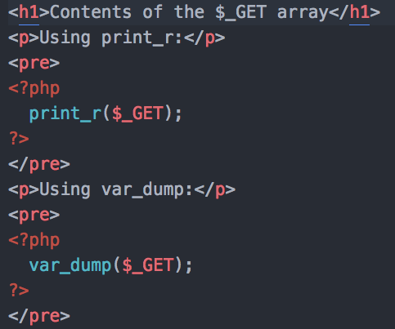
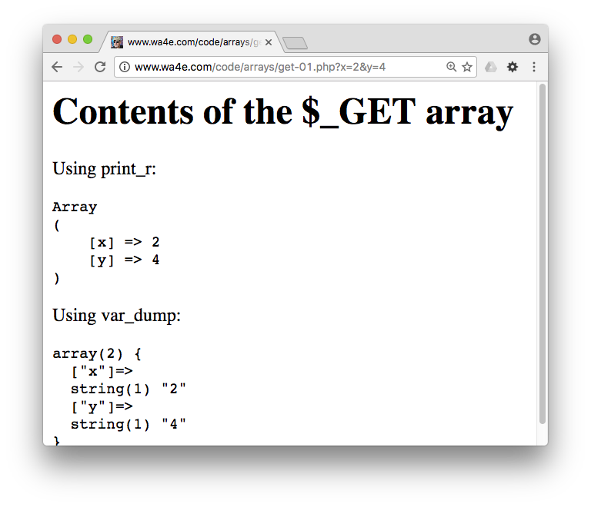
http://www.Web 2.com/code/arrays/get-01.php?x=2&y=4

Slide 28
Summary
This is a sprint through some of the unique language features of PHP Arrays.

