Slide 1
Markup Languages:
XHTML 1.0
CIT 123
Web Application - I

Slide 2
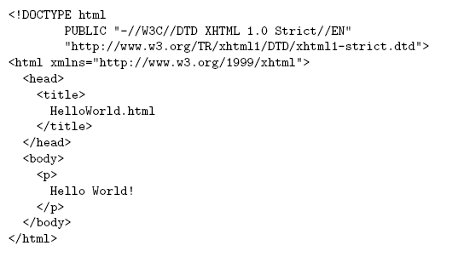
HTML “Hello World!”
Document
Type
Declaration
Document
Instance

Slide 3

HTML “Hello World”

Slide 4
HTML Tags and Elements
Any string of the form < … > is a tag
All tags in document instance of Hello World are either end tags (begin with </) or start tags (all others)
  Tags are an example of markup, that is, text treated specially by the browser
  Non-markup text is called character data and is normally displayed by the browser
String at beginning of start/end tag is an element name
Everything from start tag to matching end tag, including tags, is an element
  Content of element excludes its start and end tags

Slide 5
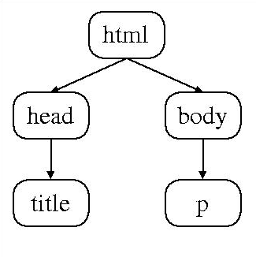
HTML Element Tree
Root
Element

Slide 6
HTML Root Element
Document type declaration specifies name of root element:
<!DOCTYPE html
Root of HTML document must be html
XHTML 1.0 (standard we will follow) requires that this element contain the xml namespace xmlns attribute specification (name/value pair)

Slide 7
HTML head and body Elements
The body element contains information displayed in the browser client area
The head element contains information used for other purposes by the browser:
  title (shown in title bar of browser window)
  scripts (client-side programs)
  style (display) information
  etc.

Slide 8
HTML History
1990: HTML invented by Tim Berners-Lee
1993: Mosaic browser adds support for images, sound, video to HTML
1994-~1997: “Browser wars” between Netscape and Microsoft, HTML defined operationally by browser support
~1997-present: Increasingly, World-Wide Web Consortium (W3C) recommendations define HTML

Slide 9
HTML Versions
HTML 4.01 (Dec 1999) syntax defined using Standard Generalized Markup Language (SGML)
XHTML 1.0 (Jan 2000) syntax defined using Extensible Markup Language (XML)
Primary differences:
  HTML allows some tag omissions (e.g., end tags)
  XHTML element and attribute names are lower case (HTML names are case-insensitive)
  XHTML requires that attribute values be quoted

Slide 10
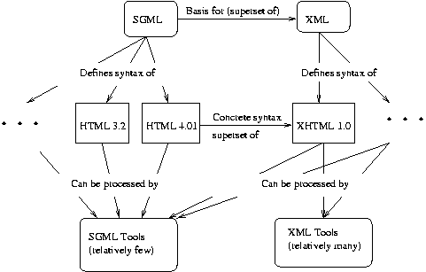
SGML and XML

Slide 11
HTML “Flavors”
For HTML 4.01 and XHTML 1.0, the document type declaration can be used to select one of three “flavors”:
  Strict: W3C ideal
  Transitional: Includes deprecated elements and attributes (W3C recommends use of style sheets instead)
  Frameset: Supports frames (subwindows within the client area)

Slide 12
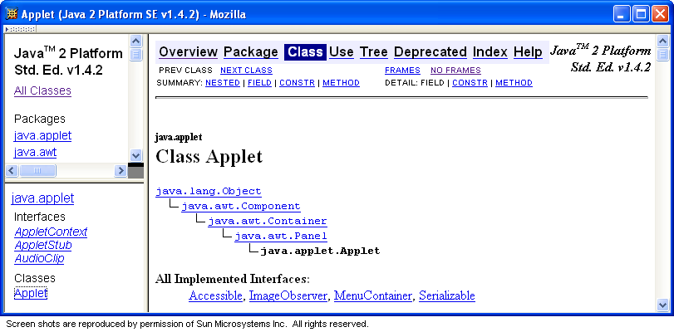
HTML Frameset

Slide 13
HTML Document Type Declarations
XHTML 1.0 Strict:
<!DOCTYPE html
PUBLIC "-//W3C//DTD XHTML 1.0 Strict//EN"
"http://www.w3.org/TR/xhtml1/DTD/xhtml1-strict.dtd">
XHTML 1.0 Frameset:
<!DOCTYPE html
PUBLIC "-//W3C//DTD XHTML 1.0 Frameset//EN“
"http://www.w3.org/TR/xhtml1/DTD/xhtml1-frameset.dtd">
HTML 4.01 Transitional:
<!DOCTYPE HTML
PUBLIC "-//W3C//DTD HTML 4.01 Transitional//EN“
"http://www.w3.org/TR/html4/loose.dtd">

Slide 14
XHTML White Space
Four white space characters: carriage return, line feed, space, horizontal tab
Normally, character data is normalized:
  All white space is converted to space characters
  Leading and trailing spaces are trimmed
  Multiple consecutive space characters are replaced by a single space character

Slide 15
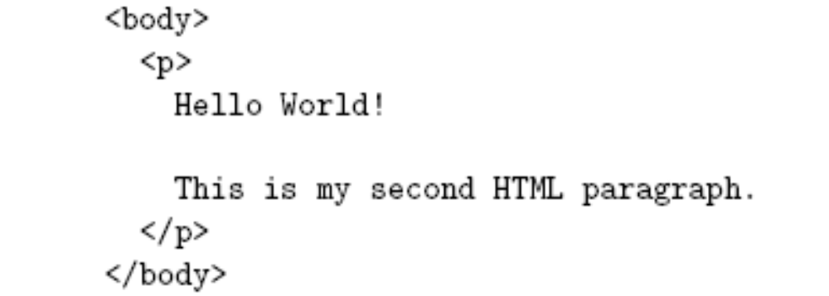
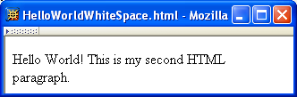
XHTML White Space

Slide 16
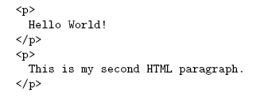
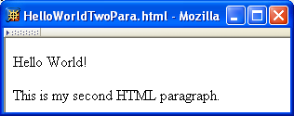
XHTML White Space

Slide 17
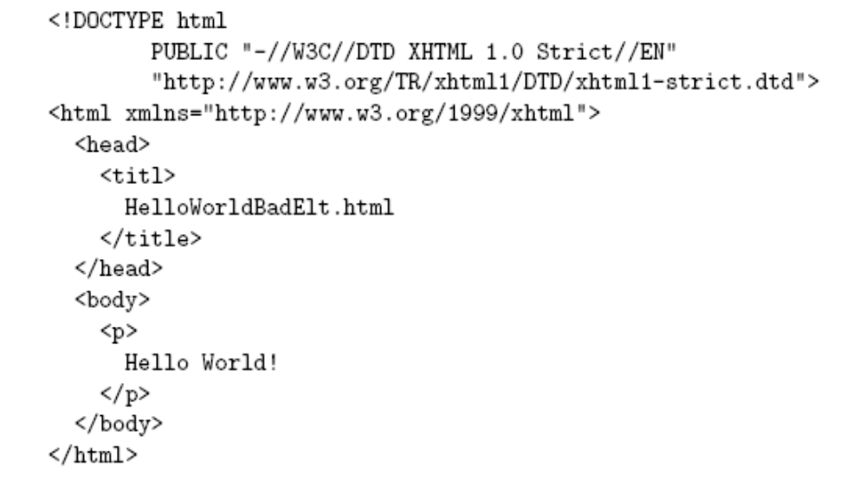
Unrecognized HTML Elements
Misspelled
element name

Slide 18
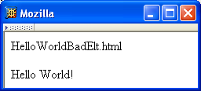
Unrecognized HTML Elements
Belongs
here
title character
data

Slide 19
Unrecognized HTML Elements
title character
data
Displayed
here

Slide 20
Unrecognized HTML Elements
Browsers ignore tags with unrecognized element names, attribute specifications with unrecognized attribute names
  Allows evolution of HTML while older browsers are still in use
Implication: an HTML document may have errors even if it displays properly
Should use an HTML validator to check syntax

Slide 21
Unrecognized HTML Elements
Example for non-frame browsers (old)
<HTML>
  <HEAD>
    <TITLE>A simple frameset document</TITLE>
  </HEAD>
  <FRAMESET cols="20%, 80%">
    <FRAME src="contents_of_frame1.html“ />
    <FRAME src="contents_of_frame2.html“ />
    <NOFRAMES>
      <P>This doc contains frames</P>
    </NOFRAMES>
  </FRAMESET>
</HTML>

Slide 22
HTML References
Since < marks the beginning of a tag, how do you include a < in an HTML document?
Use markup known as a reference
Two types:
  Character reference specifies a character by its Unicode code point
    For <, use &#60; or &#x3C; or &#x3c;
  Entity reference specifies a character by an HTML-defined name
    For <, use &lt;

Slide 23
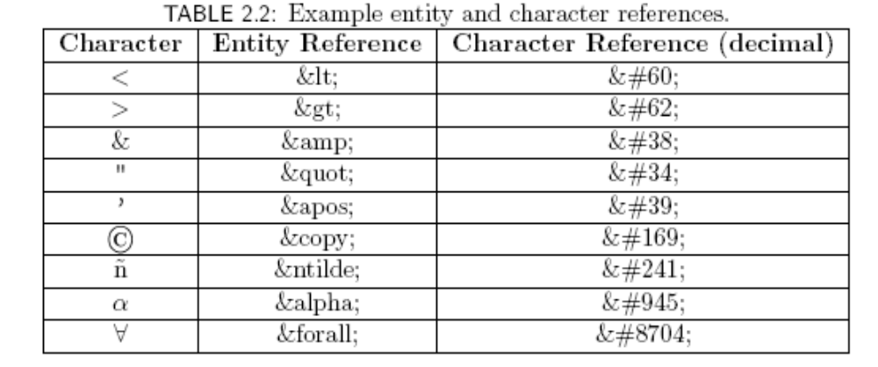
HTML References

Slide 24
HTML References
Since < and & begin markup, within character data or attribute values these characters must always be represented by references (normally &lt; and &amp;)
Good idea to represent > using reference (normally &gt;)
  Provides consistency with treatment of <
  Avoids accidental use of the reserved string ]]>

Slide 25
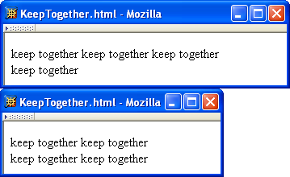
HTML References
Non-breaking space ( &nbsp; ) produces space but counts as part of a word
  Ex: keep&nbsp;together keep&nbsp;together …

Slide 26
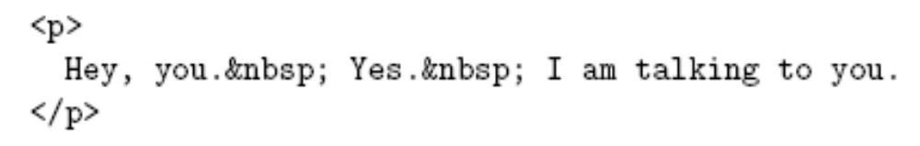
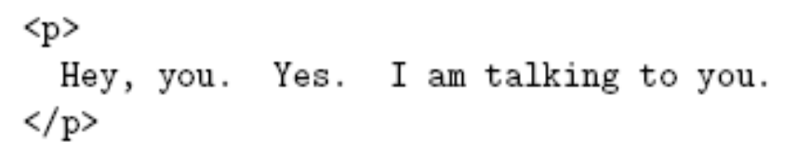
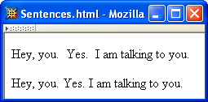
HTML References
Non-breaking space often used to create multiple spaces (not removed by normalization)
&nbsp; + space
displays as two
spaces

Slide 27
XHTML Attribute Specifications
Example:
Syntax:
  Valid attribute names specified by HTML recommendation (or XML, as in xml:lang)
  Attribute values must be quoted (matching single or double quotes)
  Multiple attribute specifications are space-separated, order-independent

Slide 28

XHTML Attribute Values
Can contain embedded quotes or references to quotes
May be normalized by browser
  Best to normalize attribute values yourself for optimal browser compatibility

Slide 29
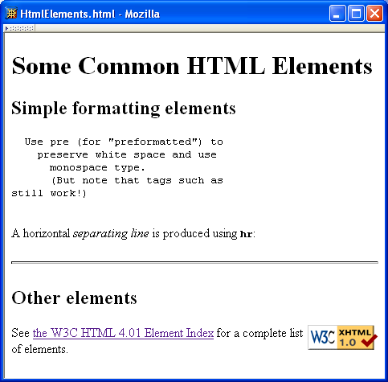
Common HTML Elements

Slide 30
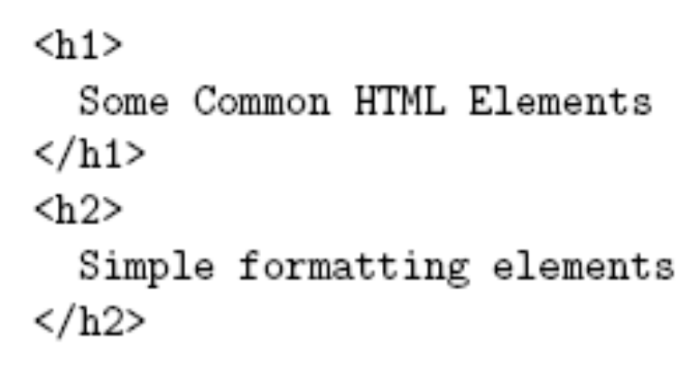
Common HTML Elements
Headings are produced using h1, h2, …, h6 elements:
Should use h1 for highest level, h2 for next highest, etc.
  Change style (next chapter) if you don’t like the “look” of a heading

Slide 31
Common HTML Elements

Slide 32
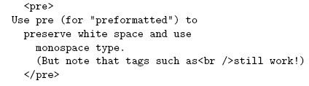
Common HTML Elements
Use pre to retain format of text and display using monospace font:
Note that any embedded markup (such as <br /> ) is still treated as markup!

Slide 33
Common HTML Elements
br element represents line break
br is example of an empty element, i.e., element that is not allowed to have content
XML allows two syntactic representations of empty elements
  Empty tag syntax <br /> is recommended for browser compatibility
  XML parsers also recognize syntax <br></br> (start tag followed immediately by end tag), but many browsers do not understand this for empty elements

Slide 34
Common HTML Elements

Slide 35

Common HTML Elements
Text can be formatted in various ways:
  Apply style sheet technology (next chapter) to a span element (a styleless wrapper):
  Use a phrase element that specifies semantics of text (not style directly):
  Use a font style element
    Not recommended, but frequently used

Slide 36
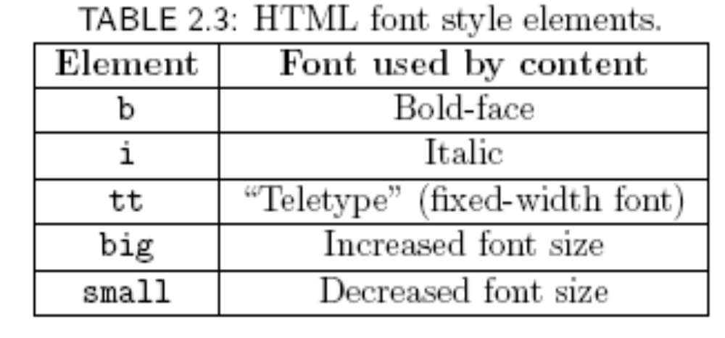
Common HTML Elements

Slide 37
Common HTML Elements

Slide 38
Common HTML Elements
Horizontal rule is produced using hr
Also an empty element
Style can be modified using style sheet technology

Slide 39
Common HTML Elements

Slide 40
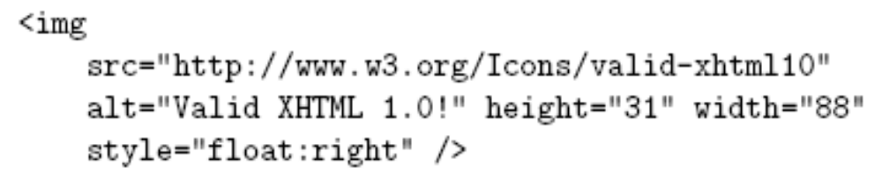
Common HTML Elements
Images can be embedded using img element
Attributes:
  src: URL of image file (required). Browser generates a GET request to this URL.
  alt: text description of image (required)
  height / width: dimensions of area that image will occupy (recommended)

Slide 41
Common HTML Elements
If height and width not specified for image, then browser may need to rearrange the client area after downloading the image (poor user interface for Web page)
If height and width specified are not the same as the original dimensions of image, browser will resize the image
Default units for height and width are “picture elements” (pixels)
  Can specify percentage of client area using string such as “50%”

Slide 42
Common HTML Elements
Monitor resolution determines pixel size
1024 elements per line
500 pixel wide line is almost
half the width of monitor
768 lines

Slide 43
Common HTML Elements
Monitor resolution determines pixel size
1280 elements per line
500 pixel wide line is less
than half the width of monitor
1024 lines

Slide 44
Common HTML Elements

Slide 45
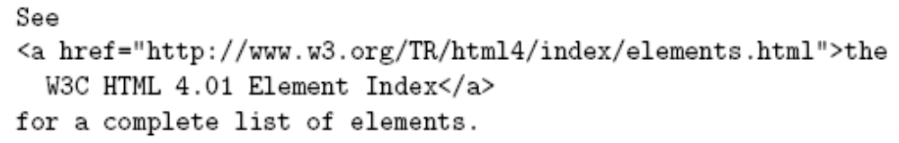
Common HTML Elements
Hyperlinks are produced by the anchor element a
Clicking on a hyperlink causes browser to issue GET request to URL specified in href attribute and render response in client area
Content of anchor element is text of hyperlink (avoid leading/trailing space in content)

Slide 46
Common HTML Elements
Anchors can be used as source (previous example) or destination
The fragment portion of a URL is used to reference a destination anchor
Browser scrolls so destination anchor is at (or near) top of client area

Slide 47

Common HTML Elements
Comments are a special form of tag
Not allowed to use -- within comment

Slide 48
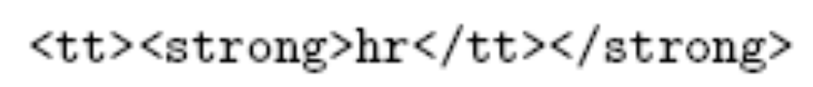
Nesting Elements
If one element is nested within another element, then the content of the inner element is also content of the outer element
XHTML requires that elements be properly nested

Slide 49
Nesting Elements
Most HTML elements are either block or inline
  Block: browser automatically generates line breaks before and after the element content
    Ex: p,div
  Inline: element content is added to the “flow”
    Ex: span, tt, strong, a

Slide 50
Nesting Elements
Syntactic rules of thumb:
  Children of body must be blocks
  Blocks can contain inline elements
  Inline elements cannot contain blocks
Specific rules for each version of (X)HTML are defined using SGML or XML (covered later)

Slide 51

Relative URL’s
Consider an <img> start tag containing attribute specification
This is an example of a relative URL: it is interpreted relative to the URL of the document that contains the img tag
  If document URL is
  http://localhost:8080/MultiFile.html
  then relative URL above represents absolute URL http://localhost:8080/valid-xhtml10.png

Slide 52
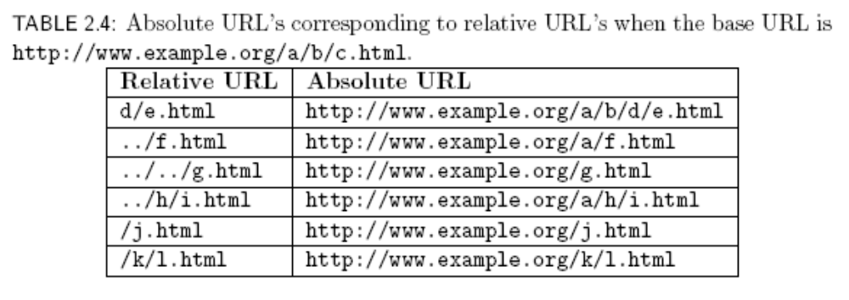
Relative URL’s

Slide 53

Relative URL’s
Query and fragment portions of a relative URL are appended to the resulting absolute URL
  Example: If document URL is
  http://localhost:8080/PageAnch.html
  and it contains the anchor element
  then the corresponding absolute URL is http://localhost:8080/PageAnch.html#section1

Slide 54
Relative URL’s
Advantages:
  Shorter than absolute URL’s
  Primary: can change the URL of a document (e.g., move document to a different directory or rename the server host) without needing to change URL’s within the document
Should use relative URL’s whenever possible

Slide 55
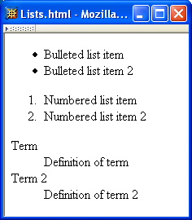
Lists

Slide 56
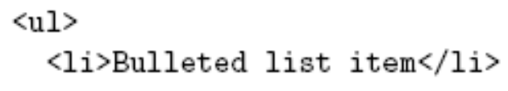
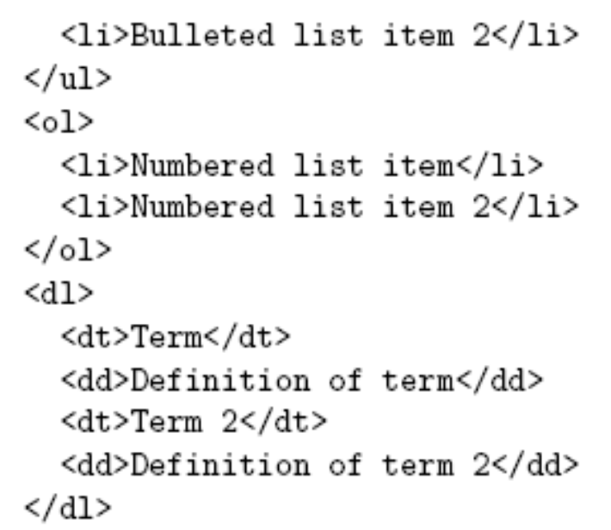
Lists
Unordered List
List Items
Ordered List
Definition List

Slide 57
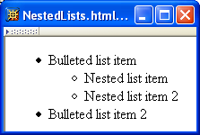
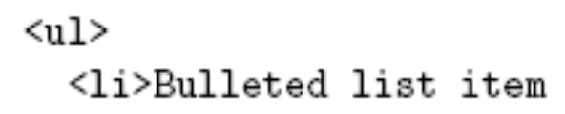
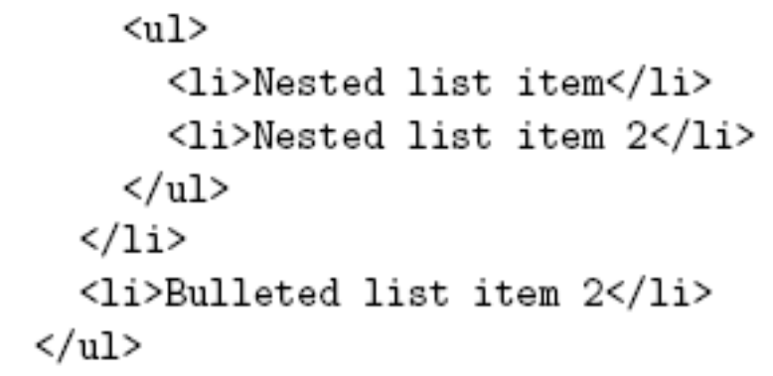
Lists

Slide 58
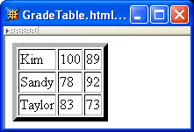
Tables
Rules
Borders
Rules

Slide 59
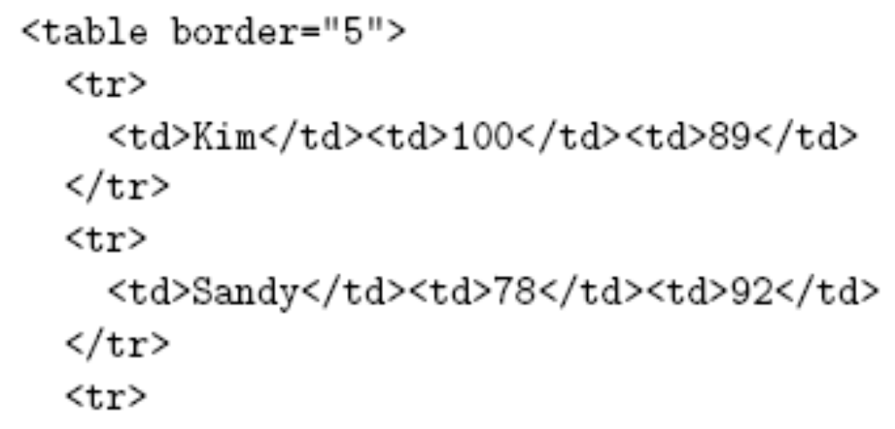
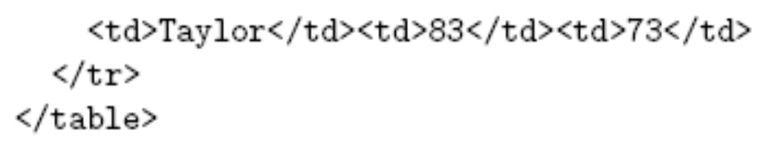
Tables
Border 5 pixels, rules 1 pixel
Table Row
Table Data

Slide 60
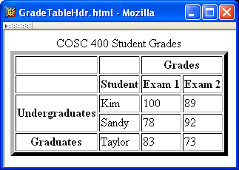
Tables

Slide 61
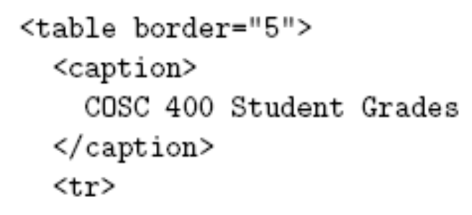
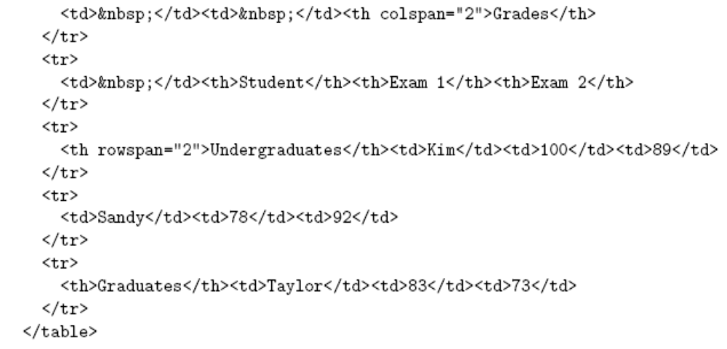
Tables
Table Header

Slide 62
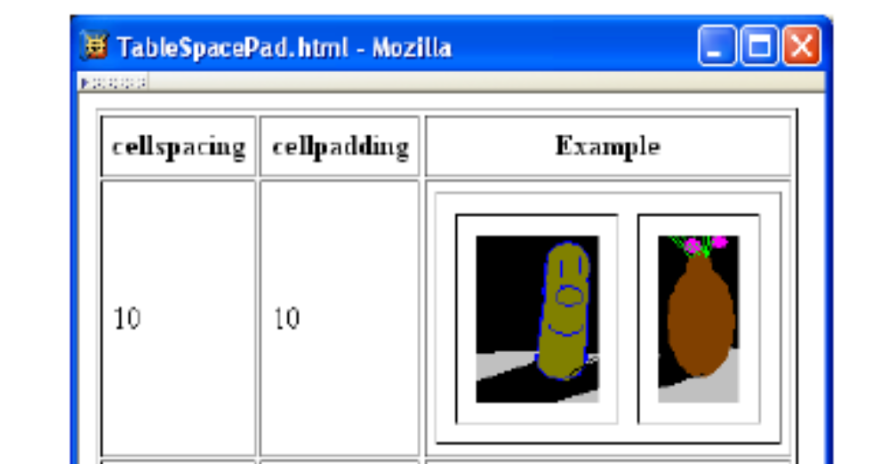
Tables

Slide 63
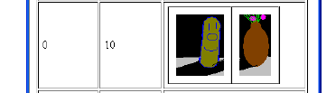
Tables
cellspacing cellpadding

Slide 64

Tables
cellspacing cellpadding

Slide 65
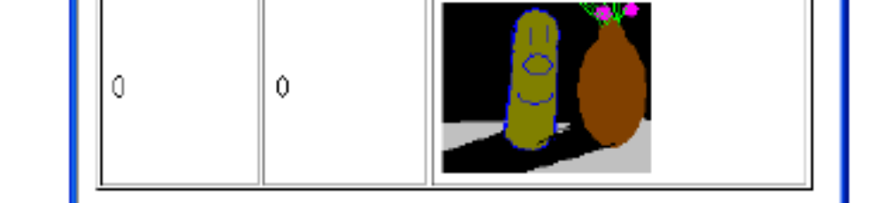
Tables
cellspacing cellpadding

Slide 66
Frames

Slide 67
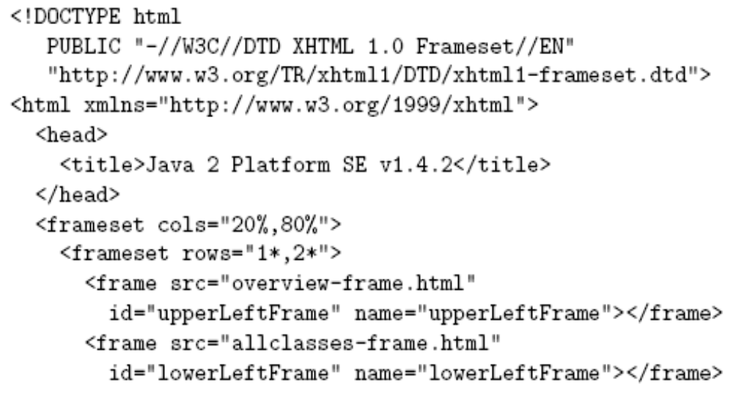
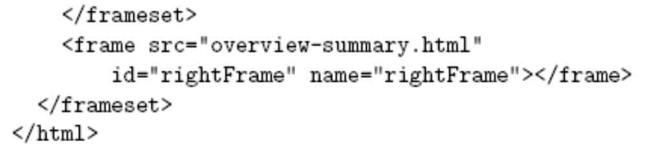
Frames
1/3,2/3 split

Slide 68
Frames
Hyperlink in one frame can load document in another:
Value of target attribute specification is id/name of a frame

Slide 69
Frames
User interface issues:
  What happens when the page is printed?
  What happens when the Back button is clicked?
  How should assistive technology “read” the page?
  How should the information be displayed on a small display?
Recommendation: avoid frames except for applications aimed at “power users”

Slide 70
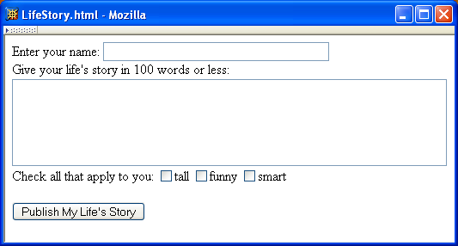
Forms

Slide 71
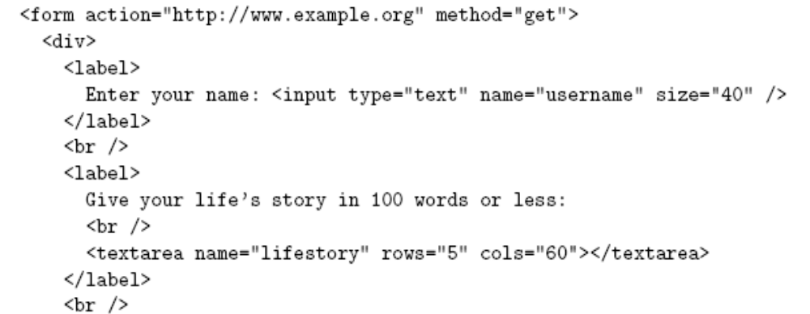
Forms
Each form is content of a form element

Slide 72
Forms
action specifies URL where form data is sent in an HTTP request

Slide 73
Forms
HTTP request method (lower case)

Slide 74
Forms
The XHTML grammar require any child of the form element to be a block
Many form elements are actually inline, so including a block element on top such a div or a table is a simple way to be compliant with the grammar

Slide 75
Forms
div is the block element analog of span (no-style block element)

Slide 76
Forms
Form control elements must be content of a block element

Slide 77
Forms
Text field control (form user-interface element)

Slide 78
Forms
Text field used for one-line inputs

Slide 79
Forms

Slide 80
Forms
Name associated with this control’s data in HTTP request

Slide 81
Forms
Width (number of characters) of text field

Slide 82
Forms
input is an empty element

Slide 83
Forms
Use label to associate text with a control
Only one control inside a label element!

Slide 84
Forms
Form controls are inline elements

Slide 85
Forms
textarea control used for multi-line input

Slide 86
Forms
Height and width in characters

Slide 87
Forms
textarea is not an empty element; any content is displayed

Slide 88
Forms

Slide 89
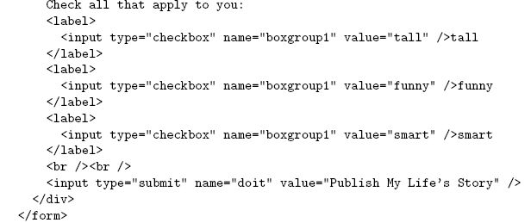
Forms
Checkbox control

Slide 90
Forms
Value sent in HTTP request if box is checked

Slide 91
Forms
Controls can share a common name

Slide 92
Forms
Submit button: form data sent to action URL if button is clicked

Slide 93
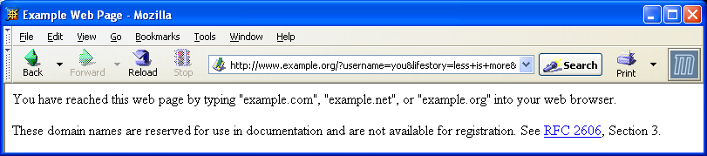
Forms

Slide 94
Forms
Form data (in GET request)

Slide 95
Forms
Displayed on button and sent to server if button clicked

Slide 96
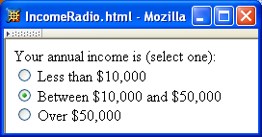
Forms
Radio buttons: at most
one can be selected at
a time.

Slide 97
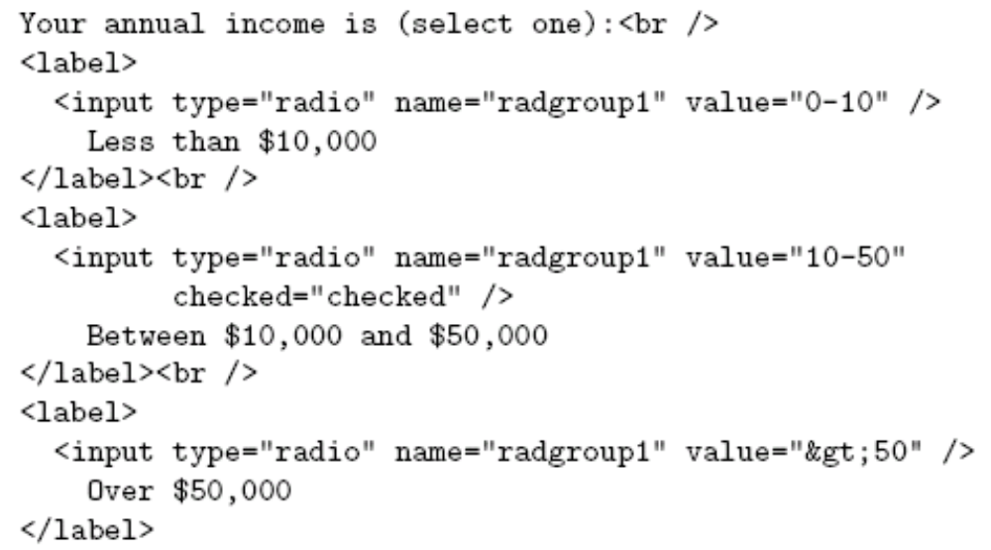
Forms
Radio button control

Slide 98
Forms
All radio buttons with the same name form a button set

Slide 99
Forms
Only one button of a set can be selected at a time

Slide 100
Forms
This button is initially selected
(checked attribute also applies
to check boxes)

Slide 101
Forms
Boolean attribute: default false,
set true by specifying name as
value

Slide 102
Forms
Represents string: >50

Slide 103
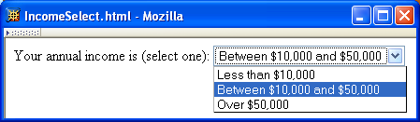
Forms
Menu

Slide 104
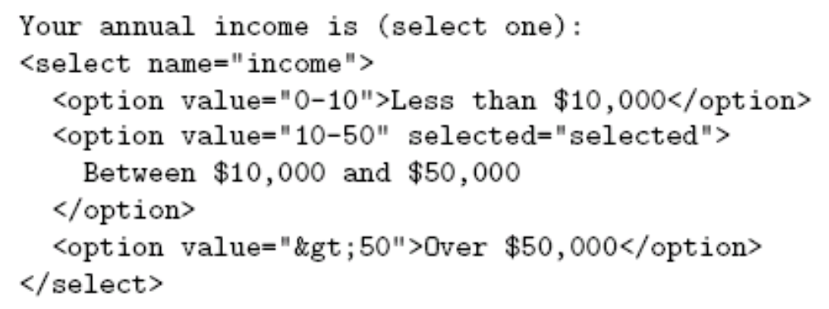
Forms
Menu control; name given once

Slide 105
Forms
Each menu item has its own value

Slide 106
Forms
Item initially displayed in menu
control

Slide 107
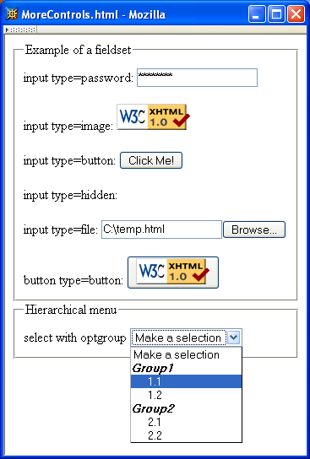
Forms
Other form controls:
  Fieldset (grouping)
  Password
  Clickable image
  Non-submit buttons
  Hidden (embed data)
  File upload
  Hierarchical menus

Slide 108
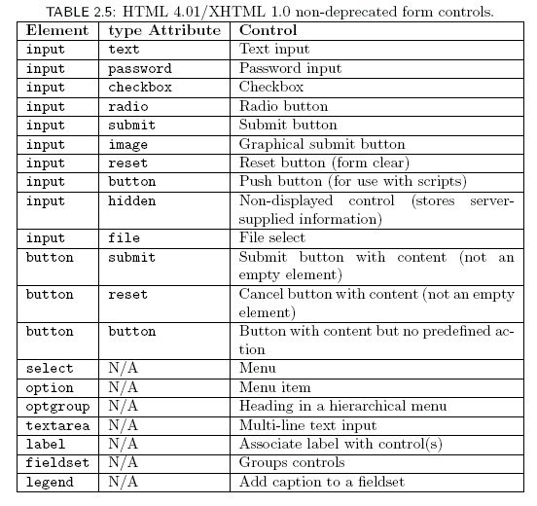
Forms

Slide 109
XML DTD
Recall that XML is used to define the syntax of XHTML
Set of XML files that define a language are known as the document type definition (DTD)
DTD primarily consists of declarations:
  Element type: name and content of elements
  Attribute list: attributes of an element
  Entity: define meaning of, e.g., &gt;

Slide 110
XML DTD
Example from
http://www.w3.org/TR/xhtml1/DTD/xhtml1-strict.dtd
<!ELEMENT html (head, body)>
<!ATTLIST html
%i18n;
id ID #IMPLIED
xmlns %URI; #FIXED 'http://www.w3.org/1999/xhtml' >
<!ENTITY % i18n
"lang %LanguageCode; #IMPLIED
xml:lang %LanguageCode; #IMPLIED
dir (ltr|rtl) #IMPLIED" >

Slide 111
XML Element Type Declaration
Element type name

Slide 112
XML Element Type Declaration
Element type content specification (or content model)

Slide 113

XML Element Type Declaration
Element type content specification (or content model)

Slide 114
XML Element Type Declaration
Element type content specification (or content model)

Slide 115

XML Element Type Declaration
Element type content specification (or content model)

Slide 116
XML Element Type Declaration
Element type content specification (or content model)

Slide 117
XML Element Type Declaration
Element type content specification (or content model)

Slide 118
XML Element Type Declaration
Element type content specification (or content model)

Slide 119
XML Element Type Declaration
<!ELEMENT textarea (#PCDATA)>
Element type content specification (or content model)

Slide 120
XML Element Type Declaration
<!ELEMENT textarea (#PCDATA)>
Element type content specification (or content model)

Slide 121
XML Element Type Declaration
Element type content specification (or content model)

Slide 122

XML Element Type Declaration
Element type content specification (or content model)

Slide 123
XML Element Type Declaration
Element type content specification (or content model)

Slide 124
XML Element Type Declaration
Child elements of table are:

Slide 125
XML Element Type Declaration
Child elements of table are:
  Optional caption

Slide 126
XML Element Type Declaration
Child elements of table are:
  Optional caption followed by

Slide 127
XML Element Type Declaration
Child elements of table are:
  Optional caption followed by
  Any number of col elements

Slide 128
XML Element Type Declaration
Child elements of table are:
  Optional caption followed by
  Any number of col elements or

Slide 129
XML Element Type Declaration
Child elements of table are:
  Optional caption followed by
  Any number of col elements or any number of colgroup elements

Slide 130
XML Element Type Declaration
Child elements of table are:
  Optional caption followed by
  Any number of col elements or any number of colgroup elements then

Slide 131
XML Element Type Declaration
Child elements of table are:
  Optional caption followed by
  Any number of col elements or any number of colgroup elements then
  Optional header

Slide 132
XML Element Type Declaration
Child elements of table are:
  Optional caption followed by
  Any number of col elements or any number of colgroup elements then
  Optional header followed by

Slide 133
XML Element Type Declaration
Child elements of table are:
  Optional caption followed by
  Any number of col elements or any number of colgroup elements then
  Optional header followed by optional footer

Slide 134
XML Element Type Declaration
Child elements of table are:
  Optional caption followed by
  Any number of col elements or any number of colgroup elements then
  Optional header followed by optional footer then

Slide 135
XML Element Type Declaration
Child elements of table are:
  Optional caption followed by
  Any number of col elements or any number of colgroup elements then
  Optional header followed by optional footer then
  One or more tbody elements

Slide 136
XML Element Type Declaration
Child elements of table are:
  Optional caption followed by
  Any number of col elements or any number of colgroup elements then
  Optional header followed by optional footer then
  One or more tbody elements or

Slide 137
XML Element Type Declaration
Child elements of table are:
  Optional caption followed by
  Any number of col elements or any number of colgroup elements then
  Optional header followed by optional footer then
  One or more tbody elements or one or more tr elements

Slide 138

XML Attribute List Declaration
Element type name

Slide 139
XML Attribute List Declaration
Recognized
attribute names

Slide 140
XML Attribute List Declaration
Attribute types
(data types allowed as attribute values)

Slide 141
XML Attribute List Declaration
ASCII characters: letter, digit, or . - _ :

Slide 142
XML Attribute List Declaration
Attribute value must be ltr or rtl

Slide 143
XML Attribute List Declaration
Like NMTOKEN but must begin with letter or _ :
Attribute value must be unique

Slide 144
XML Attribute List Declaration
Any character except XML special characters < and &
or the quote character enclosing the attribute value

Slide 145

XML Attribute List Declaration

Slide 146
XML Attribute List Declaration
Attribute default declarations

Slide 147

XML Attribute List Declaration

Slide 148

XML Entity Declaration
Entity declaration is essentially a macro
Two types of entity:
  General: referenced from HTML document using &
Entity name

Slide 149
XML Entity Declaration
Entity declaration is essentially a macro
Two types of entity:
  General: referenced from HTML document using &
Replacement text;
recursively replaced if it is a reference

Slide 150

XML Entity Declaration
Entity declaration is essentially a macro
Two types of entity:
  General: referenced from HTML document using &
  Parameter: reference from DTD using %

Slide 151
XML Entity Declaration
Entity declaration is essentially a macro
Two types of entity:
  General: referenced from HTML document using &
  Parameter: reference from DTD using %

Slide 152

DTD Files
DTD document contains element type, attribute list, and entity declarations
May also contain declaration of external entities: identifiers for secondary DTD documents
System Identifier: URL for primary DTD document

Slide 153

DTD Files
External entity name

Slide 154
DTD Files
System identifier (relative URL)

Slide 155
DTD Files
Entity reference; imports content (entity declarations, called
entity set) of external entity at this point in the primary DTD

Slide 156

HTML Creation Tools
Mozilla Composer
Microsoft FrontPage
Macromedia Dreamweaver
Etc.

