Slide 1
CIT 123
Web Technology - I
Browsers and the DOM

Slide 2
Overview
The Document Object Model (DOM) is an API that allows programs to interact with HTML (or XML) documents
  In typical browsers, the JavaScript version of the API is provided via the document host object
  W3C recommendations define standard DOM
Several other browser host objects are informal, de facto standards
  alert, prompt are examples
Anup Adhikari :: CIT 123 :: Web Technology - I

Slide 3
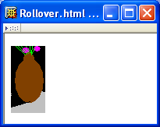
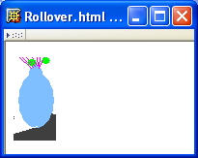
DOM Introduction
Example: “Rollover” effect
Cursor not over image
Image changes when cursor
moves over
Anup Adhikari :: CIT 123 :: Web Technology - I

Slide 4
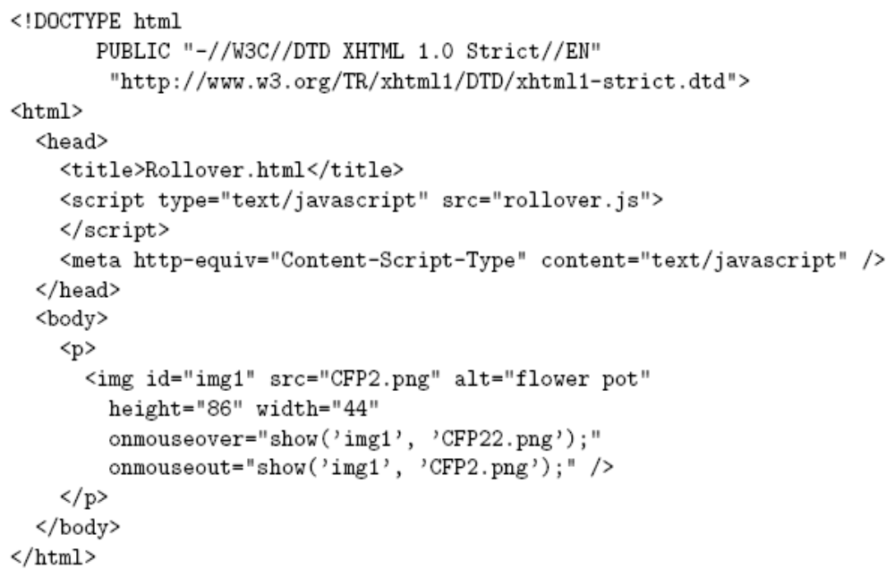
DOM Introduction
Anup Adhikari :: CIT 123 :: Web Technology - I

Slide 5
DOM Introduction
Import
JavaScript
code
Anup Adhikari :: CIT 123 :: Web Technology - I

Slide 6
DOM Introduction
Default language for scripts specified as attribute values
Anup Adhikari :: CIT 123 :: Web Technology - I

Slide 7
DOM Introduction
Calls to JavaScript
show() function when
mouse moves over/away
from image
Anup Adhikari :: CIT 123 :: Web Technology - I

Slide 8
DOM Introduction
Notice that id of image is first argument to show()
Anup Adhikari :: CIT 123 :: Web Technology - I

Slide 9
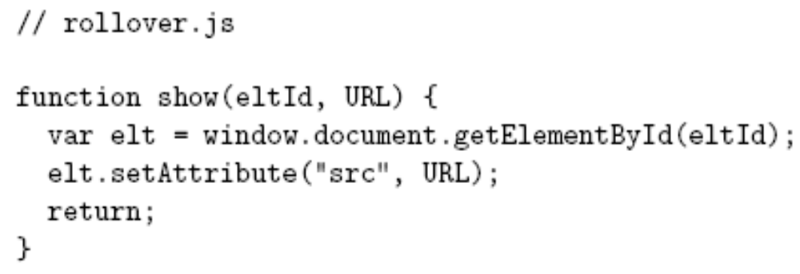
DOM Introduction
Anup Adhikari :: CIT 123 :: Web Technology - I

Slide 10
DOM Introduction
DOM method returning Object
Anup Adhikari :: CIT 123 :: Web Technology - I

Slide 11
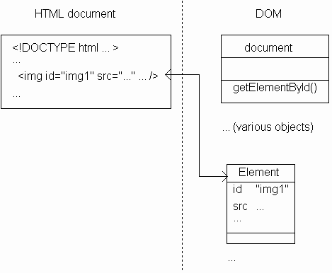
DOM Introduction
Returns instance
of Element
(DOM-defined
host object)
representing
HTML element
with given id
Anup Adhikari :: CIT 123 :: Web Technology - I

Slide 12
DOM Introduction
Some properties of
Element instance
correspond
to attributes of
HTML element
Anup Adhikari :: CIT 123 :: Web Technology - I

Slide 13
DOM Introduction
Method inherited by Element instances
for setting value of an attribute
Anup Adhikari :: CIT 123 :: Web Technology - I

Slide 14
DOM Introduction
Effect: src attribute of HTML element with
specified eltId is changed to specified URL
Anup Adhikari :: CIT 123 :: Web Technology - I

Slide 15
DOM Introduction
Image src changed to
CFP22.png when mouse
is over image,
CFP2.png when leaves
Anup Adhikari :: CIT 123 :: Web Technology - I

Slide 16
DOM History and Levels
Very simple DOM was part of Netscape 2.0
Starting with Netscape 4.0 and IE 4.0, browser DOM API’s diverged significantly
W3C responded quickly with DOM Level 1 (Oct 1998) and subsequently DOM Level 2
We cover JavaScript API for DOM2 + some coverage of browser specifics
Anup Adhikari :: CIT 123 :: Web Technology - I

Slide 17
Intrinsic Event Handling
An event is an occurrence of something potentially interesting to a script:
  Ex: mouseover and mouseout events
An HTML intrinsic event attribute is used to specify a script to be called when an event occurs
  Ex: onmouseover
  Name of attribute is on followed by event name
Anup Adhikari :: CIT 123 :: Web Technology - I

Slide 18
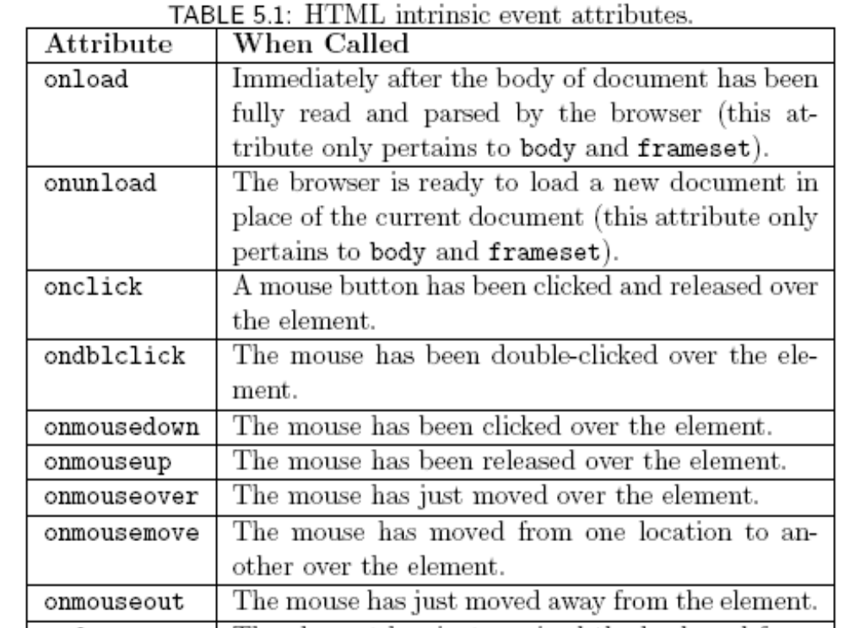
Intrinsic Event Handling
Anup Adhikari :: CIT 123 :: Web Technology - I

Slide 19
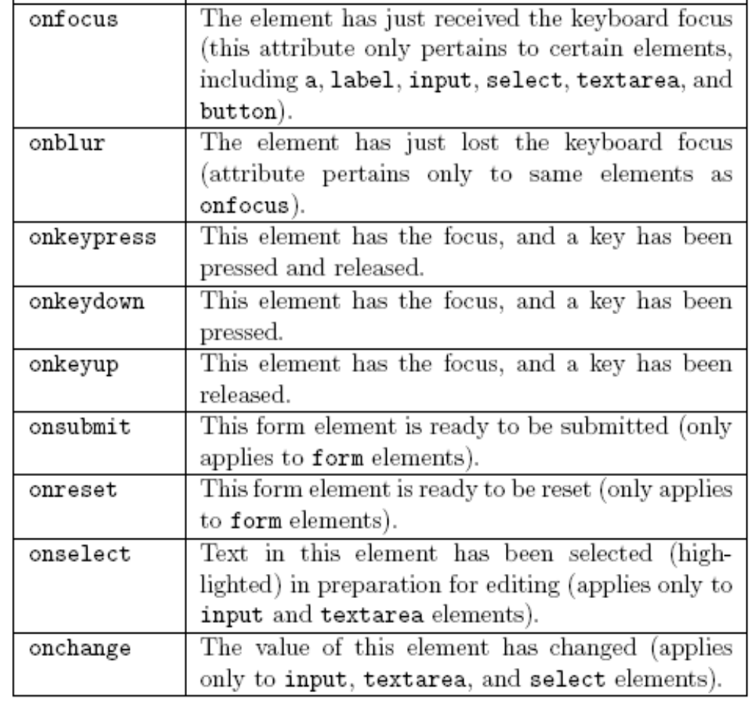
Intrinsic Event Handling
Anup Adhikari :: CIT 123 :: Web Technology - I

Slide 20
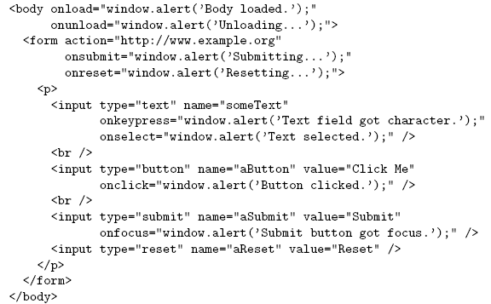
Intrinsic Event Handling
Anup Adhikari :: CIT 123 :: Web Technology - I

Slide 21
Intrinsic Event Handling
Intrinsic event attribute value is a script; what language is it written in?
HTTP Content-Script-Type header field specifies default scripting language
meta element allows document to specify values as if they were header fields
Header field name
Header field value
Anup Adhikari :: CIT 123 :: Web Technology - I

Slide 22
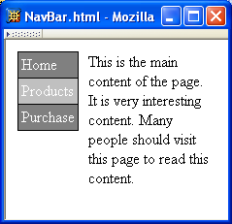
Modifying Element Style
Change
background color
of element
containing cursor
Anup Adhikari :: CIT 123 :: Web Technology - I

Slide 23
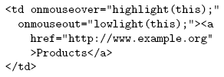
Modifying Element Style
Anup Adhikari :: CIT 123 :: Web Technology - I

Slide 24
Modifying Element Style
Like rollover, style needs to be modified
both when entering and exiting the element.
Anup Adhikari :: CIT 123 :: Web Technology - I

Slide 25
Modifying Element Style
Reference to Element instance
representing the td element
Anup Adhikari :: CIT 123 :: Web Technology - I

Slide 26
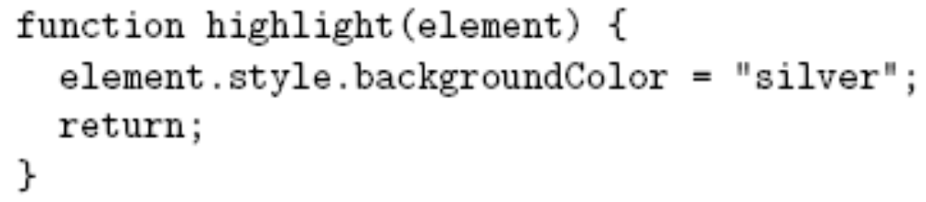
Modifying Element Style
Anup Adhikari :: CIT 123 :: Web Technology - I

Slide 27
Modifying Element Style
Reference to Element instance
Anup Adhikari :: CIT 123 :: Web Technology - I

Slide 28
Modifying Element Style
All Element instances have a style property
with an Object value
Anup Adhikari :: CIT 123 :: Web Technology - I

Slide 29
Modifying Element Style
Properties of style object
correspond to CSS style properties of
the corresponding HTML element.
Anup Adhikari :: CIT 123 :: Web Technology - I

Slide 30
Modifying Element Style
Rules for forming style property names from names of CSS style properties:
  If the CSS property name contains no hyphens, then the style object’s property name is the same
    Ex: color color
  Otherwise, all hyphens are removed and the letters that immediately followed hyphens are capitalized
    Ex: background-color backgroundColor
Anup Adhikari :: CIT 123 :: Web Technology - I

Slide 31
Modifying Element Style
Net effect: “silver” becomes the specified value for
CSS background-color property of td element;
browser immediately modifies the window.
Anup Adhikari :: CIT 123 :: Web Technology - I

Slide 32
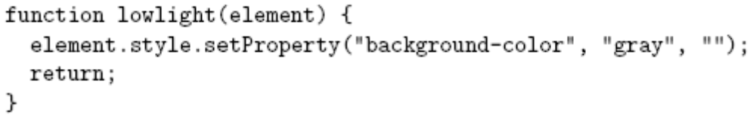
Modifying Element Style
Alternative syntax (not supported in IE6/7/8):
Anup Adhikari :: CIT 123 :: Web Technology - I

Slide 33
Modifying Element Style
Alternate syntax (not supported in IE6/7/8):
Every DOM2-compliant style object
has a setProperty() method
Anup Adhikari :: CIT 123 :: Web Technology - I

Slide 34
Modifying Element Style
Alternate syntax (not supported in IE6/7/8):
CSS property
value
CSS property
name
(unmodified)
Empty string
or
“important”
Anup Adhikari :: CIT 123 :: Web Technology - I

Slide 35
Modifying Element Style
Advantages of setProperty() syntax:
  Makes it clear that a CSS property is being set rather than merely a property of the style object
  Allows CSS property names to be used as-is rather than requiring modification (which can potentially cause confusion)
BUT lack of IE support makes it difficult to use (works with FF & Chrome)
Anup Adhikari :: CIT 123 :: Web Technology - I

Slide 36
Modifying Element Style
Obtaining specified CSS property value:
Alternate DOM2 syntax (not supported by IE6/7/8):
Anup Adhikari :: CIT 123 :: Web Technology - I

Slide 37
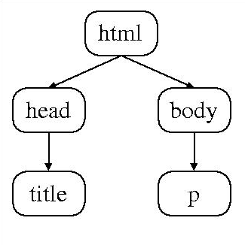
Document Tree
Recall that HTML document elements form a tree structure, e.g.,
DOM allows scripts to access and modify the document tree
Anup Adhikari :: CIT 123 :: Web Technology - I

Slide 38
Document Tree: Node
There are many types of nodes in the DOM document tree, representing elements, text, comments, the document type declaration, etc.
Every Object in the DOM document tree has properties and methods defined by the Node host object
Anup Adhikari :: CIT 123 :: Web Technology - I

Slide 39
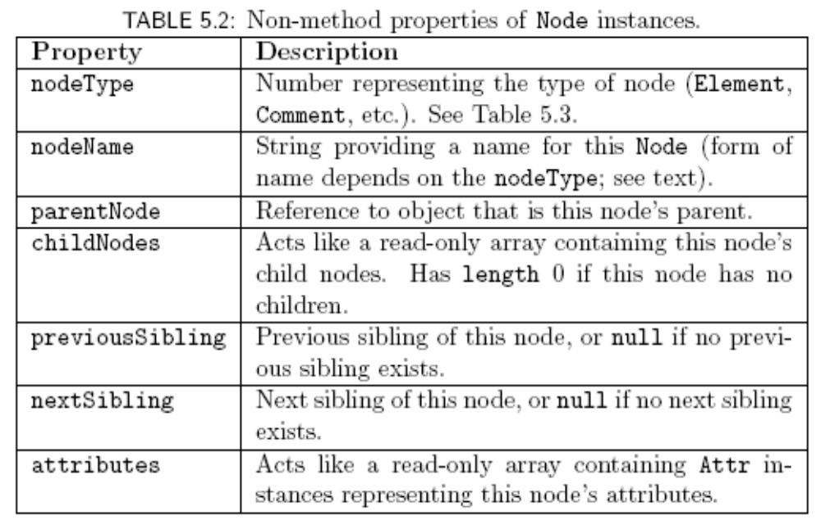
Document Tree: Node
Anup Adhikari :: CIT 123 :: Web Technology - I

Slide 40
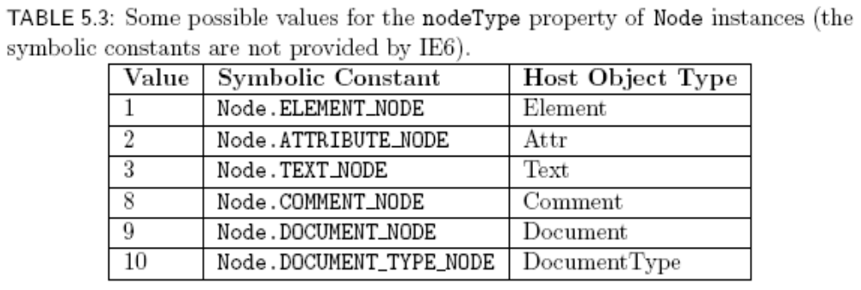
Document Tree: Node
(still doesn’t work with IE8, apparently. Chrome OK)
Anup Adhikari :: CIT 123 :: Web Technology - I

Slide 41
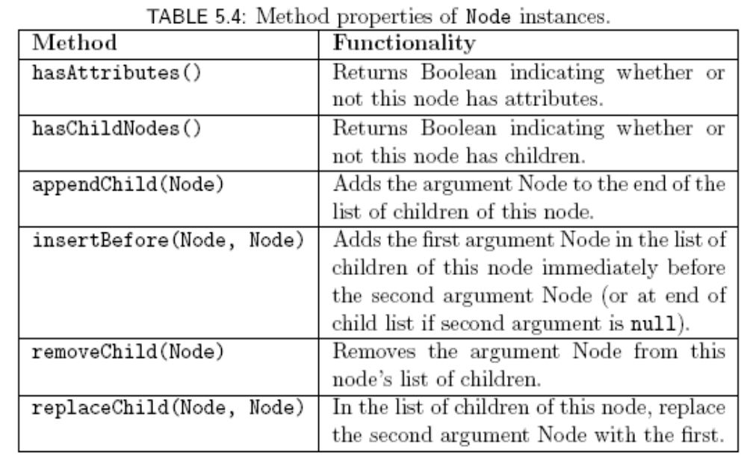
Document Tree: Node
Anup Adhikari :: CIT 123 :: Web Technology - I

Slide 42
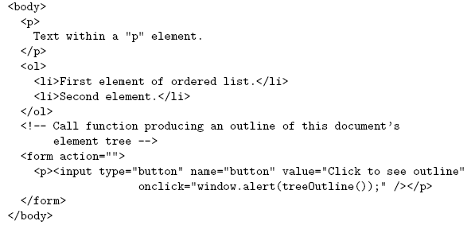
Document Tree: Node
Example HTML document
Function we will write that will
use Node methods and properties
to produce string representing
Element tree
Anup Adhikari :: CIT 123 :: Web Technology - I

Slide 43
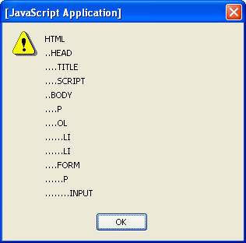
Document Tree: Node
String produced by TreeOutline():
Anup Adhikari :: CIT 123 :: Web Technology - I

Slide 44
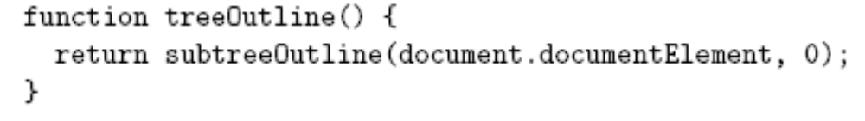
Document Tree: Node
Example: “walking” the tree of an HTML document
  Reference to html element is contained in documentElement property of document object
  Use Node-defined methods to recursively create an outline of nodeName’s:
Depth in tree
Anup Adhikari :: CIT 123 :: Web Technology - I

Slide 45
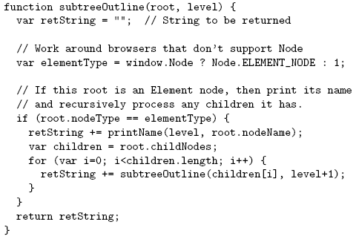
Document Tree: Node
Anup Adhikari :: CIT 123 :: Web Technology - I

Slide 46
Document Tree: Node
Contains nodeType value representing Element
Anup Adhikari :: CIT 123 :: Web Technology - I

Slide 47
Document Tree: Node
Ignore non-Element’s
Anup Adhikari :: CIT 123 :: Web Technology - I

Slide 48
Document Tree: Node
Add nodeName to string
Anup Adhikari :: CIT 123 :: Web Technology - I

Slide 49
Document Tree: Node
Recurse on
child nodes
Anup Adhikari :: CIT 123 :: Web Technology - I

Slide 50
Document Tree: Node
For Element’s, nodeName is type of the element (p, img, etc.)
Case: Name will be lower case if browser recognizes document as XHTML, upper case otherwise
  Can guarantee case by using String instance toLowerCase() / toUpperCase() methods
Anup Adhikari :: CIT 123 :: Web Technology - I

Slide 51
Document Tree: Node
Convention: write code as if browser is DOM-compliant, work around non-compliance as needed
In a DOM-compliant browser, we would use
this symbolic constant rather than the constant 1.
Problem: IE6 does not define ELEMENT_NODE
property (or Node object).
Solution: Use symbolic constant if available,
fall back to numeric constant if necessary.
Anup Adhikari :: CIT 123 :: Web Technology - I

Slide 52
Document Tree: Node
Convention: write code as if browser is DOM-compliant, work around non-compliance as needed
This expression is automatically cast to Boolean.
IE6: no Node global, so evaluates to false
DOM-compliant: Node is an Object, so evaluates
to true
Anup Adhikari :: CIT 123 :: Web Technology - I

Slide 53
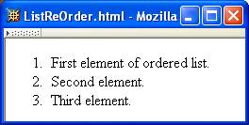
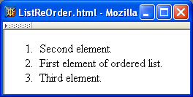
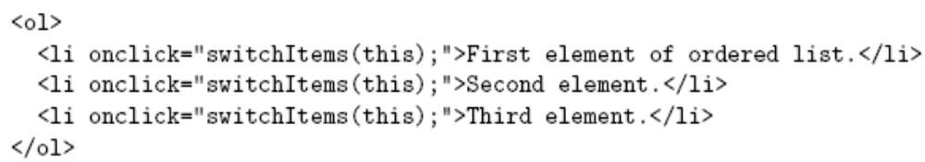
Document Tree: Modification
Initial rendering
After user clicks first list item
Anup Adhikari :: CIT 123 :: Web Technology - I

Slide 54
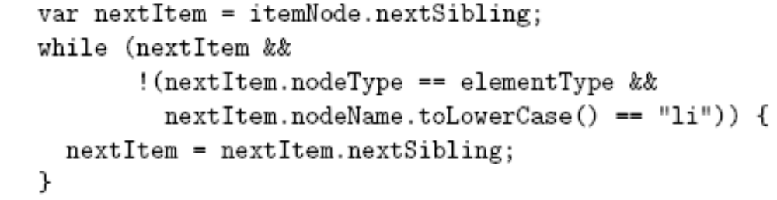
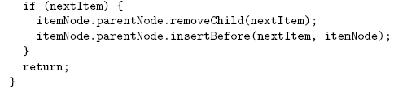
Document Tree: Modification
Find the
li Element
following the
selected one
(if it exists)
Anup Adhikari :: CIT 123 :: Web Technology - I

Slide 55
Document Tree: Modification
Returns null if
no next sibling
Anup Adhikari :: CIT 123 :: Web Technology - I

Slide 56
Document Tree: Modification
Converting
null to Boolean
produces false
Anup Adhikari :: CIT 123 :: Web Technology - I

Slide 57
Document Tree: Modification
Swap nodes
if an li
element
follows
Anup Adhikari :: CIT 123 :: Web Technology - I

Slide 58
Document Tree: Modification
Operate on a node by calling methods
on its parent
Anup Adhikari :: CIT 123 :: Web Technology - I

Slide 59
Document Tree: Modification
Remove following element from tree
Re-insert element earlier in tree
Anup Adhikari :: CIT 123 :: Web Technology - I

Slide 60
Document Tree: document
The document object is also considered a Node object
Technically, document is the root Node of the DOM tree
  html Element object is a child of document
  Other children may also include document type declaration, comments, text elements (white space)
Anup Adhikari :: CIT 123 :: Web Technology - I

Slide 61
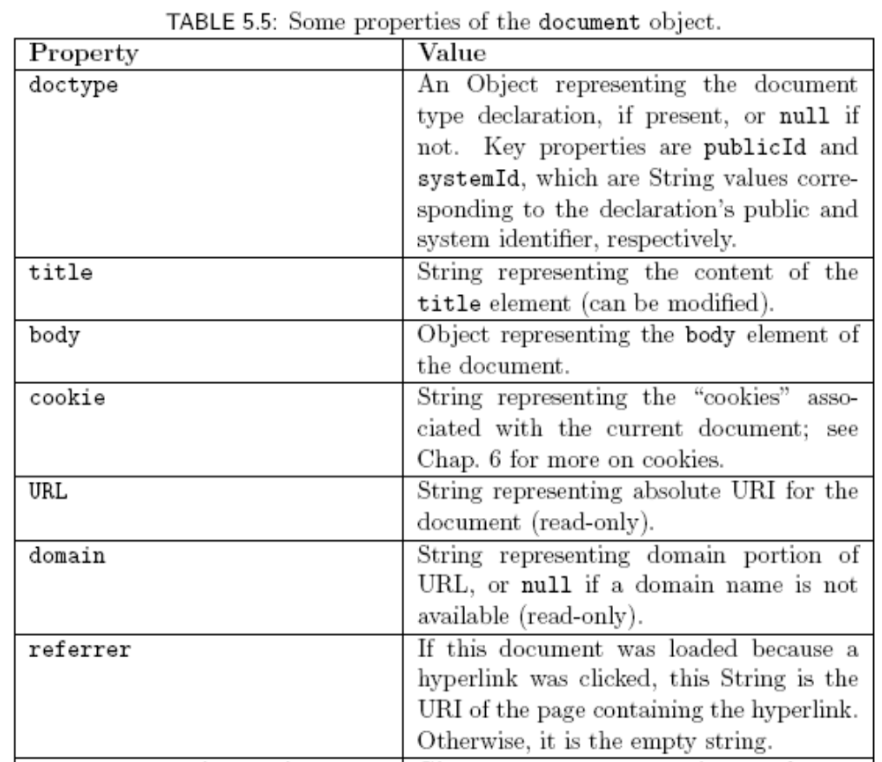
Document Tree: document
Anup Adhikari :: CIT 123 :: Web Technology - I

Slide 62
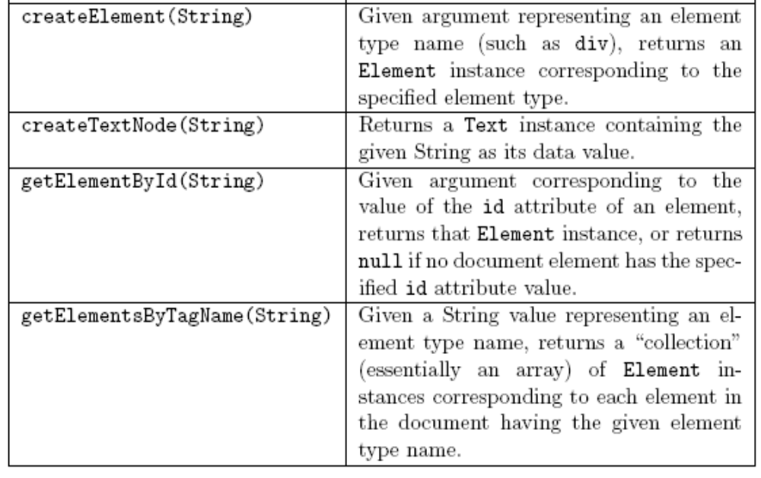
Document Tree: document
Anup Adhikari :: CIT 123 :: Web Technology - I

Slide 63
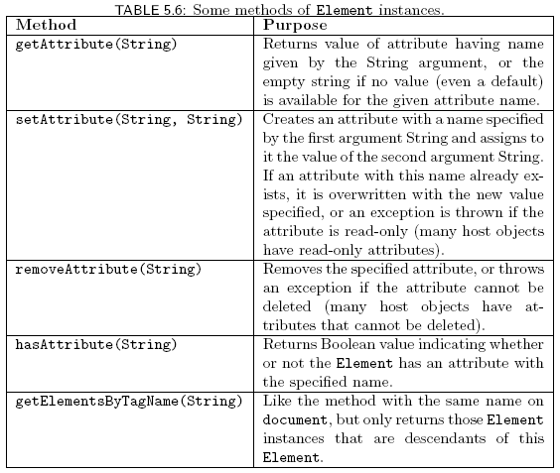
Document Tree: Element Nodes
Anup Adhikari :: CIT 123 :: Web Technology - I

Slide 64
Document Tree: Text Nodes
data property represents character data of a Text node
  Modifying the property modifies the corresponding text in the browser
By default, the DOM tree may contain sibling Text nodes
  Example: &copy; 2007 might be split into two Text nodes, one with copyright character
  Call normalize() method on an ancestor node to prevent this
Anup Adhikari :: CIT 123 :: Web Technology - I

Slide 65
Document Tree: Adding Nodes
<body onload="makeCollapsible('collapse1');">
<ol id="collapse1">
<li>First element of ordered list.</li>
<li>Second element.</li>
<li>Third element.</li>
</ol>
<p>
Paragraph following the list (does not collapse).
</p>
</body>
Body of original HTML document:
Anup Adhikari :: CIT 123 :: Web Technology - I

Slide 66
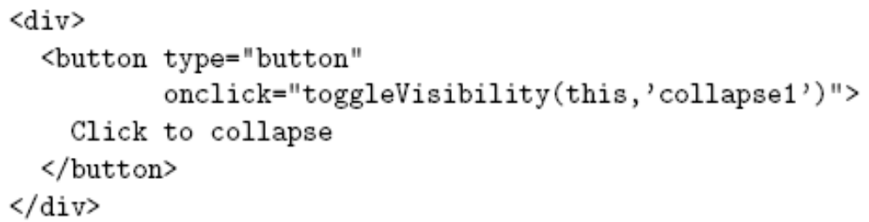
Document Tree: Adding Nodes
<body onload="makeCollapsible('collapse1');">
<ol id="collapse1">
<li>First element of ordered list.</li>
<li>Second element.</li>
<li>Third element.</li>
</ol>
<p>
Paragraph following the list (does not collapse).
</p>
</body>
Added
to DOM
tree:
Effect of executing makeCollapsible():
Anup Adhikari :: CIT 123 :: Web Technology - I

Slide 67
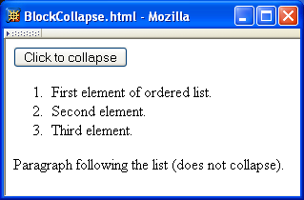
Document Tree: Adding Nodes
Added element
is displayed as if
it was part of
the HTML source
document
Anup Adhikari :: CIT 123 :: Web Technology - I

Slide 68
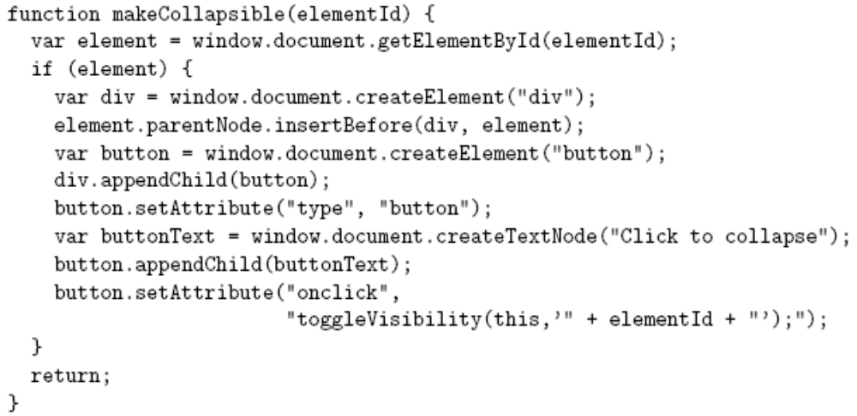
Document Tree: Adding Nodes
Anup Adhikari :: CIT 123 :: Web Technology - I

Slide 69
Document Tree: Adding Nodes
Node
creation
Anup Adhikari :: CIT 123 :: Web Technology - I

Slide 70
Document Tree: Adding Nodes
Node
addition to DOM
tree (rec. doing
this immediately
after creation).
Anup Adhikari :: CIT 123 :: Web Technology - I

Slide 71
Document Tree: Adding Nodes
Attribute
addition
Anup Adhikari :: CIT 123 :: Web Technology - I

Slide 72
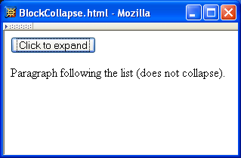
Document Tree: Adding Nodes
Before clicking button:
After clicking button:
Anup Adhikari :: CIT 123 :: Web Technology - I

Slide 73
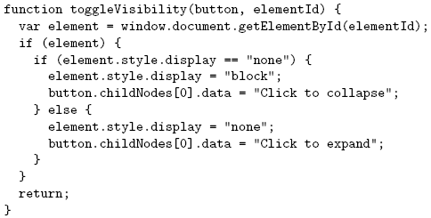
Document Tree: Adding Nodes
Anup Adhikari :: CIT 123 :: Web Technology - I

Slide 74
Document Tree: Adding Nodes
Modifying text.
Anup Adhikari :: CIT 123 :: Web Technology - I

Slide 75
Document Tree: Adding Nodes
Note that the previous example doesn’t work with IE6/7, for at
least two reasons:
“SetAttribute” doesn’t work, and should be replaced by a direct assignment
Even if
button.setAttribute("onclick", "toggleVisibility(this,'" + elementId +"');");
Was replaced with the IE friendly
button.onclick = toggleVisibility;
This seems to have been fixed in IE8
Anup Adhikari :: CIT 123 :: Web Technology - I

Slide 76
Document Tree: Adding Nodes
Adding Text nodes is often tedious, with the mandatory creation of a new node via “createTextNode” and insertion of the newly created node in the DOM.
A NON STANDARD alternative is to use innerHtml, which lets you just write blocks of html. It is faster (to write and to run), but error prone, and non standard so future support is unknown
Anup Adhikari :: CIT 123 :: Web Technology - I

Slide 77
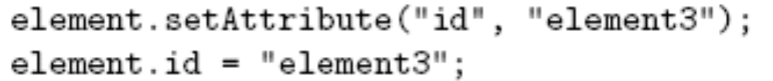
Document Tree: HTML Properties
Attribute values can be set two ways:
As with CSS properties, former has some advantages:
  Makes clear that setting an HTML attribute, not merely a property of an object
  Avoids certain special cases, e.g.
  element.setAttribute(“class”, “warning”); //DOM
  element.className = “warning”; //req’d in IE6
class is reserved word in JavaScript
Anup Adhikari :: CIT 123 :: Web Technology - I

Slide 78
DOM Event Handling
Note: IE6/7 has a different event model
Event instance created for each event
Event instance properties:
  type: name of event (click, mouseover, etc.)
  target: Node corresponding to document element that generated the event (e.g., button element for click, img for mouseover). This is the event target.
Anup Adhikari :: CIT 123 :: Web Technology - I

Slide 79
DOM Event Handling
JavaScript event listener: function that is called with Event instance when a certain event occurs
An event listener is associated with a target element by calling addEventListener() on the element (still doesn’t work with IE8, it seems)
Anup Adhikari :: CIT 123 :: Web Technology - I

Slide 80
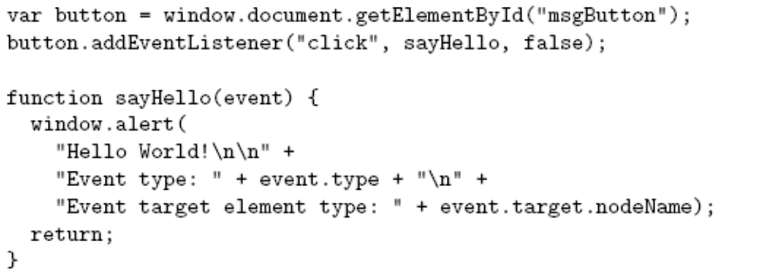
DOM Event Handling
Anup Adhikari :: CIT 123 :: Web Technology - I

Slide 81
DOM Event Handling
Event
target
Anup Adhikari :: CIT 123 :: Web Technology - I

Slide 82
DOM Event Handling
Event type
Anup Adhikari :: CIT 123 :: Web Technology - I

Slide 83
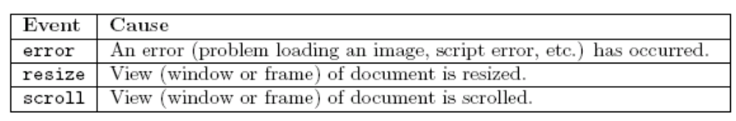
DOM Event Handling
DOM event types:
  All HTML intrinsic events except keypress, keydown, keyup, and dblclick
  Also has some others that are typically targeted at the window object:
Anup Adhikari :: CIT 123 :: Web Technology - I

Slide 84
DOM Event Handling
Event handler
Definition
of event
handler
Anup Adhikari :: CIT 123 :: Web Technology - I

Slide 85
DOM Event Handling
Event instance
Anup Adhikari :: CIT 123 :: Web Technology - I

Slide 86
DOM Event Handling
Normally false
(more later)
Anup Adhikari :: CIT 123 :: Web Technology - I

Slide 87
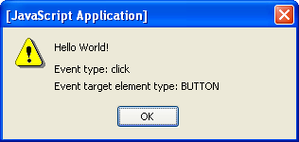
DOM Event Handling
Anup Adhikari :: CIT 123 :: Web Technology - I

Slide 88
DOM Event Handling:
Mouse Events
DOM2 mouse events
  click
  mousedown
  mouseup
  mousemove
  mouseover
  mouseout
Event instances have additional properties for mouse events
Anup Adhikari :: CIT 123 :: Web Technology - I

Slide 89
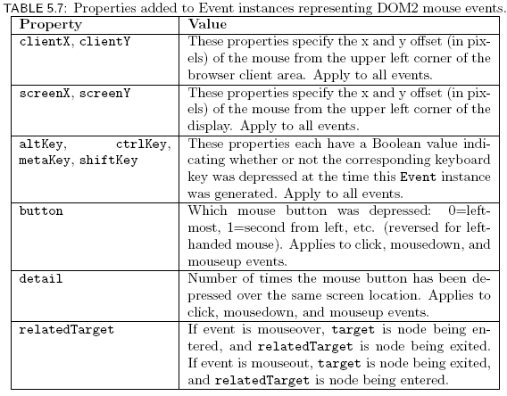
DOM Event Handling:
Mouse Events
Anup Adhikari :: CIT 123 :: Web Technology - I

Slide 90
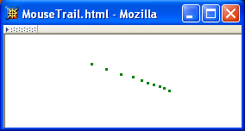
DOM Event Handling:
Mouse Events
Example: mouse “trail”
Anup Adhikari :: CIT 123 :: Web Technology - I

Slide 91


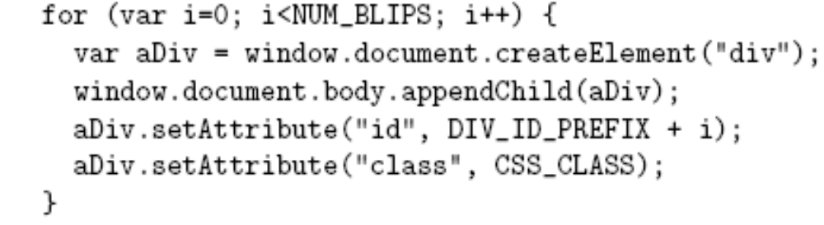
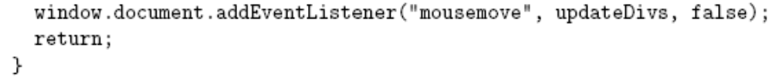
DOM Event Handling:
Mouse Events
HTML document:
JavaScript init() function:
Create
“blips”
String uniquely
identifying this div
Add event
listener
Anup Adhikari :: CIT 123 :: Web Technology - I

Slide 92
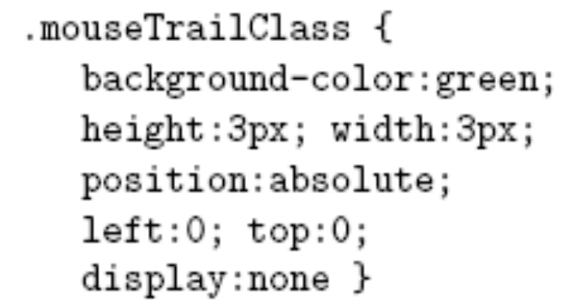
DOM Event Handling:
Mouse Events
Style sheet for “blips”:
Initially, not displayed
Anup Adhikari :: CIT 123 :: Web Technology - I

Slide 93
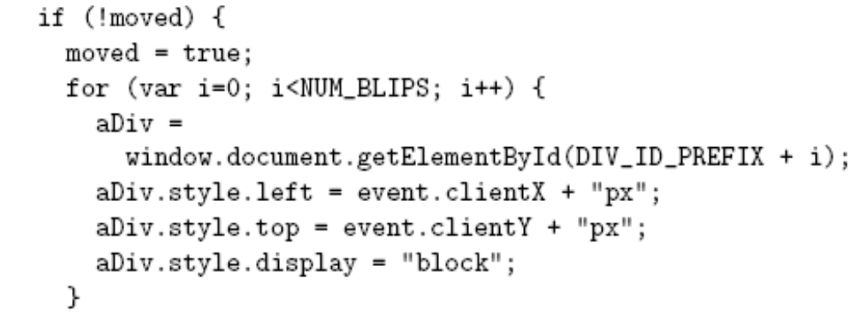
DOM Event Handling:
Mouse Events
Event handler updateDivs():
Convert mouse location
from Number to String
and append units
Anup Adhikari :: CIT 123 :: Web Technology - I

Slide 94
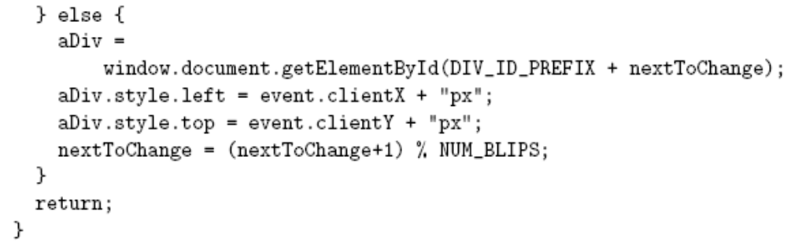
DOM Event Handling:
Mouse Events
Event handler updateDivs():
Mod (remainder) operator
used to cycle through “blip” divs
(least-recently changed is the
next div moved)
Anup Adhikari :: CIT 123 :: Web Technology - I

Slide 95
DOM Event Propagation
Target of event is lowest-level element associated with event
  Ex: target is the a element if the link is clicked:
  <td><a href=…>click</a></td>
However, event listeners associated with ancestors of the target may also be called
Anup Adhikari :: CIT 123 :: Web Technology - I

Slide 96
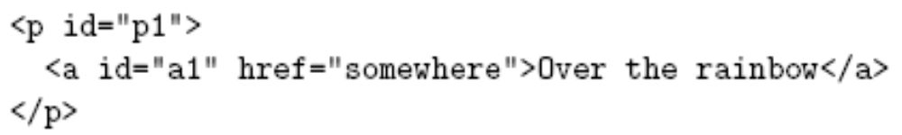
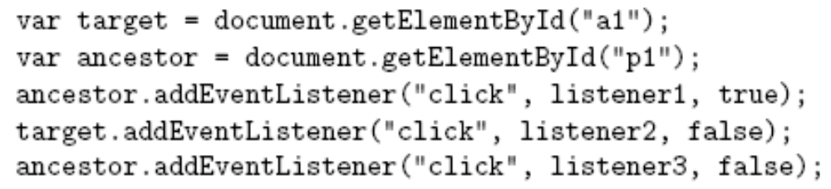
DOM Event Propagation
Three types of event listeners:
Anup Adhikari :: CIT 123 :: Web Technology - I

Slide 97
DOM Event Propagation
Three types of event listeners:
Capturing: Listener on ancestor created with true as third arg.
Anup Adhikari :: CIT 123 :: Web Technology - I

Slide 98
DOM Event Propagation
Three types of event listeners:
Target: Listener on target element
Anup Adhikari :: CIT 123 :: Web Technology - I

Slide 99
DOM Event Propagation
Three types of event listeners:
Bubbling: Listener on ancestor created with false as third arg.
Anup Adhikari :: CIT 123 :: Web Technology - I

Slide 100
DOM Event Propagation
Priority of event handlers:
Capturing event
handlers; ancestors
closest to root
have highest
priority
body
ol
li
a
Target
Anup Adhikari :: CIT 123 :: Web Technology - I

Slide 101
DOM Event Propagation
Priority of event handlers:
body
ol
li
a
2. Target event handlers
Anup Adhikari :: CIT 123 :: Web Technology - I

Slide 102
DOM Event Propagation
Priority of event handlers:
body
ol
li
a
3. Bubbling event
handlers; ancestors
closest to target have
priority.
Anup Adhikari :: CIT 123 :: Web Technology - I

Slide 103
DOM Event Propagation
Certain events do not bubble, e.g.,
  load
  unload
  focus
  blur
Anup Adhikari :: CIT 123 :: Web Technology - I

Slide 104
DOM Event Propagation
Propagation-related properties of Event instances:
  eventPhase: represents event processing phase:
    1: capturing
    2: target
    3: bubbling
  currentTarget: object (ancestor or target) associated with this event handler
Anup Adhikari :: CIT 123 :: Web Technology - I

Slide 105
DOM Event Propagation
Propagation-related method of Event instances:
  stopPropagation(): lower priority event handlers will not be called
Typical design:
  Use bubbling event handlers to provide default processing (may be stopped)
  Use capturing event handlers to provide required processing (e.g., cursor trail)
Anup Adhikari :: CIT 123 :: Web Technology - I

Slide 106
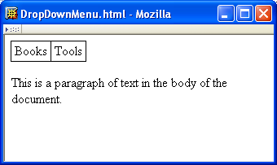
Example: Drop-down Menus
When cursor
moves over
upper menu
…
Anup Adhikari :: CIT 123 :: Web Technology - I

Slide 107
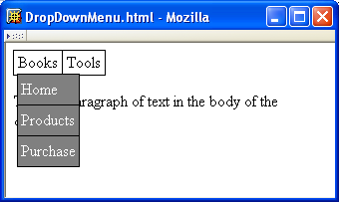
Example: Drop-down Menus
…
a drop-down
appears
Anup Adhikari :: CIT 123 :: Web Technology - I

Slide 108
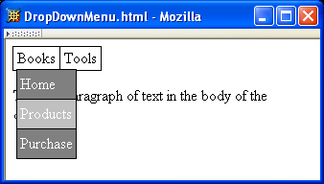
Example: Drop-down Menus
Background color changes
as cursor moves over
drop-down items
Anup Adhikari :: CIT 123 :: Web Technology - I

Slide 109
Example: Drop-down Menus
Drop-down
disappears
when cursor
leaves both
drop-down
and menu
Anup Adhikari :: CIT 123 :: Web Technology - I

Slide 110
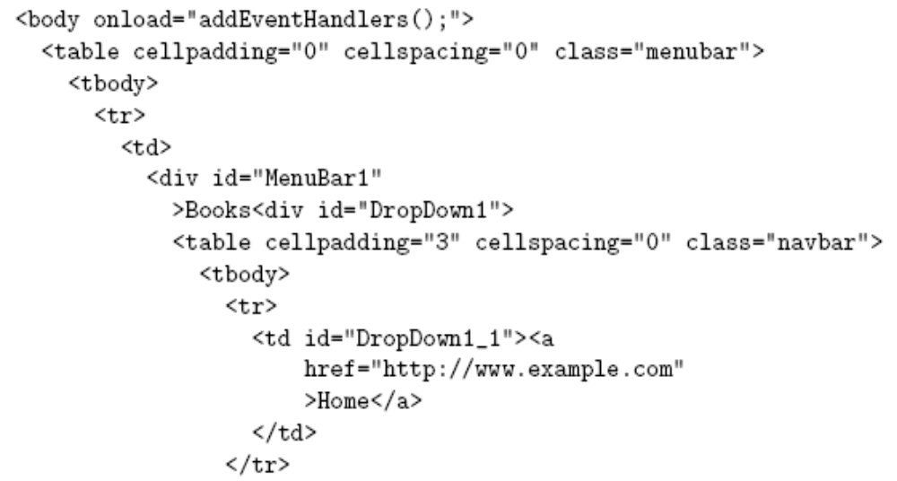
Example: Drop-down Menus
Document structure:
Anup Adhikari :: CIT 123 :: Web Technology - I

Slide 111
Example: Drop-down Menus
Event handlers will be added by
JavaScript code
Document structure:
Anup Adhikari :: CIT 123 :: Web Technology - I

Slide 112
Example: Drop-down Menus
Document structure:
Top menu
is a table
Anup Adhikari :: CIT 123 :: Web Technology - I

Slide 113
Example: Drop-down Menus
Document structure:
CSS:
Each top
menu item is
a (positioned)
div
Anup Adhikari :: CIT 123 :: Web Technology - I

Slide 114

Example: Drop-down Menus
Document structure:
CSS:
Associated
drop-down is
in a div
that is
out of the normal
flow and initially
invisible
Anup Adhikari :: CIT 123 :: Web Technology - I

Slide 115
Example: Drop-down Menus
Document structure:
Associated
drop-down is
a table
Anup Adhikari :: CIT 123 :: Web Technology - I

Slide 116


Example: Drop-down Menus
Full style rules:
Anup Adhikari :: CIT 123 :: Web Technology - I

Slide 117
Example: Drop-down Menus
Full style rules:
Top menu item div
is “positioned” but
not moved from normal
flow location
Anup Adhikari :: CIT 123 :: Web Technology - I

Slide 118
Example: Drop-down Menus
Full style rules:
Upper left corner of
drop-down div overlaps
bottom border of top
menu
Anup Adhikari :: CIT 123 :: Web Technology - I

Slide 119
Example: Drop-down Menus
Full style rules:
Drop-down drawn over
lower z-index elements
Anup Adhikari :: CIT 123 :: Web Technology - I

Slide 120

Example: Drop-down Menus
Adding event handlers to top menu:
  Document:
  JavaScript addEventHandlers():
Target
event
handlers
Anup Adhikari :: CIT 123 :: Web Technology - I

Slide 121
Example: Drop-down Menus
Adding event handlers to top menu:
  Document:
  JavaScript addEventListener():
menuBar1 will be target of events; adding reference to the drop-down
div makes it easy for event handler to access the drop-down
Anup Adhikari :: CIT 123 :: Web Technology - I

Slide 122


Example: Drop-down Menus
Anup Adhikari :: CIT 123 :: Web Technology - I

Slide 123
Example: Drop-down Menus
Basic
processing:
change
visibility of
drop-down
Anup Adhikari :: CIT 123 :: Web Technology - I

Slide 124
Example: Drop-down Menus
Ignore
bubbling
mouseover
events from
drop-down
Anup Adhikari :: CIT 123 :: Web Technology - I

Slide 125
Example: Drop-down Menus
Ignore
mouseout
event if
cursor is
remaining
over menu
item or
drop-down
(self or
descendant)
Anup Adhikari :: CIT 123 :: Web Technology - I

Slide 126

Example: Drop-down Menus
Anup Adhikari :: CIT 123 :: Web Technology - I

Slide 127

Example: Drop-down Menus
Adding event handlers to drop-down:
  Document:
  JavaScript addEventListener():
Anup Adhikari :: CIT 123 :: Web Technology - I

Slide 128



Example: Drop-down Menus
Anup Adhikari :: CIT 123 :: Web Technology - I

Slide 129
Example: Drop-down Menus
Don’t
bother
changing
style if
this event
bubbled
from a
descendant.
Anup Adhikari :: CIT 123 :: Web Technology - I

Slide 130
Example: Drop-down Menus
Don’t bubble up to showDropDown since
the drop-down must be visible
Anup Adhikari :: CIT 123 :: Web Technology - I

Slide 131
Example: Drop-down Menus
Ignore
mouseout to
a descendant
Anup Adhikari :: CIT 123 :: Web Technology - I

Slide 132
DOM Event Cancellation
Browser provides default event listener for certain elements and events
  Ex: click on hyperlink
  Ex: click on submit button
Default listeners are called after all user-specified listeners
stopPropagation() does not affect default listeners
Instead, call preventDefault() on Event instance to cancel default event handling
Anup Adhikari :: CIT 123 :: Web Technology - I

Slide 133

DOM Form Validation
Anup Adhikari :: CIT 123 :: Web Technology - I

Slide 134
DOM Form Validation
<body onload="addListeners();">
<form id="validatedForm" action="http://www.example.com">
<p>
<label>Required input:
<input type="text"
name="requiredField" id="requiredField" />
</label>
<input type="submit"
name="submit" value="Click to submit" />
</p>
</form>
</body>
Anup Adhikari :: CIT 123 :: Web Technology - I

Slide 135


DOM Form Validation
Anup Adhikari :: CIT 123 :: Web Technology - I

Slide 136
DOM Form Validation
Listen for form to be submitted
Anup Adhikari :: CIT 123 :: Web Technology - I

Slide 137
DOM Form Validation
Must use value property to access
value entered in text field on form
Anup Adhikari :: CIT 123 :: Web Technology - I

Slide 138
DOM Form Validation
Regular expression literal representing
“set of strings consisting only of white space”
Anup Adhikari :: CIT 123 :: Web Technology - I

Slide 139
DOM Form Validation
Cancel browser’s default submit event processing
Anup Adhikari :: CIT 123 :: Web Technology - I

Slide 140


DOM Event Generation
Several Element’s provide methods for generating events
  Ex: causes text in text field to be selected and a select event to occur
Anup Adhikari :: CIT 123 :: Web Technology - I

Slide 141
Detecting Host Objects
How can a JavaScript program test for the existence of a certain host object?
  Does the style element have a setProperty() method?
  If we’re also not sure that element is defined or that style exists:
Anup Adhikari :: CIT 123 :: Web Technology - I

Slide 142
Detecting Host Objects
Is a browser DOM-compliant?
  Ex: document.implementation(“Core”, “2.0”) returns true if browser implements all of DOM 2 Core module, false otherwise
  Problem: what does false tell you?
Many scripts attempt to directly determine the browser, but…
  What about new browsers?
  Some browsers can “lie” about what they are
Anup Adhikari :: CIT 123 :: Web Technology - I

Slide 143
IE6 and the DOM
No Node object (and associated constants)
No setProperty() or getPropertyValue()
Must use “className” rather than “class” in setAttribute() and getAttribute()
Empty div/span height cannot be made less than character height
Anup Adhikari :: CIT 123 :: Web Technology - I

Slide 144
IE6 and the DOM
No addEventListener() (so no multiple listeners)
Cannot use setAttribute() to specify intrinsic event attribute
  DOM:
  IE6:
Value assigned is a function Object (method)
rather than a String.
Anup Adhikari :: CIT 123 :: Web Technology - I

Slide 145

IE6 and the DOM
Adding listeners to both IE6 and DOM:
String-valued in DOM, initially null in IE6
Anup Adhikari :: CIT 123 :: Web Technology - I

Slide 146

IE6 and the DOM
Passing arguments to event listeners:
  DOM:
  IE6:
Listener is called as a method
in IE6, so this is a reference
to button
Anup Adhikari :: CIT 123 :: Web Technology - I

Slide 147



IE6 and the DOM
Passing arguments to event listeners:
Test that arguments are defined
DOM
approach
Anup Adhikari :: CIT 123 :: Web Technology - I

Slide 148
IE6 and the DOM
Passing arguments to event listeners:
Test for host object created by IE6 when event occurs
IE6
approach
Update: window.event test succeed with Chrome!
Anup Adhikari :: CIT 123 :: Web Technology - I

Slide 149
IE6 and the DOM
Passing arguments to event listeners:
DOM
approach
IE6
approach
Anup Adhikari :: CIT 123 :: Web Technology - I

Slide 150
IE6 and the DOM
Passing arguments to event listeners:
DOM
approach
IE6
approach
Anup Adhikari :: CIT 123 :: Web Technology - I

Slide 151

IE6 and the DOM
IE6 does not pass an Event instance to event listeners
Instead, IE6 creates a global object event when an (intrinsic) event occurs
Testing for non-DOM call:
In a DOM-compliant
call to event listener
there is one
argument that is
an Event instance
Basically an Array
of call arguments
Anup Adhikari :: CIT 123 :: Web Technology - I

Slide 152


IE6 and the DOM
Converting event object to Event-like:
Undefined if IE6
Global object
created by IE6
In IE6, evaluates to Object
value of DOM’s Event
currentTarget property
Anup Adhikari :: CIT 123 :: Web Technology - I

Slide 153


IE6 and the DOM
Converting event object to Event-like:
Anup Adhikari :: CIT 123 :: Web Technology - I

Slide 154
IE6 and the DOM
Converting event object to Event-like:
Use
exception
handling
for convenience
rather than
testing
for existence
of properties
Anup Adhikari :: CIT 123 :: Web Technology - I

Slide 155
IE6 and the DOM
Converting event object to Event-like:
Most type
values
(except
dblclick)
are copied
without
change
Anup Adhikari :: CIT 123 :: Web Technology - I

Slide 156
IE6 and the DOM
Converting event object to Event-like:
IE6 uses
a different
name for
target
Anup Adhikari :: CIT 123 :: Web Technology - I

Slide 157
IE6 and the DOM
Converting event object to Event-like:
currentTarget passed in from event listener:
within eventConvert(), this refers to the global object!
Anup Adhikari :: CIT 123 :: Web Technology - I

Slide 158

IE6 and the DOM
Converting event object to Event-like:
Anup Adhikari :: CIT 123 :: Web Technology - I

Slide 159
IE6 and the DOM
Converting event object to Event-like:
Use function expressions to define DOM methods as setting IE properties
Anup Adhikari :: CIT 123 :: Web Technology - I

Slide 160
IE6 and the DOM
Converting event object to Event-like:
Most mouse-event
properties are identical
Anup Adhikari :: CIT 123 :: Web Technology - I

Slide 161

IE6 and the DOM
Converting event object to Event-like:
Buttons are numbered
differently
Anup Adhikari :: CIT 123 :: Web Technology - I

Slide 162
IE6 and the DOM
Converting event object to Event-like:
Different names for
relatedTarget
Anup Adhikari :: CIT 123 :: Web Technology - I

Slide 163
IE6 and the DOM
Converting event object to Event-like:
  Capturing listeners behave somewhat differently in IE6 and DOM, so eventConvert() did not attempt to simulate the eventPhase DOM property
Anup Adhikari :: CIT 123 :: Web Technology - I

Slide 164
Other Common Host Objects
Browsers also provide many non-DOM host objects as properties of window
While no formal standard defines these objects, many host objects are very similar in IE6 and Mozilla
Anup Adhikari :: CIT 123 :: Web Technology - I

Slide 165

Other Common Host Objects
Anup Adhikari :: CIT 123 :: Web Technology - I

Slide 166

Other Common Host Objects
Anup Adhikari :: CIT 123 :: Web Technology - I

Slide 167

Other Common Host Objects
Anup Adhikari :: CIT 123 :: Web Technology - I

Slide 168
Other Common Host Objects
open() creates a pop-up window
  Each window has its own global object, host objects, etc.
  Use pop-ups with care:
    Pop-ups may be blocked by the browser
    They can annoy and/or confuse users
Anup Adhikari :: CIT 123 :: Web Technology - I

Slide 169

Other Common Host Objects
Anup Adhikari :: CIT 123 :: Web Technology - I

Slide 170

Other Common Host Objects
Anup Adhikari :: CIT 123 :: Web Technology - I

Slide 171

Other Common Host Objects
Anup Adhikari :: CIT 123 :: Web Technology - I

Slide 172
Other Common Host Objects
Anup Adhikari :: CIT 123 :: Web Technology - I

Slide 173


Other Common Host Objects
Anup Adhikari :: CIT 123 :: Web Technology - I

Slide 174
Other Common Host Objects
Anup Adhikari :: CIT 123 :: Web Technology - I

Slide 175

Other Common Host Objects
Anup Adhikari :: CIT 123 :: Web Technology - I

Slide 176

Other Common Host Objects
Anup Adhikari :: CIT 123 :: Web Technology - I

Slide 177

Other Common Host Objects
Anup Adhikari :: CIT 123 :: Web Technology - I

Slide 178
Other Common Host Objects
navigator: (unreliable) information about browser, including String-valued properties:
  appName
  appVersion
  userAgent
screen: information about physical device, including Number properties:
  availHeight, availWidth: effective screen size (pixels)
  colorDepth: bits per pixel
Anup Adhikari :: CIT 123 :: Web Technology - I

