Slide 1
Representing Web Data:
XML
CIT 123
Web Application - I

Slide 2
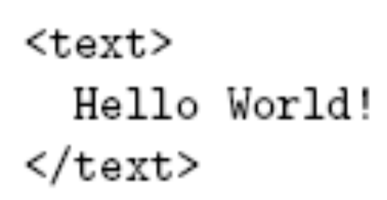
XML
Example XML document:
An XML document is one that follows certain syntax rules (most of which we followed for XHTML)

Slide 3
XML Syntax
An XML document consists of
  Markup
    Tags, which begin with < and end with >
    References, which begin with & and end with ;
      Character, e.g. &#x20;
      Entity, e.g. &lt;
        The entities lt, gt, amp, apos, and quot are recognized in every XML document.
        Other XHTML entities, such as nbsp, are only recognized in other XML documents if they are defined in the DTD
  Character data: everything not markup

Slide 4
XML Syntax
Comments
  Begin with <!--
  End -->
  Must not contain –
CDATA section
  Special element the entire content of which is interpreted as character data, even if it appears to be markup
  Begins with <![CDATA[
  Ends with ]]> (illegal except when ending CDATA)

Slide 5

XML Syntax
The CDATA section
is equivalent to the markup

Slide 6
XML Syntax
< and & must be represented by references except
  When beginning markup
  Within comments
  Within CDATA sections

Slide 7
XML Syntax
Element tags and elements
  Three types
    Start, e.g. <message>
    End, e.g. </message>
    Empty element, e.g. <br />
  Start and end tags must properly nest
  Corresponding pair of start and end element tags plus everything in between them defines an element
  Character data may only appear within an element

Slide 8
XML Syntax
Start and empty-element tags may contain attribute specifications separated by white space
  Syntax: name = quoted value
  quoted value must not contain <, can contain & only if used as start of reference
  quoted value must begin and end with matching quote characters (‘ or “)

Slide 9
XML Syntax
Element and attribute names are case sensitive
XML white space characters are space, carriage return, line feed, and tab

Slide 10
XML Documents
A well-formed XML document
  follows the XML syntax rules and
  has a single root element
Well-formed documents have a tree structure
Many XML parsers (software for reading/writing XML documents) use tree representation internally

Slide 11
XML Documents
An XML document is written according to an XML vocabulary that defines
  Recognized element and attribute names
  Allowable element content
  Semantics of elements and attributes
XHTML is one widely-used XML vocabulary
Another example: RSS (rich site summary)

Slide 12
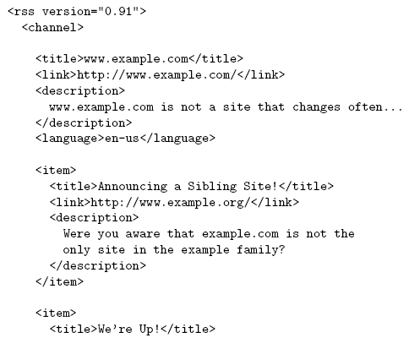
XML Documents

Slide 13
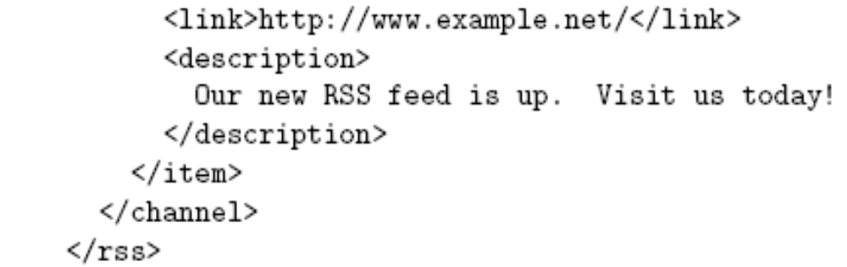
XML Documents

Slide 14
XML Documents
Valid names and content for an XML vocabulary can be specified using
  Natural language
  XML DTDs (Chapter 2)
  XML Schema (Chapter 9)
If DTD is used, then XML document can include a document type declaration:

Slide 15
XML Documents
Two types of XML parsers:
  Validating
    Requires document type declaration
    Generates error if document does not
      Conform with DTD and
      Meet XML validity constraints
        Example: every attribute value of type ID must be unique within the document
  Non-validating
    Checks for well-formedness
    Can ignore external DTD

Slide 16
XML Documents
Good practice to begin XML documents with an XML declaration
  Minimal example:
  If included, < must be very first character of the document
  To override default UTF-8/UTF-16 character encoding, include encoding declaration following version:

Slide 17
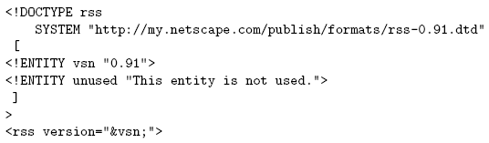
XML Documents
Internal subset of DTD
  Entity vsn will be defined by any XML parser, validating or not
Declaration of
internal subset of DTD

Slide 18
XML Namespaces
XML Namespace: Collection of element and attribute names associated with an XML vocabulary
Namespace Name: Absolute URI that is the name of the namespace
  Ex: http://www.w3.org/1999/xhtml is the namespace name of XHTML 1.0
Default namespace for elements of a document is specified using a form of the xmlns attribute:

Slide 19
XML Namespaces
Another form of xmlns attribute known as a namespace declaration can be used to associate a namespace prefix with a namespace name:
Namespace prefix
Namespace declaration

Slide 20
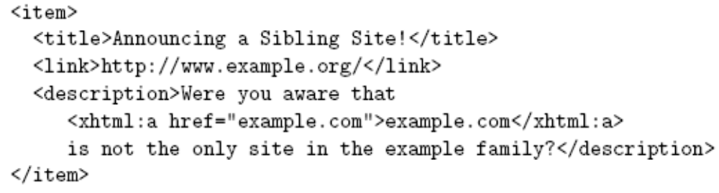
XML Namespaces
Example use of namespace prefix:

Slide 21
XML Namespaces
In a namespace-aware XML application, all element and attribute names are considered qualified names
  A qualified name has an associated expanded name that consists of a namespace name and a local name
  Ex: item is a qualified name with expanded name <null, item>
  Ex: xhtml:a is a qualified name with expanded name <http://www.w3.org/1999/xhtml, a>

Slide 22
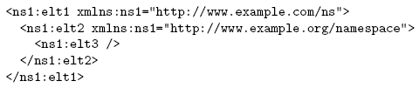
XML Namespaces
Other namespace usage:
A namespace can be declared and used on the same element

Slide 23
XML Namespaces
Other namespace usage:
A namespace prefix can be redefined for
an element and its content
These elements belong to http://www.example.org/namespace

Slide 24
JavaScript and XML
JavaScript DOM can be used to process XML documents
JavaScript XML Dom processing is often used with XMLHttpRequest
  Host object that is a constructor for other host objects
  Sends an HTTP request to server, receives back an XML document

Slide 25
JavaScript and XML
Example use:
  Previous visit count servlet: must reload document to see updated count
  Visit count with XMLHttpRequest: browser will automatically update the visit count periodically without reloading the entire page

Slide 26
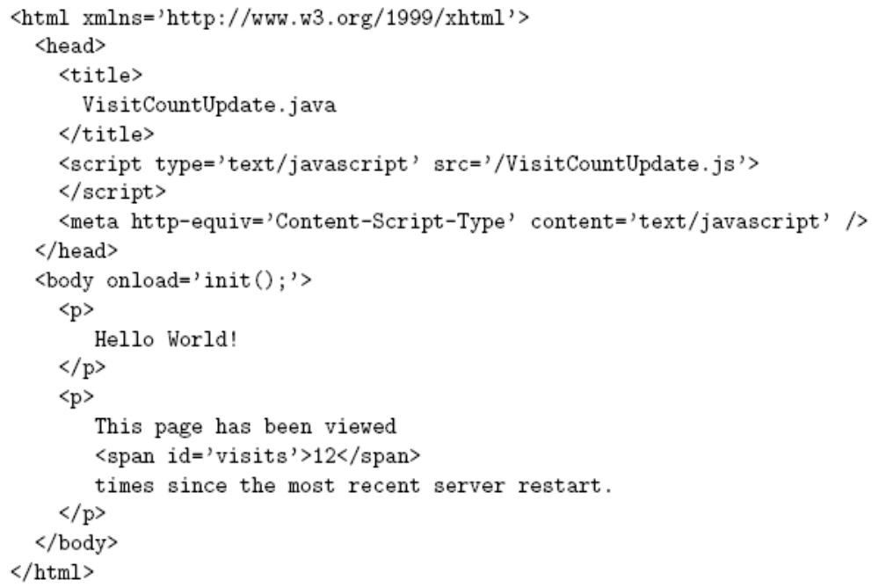
JavaScript and XML
Document
generated by
GET request to
VisitCountUpdate
servlet
JavaScript file using
XMLHttpRequest object
span that will be updated by JavaScript code

Slide 27
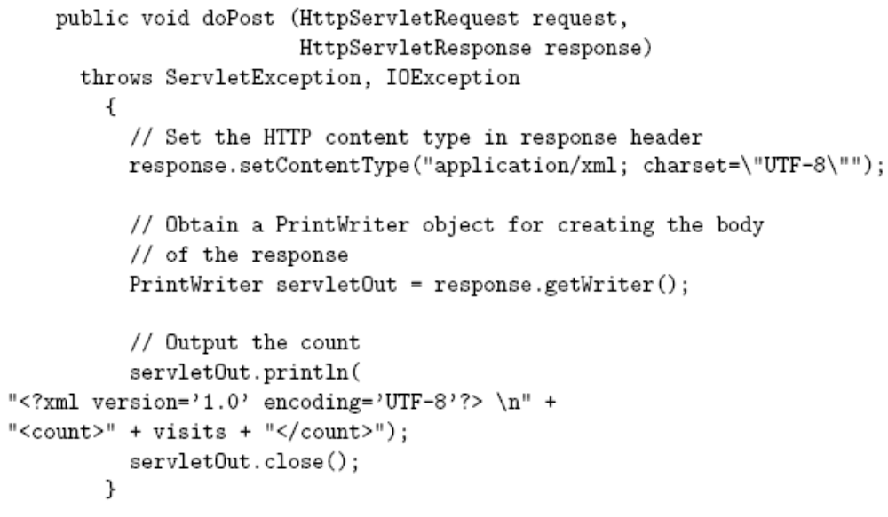
JavaScript and XML
Response is XML document
XMLHttpRequest
request is processed
by doPost() method of
servlet
Current visit count is returned as content
of count XML element

Slide 28
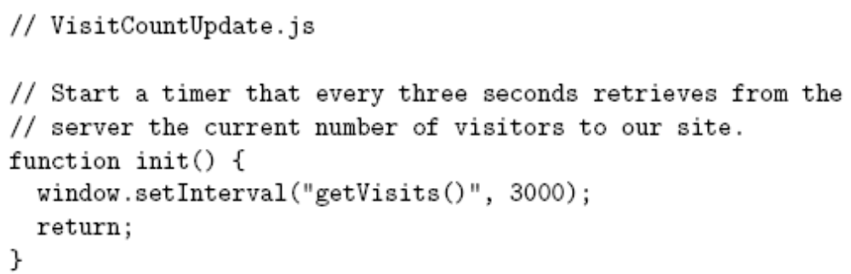
JavaScript and XML

Slide 29
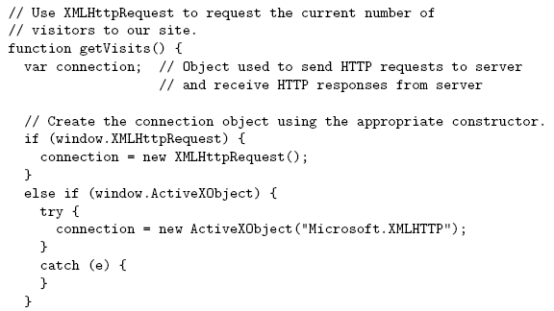
JavaScript and XML
Typical code for creating an instance of XMLHttpRequest

Slide 30
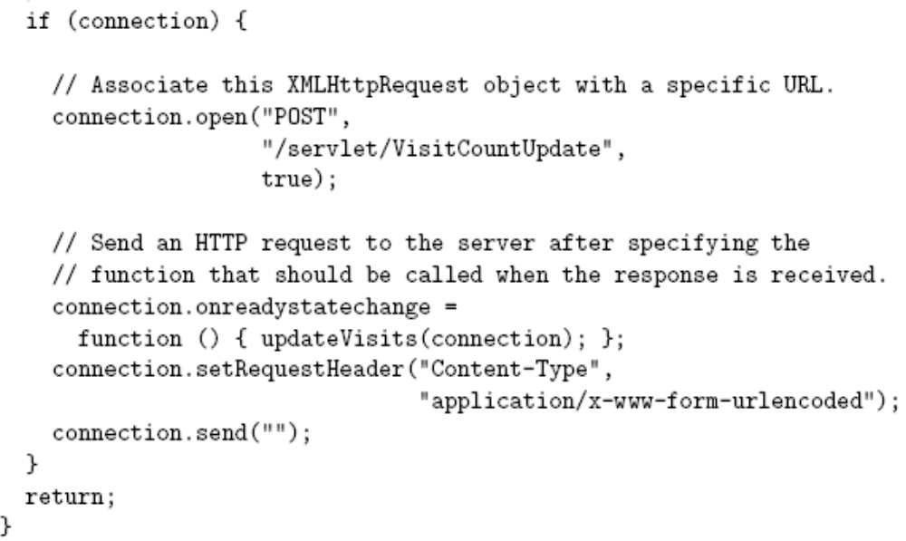
JavaScript and XML
Return immediately after sending request
(asynchronous behavior)
Function called as
state of connection
changes
Body of request (empty in this example)

Slide 31
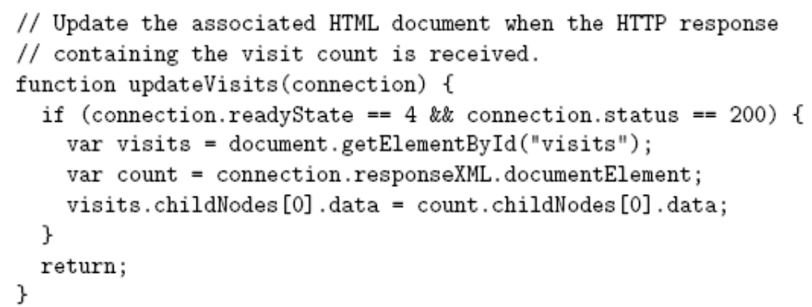
JavaScript and XML
Indicates response received
successfully
Root of
returned
XML
document

Slide 32
JavaScript and XML
Ajax: Asynchronous JavaScript and XML
Combination of
  (X)HTML
  XML
  CSS
  JavaScript
  JavaScript DOM (HTML and XML)
  XMLHttpRequest in asynchronous mode

Slide 33
Java-based DOM
Java DOM API defined by org.w3c.dom package
Semantically similar to JavaScript DOM API, but many small syntactic differences
  Nodes of DOM tree belong to classes such as Node, Document, Element, Text
  Non-method properties accessed via methods
    Ex: parentNode accessed by calling getParentNode()

Slide 34
Java-based DOM
Methods such as getElementsByTagName() return instance of NodeList
  getLength() method returns # of items
  item() method returns an item

Slide 35
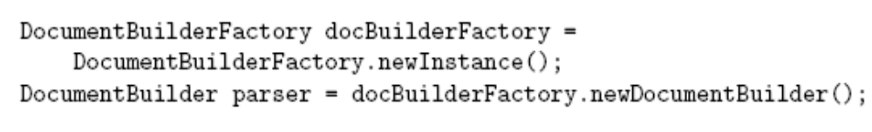
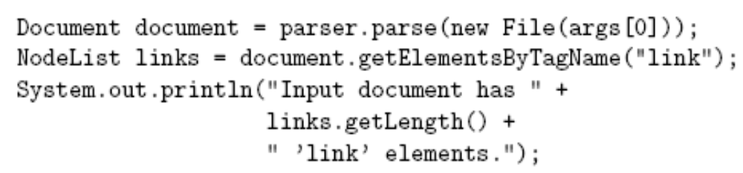
Java-based DOM
Example: program to count link elements in an RSS document:

Slide 36
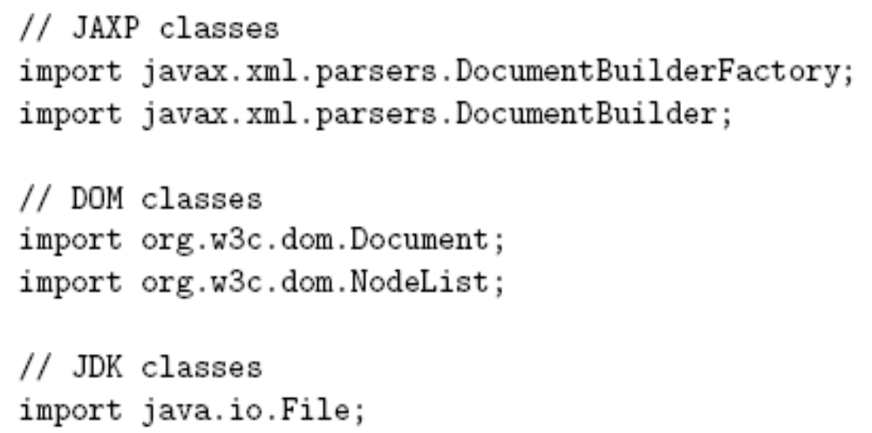
Java-based DOM
Imports:
From Java
API for XML
Processing
(JAXP)

Slide 37
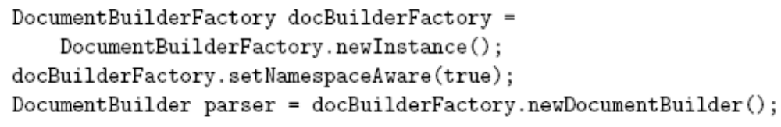
Java-based DOM
Default parser is non-validating and non-namespace-aware.
Overriding:
Also setValidating(true)

Slide 38

Java-based DOM
Namespace-aware versions of methods end in NS:
Namespace name
Local name

Slide 39
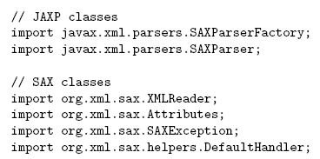
SAX

Slide 40
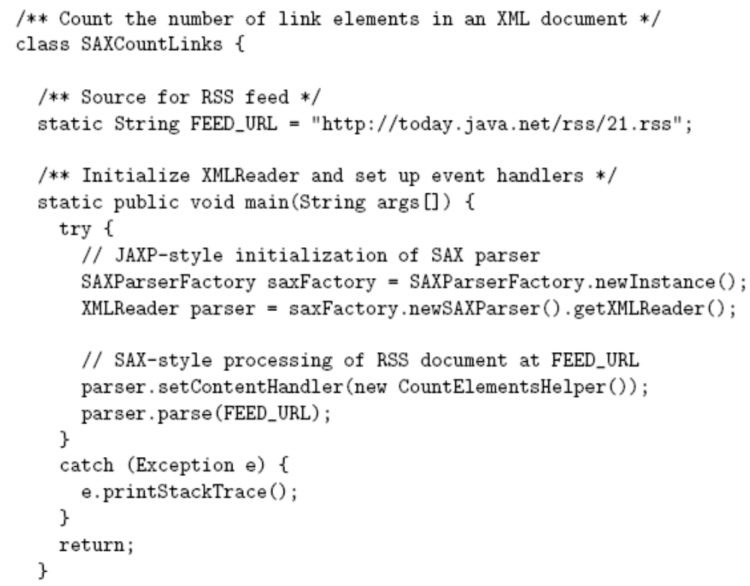
SAX

Slide 41
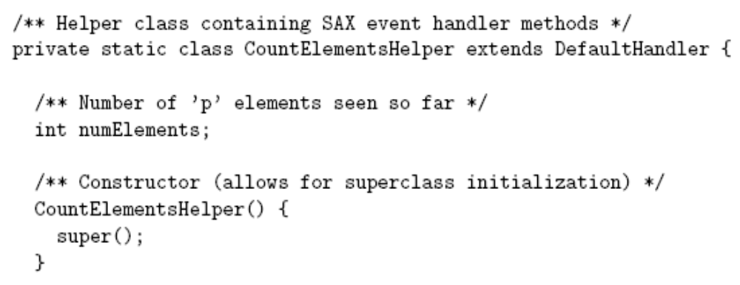
SAX

Slide 42
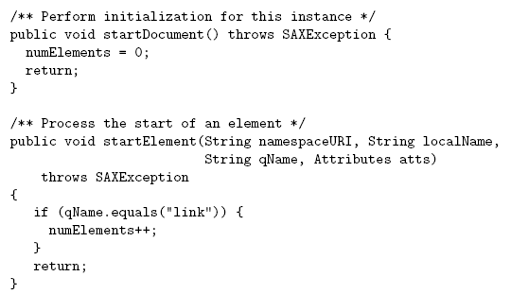
SAX
Used if not namespace-aware or
if qualified name does not belong
to any namespace.

Slide 43
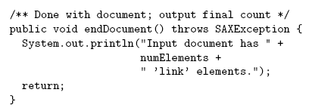
SAX

Slide 44
Transformations
JAXP provides API for transforming between DOM, SAX, and Stream (text) representations of XML documents
Example:
  Input from stream to DOM
  Modify DOM
  Output as stream

Slide 45
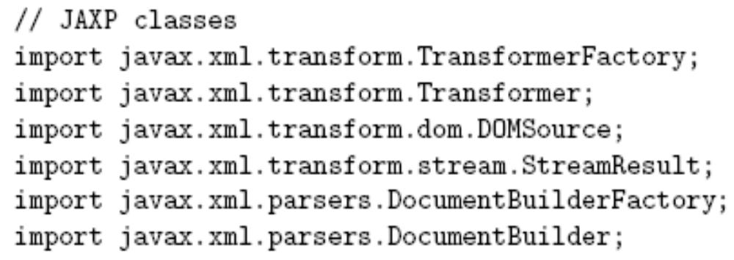
Transformations

Slide 46
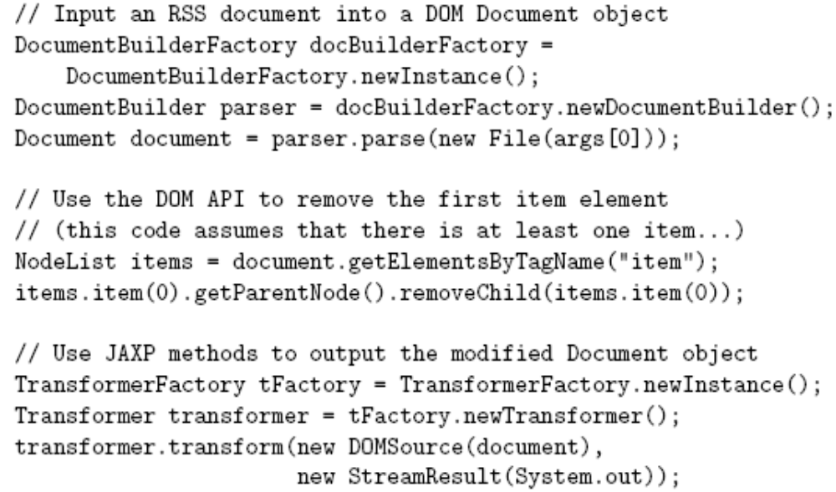
Transformations

Slide 47
Transformations
“SAX output” means that a SAX event handler is called:
  Example: the code
  feeds the XML document represented by DOM document through the SAX event handler CountElementsHelper()

Slide 48
XSL
The Extensible Stylesheet Language (XSL) is an XML vocabulary typically used to transform XML documents from one form to another form
XSL document
Input XML
document
XSLT Processor
Output XML
document

Slide 49
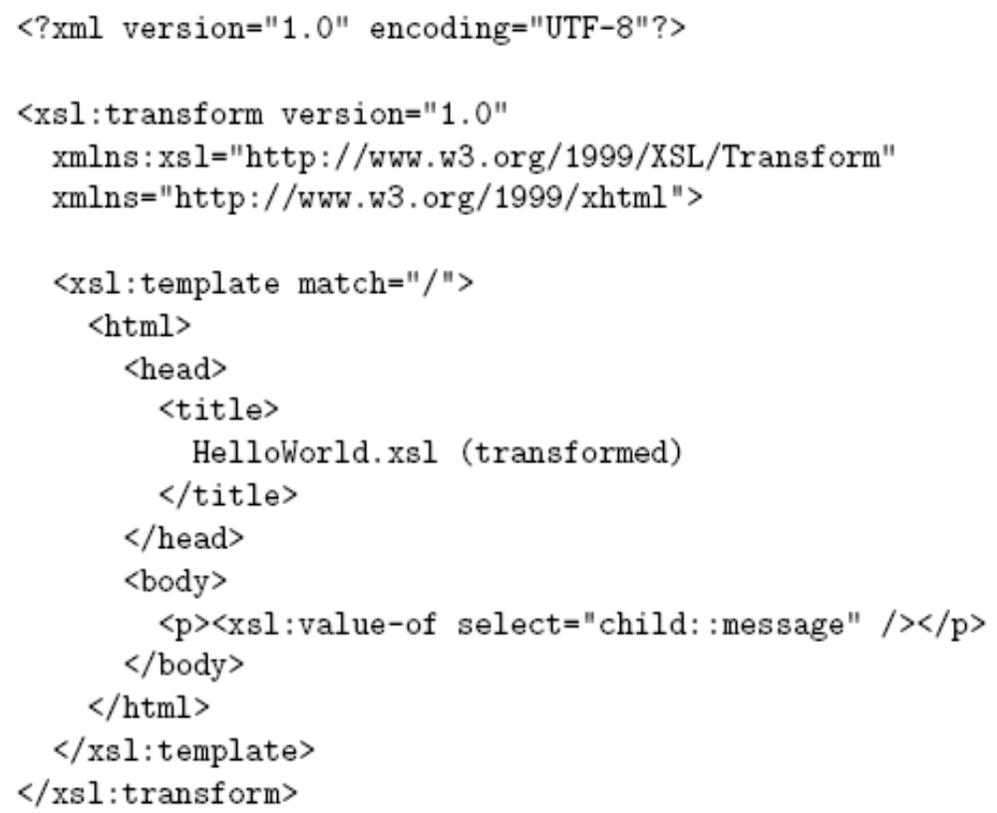
XSL
Example XSL document
HelloWorld.xsl
Everything in the body
of the document that is
not XSL markup is
template data
XSL
markup

Slide 50
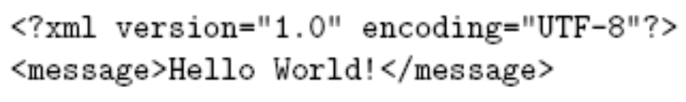
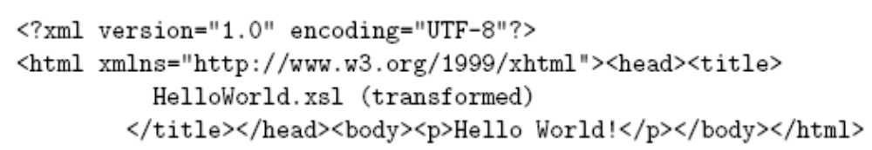
XSL
Input XML document HelloWorld.xml:
Output XML document:

Slide 51
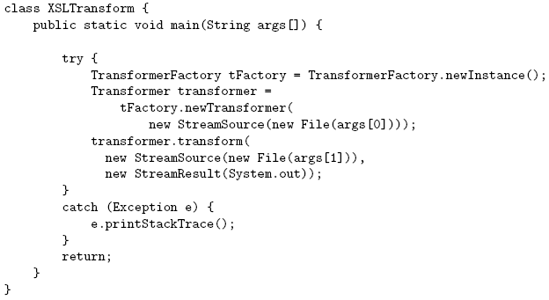
XSL

Slide 52
XSL
Components of XSL:
  XSL Transformations (XSLT): defines XSL namespace elements and attributes
  XML Path Language (XPath): used in many XSL attribute values (ex: child::message)
  XSL Formatting Objects (XSL-FO): XML vocabulary for defining document style (print-oriented)

Slide 53
XPath
XPath operates on a tree representation of an XML document
  Similar to DOM tree in that nodes have different types (element, text, comment, etc.)
  Unlike DOM, attributes are also nodes in the XPath tree
  Root of XPath tree called document root
  One of the children of the document root, called the document element, is the root element of the XML document

Slide 54

XPath
Location path: expression representing one or more XPath tree nodes
  / represents document root
  child::message is an example of a location step and has two parts:
Axis name
Node test

Slide 55
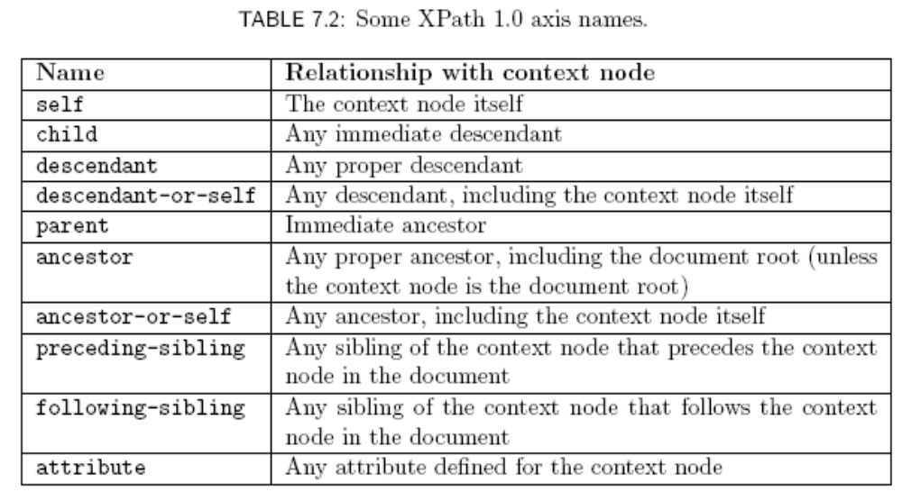
XPath
XSLT specifies
context node
Attribute nodes are
only seen along the attribute axis

Slide 56
XPath
Node test:
  Name test: qualified name representing an element (or attribute, for attribute axis) type
    Example: child::message uses a name test
    May use * as wildcard name test
  Node-type test:
    text(): true if node is a text node
    comment(): true if node is a comment node
    node(): true of any node

Slide 57
XPath
A location step can have one or more predicates that act as filters:
This predicate
applied first

Slide 58
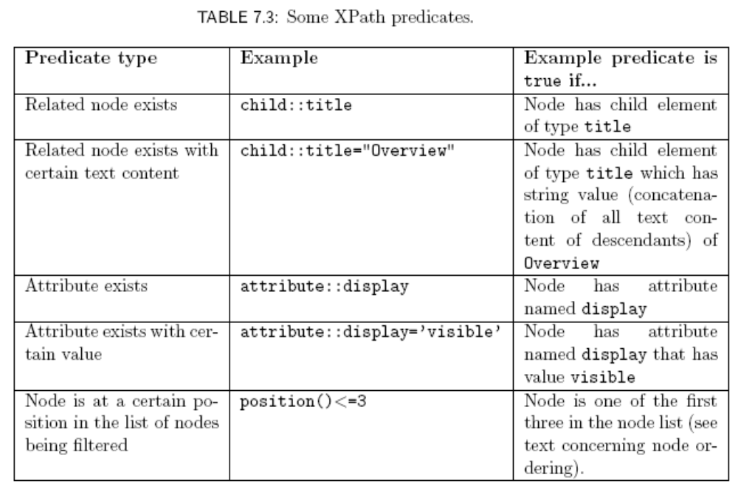
XPath

Slide 59
XPath
Abbreviations:
  Axis defaults to child if not specified
    child::para = para
  @ can be used in place of attribute::
    attribute::display = @display
  parent::node() = ..
  self::node() = .

Slide 60
XPath
A location path is one or more location steps separated by /
  Ex: child::para/child::strong (or just para/strong)
  Ex: para/strong/emph

Slide 61
XPath
Evaluating a two-step location path:
  Evaluate first location step, producing node list L₁
  For each node n_{i} in L₁
    Temporarily set context node to n_{i}
    Evaluate second location step, producing node list L_{i}
  Result is union of L_{i}s
Continue process for paths with more steps

Slide 62
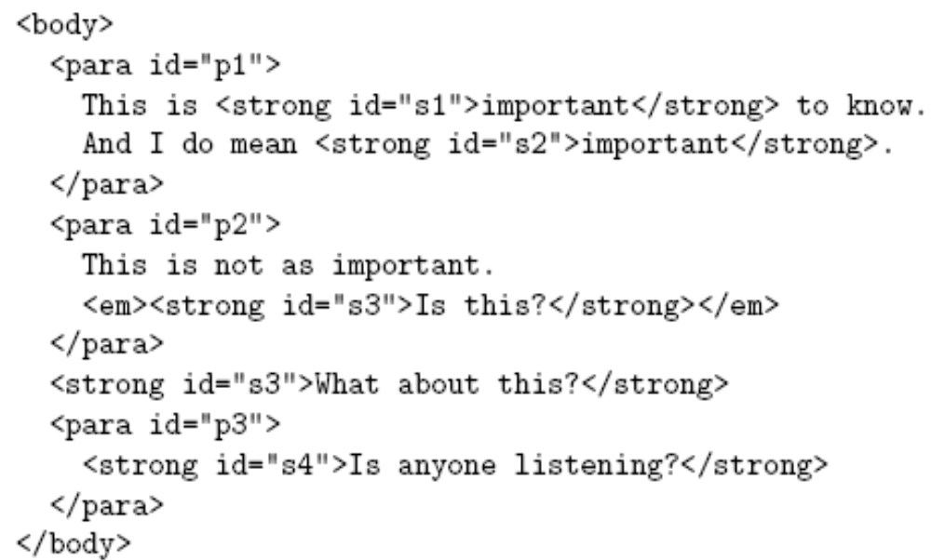
XPath
If body is context node, then:
  para/strong represents {s1,s2,s4}
  para[strong] represents {p1, p3}

Slide 63
XPath
An absolute location path begins with / and uses the document root as the context node
  Ex: /body/para represents all para nodes that are children of body which is child of document root
  Ex: / represents list consisting only of the document root
A relative location path does not begin with / and uses an element determined by the application (e.g., XSLT) as the context node
  Ex: body/para

Slide 64
XPath
Another abbreviation:
  /descendant-or-self::node()/ = //
  Examples:
    //strong: All strong elements in document
    .//strong: All strong elements that are descendants (or self) relative to the context node

Slide 65
XPath
Combining node lists:
  Use | to represent union of node lists produced by individual location paths
  Ex: strong|descendant::emph represents all nodes that are either
    children of the context node of type strong; or
    descendants of the context node of type emph

Slide 66
XSLT
Pattern of template rule
Template
of template
rule
Template
rule

Slide 67
XSLT
XSLT processor deals with three XPath trees:
  Input trees: source and style-sheet
    Elements containing only white space are normally not included in either input tree (exception: xsl:text element)
    White space retained within other elements
  Output tree: result

Slide 68
XSLT
XSLT processing (high level):
  Construct input trees
  Initialize empty result tree
  Search source tree for a node that is matched by a template rule, i.e., a node that is contained in the node list represented by the pattern of some template rule
  Instantiate the template of the matching template rule in the result tree
    Context node for XPath expressions is matched node

Slide 69
XSLT
Matches source tree document root
Context node for relative location
path is source tree document root

Slide 70
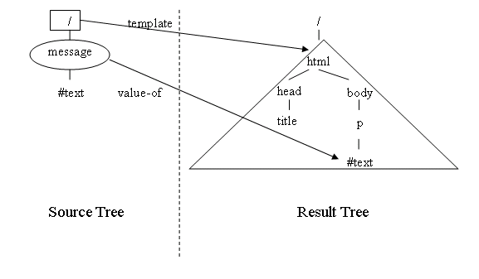
XSLT

Slide 71
XSLT
Restrictions on XPath in template rule pattern (value of match attribute):
  Only child and attribute axes are allowed directly (can indirectly use descendant-or-self axis via // notation)
  XPath expression must evaluate to a node list (some XPath expressions are functions that produce string values)

Slide 72

XSLT
…

Slide 73
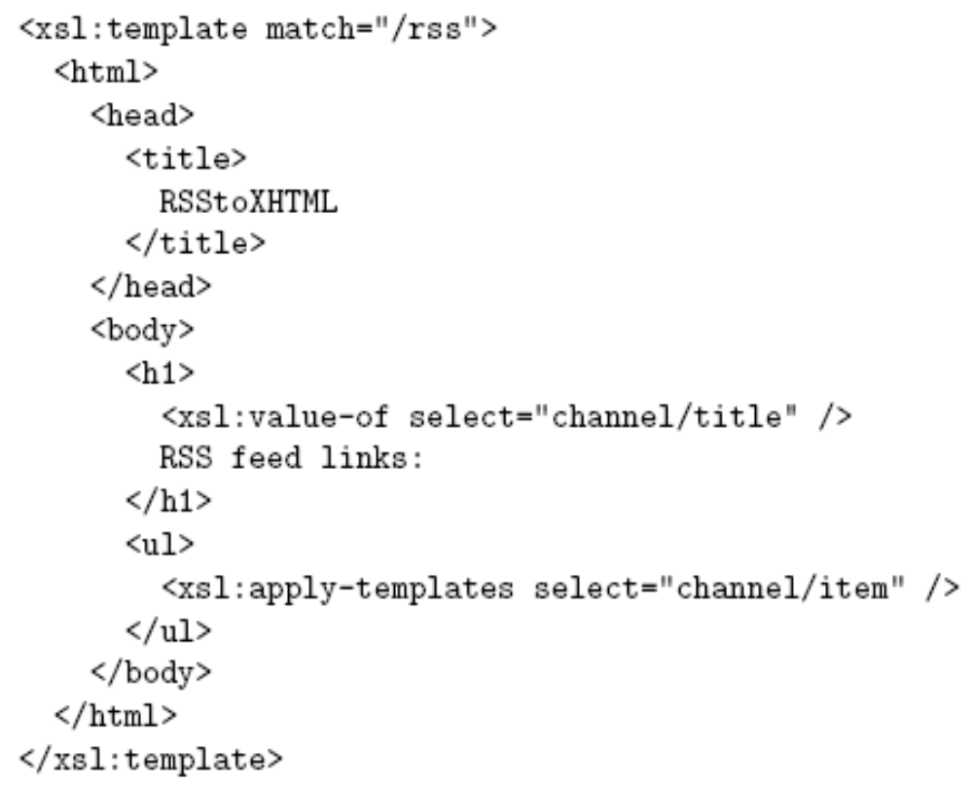

XSLT

Slide 74
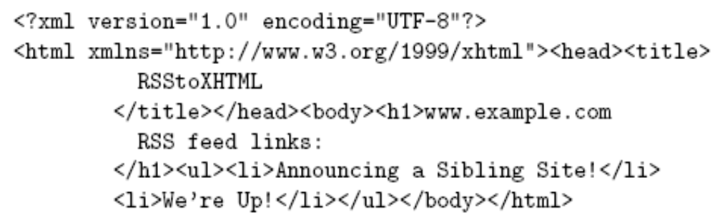
XSLT

Slide 75
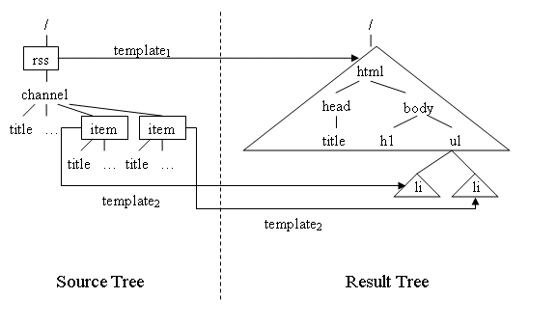
XSLT

Slide 76
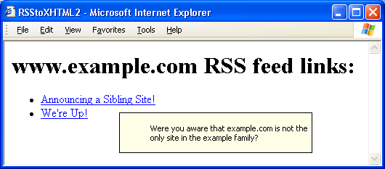
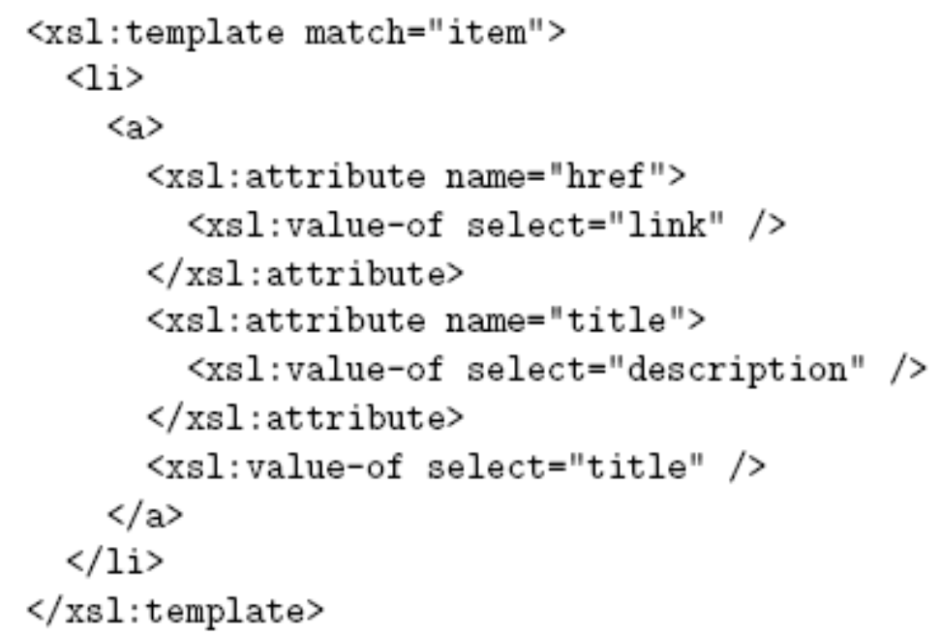
XSLT
Adding attributes:

Slide 77
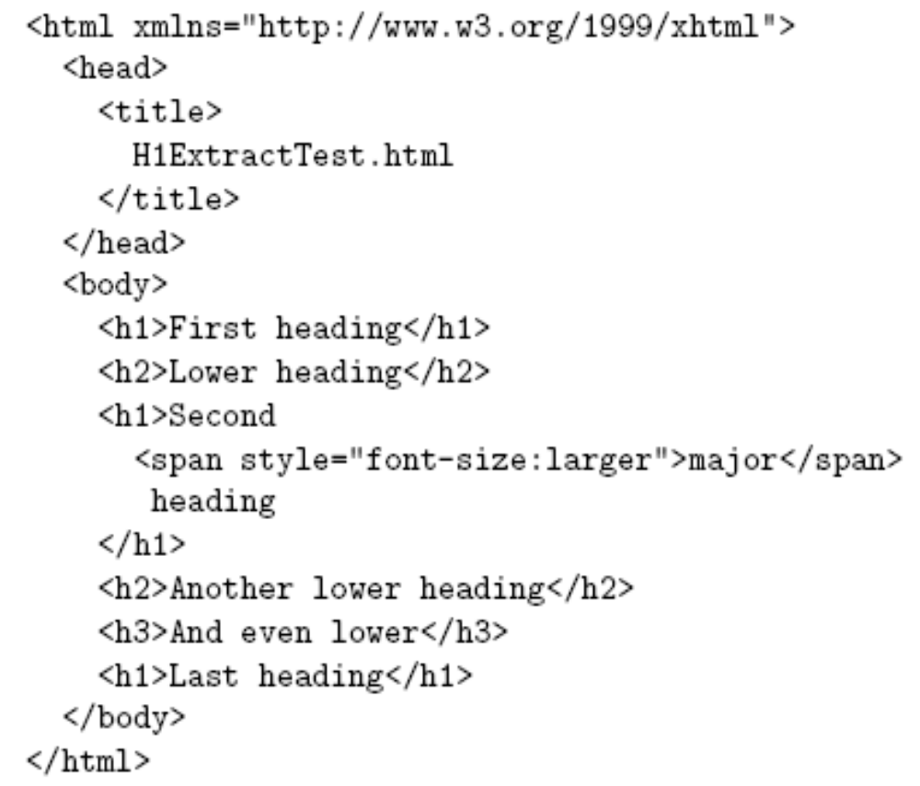
XSLT
Source document elements are in a namespace
We want to copy
all h1 elements
plus all of their
descendants

Slide 78
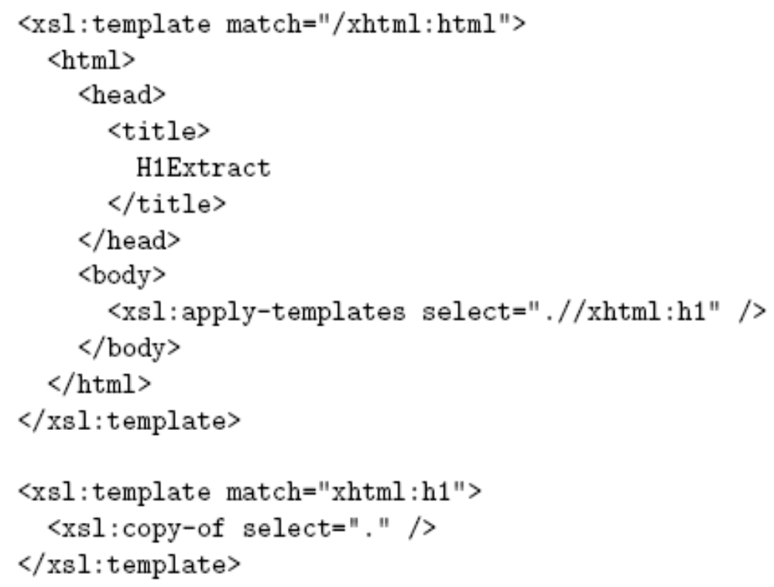
XSLT
XPath expressions must
use qualified names (because source
includes namespace)
Copy
element
and content

Slide 79
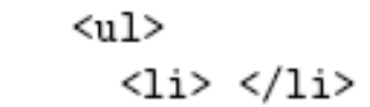

XSLT
Template markup
in the result tree becomes
  Most browsers will not accept this notation!
XSLT does not recognize &nbsp;
Solution:

Slide 80
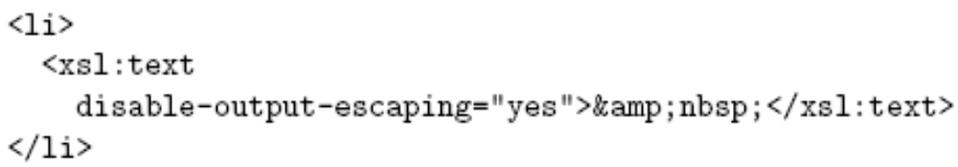
XSLT
Adding XML special characters to the result
  Template:
  Result:
disable-output-escaping also applies to value-of
Becomes & on input

Slide 81
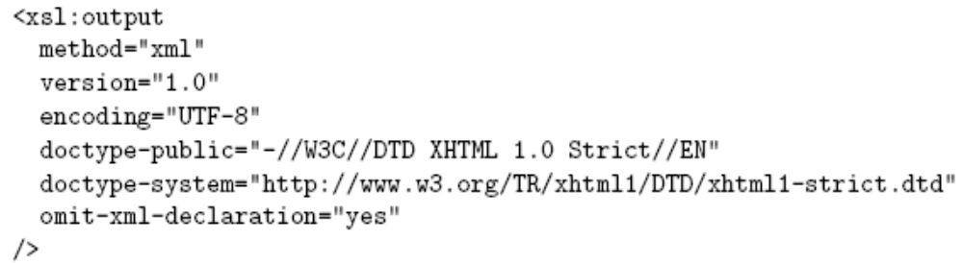
XSLT
Output formatting:
  Add xml:space=“preserve” to transform element of template to retain white space
  Use xsl:output element:

Slide 82

XML and Browsers
An XML document can contain a processing instruction telling a browser to:
  Apply XSLT to create an XHTML document:

Slide 83
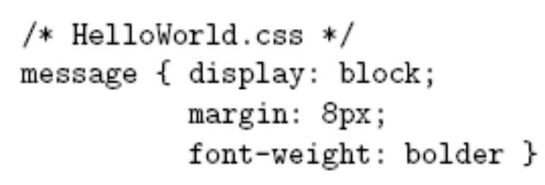
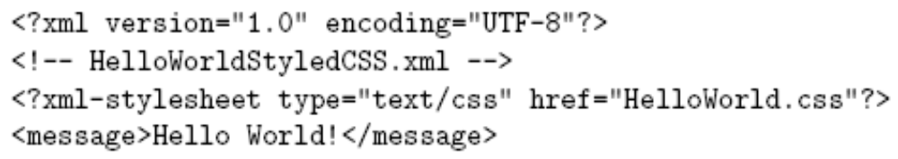
XML and Browsers
An XML document can contain a processing instruction telling a browser to:
  Apply CSS to style the XML document:

