Slide 1
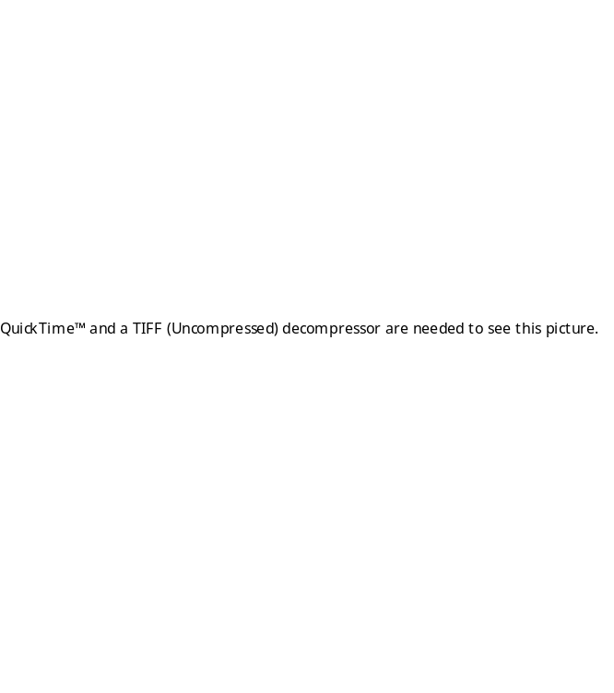
12” = 1” on this page
27.1” is figured from
the length of the window
at an angle – Side
Angle Side equation:
Square root (WidthOfWindow² -
height of board²) plus
One inch to give you room
To fit the window in the frame:
Square root (26.6² - 5.5² ) + 1”=
27.1 Inches.
All The Boards Required
4 Ea 9.5 X 1.5 X 3.5 Inches
4 Ea 4.5 X 1.5 X 3.5 Inches
3 Ea 64 X 1 X 5.5 Inches
5 Ea 27.1 X 1 X 5.5 Inches
Note: 2 of these Boards are tapered
from 5.5” to 0”***
4 Ea 17 X 1 X 5.5 Inches
2 Ea 6 X 1 X 5.5 Inches
Back
64 Inches
Height of window * 2 + 3 Inches (width of wood)
Formula:
Top View
27.1
Inches
(see above
formula)
32 Inches
Front
***Two of the boards are cut at an angle
Using the jig saw. For instructions see:
http://digital.net/~gandalf/woodcfsm.htm
and see next page.
Page <number> of 3

Slide 2
12” = 1” on this page
Top View
Back
64 Inches
Height of window * 2 + 3 Inches (width of wood)
17 Inches
27.1
Inches
(see next
page for
formula)
17 Inches
17 Inches
17 Inches
6 Inches
Hole 2.5” in
6 Inches
Hole 2.5” in
32 Inches
Front
Using the jigsaw, cut at a diagonal from 5.5” to 0”.
This makes 2 boards from one board:
Page <number> of 3

Slide 3
12” = 1” on this page
Side
27.6 Inches (26.6 (width of glass window) + 1”)
27.1 Inches
64 Inches
Front
Page <number> of 3

