Slide 1
12” = 1” on this page
Platform Bird Feeder Diagram
Bottom View
Side View
18 Inches
Allow at least 1” clearance
When attaching the 2X4’s to
the bottom so that you can
attach the hinge in a later phase
Boards
4 Ea 18 X 0.75 X 3.5 Inches
2 Ea 14 X 3.5 X 1.5 Inches
Page <number> of 2

Slide 2
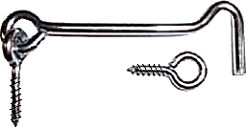
12” = 1” on this page
12” = 1” on this page
Platform Bird Feeder Diagram
Top View
Front View
(Before installing the
front board)
18 Inches
1” (or so) Hook and Eye latch
(Install last after you have
attached the front board below)
Boards
2 Ea 19.5 X 0.75 X 1.5 Inches
2 Ea 14 X 0.75 X 1.5 Inches
Attach right hand board to platform using hinges.
Then attach Hook & Eye Latch to base and right hand board.
This allows you to flip the right hand side down and use
A hose to clean off the platform feeder.
Bottom View
18 Inches
1” Hinges
Page <number> of 2

