Slide 1
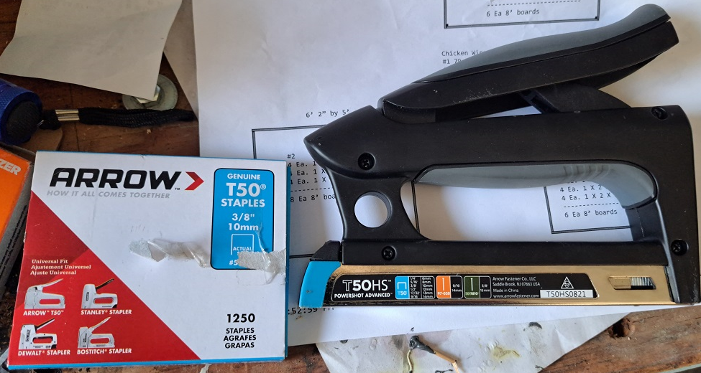
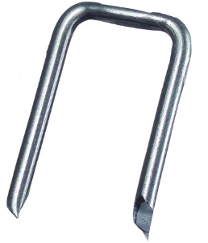
12” = 0.5”
Actual Raised Bed Dimensions Are On This Page.
Pages 2 through 7 are the dimensions of the frame to:
Frame #1 – Fit Outside Of Raised Bed #1
Frame #2 & Frame #3 – Fit Inside Raised Beds #2 and #3
Chicken Wire:
#1 79 Inches long X 32 Inches wide + 18” wide roll
#2 74 Inches long X 60 Inches wide + 18” wide roll
#3 72 Inches long X 36 Inches wide + 18” wide roll
Metal Staples to hold chicken wire on:
Raised Bed #1 - 6’ 7” by 2’ 8.5”
Frame #1
4 Ea. 1 X 2 X 89 Inches
4 Ea. 1 X 2 X 42 Inches
4 Ea. 1 X 2 X 18 Inches
-------------------------
6 Ea 8’ boards
Raised Bed #2 - 6’ by 3’
Raised Bed #3 - 6’ 2” by 5’
Frame #3
4 Ea. 1 X 2 X 72 Inches
4 Ea. 1 X 2 X 34 Inches
4 Ea. 1 X 2 X 18 Inches
-------------------------
6 Ea 8’ boards
Frame #2
4 Ea. 1 X 2 X 74 Inches
4 Ea. 1 X 2 X 58 Inches
4 Ea. 1 X 2 X 18 Inches
-------------------------
8 Ea 8’ boards

Slide 2
12” = 1”
Frame #1 Top View, 2 Ea. Top and Bottom To Fit Outside Of The Raised Bed
4 Ea. 1 X 2 X 89 Inches
(2” less to account for side 1” boards
4 Ea. 1 X 2 X 42 Inches
4 Ea. 1 X 2 X 18 Inches
4 Ea. 1 X 2 X 89 Inches
4 Ea. 1 X 2 X 42 Inches
4 Ea. 1 X 2 X 18 Inches
-------------------------
Side View, 2 Ea. Top and Bottom Frame
18 Inches

Slide 3
12” = 1”
Frame #1 Top View, 2 Ea. Top and Bottom Frame With Wire Mesh
89 Inches
42 Inches
Side View, 2 Ea. Top and Bottom Frame
18 Inches

Slide 4
12” = 1”
4 Ea. 1 X 2 X 74 Inches
4 Ea. 1 X 2 X 58 Inches
(2” less to account for top & bottom 1” boards
Frame #2 Top View, 2 Ea.
Top and Bottom Frame
4 Ea. 1 X 2 X 74 Inches
4 Ea. 1 X 2 X 58 Inches
4 Ea. 1 X 2 X 18 Inches
-------------------------
4 Ea. 1 X 2 X 18 Inches
Side View, 2 Ea. Top and Bottom Frame
18 Inches

Slide 5
12” = 1”
74 Inches
Frame #2 Top View, 2 Ea.
Top and Bottom
Frame With Wire
Mesh
58 Inches
Side View, 2 Ea. Top and Bottom Frame
18 Inches

Slide 6
12” = 1”
Frame #3 Top View, 2 Ea. Top and Bottom Frame
4 Ea. 1 X 2 X 72 Inches
4 Ea. 1 X 2 X 34 Inches
(2” less to account for top & bottom 1” boards
4 Ea. 1 X 2 X 72 Inches
4 Ea. 1 X 2 X 34 Inches
4 Ea. 1 X 2 X 18 Inches
-------------------------
4 Ea. 1 X 2 X 18 Inches
Side View, 2 Ea. Top and Bottom Frame
18 Inches

Slide 7
12” = 1”
Frame #3 Top View, 2 Ea. Top and Bottom Frame With Wire Mesh
72 Inches
34 Inches
Side View, 2 Ea. Top and Bottom Frame
18 Inches

