Slide 1

Stack Overflow Developer Survey Analysis
Technology Trends & Developer Demographics Capstone

Slide 2



OUTLINE
Executive Summary
Introduction
Methodology
Results
Visualization – Charts
Dashboard
Discussion
Findings & Implications
Conclusion
Appendix

Slide 3

EXECUTIVE SUMMARY
Analyzed Stack Overflow Developer Survey responses to identify current and emerging technology trends
JavaScript, SQL, and HTML/CSS remain the most widely used languages, while PostgreSQL leads as the top database
Go and Rust show the strongest upward momentum among languages developers want to learn
AWS dominates cloud platform usage, both currently and for future adoption
React and Node.js are the leading web frameworks in both current use and future interest
Most respondents are aged 25-34 (41.3%) and hold a Bachelor's degree
Findings support recommendations for training, tooling, and hiring priorities

Slide 4

INTRODUCTION
The Stack Overflow Developer Survey captures how developers work, what tools they use, and where the industry is heading
This project analyzes responses on programming languages, databases, platforms, and web frameworks
Goal: identify current technology adoption patterns and forecast future trends
Deliverables include exploratory analysis, an interactive Cognos dashboard, and this summary presentation

Slide 5

METHODOLOGY
Data cleaned and analyzed in Python using Jupyter notebooks
Multi-select survey fields (languages, databases, platforms, frameworks) split and exploded for accurate counting
Top-10 rankings computed for current usage and future interest across each technology category
Interactive dashboards built in IBM Cognos Analytics across three tabs
Current Technology Usage, Future Technology Trend, and Demographics
Exploded multi-select fields pre-processed into separate CSVs before upload

Slide 6
RESULTS
JavaScript, SQL, and HTML/CSS are the most widely used programming languages.
PostgreSQL is the most popular database, with increasing interest for future adoption.
Go and Rust show the highest growth in technologies developers want to learn.
AWS is the leading cloud platform for both current use and future preference.
React and Node.js remain the most commonly used web frameworks.
The majority of survey respondents are 25–34 years old and hold a Bachelor's degree.

Slide 7
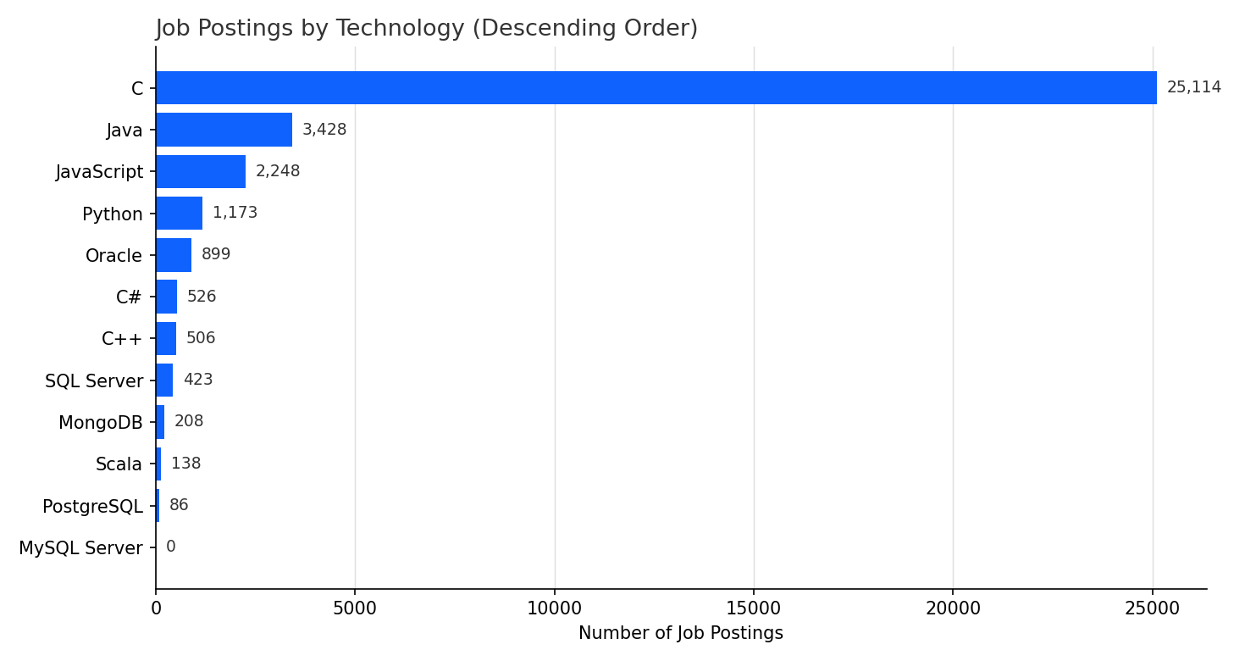
JOB POSTINGS

Slide 8
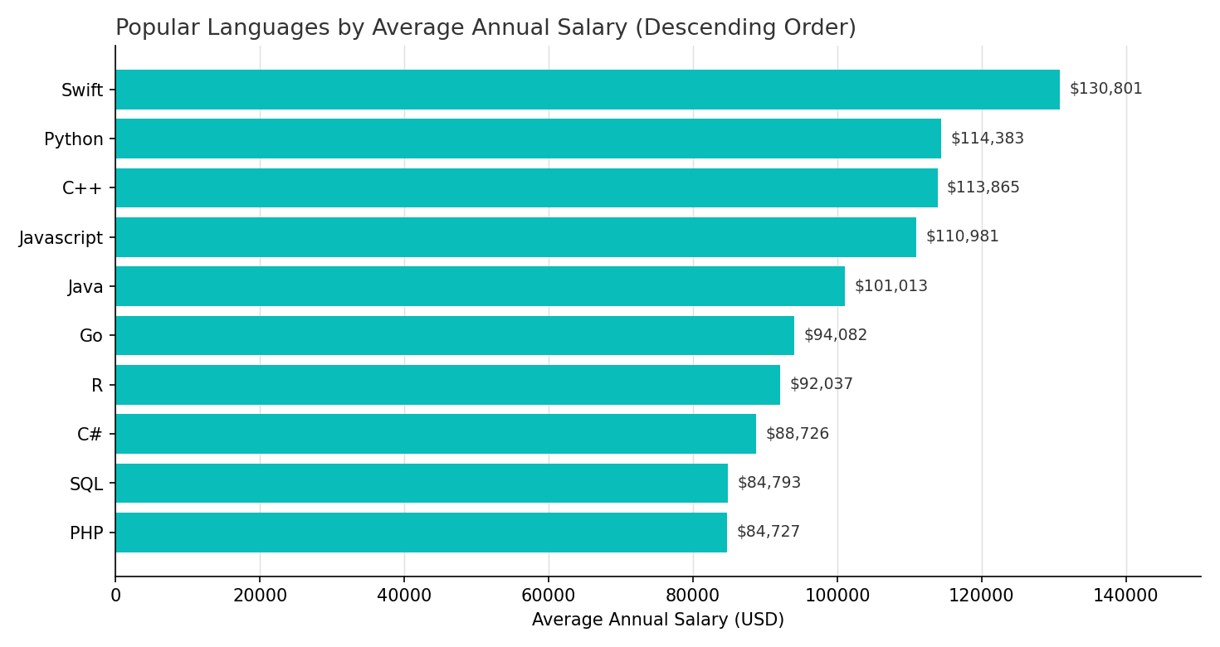
POPULAR LANGUAGES
.

Slide 9
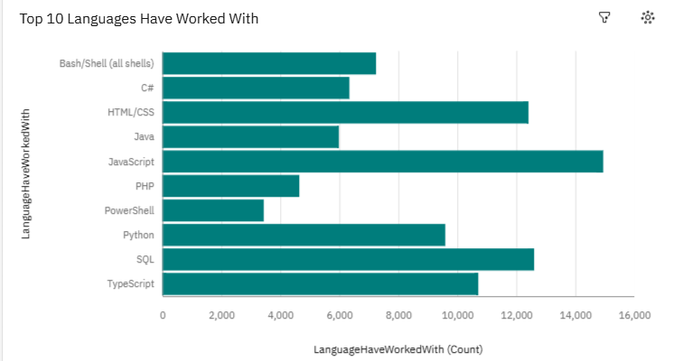
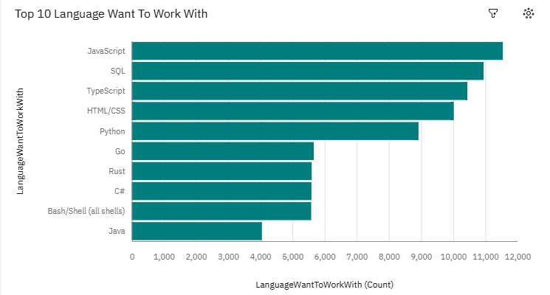
PROGRAMMING LANGUAGE TRENDS
Current Year
Next Year

Slide 10
PROGRAMMING LANGUAGE TRENDS - FINDINGS & IMPLICATIONS
Implications:-
Continue prioritizing JavaScript/TypeScript tooling and training
Invest in Go and Rust skill-building to stay ahead of demand
Monitor Java's declining future interest when planning legacy system staffing
Findings:-
JavaScript, SQL, and HTML/CSS are the most-used languages today
Python and TypeScript follow closely behind
Go and Rust newly enter the top 10 for future interest, while Java drops

Slide 11
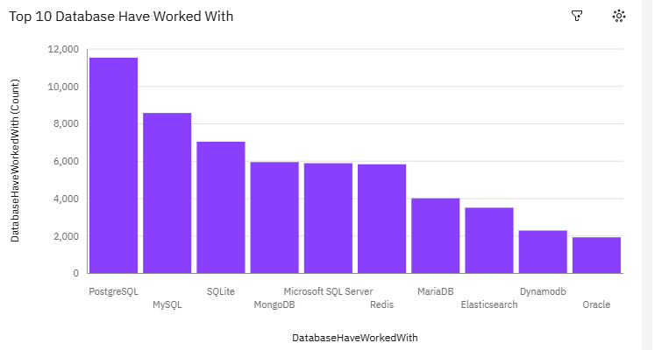
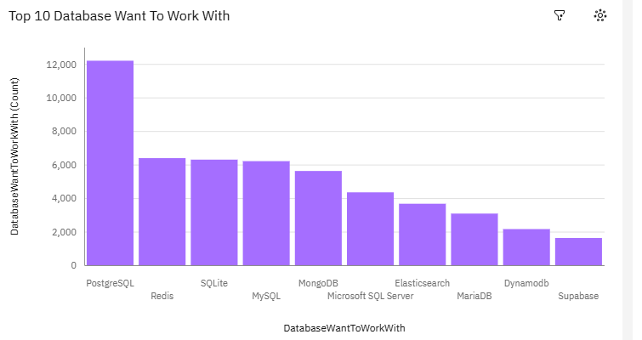
DATABASE TRENDS
Current Year
Next Year

Slide 12
DATABASE TRENDS - FINDINGS & IMPLICATIONS
Implications:-
PostgreSQL should be the default recommendation for new projects
Growing Redis interest suggests increasing demand for caching/real-time use cases
Track Supabase adoption as a signal of interest in managed Postgres/BaaS platforms
Findings:-
PostgreSQL is the clear leader today and its lead widens for future interest
MySQL and SQLite remain popular, but Redis climbs sharply in future interest
Supabase emerges as a new top-10 database for future adoption

Slide 13

DASHBOARD
An interactive IBM Cognos Analytics dashboard was built to explore developer survey trends across three tabs: Current Technology Usage, Future Technology Trends, and Demographics.
GitHub Repository: github.com/Gandhar1824/stack-overflow-developer-survey-analysis

Slide 14
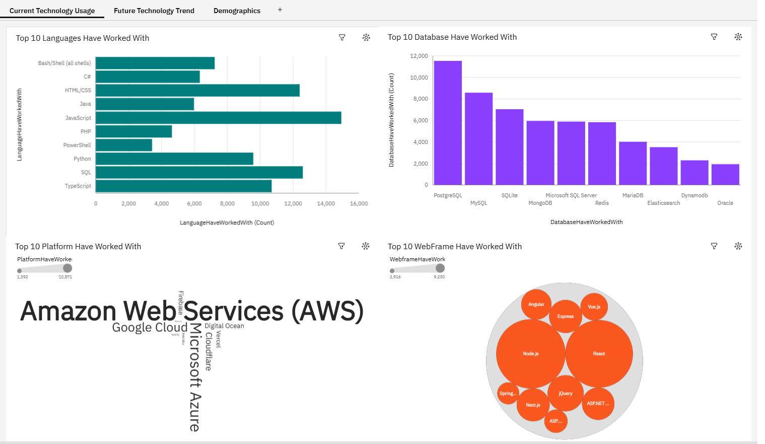
DASHBOARD TAB 1

Slide 15
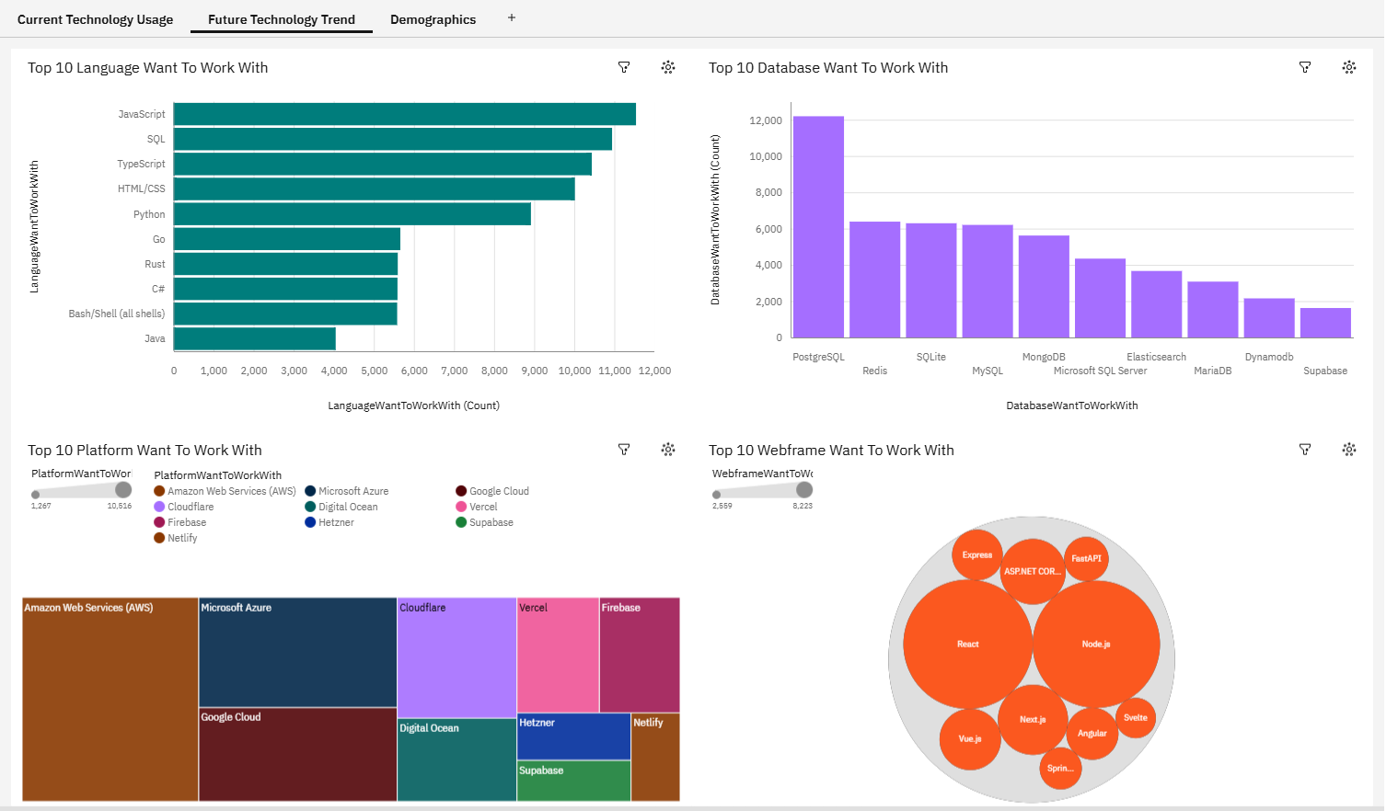
DASHBOARD TAB 2

Slide 16
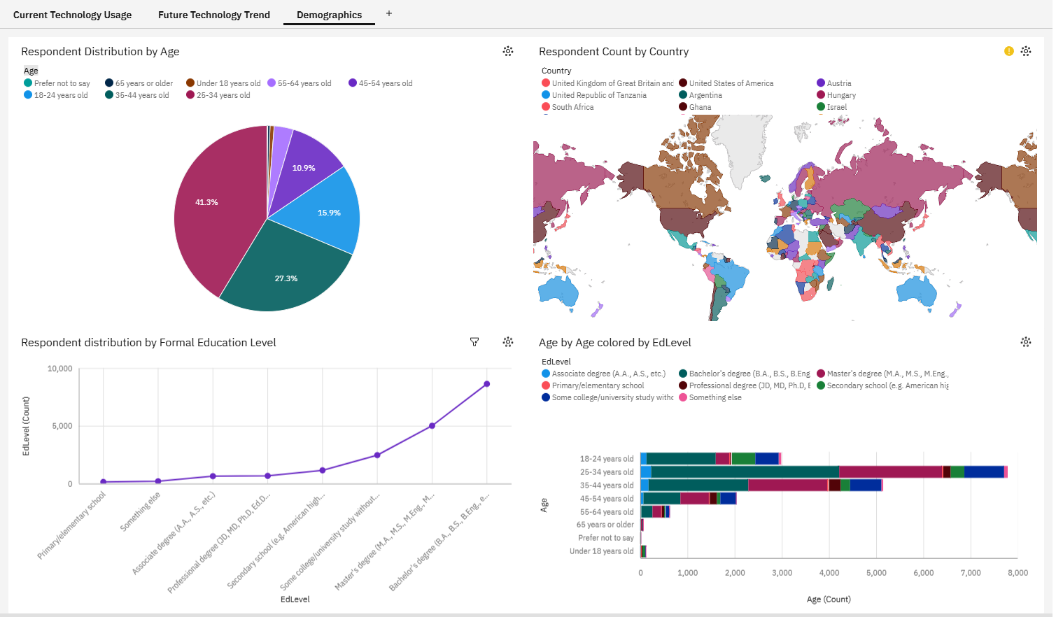
DASHBOARD TAB 3

Slide 17
DISCUSSION
The survey indicates that established technologies such as JavaScript, SQL, PostgreSQL, AWS, React, and Node.js continue to dominate the software development ecosystem.
Emerging technologies like Go, Rust, Redis, and Supabase are gaining popularity, suggesting future shifts in developer preferences.
Organizations should invest in training programs focused on both current industry standards and emerging technologies to remain competitive.
The demographic data suggests that most developers are early- to mid-career professionals, making continuous learning and upskilling essential.
These findings can help businesses make informed decisions about hiring, technology adoption, and long-term infrastructure planning.

Slide 18
OVERALL FINDINGS & IMPLICATIONS
Implications:-
Prioritize training budgets toward JavaScript/TypeScript, Go, and Rust
Standardize on PostgreSQL with Redis for caching in new architecture decisions
Continue investing in AWS-based infrastructure and React/Node.js tooling
Tailor hiring and onboarding materials to early/mid-career developers
Findings:-
JavaScript, SQL, and PostgreSQL are the current backbone of the developer stack
Go, Rust, Redis, and Supabase are the clearest rising technologies
AWS and React/Node.js show strong, stable dominance
Most respondents are 25-34 years old with a Bachelor's degree

Slide 19

CONCLUSION
JavaScript, SQL, and PostgreSQL dominate current developer technology usage
Go, Rust, Redis, and Supabase are the technologies to watch for future adoption
AWS and the React/Node.js ecosystem show the strongest platform and framework loyalty
These insights can guide training, hiring, and technology-stack decisions going forward

Slide 20
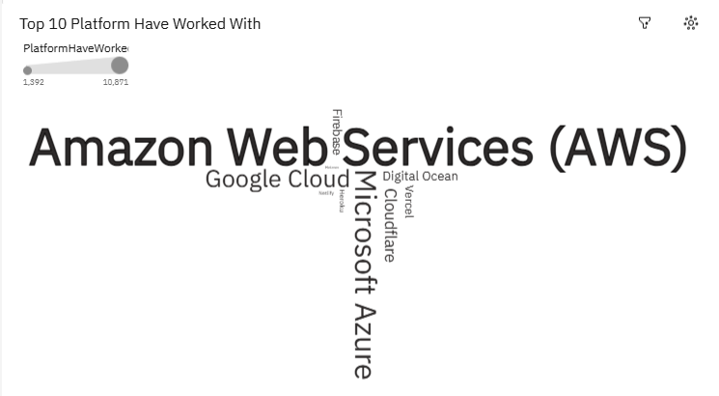
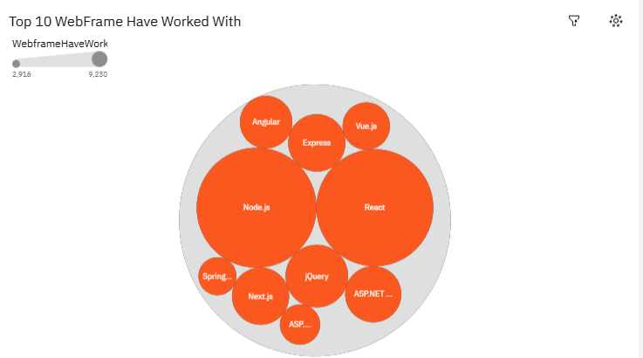
APPENDIX
Additional charts from the analysis: cloud platform usage and web framework usage, current vs. future interest.

