Slide 1
IBM Cloud Account Registration &
Kubernetes Cluster Creation
IBM Cloud and Kubernetes cluster
Arun Balasubramanyan
Jeya Gandhi Rajan M
3 - Dec - 2019

Slide 2
Agenda
IBM Cloud Account Registration
Apply Promo Code
Create Kubernetes Cluster in IBM Cloud

Slide 3
IBM Cloud Account Registration

Slide 4
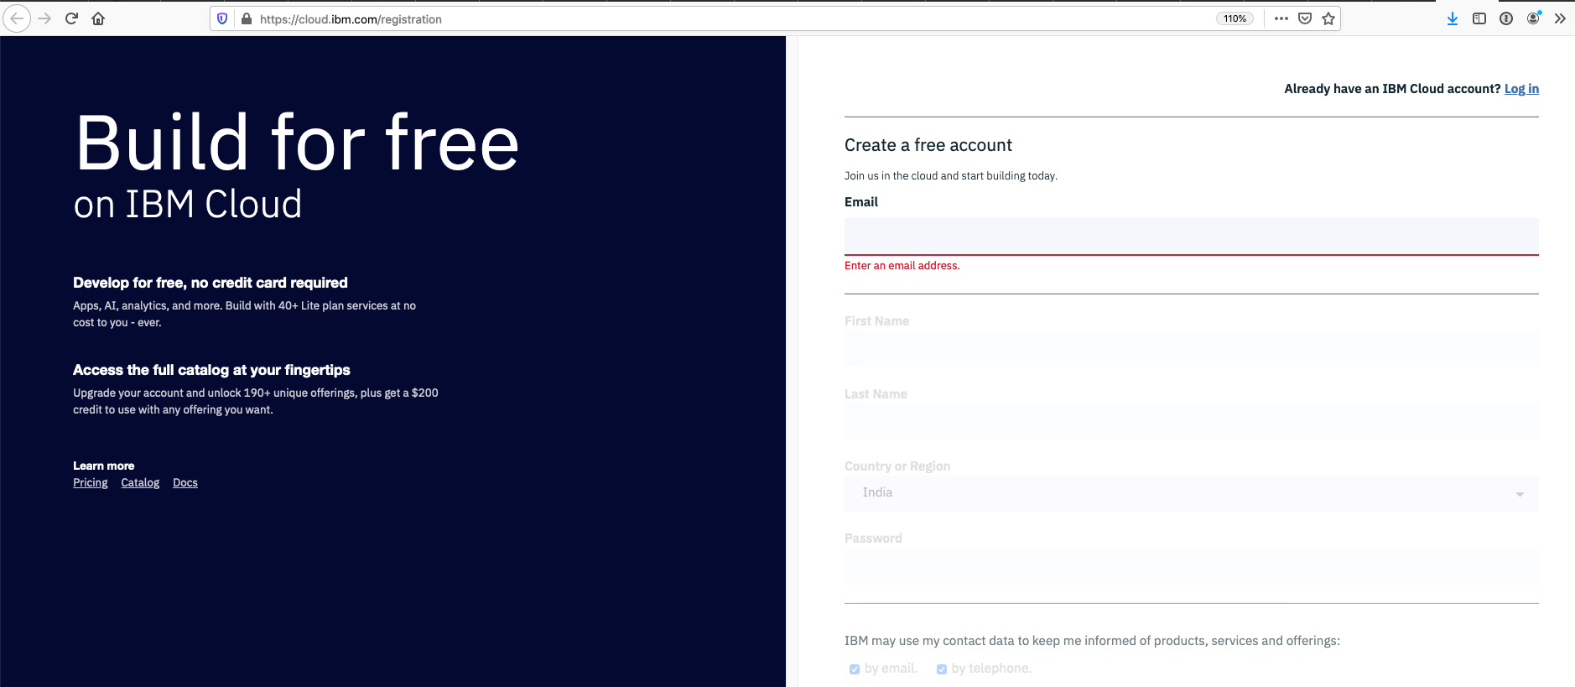
IBM Cloud Account Registration
Login into IBM Cloud for registration
https://cloud.ibm.com/registration
Create your free account with your official mail id
Activate the account by clicking on the link sent to your mail id

Slide 5
Apply Promo Code

Slide 6
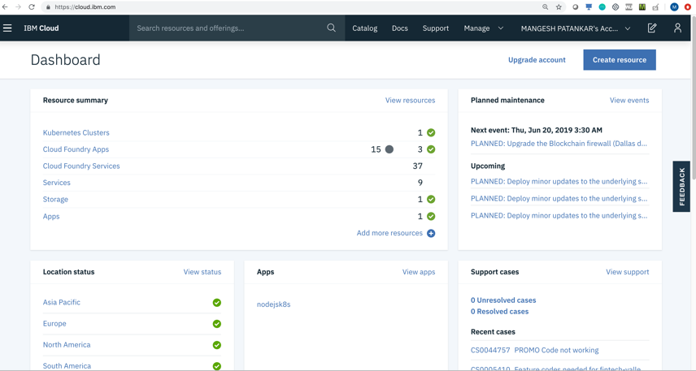
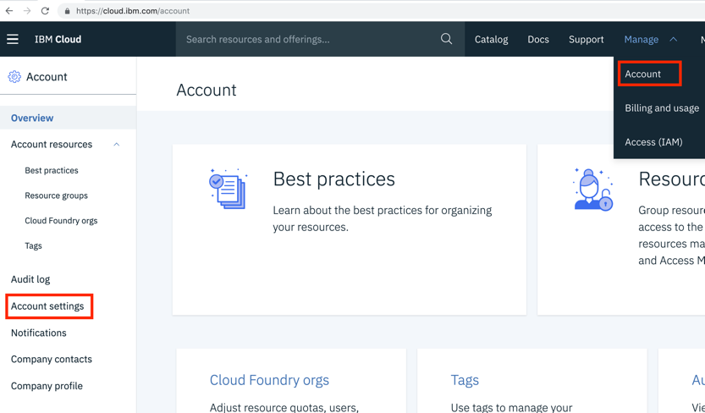
Apply Promo Code
Login into IBM Cloud
Choose Account
Choose Account Settings

Slide 7
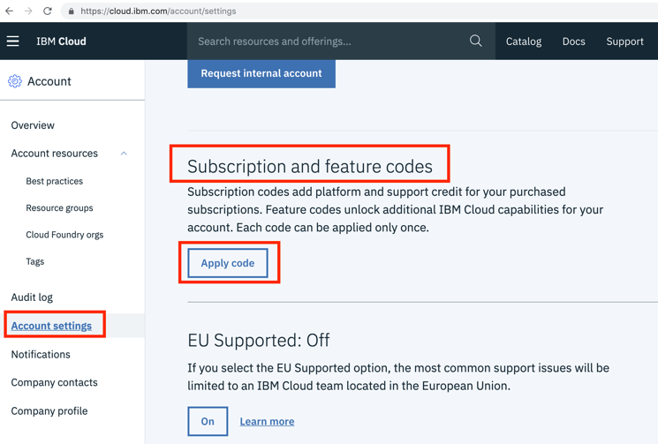
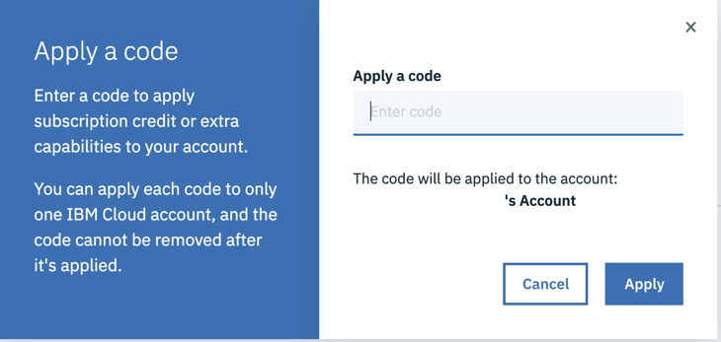
Apply Promo Code …
Choose Apply Code
Enter the Promo Code
Choose Apply

Slide 8
Create Kubernetes Cluster

Slide 9
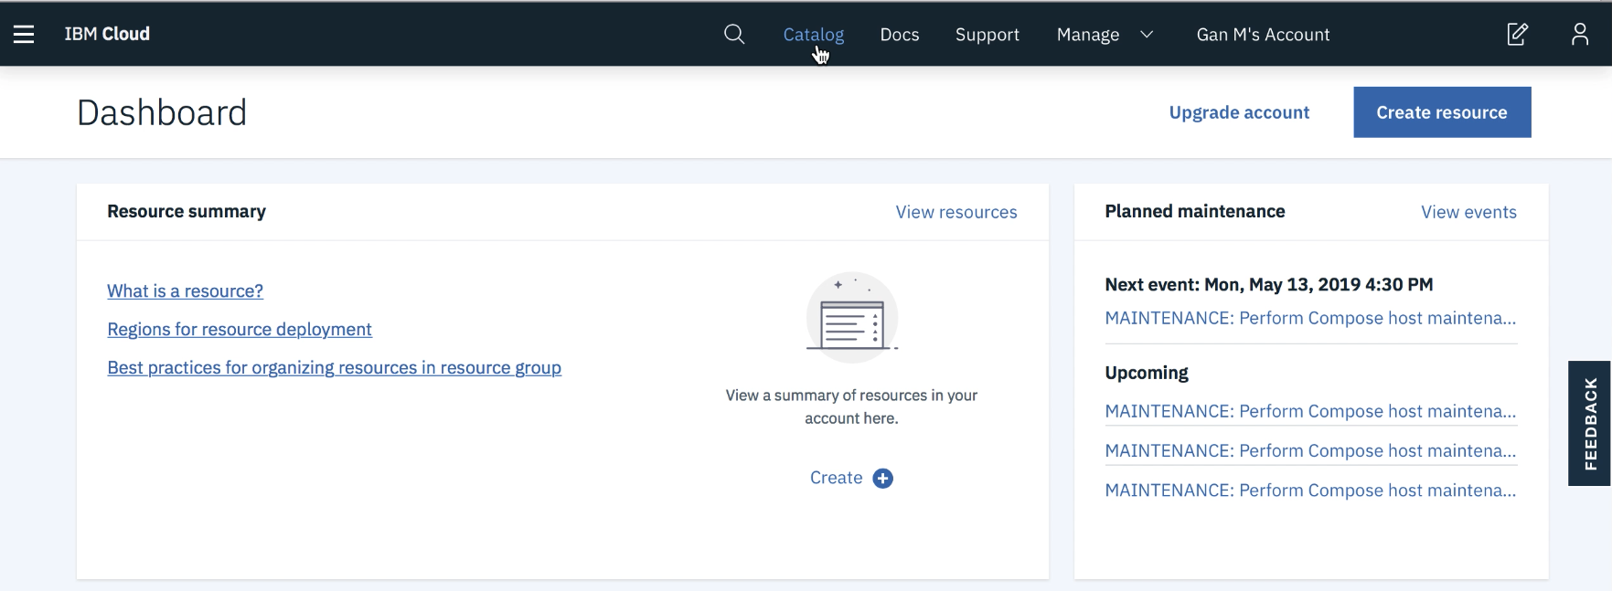
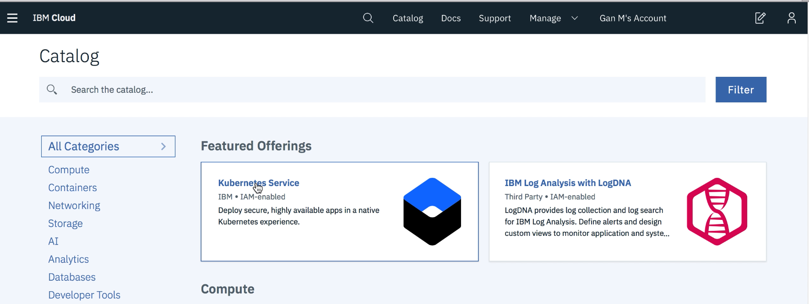
Create Kubernetes Cluster
Login to IBM Cloud with your credentials.
Click on Catalog
Click on Kubernetes Service
https://cloud.ibm.com

Slide 10
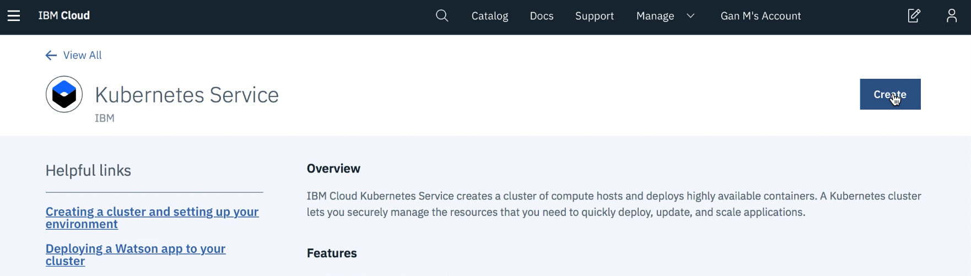
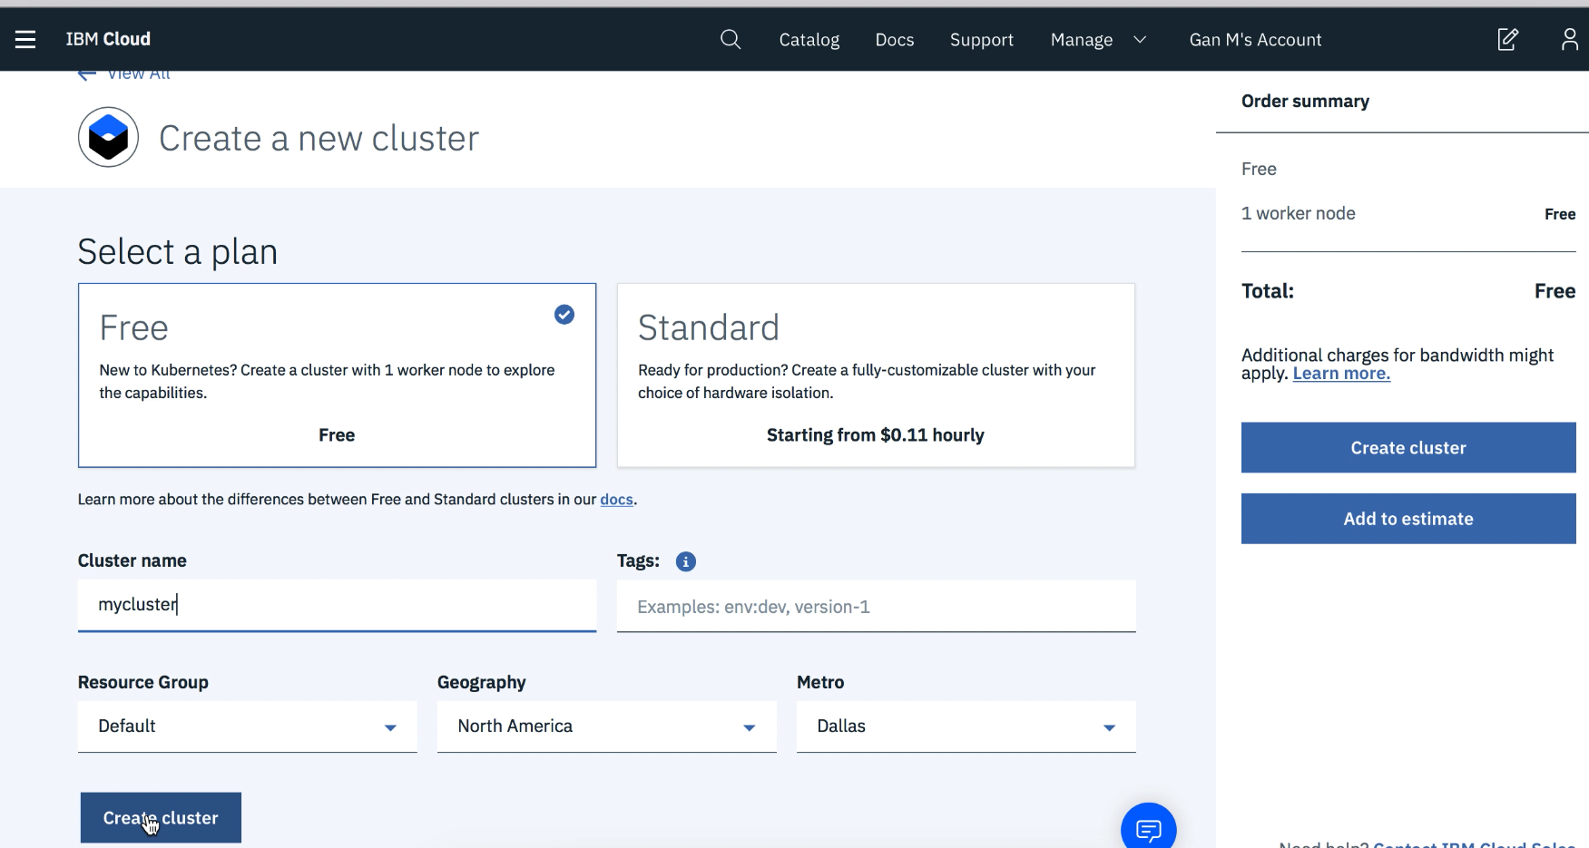
Create Kubernetes Cluster …
Click on Create
Select a Plan - Free
Click on Create Cluster

Slide 11
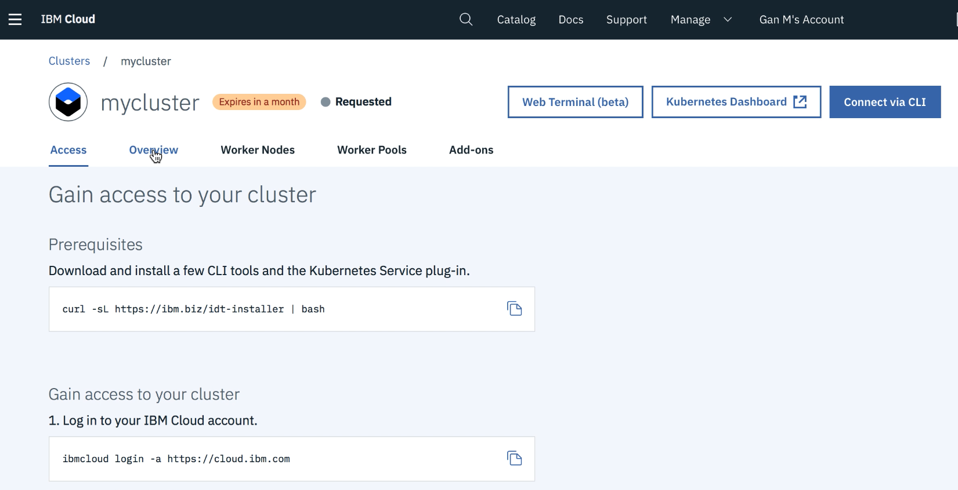
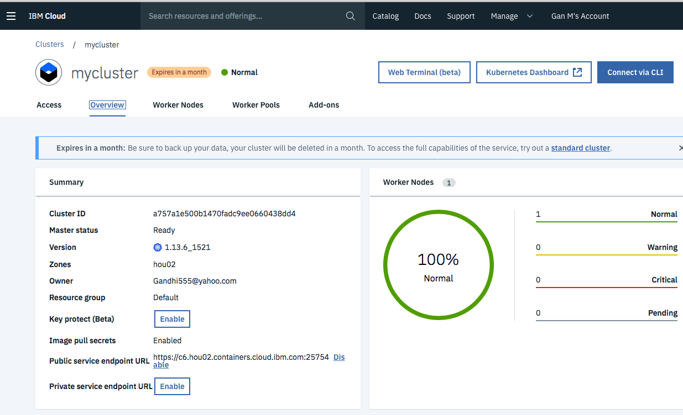
Create Kubernetes Cluster …
You will get a cluster screen with Requested Status
Note: This will take 20 -25 mins to spin up your cluster, which will be used to deploy your application later in the lab below
After the provisioning the cluster you will have the status as Normal

Slide 12
Thank You

