Slide 1
Kubernetes Workshop
IBM Cloud and Kubernetes cluster
Arun Balasubramanyan
Jeya Gandhi Rajan M

Slide 2
Agenda
Microservices and App Modernization
Dockers & Containers
Kubernetes
Hands On Lab : Deploy an application on IBM Cloud Kubernetes Cluster

Slide 3
Evolution of Application Architectures

Slide 4
Evolution of Application Architectures
Late 90’s | Enterprise Application (EAI) Services and Models Addressed integration and transactional challenges primarily by using message oriented middleware. Mostly proprietary systems needing a proliferation of custom interfaces.
Mid 00’s | Service Oriented Architectures Based on open protocols like SOAP and WSDL making integration and adoption easier. Usually deployed on an Enterprise ESB which is hard to manage and scale.
Early 10’s | API Platforms and API Management REST and JSON become the defacto standard for consuming backend data. Mobile apps become major consumers of backend data. New Open protocols like OAuth become available further simplifying API development .
2015 and beyond | Microservice Architecture Applications are composed of small, independently deployable processes communicating with each other using language-agnostic APIs and protocols.

Slide 5
Microservices and App Modernization

Slide 6
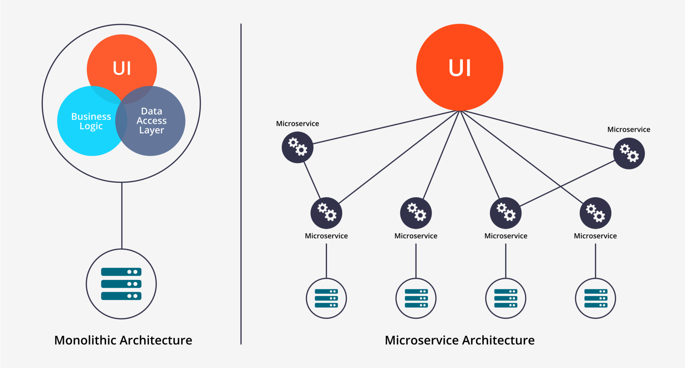
Microservices
An engineering approach focused on decomposing an application into single-function modules with well defined interfaces which are independently deployed and operated by a small team who owns the entire lifecycle of the service.
Microservices accelerate delivery by minimizing communication and coordination between people while reducing the scope and risk of change.

Slide 7
Microservices …
Monolith
Microservice
Catalog
Service
DB
Catalog
Cart
DB
Cart
Service
DB
Browser
Order
UI Service
Browser
Order
Service
DB
Account
Account
Service
DB

Slide 8
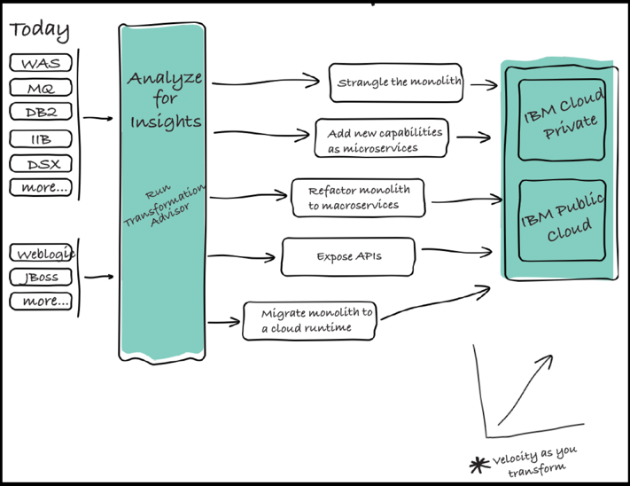
What Does App Modernization Mean Anyway ?
Containerize an Existing Application / Workload ?
Refactor Applications into Microservices ?
Strangle Monolith over time with new Microservices ?
Completely rewrite into new microservices ?
Automate deployment ?
Lift and Shift into a Cloud ?
Expose Applications through API’s ?
Augment Old Code with new microservices ? APIs / Services (AI, Data Science) ?
What About My Data !!!!!!!!

Slide 9

Typical App Modernization
Traditional
Modernized
Cloud Native
VM
Container
Container
Container
Container
App
App
Micro-service
Micro-service
Micro-service
Tech Debt
New value
Traditional Runtime
Cloud
Runtime
Cloud Runtime
Cloud Runtime
Cloud Runtime
App Mod
Microservices
Automation
DevOps
DevOps

Slide 10
Dockers & Containers

Slide 11
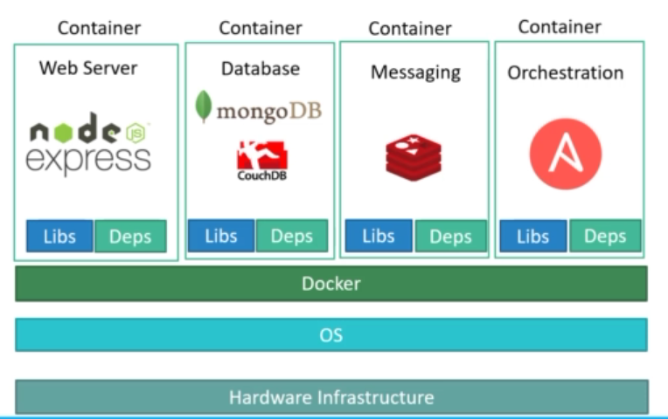
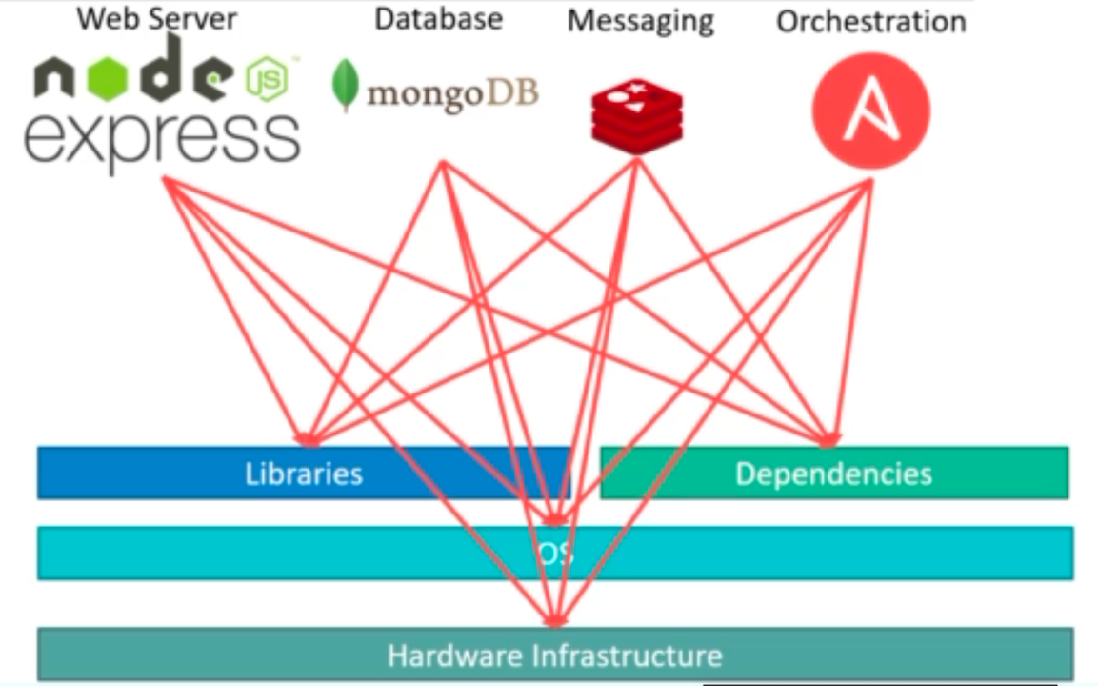
Why do you need containers?
Dependency
Long setup time
No Dependency
No setup time required

Slide 12

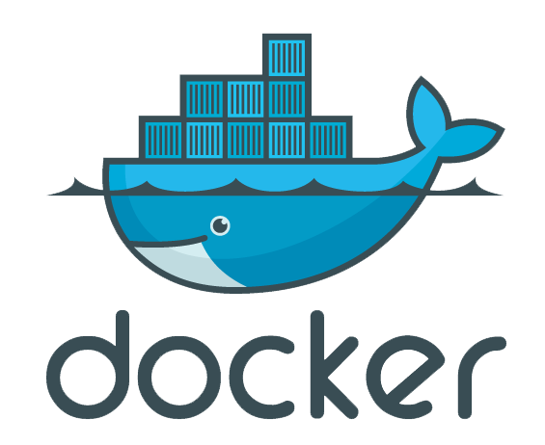
Dockers
Image
An image is an executable package that bundles everything needed to run an application.
Code
Libraries
Environment variables
Configuration files
Container
A container is a runtime instance of an image
Image can be moved between environments and run without change
Docker
Docker is a platform to develop, deploy, and run applications with containers.

Slide 13
Dockers …
Containers and virtual machines
Containers
Runs natively on Linux
Shares the kernel of the host machine with other containers
Virtual Machine
Runs a full-blown guest operating system
Container
VM
App A
App B
App C
App A
App B
App C
Bins/Libs
Bins/Libs
Bins/Libs
Bins/Libs
Bins/Libs
Bins/Libs
Docker
Guest OS
Guest OS
Guest OS
Host OS
Hypervisor
Infrastructure
Infrastructure

Slide 14

Docker Architecture
Docker Client
Docker Host
Docker Registry
docker build
Docker Daemon
Docker hub
docker run
Private Registry
docker push
Containers
Images
docker pull
CLI

Slide 15
Kubernetes

Slide 16

Containers Deployed on 3 servers – Simple

Slide 17
Jump from 3 – 50 servers
Scale out
Keep track
Where to put your containers
What container – Where?
May be containers other than docker as well
Containers are great but … can lead into lack of control & chaos

Slide 18
Kubernetes – (Κυβερνήτης - Captain in Greek)
Regain control with Containers
Kubernetes Organize and Govern the Container Chaos

Slide 19
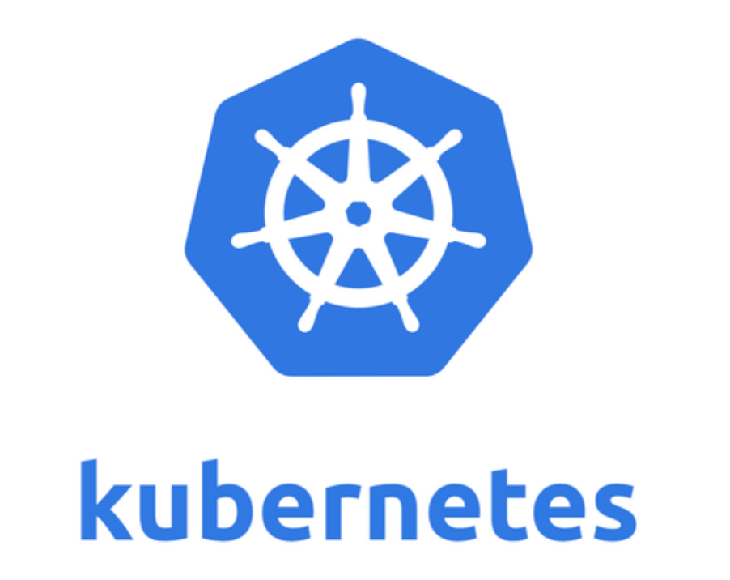
Kubernetes
Container Orchestration System to manage containerized applications across a cluster of nodes
Can scale up and down dynamically.
Self-healing
Seamless upgrading or rollback of applications.

Slide 20
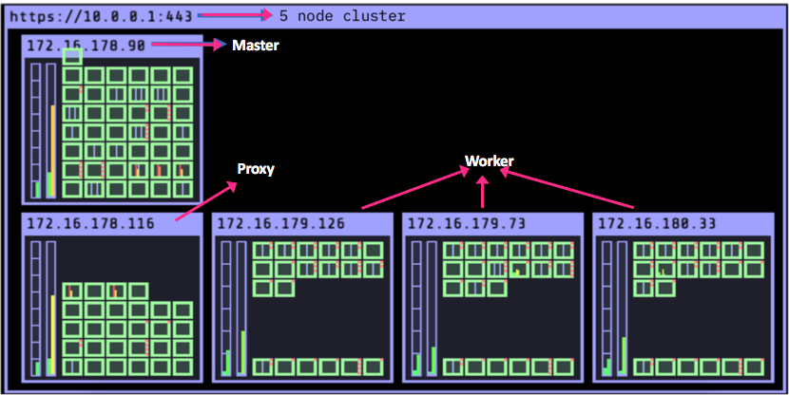
Cluster
Cluster with 5 Nodes
1 Master Node
1 Proxy Node
3 Worker nodes

Slide 21


Kubernetes Cluster
MASTER
Controller
API Server
Scheduler
etcd
Node
Kube-proxy
Kubelet
Kubelet
Kube-proxy
Node
Image Repo
(Docker hub)
Pull Image
Pull Image
Push Image
Push Image
POD
POD
POD
POD
POD
POD
POD
POD
POD

Slide 22
Kubernetes Master components
Etcd
etcd is a cluster datastore
Provides highly available key-value store for persisting cluster state
Stores objects and config information
Scheduler
Allocate the node for the newly created pod
Scheduling decisions are based on hardware/software/policy constraints, data locality and etc

Slide 23
Kubernetes Master components …
Controller
Monitors the cluster state via the apiserver
Maintain the cluster towards the desired state.
Few controllers are
Node Controller
Replication Controller
Endpoints Controller
API Server
Main management point of the entire cluster
When we issued command through kubectl, it communicates with API Server component
Handles authentication and authorization, request validation and etc

Slide 24
Kubernetes Nodes Components
kubelet
An agent that runs on each node in the cluster.
It makes sure that containers are running in a pod as per pod spec.
kube-proxy
Manages the network rules on each node.
Performs connection forwarding or load balancing for Kubernetes cluster services.
Container Runtime Engine
A container runtime is a Container Runtime Interface compatible application that executes and manages containers.
Containerd (docker)
Rkt

Slide 25
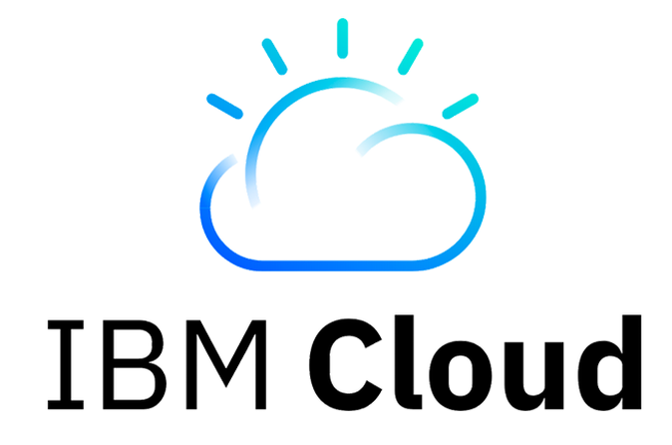


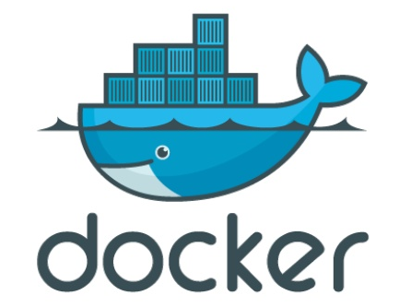


Hands On : Deploy an application on IBM Cloud Kubernetes Cluster
Architectural Flow:
Deploy HelloWorld App
Access App
Scale App
Technology Stack (IBM Cloud):
Docker Container
Kubernetes
HelloWorld App
USER

Slide 26

Hands on lab

Slide 27
Thank You

Slide 28


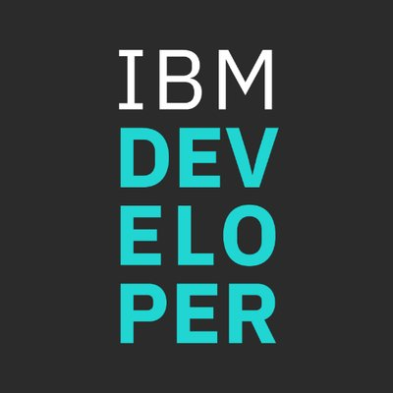

Stay Connected and continue coding !
Instructions available here https://github.com/IBMEvent/HandsOnCloud-201906
Join our Meetup groups
Mumbai : https://www.meetup.com/Cloud-Mumbai-Meetup/
Hyderabad: https://www.meetup.com/Hyderabad-Cognitive-with-Cloud
Bangalore : https://www.meetup.com/IBMDevConnect-Bangalore
Chennai: https://www.meetup.com/Chennai-CodeWeekend-Meetup/
Check out the cool developer journeys
https://developer.ibm.com/patterns/
Join our Slack team and stay in touch with the experts
https://ibmdevconnect.slack.com
Send in your request to - http://ibm.biz/slackrequest

