Slide 1
CUSTOMER SHOPPING BEHAVIOR
Customer shopping behavior has a loyalty problem, not a demand problem
An executive read of 3,900 purchases

Slide 2
THE BASE
3,900 purchases reveal a broad, measurable customer base
3,900
$59.76
What the data holds
Demographics, product choice, discount behavior, shipping, reviews, and subscription status.
transactions across 25 products, 4 categories, 50 locations, and 4 seasons
average purchase
3.75
average review rating

Slide 3
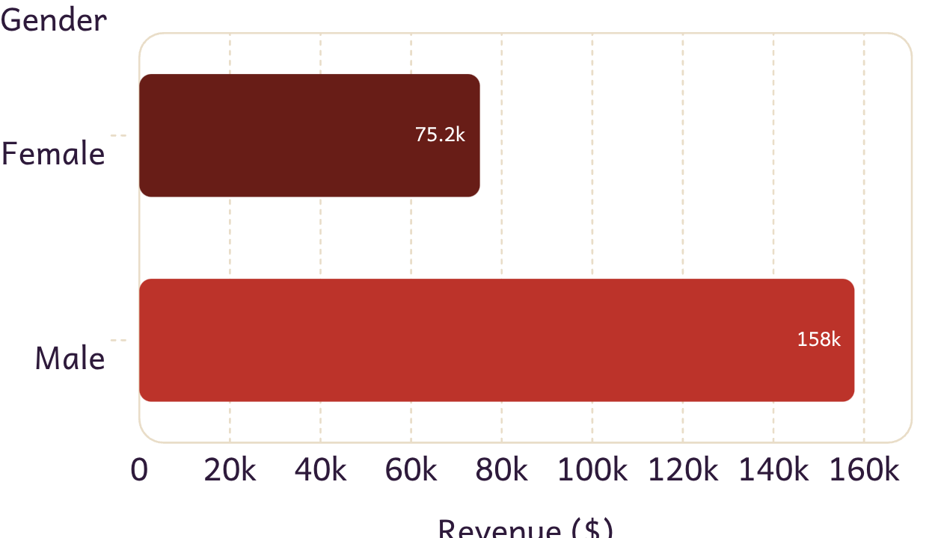
REVENUE BY GENDER
The gap is a targeting signal
Male customers generated $157,890 in revenue versus $75,191 from female customers.
Test category, offer, and message fit rather than assuming one universal customer profile.

Slide 4
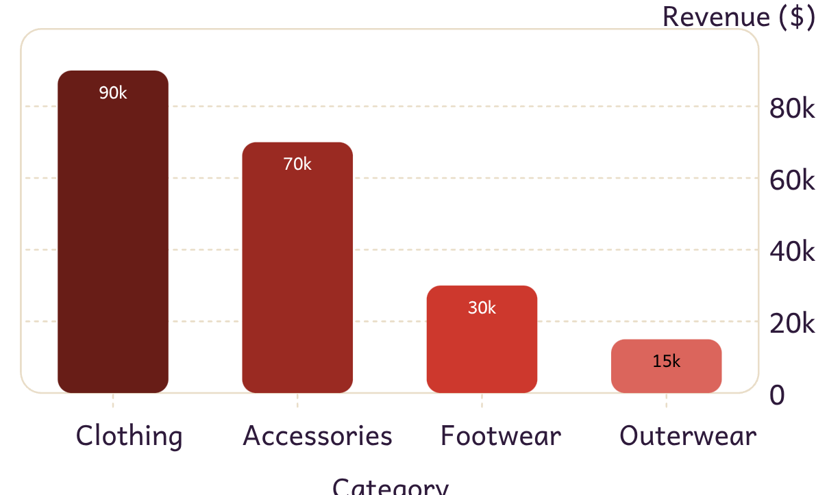
REVENUE BY CATEGORY
Clothing and accessories carry the business
Category leaders include Jewelry, Sunglasses, Belt, Blouse, Pants, Shirt, Sandals, Shoes, Sneakers, Jacket, and Coat.
Dashboard revenue: Clothing approximately $90K; Accessories approximately $70K; Footwear approximately $30K; Outerwear approximately $15K.

Slide 5
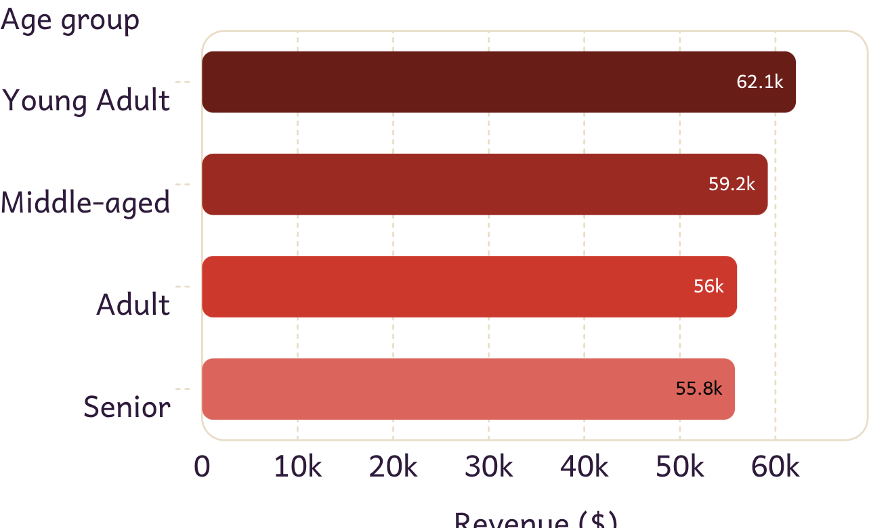
REVENUE BY AGE GROUP
Young adults lead, but no single age group dominates
The narrow spread supports differentiated creative, not a single age-based strategy.

Slide 6
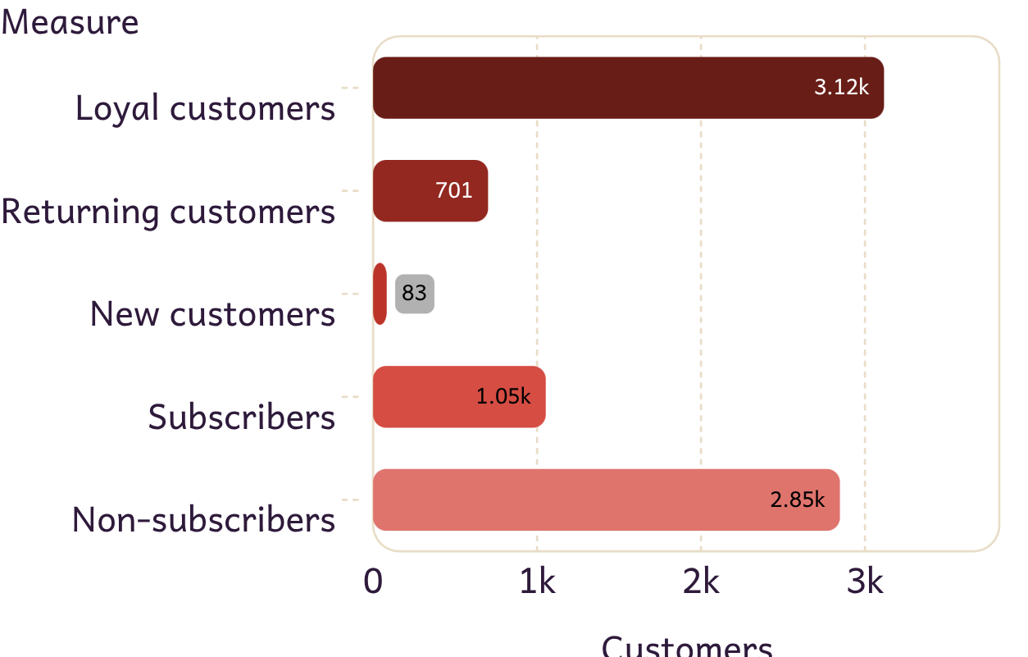
LOYALTY → SUBSCRIPTION
The base is loyal, but loyalty is not translating into subscriptions
Only 27% of customers subscribe; 73% do not.
Subscribers average $59.49 per purchase versus $59.87 for non-subscribers.

Slide 7
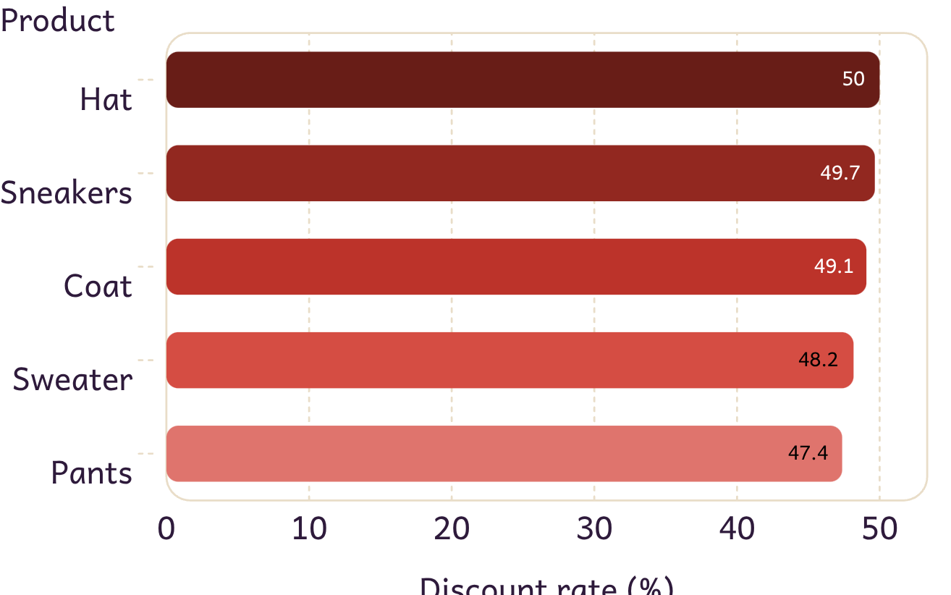
DISCOUNT DEPENDENCE
Discounts attract spend, but product-level dependence threatens margin
839 customers used discounts while spending above the average purchase amount.
Sweater and Pants also exceed 47% discounted purchases.

Slide 8
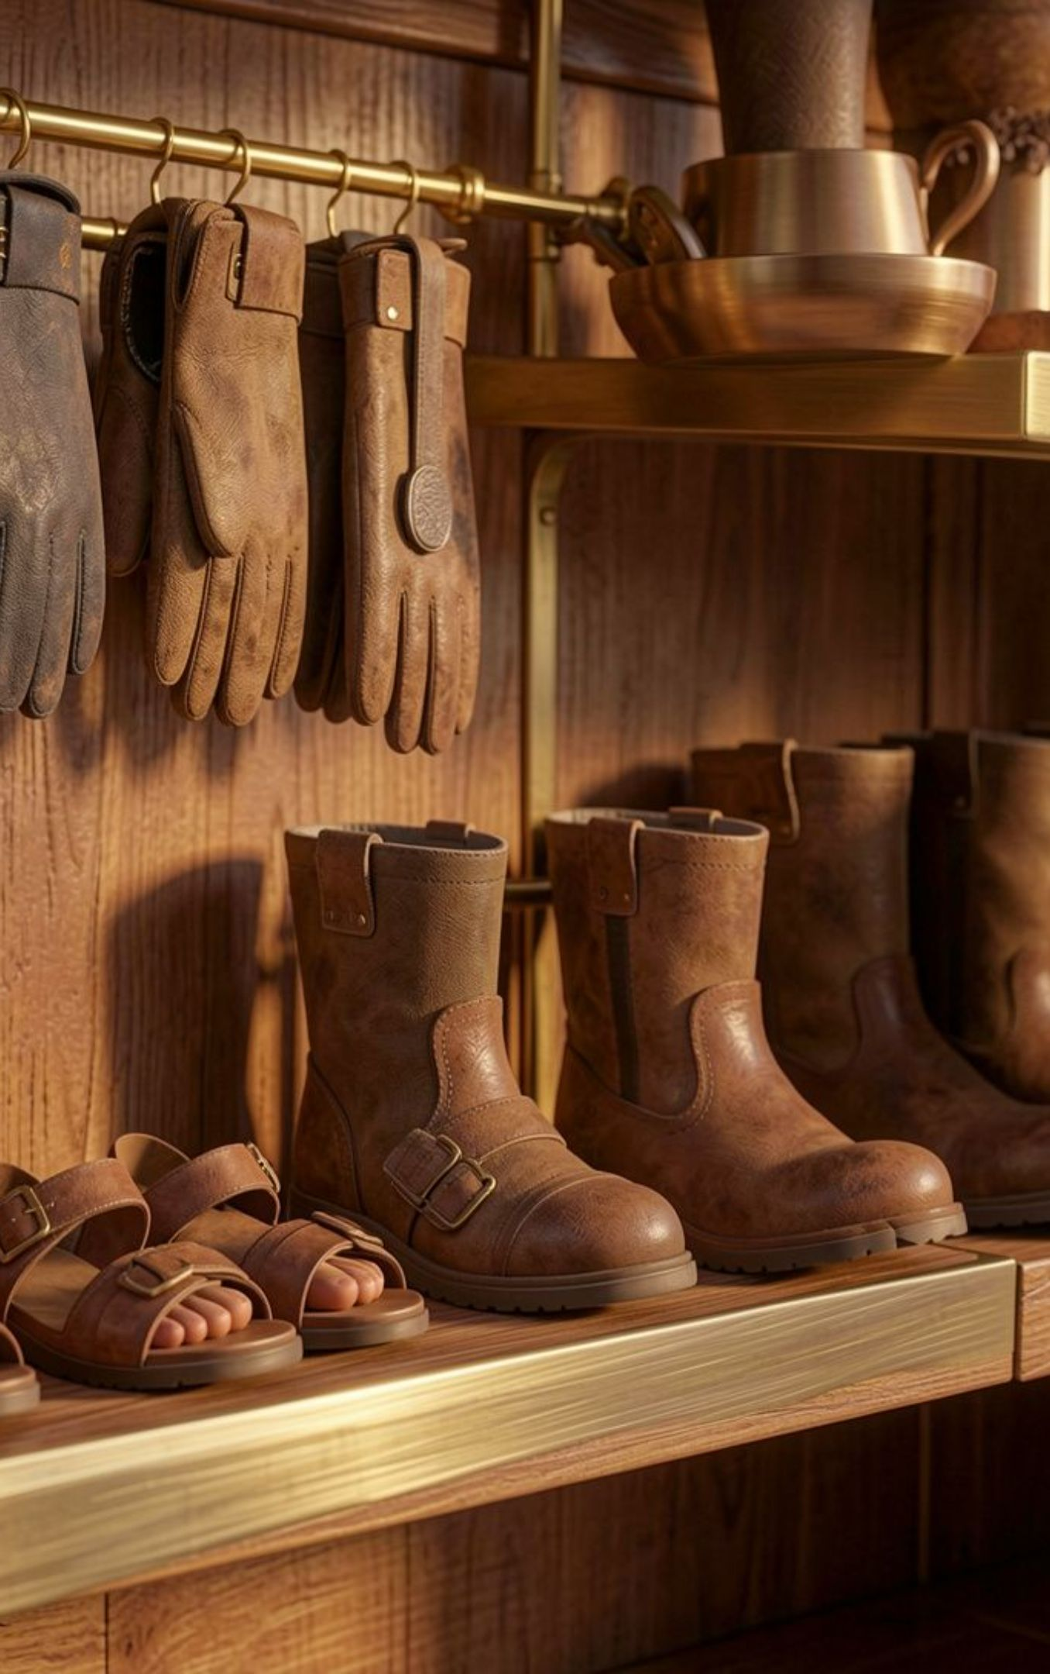
PRODUCT + DELIVERY
Product quality and delivery experience are steady levers
Top-rated products
Shipping signal
Express-shipping orders average $60.48 versus $58.46 for Standard.
Gloves 3.86 · Sandals 3.84 · Boots 3.82 · Hat 3.80 · Skirt 3.78
Use best-rated products in campaigns and test express-shipping messaging as a conversion lever.

Slide 9
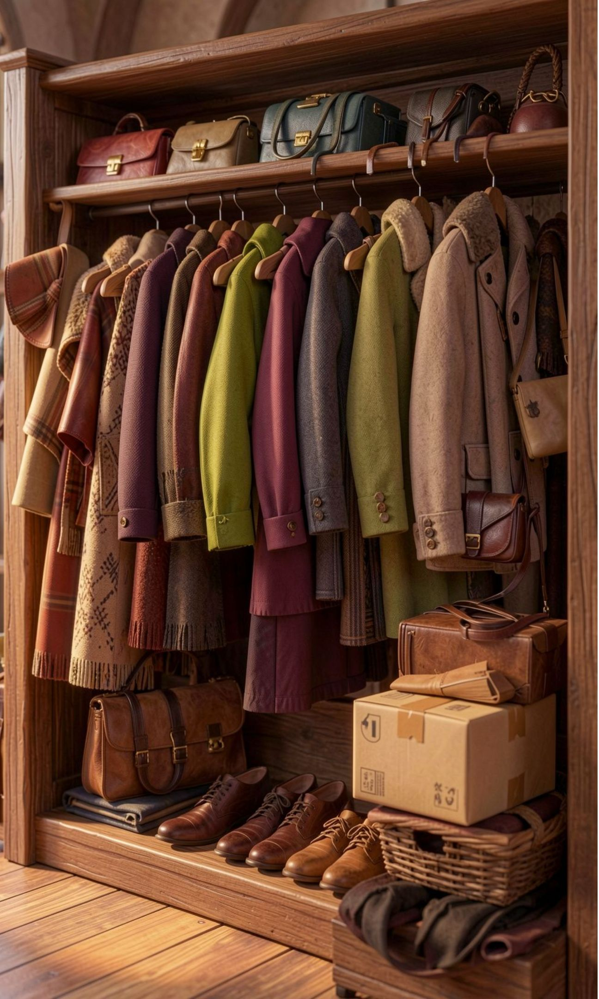
FROM SIGNALS TO GROWTH
Five moves can turn behavior signals into growth
01
Convert loyal non-subscribers with exclusive benefits and clearer value
02
Reward repeat buyers to deepen movement into the Loyal segment
03
Replace blanket discounts with product-level margin rules
04
Feature top-rated and best-selling products in campaigns
05
Tailor creative by age group, category, and shipping preference

Slide 10
SOURCE
Source
Customer Shopping Behavior Analysis

