Slide 1
Project title
CAPSTONE PROJECT
Presented By:
Student Name- G. Rupasree
College Name- NITTE MEENAKSHI INSTITUTE OF TECHNOLOGY
Department- ECE

Slide 2
OUTLINE
Problem Statement
Proposed System/Solution
System Development Approach
Algorithm & Deployment
Result
Conclusion
Future Scope
References

Slide 3
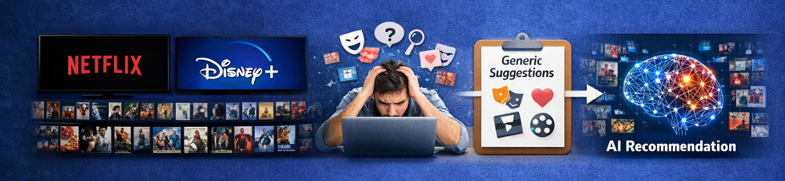
Problem Statement
With the rapid growth of streaming platforms like Netflix, Amazon Prime Video, and Disney+, users are exposed to thousands of movies, leading to information overload. Traditional search and genre-based filtering methods fail to provide personalized recommendations and do not learn from user preferences or behavior.
There is a need for an intelligent system that can analyze movie data, identify similarities, learn from user interactions, and generate personalized Top-N movie recommendations efficiently and accurately.

Slide 4
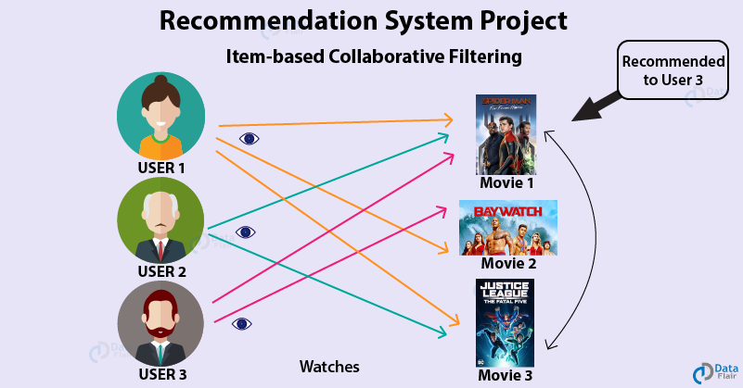
Proposed Solution
To address the problem of information overload, we propose a Machine Learning-based Movie Recommendation System that generates personalized movie suggestions based on user preferences and movie similarity.
The system uses:
Content-Based Filtering to recommend movies similar to the selected movie
Cosine Similarity to measure similarity between movie features
User rating data to improve recommendation accuracy
A trained ML model deployed using Python and Streamlit
The system provides Top-N personalized movie recommendations efficiently, improving user experience and reducing search time.

Slide 5
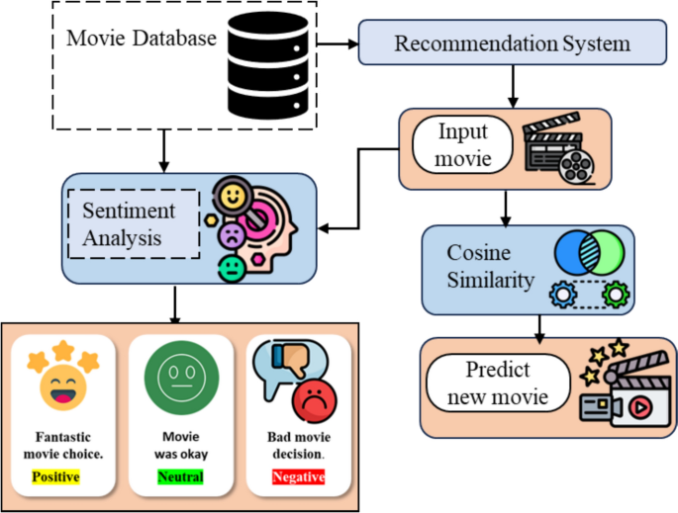
System Approach
The proposed system follows a structured Machine Learning workflow:
Data Collection: Movie dataset containing titles, genres, ratings, and descriptions
Data Preprocessing: Cleaning missing values and transforming textual data
Feature Extraction: Convert text data into numerical vectors using TF-IDF
Similarity Computation: Apply Cosine Similarity to measure movie similarity
Recommendation Generation: Retrieve Top-N similar movies
Deployment: Integrate model into a Streamlit web application
This approach ensures efficient, scalable, and personalized movie recommendations.

Slide 6
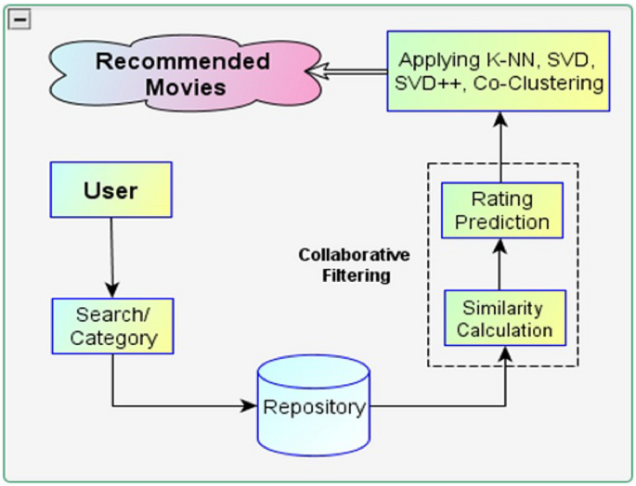
Algorithm & Deployment
Algorithm Used
Content-Based Filtering technique
TF-IDF Vectorization for feature extraction
Cosine Similarity to compute similarity between movies
Top-N ranking to generate recommendations
Deployment
Model serialized using Pickle
Backend developed using Python
Web interface built using Streamlit
Deployed on Streamlit Cloud / GitHub
The system provides real-time movie recommendations through a user-friendly web application.
.

Slide 7
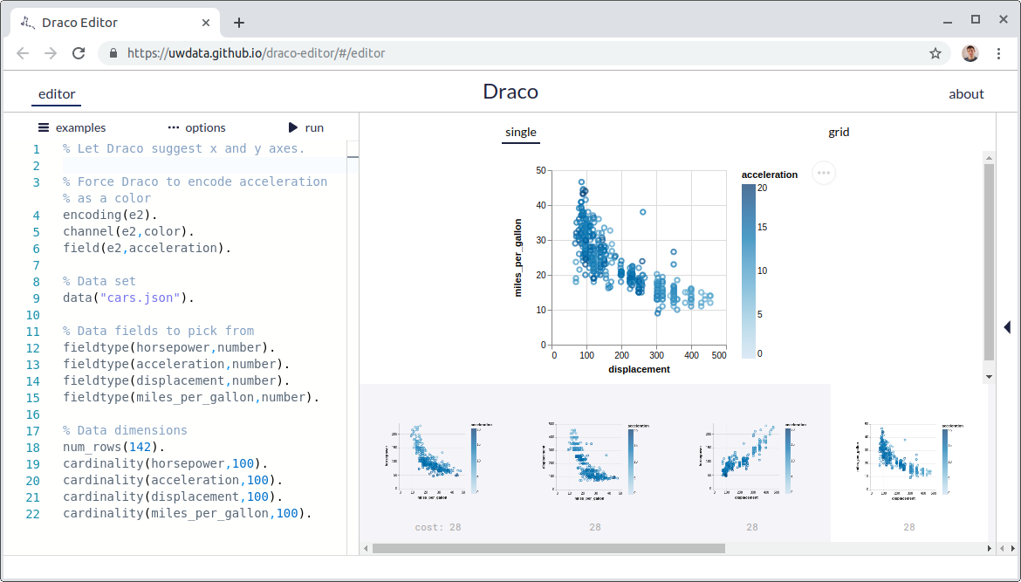
Result
The system successfully generates personalized movie recommendations.
Provides Top-5 / Top-10 similar movies based on user input.
Achieves accurate similarity matching using cosine similarity.
Fast response time with real-time recommendation output.
Improves user experience by reducing manual search effort.

Slide 8
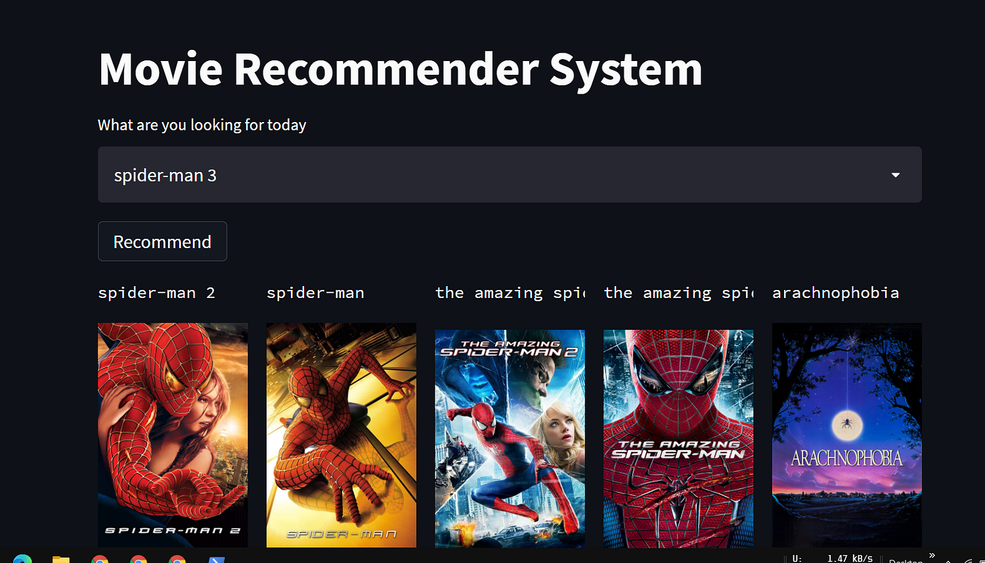
Conclusion
The Movie Recommendation System using Machine Learning effectively addresses the problem of information overload in streaming platforms. By applying content-based filtering and cosine similarity, the system generates personalized and relevant movie suggestions.
The model improves user experience, reduces search time, and demonstrates the practical application of Machine Learning in real-world recommendation systems.

Slide 9
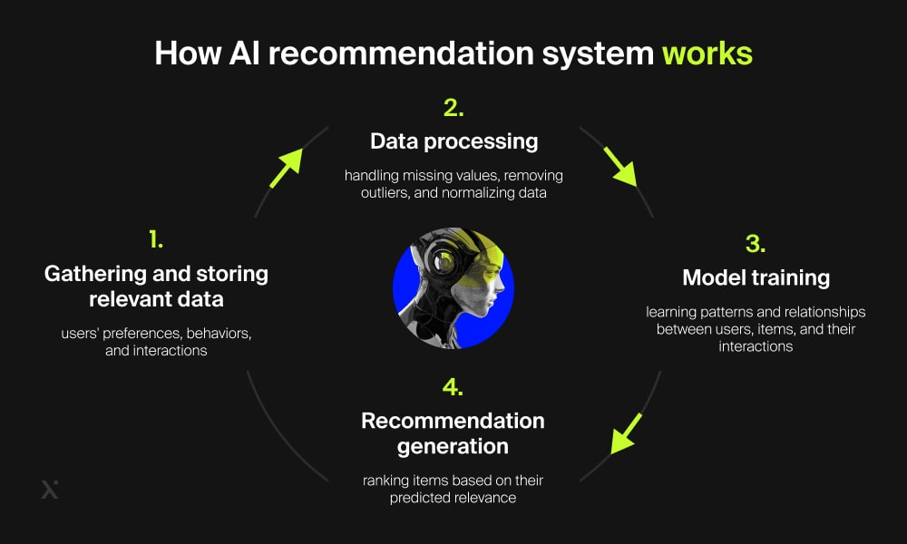
Future scope
Implement Collaborative Filtering for more accurate personalized recommendations.
Integrate Deep Learning models to improve recommendation quality.
Add user authentication and profile-based recommendation tracking.
Incorporate real-time user behavior analysis.
Develop a mobile application version of the system.
Deploy on cloud platforms for large-scale scalability.

Slide 10
References
Adomavicius, G., & Tuzhilin, A. (2005). Toward the Next Generation of Recommender Systems: A Survey of the State-of-the-Art and Possible Extensions. IEEE Transactions on Knowledge and Data Engineering.
Ricci, F., Rokach, L., & Shapira, B. (2011). Introduction to Recommender Systems Handbook. Springer.
Salton, G., & Buckley, C. (1988). Term-weighting approaches in automatic text retrieval. Information Processing & Management. (TF-IDF reference)
Lops, P., De Gemmis, M., & Semeraro, G. (2011). Content-Based Recommender Systems: State of the Art and Trends. Recommender Systems Handbook.
Sarwar, B., Karypis, G., Konstan, J., & Riedl, J. (2001). Item-Based Collaborative Filtering Recommendation Algorithms. WWW Conference.

Slide 11
Github link
https://github.com/GandlaRupasree/Movie-Recomendition-using-ML_IBM

Slide 12
THANK YOU

