Slide 1
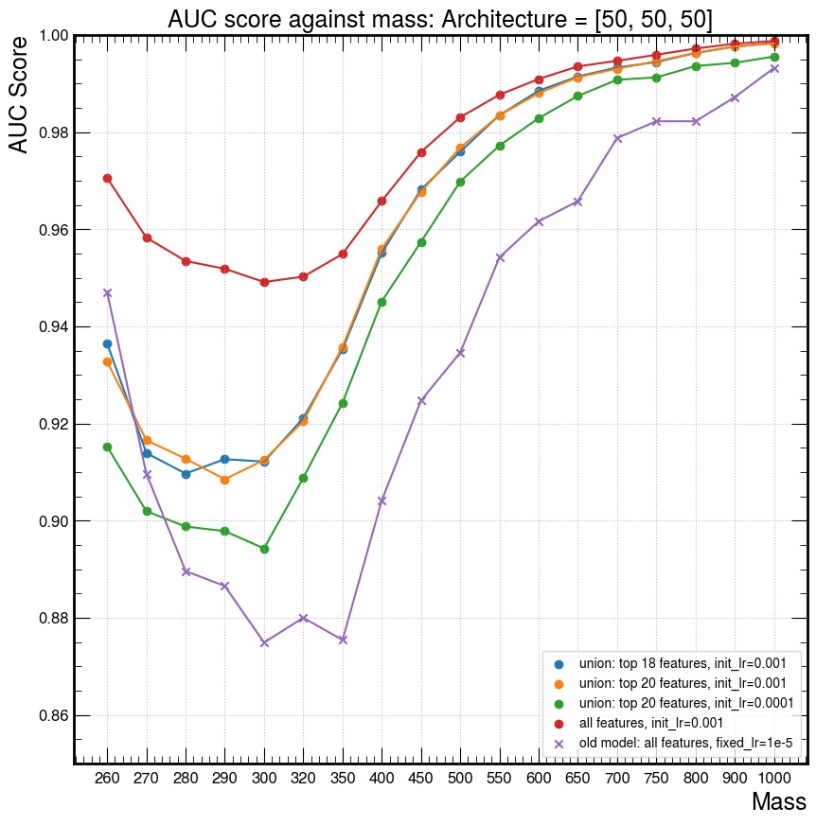
Term 2 – Week 6

Slide 2
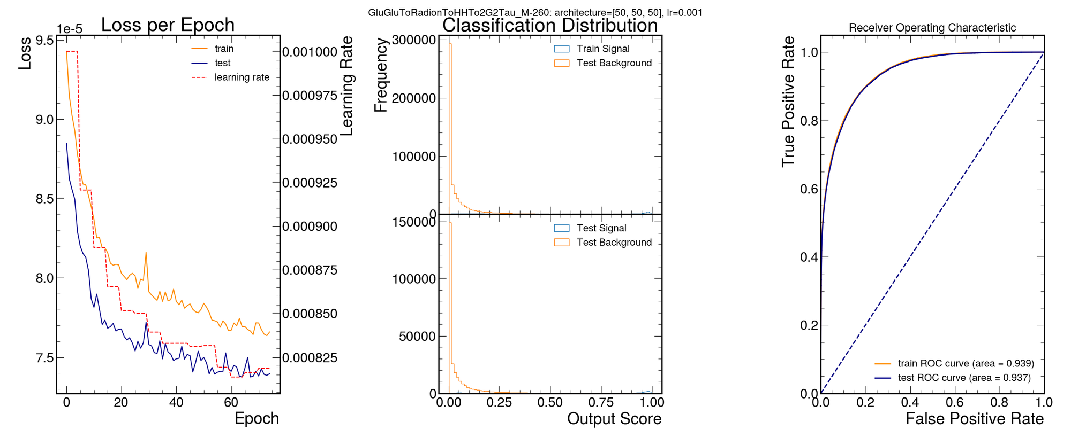
Term 2 – Week 6
Signal - 260
['reco_MX_mgg', 'dilep_leadpho_mass', 'ditau_pt', 'Diphoton_dPhi', 'ditau_dphi', 'Diphoton_pt_mgg', 'LeadPhoton_pt_mgg', 'MET_pt', 'LeadPhoton_lead_lepton_dR', 'ditau_dR', 'lead_lepton_pt', 'Diphoton_ditau_deta', 'Diphoton_lead_lepton_dR', 'LeadPhoton_ditau_dR', 'SubleadPhoton_lead_lepton_dR', 'jet_1_pt', 'Diphoton_sublead_lepton_dR', 'Diphoton_ditau_dphi', 'ditau_deta', 'ditau_met_dPhi', 'Diphoton_lead_lepton_deta', 'Diphoton_sublead_lepton_deta', 'lead_lepton_mass', 'ditau_mass', 'diphoton_met_dPhi', 'SubleadPhoton_pt_mgg', 'MX']
Union of top 18 custom_lr =0.001

Slide 3
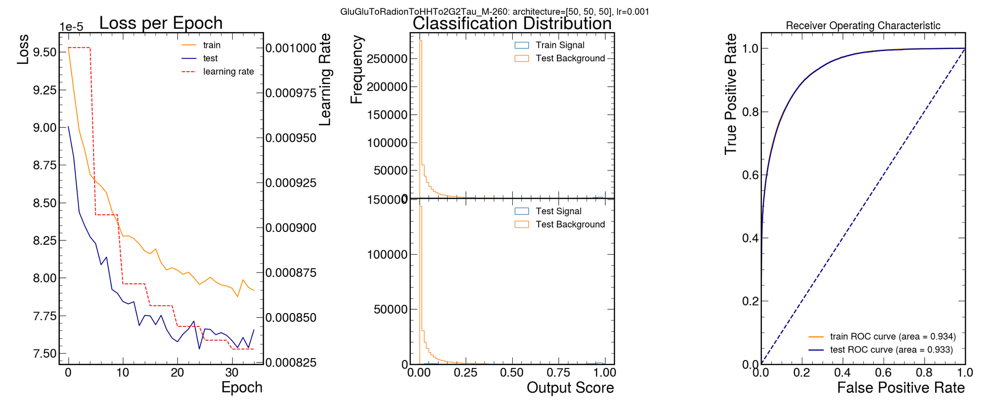
Term 2 – Week 6
Signal - 260
['reco_MX_mgg', 'dilep_leadpho_mass', 'ditau_pt', 'Diphoton_dPhi', 'ditau_dphi', 'Diphoton_pt_mgg', 'LeadPhoton_pt_mgg', 'MET_pt', 'LeadPhoton_lead_lepton_dR', 'ditau_dR', 'lead_lepton_pt', 'Diphoton_ditau_deta', 'Diphoton_lead_lepton_dR', 'LeadPhoton_ditau_dR', 'SubleadPhoton_lead_lepton_dR', 'jet_1_pt', 'Diphoton_sublead_lepton_dR', 'Diphoton_ditau_dphi', 'ditau_deta', 'ditau_met_dPhi', 'Diphoton_lead_lepton_deta', 'Diphoton_sublead_lepton_deta', 'lead_lepton_mass', 'ditau_mass', 'diphoton_met_dPhi', 'SubleadPhoton_pt_mgg', 'MX']
['reco_MX_mgg', 'dilep_leadpho_mass', 'ditau_pt', 'Diphoton_dPhi', 'ditau_dphi', 'Diphoton_pt_mgg', 'LeadPhoton_pt_mgg', 'MET_pt', 'LeadPhoton_lead_lepton_dR', 'ditau_dR', 'lead_lepton_pt', 'Diphoton_ditau_deta', 'Diphoton_lead_lepton_dR', 'LeadPhoton_ditau_dR', 'SubleadPhoton_lead_lepton_dR', 'jet_1_pt', 'Diphoton_sublead_lepton_dR', 'Diphoton_ditau_dphi', 'ditau_deta', 'ditau_met_dPhi', 'Diphoton_sublead_lepton_deta', 'Diphoton_lead_lepton_deta', 'lead_lepton_mass', 'ditau_mass', 'diphoton_met_dPhi', 'SubleadPhoton_pt_mgg', 'MX']
Union of top 18 custom_lr =0.001
Union of top 20 custom_lr =0.001

Slide 4
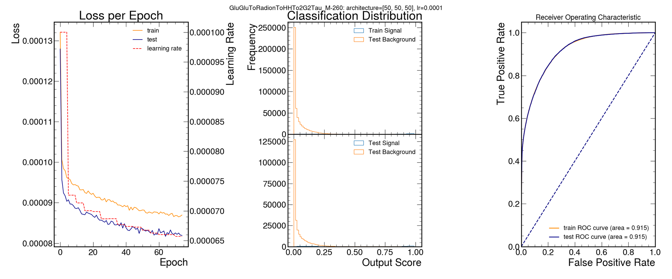
Term 2 – Week 6
['reco_MX_mgg', 'dilep_leadpho_mass', 'ditau_pt', 'Diphoton_dPhi', 'ditau_dphi', 'Diphoton_pt_mgg', 'LeadPhoton_pt_mgg', 'MET_pt', 'LeadPhoton_lead_lepton_dR', 'ditau_dR', 'lead_lepton_pt', 'Diphoton_ditau_deta', 'Diphoton_lead_lepton_dR', 'LeadPhoton_ditau_dR', 'SubleadPhoton_lead_lepton_dR', 'jet_1_pt', 'Diphoton_sublead_lepton_dR', 'Diphoton_ditau_dphi', 'ditau_deta', 'ditau_met_dPhi', 'Diphoton_lead_lepton_deta', 'Diphoton_sublead_lepton_deta', 'lead_lepton_mass', 'ditau_mass', 'diphoton_met_dPhi', 'SubleadPhoton_pt_mgg', 'MX']
Signal - 260
['reco_MX_mgg', 'dilep_leadpho_mass', 'ditau_pt', 'Diphoton_dPhi', 'ditau_dphi', 'Diphoton_pt_mgg', 'LeadPhoton_pt_mgg', 'MET_pt', 'LeadPhoton_lead_lepton_dR', 'ditau_dR', 'lead_lepton_pt', 'Diphoton_ditau_deta', 'Diphoton_lead_lepton_dR', 'LeadPhoton_ditau_dR', 'SubleadPhoton_lead_lepton_dR', 'jet_1_pt', 'Diphoton_sublead_lepton_dR', 'Diphoton_ditau_dphi', 'ditau_deta', 'ditau_met_dPhi', 'Diphoton_sublead_lepton_deta', 'Diphoton_lead_lepton_deta', 'lead_lepton_mass', 'ditau_mass', 'diphoton_met_dPhi', 'SubleadPhoton_pt_mgg', 'MX']
Union of top 18 custom_lr =0.001
Union of top 20 custom_lr =0.001

Slide 5
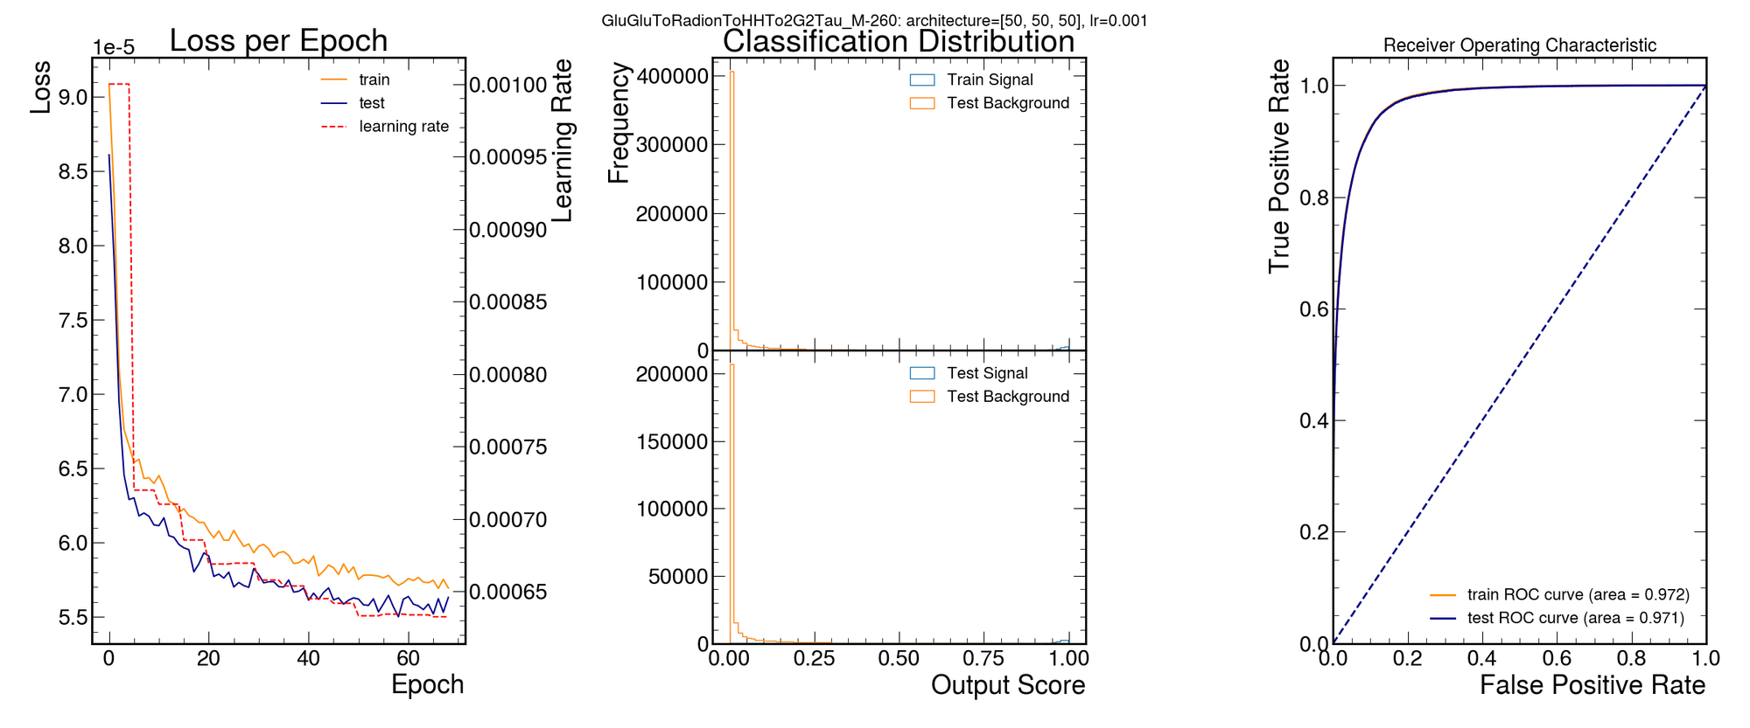
Term 2 – Week 6
['reco_MX_mgg', 'dilep_leadpho_mass', 'ditau_pt', 'Diphoton_dPhi', 'ditau_dphi', 'Diphoton_pt_mgg', 'LeadPhoton_pt_mgg', 'MET_pt', 'LeadPhoton_lead_lepton_dR', 'ditau_dR', 'lead_lepton_pt', 'Diphoton_ditau_deta', 'Diphoton_lead_lepton_dR', 'LeadPhoton_ditau_dR', 'SubleadPhoton_lead_lepton_dR', 'jet_1_pt', 'Diphoton_sublead_lepton_dR', 'Diphoton_ditau_dphi', 'ditau_deta', 'ditau_met_dPhi', 'Diphoton_lead_lepton_deta', 'Diphoton_sublead_lepton_deta', 'lead_lepton_mass', 'ditau_mass', 'diphoton_met_dPhi', 'SubleadPhoton_pt_mgg', 'MX']
Signal - 260
['reco_MX_mgg', 'dilep_leadpho_mass', 'ditau_pt', 'Diphoton_dPhi', 'ditau_dphi', 'Diphoton_pt_mgg', 'LeadPhoton_pt_mgg', 'MET_pt', 'LeadPhoton_lead_lepton_dR', 'ditau_dR', 'lead_lepton_pt', 'Diphoton_ditau_deta', 'Diphoton_lead_lepton_dR', 'LeadPhoton_ditau_dR', 'SubleadPhoton_lead_lepton_dR', 'jet_1_pt', 'Diphoton_sublead_lepton_dR', 'Diphoton_ditau_dphi', 'ditau_deta', 'ditau_met_dPhi', 'Diphoton_sublead_lepton_deta', 'Diphoton_lead_lepton_deta', 'lead_lepton_mass', 'ditau_mass', 'diphoton_met_dPhi', 'SubleadPhoton_pt_mgg', 'MX']
Union of top 18 custom_lr =0.001
Union of top 20 custom_lr=0.0001
Union of top 20 custom_lr =0.001
Union of top 20 custom_lr =0.001

Slide 6
Term 2 – Week 6
['reco_MX_mgg', 'dilep_leadpho_mass', 'ditau_pt', 'Diphoton_dPhi', 'ditau_dphi', 'Diphoton_pt_mgg', 'LeadPhoton_pt_mgg', 'MET_pt', 'LeadPhoton_lead_lepton_dR', 'ditau_dR', 'lead_lepton_pt', 'Diphoton_ditau_deta', 'Diphoton_lead_lepton_dR', 'LeadPhoton_ditau_dR', 'SubleadPhoton_lead_lepton_dR', 'jet_1_pt', 'Diphoton_sublead_lepton_dR', 'Diphoton_ditau_dphi', 'ditau_deta', 'ditau_met_dPhi', 'Diphoton_sublead_lepton_deta', 'Diphoton_lead_lepton_deta', 'lead_lepton_mass', 'ditau_mass', 'diphoton_met_dPhi', 'SubleadPhoton_pt_mgg', 'MX']
['reco_MX_mgg', 'dilep_leadpho_mass', 'ditau_pt', 'Diphoton_dPhi', 'ditau_dphi', 'Diphoton_pt_mgg', 'LeadPhoton_pt_mgg', 'MET_pt', 'LeadPhoton_lead_lepton_dR', 'ditau_dR', 'lead_lepton_pt', 'Diphoton_ditau_deta', 'Diphoton_lead_lepton_dR', 'LeadPhoton_ditau_dR', 'SubleadPhoton_lead_lepton_dR', 'jet_1_pt', 'Diphoton_sublead_lepton_dR', 'Diphoton_ditau_dphi', 'ditau_deta', 'ditau_met_dPhi', 'Diphoton_lead_lepton_deta', 'Diphoton_sublead_lepton_deta', 'lead_lepton_mass', 'ditau_mass', 'diphoton_met_dPhi', 'SubleadPhoton_pt_mgg', 'MX']
Signal - 800
Union of top 18 custom_lr =0.001
Signal - 260
['reco_MX_mgg', 'dilep_leadpho_mass', 'ditau_pt', 'Diphoton_dPhi', 'ditau_dphi', 'Diphoton_pt_mgg', 'LeadPhoton_pt_mgg', 'MET_pt', 'LeadPhoton_lead_lepton_dR', 'ditau_dR', 'lead_lepton_pt', 'Diphoton_ditau_deta', 'Diphoton_lead_lepton_dR', 'LeadPhoton_ditau_dR', 'SubleadPhoton_lead_lepton_dR', 'jet_1_pt', 'Diphoton_sublead_lepton_dR', 'Diphoton_ditau_dphi', 'ditau_deta', 'ditau_met_dPhi', 'ditau_mass', 'Diphoton_sublead_lepton_deta', 'SubleadPhoton_pt_mgg', 'Diphoton_mass', 'Diphoton_lead_lepton_deta', 'diphoton_met_dPhi', 'lead_lepton_mass', 'MX']
['reco_MX_mgg', 'dilep_leadpho_mass', 'ditau_pt', 'Diphoton_dPhi', 'ditau_dphi', 'Diphoton_pt_mgg', 'LeadPhoton_pt_mgg', 'MET_pt', 'LeadPhoton_lead_lepton_dR', 'ditau_dR', 'lead_lepton_pt', 'Diphoton_ditau_deta', 'Diphoton_lead_lepton_dR', 'LeadPhoton_ditau_dR', 'SubleadPhoton_lead_lepton_dR', 'jet_1_pt', 'Diphoton_sublead_lepton_dR', 'Diphoton_ditau_dphi', 'ditau_deta', 'ditau_met_dPhi', 'Diphoton_lead_lepton_deta', 'Diphoton_sublead_lepton_deta', 'lead_lepton_mass', 'ditau_mass', 'diphoton_met_dPhi', 'SubleadPhoton_pt_mgg', 'MX']
Union of top 20 custom_lr=0.0001
Union of full 27 custom_lr=0.001
Union of top 18 custom_lr =0.001
Union of top 20 custom_lr =0.001

Slide 7
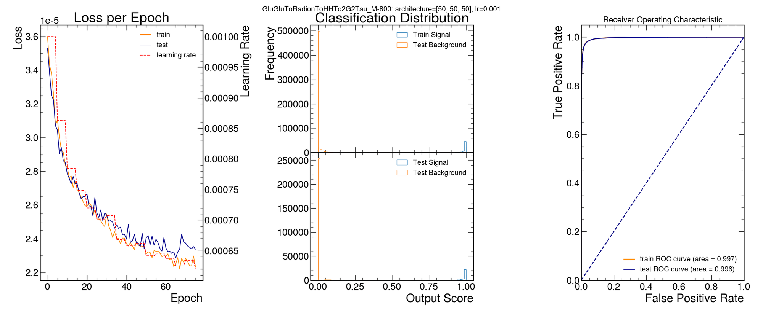
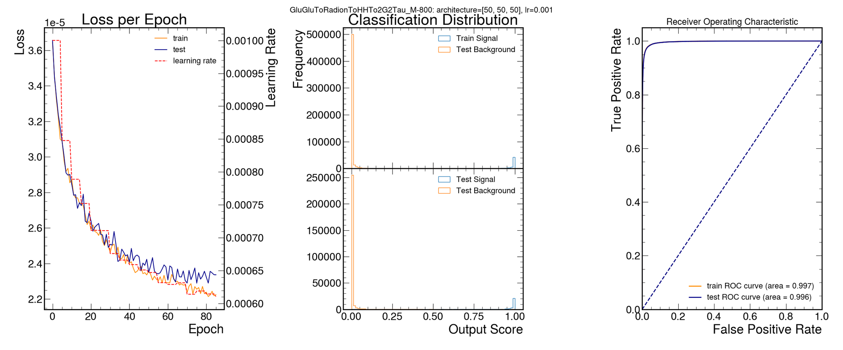
Term 2 – Week 6
['reco_MX_mgg', 'dilep_leadpho_mass', 'ditau_pt', 'Diphoton_dPhi', 'ditau_dphi', 'Diphoton_pt_mgg', 'LeadPhoton_pt_mgg', 'MET_pt', 'LeadPhoton_lead_lepton_dR', 'ditau_dR', 'lead_lepton_pt', 'Diphoton_ditau_deta', 'Diphoton_lead_lepton_dR', 'LeadPhoton_ditau_dR', 'SubleadPhoton_lead_lepton_dR', 'jet_1_pt', 'Diphoton_sublead_lepton_dR', 'Diphoton_ditau_dphi', 'ditau_deta', 'ditau_met_dPhi', 'Diphoton_sublead_lepton_deta', 'Diphoton_lead_lepton_deta', 'lead_lepton_mass', 'ditau_mass', 'diphoton_met_dPhi', 'SubleadPhoton_pt_mgg', 'MX']
['reco_MX_mgg', 'dilep_leadpho_mass', 'ditau_pt', 'Diphoton_dPhi', 'ditau_dphi', 'Diphoton_pt_mgg', 'LeadPhoton_pt_mgg', 'MET_pt', 'LeadPhoton_lead_lepton_dR', 'ditau_dR', 'lead_lepton_pt', 'Diphoton_ditau_deta', 'Diphoton_lead_lepton_dR', 'LeadPhoton_ditau_dR', 'SubleadPhoton_lead_lepton_dR', 'jet_1_pt', 'Diphoton_sublead_lepton_dR', 'Diphoton_ditau_dphi', 'ditau_deta', 'ditau_met_dPhi', 'ditau_mass', 'Diphoton_sublead_lepton_deta', 'SubleadPhoton_pt_mgg', 'Diphoton_mass', 'Diphoton_lead_lepton_deta', 'diphoton_met_dPhi', 'lead_lepton_mass', 'MX']
['reco_MX_mgg', 'dilep_leadpho_mass', 'ditau_pt', 'Diphoton_dPhi', 'ditau_dphi', 'Diphoton_pt_mgg', 'LeadPhoton_pt_mgg', 'MET_pt', 'LeadPhoton_lead_lepton_dR', 'ditau_dR', 'lead_lepton_pt', 'Diphoton_ditau_deta', 'Diphoton_lead_lepton_dR', 'LeadPhoton_ditau_dR', 'SubleadPhoton_lead_lepton_dR', 'jet_1_pt', 'Diphoton_sublead_lepton_dR', 'Diphoton_ditau_dphi', 'ditau_deta', 'ditau_met_dPhi', 'Diphoton_lead_lepton_deta', 'Diphoton_sublead_lepton_deta', 'lead_lepton_mass', 'ditau_mass', 'diphoton_met_dPhi', 'SubleadPhoton_pt_mgg', 'MX']
Signal - 260
Signal - 800
['reco_MX_mgg', 'dilep_leadpho_mass', 'ditau_pt', 'Diphoton_dPhi', 'ditau_dphi', 'Diphoton_pt_mgg', 'LeadPhoton_pt_mgg', 'MET_pt', 'LeadPhoton_lead_lepton_dR', 'ditau_dR', 'lead_lepton_pt', 'Diphoton_ditau_deta', 'Diphoton_lead_lepton_dR', 'LeadPhoton_ditau_dR', 'SubleadPhoton_lead_lepton_dR', 'jet_1_pt', 'Diphoton_sublead_lepton_dR', 'Diphoton_ditau_dphi', 'ditau_deta', 'ditau_met_dPhi', 'Diphoton_lead_lepton_deta', 'Diphoton_sublead_lepton_deta', 'lead_lepton_mass', 'ditau_mass', 'diphoton_met_dPhi', 'SubleadPhoton_pt_mgg', 'MX']
Union of full 27 custom_lr=0.001
Union of top 20 custom_lr=0.0001
Union of top 18 custom_lr =0.001
Union of top 18 custom_lr =0.001
Union of top 20 custom_lr =0.001

Slide 8
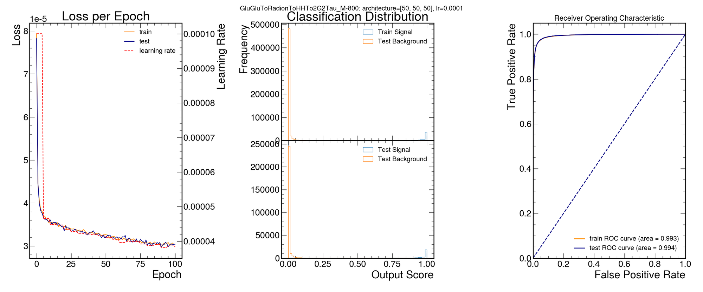
Term 2 – Week 6
['reco_MX_mgg', 'dilep_leadpho_mass', 'ditau_pt', 'Diphoton_dPhi', 'ditau_dphi', 'Diphoton_pt_mgg', 'LeadPhoton_pt_mgg', 'MET_pt', 'LeadPhoton_lead_lepton_dR', 'ditau_dR', 'lead_lepton_pt', 'Diphoton_ditau_deta', 'Diphoton_lead_lepton_dR', 'LeadPhoton_ditau_dR', 'SubleadPhoton_lead_lepton_dR', 'jet_1_pt', 'Diphoton_sublead_lepton_dR', 'Diphoton_ditau_dphi', 'ditau_deta', 'ditau_met_dPhi', 'Diphoton_sublead_lepton_deta', 'Diphoton_lead_lepton_deta', 'lead_lepton_mass', 'ditau_mass', 'diphoton_met_dPhi', 'SubleadPhoton_pt_mgg', 'MX']
['reco_MX_mgg', 'dilep_leadpho_mass', 'ditau_pt', 'Diphoton_dPhi', 'ditau_dphi', 'Diphoton_pt_mgg', 'LeadPhoton_pt_mgg', 'MET_pt', 'LeadPhoton_lead_lepton_dR', 'ditau_dR', 'lead_lepton_pt', 'Diphoton_ditau_deta', 'Diphoton_lead_lepton_dR', 'LeadPhoton_ditau_dR', 'SubleadPhoton_lead_lepton_dR', 'jet_1_pt', 'Diphoton_sublead_lepton_dR', 'Diphoton_ditau_dphi', 'ditau_deta', 'ditau_met_dPhi', 'ditau_mass', 'Diphoton_sublead_lepton_deta', 'SubleadPhoton_pt_mgg', 'Diphoton_mass', 'Diphoton_lead_lepton_deta', 'diphoton_met_dPhi', 'lead_lepton_mass', 'MX']
['reco_MX_mgg', 'dilep_leadpho_mass', 'ditau_pt', 'Diphoton_dPhi', 'ditau_dphi', 'Diphoton_pt_mgg', 'LeadPhoton_pt_mgg', 'MET_pt', 'LeadPhoton_lead_lepton_dR', 'ditau_dR', 'lead_lepton_pt', 'Diphoton_ditau_deta', 'Diphoton_lead_lepton_dR', 'LeadPhoton_ditau_dR', 'SubleadPhoton_lead_lepton_dR', 'jet_1_pt', 'Diphoton_sublead_lepton_dR', 'Diphoton_ditau_dphi', 'ditau_deta', 'ditau_met_dPhi', 'Diphoton_lead_lepton_deta', 'Diphoton_sublead_lepton_deta', 'lead_lepton_mass', 'ditau_mass', 'diphoton_met_dPhi', 'SubleadPhoton_pt_mgg', 'MX']
['reco_MX_mgg', 'dilep_leadpho_mass', 'ditau_pt', 'Diphoton_dPhi', 'ditau_dphi', 'Diphoton_pt_mgg', 'LeadPhoton_pt_mgg', 'MET_pt', 'LeadPhoton_lead_lepton_dR', 'ditau_dR', 'lead_lepton_pt', 'Diphoton_ditau_deta', 'Diphoton_lead_lepton_dR', 'LeadPhoton_ditau_dR', 'SubleadPhoton_lead_lepton_dR', 'jet_1_pt', 'Diphoton_sublead_lepton_dR', 'Diphoton_ditau_dphi', 'ditau_deta', 'ditau_met_dPhi', 'Diphoton_lead_lepton_deta', 'Diphoton_sublead_lepton_deta', 'lead_lepton_mass', 'ditau_mass', 'diphoton_met_dPhi', 'SubleadPhoton_pt_mgg', 'MX']
Signal - 260
Signal - 800
['reco_MX_mgg', 'dilep_leadpho_mass', 'ditau_pt', 'Diphoton_dPhi', 'ditau_dphi', 'Diphoton_pt_mgg', 'LeadPhoton_pt_mgg', 'MET_pt', 'LeadPhoton_lead_lepton_dR', 'ditau_dR', 'lead_lepton_pt', 'Diphoton_ditau_deta', 'Diphoton_lead_lepton_dR', 'LeadPhoton_ditau_dR', 'SubleadPhoton_lead_lepton_dR', 'jet_1_pt', 'Diphoton_sublead_lepton_dR', 'Diphoton_ditau_dphi', 'ditau_deta', 'ditau_met_dPhi', 'Diphoton_sublead_lepton_deta', 'Diphoton_lead_lepton_deta', 'lead_lepton_mass', 'ditau_mass', 'diphoton_met_dPhi', 'SubleadPhoton_pt_mgg', 'MX']
Union of top 18 custom_lr =0.001
Union of full 27 custom_lr=0.001
Union of top 20 custom_lr=0.0001
Union of top 20 custom_lr=0.001
Union of top 18 custom_lr =0.001
Union of top 20 custom_lr =0.001

Slide 9
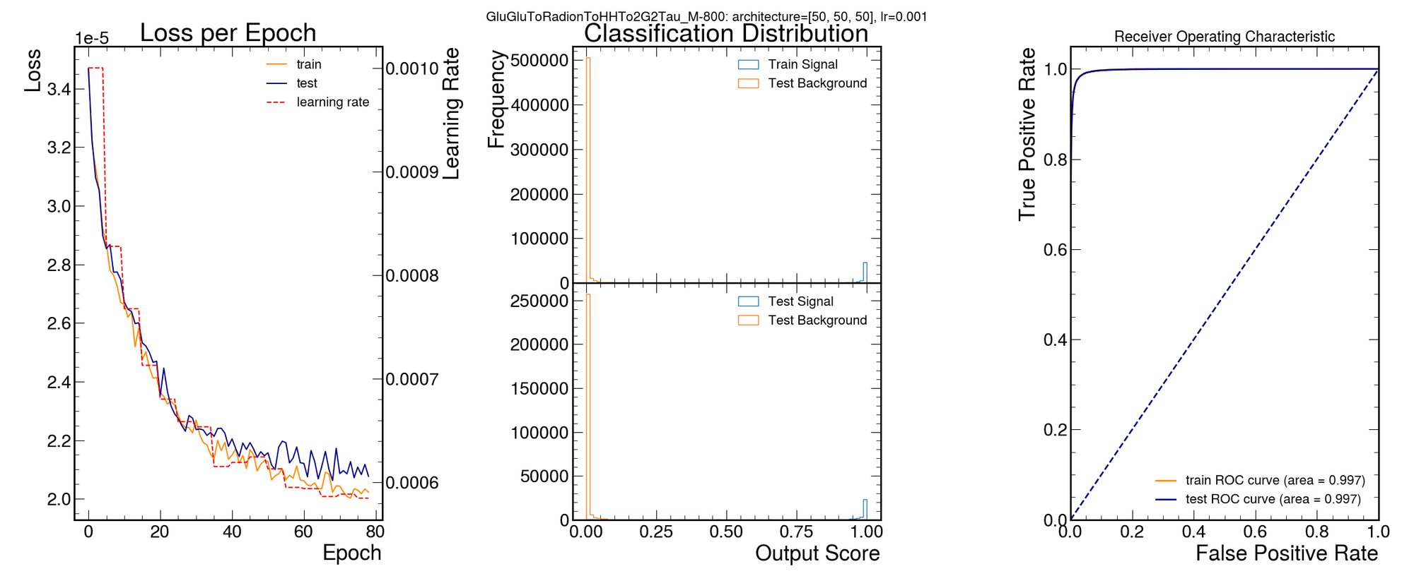
Term 2 – Week 6
['reco_MX_mgg', 'dilep_leadpho_mass', 'ditau_pt', 'Diphoton_dPhi', 'ditau_dphi', 'Diphoton_pt_mgg', 'LeadPhoton_pt_mgg', 'MET_pt', 'LeadPhoton_lead_lepton_dR', 'ditau_dR', 'lead_lepton_pt', 'Diphoton_ditau_deta', 'Diphoton_lead_lepton_dR', 'LeadPhoton_ditau_dR', 'SubleadPhoton_lead_lepton_dR', 'jet_1_pt', 'Diphoton_sublead_lepton_dR', 'Diphoton_ditau_dphi', 'ditau_deta', 'ditau_met_dPhi', 'Diphoton_sublead_lepton_deta', 'Diphoton_lead_lepton_deta', 'lead_lepton_mass', 'ditau_mass', 'diphoton_met_dPhi', 'SubleadPhoton_pt_mgg', 'MX']
['reco_MX_mgg', 'dilep_leadpho_mass', 'ditau_pt', 'Diphoton_dPhi', 'ditau_dphi', 'Diphoton_pt_mgg', 'LeadPhoton_pt_mgg', 'MET_pt', 'LeadPhoton_lead_lepton_dR', 'ditau_dR', 'lead_lepton_pt', 'Diphoton_ditau_deta', 'Diphoton_lead_lepton_dR', 'LeadPhoton_ditau_dR', 'SubleadPhoton_lead_lepton_dR', 'jet_1_pt', 'Diphoton_sublead_lepton_dR', 'Diphoton_ditau_dphi', 'ditau_deta', 'ditau_met_dPhi', 'ditau_mass', 'Diphoton_sublead_lepton_deta', 'SubleadPhoton_pt_mgg', 'Diphoton_mass', 'Diphoton_lead_lepton_deta', 'diphoton_met_dPhi', 'lead_lepton_mass', 'MX']
['reco_MX_mgg', 'dilep_leadpho_mass', 'ditau_pt', 'Diphoton_dPhi', 'ditau_dphi', 'Diphoton_pt_mgg', 'LeadPhoton_pt_mgg', 'MET_pt', 'LeadPhoton_lead_lepton_dR', 'ditau_dR', 'lead_lepton_pt', 'Diphoton_ditau_deta', 'Diphoton_lead_lepton_dR', 'LeadPhoton_ditau_dR', 'SubleadPhoton_lead_lepton_dR', 'jet_1_pt', 'Diphoton_sublead_lepton_dR', 'Diphoton_ditau_dphi', 'ditau_deta', 'ditau_met_dPhi', 'Diphoton_lead_lepton_deta', 'Diphoton_sublead_lepton_deta', 'lead_lepton_mass', 'ditau_mass', 'diphoton_met_dPhi', 'SubleadPhoton_pt_mgg', 'MX']
['reco_MX_mgg', 'dilep_leadpho_mass', 'ditau_pt', 'Diphoton_dPhi', 'ditau_dphi', 'Diphoton_pt_mgg', 'LeadPhoton_pt_mgg', 'MET_pt', 'LeadPhoton_lead_lepton_dR', 'ditau_dR', 'lead_lepton_pt', 'Diphoton_ditau_deta', 'Diphoton_lead_lepton_dR', 'LeadPhoton_ditau_dR', 'SubleadPhoton_lead_lepton_dR', 'jet_1_pt', 'Diphoton_sublead_lepton_dR', 'Diphoton_ditau_dphi', 'ditau_deta', 'ditau_met_dPhi', 'Diphoton_lead_lepton_deta', 'Diphoton_sublead_lepton_deta', 'lead_lepton_mass', 'ditau_mass', 'diphoton_met_dPhi', 'SubleadPhoton_pt_mgg', 'MX']
Signal - 260
Signal - 800
['reco_MX_mgg', 'dilep_leadpho_mass', 'ditau_pt', 'Diphoton_dPhi', 'ditau_dphi', 'Diphoton_pt_mgg', 'LeadPhoton_pt_mgg', 'MET_pt', 'LeadPhoton_lead_lepton_dR', 'ditau_dR', 'lead_lepton_pt', 'Diphoton_ditau_deta', 'Diphoton_lead_lepton_dR', 'LeadPhoton_ditau_dR', 'SubleadPhoton_lead_lepton_dR', 'jet_1_pt', 'Diphoton_sublead_lepton_dR', 'Diphoton_ditau_dphi', 'ditau_deta', 'ditau_met_dPhi', 'Diphoton_sublead_lepton_deta', 'Diphoton_lead_lepton_deta', 'lead_lepton_mass', 'ditau_mass', 'diphoton_met_dPhi', 'SubleadPhoton_pt_mgg', 'MX']
Union of top 20 custom_lr=0.001
Union of top 18 custom_lr =0.001
Union of full 27 custom_lr=0.001
Union of top 20 custom_lr=0.0001
Union of top 20 custom_lr=0.0001
Union of top 18 custom_lr =0.001
Union of top 20 custom_lr =0.001

Slide 10
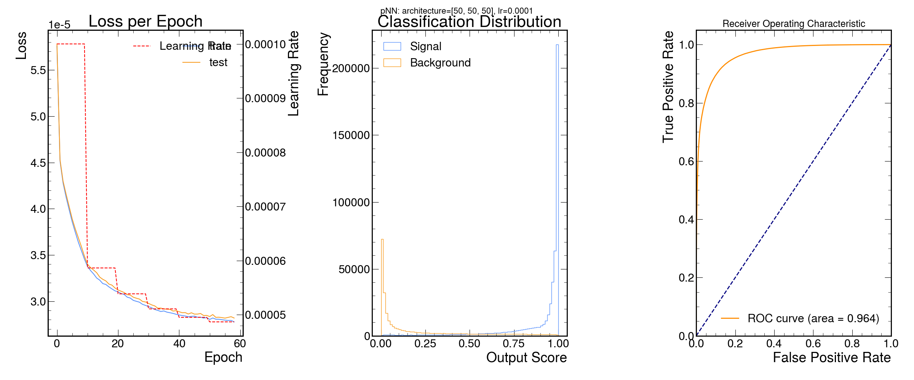
Term 2 – Week 6
Union of Top 10 Features
['reco_MX_mgg', 'dilep_leadpho_mass', 'ditau_pt', 'Diphoton_dPhi', 'ditau_dphi', 'Diphoton_pt_mgg', 'LeadPhoton_pt_mgg', 'MET_pt', 'LeadPhoton_lead_lepton_dR', 'ditau_dR', 'Diphoton_sublead_lepton_dR', 'ditau_met_dPhi', 'SubleadPhoton_lead_lepton_dR', 'lead_lepton_pt', 'jet_1_pt', 'ditau_deta', 'lead_lepton_mass', 'Diphoton_ditau_dphi', 'Diphoton_lead_lepton_deta', 'diphoton_met_dPhi', 'Diphoton_lead_lepton_dR', 'ditau_mass', 'SubleadPhoton_pt_mgg', 'MX'
['reco_MX_mgg', 'dilep_leadpho_mass', 'ditau_pt', 'Diphoton_dPhi', 'ditau_dphi', 'Diphoton_pt_mgg', 'LeadPhoton_pt_mgg', 'MET_pt', 'LeadPhoton_lead_lepton_dR', 'ditau_dR', 'lead_lepton_pt', 'Diphoton_ditau_deta', 'Diphoton_lead_lepton_dR', 'LeadPhoton_ditau_dR', 'SubleadPhoton_lead_lepton_dR', 'jet_1_pt', 'Diphoton_sublead_lepton_dR', 'Diphoton_ditau_dphi', 'ditau_deta', 'ditau_met_dPhi', 'Diphoton_sublead_lepton_deta', 'Diphoton_lead_lepton_deta', 'lead_lepton_mass', 'ditau_mass', 'diphoton_met_dPhi', 'SubleadPhoton_pt_mgg', 'MX']
['reco_MX_mgg', 'dilep_leadpho_mass', 'ditau_pt', 'Diphoton_dPhi', 'ditau_dphi', 'Diphoton_pt_mgg', 'LeadPhoton_pt_mgg', 'MET_pt', 'LeadPhoton_lead_lepton_dR', 'ditau_dR', 'lead_lepton_pt', 'Diphoton_ditau_deta', 'Diphoton_lead_lepton_dR', 'LeadPhoton_ditau_dR', 'SubleadPhoton_lead_lepton_dR', 'jet_1_pt', 'Diphoton_sublead_lepton_dR', 'Diphoton_ditau_dphi', 'ditau_deta', 'ditau_met_dPhi', 'ditau_mass', 'Diphoton_sublead_lepton_deta', 'SubleadPhoton_pt_mgg', 'Diphoton_mass', 'Diphoton_lead_lepton_deta', 'diphoton_met_dPhi', 'lead_lepton_mass', 'MX']
['reco_MX_mgg', 'dilep_leadpho_mass', 'ditau_pt', 'Diphoton_dPhi', 'ditau_dphi', 'Diphoton_pt_mgg', 'LeadPhoton_pt_mgg', 'MET_pt', 'LeadPhoton_lead_lepton_dR', 'ditau_dR', 'lead_lepton_pt', 'Diphoton_ditau_deta', 'Diphoton_lead_lepton_dR', 'LeadPhoton_ditau_dR', 'SubleadPhoton_lead_lepton_dR', 'jet_1_pt', 'Diphoton_sublead_lepton_dR', 'Diphoton_ditau_dphi', 'ditau_deta', 'ditau_met_dPhi', 'Diphoton_lead_lepton_deta', 'Diphoton_sublead_lepton_deta', 'lead_lepton_mass', 'ditau_mass', 'diphoton_met_dPhi', 'SubleadPhoton_pt_mgg', 'MX']
['reco_MX_mgg', 'dilep_leadpho_mass', 'ditau_pt', 'Diphoton_dPhi', 'ditau_dphi', 'Diphoton_pt_mgg', 'LeadPhoton_pt_mgg', 'MET_pt', 'LeadPhoton_lead_lepton_dR', 'ditau_dR', 'lead_lepton_pt', 'Diphoton_ditau_deta', 'Diphoton_lead_lepton_dR', 'LeadPhoton_ditau_dR', 'SubleadPhoton_lead_lepton_dR', 'jet_1_pt', 'Diphoton_sublead_lepton_dR', 'Diphoton_ditau_dphi', 'ditau_deta', 'ditau_met_dPhi', 'Diphoton_sublead_lepton_deta', 'Diphoton_lead_lepton_deta', 'lead_lepton_mass', 'ditau_mass', 'diphoton_met_dPhi', 'SubleadPhoton_pt_mgg', 'MX']
['reco_MX_mgg', 'dilep_leadpho_mass', 'ditau_pt', 'Diphoton_dPhi', 'ditau_dphi', 'Diphoton_pt_mgg', 'LeadPhoton_pt_mgg', 'MET_pt', 'LeadPhoton_lead_lepton_dR', 'ditau_dR', 'lead_lepton_pt', 'Diphoton_ditau_deta', 'Diphoton_lead_lepton_dR', 'LeadPhoton_ditau_dR', 'SubleadPhoton_lead_lepton_dR', 'jet_1_pt', 'Diphoton_sublead_lepton_dR', 'Diphoton_ditau_dphi', 'ditau_deta', 'ditau_met_dPhi', 'Diphoton_lead_lepton_deta', 'Diphoton_sublead_lepton_deta', 'lead_lepton_mass', 'ditau_mass', 'diphoton_met_dPhi', 'SubleadPhoton_pt_mgg', 'MX']
Signal - 260
Signal - 800
['reco_MX_mgg', 'dilep_leadpho_mass', 'ditau_pt', 'Diphoton_dPhi', 'ditau_dphi', 'Diphoton_pt_mgg', 'LeadPhoton_pt_mgg', 'MET_pt', 'LeadPhoton_lead_lepton_dR', 'ditau_dR', 'lead_lepton_pt', 'Diphoton_ditau_deta', 'Diphoton_lead_lepton_dR', 'LeadPhoton_ditau_dR', 'SubleadPhoton_lead_lepton_dR', 'jet_1_pt', 'Diphoton_sublead_lepton_dR', 'Diphoton_ditau_dphi', 'ditau_deta', 'ditau_met_dPhi', 'ditau_mass', 'Diphoton_sublead_lepton_deta', 'SubleadPhoton_pt_mgg', 'Diphoton_mass', 'Diphoton_lead_lepton_deta', 'diphoton_met_dPhi', 'lead_lepton_mass', 'MX']
Union of top 20 custom_lr=0.001
Union of top 20 custom_lr=0.0001
Union of top 18 custom_lr =0.001
Union of full 27 custom_lr=0.001
Union of top 20 custom_lr=0.0001
Union of full 27 custom_lr=0.001
Union of top 18 custom_lr =0.001
Union of top 20 custom_lr =0.001

Slide 11
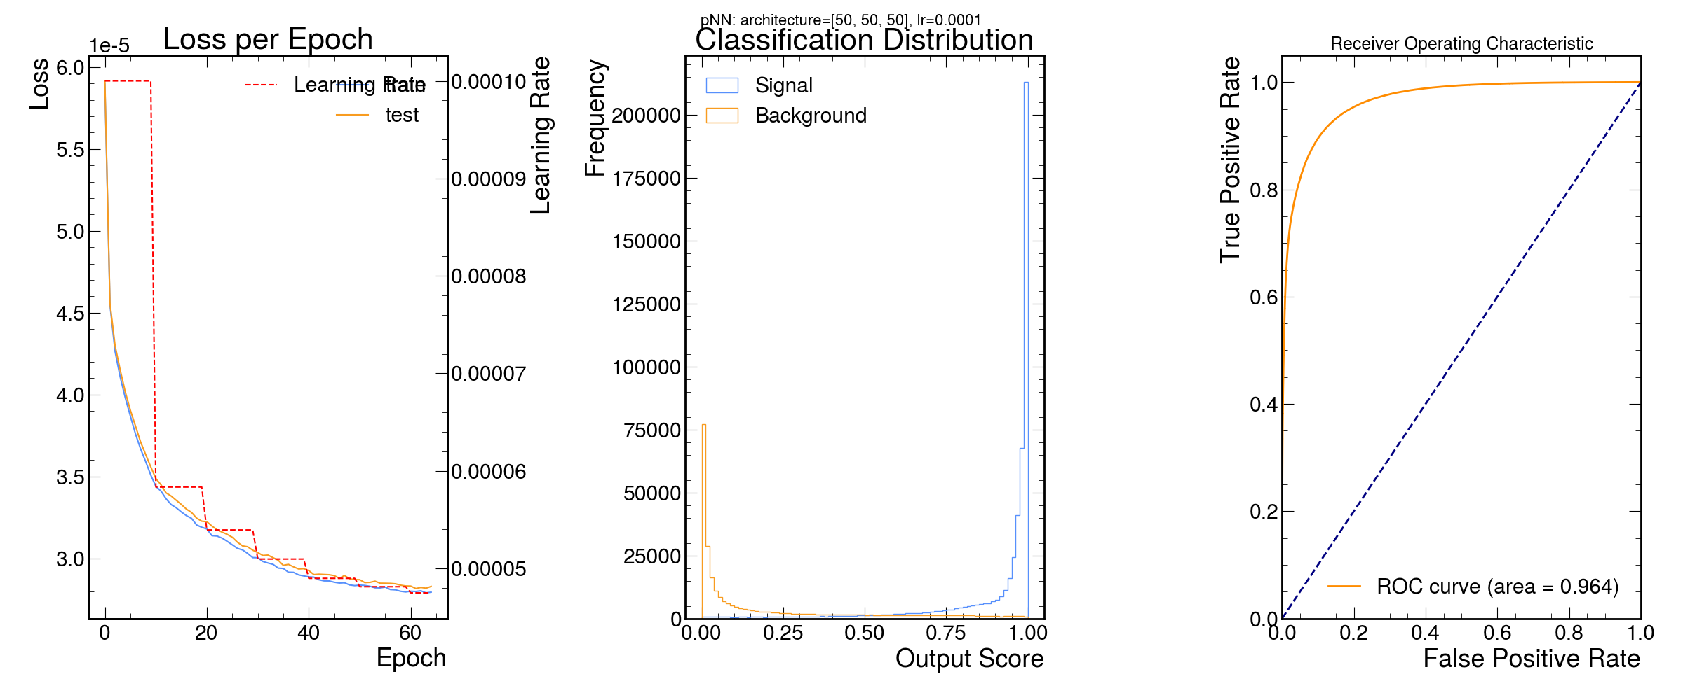
Term 2 – Week 6
Union of Top 10 Features
Union of Top 15 Features
['reco_MX_mgg', 'dilep_leadpho_mass', 'ditau_pt', 'Diphoton_dPhi', 'ditau_dphi', 'Diphoton_pt_mgg', 'LeadPhoton_pt_mgg', 'MET_pt', 'LeadPhoton_lead_lepton_dR', 'ditau_dR', 'Diphoton_sublead_lepton_dR', 'ditau_met_dPhi', 'SubleadPhoton_lead_lepton_dR', 'lead_lepton_pt', 'jet_1_pt', 'ditau_deta', 'lead_lepton_mass', 'Diphoton_ditau_dphi', 'Diphoton_lead_lepton_deta', 'diphoton_met_dPhi', 'Diphoton_lead_lepton_dR', 'ditau_mass', 'SubleadPhoton_pt_mgg', 'MX'
['reco_MX_mgg', 'dilep_leadpho_mass', 'ditau_pt', 'Diphoton_dPhi', 'ditau_dphi', 'Diphoton_pt_mgg', 'LeadPhoton_pt_mgg', 'MET_pt', 'LeadPhoton_lead_lepton_dR', 'ditau_dR', 'lead_lepton_pt', 'Diphoton_ditau_deta', 'Diphoton_lead_lepton_dR', 'LeadPhoton_ditau_dR', 'SubleadPhoton_lead_lepton_dR', 'Diphoton_sublead_lepton_dR', 'jet_1_pt', 'ditau_met_dPhi', 'ditau_deta', 'Diphoton_lead_lepton_deta', 'Diphoton_sublead_lepton_deta', 'lead_lepton_mass', 'Diphoton_ditau_dphi', 'ditau_mass', 'diphoton_met_dPhi', 'SubleadPhoton_pt_mgg', 'MX']
Signal - 800
['reco_MX_mgg', 'dilep_leadpho_mass', 'ditau_pt', 'Diphoton_dPhi', 'ditau_dphi', 'Diphoton_pt_mgg', 'LeadPhoton_pt_mgg', 'MET_pt', 'LeadPhoton_lead_lepton_dR', 'ditau_dR', 'lead_lepton_pt', 'Diphoton_ditau_deta', 'Diphoton_lead_lepton_dR', 'LeadPhoton_ditau_dR', 'SubleadPhoton_lead_lepton_dR', 'jet_1_pt', 'Diphoton_sublead_lepton_dR', 'Diphoton_ditau_dphi', 'ditau_deta', 'ditau_met_dPhi', 'ditau_mass', 'Diphoton_sublead_lepton_deta', 'SubleadPhoton_pt_mgg', 'Diphoton_mass', 'Diphoton_lead_lepton_deta', 'diphoton_met_dPhi', 'lead_lepton_mass', 'MX']
Union of full 27 custom_lr=0.001

Slide 12
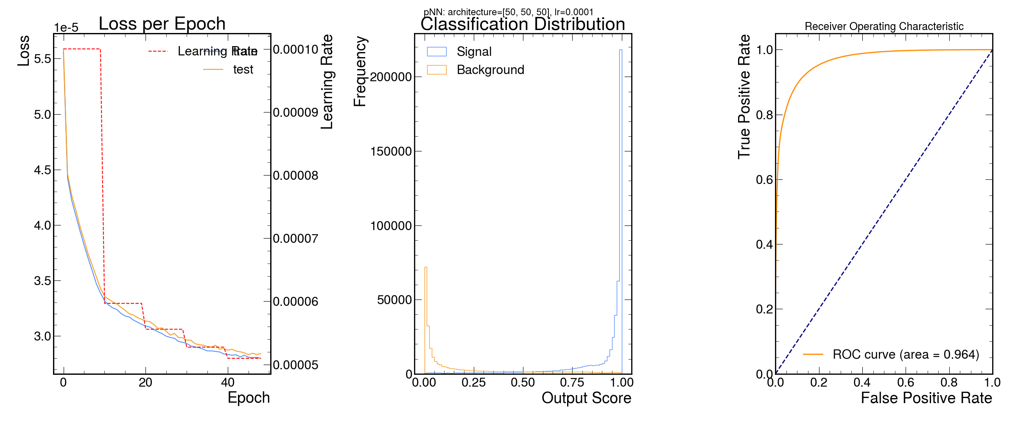
Term 2 – Week 6
Union of Top 10 Features
Union of Top 15 Features
Union of Top 20 Features
['reco_MX_mgg', 'dilep_leadpho_mass', 'ditau_pt', 'Diphoton_dPhi', 'ditau_dphi', 'Diphoton_pt_mgg', 'LeadPhoton_pt_mgg', 'MET_pt', 'LeadPhoton_lead_lepton_dR', 'ditau_dR', 'Diphoton_sublead_lepton_dR', 'ditau_met_dPhi', 'SubleadPhoton_lead_lepton_dR', 'lead_lepton_pt', 'jet_1_pt', 'ditau_deta', 'lead_lepton_mass', 'Diphoton_ditau_dphi', 'Diphoton_lead_lepton_deta', 'diphoton_met_dPhi', 'Diphoton_lead_lepton_dR', 'ditau_mass', 'SubleadPhoton_pt_mgg', 'MX'
['reco_MX_mgg', 'dilep_leadpho_mass', 'ditau_pt', 'Diphoton_dPhi', 'ditau_dphi', 'Diphoton_pt_mgg', 'LeadPhoton_pt_mgg', 'MET_pt', 'LeadPhoton_lead_lepton_dR', 'ditau_dR', 'lead_lepton_pt', 'Diphoton_ditau_deta', 'Diphoton_lead_lepton_dR', 'LeadPhoton_ditau_dR', 'SubleadPhoton_lead_lepton_dR', 'Diphoton_sublead_lepton_dR', 'jet_1_pt', 'ditau_met_dPhi', 'ditau_deta', 'Diphoton_lead_lepton_deta', 'Diphoton_sublead_lepton_deta', 'lead_lepton_mass', 'Diphoton_ditau_dphi', 'ditau_mass', 'diphoton_met_dPhi', 'SubleadPhoton_pt_mgg', 'MX']
['reco_MX_mgg', 'dilep_leadpho_mass', 'ditau_pt', 'Diphoton_dPhi', 'ditau_dphi', 'Diphoton_pt_mgg', 'LeadPhoton_pt_mgg', 'MET_pt', 'LeadPhoton_lead_lepton_dR', 'ditau_dR', 'lead_lepton_pt', 'Diphoton_ditau_deta', 'Diphoton_lead_lepton_dR', 'LeadPhoton_ditau_dR', 'SubleadPhoton_lead_lepton_dR', 'jet_1_pt', 'Diphoton_sublead_lepton_dR', 'Diphoton_ditau_dphi', 'ditau_deta', 'ditau_met_dPhi', 'Diphoton_sublead_lepton_deta', 'Diphoton_lead_lepton_deta', 'lead_lepton_mass', 'ditau_mass', 'diphoton_met_dPhi', 'SubleadPhoton_pt_mgg', 'MX']

Slide 13
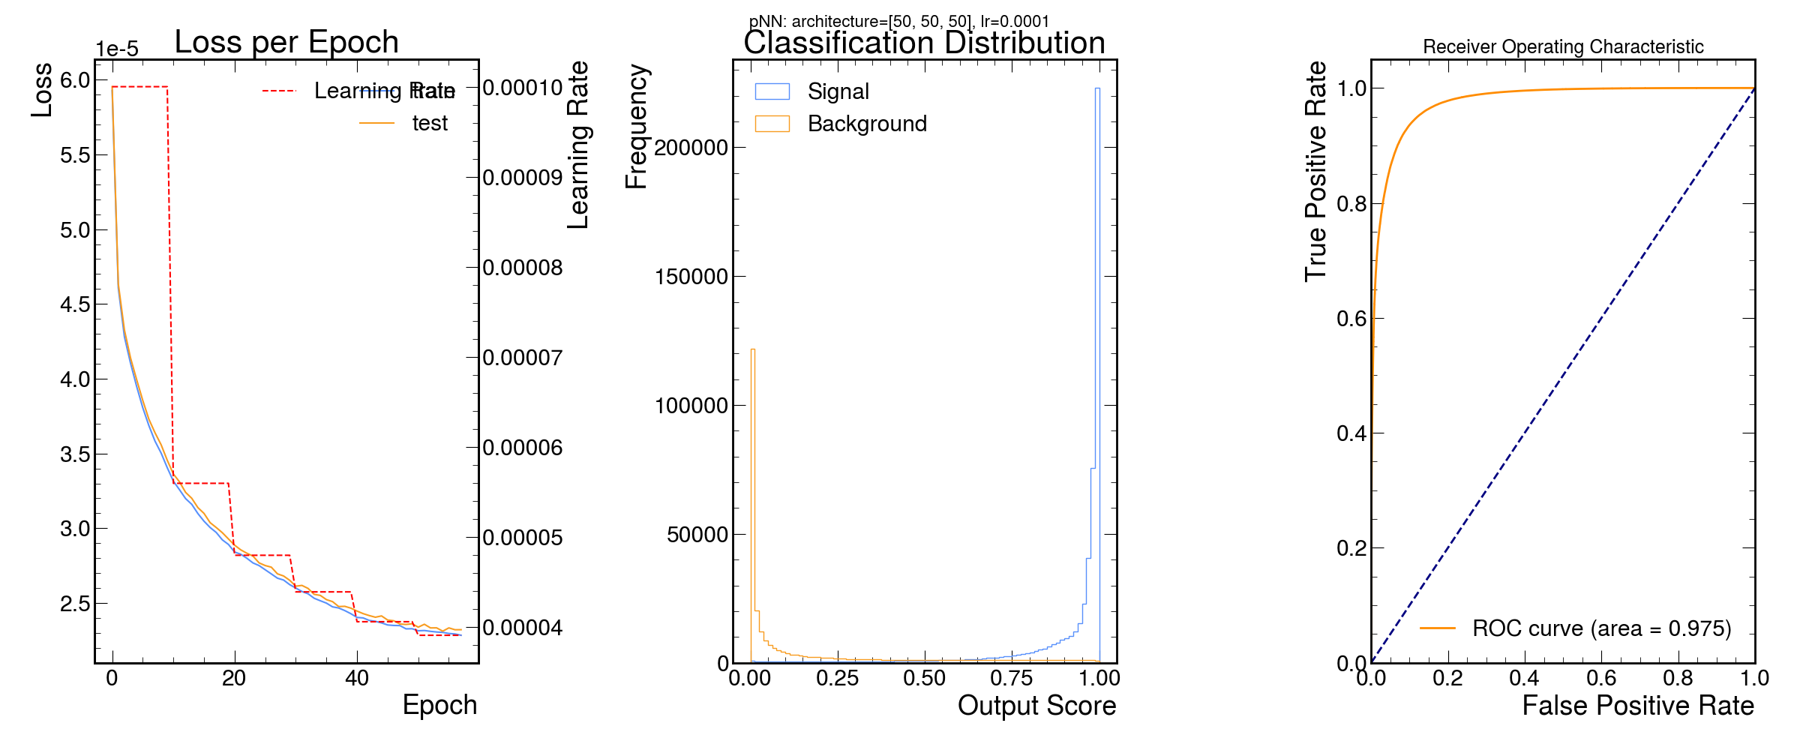
Union of Top 15 Features
Union of Top 20 Features
Union of Top 25 Features
['reco_MX_mgg', 'dilep_leadpho_mass', 'ditau_pt', 'Diphoton_dPhi', 'ditau_dphi', 'Diphoton_pt_mgg', 'LeadPhoton_pt_mgg', 'MET_pt', 'LeadPhoton_lead_lepton_dR', 'ditau_dR', 'lead_lepton_pt', 'Diphoton_ditau_deta', 'Diphoton_lead_lepton_dR', 'LeadPhoton_ditau_dR', 'SubleadPhoton_lead_lepton_dR', 'Diphoton_sublead_lepton_dR', 'jet_1_pt', 'ditau_met_dPhi', 'ditau_deta', 'Diphoton_lead_lepton_deta', 'Diphoton_sublead_lepton_deta', 'lead_lepton_mass', 'Diphoton_ditau_dphi', 'ditau_mass', 'diphoton_met_dPhi', 'SubleadPhoton_pt_mgg', 'MX']
['reco_MX_mgg', 'dilep_leadpho_mass', 'ditau_pt', 'Diphoton_dPhi', 'ditau_dphi', 'Diphoton_pt_mgg', 'LeadPhoton_pt_mgg', 'MET_pt', 'LeadPhoton_lead_lepton_dR', 'ditau_dR', 'lead_lepton_pt', 'Diphoton_ditau_deta', 'Diphoton_lead_lepton_dR', 'LeadPhoton_ditau_dR', 'SubleadPhoton_lead_lepton_dR', 'jet_1_pt', 'Diphoton_sublead_lepton_dR', 'Diphoton_ditau_dphi', 'ditau_deta', 'ditau_met_dPhi', 'Diphoton_sublead_lepton_deta', 'Diphoton_lead_lepton_deta', 'lead_lepton_mass', 'ditau_mass', 'diphoton_met_dPhi', 'SubleadPhoton_pt_mgg', 'MX']
['reco_MX_mgg', 'dilep_leadpho_mass', 'ditau_pt', 'Diphoton_dPhi', 'ditau_dphi', 'Diphoton_pt_mgg', 'LeadPhoton_pt_mgg', 'MET_pt', 'LeadPhoton_lead_lepton_dR', 'ditau_dR', 'lead_lepton_pt', 'Diphoton_ditau_deta', 'Diphoton_lead_lepton_dR', 'LeadPhoton_ditau_dR', 'SubleadPhoton_lead_lepton_dR', 'jet_1_pt', 'Diphoton_sublead_lepton_dR', 'Diphoton_ditau_dphi', 'ditau_deta', 'ditau_met_dPhi', 'ditau_mass', 'Diphoton_sublead_lepton_deta', 'SubleadPhoton_pt_mgg', 'Diphoton_mass', 'Diphoton_lead_lepton_deta', 'diphoton_met_dPhi', 'lead_lepton_mass', 'MX']

Slide 14
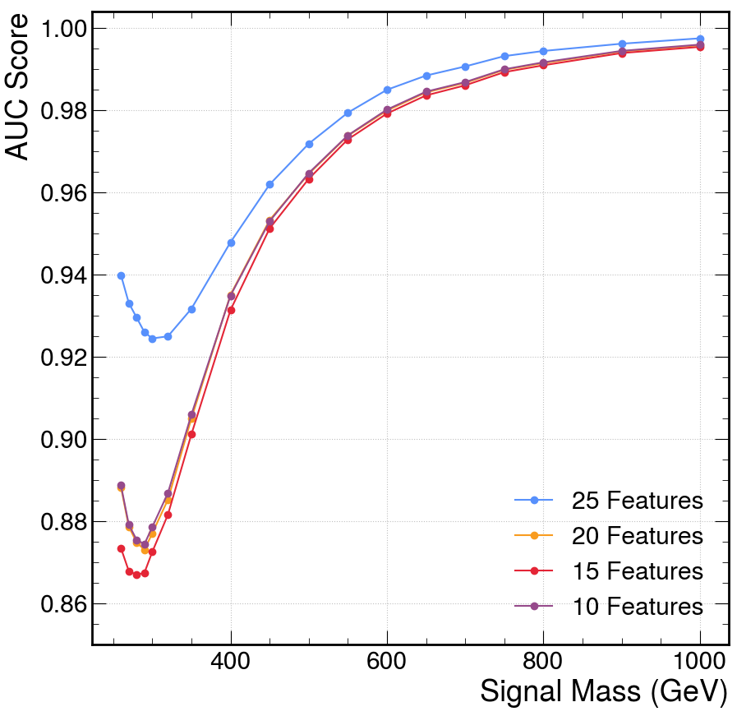
PNN
Union of Top 20 Features
Union of Top 25 Features
['reco_MX_mgg', 'dilep_leadpho_mass', 'ditau_pt', 'Diphoton_dPhi', 'ditau_dphi', 'Diphoton_pt_mgg', 'LeadPhoton_pt_mgg', 'MET_pt', 'LeadPhoton_lead_lepton_dR', 'ditau_dR', 'lead_lepton_pt', 'Diphoton_ditau_deta', 'Diphoton_lead_lepton_dR', 'LeadPhoton_ditau_dR', 'SubleadPhoton_lead_lepton_dR', 'jet_1_pt', 'Diphoton_sublead_lepton_dR', 'Diphoton_ditau_dphi', 'ditau_deta', 'ditau_met_dPhi', 'Diphoton_sublead_lepton_deta', 'Diphoton_lead_lepton_deta', 'lead_lepton_mass', 'ditau_mass', 'diphoton_met_dPhi', 'SubleadPhoton_pt_mgg', 'MX']
['reco_MX_mgg', 'dilep_leadpho_mass', 'ditau_pt', 'Diphoton_dPhi', 'ditau_dphi', 'Diphoton_pt_mgg', 'LeadPhoton_pt_mgg', 'MET_pt', 'LeadPhoton_lead_lepton_dR', 'ditau_dR', 'lead_lepton_pt', 'Diphoton_ditau_deta', 'Diphoton_lead_lepton_dR', 'LeadPhoton_ditau_dR', 'SubleadPhoton_lead_lepton_dR', 'jet_1_pt', 'Diphoton_sublead_lepton_dR', 'Diphoton_ditau_dphi', 'ditau_deta', 'ditau_met_dPhi', 'ditau_mass', 'Diphoton_sublead_lepton_deta', 'SubleadPhoton_pt_mgg', 'Diphoton_mass', 'Diphoton_lead_lepton_deta', 'diphoton_met_dPhi', 'lead_lepton_mass', 'MX']

Slide 15
PNN
Individual Classifier
Union of Top 25 Features
['reco_MX_mgg', 'dilep_leadpho_mass', 'ditau_pt', 'Diphoton_dPhi', 'ditau_dphi', 'Diphoton_pt_mgg', 'LeadPhoton_pt_mgg', 'MET_pt', 'LeadPhoton_lead_lepton_dR', 'ditau_dR', 'lead_lepton_pt', 'Diphoton_ditau_deta', 'Diphoton_lead_lepton_dR', 'LeadPhoton_ditau_dR', 'SubleadPhoton_lead_lepton_dR', 'jet_1_pt', 'Diphoton_sublead_lepton_dR', 'Diphoton_ditau_dphi', 'ditau_deta', 'ditau_met_dPhi', 'ditau_mass', 'Diphoton_sublead_lepton_deta', 'SubleadPhoton_pt_mgg', 'Diphoton_mass', 'Diphoton_lead_lepton_deta', 'diphoton_met_dPhi', 'lead_lepton_mass', 'MX']

Slide 16
PNN
Individual Classifier
Union of Top 25 Features
['reco_MX_mgg', 'dilep_leadpho_mass', 'ditau_pt', 'Diphoton_dPhi', 'ditau_dphi', 'Diphoton_pt_mgg', 'LeadPhoton_pt_mgg', 'MET_pt', 'LeadPhoton_lead_lepton_dR', 'ditau_dR', 'lead_lepton_pt', 'Diphoton_ditau_deta', 'Diphoton_lead_lepton_dR', 'LeadPhoton_ditau_dR', 'SubleadPhoton_lead_lepton_dR', 'jet_1_pt', 'Diphoton_sublead_lepton_dR', 'Diphoton_ditau_dphi', 'ditau_deta', 'ditau_met_dPhi', 'ditau_mass', 'Diphoton_sublead_lepton_deta', 'SubleadPhoton_pt_mgg', 'Diphoton_mass', 'Diphoton_lead_lepton_deta', 'diphoton_met_dPhi', 'lead_lepton_mass', 'MX']

