Slide 1
Lending Club: EDA Case Study
Presented by:
Ganesamoorthi M
Gautam Poddar

Slide 2
Case Study Analysis
Business Problem
consumer finance company which specialises in lending various types of loans to urban customers. When the company receives a loan application, the company has to make a decision for loan approval based on the applicant’s profile.
Suggest that whether the person will repay the money.
Key Observations from Dataset
Higher the Interest rate and higher the loan amount is causing the Higher charged off .
Higher Charged off is happening between Sep, Oct, Nov and Dec Month - It based on loan issued date.
Small Business purpose loan has high impact on Charged Off.
60 Months payments loans has high impact of charged-off.
lower income range is the more risky when it comes to loan repayment.
Higher instalments has more risks of charged off.
Key Assumption
Here we have considered the missing employee length as Zero.
Here we considered pub_rec_bankruptcies empty value as Zero
We have set the outliner limit as 95% and excluded the records
Excluded the columns which is not a driving factor and not many unique values.

Slide 3
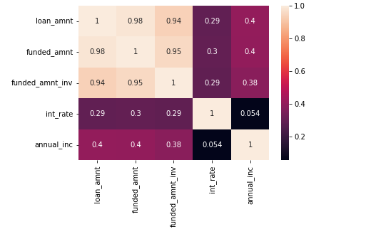
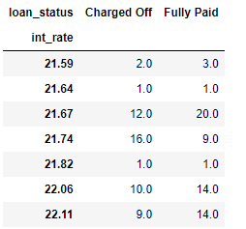
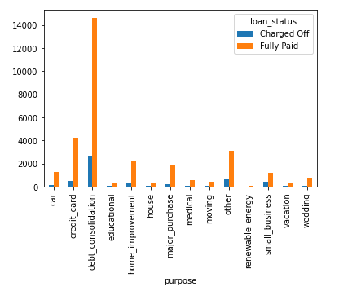
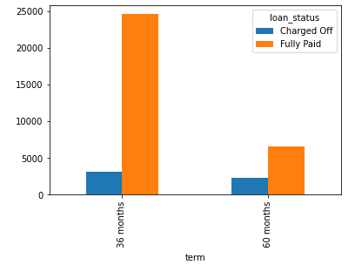
Key Observation From Dataset

Slide 4
Recommendations
Higher tenure(60 Months) loans are high risky than lower tenure(36 Months) loans.
Highest loan amount has more risk than compare to lower the loan amount.
More likely small business has high risk than other categories.
Higher the interest has more risk of charged-off.
Lower income has higher interest repayment will have a higher risk of re-payment of amount.
Employment length is also one of the driving factor. Based on the employment length(Higher employment) we can consider to give a loan to a person.
CA,FL,NY and CA address states has higher charged-off.
F and G grade has high Charged off ratio.

