Slide 1
Pancake Flipping Statistical Analysis and Inference
Prepared by
Ganesan Vijayan
7/22/2021

Slide 2
Pancake Flipping -Statistical Analysis and Inference
Problem Statement:
Arielle and Boris compete in the little-known sport of pancake flipping, and have both been nominated for this season's "best pancake flipper" award. Half the people in the pancake flipping league office think Arielle is the better pancake flipper, and the other half think Boris is, so they have retained a data scientist to help solve the issue. The stats from this season are attached. The columns are:
the contestant's name,
the match day,
which hand they used to flip the pancakes,
their score (how many pancakes they flipped successfully), and
how many total pancakes they attempted to flip
Is Arielle or Boris the better pancake flipper? Justify your decision. Do both sides have a
case here?

Slide 3
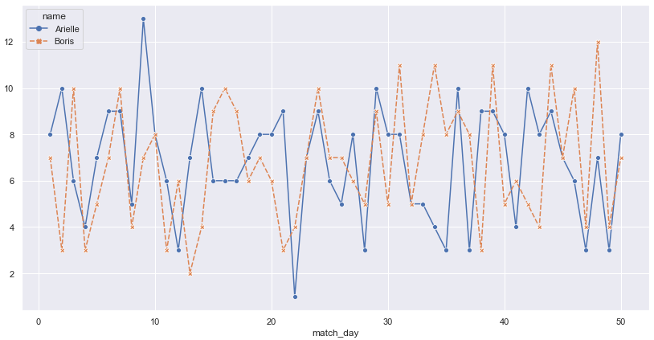
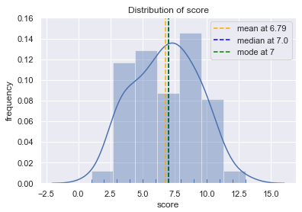
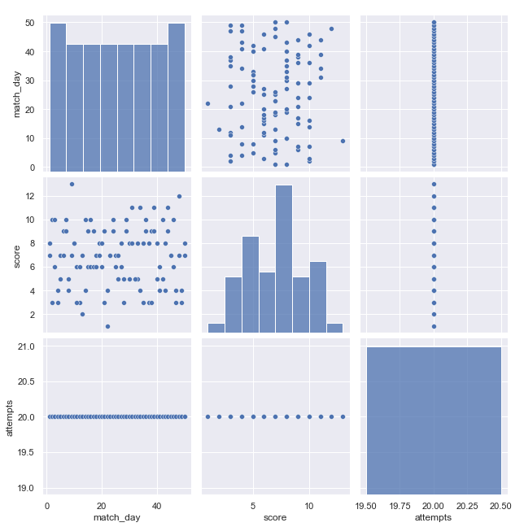
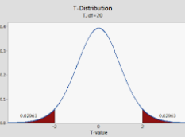
Pancake Flipping -Statistical Analysis and Inference
Solution Approach:
Below are the statistical steps involved in the overall analysis and decisioning:
EDA: Understand the attributes given in the dataset
EDA: Check if there are any missing values in the given dataset
EDA: Check if there are any duplicate records
EDA: Check skewness and data distribution within each column
EDA: Identify the outliers present in each feature and scope for feature scaling/normalization
EDA: Understand nuances present in the given scenario through visual representation
Feature Selection via EDA: Pick significantly contributing variables(independent) using multivariate analysis for further analysis
Data Preprocessing: Check if there is a class imbalance issue and data cleansing if any
Statistical Tests: Perform parametric t-test to decide on the better performer from two independent groups

Slide 4
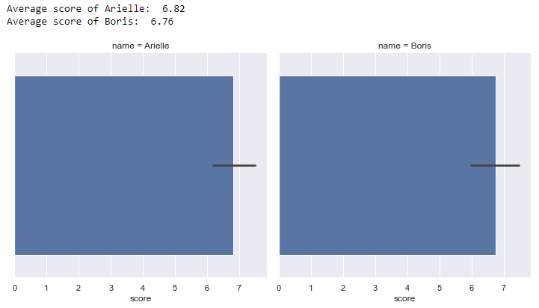
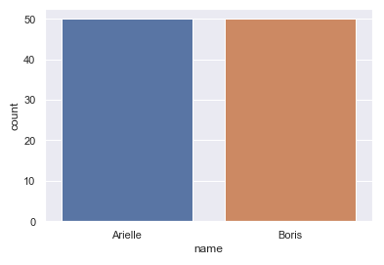
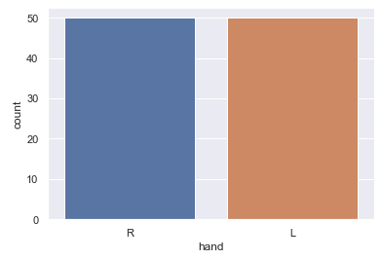
Pancake Flipping -Statistical Analysis and Inference
Exploratory Data Analysis:
'match_day' wise individual performance trend chart
Mean 'score' comparision of an individual
score
Sample data count check based on 'name'
Sample data count check based on 'hand'
Key observations from the given charts:
Both Arielle and Boris have participanted in all 50 days matche and used their 'Right' and 'Left' hand equally to flip the pancake in the competition.
There is a spike in the performance of Arielle on Day 9(high performance in the entire match days) and Day 22(low performance in the entire match days) where as 'Boris' has shown his consistent performance through the match days.
However, the average performance of Arielle is slightly better than Boris's with very minimal difference.
To decide on the better performer further, I'm going to perform a t-test which helps us understand which on to go with based on hypothesis tests.

Slide 5
Pancake Flipping -Statistical Analysis and Inference
Conclusion:
After performing an independent t-test for mean analysis on two independent groups 'Arielle' and 'Boris' considering different variance values, here are the parameters and inferential statistical results,
Null hypothesis(Ho): Arielle's pancake flipping performance is greater than or equal(>=) to Boris
Alternate hypothesis(Ha): Arielle's pancake flipping performance is lesser than(<) Boris
Actual p-value is 0.91 which is greater than alpha value 0.05 at confidence interval of 95%. Hence, we CANNOT reject the Ho(Null Hypothesis).
As mean success rate of Arielle is slightly better than or equal to Boris, I can observe that Arielle is performing better. However, Boris perform is very close to Arielle but NOT better.
Finally, with all the above performed exploratory and inferential statistical analysis, I have decided that Arielle's pancake flipping skill is better over Boris's.

