Slide 1


PRAANAYU
CMR COLLEGE OF ENGINEERING & TECHNOLOGY
(Autonomous)
Kandlakoya, Medchal, HYDERABAD
CENTRE FOR ENGINEERING EDUCATION RESEARCH
REVIEW-II
SOCIAL INNOVATION IN PRACTICE (A400507)
III SEMESTER A.Y 2024-25
Student Team Details
S.Manoj Kumar- 23H51A66AY
D.Sneha Rani - 23H51A66BW
R.Ganesh- 23H51A66DT
M.Srishma - 23H51A66HO
V.Shiva Keshav - 23H51A66T5
D.Avanthika - 23H51A66W7
Faculty Mentors
1.Mr.K.Raju Asst.Professor
2.Mrs.A.Samatha Asst.Professor
3.Mr.S.Suresh Asst.Professor
Praanayu CMR College of Engineering & Technology

Slide 2

CONTENT
Problem Statement
Existing Solutions
Gaps in Existing Solutions
Proposed Solution
Components required
Block Diagram
Flow Chart
Working Principle of all components used
Working of the model
Results and Conclusions

Slide 3

PROBLEM STATEMENT
The people are facing difficulties in doctor appointments and also the hospitals are facing difficulties in managing the crowd so we need to develop a solution to minimize the crowd near the hospitals and make the appointments easy for patients.
Praanayu CMR College of Engineering & Technology

Slide 4


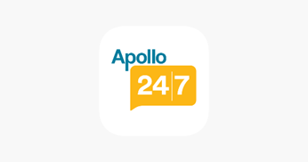

EXISTING SOLUTIONS
PRACTO
PHARMEASY
APOLLO 24/7
TATA 1 mg
Praanayu CMR College of Engineering & Technology

Slide 5
GAPS IN EXISTING SOLUTIONS
The main drawbacks of existing solutions are none of the existing solutions predict the accurate time for consultancy.
They do not provide Ayurvedic or Homeopathy Treatment .
The mentioned existing solutions do not provide any kind of transportation for patients .
Praanayu CMR College of Engineering & Technology

Slide 6
PROPOSED SOLUTION
Our project aims to create an innovative online platform for doctor appointments, leveraging predictive algorithms to optimize and forecast accurate appointment times. This solution aims to minimize overcrowding in healthcare facilities, streamline patient scheduling, and enhance the overall healthcare experience by efficiently managing doctor-patient interactions.
Communicate
Iterate
Praanayu CMR College of Engineering & Technology

Slide 7
COMPONENTS REQUIRED
SOFTWARE REQUIREMENTS:
We need to develop a front end and back end for the app using languages like
HTML Java script
Java Python
CSS C#
Immersive Automatic Water Heater CMR College of Engineering & Technology

Slide 8
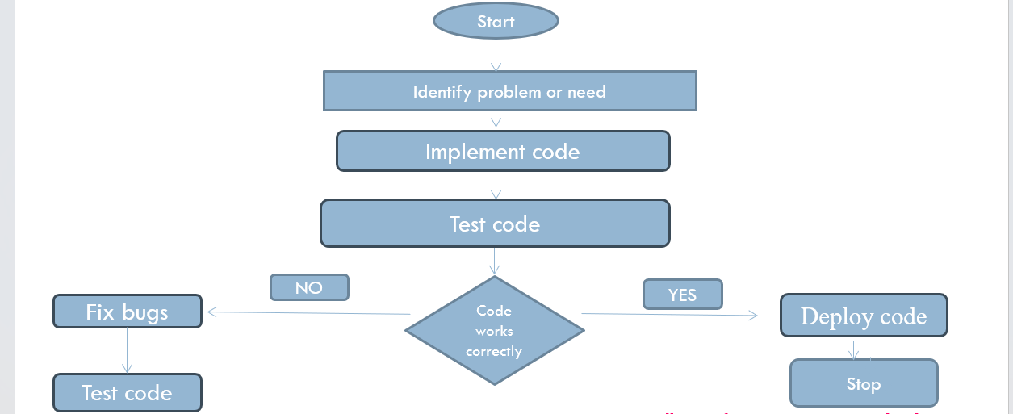
FLOW CHART
Start
Initialise all the Modules
Condition check
IF
NO
YES
Stop
Praanayu CMR College of Engineering & Technology

Slide 9
WORKING OF THE MODEL
(STEP WISE EXECUTION)
Praanayu CMR College of Engineering & Technology

Slide 10
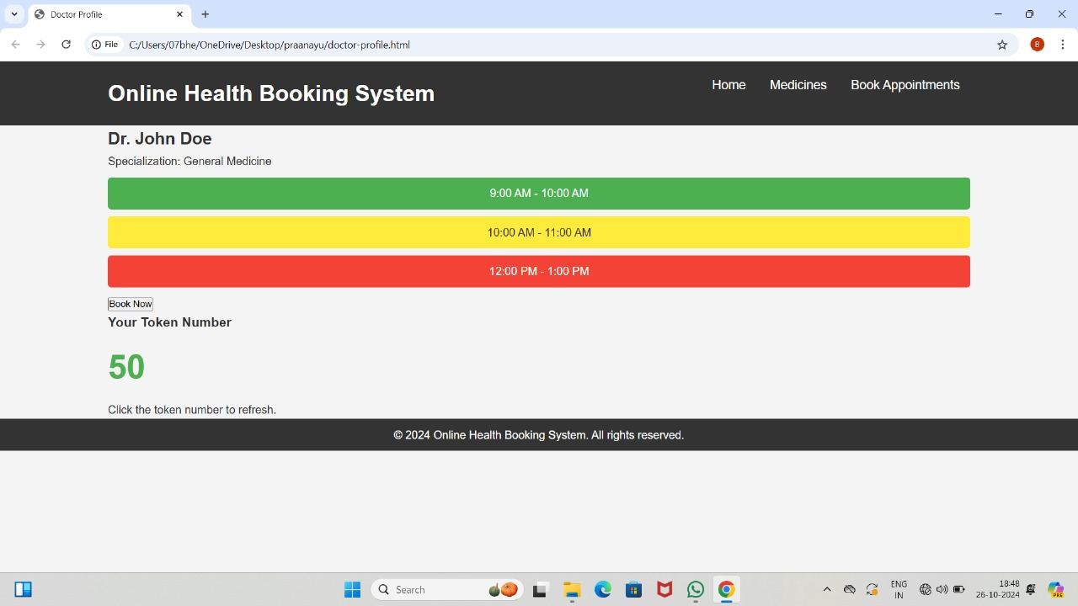
PROTOTYPE MODEL
Praanayu CMR College of Engineering & Technology

Slide 11
RESULTS AND DISCUSSIONS
Picture of the Project Model
Praanayu CMR College of Engineering & Technology

Slide 12
ADVANTAGES & DISADVANTAGES
ADVANTAGES
DISADVANTAGES
Long wait times
Limited accessiblity
Inflexibililty
High cost
Risk of infection
Time consumption
Administrative error
Reduced Waiting Times
Enhanced Patient Experience
Optimized Resource Allocation
Improved Doctor Efficiency
Enhanced Accessibility
Increased Patient Compliance
Praanayu CMR College of Engineering & Technology

Slide 13

CONCLUSION
By developing this kind of app every patient feels comfortable to go to the hospital, including those who avoid crowding. The appointments will be easy and also due to this app the crowding near the hospitals reduces , which ensures a peaceful treatment to patients.
Praanayu CMR College of Engineering & Technology

Slide 14
REFERENCES
https://pharmeasy.in/
https://www.apollo247.com/
https://www.practo.com/
https://www.1mg.com/?srsltid=AfmBOooY_T2qMddbem9ShjBhDoKVb0lU
Praanayu CMR College of Engineering & Technology

Slide 15


Slide 16

Questions…..

