Slide 1


Policy-Based Reinforcement Learning for Continuous Control
Gudied by:
SENTHIL G A
Presented by:
T.Ganesh(192425246)

Slide 2
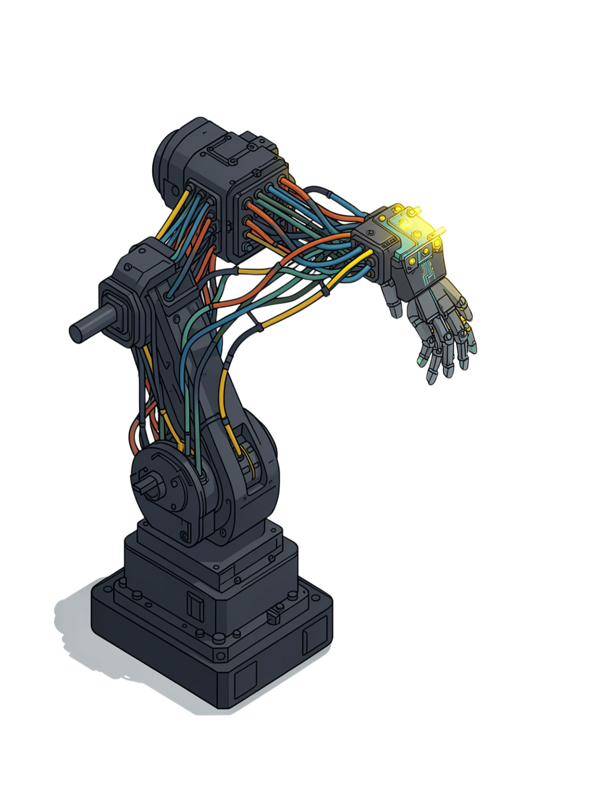
Policy-Based Reinforcement Learning for Continuous Control
From vanilla policy gradients to real-world robotics — a student's guide to directly optimizing decision-making policies.

Slide 3
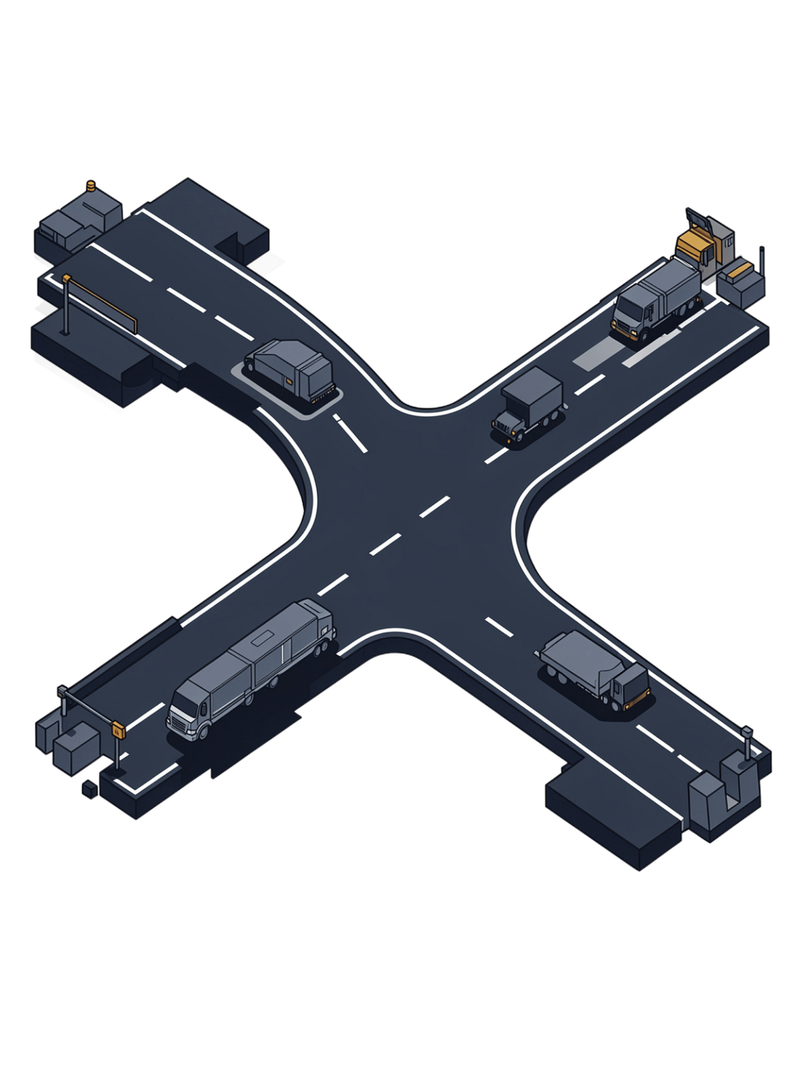

Why Policy Gradients Matter
The Core Distinction
Why It Matters
Value-based methods (Q-learning, DQN) learn a Q-function and derive a policy indirectly. Policy-based methods directly parameterize and optimize π_θ(a|s) — the mapping from states to actions — maximizing expected return J(θ) end-to-end.
Continuous Action Spaces
Robotics and driving demand fine-grained, real-valued actions — not discrete bins.
Direct Optimization
No discretization required — actions live in continuous space by design.
Gradient ascent on the policy objective without a value-function detour.
Stochastic Policies
Built-in exploration — sample actions from a learned distribution.

Slide 4
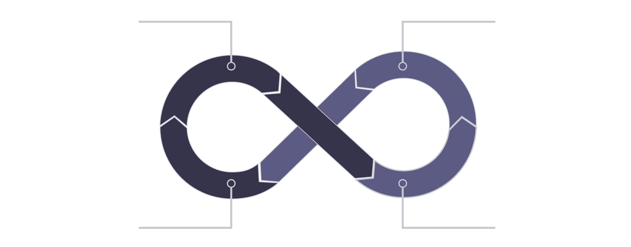
The Core Idea: Trial and Error Formalized
Sample Trajectories
Observe Rewards
Decrease Probabilities
Increase Probabilities
At its heart, policy gradient learning formalizes natural trial-and-error: the agent acts, observes outcomes, and nudges its policy to favor what worked — repeated until convergence.

Slide 5

REINFORCE Algorithm Explained
The Objective
Three Key Properties
Maximize expected cumulative (discounted) reward:
1
Model-Free
No environment model required — learn from experience alone.
The Gradient Update
2
On-Policy
Must sample trajectories from the policy currently being optimized.
Where G_t is the return from time step t. No value functions or Q-functions needed — only trajectory samples and reward queries.
3
Unbiased but High-Variance
Correct in expectation, but noisy — motivates modern improvements.

Slide 6
Vanilla Policy Gradient vs. Advanced Methods
REINFORCE (Vanilla PG)
Actor-Critic (A2C / A3C)
PPO (Proximal Policy Optimization)
Simple to implement
High variance updates
Slow to converge
Foundational baseline
Adds a value-function baseline
Significantly reduces variance
Two networks trained jointly
Faster, more stable learning
Clips gradient step size
Prevents destructive large updates
State-of-the-art stability
Industry & research standard
Each generation adds one key ingredient: REINFORCE sets the foundation, Actor-Critic tames variance, and PPO adds training stability — the evolution reflects the field's growing demand for reliability.

Slide 7
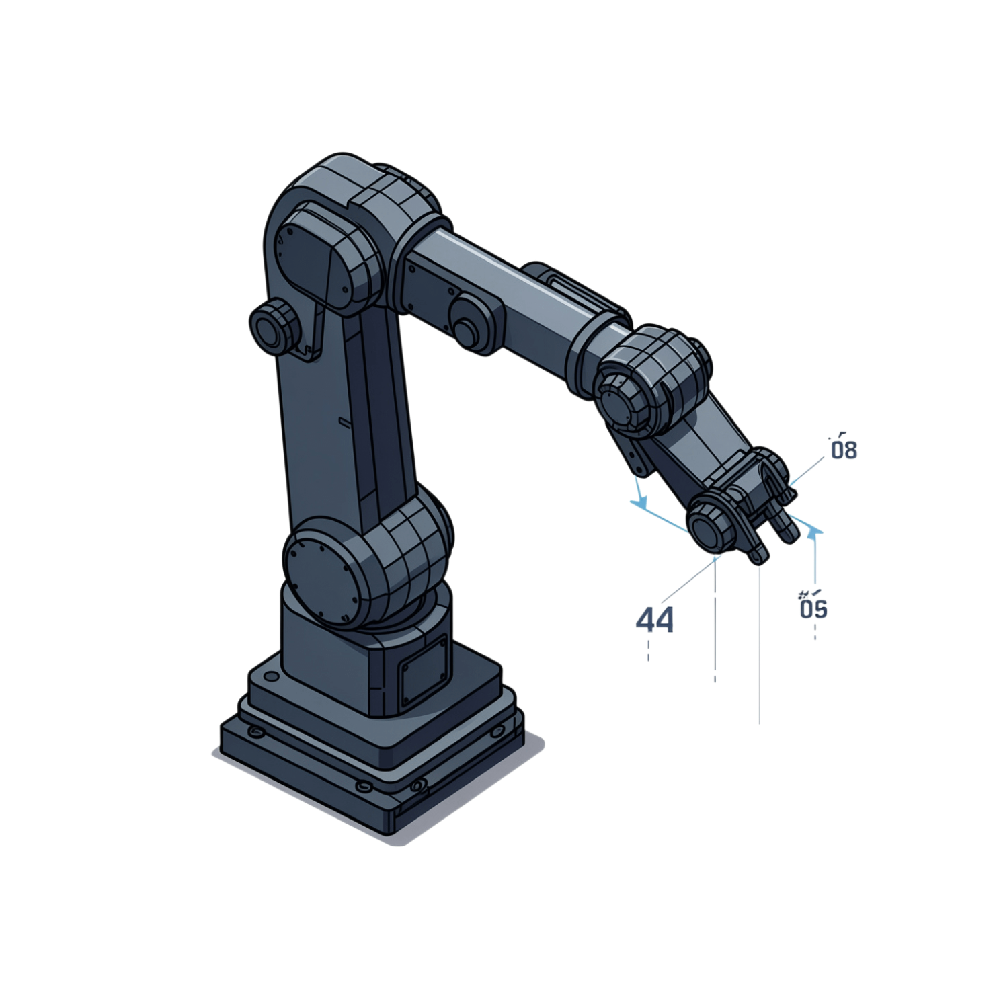
Stochastic Policy Search in Action
Instead of outputting a single action, a stochastic policy outputs a probability distribution — typically a Gaussian for continuous control — and samples from it at every step.
Natural Exploration
Differentiable Sampling
Concrete Example
No ε-greedy heuristic needed — randomness is baked into the policy itself.
The log-probability trick makes the sampling process differentiable for gradient computation.
A robot arm learns to reach a target by sampling different joint angle combinations and reinforcing trajectories that succeed.

Slide 8
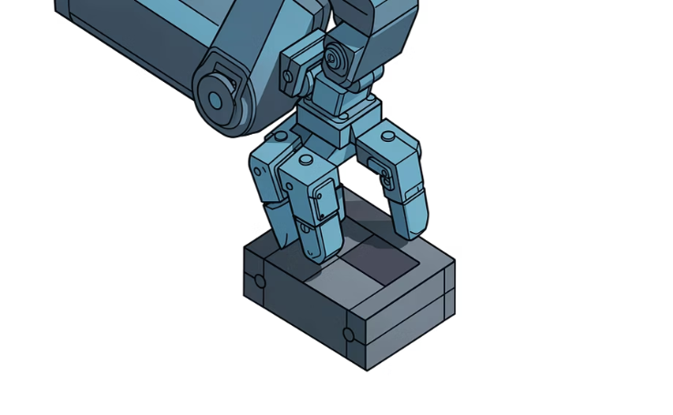
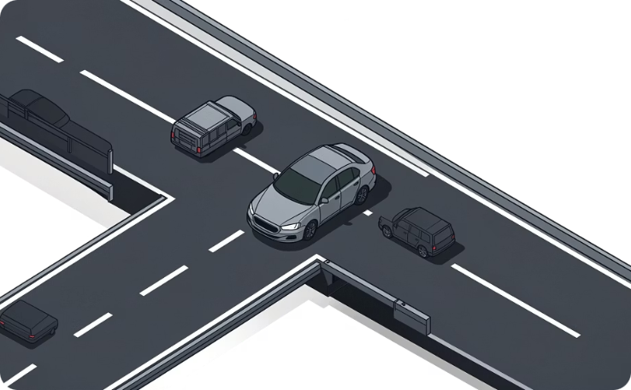
Real-World Applications: Robotics & Autonomous Driving
Robotics
Autonomous Driving
Continuous joint control, grasping, and locomotion. PPO trained directly on real model vehicles converges in ~200 episodes and tolerates real-world uncertainty and sensor noise — bridging the sim-to-real gap.
Lane changes, merging, and collision avoidance. Deep RL methods capture interactive dynamics critical for safe and efficient highway merging, handling complex real-world traffic scenarios beyond rule-based planners.

Slide 9

Key Takeaways for Students
1
2
Direct Policy Optimization
REINFORCE is the Foundation
Policy gradients bypass value functions and optimize the decision-making policy end-to-end.
High-variance but conceptually pure — modern methods (Actor-Critic, PPO) add variance reduction on top.
3
4
Stochastic = Natural Exploration
Proven in the Real World
Probability distributions over actions enable seamless exploration in continuous spaces.
Robotics and autonomous systems are active, high-impact application domains — and the research frontier.
Policy-based RL is not just theory — it powers real robots and vehicles today. Master REINFORCE, then build up to PPO.

Slide 10
Sources
14.5 Policy Gradient – Dive into Deep Learning
Policy Gradient (REINFORCE) — Stanford CS229 Notes
Real-World Autonomous Driving Control: An Empirical Study Using the Proximal Policy Optimization (PPO) Algorithm
A Review on Reinforcement Learning-Based Highway Autonomous Driving

