Slide 1
VisionSpeak: IVIS (Intelligent Vision Interpretation System)
Project By
Name: Avasarala Sai Ganesh
Roll Number: 24M11MC007
Guide: Dr. Bapuji Rao, Assistant Professor
Department: Computer Applications

Slide 2
PROBLEM STATEMENT
Visually impaired individuals face significant challenges in independently accessing printed text and Braille. Existing assistive tools are often costly, limited to a single format, or lack real-time accuracy, especially in noisy or unstructured environments. To address these limitations, this project proposes an AI-driven, vision-based system that recognizes both printed text and Braille from images and converts them into speech in real time, enhancing accessibility and user independence.

Slide 3
OBJECTIVES
To design an intelligent assistive system for visually impaired individuals
To capture and preprocess images containing printed text and Braille
To recognize printed text using Optical Character Recognition (OCR)
To identify Braille characters using a CNN-based deep learning model
To convert recognized text into clear and natural speech output
To improve accessibility, independence, and inclusive learning

Slide 4
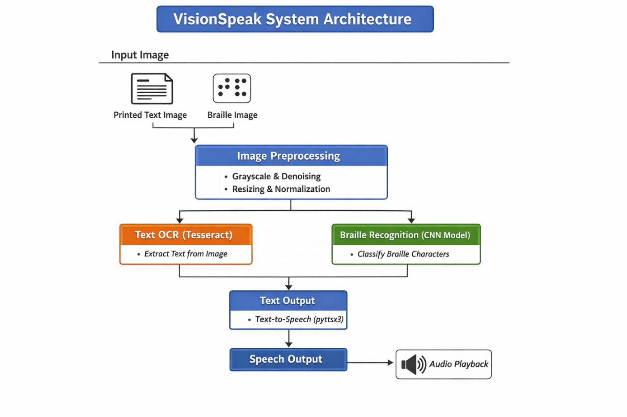
METHODOLOGY
Image preprocessing (OpenCV)
Tesseract OCR
CNN using TensorFlow / Keras
pyttsx3
Integrated pipeline

Slide 5
IMPLEMENTATION DETAILS
Software and Hardware Requirements
Software:
Python
OpenCV (Image Processing)
TensorFlow / Keras (CNN Model)
Tesseract OCR (Text Recognition)
pyttsx3 (Text-to-Speech)
NumPy, scikit-learn
Dataset Description
Standard Braille character image dataset (A–Z), Images resized to 64×64 for CNN training, Separate dataset of printed text images for OCR testing.
Hardware:
System with minimum 8GB RAM
CPU (Intel i5 or equivalent)
Basic GPU (optional, for faster training)

Slide 6
EXPECTED OUTCOMES
Accurate recognition of printed text and Braille characters
Real-time conversion of visual information into audio output
Improved usability for visually impaired users
Enhanced access to educational and daily-life information

Slide 7
CONCLUSION
This project presents VisionSpeak, an intelligent assistive system that effectively converts printed text and Braille into speech using computer vision and deep learning techniques. By integrating OCR, CNN-based Braille recognition, and text-to-speech synthesis, the system overcomes limitations of traditional assistive tools. The proposed solution demonstrates improved accuracy, usability, and real-time performance, making it suitable for practical deployment as an assistive technology for visually impaired individuals.

Slide 8
Thank You

