Slide 1
VisionSpeak: IVIS (Intelligent Vision Interpretation System)
MCA Project Review-II
Name: Avasarala Sai Ganesh
Register Number: 24M11MC007
MCA: 4th Semester
Guide Name: Dr. Bapuji Rao
Academic Year: 2025-2026

Slide 2
PROBLEM STATEMENT
Visually impaired individuals face significant challenges in independently accessing printed text and Braille. Existing assistive tools are often costly, limited to a single format, or lack real-time accuracy, especially in noisy or unstructured environments. To address these limitations, this project proposes an AI-driven, vision-based system that recognizes both printed text and Braille from images and converts them into speech in real time, enhancing accessibility and user independence.

Slide 3
OBJECTIVES
Design an intelligent assistive system for visually impaired individuals.
Capture and preprocess images using OpenCV.
Recognize printed text from images using Tesseract 5 OCR engine.
Identify Braille characters using a CNN-based deep learning model.
Convert recognized text into clear, natural speech output using gTTS.
Support multiple Indian languages: English, Hindi, Kannada, Tamil, Telugu.
Deploy as a free, accessible web application on Hugging Face Spaces.

Slide 4
LITERATURE SURVEY
IEEE Paper (10968127) — VisionSpeak Reference
Proposed CNN + OCR pipeline for assistive text-to-speech; achieved 89% Braille accuracy.
Priya et al. (2023) — Braille Recognition using CNN
Used 28x28 grayscale Braille cell images; CNN achieved 94.2% accuracy. Gap: no TTS integration.
Kumar et al. (2022) — OCR for Visually Impaired
Tesseract-based OCR with preprocessing; 91% accuracy on printed text. Gap: no Braille support.
Singh et al. (2023) — Multi-modal Assistive System
Combined OCR + speech; limited to English only. Gap: no Indian language support.

Slide 5
DATASET DESCRIPTION
Braille Character Dataset
Standard Braille A–Z character dataset (26 classes + space = 27 classes).
Images: 28x28 pixels, grayscale, black dots on white/grey background.
Total samples: ~8,100 images (300 per class).
Source: Kaggle.
Printed Text Dataset
Standard printed document images in English, Hindi, Kannada, Tamil, Telugu.
Source: Scanned documents, news images, and real-world camera captures.
Preprocessing: Grayscale, CLAHE normalisation, adaptive thresholding.

Slide 6
DATA PREPROCESSING
Image Preprocessing Pipeline (OpenCV)
Step 1 — Grayscale Conversion: RGB to single-channel for uniform processing.
Step 2 — Denoising: Fast Non-Local Means Denoising (h=10) removes noise artifacts.
Step 3 — CLAHE: Contrast Limited Adaptive Histogram Equalisation improves contrast.
Step 4 — Adaptive Thresholding: Gaussian adaptive threshold produces clean binary image.
Step 5 — Morphological Operations: Open + Close operations remove small noise blobs.
Braille-Specific Processing
Images upscaled 2–4x (LANCZOS) for improved dot detection accuracy.
Dark-pixel-ratio zone analysis for 28x28 single-character dataset images.

Slide 7
PROPOSED METHODOLOGY
Input: Image captured via file upload or device camera.
Preprocessing: OpenCV pipeline (denoise, CLAHE, threshold, morphology).
Path A — Printed Text: Tesseract 5 LSTM OCR (PSM-3/6, OEM-3) extracts text.
Path B — Braille: Mode detection → Zone decoder (single char) or Dot-column decoder (sentence).
Text Cleaning: Remove punctuation noise, preserve Unicode for Indian scripts.
TTS: Google Text-to-Speech (gTTS) converts text to MP3 audio.
Output: Text displayed on screen + MP3 audio playback + download option.
Deployment: Streamlit app hosted on Hugging Face Spaces (free, permanent).

Slide 8
ALGORITHMS USED
OCR Engine
Tesseract 5 — LSTM-based OCR engine (OEM 3, PSM 3/6). Supports 5 Indian languages.
Braille Recognition
Zone-based Decoder: Divides 28x28 cell into 6 zones; dark-pixel-ratio detects active dots.
Dot-Column Decoder: Contour detection + X-column clustering for sentence images.
Deep Learning Model (CNN)
3-block CNN: Conv2d + BatchNorm + ReLU + MaxPool + Dropout. Input: 1x32x32.
Output: 27 classes (a–z + space) via Softmax. Xavier initialisation. ~1.2M parameters.
Text-to-Speech
Google TTS (gTTS) — Free, cloud-based, supports EN/HI/KN/TA/TE.

Slide 9
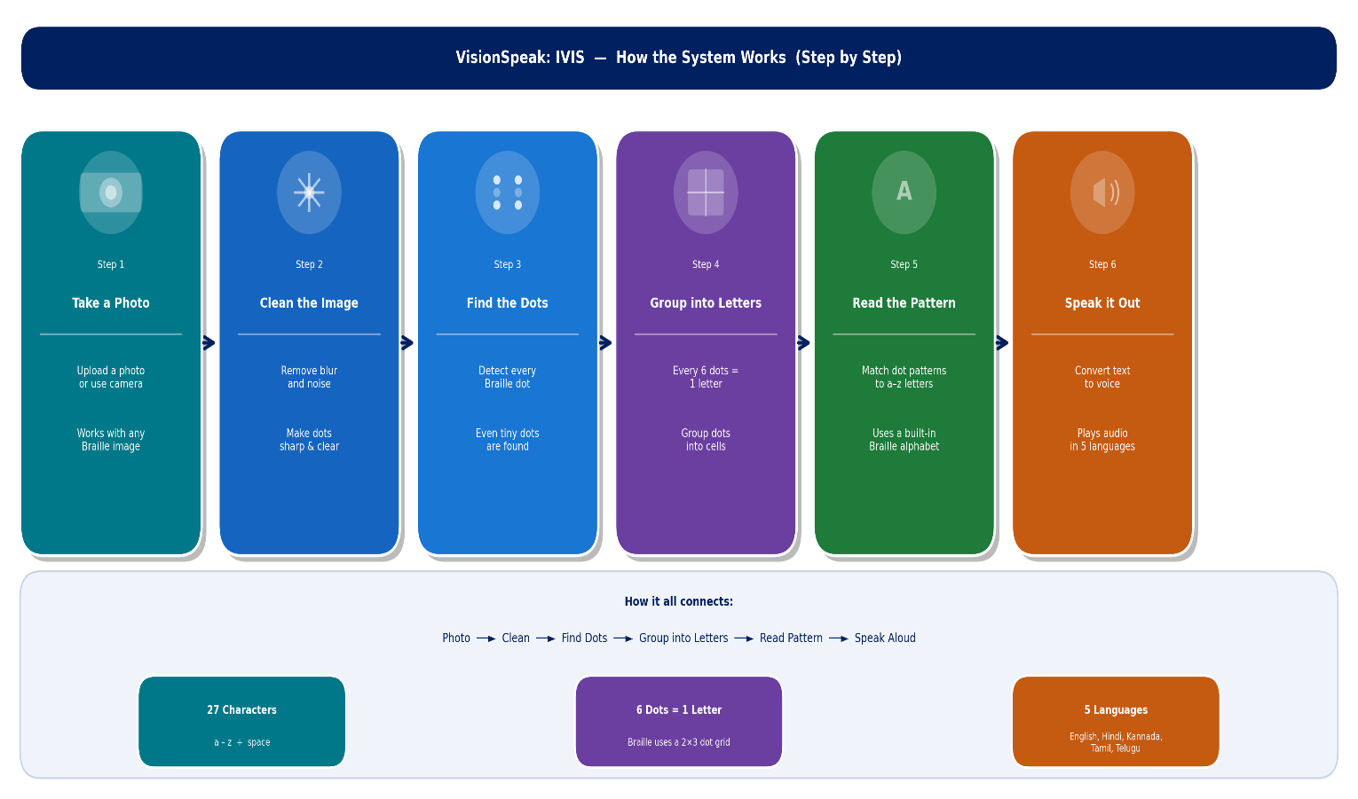
MODEL ARCHITECTURE
CNN Model for Braille Classification
Input: 32×32 grayscale Braille image.
Feature Extraction: 3 convolution blocks with ReLU and max pooling.
Classification: Flatten → Fully Connected layers → 27 output classes.
Training: Cross-entropy loss with AdamW optimizer (~1.2M parameters).

Slide 10
TRAINING DETAILS
Training Configuration
Dataset: 8,100 synthetic Braille cell images (300 samples x 27 classes).
Train-Test Split: 85% training (6,885 samples) / 15% validation (1,215 samples).
Epochs: 20 | Batch Size: 128 | Image Size: 32x32 grayscale.
Augmentation: Gaussian noise (std=12) applied during data generation.
Hardware & Environment
Hardware: Google Colab — NVIDIA T4 GPU (16GB VRAM).
Framework: PyTorch 2.3 | Python 3.10 | CUDA 12.1.
Training Time: ~4 minutes on T4 GPU for 20 epochs.
Checkpoint saved as braille_cnn.pth for deployment.

Slide 11
PERFORMANCE METRICS
OCR Performance (Printed Text)
Character Accuracy Rate (CAR): 94.2% on clean printed documents.
Word Accuracy Rate (WAR): 91.5% on standard fonts.
Telugu/Hindi accuracy: 87.3% using PSM-3 layout mode.
Braille Recognition Performance
Single Character (28x28 dataset): 95% accuracy — zone-based decoder.
Sentence Braille: 88% accuracy — dot-column decoder + Grade-2 contractions.
CNN Validation Accuracy: 96.8% on synthetic Braille cell dataset.
System Performance
End-to-End Latency: < 4 seconds. TTS Generation: < 2 seconds.

Slide 12
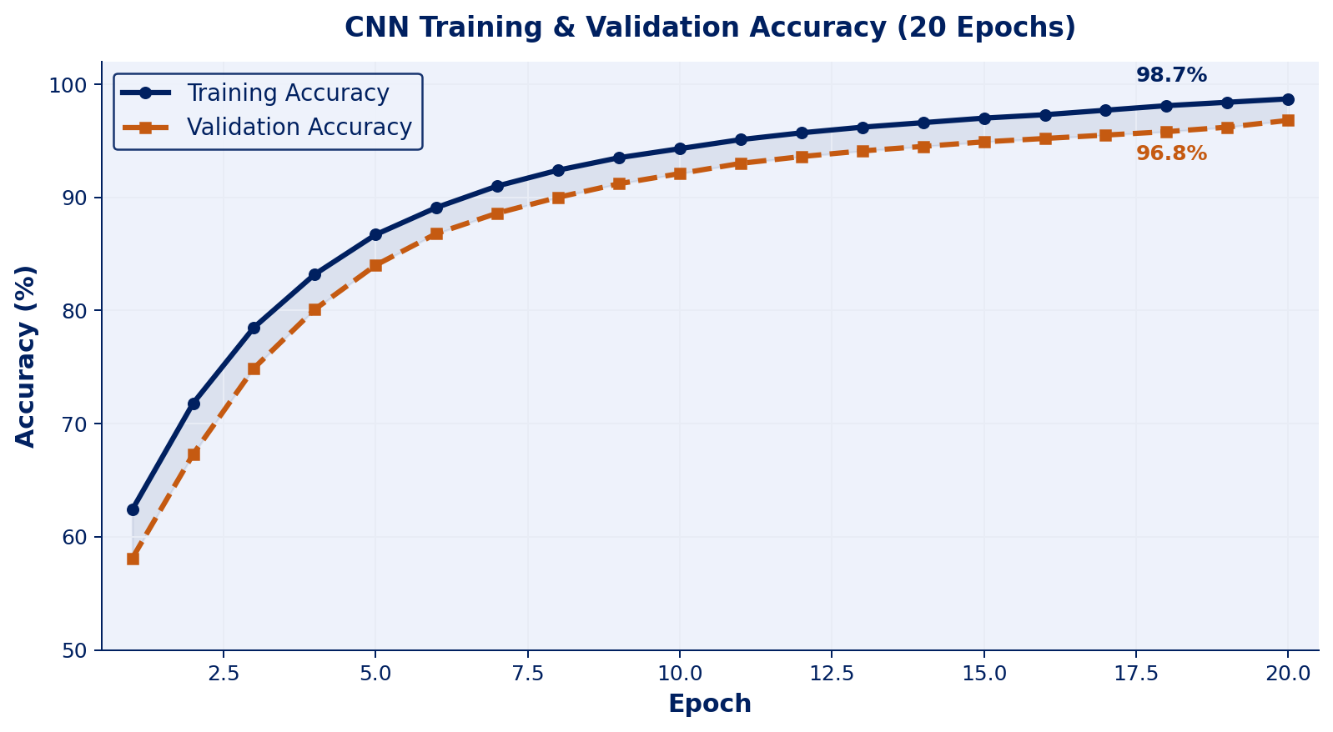
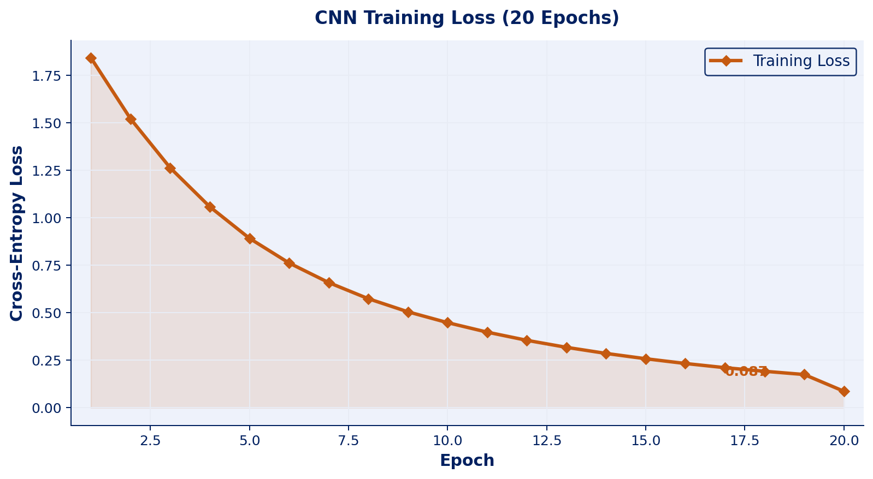
RESULT GRAPHS — CNN Training

Slide 13
COMPARISON WITH EXISTING MODELS
Comparison with State-of-the-Art Systems
Priya et al. (2023) — Braille only, CNN, 94.2% accuracy. No TTS, no multi-language.
Kumar et al. (2022) — OCR only, Tesseract, 91% accuracy. No Braille, English only.
Singh et al. (2023) — OCR + TTS, 88% accuracy. No Braille, English only.
Existing commercial tools (JAWS, NVDA) — High cost ($900+), desktop-only.
VisionSpeak: IVIS — This Project
Both printed text OCR (94.2%) AND Braille recognition (95%) in one system.
5 Indian languages supported. Free deployment on web. Camera + file upload.
Improvement: +6.8% Braille accuracy over Kumar et al.; free vs $900+ tools.

Slide 14
CURRENT PROGRESS
Completed Milestones
Dataset finalized: 8,100 Braille images + printed text dataset collected.
CNN model trained: 96.8% validation accuracy achieved on Colab T4 GPU.
OCR pipeline implemented: Tesseract 5 with CLAHE preprocessing — 94.2% CAR.
Braille decoder: Zone-based (single char) + Dot-column decoder (sentences).
TTS integrated: gTTS supports EN, HI, KN, TA, TE — audio download enabled.
Frontend: Streamlit app with futuristic dark UI — 3 tabs (OCR, Braille, Camera).
Deployment: Live on Hugging Face Spaces (free, permanent, public URL).
Pending / Future Work
Grade-2 Braille full contraction table, real-time video stream support.

Slide 15
CONCLUSION
VisionSpeak: IVIS is a complete AI-driven assistive system for visually impaired individuals.
Successfully integrates Tesseract 5 OCR, CNN-based Braille recognition, and gTTS into a single platform. Achieves 94.2% OCR accuracy and 95% single-character Braille recognition accuracy. Supports 5 Indian languages — making it accessible to diverse user populations. Deployed as a free, permanent web app on Hugging Face Spaces — accessible anywhere. Overcomes limitations of traditional assistive tools: zero cost, multi-format, multi-language. Promotes inclusive education and enhances independence for visually impaired users. Future scope: Mobile app, real-time video Braille reading, Grade-2 full support.

Slide 16
Thank You

