Slide 1

HACKGEN AI HACKATHON
FROM TEAM PEAKY BLINDERS
CINEBRO
FROM SCRIPT TO SCREEN, YOUR CREATIVE PARTNER IN EVERY FRAME.
“Aspiring filmmakers often struggle to visualize their scripts and match scenes with the right cinematic mood, lighting, and camera work. Existing tools are fragmented and lack AI-driven creative support across the filmmaking pipeline.There’s a need for a unified platform that bridges script, visuals, and cinematic language—intelligently and creatively.”
YOU DON’T CHOOSE ART, ART CHOOSES YOU

Slide 2
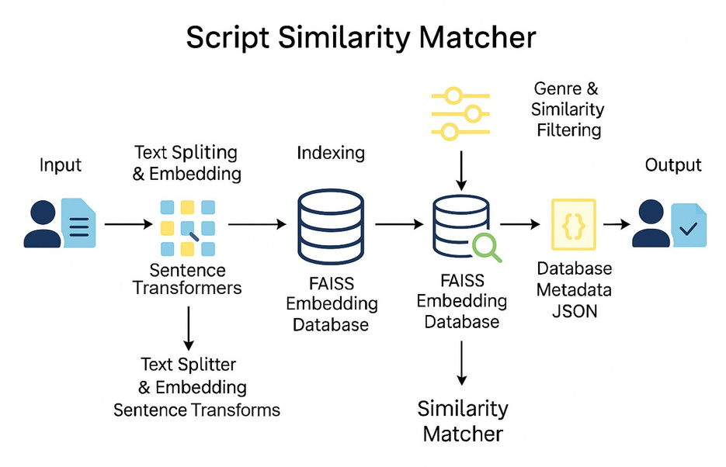
FROM TEAM PEAKY BLINDERS
HACKGEN AI HACKATHON
FEATURE 1:
SCRIPT SIMILARITY FINDER
“Filmmakers, writers and studios often need to verify if a newly written script closely resembles existing screenplays - intentionally or unintentionally. Manually comparing scripts is time consuming and inefficient.”
SOLUTION
We developed an AI-powered Script Similarity Matcher that semantically compares new screenplays against a database of indexed film scripts.
The system breaks scripts into meaningful chunks (dialogue and descriptions), embeds them using pre-trained language models, and searches for matches using FAISS vector similarity.
The user can upload a script and instantly get the most contextually similar chunks from existing films
FUTURE ENHANCEMENTS
Multilingual Script support: Integrate language detection to support non English (eg: Malayalam, Tamil,etc) screenplays
Large Scale Database: Expand to a cloud hosted script repo and index thousands of screenplays.
TECH STACK : PYTHON, FAISS, HUGGINGFACE, LANGCHAIN

Slide 3
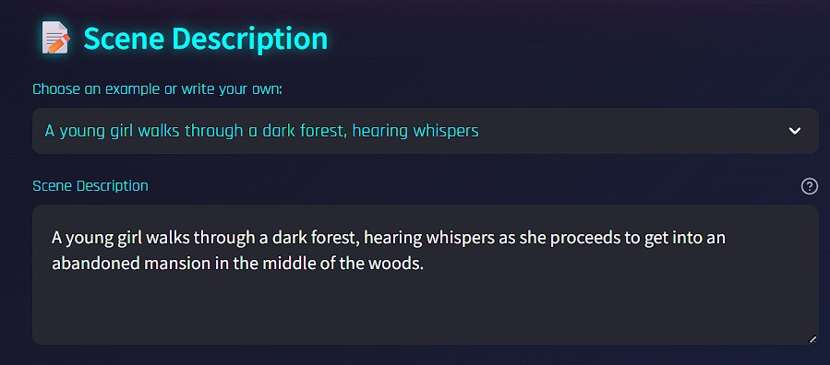
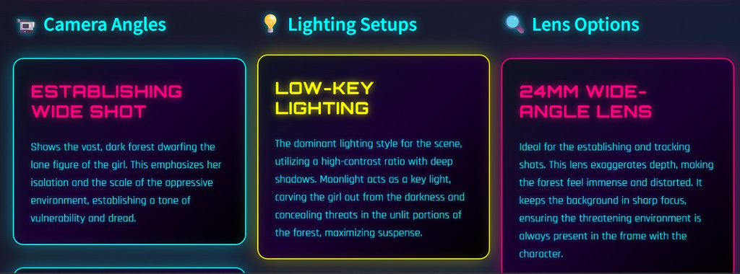
FROM TEAM PEAKY BLINDERS
HACKGEN AI HACKATHON
FEATURE 2:
CINEMATOGRAPHY SHOT RECOMMENDER
“Filmmakers often struggle to quickly translate creative scene ideas into technical camera, lighting, and lens setups during pre-production.”
SOLUTION
A prompt-based AI system leveraging Large Language Models (LLMs) to generate a cinematographic shot list (camera angles, lighting, lens options) from natural language scene descriptions. Outputs are cleanly formatted and exportable as PDF.
FUTURE ENHANCEMENTS
Budget-aware Shot Suggestions: Offer alternatives based on production budget (e.g., expensive crane shot → handheld equivalent).
Real-time shot visualization allows users to instantly preview camera angles, lighting, and lens effects as they input or modify scene prompts.
TECH STACK : PYTHON, GEMINI, REPORTLAB

Slide 4
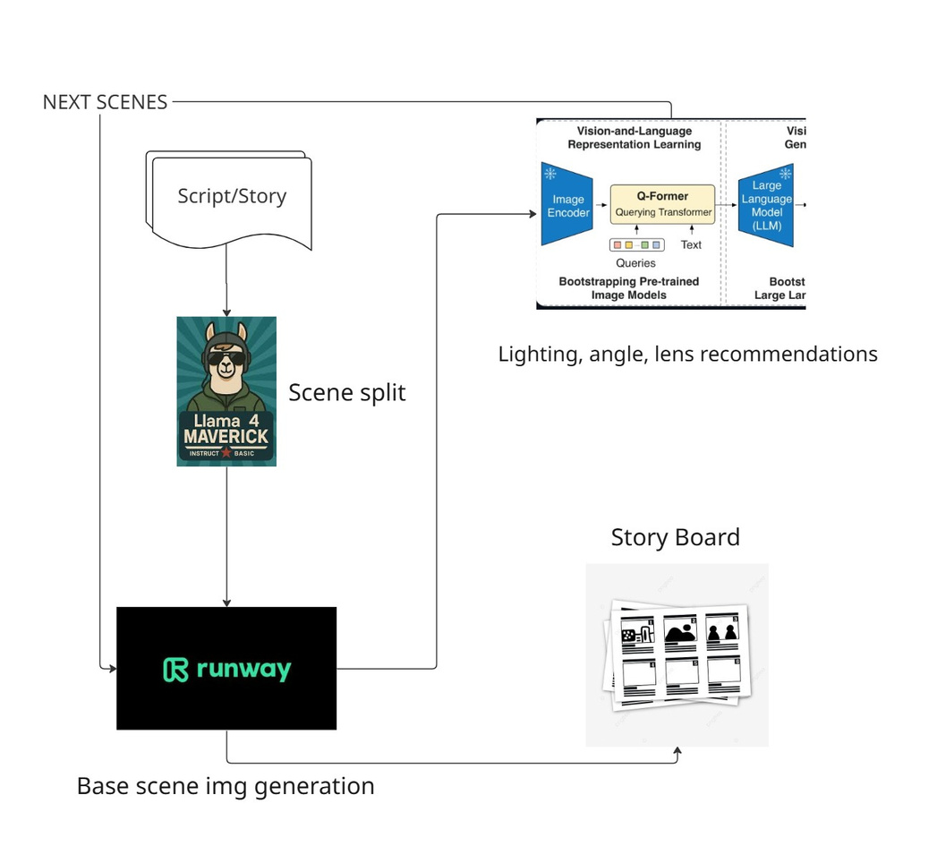
FROM TEAM PEAKY BLINDERS
HACKGEN AI HACKATHON
FEATURE 3:
STORY BOARD ASSIST
Traditional storyboarding is time-consuming and often inconsistent, requiring filmmakers to manually visualize scenes while lacking technical cinematography expertise.
SOLUTION
The Film Assist Storyboard Generator solves this by automatically converting scripts into AI-generated storyboards with consistent visuals, professional camera/lens/lighting recommendations, and exportable production assets—streamlining pre-production and empowering creators with cinematic precision.
FUTURE ENHANCEMENTS
Generating videos by video stitching.
Multi agentic model approach to build 3d models.
TECH STACK : PYTHON, CLIP ENCODER/PROCESSOR, HUGGINGFACE, RUNWAY-GEN4-IMAGE & VIDEO, GROQ ( LLAMA 4 MAVERICK )

Slide 5
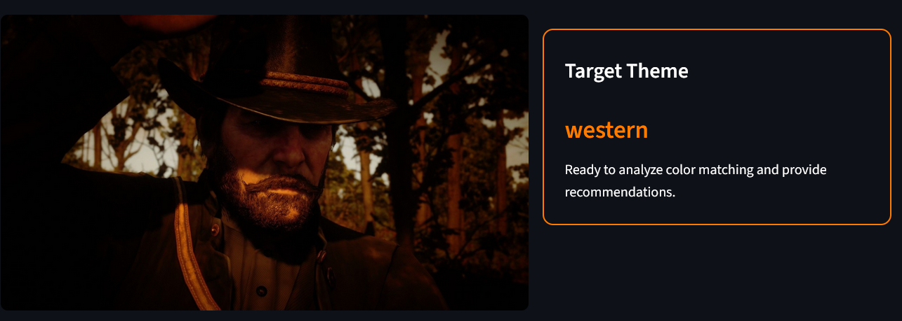
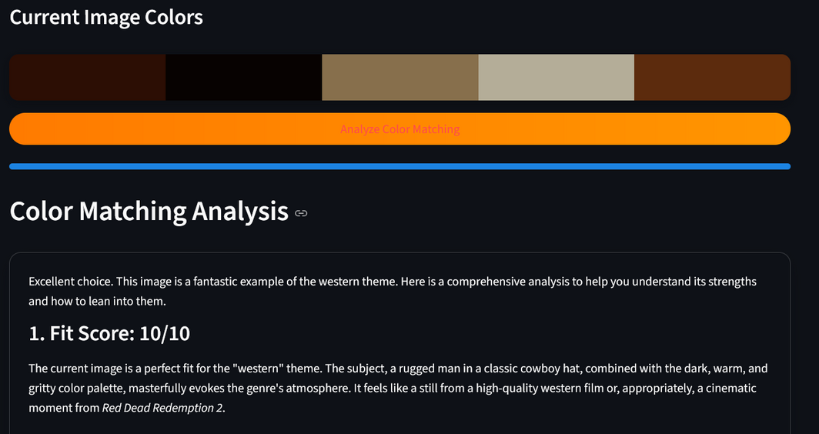
FROM TEAM PEAKY BLINDERS
HACKGEN AI HACKATHON
FEATURE 4:
THEME AND DESIGN RECOMMENDER
In film and design production, designers and directors often struggle to manually extract mood-aligned palettes from references or to evaluate how well a given image (such as a costume or scene) fits a desired mood or cinematic style.
SOLUTION
Text-only: Analyze the user's scene description to predict the mood/theme and recommend matching color palettes, costumes, and lighting styles.
Image-only: Extract dominant colors from the uploaded image(s), predict the current mood, and suggest visual changes to align with the desired theme.
Text + Image: Combine scene description and image color analysis to provide theme fit score, mood detection, and scene enhancement recommendations.
Future Enhancement: Expand and refine the dataset to include more themes with detailed mappings of colors, costume types, lighting styles, and moods for each theme (e.g., noir, fantasy, post-apocalyptic).
TECH STACK : PYTHON, GEMINI, COLORTHIEF, DUCKDUCKGO

