Slide 1



TABLE OF CONTENT
1
WORKS DONE
2
LEARNINGS
3
FUTURE GOALS
GANESH S
DUSHYANT P

Slide 2
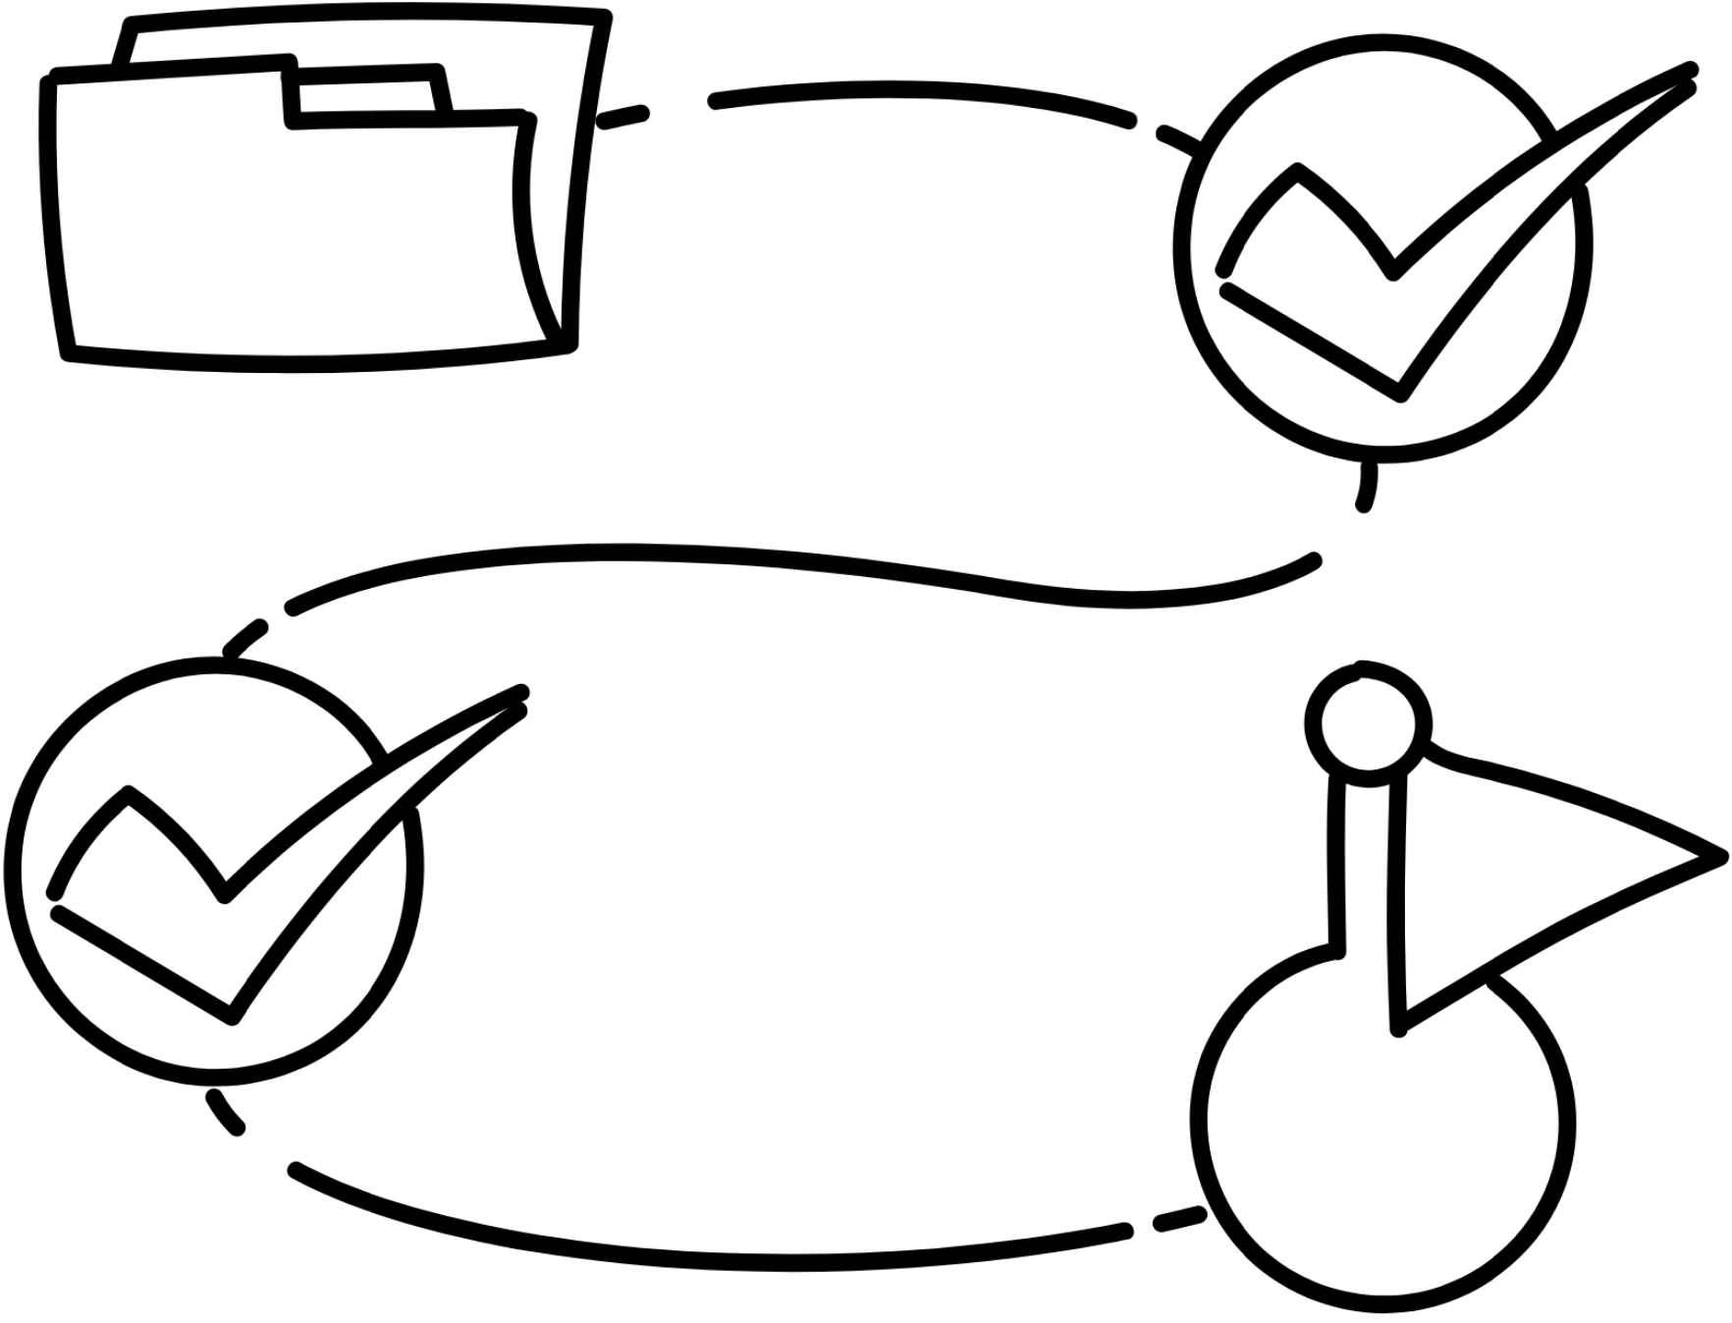

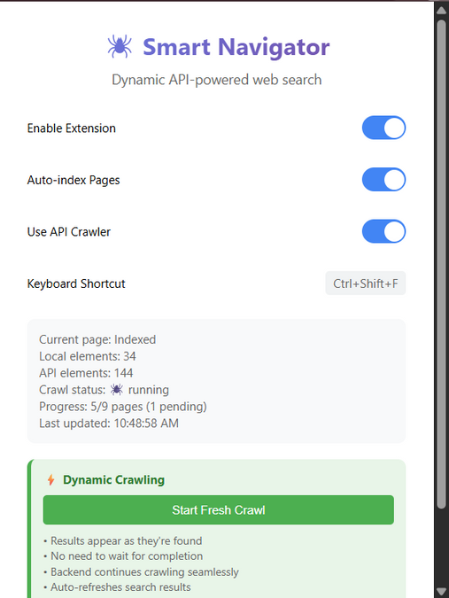
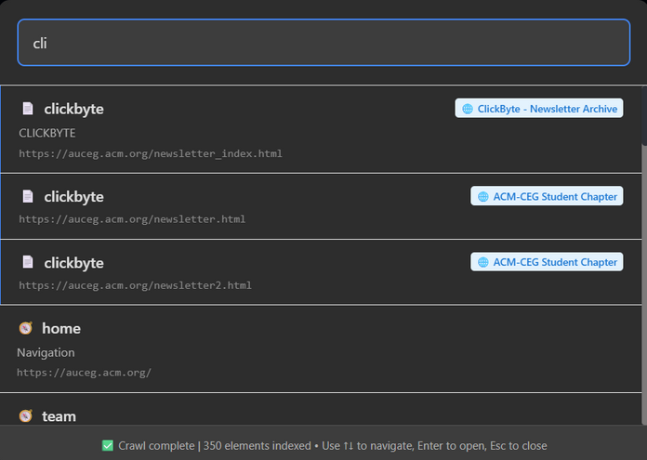
WORKS DONE
Chrome ui
Flask Backend
Optimizing
Testing and deployment
1) Global-Web navigator
A Chrome extension designed to navigate any website’s internal structure intelligently — providing deep page discovery, smart bookmarking, and enhanced search shortcuts.
Tech-stack:
Backend: Flask + Python (Threading, BeautifulSoup)
Database: SQLite with auto-table creation
Frontend: Chrome Extension (with popup + API calls) built with js.
Core System Components
Chrome Extension UI
Multithreaded Web Crawler
Auto-link discovery
Depth-first site mapping
Element context extraction
SQLite-backed Cache DB for fast recall
Semantic Search API with keyword scoring

Slide 3
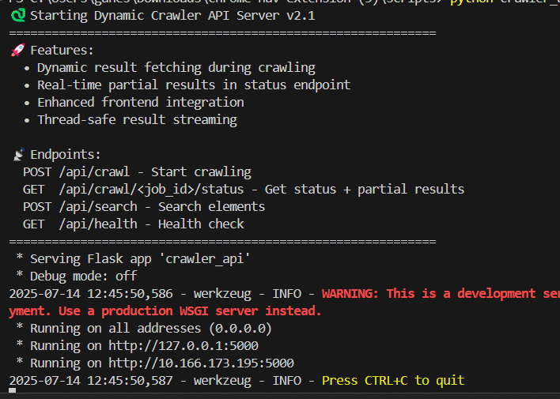
WORKS DONE
Search Bar
Extension popup
Backend api-endpoints

Slide 4
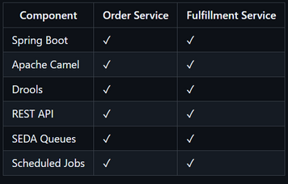
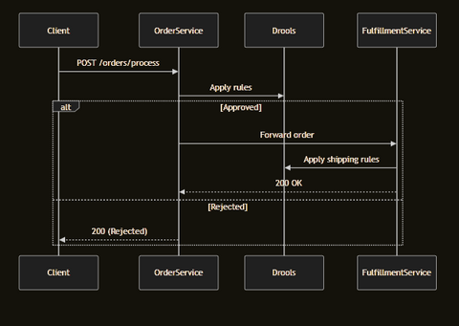
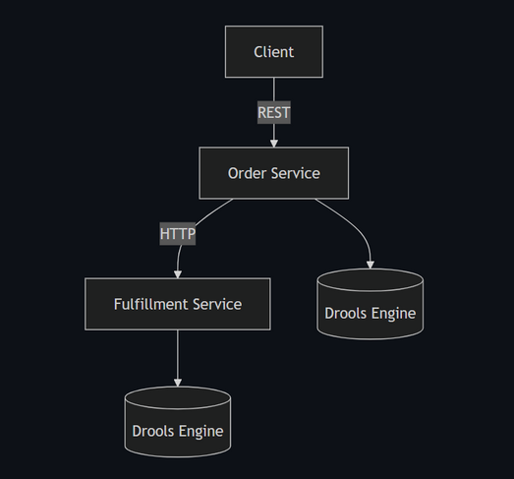
WORKS DONE
Standalone microservice
Camel routing
Integration of 2 microservices
Testing and deployment
2) Camel-springboot
A distributed system demonstrating integration of Apache Camel with Drools across two microservices:
Order Processing Service - Handles order validation and approval
Fulfillment Service - Manages shipping and logistics
Tech-stack:
Backend: Springboot + apache camel routing + REST APIs
Core System Components
CamelContext – The runtime integration engine
RouteBuilder – Java DSL to define routes
Spring Boot Starter Camel – Seamless Spring Boot integration
Camel DSL – from() → to() chains
Custom Beans – Java processors & validators

Slide 5
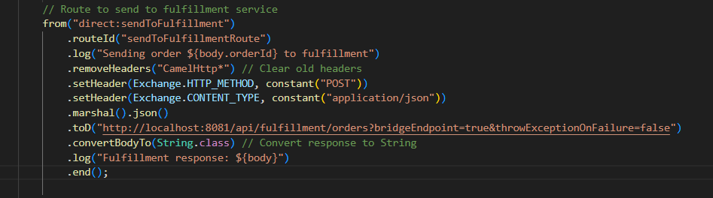
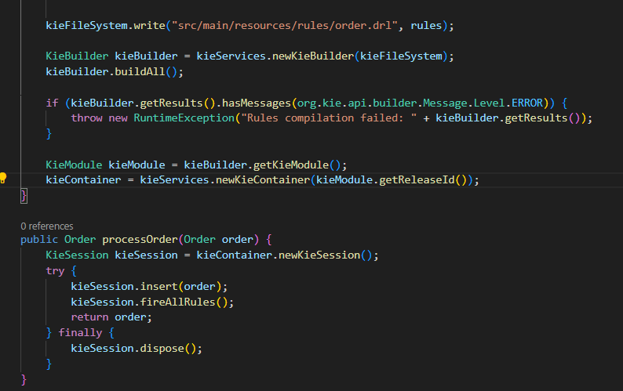
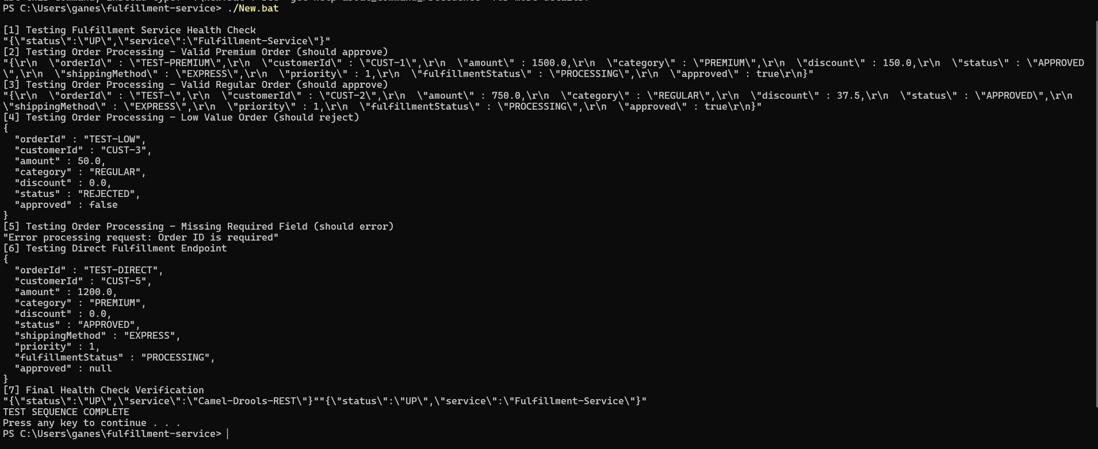
WORKS DONE

Slide 6
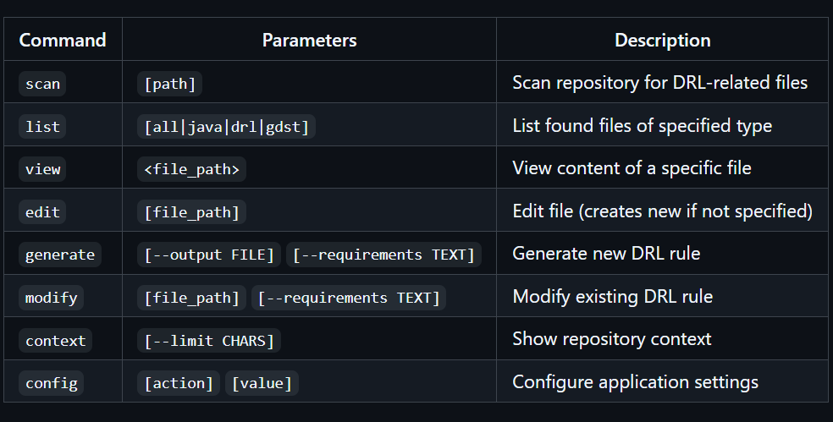
WORKS DONE
Context extraction
Chunking for llm tokens
Interactive CLI
3) Drl generation/modification
Documentation
This project presents an AI-powered Drools Rule Language (DRL) Management System that enables developers and analysts to manage, generate, and modify DRL business rules more efficiently. The solution integrates Groq’s large language models to streamline rule authoring with deep contextual awareness, improving rule accuracy and development speed.
Tech-stack:
Backend & CLI Interface
Python 3.x
AI Integration
Groq SDK (groq)
LLM Model: deepseek-r1-distill-llama-70b | Used for large-context ingestion and intelligent reasoning over rule
Repository Intelligence
Custom RepositoryScanner Recursively scans .java, .drl, and .gdst files |
Java Parser via Regex | Extracts class names, fields, annotations, and methods for model context |
Core System Features
Automatically scans Java/DRL/GDST files
Uses Groq LLM to generate or modify rules
Maintains context memory for consistency
Simplifies rule debugging and compliance workflows

Slide 7
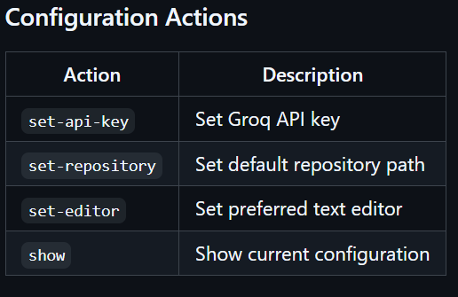
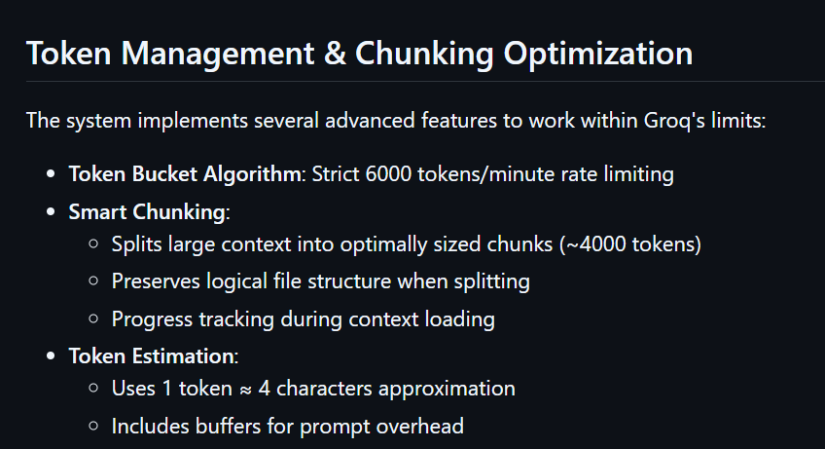
WORKS DONE

Slide 8
WORKS DONE
Zoom Access
Outlook access
4) Zoom MOM Generator
Summarization
Delivery
Zoom MoM Gen is an intelligent backend platform that automatically creates professional Minutes of Meeting (MoM) from recordings of Zoom meetings. By utilizing Zoom OAuth APIs, AI-driven transcription, and natural language generation, it delivers precise and organized meeting summaries in real-time. The generated MoMs are seamlessly emailed to participants through Outlook integration and stored for future reference. Additionally, it supports local file monitoring to transcribe recordings that are manually downloaded.
This system streamlines team communication by eliminating the need for manual note-taking and providing clean, HTML-formatted summaries, even from local Zoom recordings.
Tech-stack:
Backend
Node.js + Express.js – REST API Server
SQLite3 – Lightweight embedded database
🔗 API Integrations
Zoom API – Meeting & Recording Access
Microsoft Graph API – Email delivery
R2D2 Stylus API – MoM summarization

Slide 9
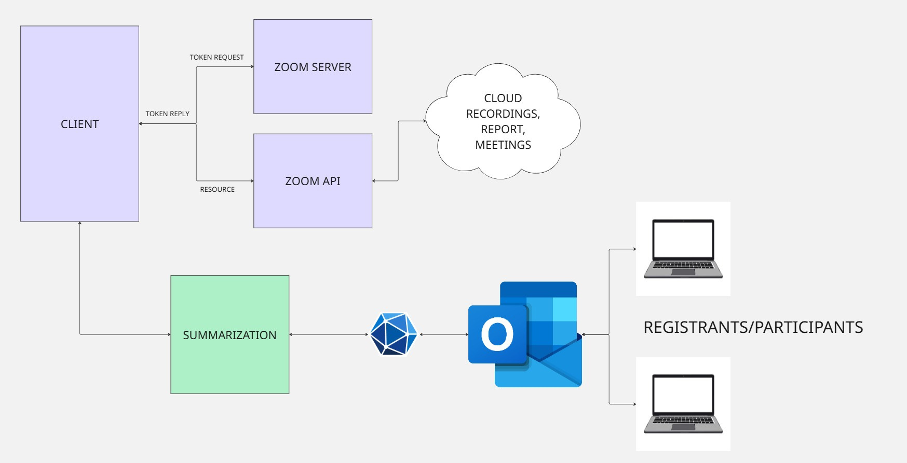
WORKS DONE
GRAPH API

Slide 10
Client
FastAPI
Rules Engine
Database
(PostgreSQL)
WORKS DONE
Logging
Notifications
5) Automated Overpayment Adjustment System
Problem Statement
Manual Process: Agents currently handle overpayments (e.g., refunds, loyalty points) manually.
Challenges:
Time-consuming
Prone to errors
Inconsistent rule application
Our Solution
Automated Backend System that:
Detects overpayments (paid_amount > actual_fee)
Applies configurable rules (e.g., convert to points, pay school fees)
Logs adjustments in PostgreSQL
How It Helps
Reduces Agent Workload
Improves Accuracy
Cost Savings

Slide 11
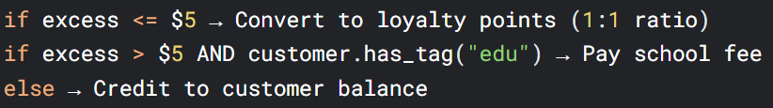
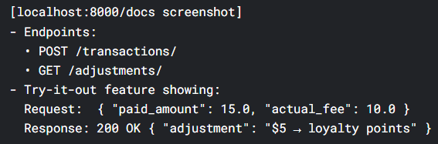
WORKS DONE
Logic flow
5) Automated Overpayment Adjustment System
1. Detection Layer (FastAPI)
Technology: Python + FastAPI
How it works:
Receives transaction data via REST API
Instantly compares paid_amount vs actual_fee
Triggers adjustment workflow if paid_amount > actual_fee
2. Rules Engine (Python)
3. Action Execution
Database: PostgreSQL via SQLAlchemy ORM
4. Audit System
Technology: SQLAlchemy models
Tracks:
Original transaction, Applied rule, Adjustment result, Timestamp, Status (success/failed)
API response output

Slide 12
LEARNINGS
OTHERS...
1. OAuth Integration
Implemented OAuth 2.0 for Zoom and Outlook securely.
Understood token flow: access tokens, refresh tokens, expiration handling.
Managed session state and redirection callbacks
CAMEL - SPRINGBOOT
We had the opportunity to gain hands-on experience with Apache Camel integrated with Spring Boot, which deepened our understanding of enterprise integration patterns and real-world middleware solutions. Working in this allowed us to explore how Camel routes are designed for seamless message transformation, routing, and communication between microservices. We learned how to build scalable, maintainable APIs by leveraging Camel components,
2. AI/ML Integration
Explored Genai tools for various tasks ( summarization, drl generation etc... )
Optimized llm context management by sending data in chunks.
Learned prompt engineering to extract action items, decisions, and summaries effectively.

Slide 13
FUTURE GOAL
Deepen expertise in Apache Camel + Spring Boot for enterprise-level integrations.
Focus on building KModule-driven, rule-based systems using Drools.
Implement dynamic session mapping, linking each request to a specific KSession based on context.
Enable scalable and intelligent decision-making pipelines through rule-based routing.
Explore multi-KSession orchestration to manage multiple rule sets dynamically.
Develop advanced rule chaining for complex business logic scenarios.
Ensure seamless integration of Drools with REST endpoints in Camel routes.
Maintain modularity, reusability, and adaptability of services across evolving business needs.
CAMEL - SPRINGBOOT -
KMODULE - SESSION MAPPING

