Slide 1

CMR TECHNICAL CAMPUS
Department of Information Technology
Major Project Stage-II Review-I
Design and Implementation of an Intelligent Email Automation System Using RPA and Generative AI
Presented By:
Batch No:19
K.Naina Harshitha(227R1A1230)
S.Ganesh(227R1A1252)
J.Adithya(227R1A1222)
Project Supervisor:
Name : G.Shankar
Designation : Assistant Professor

Slide 2
INDEX
INTRODUCTION AND OVERVIEW
EXISTING SYSTEM
DISADVANTAGES
PROPOSED SYSTEM
ADVANTAGES
HARDWARE AND SOFTWARE REQUIREMENTS
NOVELTY OF PROJECT
ARCHITECTURE
MODULES
UML DIAGRAMS

Slide 3
INTRODUCTION AND OVERVIEW
Email communication produces a large number of messages that are difficult to handle manually. This project automates email management using UiPath RPA and Generative AI.
The system retrieves emails through the IMAP protocol and extracts the email body. It also processes attachments such as PDF and document files.
Generative AI is used to summarize the email content and attachments. This helps in providing concise and meaningful information to the user.
The summarized content is sent to the user via WhatsApp Web automation. The system also detects the email language and translates it if required.
An intelligent reply is generated based on the summarized content. After user approval through WhatsApp, the reply is sent using SMTP.

Slide 4
EXISTING SYSTEM
“E-Mail Assistant — Automation of E-Mail Handling and Management using RPA (2022)”
This paper explains how UiPath RPA can be used to automate email handling tasks such as sorting emails . The main goal is to reduce manual effort in managing emails.
“ “RPA-Driven Email Automation (2024)”
This paper presents an RPA-based email system that automatically detects spam and classifies emails using predefined rules. It focuses on filtering emails rather than understanding their content.
“AI-Powered Email Automation (2025)”
This paper describes an AI-based email automation system developed using UiPath for handling customer emails. The system mainly automates replies using predefined workflows.

Slide 5
DISADVANTAGES
(2022)
The system is mainly rule-based and does not understand email context.
It does not provide AI-based summarization of email body or attachments.
No support for language detection, translation, or intelligent reply generation.
(2024)
Uses keyword-based and rule-based methods for email classification.
Does not support email or attachment summarization.
No multilingual support or AI-generated replies.
(2025)
Limited handling of email attachments such as PDF or documents.
Lacks user approval control before sending automated replies.

Slide 6
PROPOSED SYSTEM
The system automates email processing using UiPath Robotic Process Automation integrated with Generative AI.
Incoming emails are retrieved from the mail server using the IMAP protocol.
The email body and attachments are extracted, and text from PDF or document attachments is processed separately.
Generative AI is used to summarize both email content and attachment text to reduce lengthy information.
The system detects the language of the email and performs translation when required.
Summarized content and AI-generated reply suggestions are sent to the user via WhatsApp Web automation for approval.
After user confirmation, the final email response is sent automatically using the SMTP protocol.

Slide 7
ADVANTAGES
Reduces manual effort by automating email reading, summarization, and replying.
Provides clear and concise summaries of long emails and attached documents.
Supports multilingual communication through language detection and translation.
Handles email attachments such as PDF and document files intelligently.
Sends instant notifications to users through WhatsApp for faster awareness.
Generates intelligent replies using Generative AI instead of fixed rules based.
Includes user approval before sending replies, ensuring safe automation.
Improves productivity and response time in organizations.
Can be used across different domains such as education, business, and customer support.

Slide 8
SOFTWARE REQUIREMENTS
HARDWARE REQUIREMENTS
Operating System :Windows 10 / 11
Development Tool :UiPath Studio
Community
Framework :UiPath Robotic Process
Automation (RPA)
Web Browser :Google Chrome /
Microsoft Edge
Processor :Intel Core i3 or higher
RAM :8 GB
Storage :Minimum 2 GB free disk space
Peripherals :Keyboard, Mouse

Slide 9
NOVELTY OF PROJECT
The novelty of this project lies in integrating Robotic Process Automation (RPA) with Generative Artificial Intelligence to build an intelligent, user-controlled email automation system. Unlike traditional rule-based email automation, the system understands email content and attachments using Generative AI, supports multilingual communication, and involves the user in decision-making through real-time WhatsApp approval. This combination makes the system both intelligent and reliable.

Slide 10

MODULES
Module | Main Function
1 · Email Retrieval (IMAP) | Connects to the mail server, fetches unread messages (subject + body).
2 · Language Detection & Translation | Detects the email’s language; translates non-English text to English for processing.
3 · AI Summarization (Gen AI) | Sends the email text to OpenAI, receives a short line summary.
4 · Content Generation & Reply | Builds the reply message using the summary and sends it back via SMTP/Reply Mail.
5 · Communication (WhatsApp ) | Sends the same summarized reply to the user’s phone using a messaging API.

Slide 11
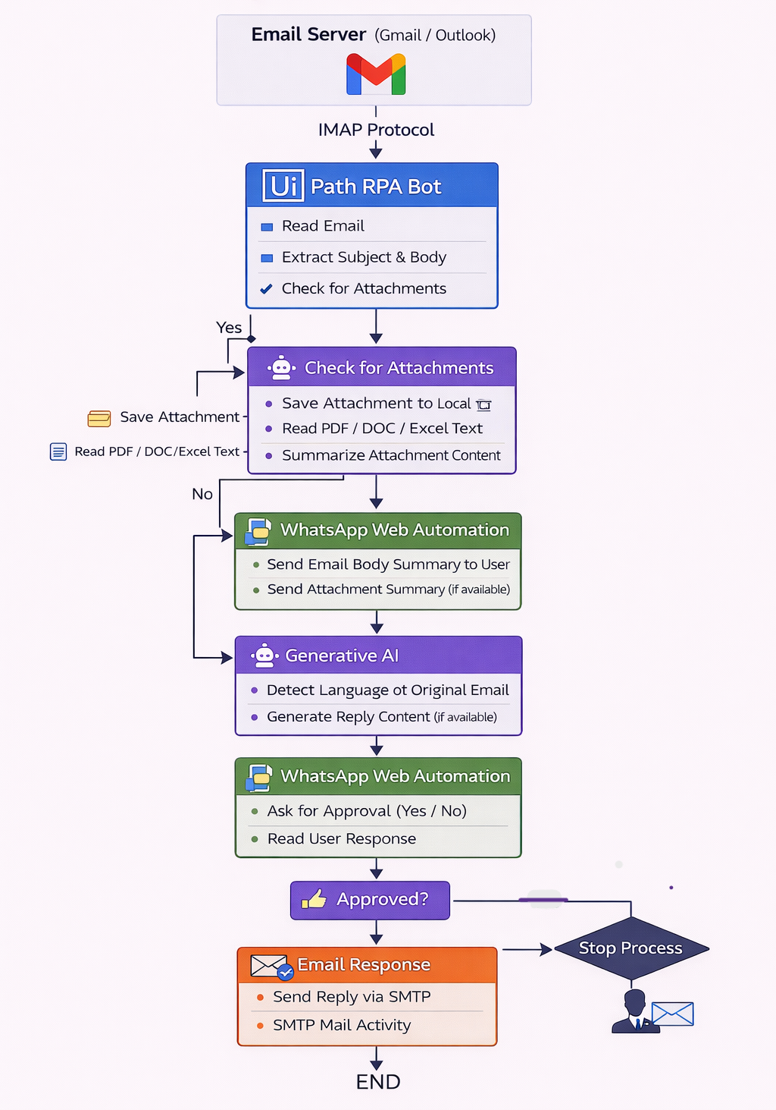
SYSTEM ARCHITECTURE
The system architecture of the Email Automation project shows how different components like the IMAP mail server, UiPath RPA bot, language detection, translation, summarization, content generation, and message-sending modules work together to automate the email process.

Slide 12
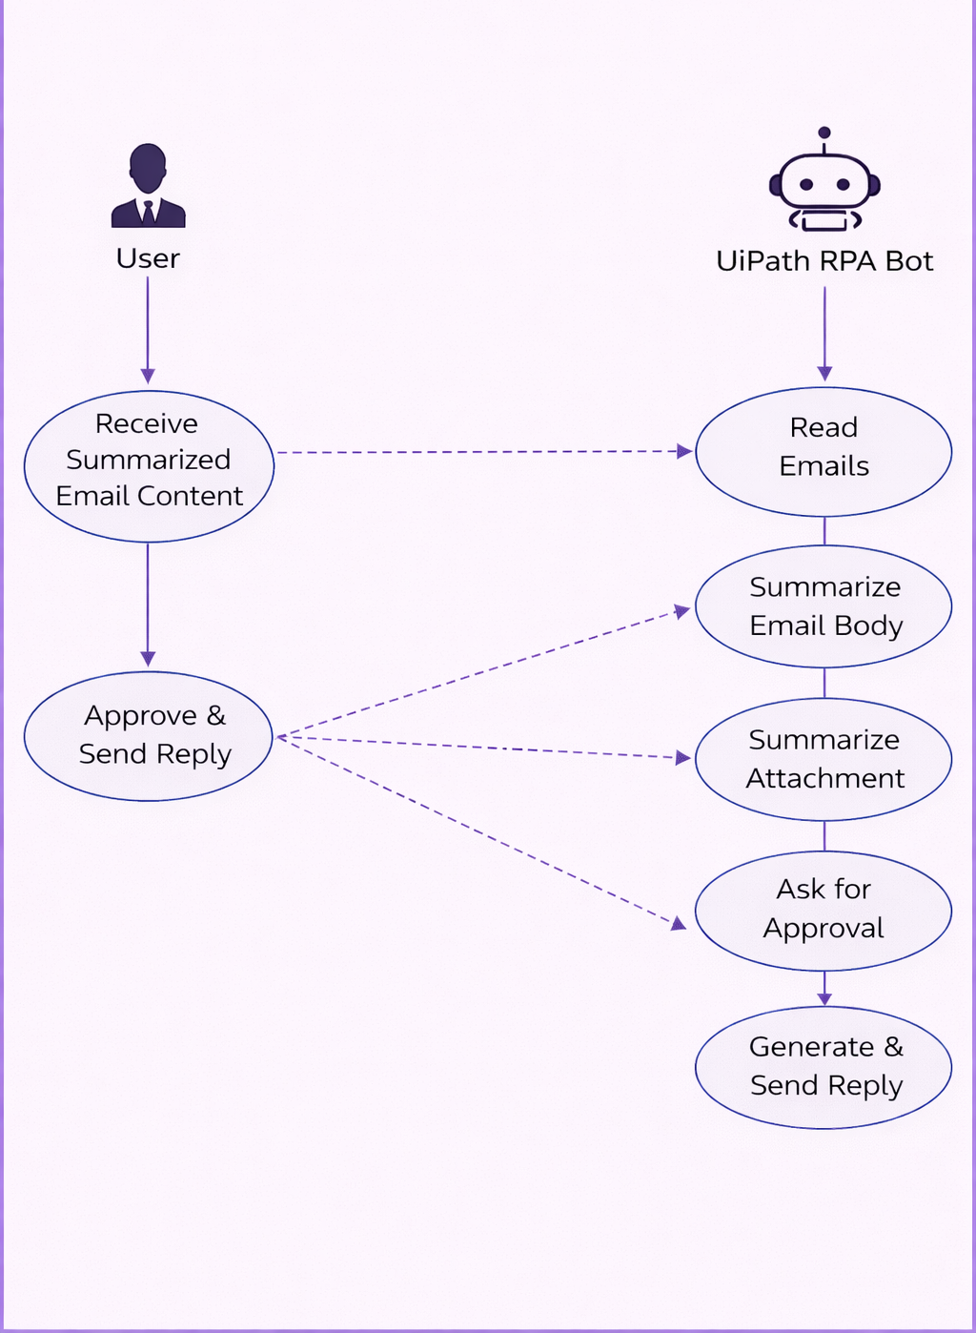
UML DIAGRAMS
USE CASE DIAGRAM:

Slide 13
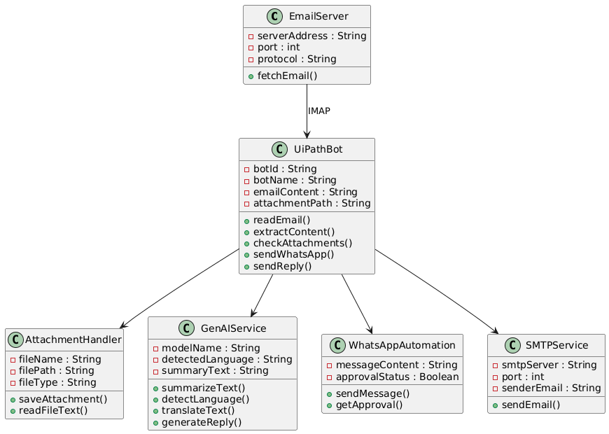
CLASS DIAGRAM

Slide 14
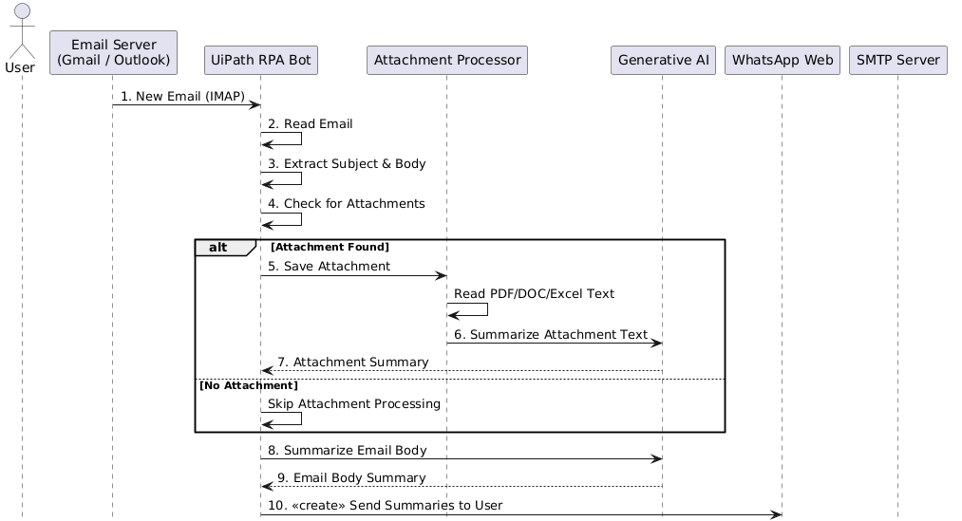
SEQUENCE DIAGRAM:

Slide 15
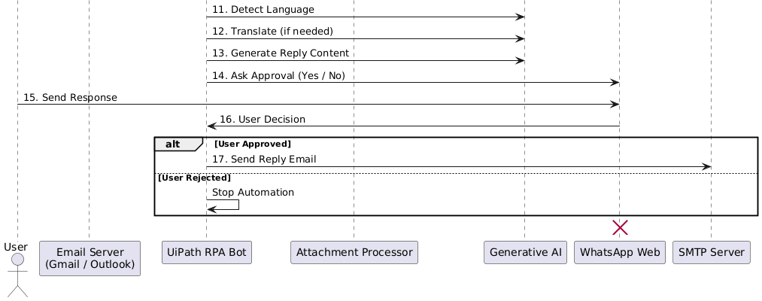
SEQUENCE DIAGRAM:

Slide 16
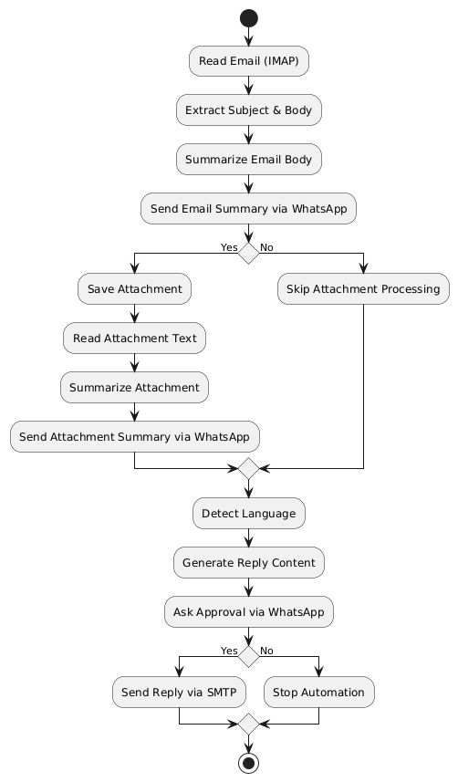
ACTIVITY DIAGRAM:

Slide 17
THANK YOU

