Slide 1
Image Super-Resolution via a Convolutional Neural Network
UE24CS352A Machine Learning · Mini-Project
Team: [Name 1, SRN] & [Name 2, SRN] | Problem no. [__]

Slide 2
Problem statement
Super-resolution: rebuild a sharp 224×224 image from a blurry low-resolution one
Interpolation (nearest / bilinear / bicubic) only smooths — it adds no new detail
Goal: learn the LR → HR mapping with SRCNN (Dong et al., 2015) and beat the interpolation baselines
Metric: PSNR = 10·log10(1 / MSE) — higher is better
Reference: CS229 report by Garber, Grossman & Johnson-Yu

Slide 3
Dataset
100 images of 224×224, split 60 train / 20 val / 20 test (same protocol as the paper)
LR input generated on the fly: HR → 112×112 (bilinear) → 224×224 (bicubic)
Split by source photo → no content overlap between train and test
Honest note: DIV2K could not be downloaded in our offline build environment, so images are crops of scikit-image sample photos; prepare_div2k.py rebuilds the set from real DIV2K
PSNR values are therefore not comparable to the paper's

Slide 4
Approach: the SRCNN model
Input
bicubic-upsampled
LR image (3 ch)
Conv 9×9
3 → 64 + ReLU
patch extraction
Conv 1×1
64 → 32 + ReLU
non-linear mapping
Conv 5×5
32 → 3
reconstruction
Output
HR image
224×224
→
→
→
→
~20k parameters, trained with MSE loss + Adam
Fully convolutional: trained on 48×48 patches, evaluated on whole images
Our refinement: Residual SRCNN — output = network(x) + bicubic input

Slide 5
Implementation
Pure NumPy: convolutions (im2col), back-propagation, batch-norm, tanh, Adam — written by hand
Why: PyTorch/TensorFlow unavailable in our environment; also runs on any CPU laptop
Verified: finite-difference gradient test — relative error < 1e-7 for all variants
Experiments: lr {1e-2, 1e-3, 1e-4}, tanh, batch-norm, L2 regularisation, residual refinement
40 epochs, batch 16, seeded & reproducible; best-validation epoch kept
Repo: README, scripts/{train, run_experiments, make_report, demo}.py

Slide 6
Results
Experiment | Max val PSNR | Test MSE | Test PSNR
Basic SRCNN (lr 0.001) | 30.943 | 0.000538 | 36.567
+ Regularization (wd 1e-4) | 30.881 | 0.000585 | 36.019
+ Tanh | 28.717 | 0.000848 | 33.027
+ Batch Norm | 27.197 | 0.001725 | 27.733
Residual SRCNN (refinement) | 31.785 | 0.000432 | 37.848
Bicubic | 29.866 | 0.000734 | 36.857
Bilinear | 28.901 | 0.000937 | 35.351
Nearest | 28.833 | 0.000946 | 34.432
Higher PSNR is better. Green = best model. Bilinear/nearest/bicubic are the non-neural baselines.

Slide 7
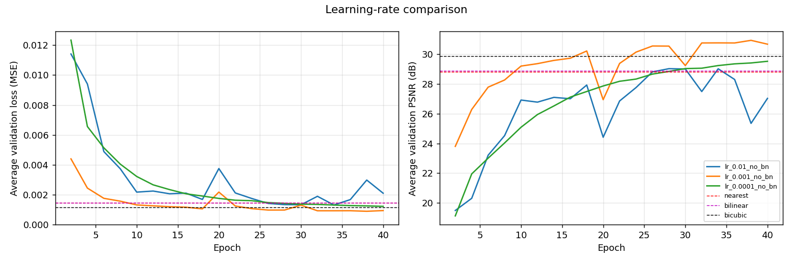
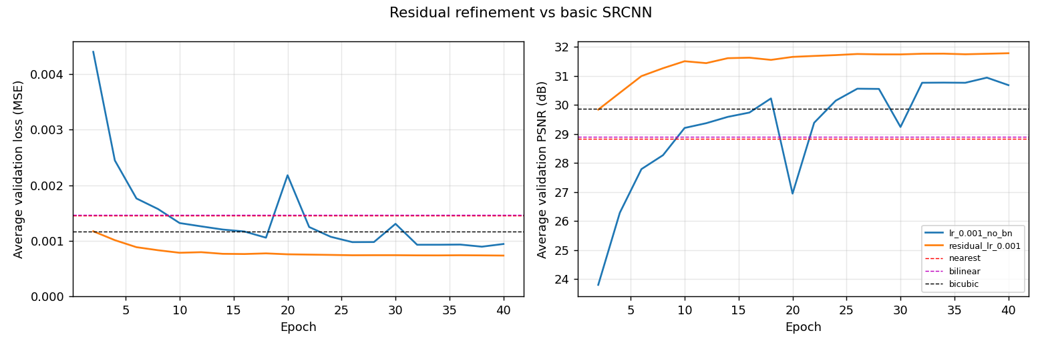
Experiments: what helped, what hurt
lr 0.001 best (val 30.94 dB); 0.01 unstable; 0.0001 slow
Tanh and batch-norm hurt (28.7, 27.2 dB); BN curves very noisy
L2 regularisation: no gain; large factors degrade
Same trends as the paper
Residual SRCNN: 31.79 dB val — best of all

Slide 8
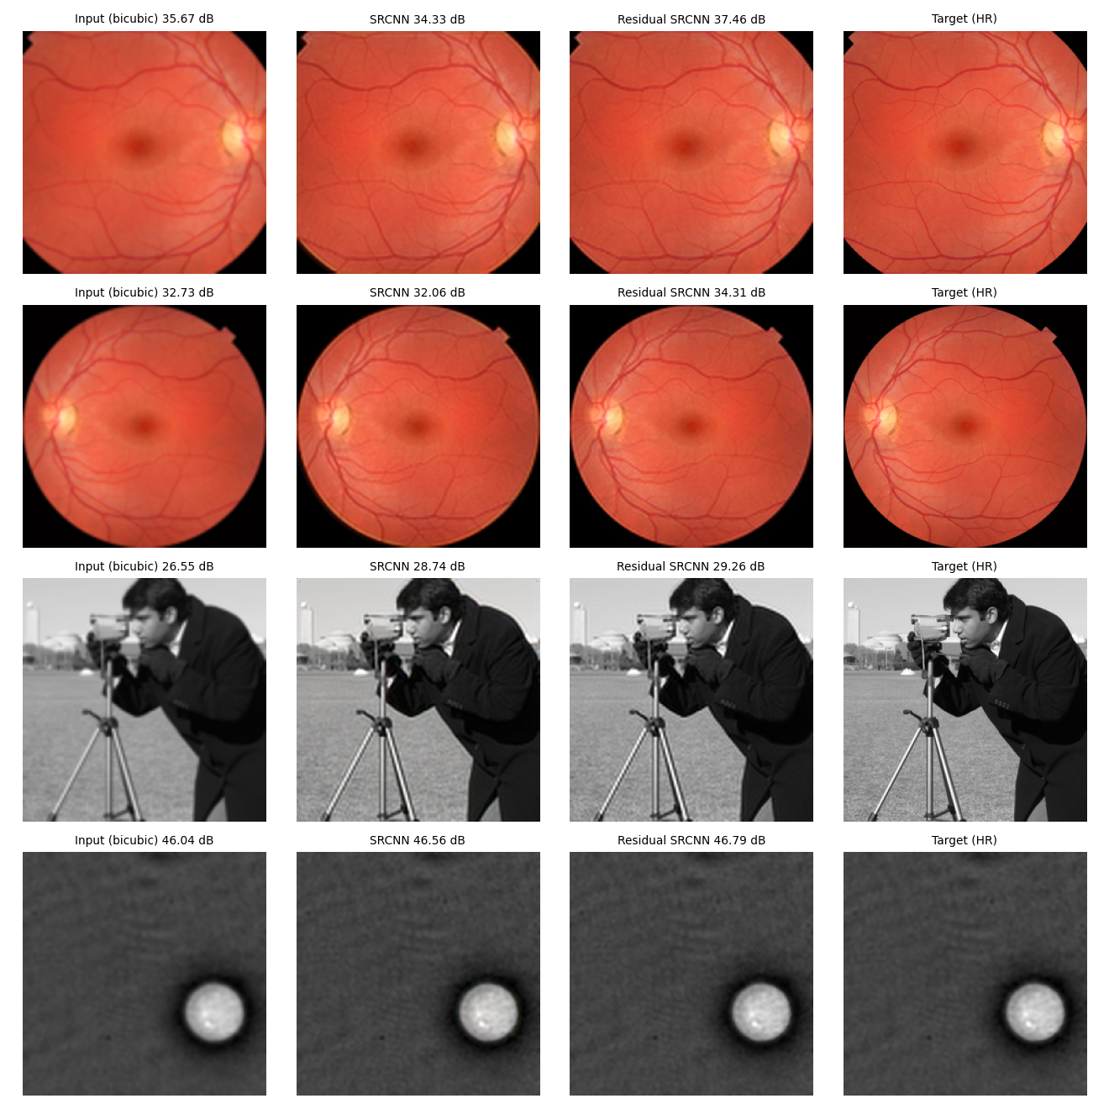
Honest finding: basic SRCNN vs bicubic
Validation: basic SRCNN +1.1 dB over bicubic
Test: basic SRCNN 36.57 vs bicubic 36.86 dB (better on 9/20 images)
Cause: very smooth test photos; plain SRCNN regenerates every pixel → small colour/brightness shifts
Residual SRCNN: 37.85 dB test (+1.0 dB), better on 16/20 images
Caveat: refinement added after seeing the test result; single seed; 20 test images from 3 photos

Slide 9
Conclusions & future work
SRCNN learned from just 60 images sharpens edges; residual learning makes it beat bicubic on average (16 of 20 test images)
Paper's trends reproduced: lr 0.001 best; tanh, batch-norm, L2 regularisation do not help
Limits: small data, one seed, CPU-only, DIV2K not used
Next: real DIV2K, multiple seeds, deeper nets (VDSR/EDSR), GAN losses
Live demo: python scripts/demo.py --input <image>

