Slide 1
MACHINE LEARNING MINI-PROJECT
Image Super-Resolution
using SRCNN
Turning low-resolution images into sharper, higher-resolution images with a convolutional neural network.
UE24CS352A • NumPy implementation • Project walkthrough
PROJECT OVERVIEW

Slide 2
1. Project overview
What problem are we solving, and what did we build?
Problem
Approach
Implementation
Low-resolution images lose fine details and appear blurry or pixelated.
Use SRCNN: a small convolutional neural network that learns to reconstruct image details.
Forward pass, backpropagation, and Adam optimizer are implemented in pure NumPy.
• Input: a low-resolution image, enlarged to the target size using bicubic interpolation.
• Output: a predicted high-resolution image with learned corrections.
• Evaluation: compare predictions with the original target using MSE loss and PSNR.
• Research question: does a learned CNN reconstruction outperform traditional resizing methods?
SRCNN Image Super-Resolution • Machine Learning Mini-Project
2

Slide 3
2. Why image super-resolution?
Upscaling adds pixels; super-resolution tries to recover plausible detail.
Low resolution
Interpolation
SRCNN
Fewer pixels mean edges, textures and small structures are lost.
Bilinear/bicubic resizing estimates new pixel values from nearby pixels.
Learns patterns from examples to predict a closer approximation to the high-resolution target.
Important limitation: a model cannot know the exact original details that were removed. It estimates detail from learned patterns, so outputs may still be imperfect.
Use cases: medical/scientific imagery, satellite images, old photos, digital zoom and image restoration.
SRCNN Image Super-Resolution • Machine Learning Mini-Project
3

Slide 4
3. End-to-end workflow
The full pipeline from training data to a super-resolved image
1
2
3
4
5
High-resolution image
Degrade image
Upsample
SRCNN model
Evaluate
224 × 224 target
→
Downsample to 112 × 112
→
Bicubic back to 224 × 224
→
Predict refined pixels
→
MSE loss + PSNR
Training pairs are created from the same image: the degraded image is the input (X), and the original image is the target (Y). The model learns by reducing the difference between its prediction and Y.
SRCNN Image Super-Resolution • Machine Learning Mini-Project
4

Slide 5
4. SRCNN architecture
Three convolutional layers: extract features → map features → reconstruct pixels
Input
Conv 1 + ReLU
Conv 2 + ReLU
Conv 3
Output
224 × 224 × 3
bicubic image
→
9 × 9 filters
3 → 64 channels
→
1 × 1 filters
64 → 32 channels
→
5 × 5 filters
32 → 3 channels
→
224 × 224 × 3
• Conv 1 — patch/feature extraction: detects local edges, corners and texture patterns.
• Conv 2 — non-linear mapping: combines extracted features into useful representations.
• Conv 3 — reconstruction: maps features back to the three RGB colour channels.
• ReLU: keeps positive activations and adds non-linearity between layers.
SRCNN Image Super-Resolution • Machine Learning Mini-Project
5

Slide 6
5. How the model learns
Training adjusts convolution filters so the predicted image resembles the target.
Forward pass
Loss calculation
Backward pass + update
Input image passes through all 3 convolution layers to produce Ŷ.
Mean Squared Error (MSE) measures average squared pixel difference.
Hand-written gradients flow backward; Adam updates weights and biases.
MSE = average of (prediction − target)²
Adam = adaptive gradient-based optimizer
Lower MSE means smaller average pixel errors.
It uses gradient information and running averages to choose parameter updates. The best checkpoint is selected by validation PSNR.
Gradient test: finite-difference checks help verify that the manually coded backpropagation gradients are numerically consistent.
SRCNN Image Super-Resolution • Machine Learning Mini-Project
6

Slide 7
6. Dataset and experiment design
A controlled image degradation setup makes training and evaluation reproducible.
Dataset
Split
Training
100 RGB images, each prepared as 224 × 224 crops.
60 train / 20 validation / 20 test images; split by source photo.
Random 48 × 48 patches, flips for augmentation, Adam optimization.
• Train set: learn model parameters.
• Validation set: compare epochs/configurations and keep the best checkpoint.
• Test set: final evaluation on images not used to train or select the model.
• Reproducibility: seeded experiments and saved model weights/histories.
Dataset caveat: bundled images are sample-photo crops, not the full DIV2K benchmark; real DIV2K can be prepared separately.
SRCNN Image Super-Resolution • Machine Learning Mini-Project
7

Slide 8
7. How do we measure quality?
PSNR is the main image-quality metric reported by this project.
MSE — Mean Squared Error
PSNR — Peak Signal-to-Noise Ratio
Average squared difference between predicted and target pixel values. Lower is better.
A logarithmic metric derived from MSE. Higher PSNR generally means closer pixel-level similarity.
PSNR = 10 · log₁₀(MAX² / MSE)
Interpretation:
• +1 dB can indicate a measurable pixel-error reduction.
• PSNR does not fully capture perceived sharpness or semantic quality.
• Results depend strongly on the dataset and degradation process.
Here image values are normalized to [0, 1], so MAX = 1. PSNR is reported in decibels (dB).
SRCNN Image Super-Resolution • Machine Learning Mini-Project
8

Slide 9
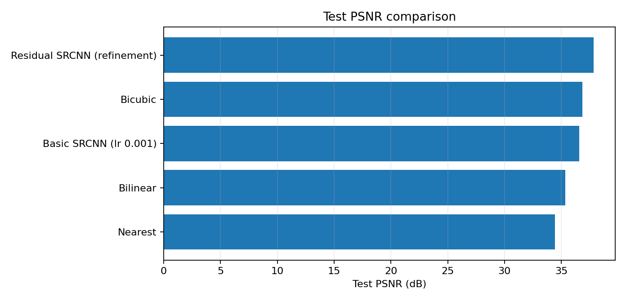
8. Main results
Residual SRCNN achieved the highest reported test PSNR in this project.
Best variant
Residual SRCNN
37.848 dB
Basic SRCNN
36.567 dB
Residual model adds the input image to the network output, helping the network learn a correction.
SRCNN Image Super-Resolution • Machine Learning Mini-Project
9

Slide 10
9. Experiments and what we learned
The team tested architecture/training choices, not only one model.
Experiment | Test PSNR (dB) | Interpretation
Basic SRCNN | 36.567 | Reference configuration
Residual SRCNN | 37.848 | Best test PSNR; predicts a correction
L2 regularization | 36.019 | Slightly below basic SRCNN here
Tanh output | 33.027 | Lower PSNR in this setup
Batch normalization | 27.733 | Lower PSNR in this setup
Bicubic baseline | 36.857 | Strong interpolation baseline
Interpret results cautiously: hyperparameters that help one dataset may not help another.
SRCNN Image Super-Resolution • Machine Learning Mini-Project
10

Slide 11
10. Our refinement: residual SRCNN
Instead of predicting the entire image from scratch, learn the correction to the upsampled input.
Bicubic input
SRCNN
Add
Output
→
→
→
Baseline enlarged image
Predict learned correction
Input + correction
Refined image
Conceptually: output = bicubic input + learned residual
Why it can help: the interpolated image already contains the broad structure, so the network can focus on the missing details and corrections instead of relearning the whole image.
SRCNN Image Super-Resolution • Machine Learning Mini-Project
11

Slide 12
11. How to run the live demo
The project includes scripts for training, evaluation, and side-by-side comparison.
Run a sample demo
Train a model
python scripts/demo.py --input data/test/test_000_retina.png
python scripts/train.py --epochs 30 --lr 0.001
• The demo loads saved weights from results/ by default.
• It writes a comparison image and a separate SRCNN output image.
• With the default demo mode, it degrades the input and can report bicubic vs SRCNN PSNR against the original.
• Use --no_degrade when the input is already low-resolution; no PSNR is reported because the original target is unknown.
Run commands from the project root after activating the virtual environment and installing requirements.
SRCNN Image Super-Resolution • Machine Learning Mini-Project
12

Slide 13
12. Limitations and honest interpretation
The results are promising for the residual variant, but they are not a universal claim.
• Small test set: only 20 test images; results can vary with image content.
• Single seed: differences of a few tenths of a dB are not statistically established.
• Dataset mismatch: the bundled sample crops are not the paper's full DIV2K benchmark.
• Basic model result: plain SRCNN slightly trails bicubic on the reported test set (36.567 vs 36.857 dB).
• Metric limitation: PSNR measures pixel fidelity, not necessarily how sharp or realistic an image looks.
• Compute: pure NumPy makes the implementation transparent and laptop-friendly, but training is slower than GPU frameworks.
Next steps: evaluate on a larger standard dataset, run multiple seeds, inspect visual crops, and compare perceptual metrics.
SRCNN Image Super-Resolution • Machine Learning Mini-Project
13

Slide 14
CONCLUSION
A compact CNN can learn image reconstruction beyond simple resizing.
• Built SRCNN from scratch in NumPy, including forward/backward passes and Adam.
• Created paired low-/high-resolution data and evaluated with MSE and PSNR.
• Compared interpolation baselines and model variants.
• Residual SRCNN was the strongest configuration in this project’s reported test results.
Thank you • Questions?

